Slide 2
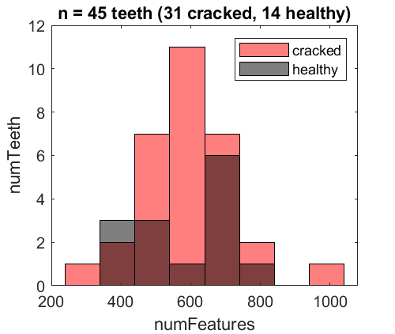
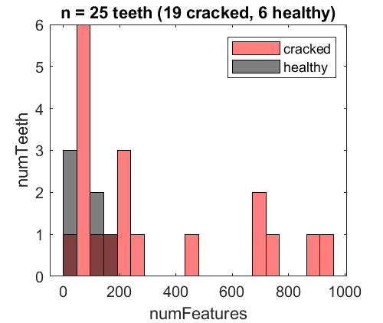
a
MicroCT
b
Hr-CBCT

Slide 3
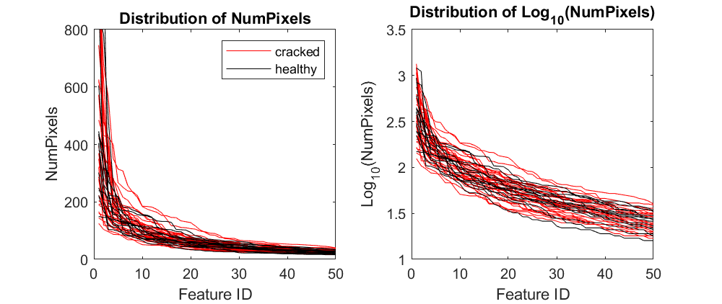
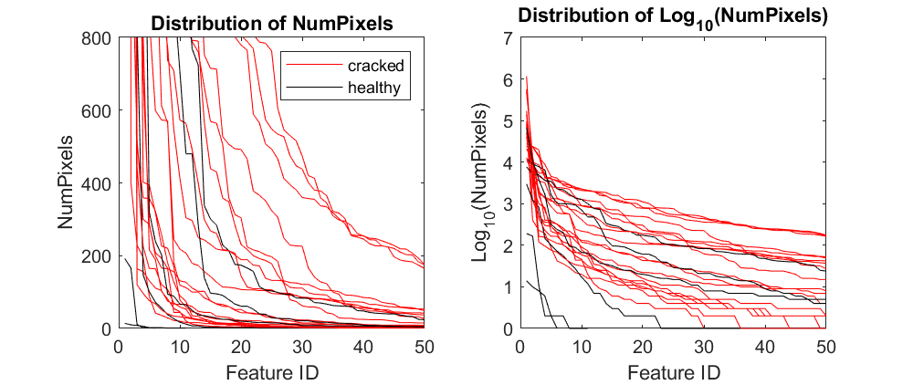
a
MicroCT
b
Hr-CBCT

Slide 4
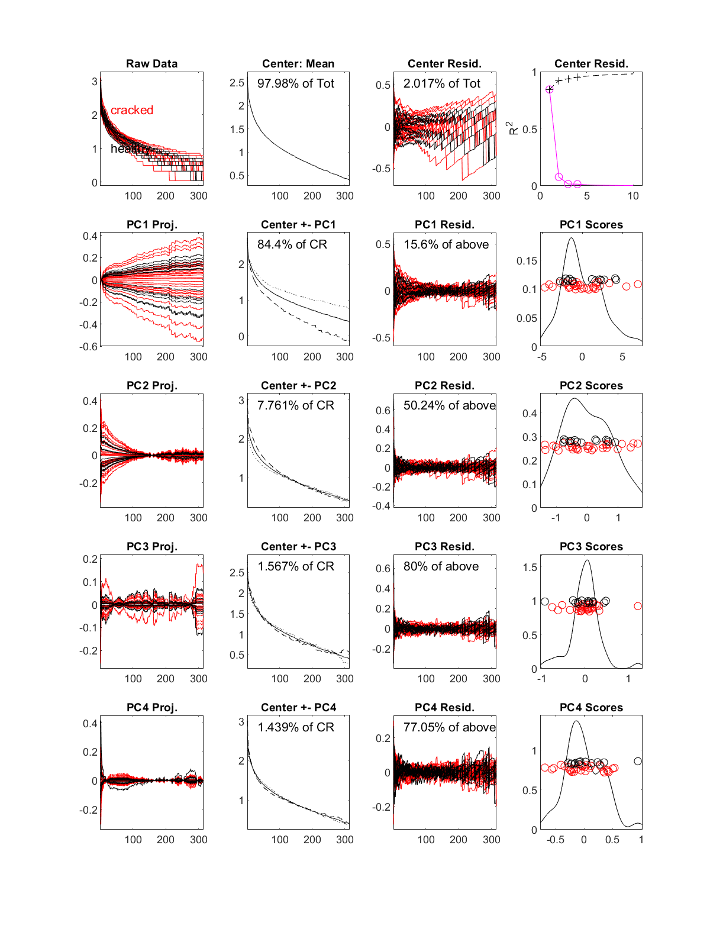
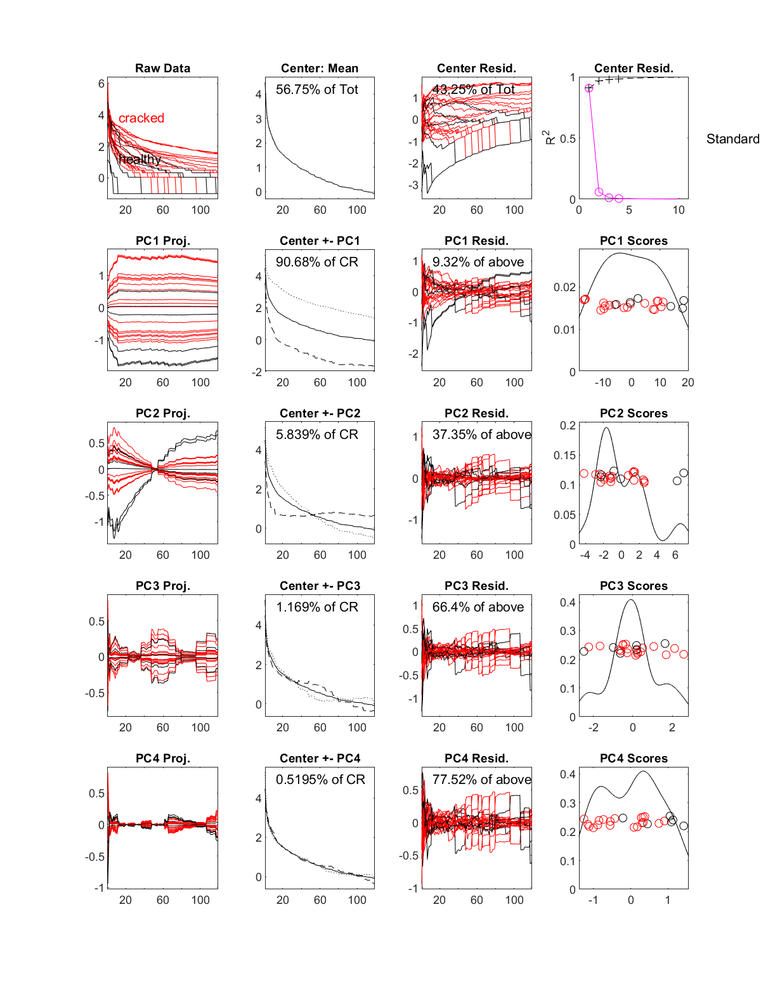
a
MicroCT
b
Hr-CBCT
Log₁₀(data)
Log₁₀(data)

