Slide 1

5243 Project 3
Group 7
Angel Wang, Bessie Wang, Zan Li, Hannah Gao, Yichuan Lin

Slide 2
Project Objectives
Our aim
What we did
1. Establish a quicker and more convenient quickstart notebook for users using different platforms to access Climsim.
2. Seek different models to allow developers to optimize models for more accurate outputs in Climsim.
1. A quick start for R users
2. Cloud-based notebooks: Google Colab & Google Drive
3. Data loader: Generate filelist from Hugging Face
4. Leveraging advanced ML models:
Support Vector Regression
Neural Network Regression
Recurrent Neural Network
Notes:
1. Establish a quicker and more convenient quickstart notebook for users using different platforms to access Climsim.
2. Seek different models to allow developers to optimize models for more accurate outputs in Climsim.
We tackled the four tasks and I’m going to explain more in detail

Slide 3
Models we tested
SVR model
NNR Model
RNN Model
SVR stands for Support Vector Regression
It is a variation of the Support Vector Machine (SVM) algorithm, and is designed for predicting continuous values, making it suitable for regression tasks
Original subsampled data
NNR stands for Neural Network Regression
Neural Network Regression models offer the flexibility to capture complex and non-linear relationships in climate data
Original subsampled data
RNN stands for Recurrent Neural Network
Neural Network Regression models process sequential data, such as time series
Self-sampled data: 1 day’s data for train, 1 day’s data for validation
Notes:
SVR- Support Vector Regression good at predicting continuous values
NNR- Neural Network Regression good at capturing complex and non-linear relationships
RNN- Recurrent Neural Network which is great for time series

Slide 4
Why we chose these models?
Why SVR?
Support Vector Regression is known for its robustness against outliers and noise in the data, which can be common in climate datasets due to measurement errors or extreme events.
When the relationship between climate variables is complex and non-linear, SVR with non-linear kernels (e.g., radial basis function, polynomial) can capture these non-linear patterns effectively.
Why NNR?
When working with large and diverse climate datasets, deep neural networks can learn intricate patterns and relationships in the data, often leading to improved performance.
Deep neural networks can scale to handle massive datasets, making them suitable for high-resolution climate simulations and modeling.
Why RNN?
The original ClimSim paper utilized a Convolutional Neural Network (CNN), which is good at handling spatial data but assumes data points are independent and identically distributed (i.i.d.).
Since climate data is characterized by temporal and sequential dependencies, we opted for a Recurrent Neural Network, which is designed to process sequential data and can learn dependencies across time steps.
Notes:
We choose these models based on their different qualities. So for SVR its robustness against outliers and noise in the data makes it effective in non-linear relationships; NNR is suitable for high-resolution climate simulations and modeling; and RNN process sequential data.

Slide 5
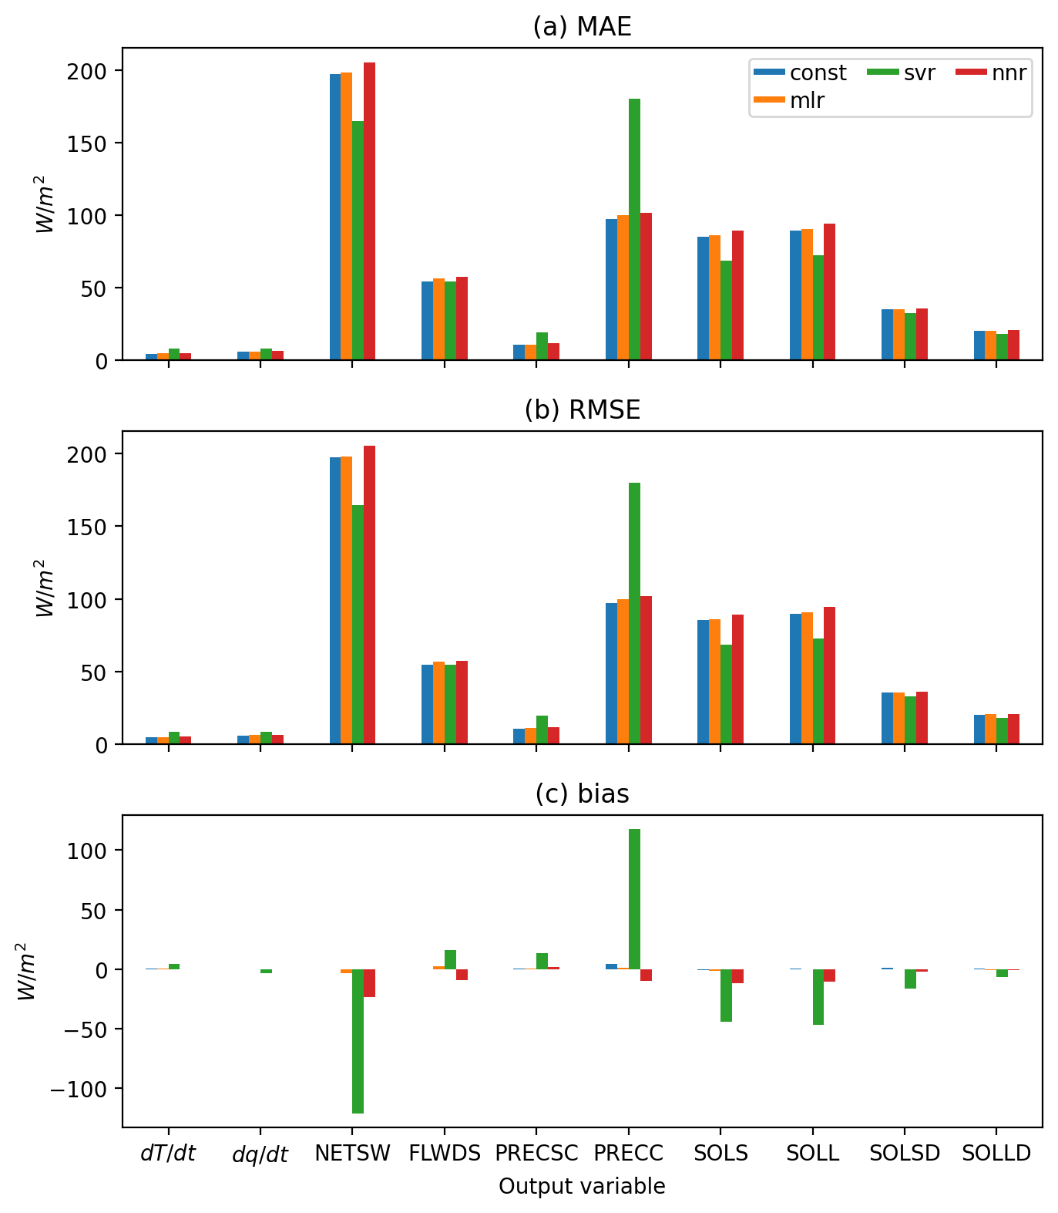
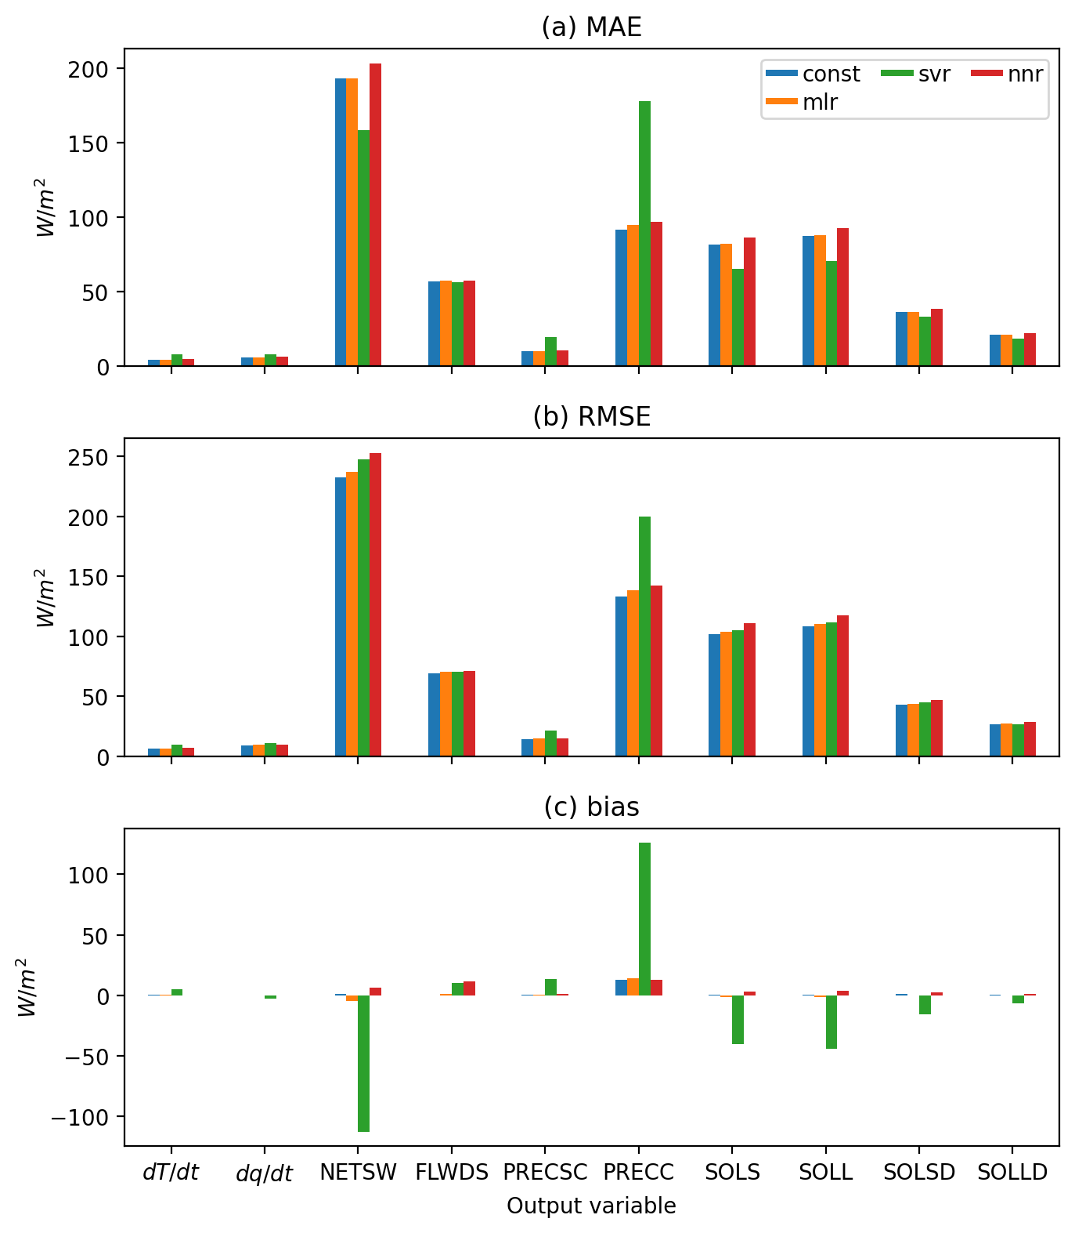
SVR model & NNR model
Graph using input data
Graph using scoring data
* using the subsampled data from original quickstart_notebook.iqynb
Notes:
By analyzing the graph, SVR model exhibits lower MAE and RMSE values for variables such as NETShortWave and visible direct solar flux (SOLS) and significantly higher for rain rate (PRECC). In contrast, the NNR model's performance is relatively similar to that of the Multiple Linear Regression (MLR)and a constant prediction model. One notable factor that caused this is that the analysis was conducted using simplified SVR and NNR models. To obtain a more suitable model, it may be necessary to explore more complex variants of these models, which can better capture the intricate relationships within the data.
By analyzing the graph, it becomes evident that the Support Vector Regression (SVR) model exhibits lower Mean Absolute Error (MAE) and Root Mean Squared Error (RMSE) values for certain variables, such as NETSW and SOLS. However, the SVR model yields significantly higher MAE and RMSE values for the variable PRECC. In contrast, the Neural Network Regression (NNR) model's performance is relatively similar to that of the Multiple Linear Regression (MLR) model and a constant prediction model.
There are several factors contributing to the elevated MAE and RMSE, with potential areas for improvement. One notable factor is that the analysis was conducted using simplified SVR and NNR models. To obtain a more suitable model, it may be necessary to explore more complex variants of these models, which can better capture the intricate relationships within the data. Additionally, both SVR and NNR models were trained on the original subset dataset, which does not account for any temporal dependencies or patterns over time. This limitation can result in suboptimal performance for tasks that involve time-series data, such as climate simulations.
However, the analysis suggests that these two models do not outperform the six baseline models provided in the paper. Therefore, we decided to look into some more models, something we can consider: 1.development of more intricate models built upon the foundation of these two simple models 2. explore models that are inherently better equipped to handle the time-dependent characteristics present in climate data.

Slide 6
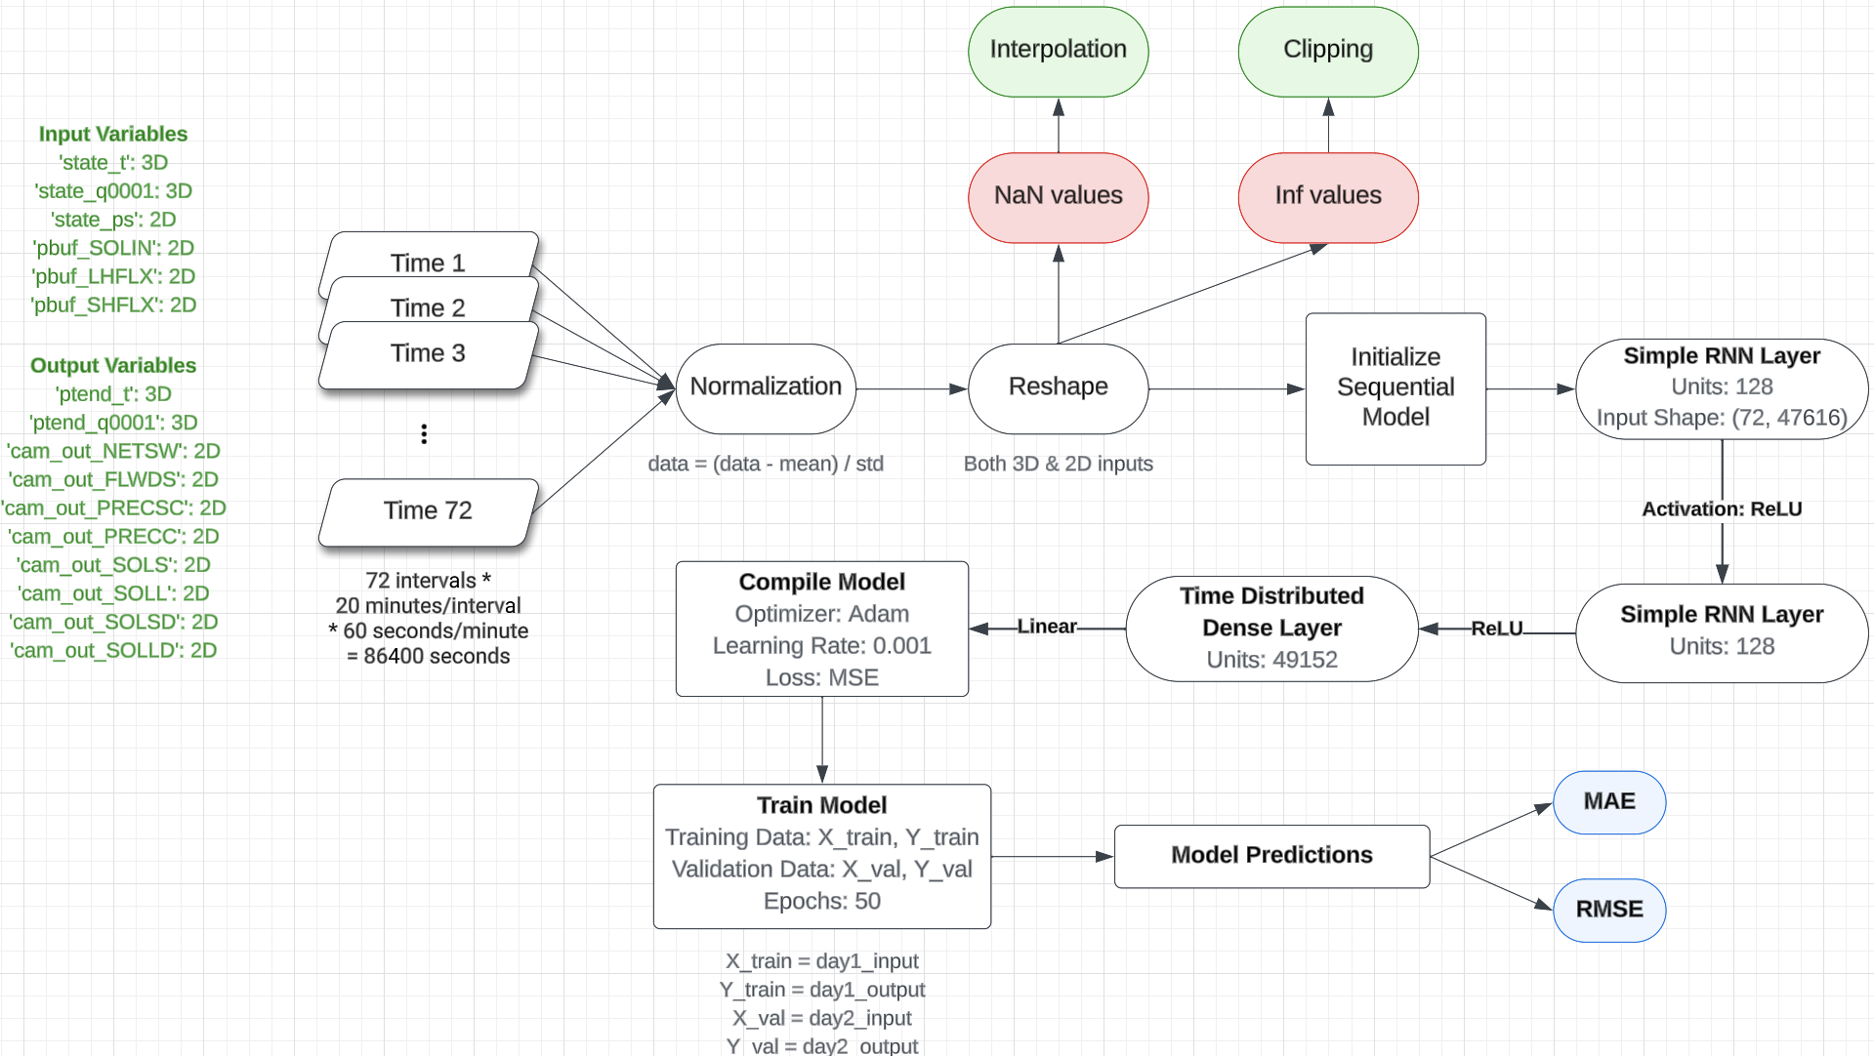
Recurrent Neural Network (RNN)
Notes:
For RNN model, we wanted to use day1’s data for training and day2’s data for validation. In the pre-processing stage, we normalized and reshaped it because we need to scale the data to a common range and in a specific shape. Then we initialize a sequential model with two simple RNN layers and one time distributed dense layer. After training and validation, we produce MAE & RMSE.
We start with day 1 and day 2’s data. These were downloaded manually from ClimSim’s dataset on HuggingFace.
We want to use day1’s data for training and day2’s data for validation.
First, in the pre-processing stage, we have to normalize the data and reshape them.
Normalization is needed to scale the data to a common range, making it easier for the model to learn.
We’re reshaping because RNNs expect input data to be in a specific shape, typically a 3D tensor with dimensions (batch_size, sequence_length, feature_count).
Then we initialize a sequential model with two simple RNN layers and one time distributed dense layer.
The 2 simpleRNN layers learn to extract temporal features from the data.
The 1 time distributed dense layer is used because we want to make predictions for each time step in the sequence. A regular dense layer would only make a single prediction for the entire sequence.
Then we train the model with the model we just defined.
Then we validate the results with pre-processed validation data.
Then we produce MAE & RMSE, which are important model evaluation metrics, for every output variable.
MAE measures the average difference between the predicted values and the actual values.
RMSE is similar to MAE, but it penalizes larger errors more severely.

Slide 7
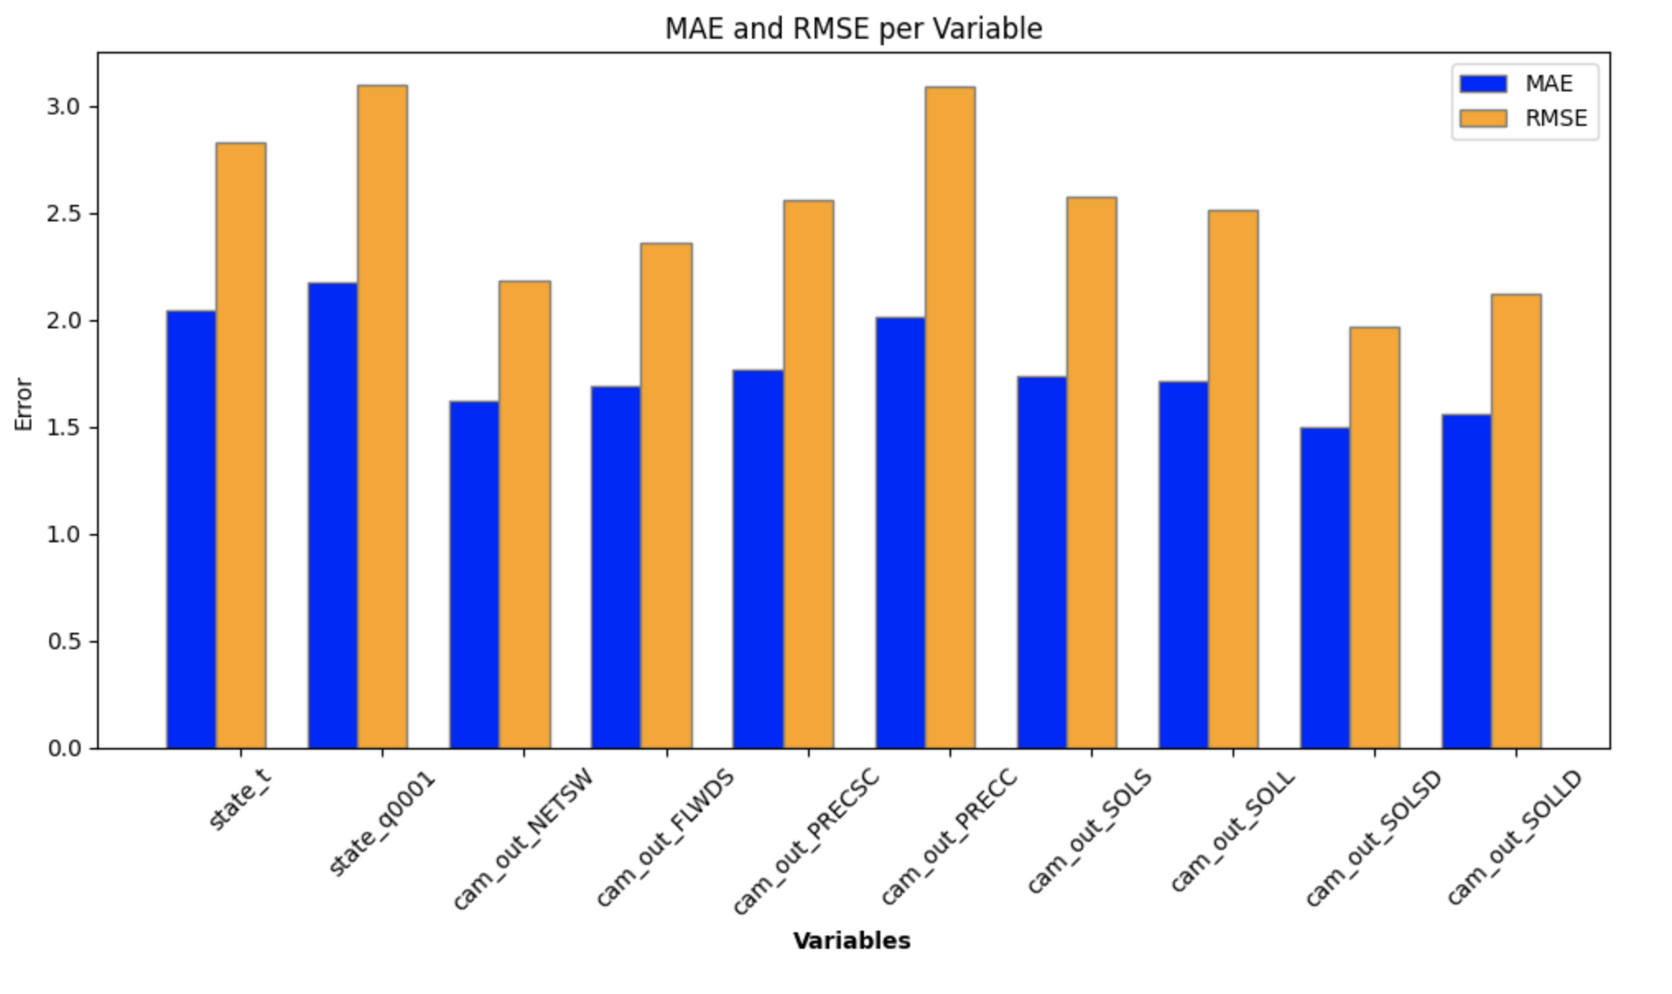
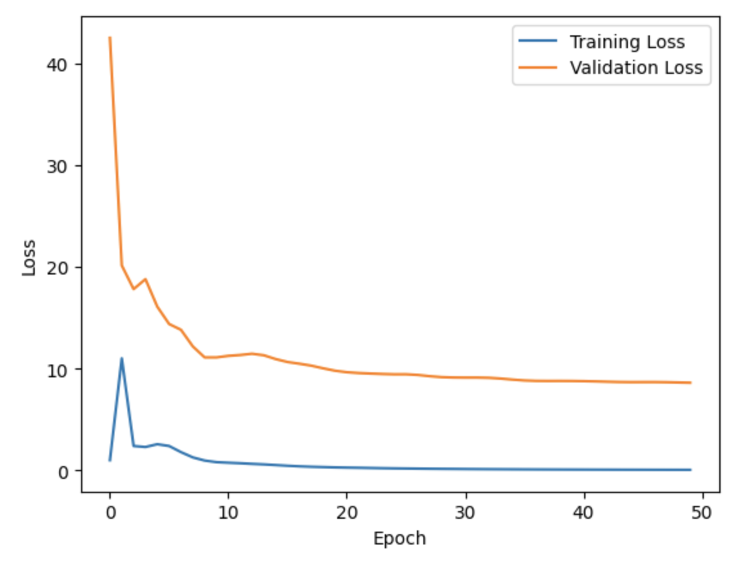
Recurrent Neural Network (RNN)
Notes:
Based on the graph, we can see that there is a great loss of training and validation, and the MAE and RMSE are rather similar across variables. For RNN, there are some limitations that we have a rather small training sample and we clipped our data in a very arbitrary range. If there’s more time, we could look deeper into the data distributions and figure out better ways to handle infinity values.
Things we can improve on the RNN model:
We have a rather small training sample, which is only 1 day’s data. In other models in the ClimSim paper, we’re using years of data to train. If we have the computing power, we can try increasing the training data size.
Technically the training and testing data should be independent. However, since our model is pretty simple (training on day1 and validating on day2), this might not be the case.
We clipped our data in a very arbitrary range of [-10, 10]. If there’s more time, we could look deeper into the data distributions and figure out better ways to handle infinity values, or normalization in general.
Simple RNN layers might not be the best model for capturing long-term dependencies in the data. We might consider using LSTM (Long Short-Term Memory) layers, which is designed to capture such dependencies.

Slide 8
Data Loader
Loading data from Hugging Face
Regular Expression to generate fileslist
Loop to construct URL
Challenges
Save_as_npy
Target_variables
Notes:
Data Loader: We generated a comprehensive list of filenames corresponding to different dates and times. Next, we tried to set up a loop that dynamically constructs each file's URL and downloads it to a specified directory. The challenging part was that we had a bunch of target variables that were nowhere to be found in the data, causing the KeyErrors. We are currently investigating these challenges and hoping to of finding effective solutions.
In developing a data loader for climate simulation data from Hugging Face, I encountered several challenges. Firstly, We needed to generate a comprehensive list of filenames corresponding to different dates and times. To address this, I created custom functions that utilizing regular expressions to systematically generate all possible filename patterns and append time stamps, ensuring complete coverage of the dataset. Next, the challenge was to automate the downloading process for these files.We set up a loop that dynamically constructs each file's URL based on its date and time, then downloads it to a specified directory.
We started off using this create_npy_data_splits.ipynb script to work on the .nc files I had downloaded. Pretty soon, We got – a FileNotFoundError. It was looking for a file named '/content/ClimSim/ClimSim/e3smdata/E3SM-MMF.mlo.0002-01-02-00000.nc' that just wasn't there. To figure this out, we went back to the original data_utils class and decided to remove the replace part from the get_target method.
After that, we got another issue – a KeyError: cam_out_NETSW. It looked like the script expected a variable in the dataset that was missing. We realized the root of the problem: the target variables we set up in the class didn't match what was actually in the dataset. We had a bunch of target variables that were nowhere to be found in the data, causing these KeyErrors.
We are currently investigating these challenges with the hope of finding effective solutions in the upcoming stages.

Slide 9
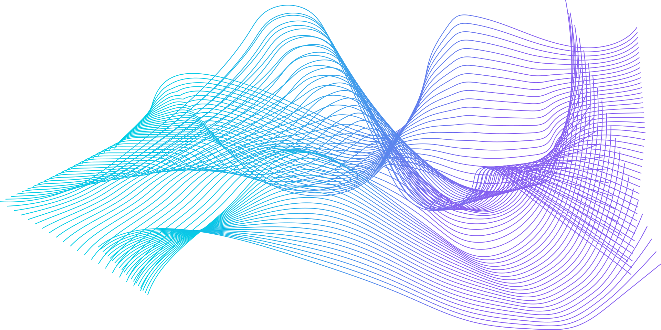
Quickstart for Users
R
Rewriting functions such as “load_npy_file” and “output_weighting”
by library the reticulate package and create a default python environment
Google Colab
Mount Google Drive to provide data access:
from google.colab import drive
drive.mount('/content/drive')
data_path= '/content/drive/MyDrive/Climsim/'
Github LFS
!curl -s https://packagecloud.io/install/repositories/github/git-lfs/script.deb.sh | sudo bash
!sudo apt-get install git-lfs
!git lfs install
!git clone https://huggingface.co/datasets/LEAP/subsampled_low_res
Notes:
Rewriting functions such as “load_npy_file” and “output_weighting” by library the reticulate package and create a default python environment for it, we successfully adapt the quickstart notebook using R. And then, using the codes showing here, we successfully mount google drive into Google Colab and also Git large file storage which provides another way for data access.

Slide 10
Easy access for future users
Models for ML researchers
Quickstart Cloud-notebooks & R
Loading data directly from Hugging Face
SVR, NNR, RNN
Notes:
In conclusion, our project makes it easier for future users to access the data from Hugging Face, Github and Climsim dataset in general using R and google colab, and models provided for ML researchers.

Slide 11
Q&A

