Slide 1
Project Title: Dropout Risk Detection
Student Name:
Angel Xavier-01
Taanshu Babariya-03
Mariam Badure-04
Jaden Borges-08
Batch: A1
Course: ML Mini Project
Guide Name: Dr. Joanne Gomes
Institute Name: St. Francis Institute of Technology

Slide 2
Problem Statement
Many students drop out due to low performance, poor attendance, and weak engagement.
Existing systems fail to provide early, real-time risk prediction.
This project uses student data + ML to classify At-Risk / Not At-Risk students for timely intervention.
Objectives
Build an accurate ML prediction model
Compare algorithms and identify key dropout factors
Generate early alerts for support actions
SDG Mapping
United Nations SDG 4 – Quality Education
United Nations SDG 10 – Reduced Inequalities
United Nations SDG 9 – Innovation in Education
Social Usefulness
Reduces dropout rates
Improves student success and retention
Enables better counseling and institutional decisions
Builds a skilled workforce for society

Slide 3
Literature Summary
Ref | Author | Problem | Dataset | Method | Features
[1] | Villar & Andrade, 2024 | Limited to single dataset, lacks real-time deployment | Real-world university dataset | Multiple ML models | Academic + student records
[2] | Marcolino et al., 2025 | Depends only on LMS logs, ignores socio-economic factors | LMS / Moodle logs | CatBoost + NSGA-II | Clickstream, engagement
[3] | Cho et al., 2023 | Focuses only on academic performance, missing emotional/behavioral factors | Large academic dataset | Multi-model + SMOTE | Grades, attendance
[4] | Kim et al., 2023 | Complex hybrid model, difficult to generalize across universities | Single university dataset | Hybrid ML + SHAP | Academic + clustering features

Slide 4
Literature Summary
Ref | Accuracy | Limitations | Research Gap | Your Contribution
[1] | 91% | Single dataset, no deployment | No real-time student monitoring | Lightweight real-time risk prediction model
[2] | 85% | LMS-only data, limited scope | Missing academic + behavioral fusion | Multi-feature academic + engagement model
[3] | 89% | Only Academic Features | Ignores emotional & engagement signals | Add attendance + engagement + performance
[4] | 93% | Complex hybrid model | Hard to generalize across institutes | Simple interpretable ML pipeline

Slide 5
Research Gaps Identified
Research Gaps
Limited to single dataset
No real-time implementation
Limited feature diversity
Improvements (Realistic)
Add more relevant features (attendance, engagement)
Improve data balancing techniques
Test with different ML models
Possible Extensions (Future Scope)
Multi-university dataset integration
Real-time prediction system
Integration with LMS platforms

Slide 6
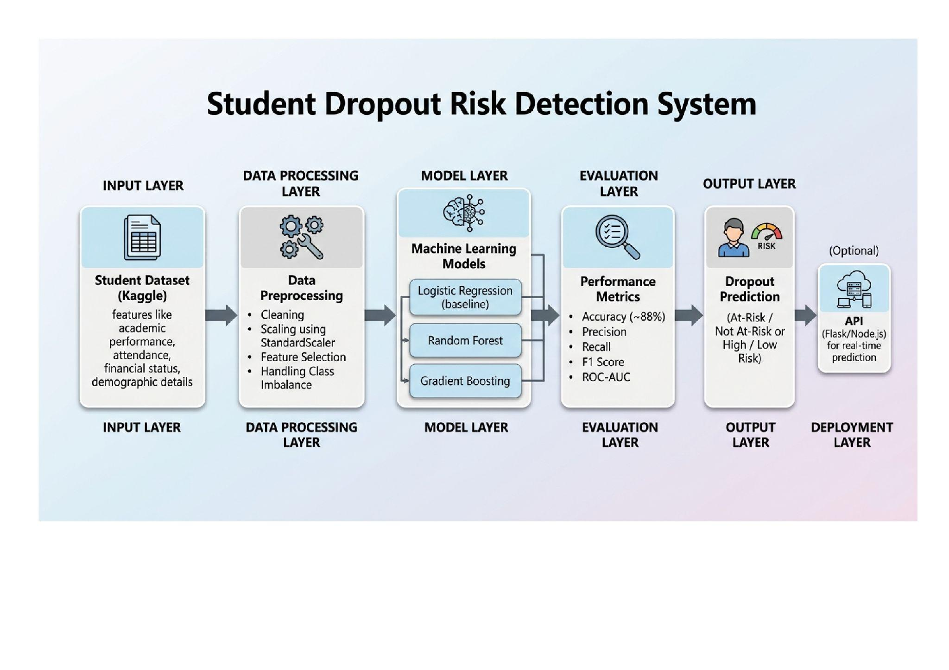
System Architecture

Slide 7
Dataset & Pre-processing
Dataset Description
The dataset (dataset.csv) contains student-related information used to predict whether a student will drop out, graduate, or remain enrolled .
It includes a mix of:
Demographic features: Age at enrollment, gender, nationality
Socio-economic features: Scholarship status, debtor status, tuition fee payment
Academic features:
  Curricular units (enrolled, evaluated, approved) for 1st and 2nd semester
  Grades and performance indicators
Background information:
  Parents’ qualifications and occupations
  Previous qualification
Macro-economic indicators:
  Unemployment rate, inflation rate, GDP
The target variable is:
Target → {Dropout, Graduate, Enrolled}
Converted into:
Dropout (binary: 1 = Dropout, 0 = otherwise)

Slide 8
Final Features Used
Only the most important features are updated:
Age at enrollment – reflects maturity and adaptability, which can influence continuation.
Scholarship holder – indicates financial support, reducing dropout risk.
Debtor – shows financial burden, increasing dropout risk.
Tuition fees up to date – reflects financial stability and commitment to studies.
Curricular units 1st sem (approved) – measures initial academic performance.
Curricular units 2nd sem (approved) – shows ongoing academic progress and consistency.

Slide 9
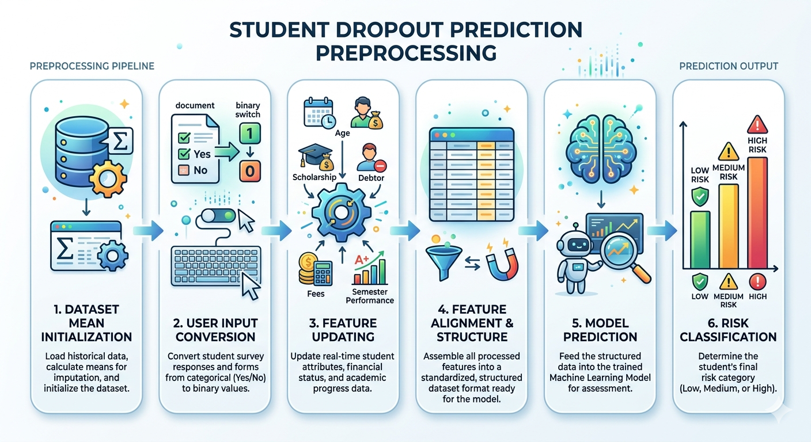
Preprocessing steps

Slide 10
Methodology
Algorithms used
Logistic Regression
Random Forest (with hyperparameter tuning)
Gradient Boosting (final selected model)
Model pipeline
Data loading → preprocessing → train-test split
Feature scaling using StandardScaler
Apply SMOTE for imbalance handling
Train models (LR, RF, GB)
Evaluate using Accuracy, Precision, Recall, F1-score
Select best model (Gradient Boosting)
Take user input → update features → predict → assign risk level
Tools & technologies
Python
Google Colab
Libraries:
Pandas, NumPy (data handling)
Scikit-learn (ML models & evaluation)
Imbalanced-learn (SMOTE)

Slide 11
Model Comparison
Comparison of all models
Logistic Regression (with SMOTE)
Good recall (captures more dropouts)
Slightly lower precision
Random Forest (Tuned)
Balanced performance
Good precision but slightly lower recall
Gradient Boosting
Best overall performance
Highest accuracy and F1-score
Selected as final model

Slide 12
Performance metrics table
Model | Accuracy | Precision | Recall | F1 Score
Logistic Regression | 0.8746 | 0.7836 | 0.8415 | 0.8115
Random Forest (Tuned) | 0.8825 | 0.8409 | 0.7817 | 0.8102
Gradient Boosting | 0.8870 | 0.8333 | 0.8099 | 0.8214

Slide 13
Best Model & Justification
Selected model with its evaluation metrics
Selected Model: Gradient Boosting
Accuracy: 0.8870
Precision: 0.8333
Recall: 0.8099
F1 Score: 0.8214
Reason for selection
Achieved the highest F1-score, giving the best balance between precision and recall
Provided overall best performance among all models
More reliable for detecting dropout cases without too many false predictions

Slide 14
Results & Analysis
Result Analysis
Models were evaluated using Accuracy, Precision, Recall, and F1-score
Gradient Boosting achieved the best performance with highest F1-score (0.8214)
Logistic Regression showed higher recall, while Random Forest showed better precision
Overall, Gradient Boosting provides the most balanced results
Key observations
Gradient Boosting is the best-performing model
Logistic Regression performs well in identifying more dropout cases (higher recall)
Random Forest provides balanced but slightly lower performance
Model selection is based on F1-score comparison

Slide 15
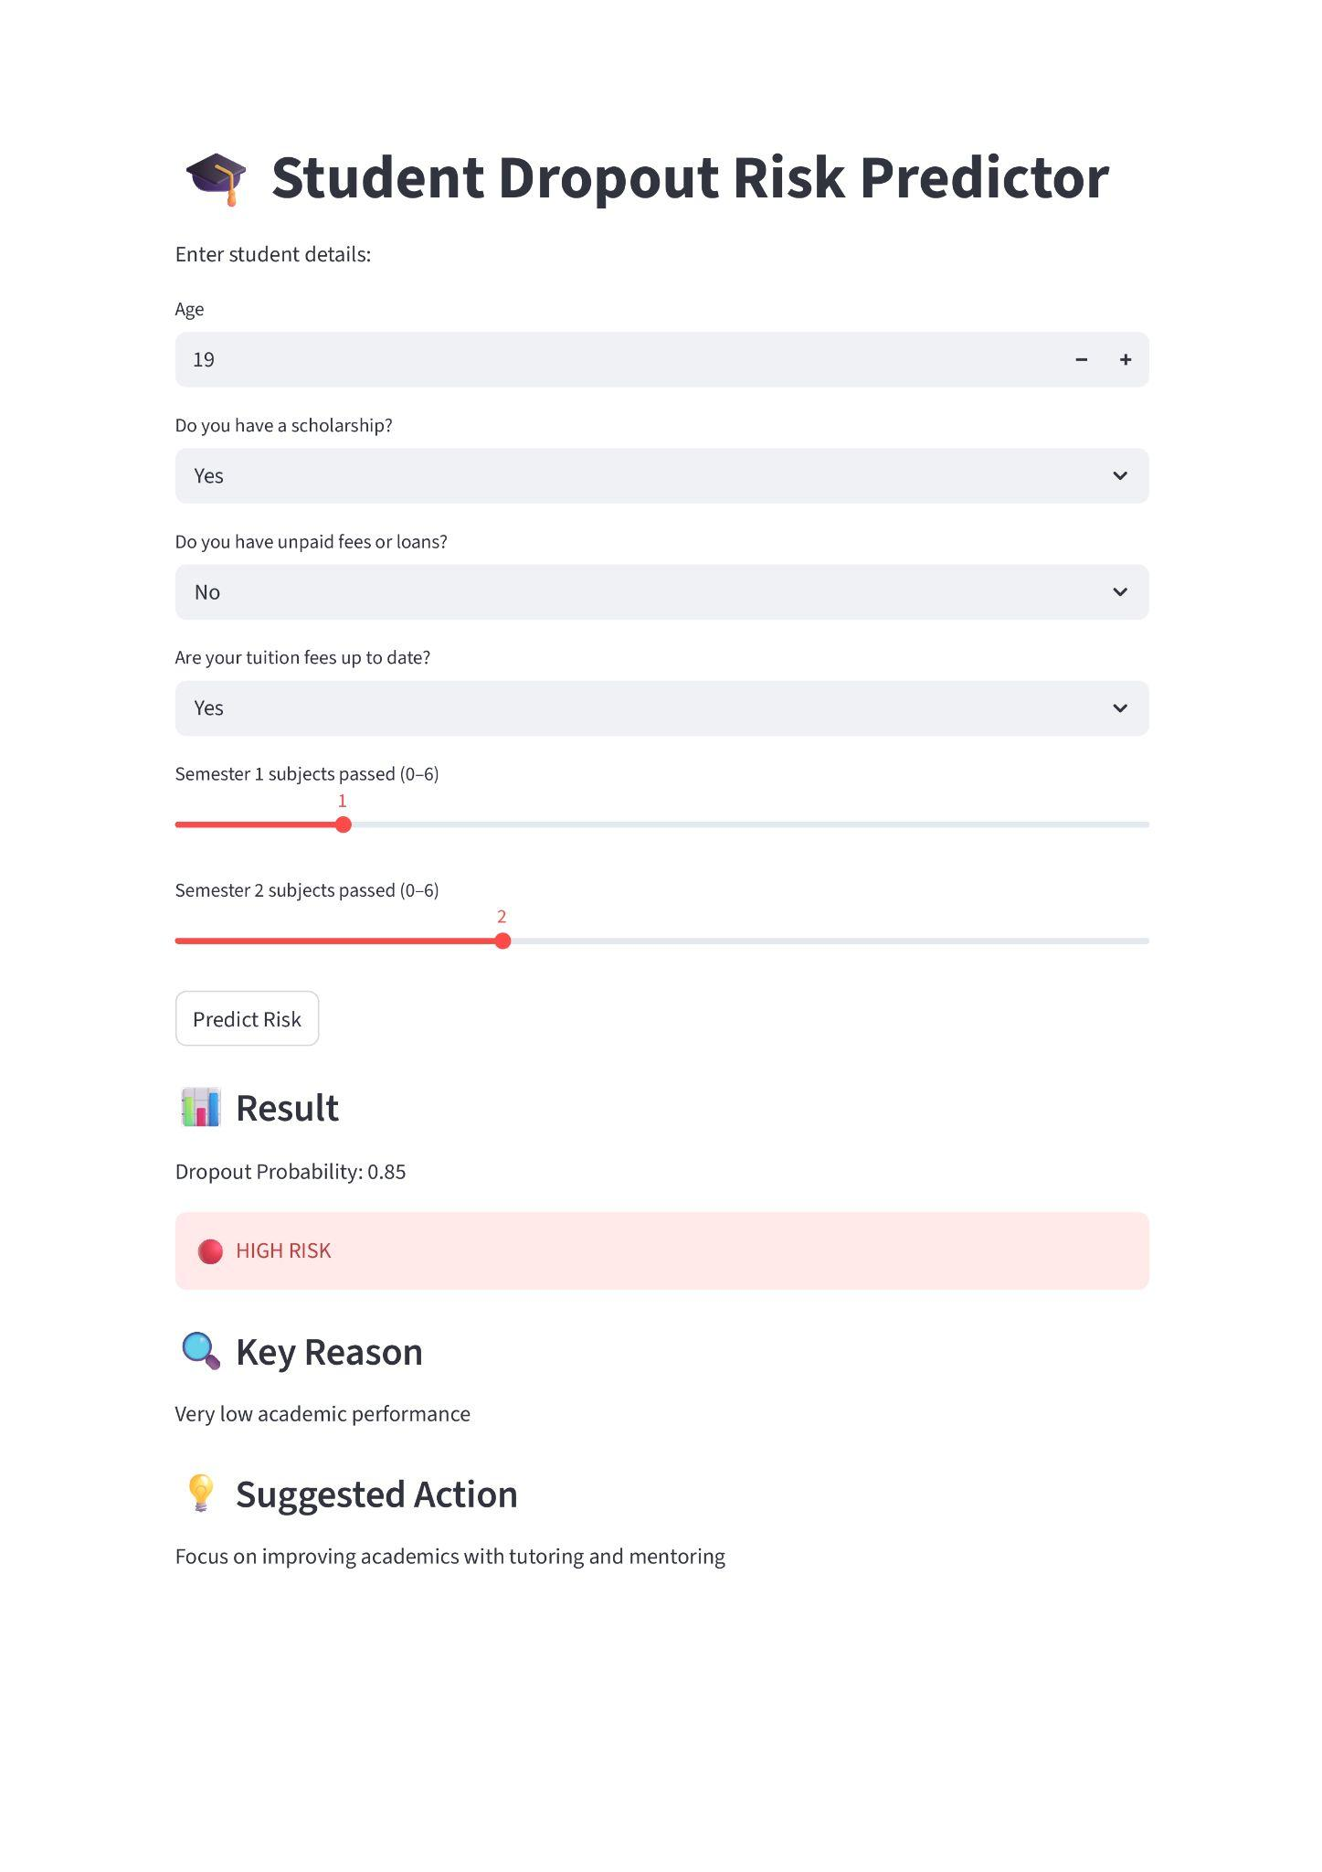
System Demo

Slide 16
Contribution
What is new in your work
Users can enter their own details to check if they are at risk of dropout
System provides risk levels (Low, Medium, High) instead of just prediction
Gives a specific reason for dropout risk
Provides personalized suggestions to reduce the risk
Improvements over existing methods
Better handling of class imbalance using SMOTE
Compared multiple models and selected the best using F1-score instead of only accuracy
Improved usability by allowing prediction with minimal inputs
Provided explainable results (reason + suggestion) instead of just prediction output
Achieved more balanced performance (precision + recall) using Gradient Boosting

Slide 17
Challenges & Solutions
Problems faced
Class imbalance (fewer dropout cases)
Model performance variation between algorithms
Using all features for real-time input was impractical
Model output not easily understandable for users
How they were solved
Used SMOTE to handle class imbalance
Compared multiple models and selected best using F1-score
Reduced input to key features and filled others with mean values
Added risk levels, reasons, and suggestions to make output understandable

Slide 18
Future Work
Possible improvements
Improve accuracy by using more advanced models or better tuning
Include more relevant features (attendance, internal marks, behavior)
Add feature selection techniques to remove less important variables
Perform cross-validation for more reliable evaluation
Enhance model performance with better imbalance handling techniques
Extension ideas
Develop a web/mobile application for real-time student use
Integrate with college database systems for automatic data input
Add visual dashboards for tracking student risk trends
Extend system to predict academic performance or placement chances
Implement early warning system for institutions to take preventive action

Slide 19
Phase-3 Deliverables
Deliverable 1: Final PPT
Deliverable 2: Google Colab Notebook
Deliverable 3: Dataset
Deliverable 4: Code Repository (GitHub)
https://github.com/angelxavier905/AIML_ML-Lab/tree/main/ML_Mini

Slide 20
Conclusion
Summary of work
Built a student dropout prediction system using machine learning
Preprocessed data, handled imbalance using SMOTE, and trained multiple models
Compared Logistic Regression, Random Forest, and Gradient Boosting
Selected Gradient Boosting as the best model based on F1-score
Developed a Smart Risk Checker where users can input details
System provides prediction, risk level, reason, and suggestions
Key learnings
Importance of data preprocessing and class imbalance handling
Understanding of model comparison using metrics like Precision, Recall, F1-score
Practical use of multiple ML algorithms and model tuning
Learned how to build an interpretable and user-friendly ML system
Gained experience in converting a model into a real-world application

Slide 21
References
• Kaggle Dataset: Predict Students Dropout and Academic Success
• Villar & Andrade (2024) – Discover AI
• Marcolino et al. (2025) – Scientific Reports
• Cho et al. (2023) – Applied Sciences
• Kim et al. (2023) – Applied Sciences

