Slide 1
CMPT 825 Natural Language Processing
Angel Xuan Chang angelxuanchang.github.io/nlp-class
Adapted from material by Anoop Sarkar

Slide 2
Programming Languages
C, C++, Java, Python, …
unambiguous
fixed
designed
learnable?
known simple semantics
Natural Languages
French, English, Korean, Chinese, Tagalog, …
ambiguous
evolving
transmitted
learnable
complex semantics

Slide 3
Why is NLP computationally hard?

Slide 4
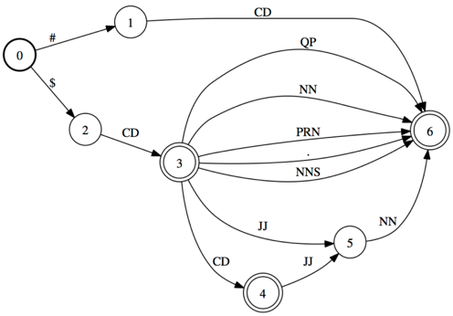
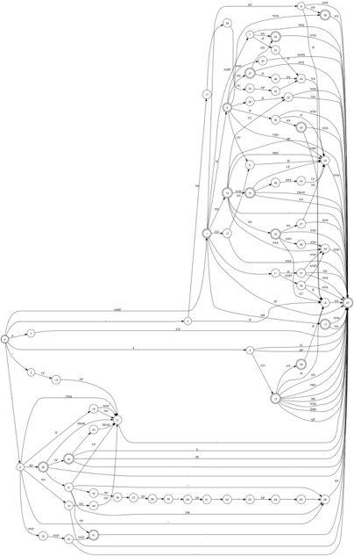
$
3
monthly
fee
$
1
pershare
pricing
$
CD
JJ
NN
a noun phrase type
10 noun phrase types
100 noun phrase types
6K noun phrase types
Language is complex
1000 noun phrase types

Slide 5
Language is ambiguous
Lung cancer in women mushrooms
Mushrooms is noun or a verb?
Ban on nude dancing on governor's desk
Similar to “if-then-else” ambiguity
Island Monks Fly in Satellite to Watch Pope Funeral
“fly in” vs. “fly [_{OBJ} in Satellite]” hidden segmentation
British Left Waffles on Falkland Islands
Is it British/Noun Left/Verb or British Left/NP Waffles/Verb?

Slide 6
Language is diverse
Many ways of saying the same thing
“Siri, play music”, “Siri, please play a song”, …
Both at word and sentence level
“music” vs “song” vs “tune”
“play something nice”

Slide 7
Language is Parsed
for more see crashblossoms.com
Google's Computer Might Betters Translation Tool
New York Times March 8, 2010
Number of Lothian patients made ill by drinking rockets
Edinburgh Evening News, March 4, 2010
Violinist linked to JAL crash blossoms
http://languagelog.ldc.upenn.edu/nll/?p=1693

Slide 8
What is the difference?
NLP = Natural Language Processing
Building useful systems
CL = Computational Linguistics
Understanding human language

Slide 9
Different levels of language
Phonetics: acoustic and perceptual elements
Phonology: basic sounds (phonemes) and rules for combination
e.g. syllable constraints in Japanese. E.g. English loanword for “dog” in Japanese is “doggu”
Morphology: how morphemes combine to form words, relationship of phonemes to meaning
e.g. delight-ed vs. de-light-ed

Slide 10
Different levels of language
Syntax: sentence formation
e.g. The clown who the musician hits watches the ballerina
Semantics: meaning (from syntax to logical formulas)
e.g. Everyone is not here => what does this mean? Nobody / Not everyone is here.
Pragmatics: meaning that is not part of compositional meaning,
e.g. “The ham sandwich wants a beer”

Slide 11
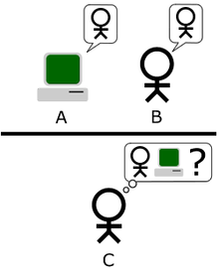
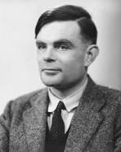
Imagine an "Imitation Game," in which a man and a woman go into separate rooms and guests try to tell them apart by writing a series of questions and reading the typewritten answers sent back. In this game both the man and the woman aim to convince the guests that they are the other.
We now ask the question, "What will happen when a machine takes the part of A in this game?" Will the interrogator decide wrongly as often when the game is played like this as he does when the game is played between a man and a woman? These questions replace our original, "Can machines think?"
Alan Turing

Slide 12
Winograd Schema
(H. Levesque, AAAI 2011)
The town councillors refused to give the angry demonstrators a permit because they feared violence.
Who feared violence?
Answer 0: the town councillors
Answer 1: the angry demonstrators
The town councillors refused to give the angry demonstrators a permit because they advocated violence.
Who advocated violence?
Answer 0: the town councillors
Answer 1: the angry demonstrators

Slide 13
Some examples of NLP achievements

Slide 14
IBM Watson plays Jeopardy

Slide 15
Speech to Speech Translation
KIT Lecture Translator
NICT Speech Translator
Skype Translator

Slide 16
Topics in NLP research
Dialogue and Interactive Systems
Discourse and Pragmatics
Generation and Summarization
Information Extraction and Question Answering
Information Retrieval
Language Resources and Evaluation
Language and Vision
Linguistic and Psycholinguistic Aspects of CL
Machine Learning for NLP
Machine Translation
NLP for Web, Social Media and Social Sciences
NLP-enabled Technology
Phonology, Morphology and Word Segmentation
Semantics
Sentiment Analysis and Opinion Mining
Spoken Language Processing
Tagging, Chunking, Syntax and Parsing
Text Categorization and Topic Models

Slide 17
Course Logistics
All class communication will be on Piazza
Sign up at piazza.com/sfu.ca/spring2020/cmpt825
Angel’s office hours: Thu 9:30am to 10:30am TASC1 8031
TA office hours: TBA this week

Slide 18
Course Logistics
Prerequisites
Experience with python
Familiarity with machine learning
Math fundamentals: probability, statistics, linear algebra, calculus
There is no official textbook for the course, but if you would like to read further about NLP, here are some good reference books:
Neural Network methods for Natural Language Processing by Yoav Goldberg.
Speech and Language Processing by Daniel Jurafsky and James Martin

Slide 19
Course Grading
Programming setup homework: HW0 due on Jan 16, 2020 (2%)
Four programming homeworks. Due dates: HW1 on Jan 30, 2020, HW2 on Feb 13, 2020, HW3 on Mar 5, 2020, HW4 on Mar 19, 2020 (10% each)
In class midterm: Feb 20, 2020 (25%)
Participation: Helping other students on the discussion board in a positive way (5%)
Final Project Proposal: Due on Mar 12, 2020 (5%)
Final Project Milestone: Due on Mar 26, 2020 (5%)
Final Project: Due on Apr 14, 2020 (18%)

Slide 20
Next time
Lecture on NLP tasks
Before next time: make sure you sign up on piazza: piazza.com/sfu.ca/spring2020/cmpt825

