Slide 1

NLP and Text Visualization
SFU Natural Language Lab
http://natlang.cs.sfu.ca/
Notes:
Hi I am Maryam Siahbani, phd student at natlang lab in SFU.
I am gonna talk about “Visualization using an ontology based on semantic roles”.
The content of this presentation is mainly from our paper in AKBC 2013.

Slide 2
SUBJECT PUNCHED QUICKLY OXIDIZED TCEJBUS DEHCNUP YLKCIUQ DEZIDIXO
CERTAIN QUICKLY PUNCHED METHODS NIATREC YLKCIUQ DEHCNUP SDOHTEM
SCIENCE ENGLISH RECORDS COLUMNS ECNEICS HSILGNE SDROCER SNMULOC
GOVERNS PRECISE EXAMPLE MERCURY SNREVOG ESICERP ELPMAXE YRUCREM
CERTAIN QUICKLY PUNCHED METHODS NIATREC YLKCIUQ DEHCNUP SDOHTEM
GOVERNS PRECISE EXAMPLE MERCURY SNREVOG ESICERP ELPMAXE YRUCREM
SCIENCE ENGLISH RECORDS COLUMNS ECNEICS HSILGNE SDROCER SNMULOC
SUBJECT PUNCHED QUICKLY OXIDIZED TCEJBUS DEHCNUP YLKCIUQ DEZIDIXO
CERTAIN QUICKLY PUNCHED METHODS NIATREC YLKCIUQ DEHCNUP SDOHTEM
SCIENCE ENGLISH RECORDS COLUMNS ECNEICS HSILGNE SDROCER SNMULOC

Slide 3
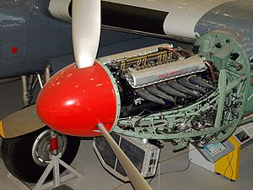
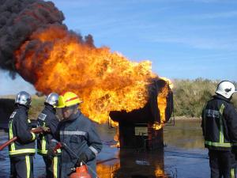
the engine.
the engine caught fire.
Passengers believed the engine caught fire.
Passengers reported they saw streaks of flames out of the engine and believed the engine had caught fire.
?
Notes:
It is hard to visualize abstract concepts.
To visualize an engine we can simply use an image.
“the engine caught fire”
How about this statement: “Passengers believed the engine caught fire.” or this:

Slide 4
Text is tough (to visualize)*
Very high dimensionality
Tens to hundreds of thousands of features
Language is compositional and ambiguous
Can be combined together in innumerable ways
Abstract concepts
So difficult to visualize
Not pre-attentive
Must foveate to read
Unordered
* i247: Information Visualization and Presentation by Marti Hearst
Notes:
First, let’s have a look at main issues we face to in visualizing text. An excellent resource on text visualization research is Marti Hearst’s lecture notes.
Text is very high dimensional data (you can extract millions of features from words in text)
Language is inherently ambiguous and hard to understand
text may contain many abstract concepts
it is not pre-attentive,
unordered!!

Slide 5
Lensing Language
Explore new visualizations that exploit parsed language
Semantic parsing of natural language: going beyond topic models and clustering bags of words
Exploit language understanding: who did what to whom, where, when and how ...
"Embodied" visualization: place spatial, temporal and social entities into an intuitive low dimensional space
Notes:
In order to obtain such view from text, we apply semantic parsing.
It extracts detailed facts about events and we used them to explore new visualizations.
predicate-centred view of events provided by semantic parsing helps to build structures in the form of who did what to whom, when and how.
Then we placed obtained information in spatial, temporal and social entities into a low dimensional space.
We use data sets that are smaller than the "macro-reading" approach but still large enough that human readers would not be able to conveniently read through the entire material. Thus, our system enables a sense-making process [13] for users that wish to navigate information encoded as natural language in a particular data set.

Slide 6
Predicate-centric Ontology
Semantic Role Labeling to extract predicate argument structures
Verbose labeling
Automatically populate a novel predicate-centric ontology
Using ontology as facet in visualization
Easily find uncommon facts
Micro-reading in contrast to macro reading
Killer
Corpse
Entity defeated
Entity victorious
Notes:
Let’s see how we create the ontology .
We apply SRL to extract
This is a micro-reading approach and in contrast to macro reading methods which needs a lot of data to extract common-sense knowledge
extracts facts using “micro-reading" of text in contrast to approaches that extract common-sense knowledge using “macro-reading“ methods.

Slide 7
Semantic Role Labeling
identifying semantic arguments for a verb of a sentence and defining their roles such as who did what to whom, when and where
The boy hit a ball
hit : Predicate
The boy: Agent
Hitter
Semantic Roles
Verbose labels
a ball: Patient
Thing hit
Notes:
SRL is the task of identifying semantic arguments of a verb (we call it predicate) and defining their roles and labeled them.
This approach particularly works well in domains like Wikipedia which is about events, very few events and sentiment is no an issue.
The events ideally describe who did what to whom, when and where which is retrieved using the sentence predicate-argument structure.

Slide 8
Predicate Sense Disambiguation
Mary gamely kicked in $5 to John’s bail.
Accuracy: 92%
Kick.01
A0: kicker
A1: thing kicked
A2: instrument
Kick.03
A0: contributor
A1: contribution
A2: given to
Features:
Parse
tree
Contextual
(POS,...)

Slide 9
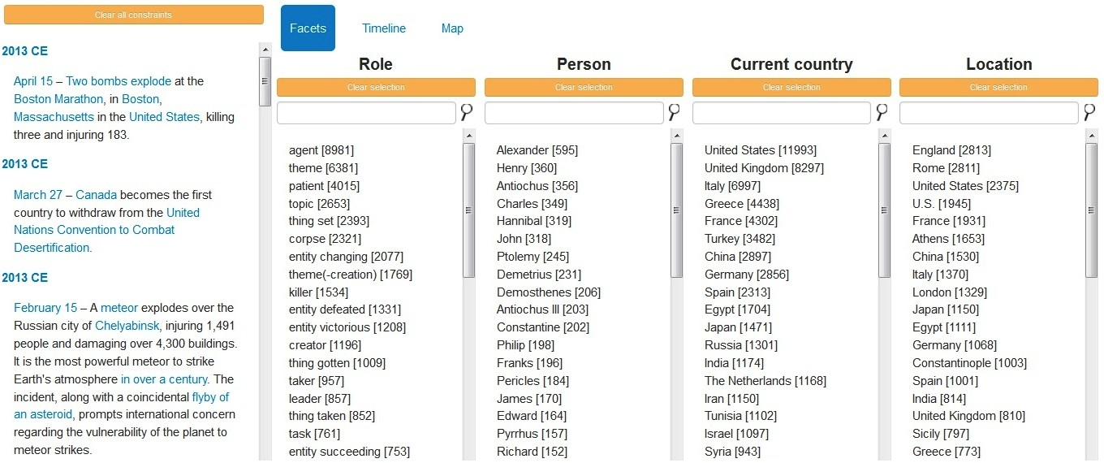
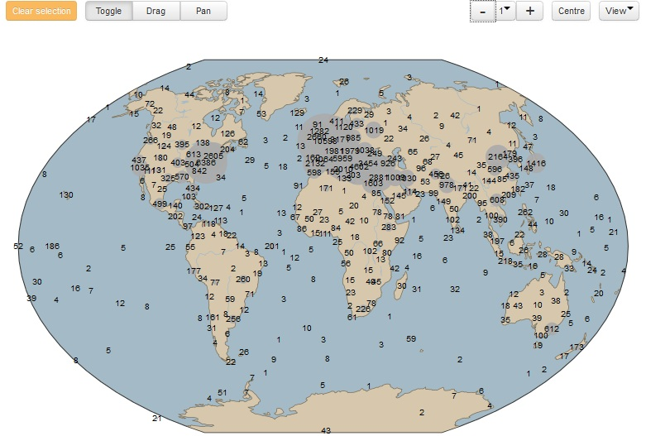
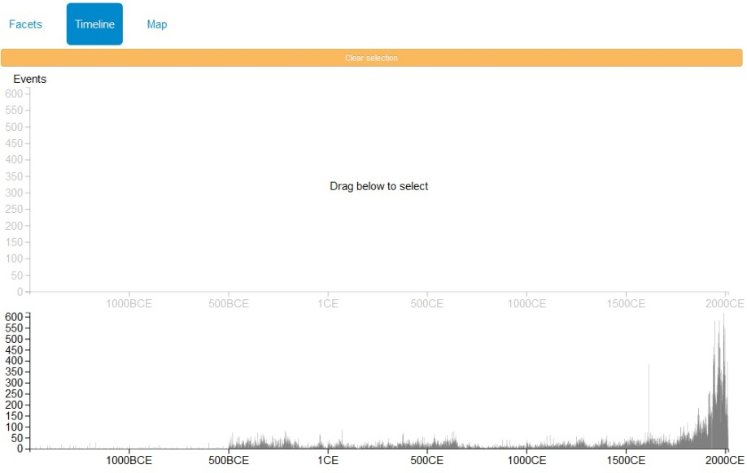
Visualization
Faceted Browsing
Map
Timeline

Slide 10
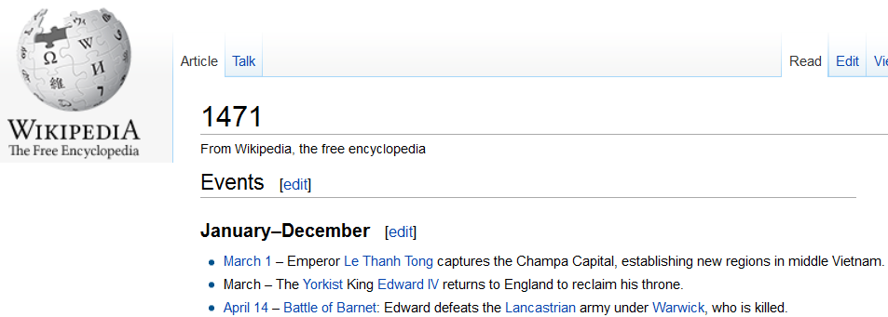
Framework
Wikipedia Human History
Time
~41K descriptions
Descriptions
Google reverse
geo-coding
Entity Extraction
(NER & hyperlinks)
Locations
Country
~12K locations
~12K persons
kill 2100
found 1801
defeat 1637
Persons
Knowledge Base
predicate
Predicate Sense Disambiguation
event1
arg0
roleArg0
SRL
.
roleArg1
event2
.
.
.
.
.
.

Slide 11
{
"arg0": "Emperor Le Thanh Tong",
"arg1": "the Champa Capital",
"event": "capture",
"latitude": 21.03,
"longitude": 105.85,
"country": "Vietnam",
"roleArg0": "getter",
"roleArg1": "thing gotten",
"year": 1471,
"person": "Le Thanh Tong“,
"location": {"Champa Capital", “Vietnam“},
"description": "March 1 – Emperor Le Thanh Tong captures the Champa Capital, establishing new regions in middle Vietnam.”,
"Wikipedia_categories": {
"Vietnamese poets", "Lê Dynasty emperors", "Southeast Asian countries", "15th-century monarchs in Asia",...}
}
~83K events

Slide 12
Verifying Name Entities
Map to Wikipedia articles
Person
Wikipedia categories and infobox: “YEAR births”, “YEAR deaths”, “Kings of*”, “Born”, “Religion”,...
Location
Latitude & longitude
Organization
Wikipedia categories and infobox: “Established in*”, “Companies*”, “Founder”, “Headquarters”, “Employees”, ...
Ongoing work on machine learning for domain adaptation and Wikipedia Categories

Slide 13
Demo

