Slide 1
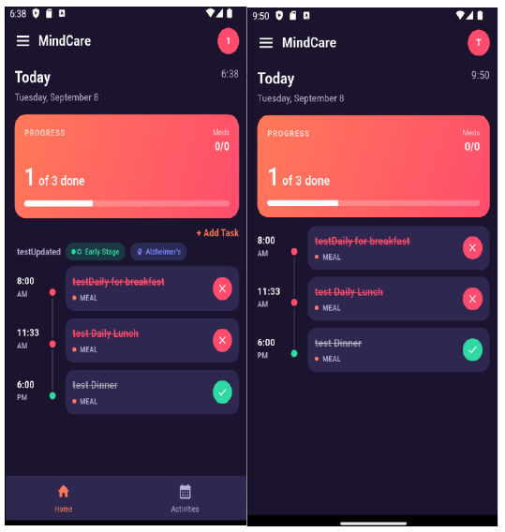
FYP II · FINAL PRESENTATION
A Mobile-Based Cognitive and Daily Assistance Application for Dementia Patients with Gamification
ANGEL YAP YOON YING · 2205499
Universiti Tunku Abdul Rahman
Notes:
Project title and student details are taken from the final report cover. Interface image: Final_Proposal_2205499.pdf, Figure 6.19.

Slide 2
PROJECT EVOLUTION
What changed from proposal to final product
The final report transformed a broad concept into a traceable, personalised care platform.
9
33
4 → 5
91.0
broad functional requirements
traceable functional requirements in the final report
problem statements after adding personalization
average SUS score against an 85 target
→
Reminder app
Recurring occurrence engine with response-aware notifications
→
Generic games
Dementia type-and-stage game sets with errorless guidance
→
Fixed challenge
Per-game adaptive difficulty with caregiver override and audit history
→
Basic monitoring
Period analytics, game statistics and caregiver-only risk indicators
Sources: earlier proposal pp. 44–45; final report pp. 21–30, 51–54, 224–225.
02
Notes:
Source comparison: Proposal_ANGELYAPYOONYING_2205499.pdf, functional requirements on pp. 44–45; Final_Proposal_2205499.pdf, Chapters 1, 4, and 7.

Slide 3
CHAPTER 1 · INTRODUCTION
Problem statement evolution
Four original problems remained; a fifth was added after development exposed the need for personalisation.
01
Difficulty in Managing Daily Tasks and Medications
Memory and executive-function decline made routine adherence difficult.
NEW IN FINAL REPORT
05
02
Lack of Motivational Support in Dementia Care Routines
Traditional prompts alone did not sustain participation.
Lack of personalized and adaptive cognitive support
03
Poor Usability and Cognitive Overload in Existing Applications
Complex interfaces reduced independent use.
A single game set and fixed difficulty could be too demanding or too easy. The final system therefore matched activities to dementia type and stage, then adapted each game using recent performance.
04
Inadequate Integration of Care Coordination
Separate tools limited timely caregiver awareness.
Sources: earlier proposal pp. 13–14; final report pp. 21–23.
03
Notes:
Problem statements compared between the earlier proposal (pp. 13–14) and the final report (pp. 21–23). The fifth problem is new in the final report.

Slide 4
CHAPTER 1 · INTRODUCTION
Objectives became more specific and measurable
The target population remained early-to-middle-stage dementia patients, while caregiver responsibilities became explicit.
EARLIER PROPOSAL
FINAL OBJECTIVES
01
To design and implement a mobile-based application for dementia patients and caregivers that integrates daily task and medication management, cognitive exercises, gamified features, and real-time patient activity monitoring to support patient engagement, routine adherence, and caregiver coordination.
01
Build a mobile app for tasks, medication, games and gamification
02
02
To assess usability and user acceptance for the developed mobile application using User Acceptance Testing (UAT) along with the System Usability Scale (SUS), with a target usability score of at least 85%.
Create real-time caregiver monitoring
03
03
To develop and technically validate a personalized adaptive cognitive exercise module that assigns games according to dementia type and stage, automatically adjusts each game’s difficulty based on the patient’s recent performance, and enables caregiver review and override to maintain an appropriate and achievable level of challenge
Evaluate UAT and achieve SUS ≥ 85
PATIENT
Completes routines, games and rewards
CAREGIVER
Sources: earlier proposal pp. 16–17; final report pp. 25–27.
04
Notes:
Objectives and target users compared between the earlier proposal (pp. 16–17) and final report (pp. 25–27). The formal adaptive-cognition objective is new.

Slide 5
CHAPTER 2 · LITERATURE REVIEW
Where the final features came from
Existing apps showed useful fragments; literature justified how those fragments should be adapted for dementia care.
EVIDENCE / SOURCE
DESIGN DECISION
END-USER VALUE
ROUTINES
Recurring tasks, medication dosage and alerts
Supports adherence and reduces delayed caregiver awareness
Elli Cares + reminder research
COGNITION
Accessible games, performance logging and visual feedback
Encourages cognitive participation without a separate app
XDementia + BrainTrack
ACCESSIBILITY
Large targets, high contrast, role-specific navigation
Reduces cognitive load and supports independent use
DEMIGNED principles + usability reviews
MOTIVATION
Points, streaks, levels and unlockable reward games
Reinforces repeated participation in routines and games
Gamification evidence
PERSONALISATION
Type/stage routing and per-game adaptive difficulty
Keeps challenge appropriate and avoids frustration
Research findings
Sources: Final report Chapter 2; Lim & Sharmeen (2018); Manera et al. (2017); Ortega Morán et al. (2024); Engelsma et al. (2024); Greysen et al. (2024).
05
Notes:
Evidence sources are listed in Final_Proposal_2205499.pdf references: Lim & Sharmeen (2018); Manera et al. (2017); Lu et al. (2021); Ortega Morán et al. (2024); Bahar-Fuchs et al. (2017); Engelsma et al. (2024); Greysen et al. (2024); Koivisto & Malik (2021). Existing app observations are from final report Chapter 2.

Slide 6
CHAPTER 2 · LITERATURE REVIEW
MindCare closes the gap between assistance and cognitive support
No reviewed application combined the full caregiver workflow with personalised cognitive adaptation.
Feature | Elli Cares | XDementia | BrainTrack | MindCare
Task & medication reminders | Yes | No | No | Yes
Caregiver support | Yes | No | No | Yes
Recurring schedules | Yes | No | No | Yes
Cognitive games | No | Yes | Yes | Yes
Adaptive game difficulty | No | Yes | No | Yes
Game performance statistics | No | Yes | Yes | Yes
Type & stage-specific games | No | No | No | Yes
Caregiver override + history | No | No | No | Yes
Risk / attention indicator | No | No | No | Yes
Unlockable reward games | No | No | No | Yes
Source: Final report Table 2.10, pp. 36–37 (condensed to presentation-critical features).
06
Notes:
Source: Final_Proposal_2205499.pdf, Table 2.10, pp. 36–37. The table is condensed for presentation readability while preserving the report's Yes/No values.

Slide 7
CHAPTER 3 · METHODOLOGY
Prototyping model across the project
Each project phase applied a prototyping activity, from FYP I research to final validation.
FYP I
ITERATION 1
ITERATION 2
FYP II
FINAL
01
02
03
04
05
Understand
Prototype
Evaluate & build
Refine
Validate
Problems, literature, scope and requirements
Low- and high-fidelity interfaces and workflows
Feedback guided authentication, patients, tasks and notifications
Personalised games, adaptive difficulty, analytics, risk and rewards
Formal testing and final project deliverables
FYP II expansion
Feedback expanded MindCare from a basic prototype into a personalised care workflow with adaptive games, analytics, risk monitoring and rewards.
07
Sources: Final report Chapter 3, pp. 38–40; WBS, pp. 42–47.
07
Notes:
Source: Final_Proposal_2205499.pdf, Chapter 3, pp. 38–40. The flow summarises the described prototyping stages.

Slide 8
CHAPTER 4 · REQUIREMENTS
Functional requirements expanded from 9 to 33
The final list converted broad expectations into testable, role-specific behaviour.
EARLIER
FINAL
9
33
FR01–04
Access & settings
→
FR05–07
Cognitive & adaptive
General statements
Traceable requirements
FR08–12
Gamification
Authentication, dashboard, status, notification, games, streaks and basic caregiver monitoring.
Each requirement has an FR ID, module and role, enabling direct mapping into unit, integration, system and acceptance tests.
FR13–17
Patient management
FR18–31
Tasks & reminders
FR32–33
Monitoring & analytics
6 MODULES
Sources: earlier proposal pp. 44–45; final report Table 4.1, pp. 51–54.
09
Notes:
Source comparison: earlier proposal functional requirement list (9 items) and final report Table 4.1 (33 FR IDs across six modules).

Slide 9
CHAPTER 4 · REQUIREMENTS
New capabilities added during development
These additions account for most of the change between the original proposal and the completed system.
01
Complete recurrence
02
Responsive reminders
Daily, weekly, monthly, yearly and custom schedules; occurrence-specific status.
5–15 minute repetition, sound, Complete/Missed actions and automatic missed handling.
03
Personalised games
04
Adaptive difficulty
Four type-and-stage game sets with supportive errorless guidance.
Per-game promotion/demotion, caregiver override, freeze/resume and audit history.
05
Monitoring depth
06
Reward pathway
Period analytics, trends, rankings, hint use and graded caregiver risk signals.
Daily streak cycle, shared points, levels and points-unlocked Just for Fun games.
Source: Final report Table 4.1 and Chapter 6.
10
Notes:
Source: Final_Proposal_2205499.pdf, Table 4.1 and Chapter 6. The wording condenses implemented behaviours into presentation highlights.

Slide 10
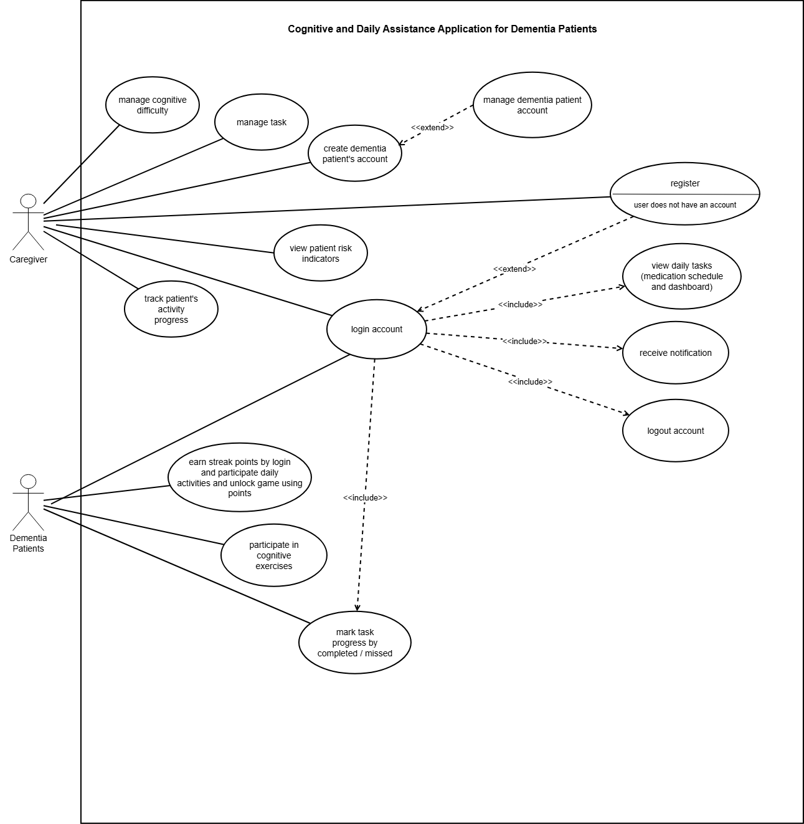
CHAPTER 4 · REQUIREMENTS
Updated use-case diagram
11
Notes:
User requested an editable placeholder because the updated use-case diagram will be inserted manually.

Slide 11
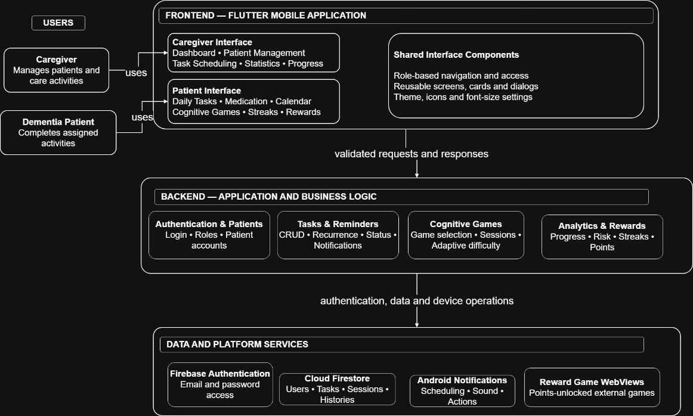
CHAPTER 5 · SYSTEM DESIGN
Architecture and data design
12
Notes:
User requested placeholders for Chapter 5 diagrams. Replace the left and right frames with the final system architecture and ERD images.

Slide 12
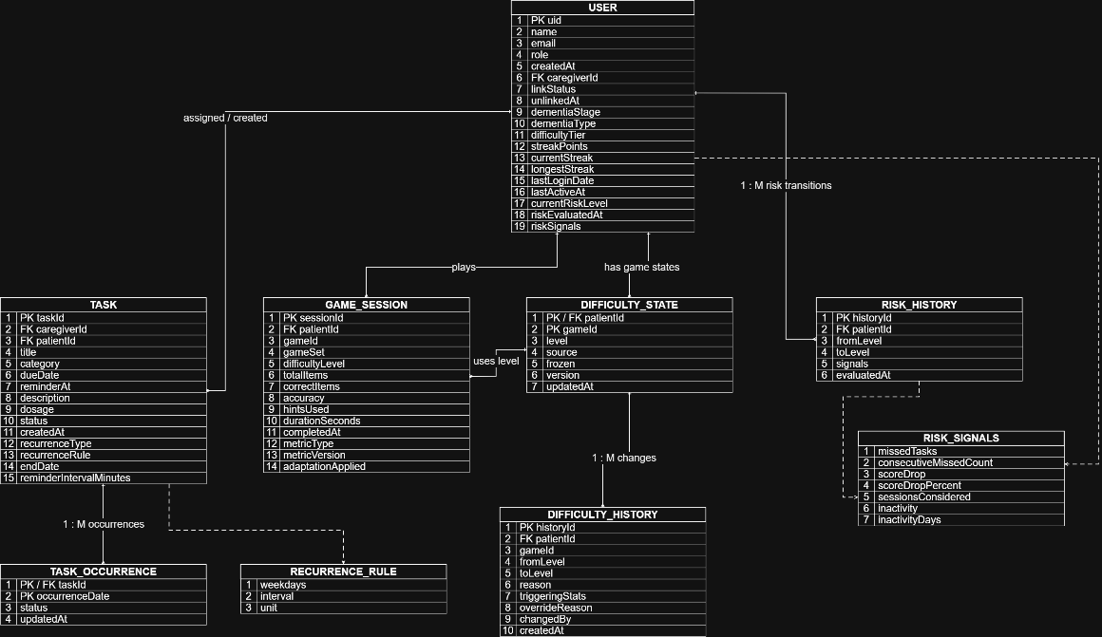
CHAPTER 5 · SYSTEM DESIGN
Architecture and data design
12
Notes:
User requested placeholders for Chapter 5 diagrams. Replace the left and right frames with the final system architecture and ERD images.

Slide 13
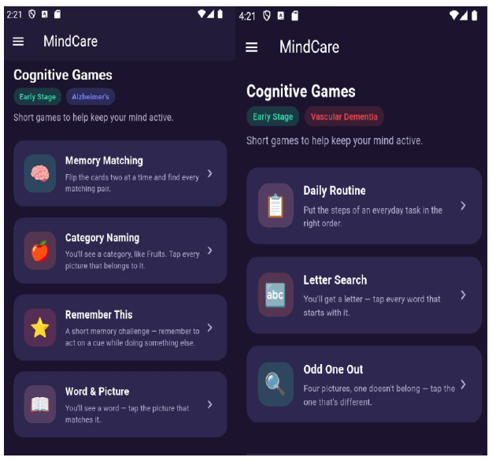
CHAPTER 6 · IMPLEMENTATION
The final interface connected both roles
CAREGIVER + PATIENT DASHBOARDS
PERSONALISED GAME SETS
Source: Final report Figures 6.6 and 6.19.
13
Notes:
Interface images: Final_Proposal_2205499.pdf, Figures 6.6 and 6.19.

Slide 14
CHAPTER 7 · SYSTEM TESTING
Testing covered logic, integration, workflows and acceptance
The final report documented tests from isolated functions through complete caregiver and patient journeys.
14
9
17
34
UNIT CASES
INTEGRATION FLOWS
SYSTEM SCENARIOS
UAT CASES
Authentication, recurrence, game calculations, gamification and risk rules
Cross-module task, notification, game, analytics and risk interactions
End-to-end caregiver and patient workflows
19 caregiver + 15 patient acceptance checks
Testing focus
The most important checks followed the full chains: recurrence → reminder → status → points/progress, and game session → adaptive difficulty → statistics/history.
Source: Final report Chapter 7, Tables 7.1–7.9.
16
Notes:
Counts are based on the test IDs documented in Final_Proposal_2205499.pdf Chapter 7: 14 unit cases, 9 integration cases, 17 system scenarios, and 34 UAT cases.

Slide 15
CHAPTER 7 · SYSTEM TESTING
All 34 user-acceptance cases passed
Both roles accepted the workflows relevant to their responsibilities.
19 / 19
15 / 15
100%
caregiver acceptance cases passed
patient acceptance cases passed
overall UAT pass rate
✓
Role separation
Correct dashboards, navigation and logout locations
✓
Task lifecycle
Create, recur, remind, respond, edit, delete and monitor
✓
Adaptive cognition
Correct game set, supportive guidance and independent level adjustment
✓
Motivation
Daily streak, shared points, level progress and reward unlocking
Source: Final report Table 7.9, pp. 216–223.
17
Notes:
Source: Final_Proposal_2205499.pdf, Table 7.9. All 19 caregiver UAT cases and all 15 patient UAT cases are marked PASS.

Slide 16
CHAPTER 7 · SYSTEM TESTING
Usability exceeded the target
Five participants produced an average System Usability Scale score of 91.0.
91.0
AVERAGE SUS
+6.0 ABOVE TARGET
Finding
Participants found MindCare highly usable, understandable and consistent across its features.
Source: Final report Table 7.11, pp. 224–225. Target SUS = 85.
18
Notes:
Source: Final_Proposal_2205499.pdf, Table 7.11. Participant SUS scores: 87.5, 90.0, 92.5, 95.0, 90.0; average 91.0; target 85.

Slide 17
CHAPTER 7 · SYSTEM TESTING
What the results demonstrated
The evidence supported usability and workflow completion, while also revealing the boundary of the evaluation.
01
Complex workflows remained understandable
UAT covered recurrence, repeated reminders, occurrence status, adaptive games and reward unlocking without role confusion.
INTERPRET WITH CARE
The usability result was strong, but the sample contained only five participants.
02
Personalisation was demonstrated
The correct game set was selected from dementia type and stage, and each game adapted independently from recent session data.
The risk indicator remained a caregiver-support rule rather than a clinical diagnosis. Broader trials and professional review would be needed before making clinical claims.
03
Caregiver control stayed visible
Statistics, override reasons, change history, analytics and risk explanations supported accountable monitoring.
Sources: Final report Chapters 7–8.
19
Notes:
Source: Final_Proposal_2205499.pdf, Chapters 7 and 8. The sample-size and non-clinical limitations are stated in Section 8.3.

Slide 18
CHAPTER 8 · CONCLUSION
All three formal objectives were achieved
The final outcomes can be linked directly to implemented modules and measured evidence.
OBJECTIVE 1
To design and implement a mobile-based application for dementia patients and caregivers that integrates daily task and medication management, cognitive exercises, gamified features, and real-time patient activity monitoring to support patient engagement, routine adherence, and caregiver coordination.
Achieved through patient management, recurring task and medication schedules, repeated reminders, role-specific dashboards, status tracking, analytics and rewards.
OBJECTIVE 2
To assess usability and user acceptance for the developed mobile application using User Acceptance Testing (UAT) along with the System Usability Scale (SUS), with a target usability score of at least 85%.
Achieved through 34 passed UAT cases and an average SUS score of 91.0, which exceeded the target of 85.
Sources: Final report Objectives (pp. 25–26), Chapter 7 and Section 8.2.
20
Notes:
Sources: Final_Proposal_2205499.pdf, formal objectives on pp. 25–26, testing evidence in Chapter 7, and objective achievements in Section 8.2.

Slide 19
CHAPTER 8 · CONCLUSION
All three formal objectives were achieved
The final outcomes can be linked directly to implemented modules and measured evidence.
OBJECTIVE 3
To develop and technically validate a personalized adaptive cognitive exercise module that assigns games according to dementia type and stage, automatically adjusts each game’s difficulty based on the patient’s recent performance, and enables caregiver review and override to maintain an appropriate and achievable level of challenge.
Achieved through four dementia type-and-stage game sets, per-game automatic difficulty, caregiver override, freeze/resume and difficulty history.
Sources: Final report Objectives (pp. 25–26), Chapter 7 and Section 8.2.
20
Notes:
Sources: Final_Proposal_2205499.pdf, formal objectives on pp. 25–26, testing evidence in Chapter 7, and objective achievements in Section 8.2.

Slide 20
CHAPTER 8 · FUTURE WORK
The next stage is reliability, reach and clinical validation
Future work should strengthen the platform without expanding beyond its role as a support tool.
01
Offline-first routines
02
Broader access
03
Personal media
Cache task lists and synchronise safely after connectivity returns.
Add iOS support, multilingual interfaces, voice and text-to-speech reminders.
Allow familiar photos and sounds in recognition activities.
04
Owned reward games
05
Clinical review
06
Larger evaluation
Reduce dependency on external WebView sites by hosting controlled content.
Validate game parameters and risk thresholds with healthcare professionals.
Test with more dementia patients and caregivers over a longer period.
Positioning: MindCare supported daily routines and caregiver decisions; it did not diagnose dementia or replace clinical judgement.
Source: Final report Section 8.3, pp. 227–228.
21
Notes:
Source: Final_Proposal_2205499.pdf, Section 8.3, pp. 227–228. The owned reward-game recommendation follows from the report's stated dependency on external WebView sites.

Slide 21
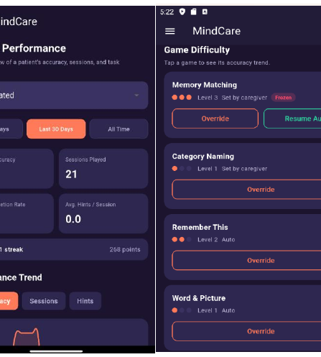
MindCare evolved beyond reminders.
It connected daily assistance, adaptive cognitive engagement and caregiver insight in one accessible mobile workflow.
34 / 34 UAT
91.0 SUS
33 FRs
Thank you
Demonstration & Questions & Discussion
Notes:
Closing summary. Interface image: Final_Proposal_2205499.pdf, Figure 6.8. UAT and SUS figures are from Chapter 7.

