Slide 1
MOVIE GENRE CLASSIFICATION
Angélica María Gómez Buitrago
Juan Camilo Castillo Castro

Slide 2


Tools and Approach
CPU
GPU
ML Images
DL Images
Output
Probabilities Average
Output
Probabilities Average
ML Text
DL Text

Slide 3


Machine Learning Models
ML Images
ML Text
Preprocessing
ExtraTree
Classifier
Fit and Test
Greyscale Images
Apply PCA (40 pc)
Preprocessing
RandomForest
Classifier
Fit and Test
Countvectorizer: Ngrams(1,2)
Countvectorizer Ngrams (1,2) + stop_words
TfidfVectorizer
Number of estimators (220), the depht (10) and the n-jobs (-5).
We changed the number of estimators (220), the depht (10) and the n-jobs (-5).
Slightly better than RF Classifier

Slide 4
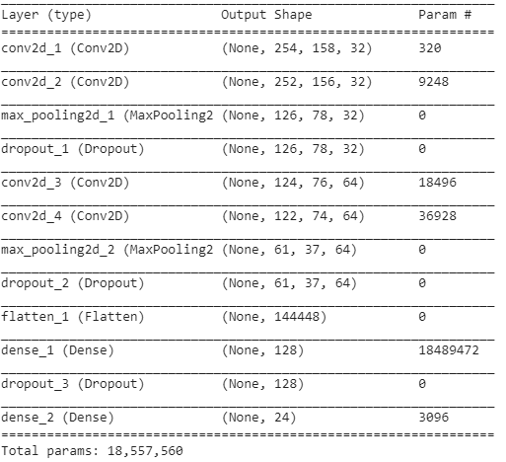

Deep Learning Models (1)
DL Images
Preprocessing
Build CNN
Fit and Test
(5 epochs)
Greyscale images
Data Generator

Slide 5
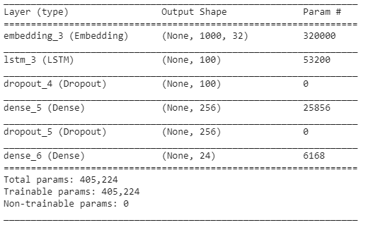
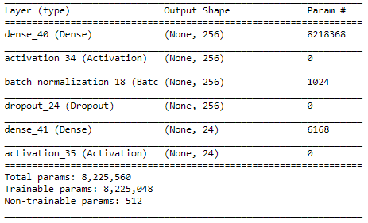


Deep Learning Models (2)
DL Text
Basic NN
LSTM NN
Preprocessing
Build Basic Neural Network
Fit and Test
(50 epochs)
Countvectorizer: Ngrams(1,2)
Countvectorizer Ngrams (1,2) + stop_words
TfidfVectorizer
Preprocessing
Build LSTM Neural Network
Fit and Test
(3 epochs)
Tokenizer:
max_words = 10000 / max_len = 1000
! Even with GPU it took a lot of time to run

Slide 6
THANK YOU

