Slide 2
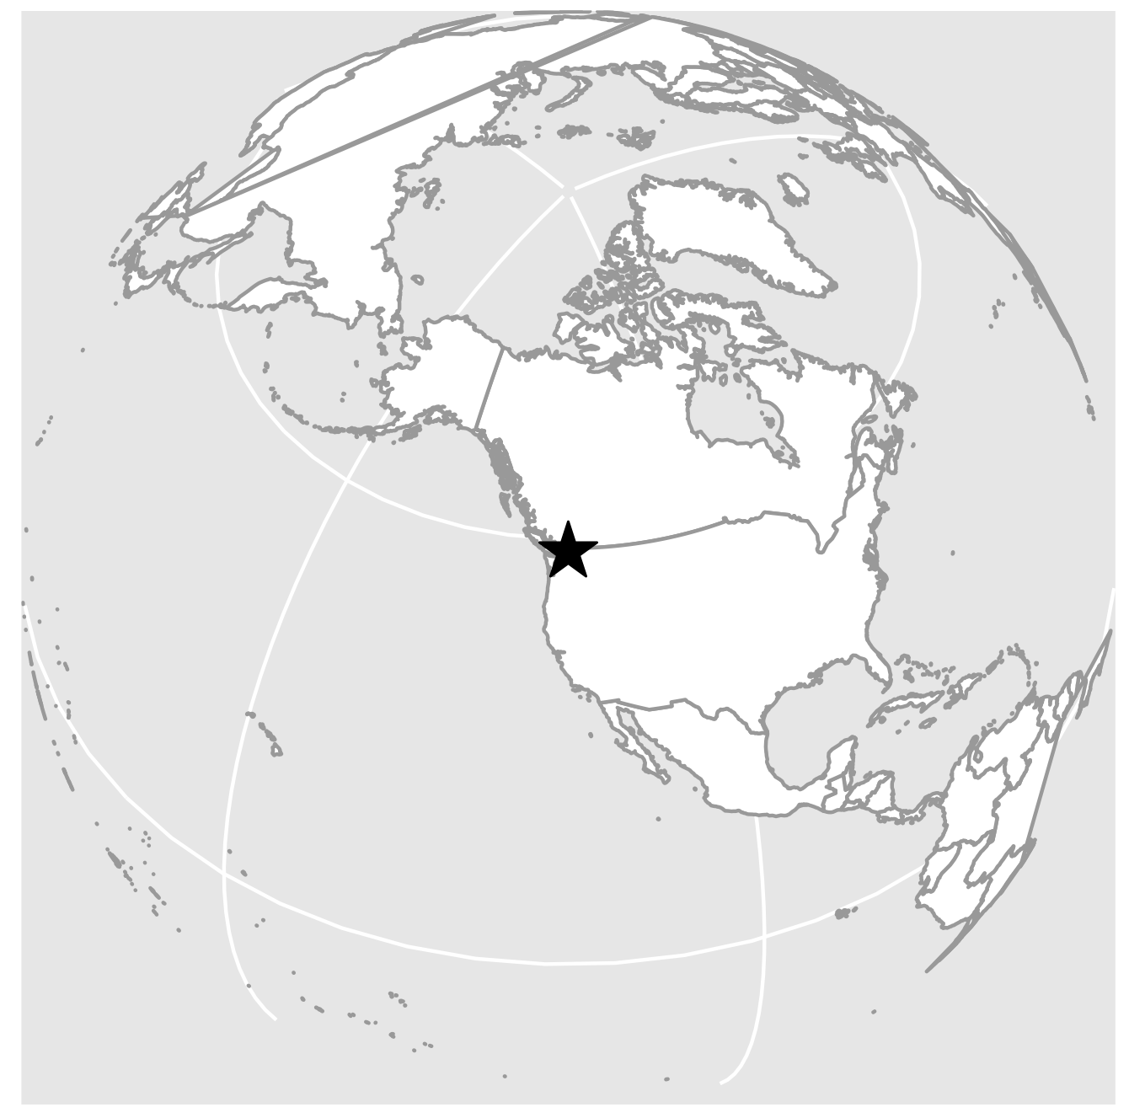
A
121.5 °W
Burned
121 °W
Unburned
Fire
120.5 °W
48.8 °N
B
48.6 °N
48.4 °N

Slide 3
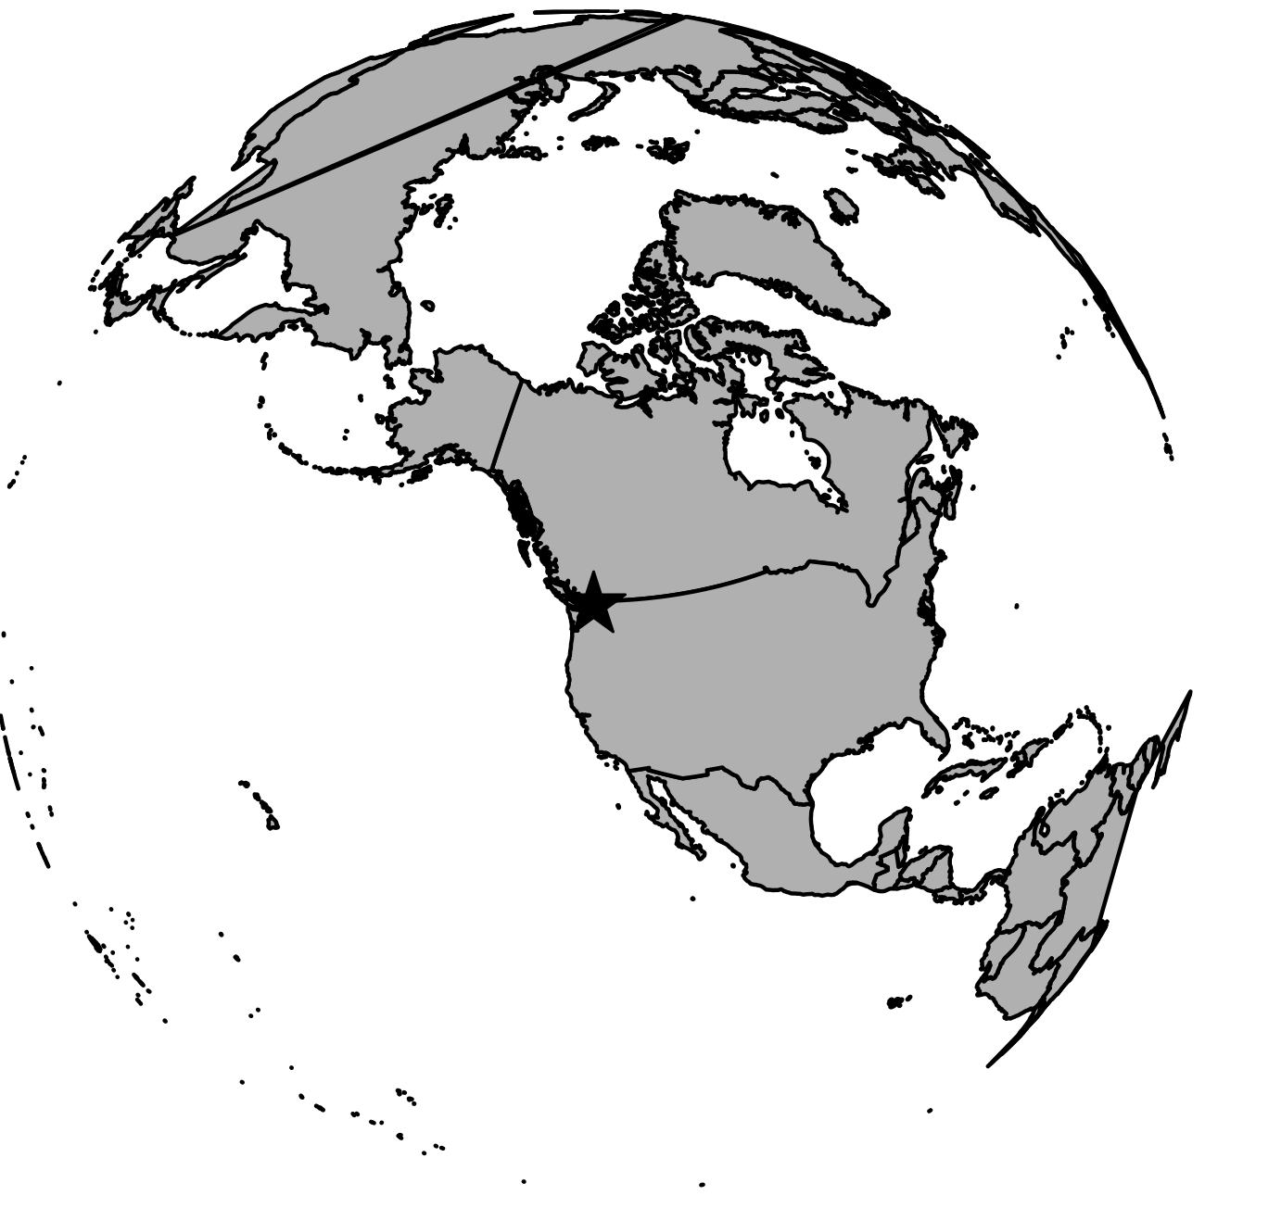
A
121.5 °W
Burned
121 °W
Unburned
Fire
120.5 °W
N
48.8 °N
B
48.6 °N
0
10 km
48.4 °N

