Slide 1
ELECTRIC MOTOR TEMPERATURE
Team 14
Angel N Fernandes
Venkat Akash Varun

Slide 2
INTRODUCTION
01

Slide 3
BACKGROUND
The dataset under consideration comprises sensor data obtained from a permanent magnet synchronous motor (PMSM) deployed on a test bench, representing a prototype model of a leading German OEM.
These measurements were meticulously gathered by the LEA department at Paderborn University, utilizing a range of driving cycles to simulate real-world conditions.
Each recording, sampled at 2 Hz, spans one to six hours and is distinguished by a unique "profile _id.”
The motor operates under a hand-designed driving cycle, defining reference speed and torque, with resulting quantities such as motor speed and torque derived from standard control strategies.
Notes:
The dataset includes sensor data from a test bench where a permanent magnet synchronous motor (PMSM) is placed.
This motor is a prototype model from an Original Equipment Manufacturer (OEM), and the measurements were taken as part of research by the Power Electronics and Electrical Drive department at Paderborn University in Germany.
The dataset is quite large, and contains approximately 1.3 million records.
Each record is sampled at 2 Hz and covers a time span ranging from one to six hours. Each session is identified by a unique "profile_id," and there are up to 54 sessions.
The motor is operated using manually designed driving cycles that specify a reference motor speed and a reference torque.

Slide 4
MOTIVATION
The motivation for this proposal stems from the challenges in measuring crucial parameters like rotor temperature (pm"), stator temperatures ("stator_*"), and torque in a commercial vehicle in a reliable and cost-effective manner.
Rotor temperature and torque are particularly difficult to measure economically but are pivotal for efficient motor operation.
A robust estimator for rotor temperature not only aids in manufacturing motors with reduced material but also empowers control strategies to optimize the motor's performance.
Accurate torque estimates enhance motor control, leading to reduced power losses and minimizing heat build-up, thereby improving overall efficiency.
Notes:
This project is motivated by the difficulty of measuring important factors like rotor temperature, stator temperatures, and torque in commercial vehicles in a reliable and affordable way.
Measuring rotor temperature and torque is especially challenging but crucial for making motors work efficiently.
Having a reliable way to estimate rotor temperature helps in making motors with less material and improves control strategies for better motor performance.
Accurate torque estimates improve motor control, reduce power losses, and minimize heat buildup, making the motor more efficient overall.

Slide 5
GOAL
The primary goal of this proposal is to develop advanced predictive models for the key features of interest, including rotor temperature, stator temperatures, and torque.
Leveraging machine learning techniques, we aim to create robust estimators that can predict these critical motor parameters with high accuracy.
Such models have the potential to revolutionize the automotive industry by enabling the manufacturing of motors with optimized materials, improving control strategies, and ultimately enhancing the efficiency of electric vehicles.
The proposed predictive models will contribute to a deeper understanding of motor behavior and facilitate advancements in motor design and control strategies.
Notes:
This project aims to build advanced predictive models for essential motor features like rotor temperature, stator temperatures, and torque.
They have the potential to revolutionize motor manufacturing by allowing the use of optimized materials, refining control strategies, and ultimately boosting the efficiency of electric vehicles.

Slide 6
02
DESCRIPTION OF THE DATASET

Slide 7
The motor is stimulated by manually crafted driving cycles representing a target motor speed and torque.
The currents in d/q-coordinates ("i_d" and "i_q") and voltages in d/q-coordinates ("u_d" and "u_q") result from a standard control strategy aiming to track the specified speed and torque references.
The "motor_speed" and "torque" columns represent the outcomes of this strategy, derived from the set currents and voltages.
Many driving cycles simulate random walks in the speed-torque plane, providing a more accurate emulation of real-world driving conditions than constant excitations and gradual changes.
The dataset contains 13,30,816 rows.
Notes:
The motor is operated using carefully designed driving cycles that set a target motor speed and torque.
The currents in d/q-coordinates ("i_d" and "i_q") and voltages in d/q-coordinates ("u_d" and "u_q") are a result of a standard control strategy aimed at following the specified speed and torque references.
The "motor_speed" and "torque" columns in the dataset represent the outcomes of this strategy, calculated from the given currents and voltages.
Unlike constant excitations and gradual changes, many driving cycles in the dataset simulate random walks in the speed-torque plane. This approach provides a more accurate emulation of real-world driving conditions.

Slide 8
u_q: Voltage q-component measurement in dq-coordinates (in V)
coolant: Coolant temperature (in °C)
stator_winding: Stator winding temperature (in °C) measured with thermocouples
u_d: Voltage d-component measurement in dq-coordinates
stator_tooth: Stator tooth temperature (in °C) measured with thermocouples
motor_speed: Motor speed (in rpm)
i_d: Current d-component measurement in dq-coordinates
i_q: Current q-component measurement in dq-coordinates
pm: Permanent magnet temperature (in °C) measured with thermocouples and transmitted wirelessly via a thermography unit.
stator_yoke: Stator yoke temperature (in °C) measured with thermocouples
ambient: Ambient temperature (in °C)
torque: Motor torque (in Nm)
profile_id: Unique measurement session id

Slide 9
03
ANALYSIS AND RESULTS

Slide 10
Data Preprocessing and Cleaning
The dataset underwent a comprehensive quality check, examining both missing values and duplicates, resulting in the identification of zero missing values.
To gain a preliminary understanding, basic descriptive statistics were generated for all numerical variables.
Subsequently, an assessment of outliers was conducted by creating a boxplot for all columns, excluding 'profile_id'.
Rows containing outliers were discerned and subsequently excluded, resulting in the removal of 7,252 outliers and a refined dataset comprising 1,323,564 rows.
Notes:
The dataset underwent a thorough quality check to assess both missing values and duplicates, revealing no missing values.
Basic descriptive statistics were then generated for all numerical variables to gain a preliminary understanding.
Next, an evaluation of outliers was performed by creating a boxplot for all columns, excluding 'profile_id’.
Rows containing outliers were identified and subsequently removed, leading to the exclusion of 7,252 outliers. The refined dataset now consists of 1,323,564 rows.

Slide 11
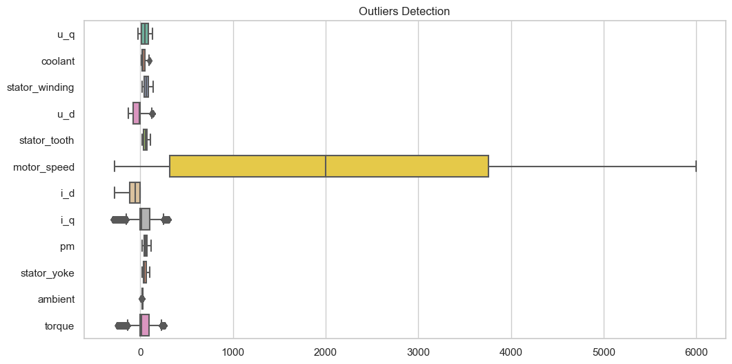
Notes:
Here is a visual of the outliers in the form of a box plot.

Slide 12
Exploratory Data Analysis
A correlation matrix for the cleaned data was generated.
There are strong correlations in some data, but there is no need to cancel out these variables, as they are technical variations that are naturally correlated, and not a spurious strong brightness.

Slide 13
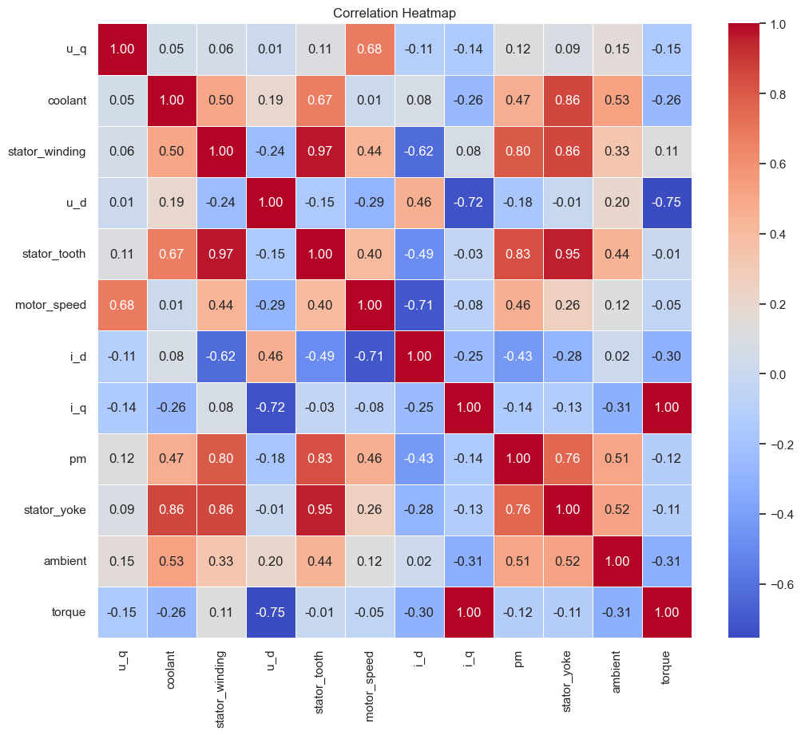
A heatmap using the Seaborn library was also generated to visualize the correlation matrix of numeric columns in the DataFrame.
The heatmap visually represents the correlation between numeric columns in the DataFrame.

Slide 14
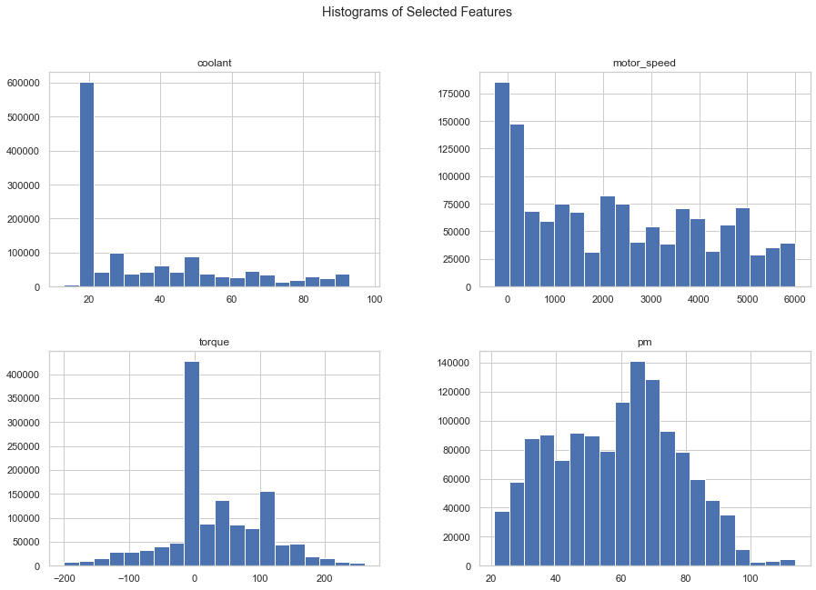
The histograms of the selected features provide a clear depiction of the individual variable distributions, offering a concise representation of the spread and concentration of values within each respective column.
Notes:
The histograms of the selected features provide a clear depiction of the individual variable distributions, offering a concise representation of the spread and concentration of values within each respective column.

Slide 15
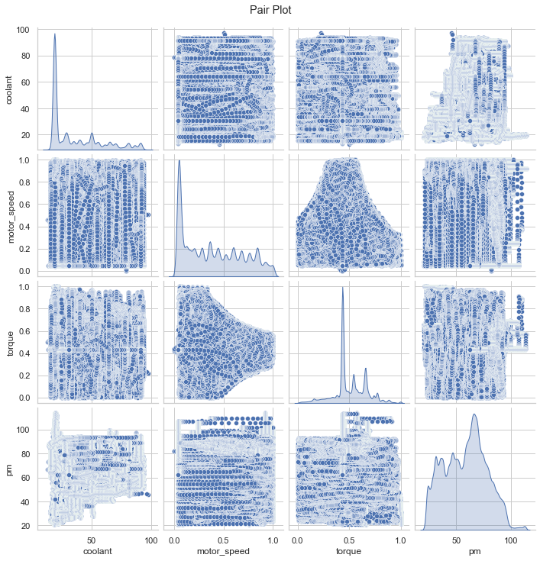
The pair plot generated from the provided code visually examines the relationships between pairs of selected features, offering insights into both the bivariate correlations through scatter plots
Notes:
The pair plot generated from the provided code visually examines the relationships between pairs of selected features, offering insights into both the bivariate correlations through scatter plots

Slide 16
Feature Engineering
We calculate real power (P) and reactive power (Q) using a formula that considers the voltage and current components. These power metrics are pivotal for understanding the energy dynamics and electrical performance of the motor.
For a balanced three-phase system in a dq-coordinate system, the real power P can be calculated as:
P = 3/2（u_d * i_d + u_q * i_q）
The reactive power Q can be calculated as:
Q = 3/2（u_d * i_d - u_q * i_q）
The power magnitude (S) in a three-phase system can be calculated using the following formula:
S = (P2 + Q2)**2
This magnitude serves as a comprehensive measure of the overall power consumption of the motor, providing a holistic perspective on its electrical characteristics.

Slide 17
04
MODEL SELECTION & EVALUATION

Slide 18
Based on the immense data we had, we decided to predict 3 features for efficiency.
The features are Permanent magnet temperature (pm), Motor power (motor_power) and Stator winding temperature (stator_winding).
To get the best results and find the best model, we selected only certain features as independent variables for each target.
To predict each target, Linear Regression, Decision Tree, XGBoost and K-nearest Neighbor Classifiers were used.
We also attempt to classify the stator winding temperature using 4 levels (heating, hot, normal and risk) using the Gaussian Naive Bayes model.
Notes:
Given the extensive dataset, we aimed to predict three efficiency-related features: Permanent magnet temperature (pm), Motor power (motor_power), and Stator winding temperature (stator_winding).
To optimize results and identify the best models, we carefully chose specific features as independent variables for each target.
For prediction, we used Linear Regression, Decision Tree, XGBoost, and K-nearest Neighbor Classifiers.
Additionally, we attempted to classify stator winding temperature into four levels (heating, hot, normal, and risk) using the Gaussian Naive Bayes model.
The data was split 80-20 train-test.

Slide 19
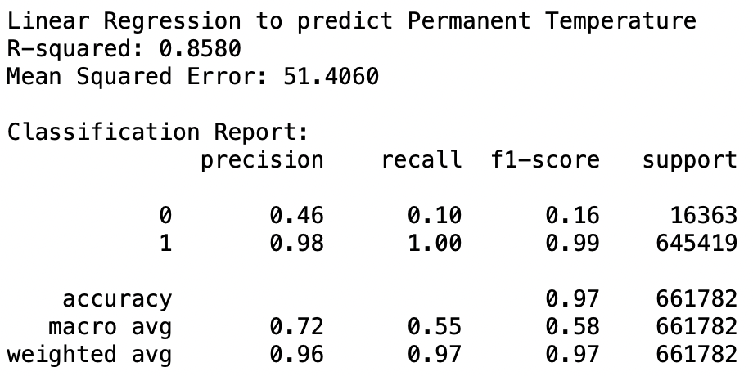
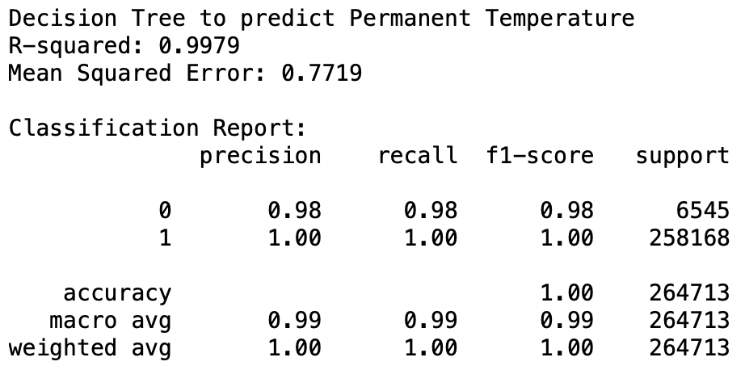
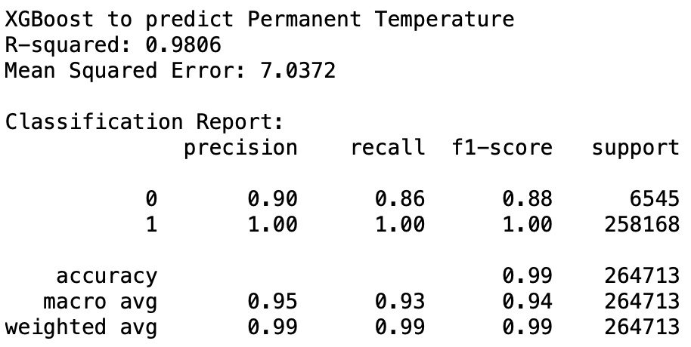
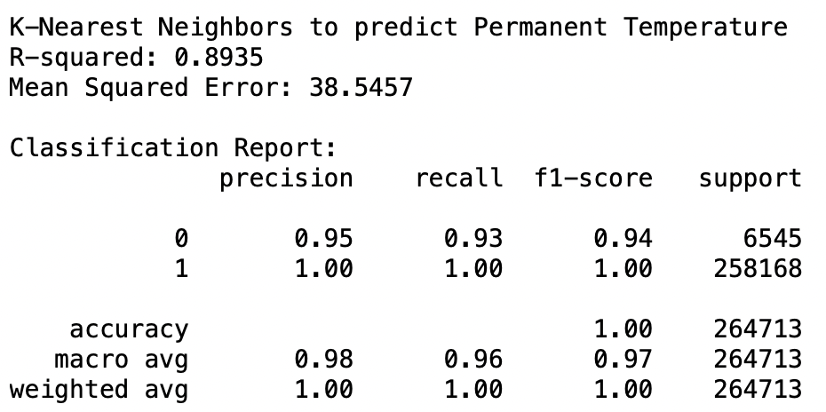
Permanent Magnet Temperature (pm)
Notes:
Permanent Magnet Temperature depends on mostly all columns in the database including the reactive power, real power and power magnitude.
The Classification Report shows high accuracy (97%), with excellent precision, recall, and F1-score for the training data.
However, the model struggles with the testing data, as reflected in lower precision, recall, and F1-score values for that class.
Overall, the Linear Regression model appears effective but may benefit from some improvements.
The Decision Tree model performed exceptionally well with its R-squared value of 0.9979.
The Mean Squared Error is low at 0.7719, signifying accurate predictions.
In terms of classification, the model achieves perfect precision, recall, and F1-score, resulting in an overall accuracy of 100%.
The model exhibits excellent performance and precise predictions.
The XGBoost model performs well with an R-squared value of 0.9806
In terms of classification, the model achieves high precision, recall, and F1-score resulting in an overall accuracy of 99%.
The model demonstrates strong predictive capabilities for Permanent Temperature, combining accurate regression and classification results.
The KNN model performs well with an R-squared value of 0.8935.
In terms of classification, the model achieves high precision, recall, and F1-score resulting in an overall accuracy of 100%.
The KNN model demonstrates strong predictive capabilities for Permanent Temperature, providing accurate regression and classification results.
So, overall Decision Tree seems to be a great model to predict Permanent magnet Temperature.

Slide 20
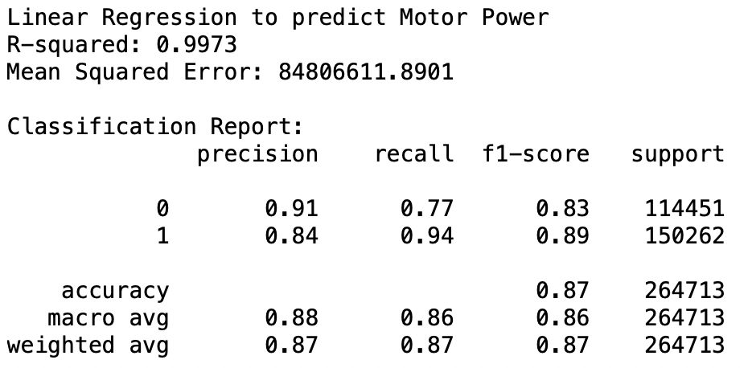
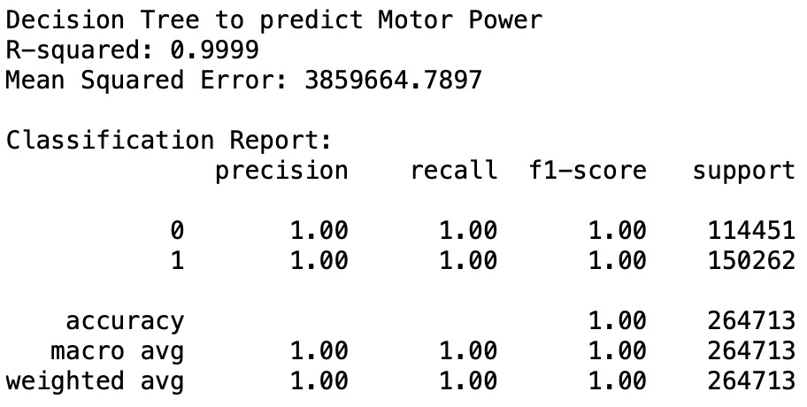
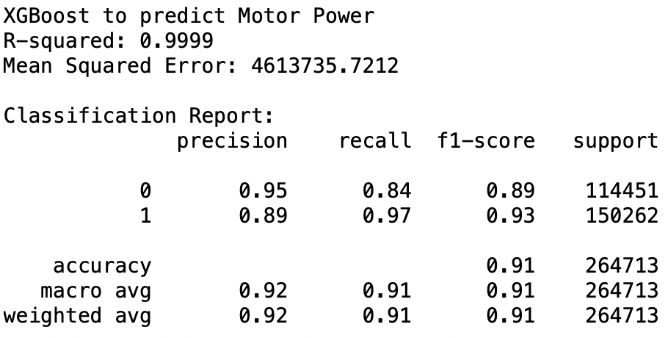
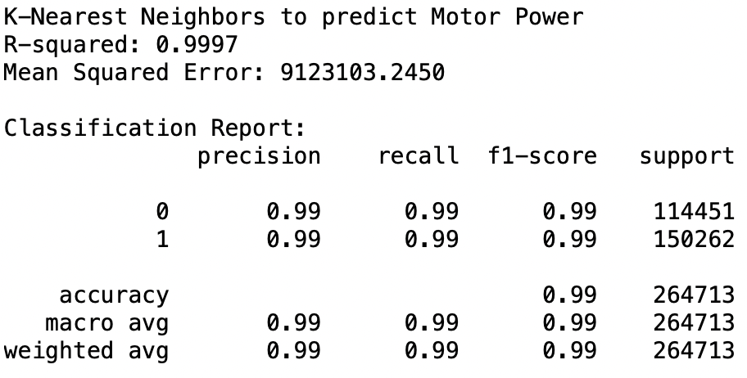
Motor Power
Notes:
Motor Power depends on mostly all d/q component measurements, temperatures, torque and motor speed.
The Linear Regression model demonstrated effective prediction for Motor Power, combining accurate regression and reasonably good classification results with a high R-squared value.
In terms of classification, the model achieves an accuracy of 87%, with reasonably good precision, recall, and F1-score.
The Decision Tree model achieved exceptional results with its R-squared value, suggesting that it is highly effective and precise in predicting Motor Power.
In terms of classification, the model demonstrates perfect precision, recall, and F1-score, resulting in an overall accuracy of 100%.
We suspect it may be overfitting the dataset.
In the XGBoost model, the model achieves an accuracy of 91%, with good precision, recall, and F1-score values.
Overall, the XGBoost model demonstrated strong predictive capabilities for Motor Power, providing accurate regression and classification results.
The output represents the performance of a K-Nearest Neighbors (KNN) model in predicting Motor Power.
The mean squared error is relatively low.
In terms of classification, the model achieves a very high accuracy of 99%, with excellent precision, recall, and F1-score values, indicating that the KNN model provides accurate regression and classification results for Motor Power.
So, overall XGBoost seems to be a great model to predict Permanent magnet Temperature.

Slide 21
Linear Discriminant Analysis (LDA) of Temperature of Cars with Electric Motors: Stator Winding
Linear Discriminant Analysis (LDA) applied to the temperature of cars with electric motors, specifically focusing on the stator winding, is a statistical method used for classification and dimensionality reduction.
In the context of electric vehicles or hybrid cars with electric motors, the stator winding temperature is a critical parameter that can impact the motor's efficiency and overall performance.
LDA aims to analyze and differentiate temperature patterns within the stator winding by identifying linear combinations of features that maximize the separation between different classes or temperature states.
The outcomes of LDA can be valuable for optimizing the design and operation of electric motors in cars, enhancing their efficiency, reliability, and overall thermal management.

Slide 22
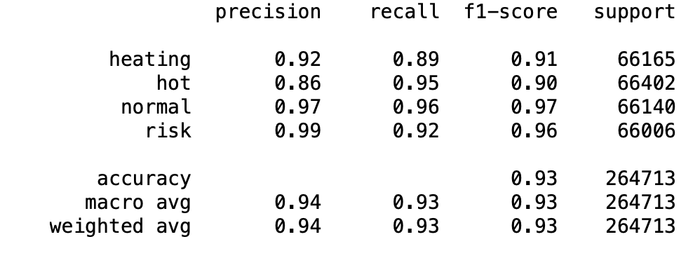
Linear Discriminant Analysis

Slide 23
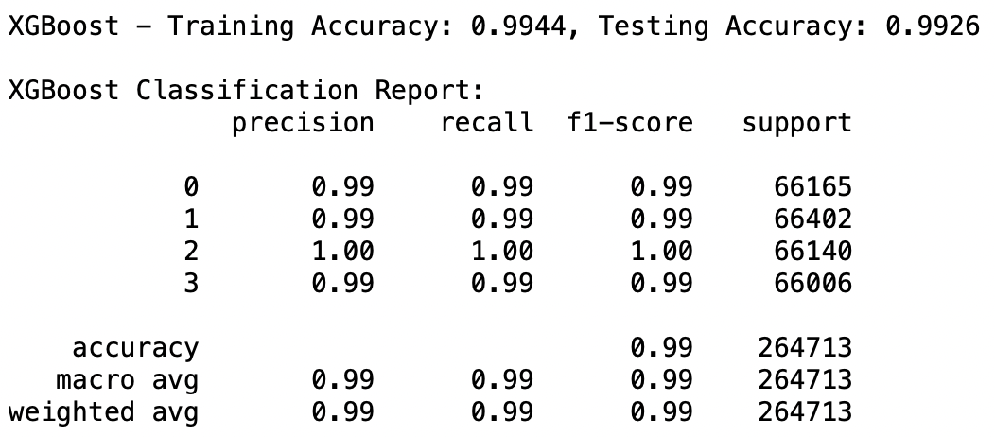
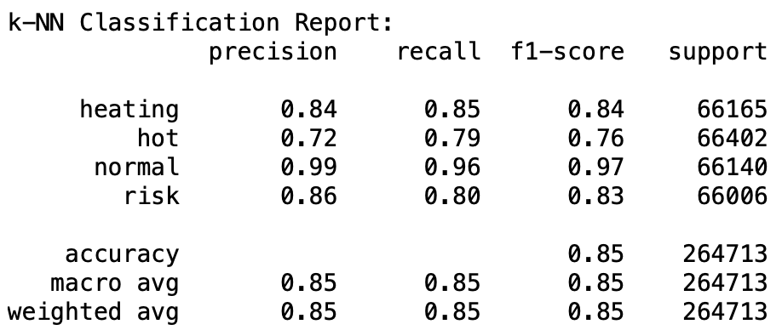
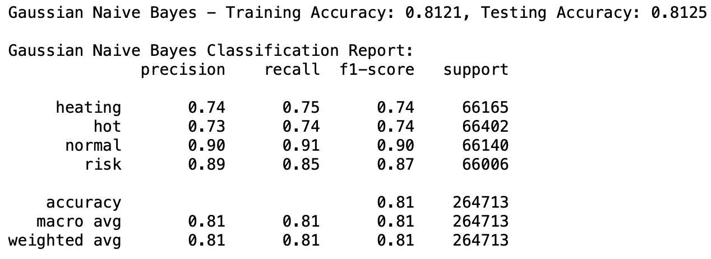
Stator Winding Temperature by Levels

Slide 24
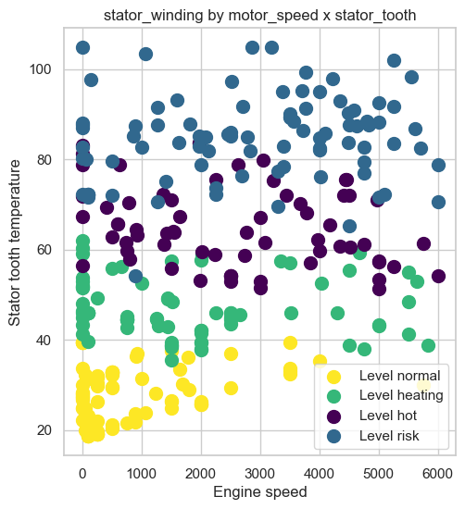
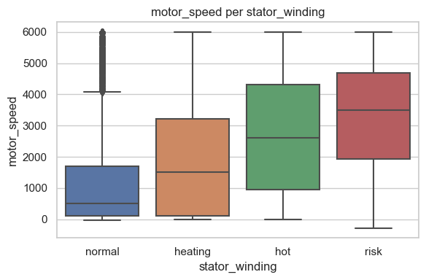
Categorization of stator winding temperature into 4 levels - heating, hot, normal and risk

Slide 25
05
MODEL COMPARISON

Slide 26
The Decision Tree emerges as the top performer, showcasing remarkable accuracy and explanatory power in predicting Permanent Temperature.
The Decision Tree, XGBoost, and KNN models stand out as highly effective in predicting Motor Power, showcasing robust performance in both regression and classification aspects.
In the evaluation of models predicting Stator Winding Temperature by Levels, LinearDiscriminant Analysis, KNN & xgboost are showcasing the best performance.

Slide 27
06
CONCLUSION

Slide 28
In conclusion, our project successfully leveraged a combination of data preprocessing, exploratory data analysis, and machine learning models to predict key temperature variables, such as permanent magnet temperature (pm), power magnitude, motor power, stator winding temperature.
The implemented linear regression, random forest classifier, and decision tree models demonstrated commendable predictive accuracy and provided valuable insights into the temperature variations of the electric motor components.
By adhering to the specified instructions, including data cleaning, thoughtful feature engineering, and methodical model selection, we achieved a robust and well-structured analysis.
Overall, our project successfully met its goals, showcasing the effectiveness of the chosen methodologies and contributing valuable knowledge to the domain of electric motor temperature prediction.
Notes:
In summary, our project effectively utilized a combination of data preprocessing, exploratory data analysis, and machine learning models to predict crucial temperature variables such as permanent magnet temperature (pm), motor power, and stator winding temperature.
The implemented linear regression, XGBoost, KNN, and decision tree models demonstrated strong predictive accuracy, offering valuable insights into the temperature variations of electric motor components.
Through meticulous adherence to specified instructions, including data cleaning, thoughtful feature engineering, and methodical model selection, we achieved a robust and well-structured analysis.

Slide 29
THANKS!

