Slide 1
Chapter 7
The Object-Oriented Approach to Requirements

Slide 2
Object-Oriented Analysis
Object-oriented viewpoint
  The consists of objects that work together, or collaborate to carry out functions
Unified Modeling Language (UML)
  In 1997 presented to the Object Management Group (OMG) as a standard modeling technique
  Based on work by Booch, Rumbaugh and Jacobson
  UML has become a standard

Slide 3
Object-Oriented Requirements
Types of OO diagrams
  Class diagram（类图）
  The use case diagram（用例图）
    Shows “uses” of the new system
  The collaborative diagram（协作图）
    Shows how objects “collaborate”
  The sequence diagram（顺序图）
    Shows sequencing of messaging
  The statechart diagram（状态图）
    Describes the states and behaviour of objects

Slide 4
Object-Oriented Requirements
OO Requirements =
  Event Table +
  Class Diagram +
  Use Case Diagrams +
  Interaction Diagrams (collaboration and/or sequence diagrams) +
  Statechart Diagram

Slide 5
Review – Differences between traditional structured and the OO approach
SDLC for both has same phases
Both approaches begin with the event table
  Require identification of “events”
Both require identification of “things”
  ERD vs. Class diagram
Main difference
  The diagrams or models used are quite different

Slide 6
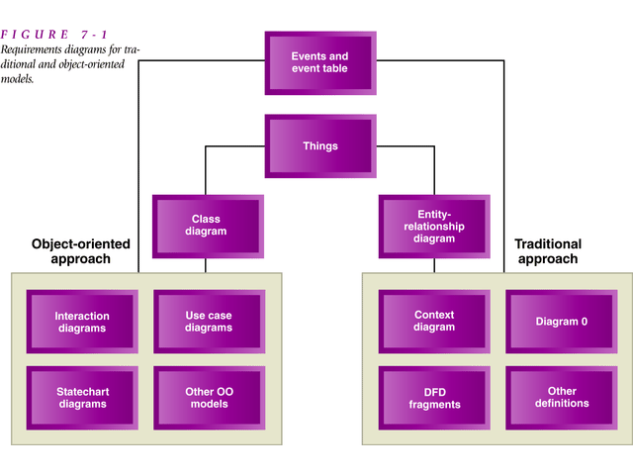

Slide 7
The Class Diagram
There are two kinds of descriptions of systems
  Structural information (components of the system)
  Behavioral information (logic performed by components)
Class diagram provides definition of structural components of the system
The other OO diagrams (e.g. use case, sequence, collaboration) focus on activities the system performs
  NOTE – with OO Analysis the class diagrams to describe system requirements can map very closely to the structure (ie. classes) in the OO computer program that will be eventually created

Slide 8
Object-Oriented method
Class: the type or classification to which all similar objects belong
Object encapsulate data and methods into one unit
Object
Attribute 1
Attribute 2
……
Data belong to object
message
Method 1
Method 2
……
message
Procedure that process data

Slide 9
Object-Oriented method
Class A
Attr1, …
Meth1, …
Class C
Attr1, …
Meth1, …
Inherit
Is-a
Inherit
Is-a
common reference
N:N
Class A1
Attr1, …
Meth1, …
Class A2
Attr1, …
Meth1, …
Class B
Attr1, …
Meth1, …
Multi-inherit
Is-a
Class A1
Attr1, …
Meth1, …
Aggregation
is-part-of
1:N

Slide 10
The Use Cases and Actors
Use Case – a single use or function performed by the system for those who use the system
  Describes the activity the system carries out in response to an event
    E.g. examples of use cases for word processing
      “write a letter”, “print a newsletter”
  Two concepts
    A person is involved, the person uses the system
    Actor: a role played by a user of the system (a stick figure)

Slide 11
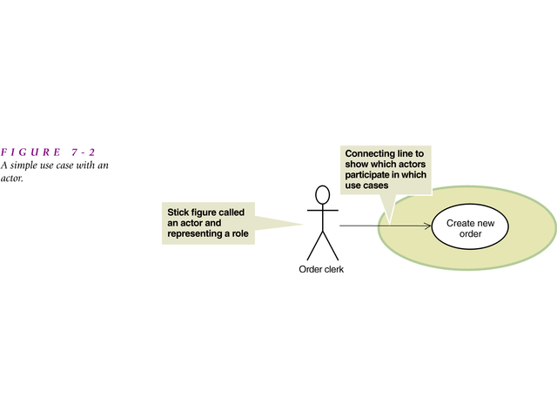

Slide 12
Scenarios (情景)
Scenario
  A particular sequence of activities within a case
  one use case may have several different scenarios
    In the RMO example, for the use case “Create new order” there are at least two scenarios
      “Customer creates telephone order”
      “Customer creates web order”
    Describe individual steps with a narrative called a flow of activities

Slide 13
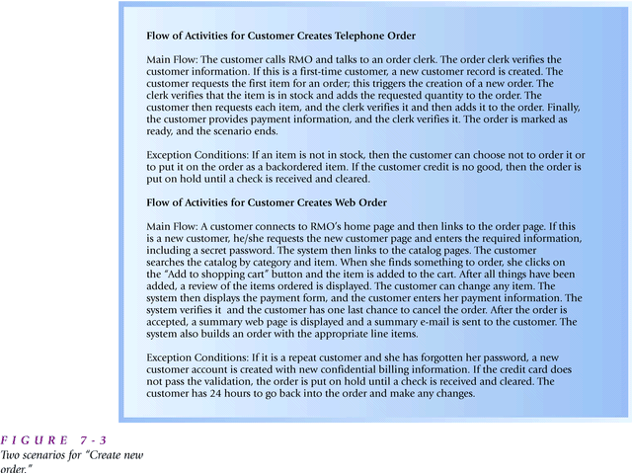

Slide 14
The Use Case Diagram
A graphical model that summarizes the information about the actors and use cases
  The uses derive from the events in the event table
  Can think of it as a functional description of the system
    Identifies functions to be supported by the system

Slide 15
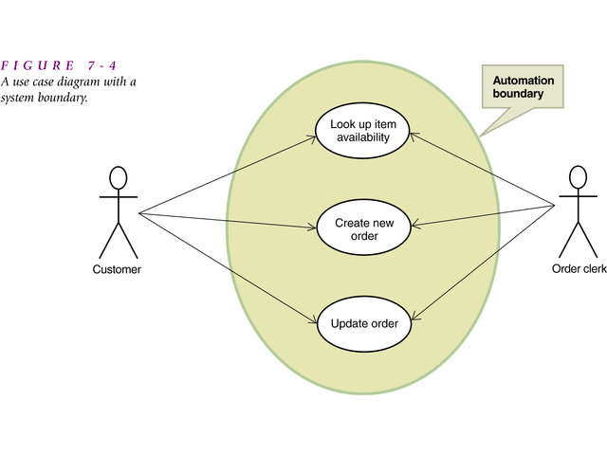
  Fig. 7-4 Order-entry subsystem
shows a use case with a second actor and additional use cases

Slide 16
Use Case (continued)
Fig. 7-5 (next slide) shows the 14 use cases for external events (triggered by external actors) for RMO example – order entry subsystem
  Note that internally triggered events are often not represented by use case diagrams

Slide 17
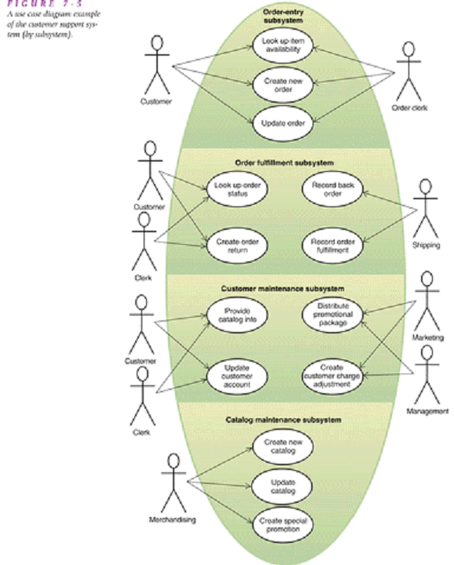

Slide 18
Use Case (continued)
Another approach
  Draw all the use cases that involve a specific actor
    See Fig. 7-6 (next slide)
      Shows all the use cases for the customer actor
    Useful in this example for showing all the activities that are accessible through the Internet

Slide 19
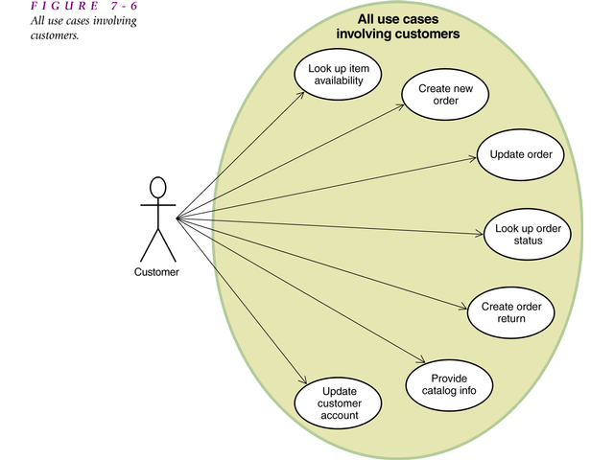

Slide 20
Use Case (continued)
<<Includes>> Relationships
  It may be necessary for one use case to use the services of another case
    E.g. the use case called “Create new order” may need to “validate customer account”
    This relationship is:
      Create new order <<includes>> Validate customer account
    Sometimes this is referred to as the <<includes>> relationship or the <<uses>> relationship

Slide 21
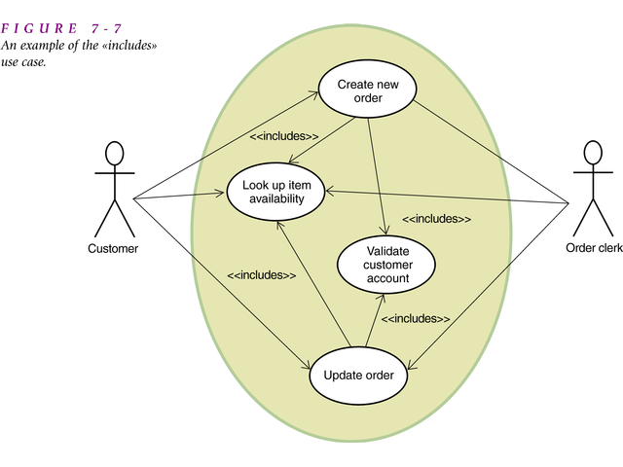

Slide 22
The Use Case Diagram Compared to Structured Techniques
Objective of the use case diagram
  To provide an overview of the system (including actors and the functions they perform)
  A use case diagram in this sense is like a context diagram, However, more like DFD fragments in that they identify an individual function
Difference with structured techniques
  The use case diagram begins by defining the automation boundary – in DFD this boundary is often not defined
  The use case diagram does not indicate data flow (this is done with other types of OO diagrams)

Slide 23
Development of a Use Case Diagram
two ways of developing a use case diagram
  Start with an event table and analyze each event to determine:
      How the system is to support the event
      The actors who initiate the event
      Other use cases that will need to be invoked
    Generally, each event will become a use case
  Start by identifying all the actors who use the system
    Build a list of actors based on the event table by looking at the Trigger and Source columns
    Instead of listing as e.g. Bob or Mary, may want to identify the specific roles that people play (e.g. clerk, doctor etc.)

Slide 24
Development of a Use Case Diagram
(cont.)
Once the actors and use cases are identified, next step is to develop a flow of activities as the starting for identifying the various scenarios

Slide 25
Object Interactions: Collaboration and Sequence Diagrams
Use case diagram does not show flow of information
Two types of diagrams describe flow of information and interactions between objects
  Collaboration diagram (协作图) emphasizes the objects that interact together to support a use case
  Sequence diagram (顺序图) focuses more on the messages

Slide 26
Object Interactions: Collaboration and Sequence Diagrams (cont.)
  Those who prefer a top-down approach tend to draw a collaboration diagram
  Those who prefer a bottom-up approach tend to draw a sequence diagram
    A sequence diagram shows information flow within a single use case or a single scenario

Slide 27
Sequence Diagrams
To develop a sequence diagram we use both the class diagram and the flow of events for each scenario
  We identify which objects collaborate and what interactions are necessary
Sequence Diagrams
  Shows the sequence of interactions between objects that occur during the flow of events in a single scenario or use case

Slide 28
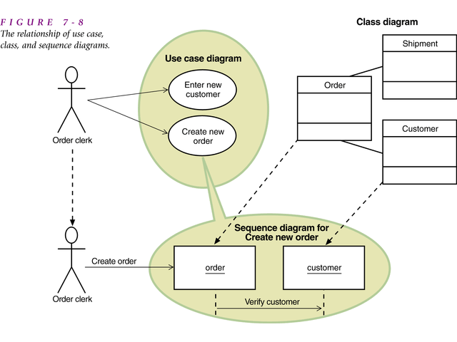

Slide 29
Sequence Diagrams (continued)
Four basic symbols in a sequence diagram
  The actor symbol (a stickman)
  The object symbol (a rectangle with the name underlined)
  The lifeline symbol (a dashed line or a narrow vertical rectangle)
  The message symbol (a directional arrow with a message descriptor)

Slide 30
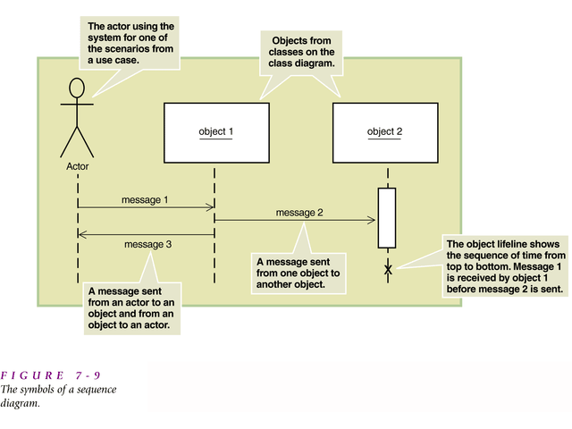

Slide 31
Objects in the Sequence Diagram
Object class
  A rectangle with the name inside
A particular object
  A particular “instance” of an object
  A rectangle with a name, but it is underlined

Slide 32
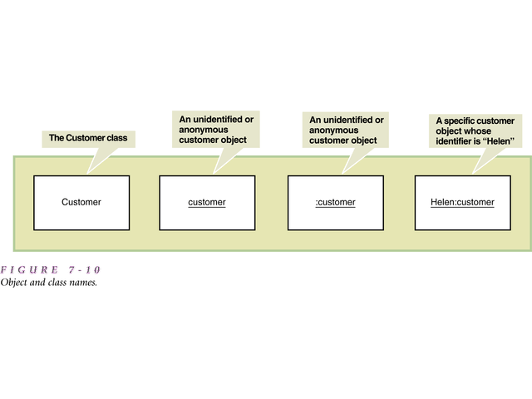

Slide 33
Actors and Objects
Can have an actor Customer
  The external physical person playing the role of customer
Can also have an object Customer
  A computer object that contains information about the customer (it’s a “virtual” customer)

Slide 34
Actors and Objects
Actors and objects are active during the scenario
  Lifeline: The vertical line under an object on a sequence diagram to show the passage of time for the object
    Time flows from top to bottom (Messages that occur further up occur before those below)
  Activation Lifeline: the narrow vertical rectangle to emphasize that an object is active only during part of a scenario

Slide 35
Messages
Objects send messages to each other to get things done
  Messages invoke particular methods
  Receiving object responds by executing methods
  Message names
    eg. “ring telephone”, “update account”

Slide 36
Messages
Message symbol has two parts
  The directional arrow
  Message descriptor
[true/false condition] return-value :=
message-name (parameter list)

Slide 37
Messages (continued)
Message names – some examples of formats
  RingTelephone
  ItemInquiry ()
  CreateOrderItem (itemid, qty)
  [FirstItem] OrderNumber := CreateOrder ()

Slide 38
Example – Sequence Diagram for RMO “Look up item availability” use case
First message comes from the Customer to a catalog objects, such as “Spring 2000 catalog”
Next a message is sent from the Catalog to the product item
Individual inventory items can be found from products so the product item forwards the message to the specific inventory item
Messages then go back the other way to the Customer (to provide item availability info)
See next slide (figure 7-12 in the text)

Slide 39
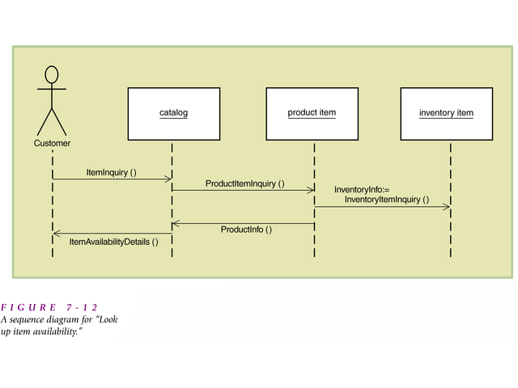

Slide 40
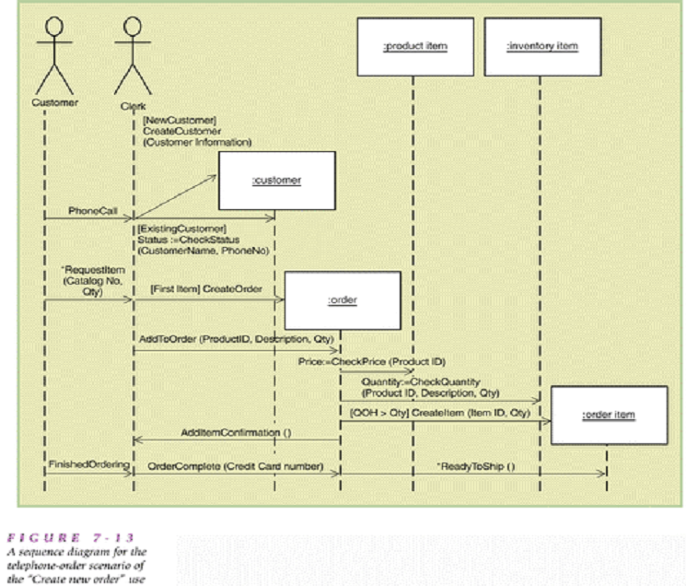
[NewCustomer]CreateCustomer
(Customer Information)
[ExistingCustomer]Status:=CheckStatus(CustomerName, PhoneNo)
* RequestItem(Catalog No, Qty)
图7-13：A sequence diagram for the telephone-order scenario of the “Create new order” use

Slide 41
Steps in creating a sequence diagram
Identify all the objects and actors that are involved in the scenario
Identify each message that will be required
Determine if each message is always sent or sent only under certain conditions
Sequence the messages correctly and attach them to the appropriate lifelines of actors and objects
Add the formal syntax on the messages for conditions, message names and passed parameters
Add response messages and communications

Slide 42
Collaboration Diagrams
Objective: to quickly get an overview of all the objects that collaborate to support a scenario
  Uses similar symbols but there is no lifeline
  Instead each message is numbered (to show the order of messages)
  Syntax of message descriptor:
  Link: connecting line between two objects or actors
[true/false condition] sequence-number:
return-value :=Message-name (parameter list)

Slide 43
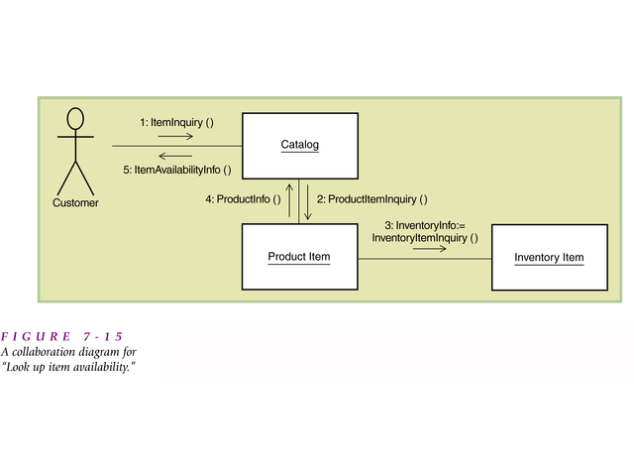
客户提出产品信息查询请求
查询某产品的信息
前面的消息1和消息2都没有返回参数，因而需要为它们各自添加一条应答消息，以返回相应的查询结果。
查询某产品的库存信息，查询结果被作为该消息的返回参数，因而不需要添加应答消息。

Slide 44
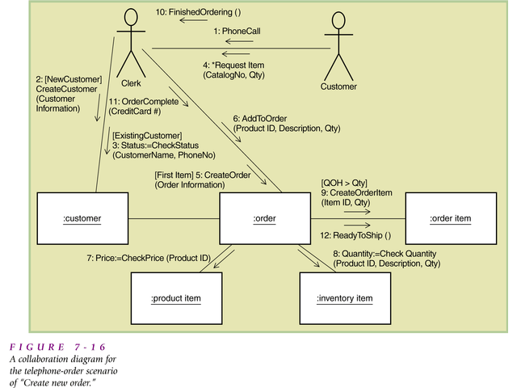
需要被重复发送的消息：
  4: *Request Item(…)

Slide 45
Notes on Collaboration Diagrams
A collaboration diagram can’t easily describe information about concurrent messages (or messages that initiate at the same time)
Does not indicate information about creation or deletion of objects
Often drawn without messages
Need another type of diagram to show the internals of each class and behaviors

Slide 46
Object Behavior: States, State Transitions, and Statechart Diagrams
Need to be able to specify internal logic for each object
  Sequence diagrams give external view of object behavior – shows messages passed around
  What does an object do when it gets a message?
  Need to use a statechart (based on class diagram and sequence diagrams)

Slide 47
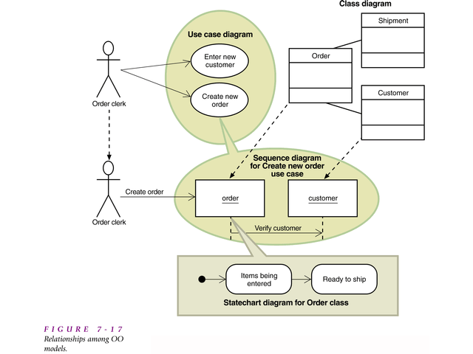

Slide 48
Object Behavior
Statechart diagram
  A diagram showing the life of an object in states and transitions
  Based on information from the class diagram and the sequence diagram
  How an object performs its actions is called object behavior

Slide 49
Object Behavior (cont.)
Life cycle of an object
  Each object is an instance of a class, and comes into existence in some manner
  During its existence it is “in” certain states and makes transitions from state to state
  These states and the changes an object makes are shown in a statechart diagram

Slide 50
Object States
A state for an object is a condition during its lifetime when it
  Satisfies some criteria
  Performs some action
  Waits for an event
Each unique state has a unique name
  E.g. “on”, “working”, “loading equipment” etc.
States are semi-permanent (半持久) conditions
  can be interrupted by external events
  An object stays in a state until some event causes it to move to another state

Slide 51
Object States (continued)
When an object is in a state it may be
  Quiescent (ie. Nothing happening)
  Active (ie. Performing some action)
E.g.
  a computer monitor may be in“off” or “on” states

Slide 52
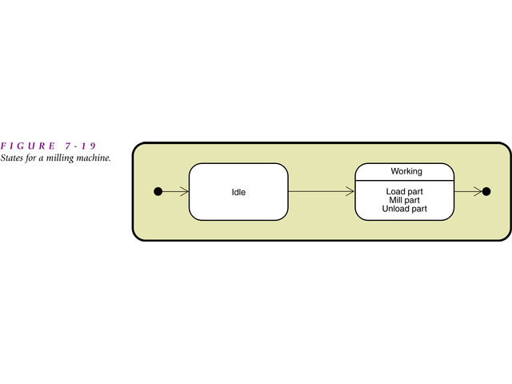
A state is represented by a rectangle with rounded corners (with the name of the state inside)
Any actions that must be performed during the period of the state are placed below the state name in the rectangle

Slide 53
Object States (continued)
In the diagram, the beginning and ending of the statechart was indicated by two darkened circles
In complex systems we need to model situations where there is concurrent states
  Concurrency or concurrent states
    the condition of being in more than one state at a time within a statechart

Slide 54
Object States (continued)
Composite state
  A high level state that has other states nested within it
    Example on next slide – a milling object can be “off” or “on”
    If it is on it may have two paths
      one for the input bin
      one for the machining portion

Slide 55
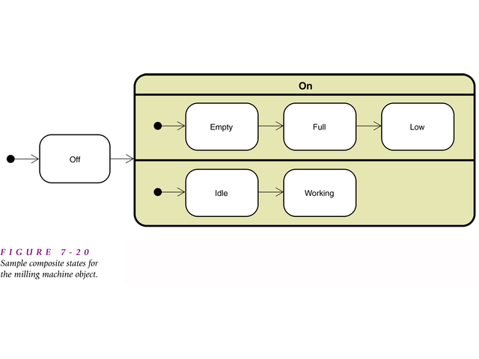

Slide 56
Object Transitions
Transition（转换）
  a component of a statechart that signifies the movement from one state to the next
Destination state（目标状态）
  The destination of a transition connected to the arrowhead of the transition symbol
Origin state（原状态）
  The origin for a transition connected to the tail of a transition arrow symbol
Message event（消息事件）
  The trigger for a transition consisting of a message that has the properties of an event
Guard-condition (保护条件)
  A true/false test to see whether a transition can be taken

Slide 57
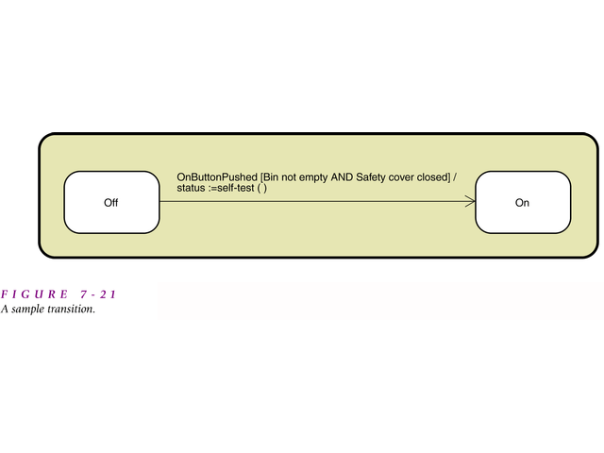
    OnButtonPushed
    [Bin not empty AND safety cover closed]
    / status := self-test()

Slide 58
Object Transitions (continued)
Transition label (on the arrow in last slide)
    Transition-name (parameters, …)
    [guard condition]
    / action-expression
  The transition-name is the name of a message event that causes the object to leave the origin state
  The parameter list identifies parameters that the message is to pass to the object (e.g. a customer name)
  The guard condition is a test on the transition
  The action-expression is the statement on the transition to be performed

Slide 59
Object Transitions (continued)
Action-expression
  The statement on a transition to describe the action to be performed
  Executes when the transition fires
  Could be a compound series of steps

Slide 60
Object Transitions (continued)
Internal transition (内部转换)
  A transition within a state that does not remove the object from the state
    Entry / action expression
    Do / action expression
    Exit / action expression

Slide 61
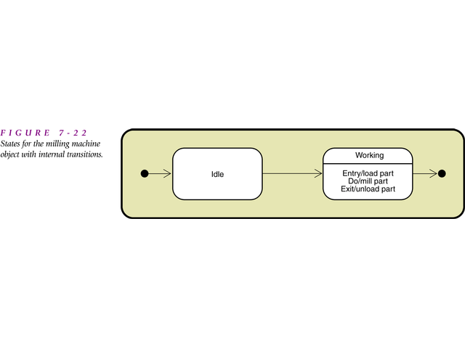

Slide 62
Messages, Transitions, and Actions
Note that sequence diagrams and statecharts are related in that both show messages
  Transition names in statechart correspond to message names in the sequence diagram
  Objects in statecharts receive and send messages
  Messages are normally sent as part of action statement
    Represented using dot (点) notation
    e.g. ControlPanel.UpdateStatus (status)

Slide 63
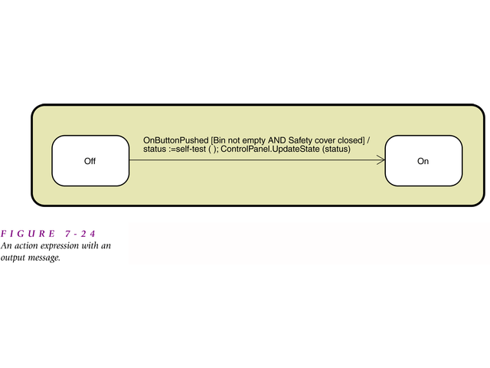
  OnButtonPushed
  [Bin not empty AND Safety cover closed]
  /
  status:=self_test(); ControlPanel.UpdateState(status)

Slide 64
Statechart Diagrams
Next slide shows a statechart diagram for an order object (for the RMO example)
  Moves from state of “waiting to be shipped” to “shipped”
  A state name should describe a state of being
  The object moves from state to state depending on the transitions and messages it gets
  Initial transition is called “CreateOrder ()” (almost all statecharts begin with a create message)

Slide 65
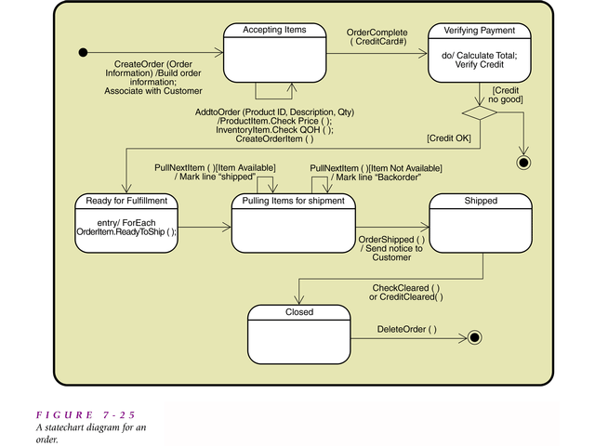

Slide 66
Statechart Diagrams (continued)
Completion transition
  A transition with no trigger event so that it is taken when the origin state completes its actions
Decision pseudostate (伪状态)
  A diamond on a statechart to represent a decision point on a path
Path
  A valid sequence of transitions and states through a statechart

Slide 67
Approach to developing a statechart (e.g. for the order object)
All incoming message events are identified across all sequence diagrams involving orders
All output messages are identifed
Once all the messages are identifed, the analyst brainstorms the possible states that might exist for the object
Incoming message events help identify transitions

Slide 68
Concurrent Behavior
Concurrent behavior means an object can do multiple things in parallel
Statechart represents concurrent behavior with multiple paths
  Each separate path is called a thread
In the next slide, the solid vertical bar represents a synchronization pseudostate
  Denotes a path where the paths split into multiple threads

Slide 69
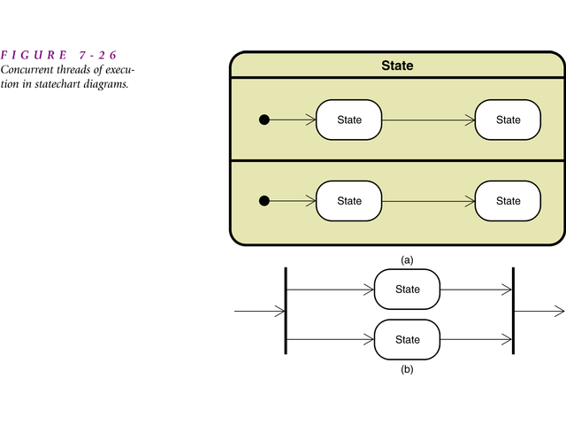

Slide 70
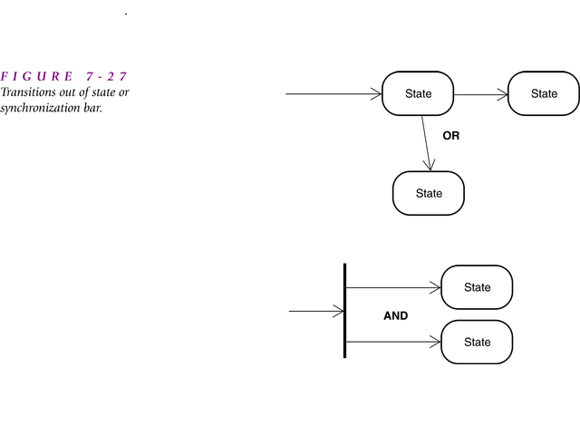

Slide 71
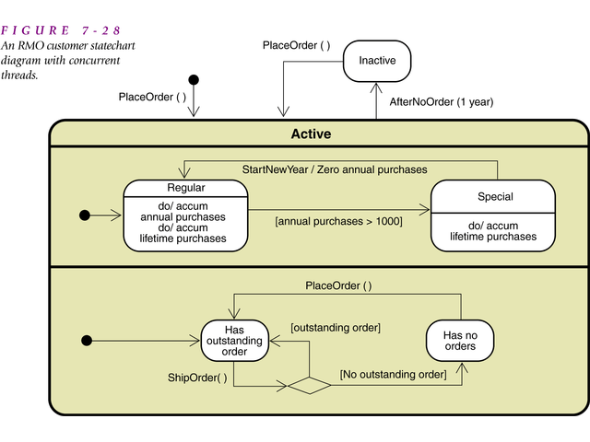

Slide 72
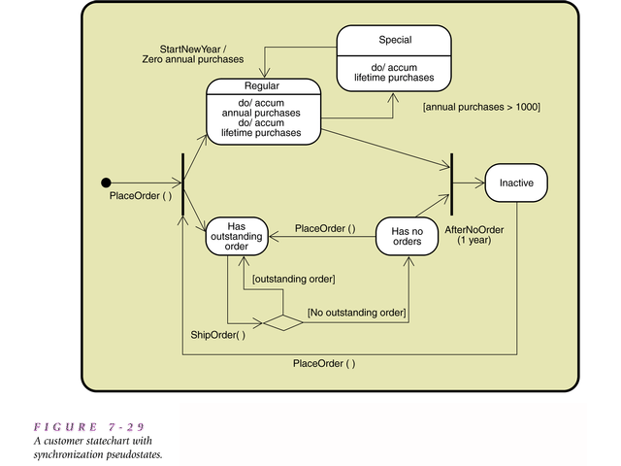

Slide 73
Statechart Development
Review the class diagram and select classes you will want to make statecharts for
Identify all the input messages across all sequence diagrams for the selected class you are making a statechart for
For each selected class, make a list of all the states you can identify

Slide 74
4. Build statechart fragments (a portion of the path in a statechart) and sequence the fragments in the correct order
5. Review the paths and look for independent, concurrent paths
6. Expand each transition with the appropriate message event, guard-condition, and action-expression

Slide 75
7. Review and test each statechart
  make sure your states are “states of being”
  Follow the life cycle of an object from creation to deletion
  Be sure your diagram covers all normal and exception conditions
  Make sure you’ve included all relevant transitions
  Review all possible messages and make sure they are handled

