Slide 1
Homicide in the united states
DSC530 Final Project
Angie Oehler

Slide 2
The dataset
This dataset is provided by the Murder Accountability Project, which is a nonprofit organization seeking to draw attention to unsolved murders in the United States.
Information is collected from federal, state, and local agencies regarding the murders in each of their jurisdictions.
The data dictionary for this dataset is very well done and is comprehensive.
Here are the links to the data set and its associated information:
Data set:
http://www.murderdata.org/p/data-docs.html
Information about the project:
http://www.murderdata.org/p/about.html
Data dictionary:
file:///C:/Users/Madam%20President/Desktop/Fall%202020/Murder%20data%20descriptions.pdf

Slide 3
Questions to explore in the dataset
Is there a relationship between the age of victims and the year of their death?
How common are multiple victims by the same offender?
What is the relationship between the age of the victims and the age of the offenders?
What is the distribution of victim ages?
What does the count of additional victims look like compared to the count of additional offenders?
How do the count of additional victims and year of death compare together?

Slide 4
Variables Available in the Dataset
Year occurred/reported,1976 – 2017
Month the homicide occurred/reported
State where the homicide was reported
City/county agency involved
Victim’s age
Victim’s sex
Victim’s race:
Offender’s age (999 when unknown)
Offender’s sex
Offender’s race
Weapon used
Relationship between victim & offender
Circumstances of event
Victim count when more than one
Offender count when more than one
Indicator if case is solved

Slide 5
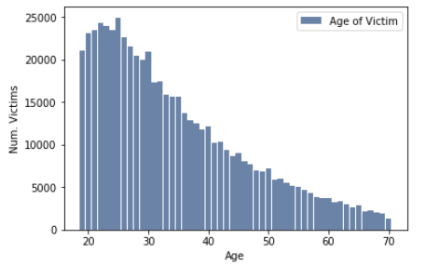
Victim Age
Statistics for Victim Age:
Mean: 34.4595
Mode: 25
Spread: 149.633
Standard Deviation: 12.232
The victim’s age is positively skewed, with a steep slope to the right. The average victim age is 34.5, but the most common victim age is 25.
With a standard deviation of 12 years, and a mean of 34.5 years, I would expect most victims to be between the ages of 22 and 46 years old.

Slide 6
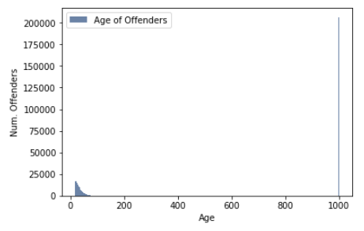
Offender Age
Statistics for Offender Age:
Mean: 382.486
Mode: 999
Spread: 215479.967
Standard Deviation: 464.1982
The offender age statistic is badly distorted by the number of unknowns, which is represented by ‘999’ in the dataset.
Removing these figures was considered; however, that would have an affect on the remaining variables. I believe it is better to leave this variable as it is.

Slide 7
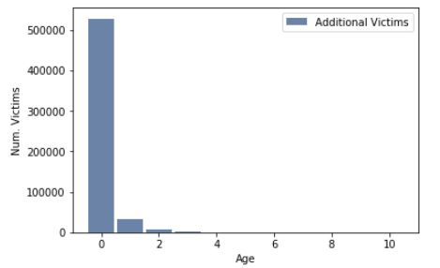
Victim Count
Additional Victims of the Same Offender:
Mean: 0.1087
Mode: 0
Spread: 0.2538
Standard Deviation: 0.5038
With a mean of 0.111and a mode of 0, I would expect victims will be the only individual killed by the offender.
The standard deviation is 0.5, which tells me that the majority of homicides will consist of a single victim; however, it may go up to two victims.
Additional Victims:
0 528374
1 32834
2 6037
3 1949
4 669
5 321
6 212
7 122
8 132
9 271
10 144

Slide 8
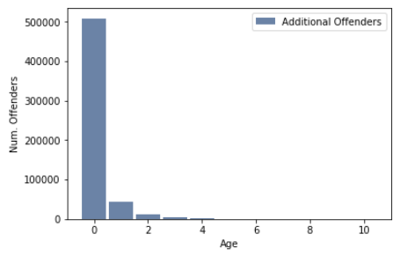
Offender Count
Additional Offenders Beyond the Original
Mean: 0.158
Mode: 0
Spread: 0.29
Standard Deviation: 0.536
Both the mode and the mean are less than one, which indicates that most homicides are committed by a single offender.
The standard deviation is 0.56, which suggests that the majority of homicides will be committed by 2 offenders or less.

Slide 9
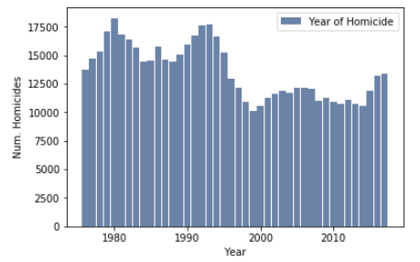
Year Occurred/reported
This statistic is positively skewed with a mean of 1994 and a mode of 1980. The right tail appears to remain relatively steady with a slight ebb and flow.
Taking the standard deviation of 12, I would expect the majority of homicides to occur between the years of 1982 – 2006. Interestingly, the mode falls outside of this range.
This statistic could benefit from further analysis provided by a scatter plot.
Year the Homicide Occurred:
Mean: 1994.9
Mode: 1980
Spread: 145.5
Standard Deviation: 12.1

Slide 10
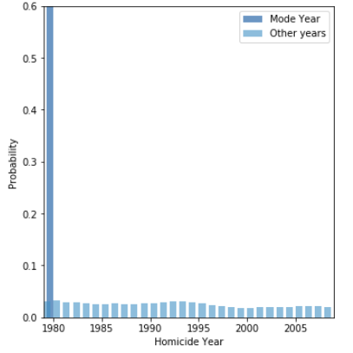
PMF for year of homicide
1980 experienced the most homicides with a total of 18,261.
Outside the standard deviation range of 1982 – 2006
Given this year comparison to the other years, there is a high likelihood that a reported homicide would have occurred in 1980.

Slide 11
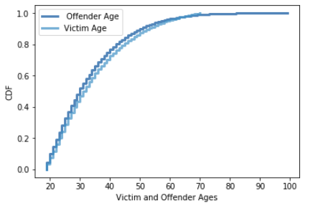
Cdfs VICTIM and OFFENDER AGES
Offenders as a group tend to be younger than victims as a group.
Compare the victim mean and mode to offenders of the same age:
Mean – 34 years old:
Percentage of victims under age 34: 59%
Percentage of offenders under age 34: 64%
Mode – 25 years old:
Percentage of victims under age 25: 29%
Percentage of offenders under age 25: 33%

Slide 12
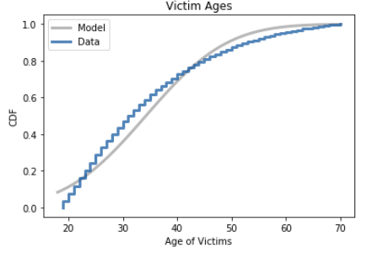
Victim Age Distribution
Victim age doesn’t follow a standard distribution.
Crosses the normal model in the low 20’s and remains above the normal distribution until 40.
Victim ages between their late 30’s and early 40’s come cross the normal model again and remain below the normal distribution until 70.
Victims in their late 60’s again come up to the normal model, and both finish together.

Slide 13
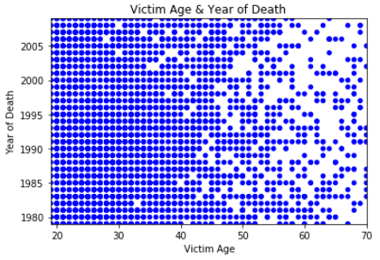
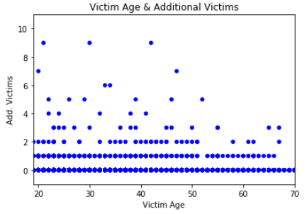
Scatterplots
Vic. Age & Year of Death
Vic. Age & Add. Victims
Age of victim and their year of death pretty consistent until about 45, then thins out.
There are some gaps throughout.
Example: victims aged 33 in 1983 are not appears to have a gap.
Gaps become more common after age 45 and widen through age 70.
No additional victims beyond the primary victim is the most common pattern.
1 additional victim is predominate until 68 years of age.
Highest concentration of multiple victims occurs between the ages of 20 and 40, with counts up to 9.

Slide 14
Correlation test
Hypothesis:
There is a relationship between the year a victim died and the age of the victim.
P-value:
The p-value is 0.076, which indicates that there is an 8% chance that the victim’s age and year of death are correlated.
There is a relationship; however, I do not consider it to be statistically significant.

Slide 15
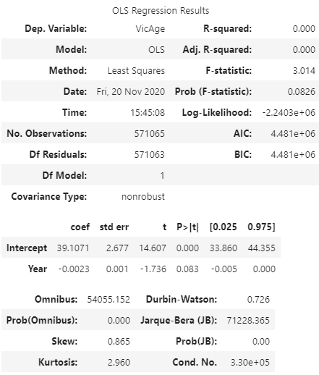
Regression Analysis Victim Age and Year of Death
Intercept - 39.107
Slope - -0.002
Slope p-value - 0.083
Coefficient of Determinism - 5.277001351555732e-06

