Slide 1
Atmospheric Scattering in Three JS
Angela Gross // CSCI-441

Slide 2
Rayleigh and Mie Scattering
Rayleigh Scattering
  Air molecules scattering light
  Responsible for blue skies and the red-oranges in sunsets
Mie Scattering
  “Haze particles” scattering light
  Responsible for the whitening of the sky
  Turbidity used to describe Mie numerically
Notes:
Rayleigh scattering describes the behavior of air molecules scattering the light and is responsible for the sky being blue. This is due to the varying of a relevant extinction (or absorption) coefficient in preference of shorter wavelengths, and so blue light (400nm) is scattered a great deal more than red light (700 nm). The reds and oranges seen during sunsets are caused by this preferential scattering as well because the light must traverse through more atmosphere to our eyes.
Mie scattering, on the other hand, explains the behavior of light scattering due to “haze particles”, or particles that are generally larger and scatter more light than molecules. The scattering of these particles cause the whitening of the sky. Although it is difficult to describe haze particles numerically, Preetham uses turbidity, or the ratio of scattering due to haze particles, as a way to do so. Turbidity grossly simplifies the actual nature of the atmosphere, but it is a good enough parameter to use in the application of computer graphics and produces fairly good results.
Preetham, A. J., Peter Shirley, and Brian Smits. "A Practical Analytic Model for Daylight." University of Utah.

Slide 3












Relevant Formulas
Out-scattering
In-scattering
$$\left.L\left(s,θ\right)=L_{0}F_{ex}\left(s\right)+L_{in}(s,θ\right)$$
$$F_{ex}\left(s\right)=e^{−Β_{ex}s}$$
Incoming Light
Extinction
Solar In-Scattering
$$L_{in}\left(s,θ\right)=\frac{Β_{sc}\left(θ\right)}{Β_{ex}}E_{sun}\left(1−F_{ex}\left(s\right)\right)$$
$$Β_{ex}=B_{R}+B_{M}$$
$$Β_{R}=\frac{8π^{3}{\left(n^{2}−1\right)}^{2}}{3Nλ^{4}}\left(\frac{6+3p_{n}}{6−7p_{n}}\right)$$
$$\left.Β_{sc}\left(θ\right)=Β_{R}f_{R}\left(θ\right)+B_{M}f_{M}(θ\right)$$
$$f_{R}\left(θ\right)=\frac{3}{16π}\left(1+\cos^{2}{θ}\right)$$
$$Β_{M}=0.434cπ{\left(\frac{2π}{λ}\right)}^{v−2}K$$
$$f_{M}=\frac{1−g^{2}}{4π{\left(1+g^{2}−2gcosθ\right)}^{\frac{3}{2}}}$$
$$c=\left(0.6544T−0.6510\right)×{10}^{−16}$$
s: distance travelled to eye
n: refractive index of air
N: # molecules / unit volume
$p_{n}$: depolarization factor
$λ$: wavelength of light
v: Junge’s exponent
K: spectral quantities
T: turbidity (ratio of haze to molecules)
$E_{sun}$: irradiance of sun
$θ$: angle between viewing and sun vectors
g: constant for Henyey-Greenstein’s phase approximation
Notes:
Preetham, A. J., Peter Shirley, and Brian Smits. "A Practical Analytic Model for Daylight." University of Utah.
"The Henyey-Greenstein Phase Function." http://www.astro.umd.edu/~jph/HG_note.pdf.
Preetham, A. J., and N. Hoffman. n.d. "Rendering Outdoor Light Scattering in Real Time." http://www2.ati.com/developer/gdc/GDC02_HoffmanPreetham.pdf.

Slide 4
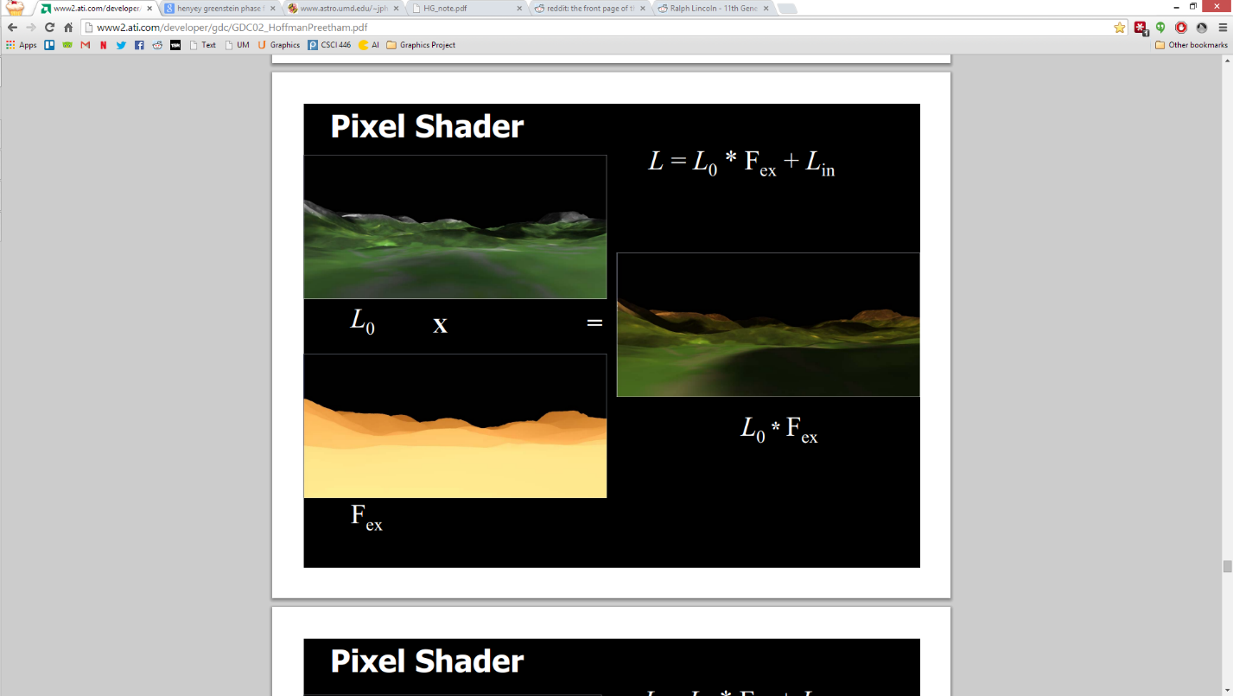
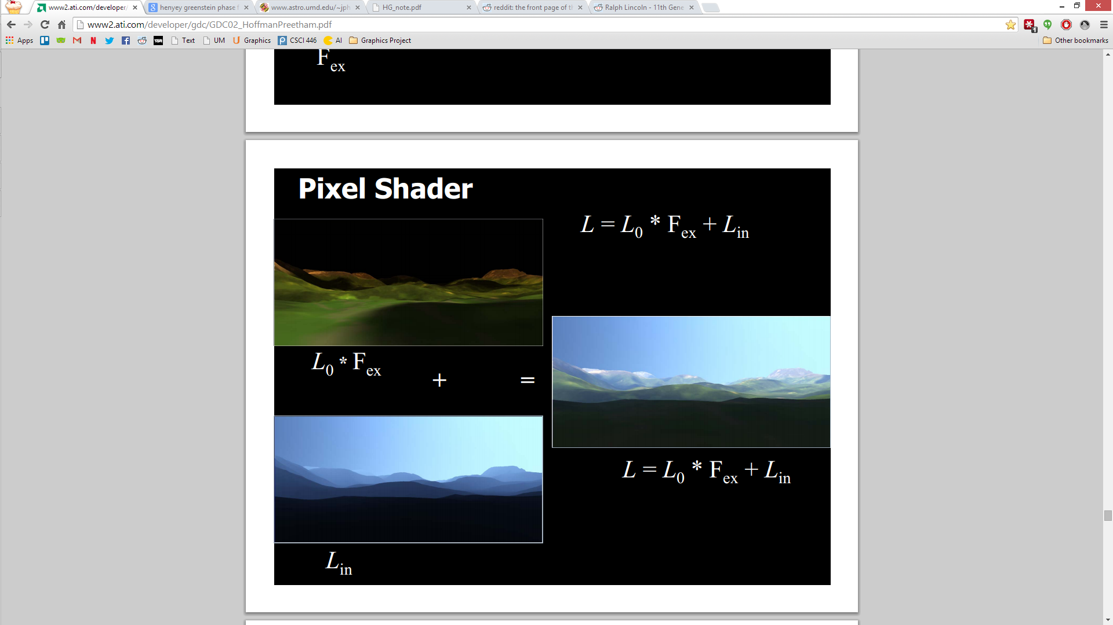
Formula Visualizations
Left: Product of incoming light ($L_{0}$) and extinction ($F_{ex}$).
Right: Combination of the product of incoming light and extinction and solar in-scattering.
Notes:
Preetham, A. J., and N. Hoffman. n.d. "Rendering Outdoor Light Scattering in Real Time." http://www2.ati.com/developer/gdc/GDC02_HoffmanPreetham.pdf.

Slide 5
Simon Wallner and Joshua Koo
Shaders by Simon Wallner
  http://www.simonwallner.at/projects/atmospheric-scattering
  C++ implementation(using GLSL shaders)
  Based on Preetham’s papers
  Lack of vibrant reds, oranges, and blues
Shader by Joshua Koo
  http://threejs.org/examples/#webgl_shaders_sky
  He used Simon Wallner’s shader to port Preetham’s to Three JS
  Added high-dynamic rendering (white-balancing)
Notes:
Wallner, Simon. n.d. Atmospheric Scattering. http://www.simonwallner.at/projects/atmospheric-scattering.
Koo, Joshua. n.d. Sun Sky Shader. http://threejs.org/examples/#webgl_shaders_sky.

Slide 6

My Improvements
Removed:
  $L_{in}(s, θ)$ raised to the $\frac{3}{2}$ power
    vec3 Lin = pow(sunE * ((betaRTheta + betaMTheta) / (betaR + betaM)) * (1.0 - Fex),vec3(1.5))
  Concentration factor, $c=0.2T×10×{10}^{−18}$, instead of $c=\left(0.6544T−0.6510\right)×{10}^{−16}$
  Unclear interpolation
    Lin *= mix(vec3(1.0),pow(sunE * ((betaRTheta + betaMTheta) / (betaR + betaM)) * Fex,vec3(1.0/2.0)),clamp(pow(1.0-dot(up, sunDirection),5.0),0.0,1.0))
Added:
  By a suggestion in Wallner’s post, added interpolation for more vibrant reds
    Fex = mix(1.0 - Fex, Fex, abs(sunDirection.y))
  Wallner’s use of $L_{0}$ (not Koo’s)
    L0 = texture2D(textureSampler, vUv).rgb

Slide 7
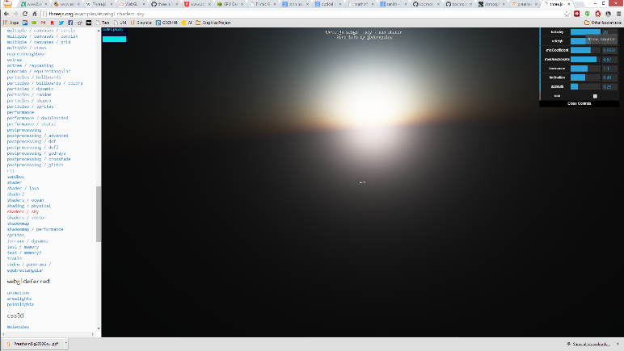
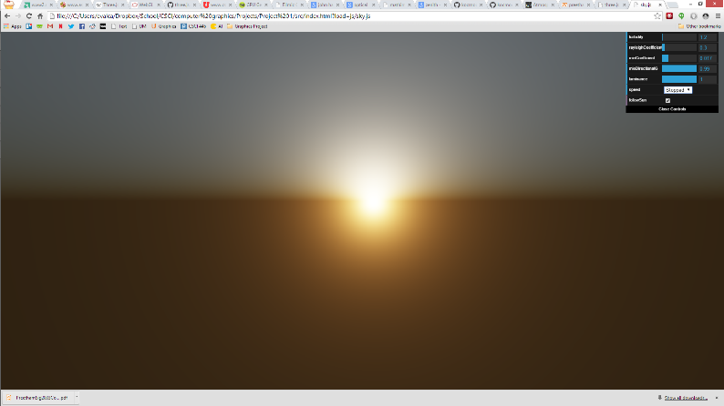
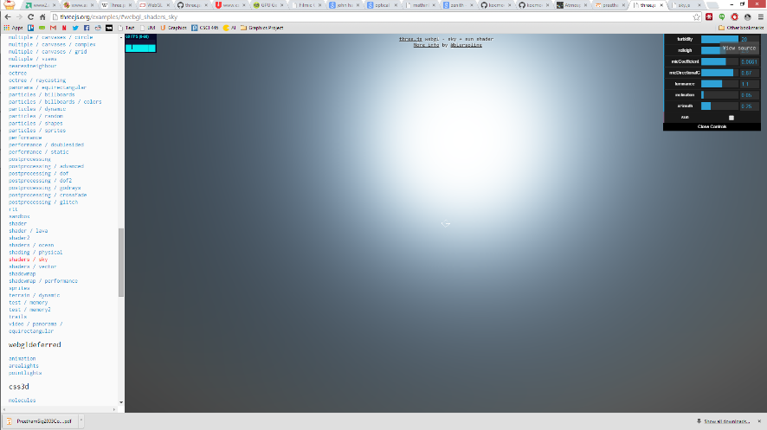
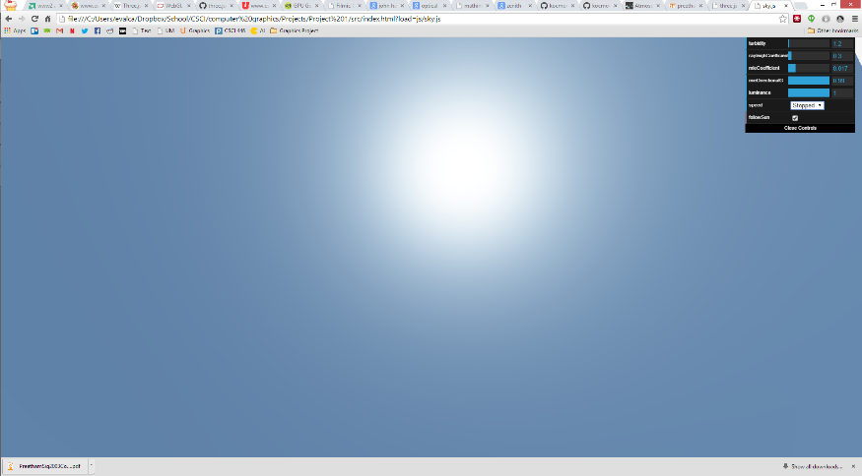
Joshua Koo vs. Angela Gross

Slide 8
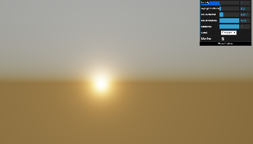
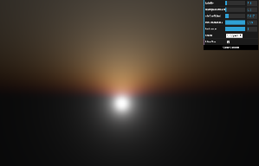
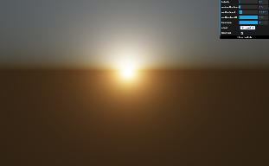
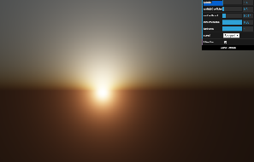
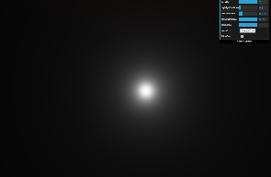
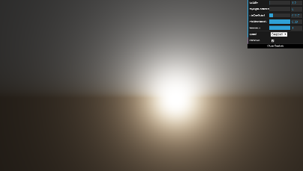

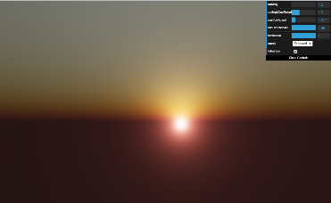
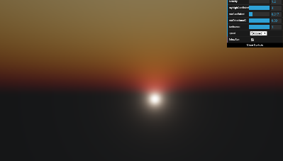
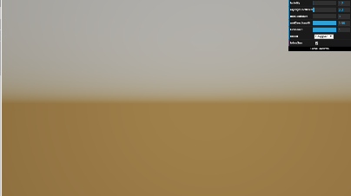
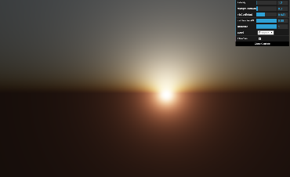
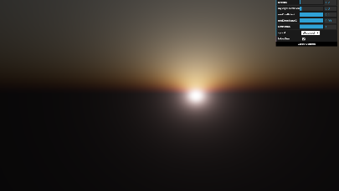
Analysis
Figure 1 - 5: From left to right: Turbidities 1.0, 1.2, 1.4, 3.1, 7.8, and 20.0
Figures 6-9: From left to right: Rayleigh Coefficients 0.0, 0.3, 1.3, and 4.0
Figures 10-13: From left to right: Mie Coefficients 0.0, 0.017, 0.043, and 0.1
Notes:
Let’s begin with turbidity and the different values for the parameter. The turbidity values, as explained in the introduction, describe how many haze particles are in the atmosphere. This makes sense because, as we can see above, increasing the ratio of haze particles shifts the skies hues toward red and, as we see in Figure 5, the sky is nearly without color.
The Rayleigh coefficient is also examined visually with Figures 6 – 9 and, as expected, is also responsible for adding reds along with oranges and yellows.
The Mie coefficient also has a similar effect on the color, but it additionally provides the illumination/embodiment of the sun as shown in Figures 10 – 13.

Slide 9
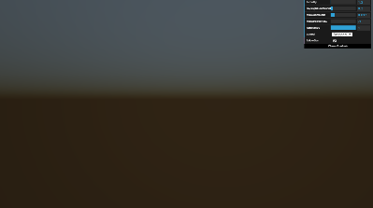
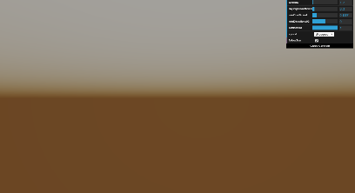
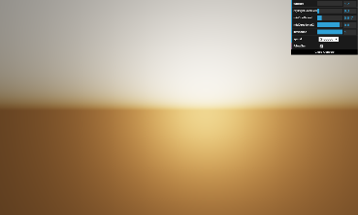
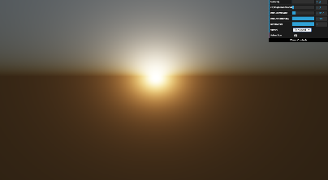
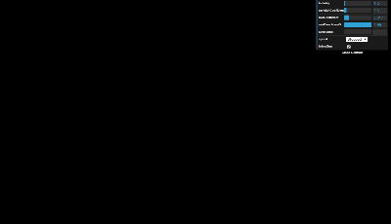
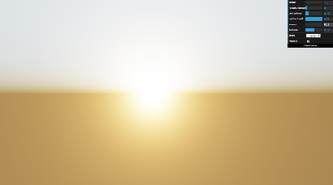
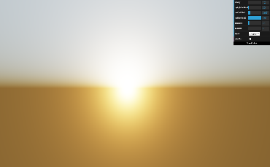

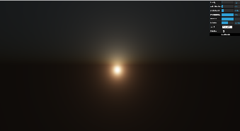

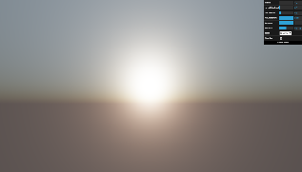
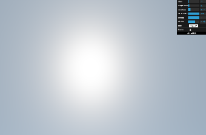
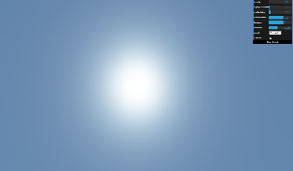
Analysis
Figures 14-17: From left to right: Mie Directional G’s -1.0, 0.0, 0.8, and 0.99
Figures 18-21: From left to right: Luminances 0.0, 0.01, 0.1, and 1.0
Figures 22-26: From left to right: Inclinations -0.0061, 0, 0.0188, 0.1055, and 0.2356
Notes:
The Mie directional G values do not contribute to the red colors, but it does help define the illumination and irradiance of the sun as seen in Figures 14 – 17.
The luminance values alter the HDR rendering that Koo added to the shader. Without it, as we see in Figure 18, none of the light will scatter and all will be absorbed. In general, we see that luminance helps with the white-balancing of the scene.
Finally, the inclination alters the position (or time, if you will) of the scene, and, at least in this shader, can only be modified when the speed is equal to “Stopped”. As expected, yellows, oranges, and reds appear when the sun is on the horizon due to Rayleigh scattering, and the light shifts toward blue as the sun rises for the same reason.

Slide 10
Demonstration
Koo, Joshua. "Sky Sun Shader." Three.js. http://threejs.org/examples/#webgl_shaders_sky.
Gross, Angela. “Atmospheric Scattering Shader.”

Slide 11
Bibliography
Angel, Edward. 2009. Interactive Computer Graphics: A Top-Down Approach Using OpenGL. Pearson Education, Inc. Chapter 9: Shaders
Haines, Eric. n.d. Interactive 3D Graphics. https://www.udacity.com/course/cs291. Lesson 9: Shader Programming
Hendrickx, Q., R. Smelik, and R. Bidarra. n.d. "An Effective Composition Method for Novice Shader Programmers." Delft University of Technology.
Koo, Joshua. n.d. Sun Sky Shader. http://threejs.org/examples/#webgl_shaders_sky.
Mozilla. n.d. Lighting in WebGL. https://developer.mozilla.org/en-US/docs/Web/WebGL/Lighting_in_WebGL.
mrdoob. n.d. Three.js. https://github.com/mrdoob/three.js.
O'Neil, Sean. n.d. GPU Gems. http://http.developer.nvidia.com/GPUGems2/gpugems2_chapter16.html.
Preetham, A. J. n.d. "Modeling Skylight and Aerial Perspective." http://mathinfo.univ-reims.fr/IMG/pdf/PreethamSig2003CourseNotes.pdf.
Preetham, A. J., and N. Hoffman. n.d. "Rendering Outdoor Light Scattering in Real Time." http://www2.ati.com/developer/gdc/GDC02_HoffmanPreetham.pdf.
Preetham, A. J., Peter Shirley, and Brian Smits. n.d. "A Practical Analytic Model for Daylight." University of Utah. http://www.cs.utah.edu/~shirley/papers/sunsky/sunsky.pdf.
n.d. "The Henyey-Greenstein Phase Function." http://www.astro.umd.edu/~jph/HG_note.pdf.
Wallner, Simon. n.d. Atmospheric Scattering. http://www.simonwallner.at/projects/atmospheric-scattering.
Xing, Guanyu, Xuehong Zhou, Qunsheng Peng, Yanli Liu, and Xueying Qin. 2013. "Lighting Simulation of Augmented Outdoor Scene Based on a." Computer Graphics Forum 32 (7).

