Slide 1
Parallax and Normal Mapping
Angela Gross // CSCI-446

Slide 2
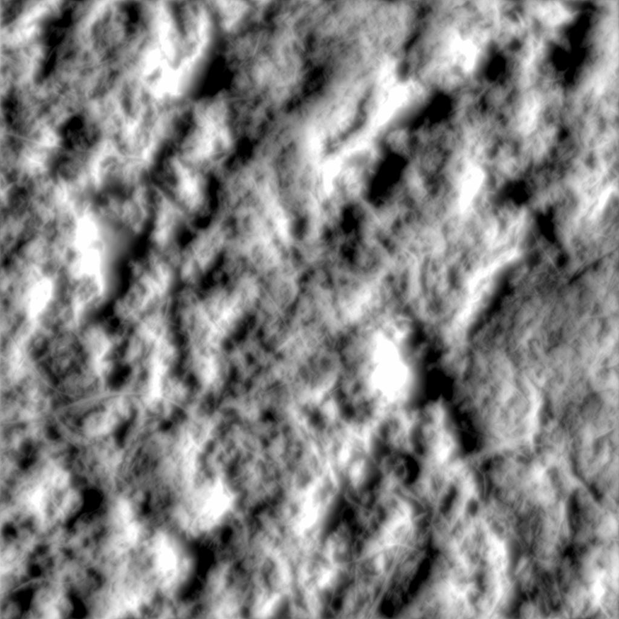
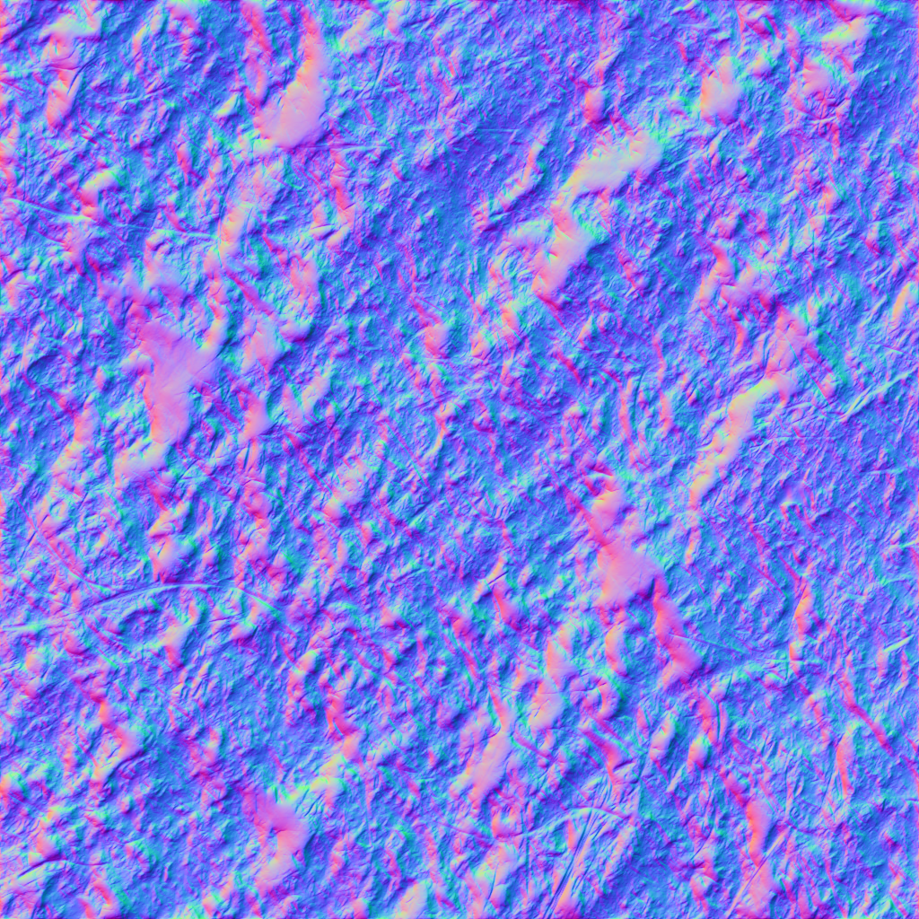

Texture Mapping
Normal Mapping
  Updates normal by using a texture that encodes the normal in the RGB
    RGB is stored in [0, 1], but normal is encoded in [-1, 1]
    $\hat{n}=normalMap{\left(u, v\right)}_{rgb}∗2−1$
      Texel $(u,v)$
Parallax Mapping
  Displaces (u,v) so the texture “pops”
  $\left(u^{′},v^{′}\right)=\left(u,v\right)+h∗\left(V_{xy} \right)$
    $h=heightMap{\left(u, v\right)}_{a}∗scale+bias$
    Uses texture that encodes the height at $(u,v)$
    View vector, $V$
Height map (left) and normal map (right)
Notes:
Scaled and biased since heights are limited by [0, 255] and may be negative and/or in floating point.
Originally would divide Vxy by Vz, but did not look good since this offset will approach infinity at grazing angles
Premecz, Matyas. "Iterative Parallax Mapping with Slope Information." http://www.cescg.org/CESCG-2006/papers/TUBudapest-Premecz-Matyas.pdf
DesLauriers, Matt. Lesson 6: Normal Mapping. https://github.com/mattdesl/lwjgl-basics/wiki/ShaderLesson6

Slide 3
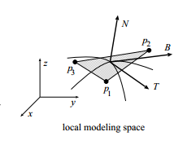
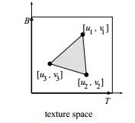

Tangent Space
Normal map values are in tangent space and not model space.
Two of the basis vectors that define tangent space correlate to the u and v axis in texture space.
Tangent Space Basis
  Tangent (provided as an attribute)
  Normal (provided as an attribute)
  Binormal
    $B=\left(T×N\right)m$
      m is the handedness (can be provided by $T.w$)
  $TBN=[T B N]$ (3 x 3 matrix)
$v_{TS}={TBN×v}_{MS}$

Slide 4
Demonstration!

