Slide 1

Bearing Fault Detection and Classification Using Machine Learning
BY:
ANGELINA CELINE S- 950022104028
Department of Computer Science Engineering
Anna University Regional Campus Tirunelveli
Month & Year: November 2025

Slide 2
Bearing Fault Detection and Classification Using Machine Learning
Detect faults in rotating machinery bearings
Classify normal and faulty conditions
Improve predictive maintenance and reliability

Slide 3
Problem Statement
Bearings are critical in rotating machines
Faults lead to operational disruption and high maintenance cost
Traditional vibration analysis needs domain experts & is not scalable

Slide 4
Objective
Detect and classify bearing faults
Compare ML and Deep Learning approaches
Use benchmark CWRU & Paderborn datasets
Evaluate models using accuracy metrics

Slide 5
Datasets Used
CWRU (Case Western Reserve University) dataset
Paderborn University bearing dataset
Combined dataset improves generalization

Slide 6
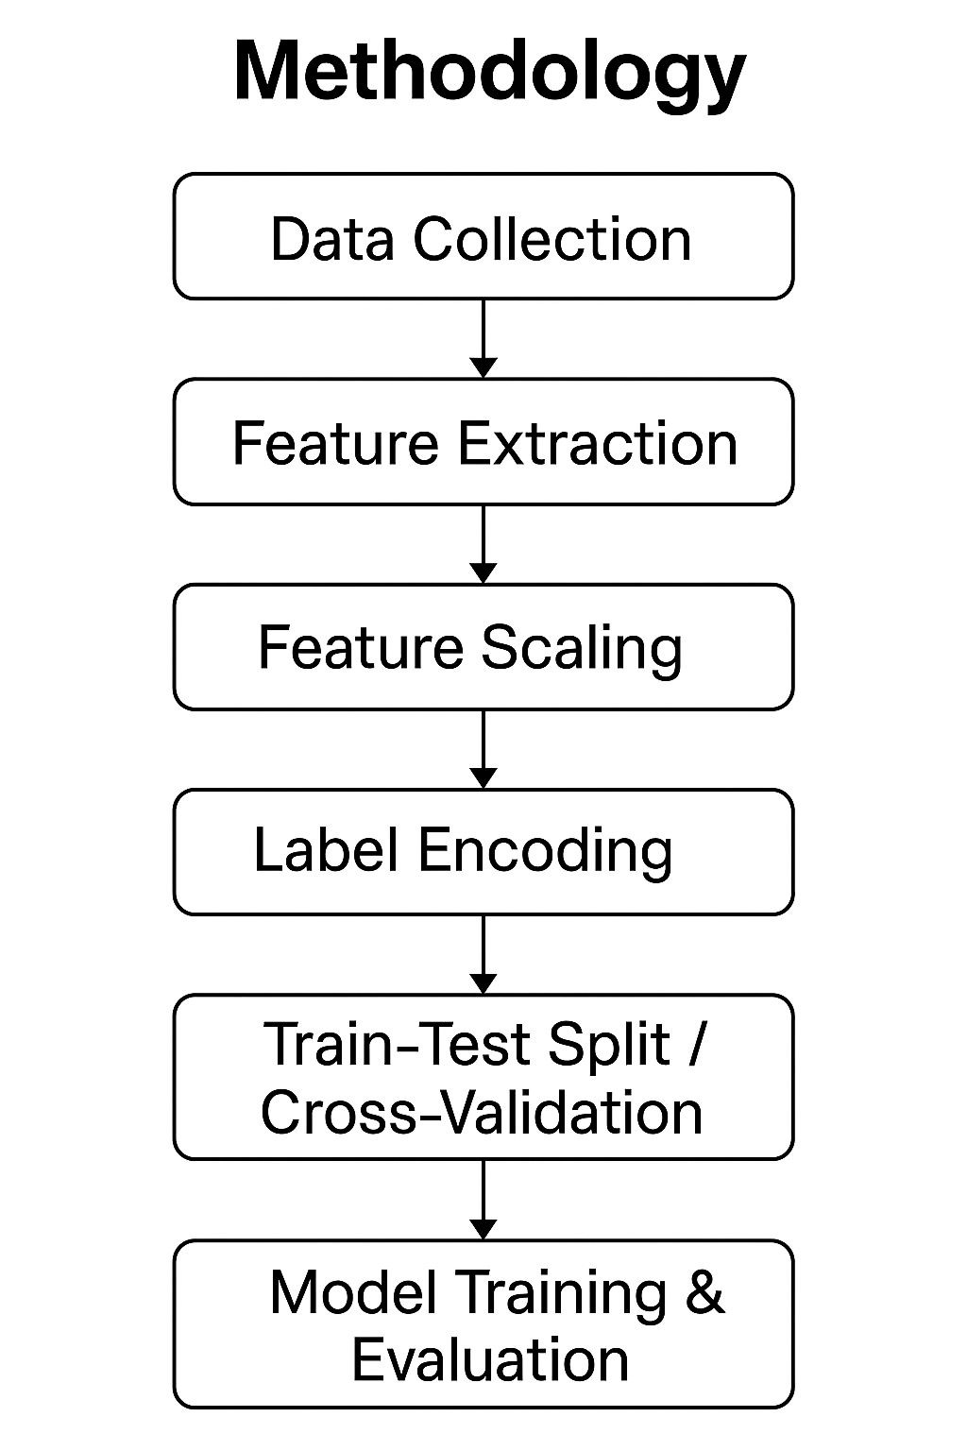
Methodology Overview
Data collection (CWRU + Paderborn)
Feature extraction (RMS, kurtosis, skewness etc.)
Feature scaling & label encoding
Train-test split & cross-validation
Model training & performance evaluation

Slide 7
Algorithms Used
Support Vector Machine (RBF Kernel)
K-Nearest Neighbors (KNN)
Decision Tree
1D Convolutional Neural Network (1D-CNN)

Slide 8
Key Model Details
SVM: RBF kernel, highest accuracy (93.18%)
KNN: k=5
Decision Tree: depth=5
1D-CNN learns from raw signals

Slide 9
Performance Metrics
SVM: 93.18% accuracy
KNN: 91.95% accuracy
1D-CNN: 91.88% accuracy
Decision Tree: 66% accuracy

Slide 10
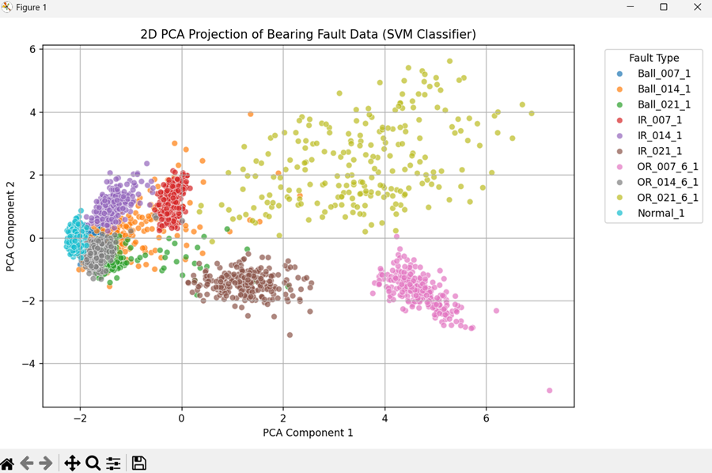
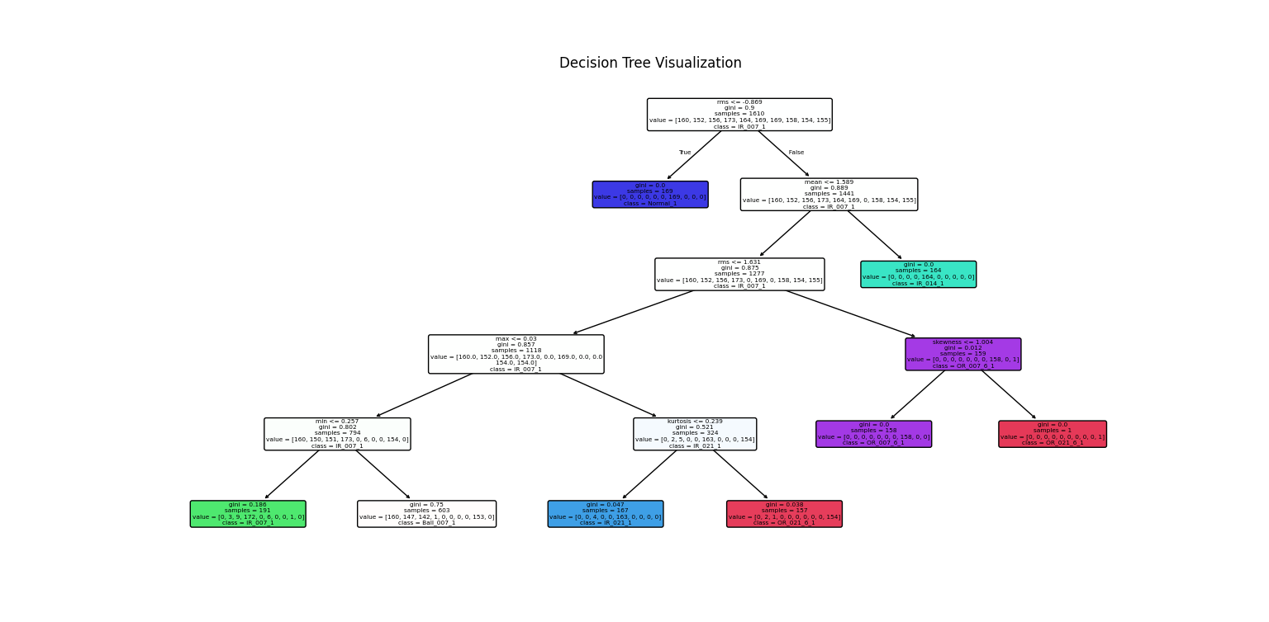
Performance Metrics

Slide 11
Results Highlights
SVM best for feature-based learning
CNN close second, raw signal classification
Decision Tree weaker due to complex data
Combined datasets improved robustness

Slide 12
Conclusion
ML & DL effective for bearing fault diagnosis
SVM highest accuracy (93.18%)
CNN works without feature engineering
Future: real‑time deployment & multi‑sensor data

Slide 13
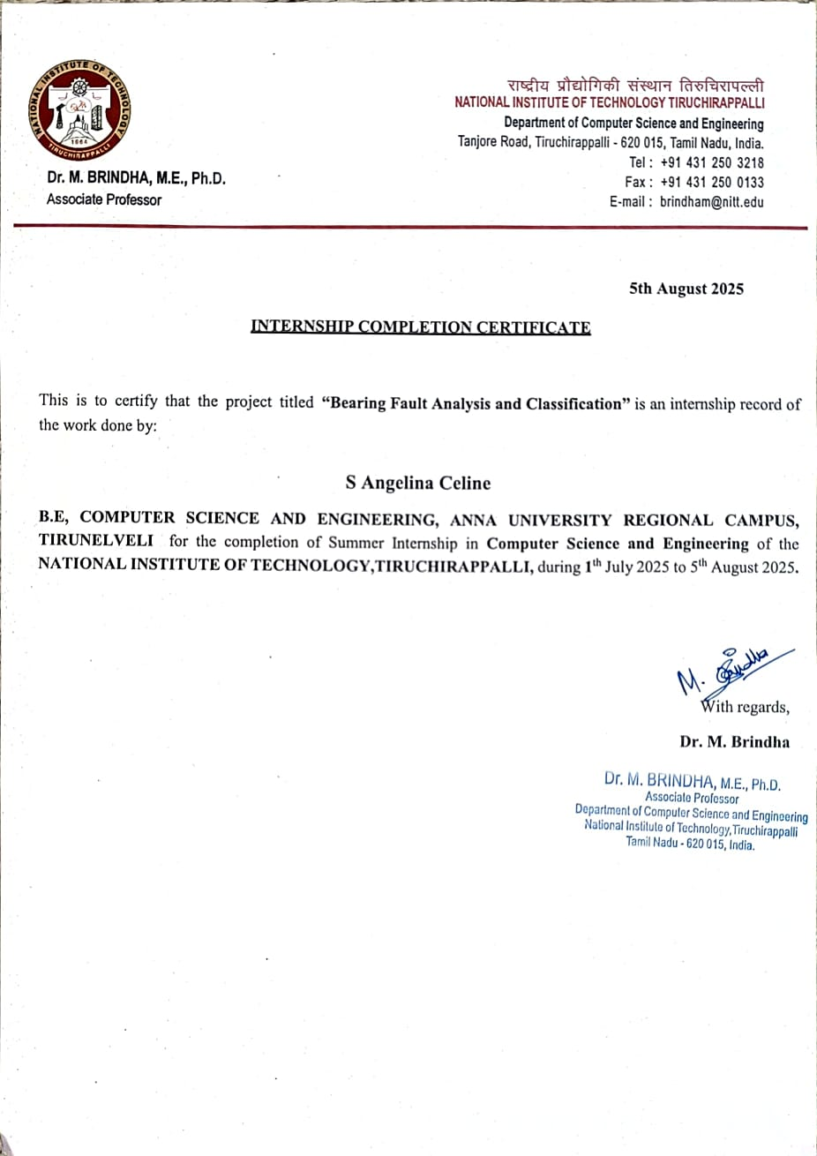
Certification

