Slide 1
Are We Lending to the Right Borrowers?
Consumer Credit Policy Analysis · Lending Club 2007–2020 Q3
ClarityPay Take-Home Exercise
1,860,331 completed loans | 2007–2020 Q3

Slide 2
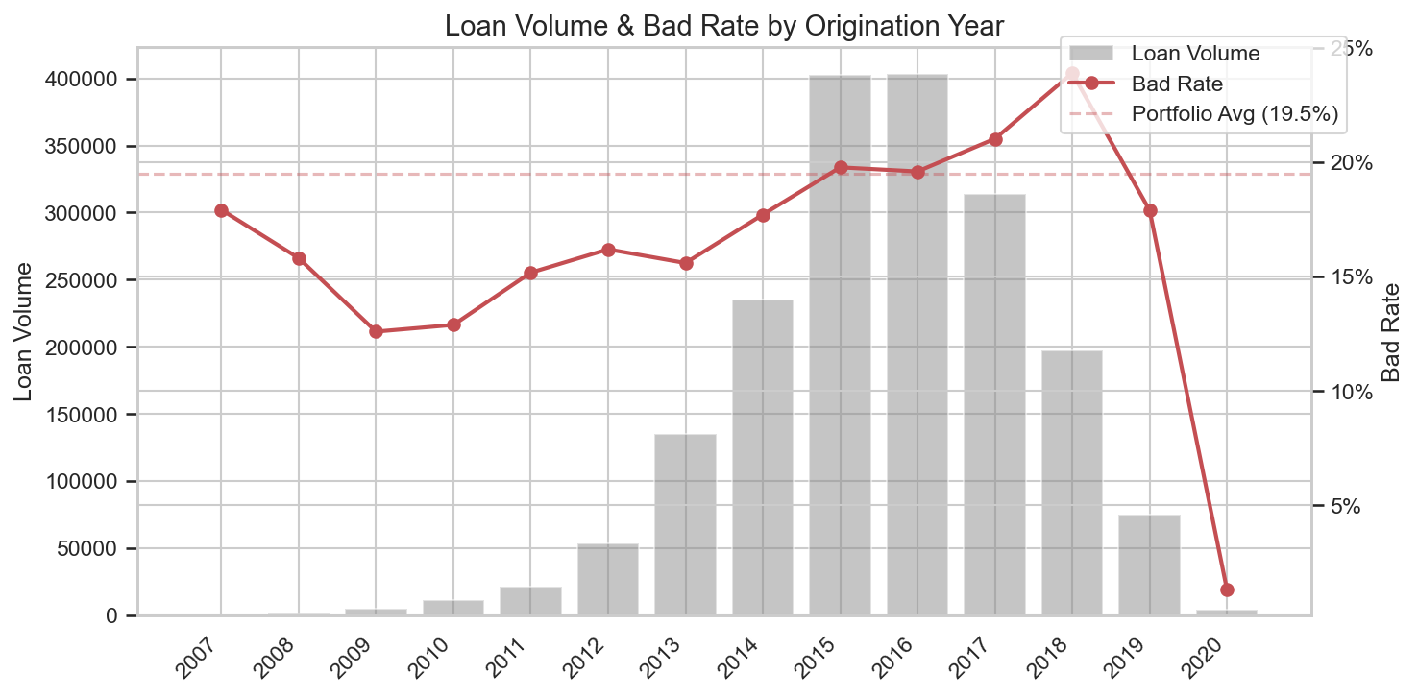
1.86 Million Completed Loans Analyzed; 1 in 5 Lending Club Loans Were Never Repaid
Scope: Fully Paid or Charged Off only
Loan Status
Count
Share
Total loans analyzed
1,860,331
Fully Paid
1,497,783
51.2%
Current
1,031,016
35.2%
Fully Paid
1,497,783 (80.5%)
Charged Off
362,548
12.4%
Late (31-120 days)
16,154
0.6%
Charged Off
362,548 (19.5%)
In Grace Period
10,028
0.3%
Late (16-30 days)
2,719
0.1%
Date range
Jan 2007 – Sep 2020
Issued
2,062
0.1%
Credit policy: Fully Paid
1,988
0.1%
Credit policy: Charged Off
761
0.0%
Default
433
0.0%
Total
2,925,493
100%

Slide 3
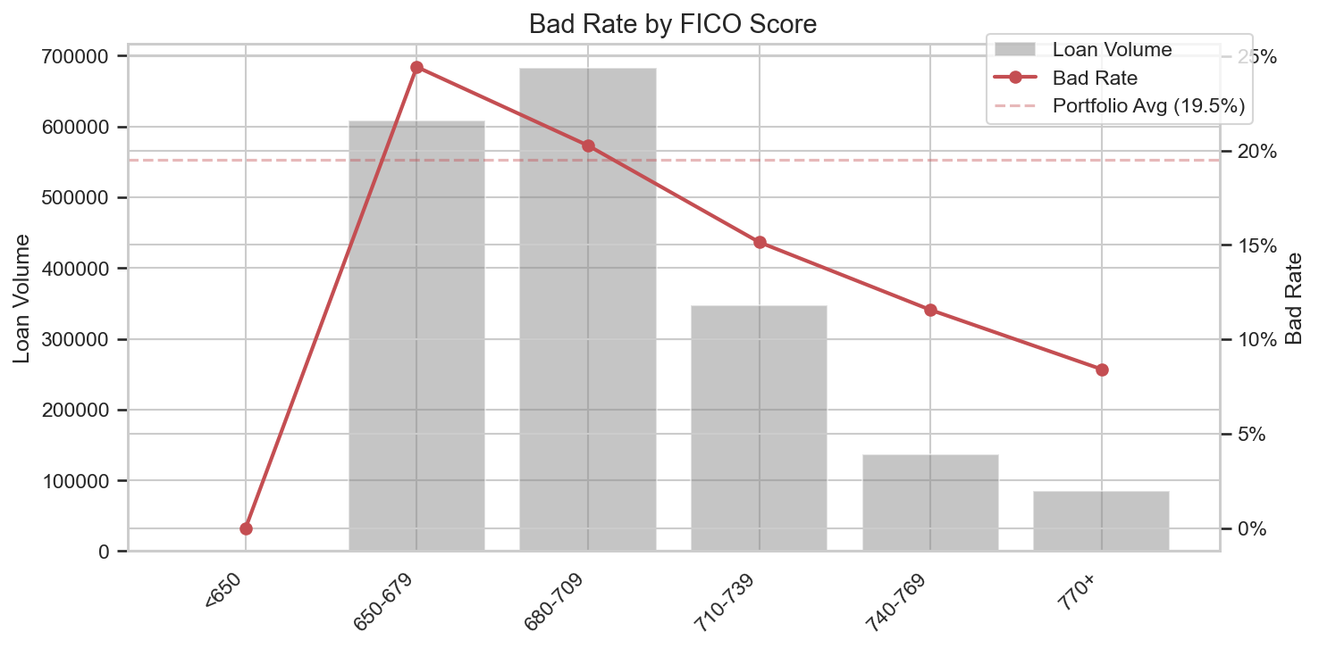
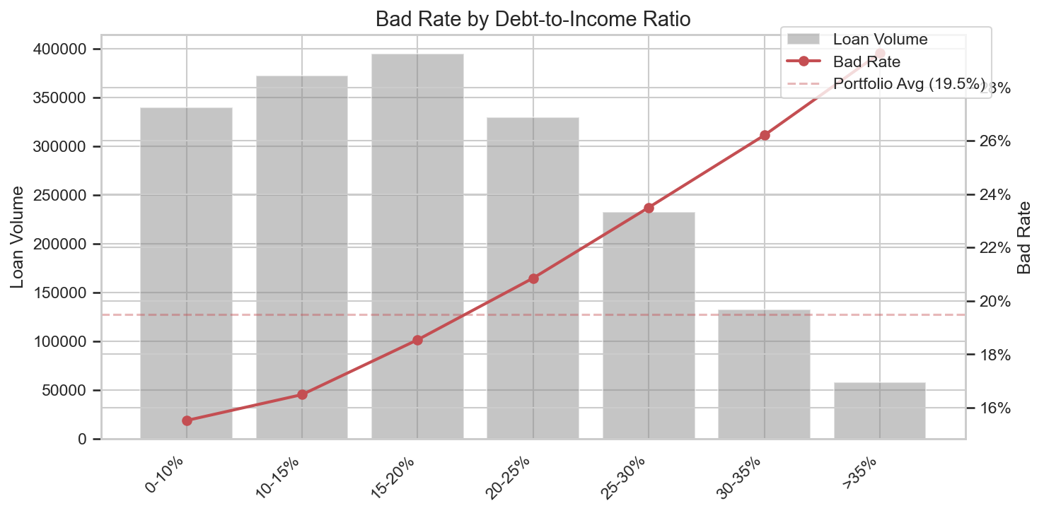
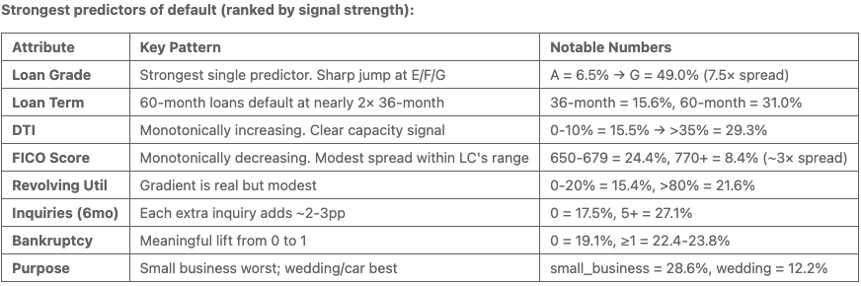
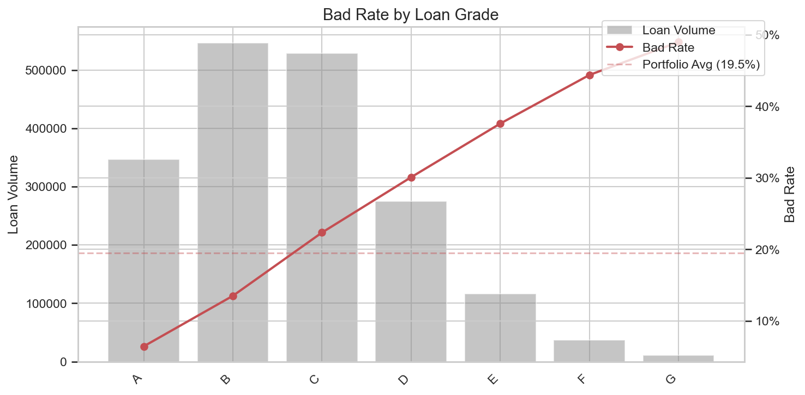
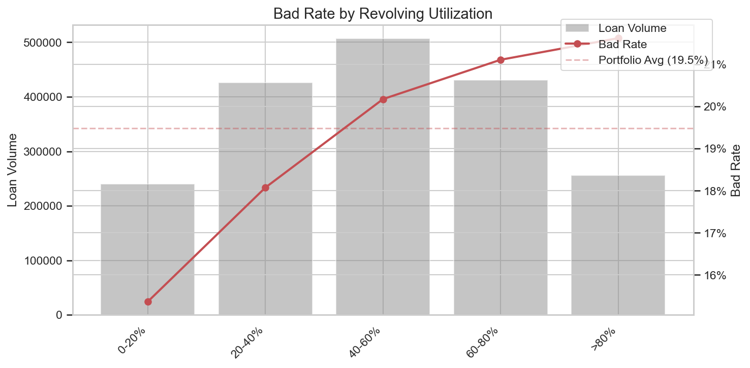
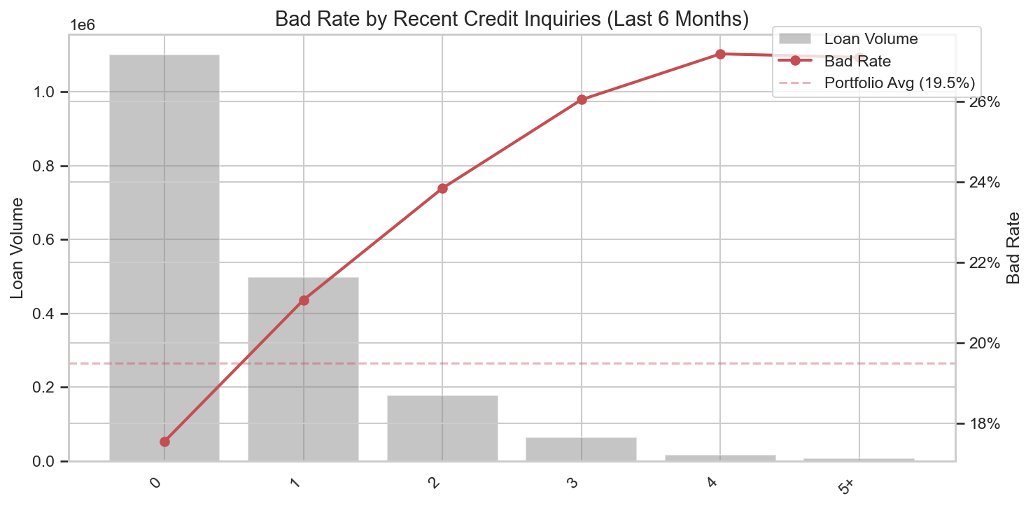
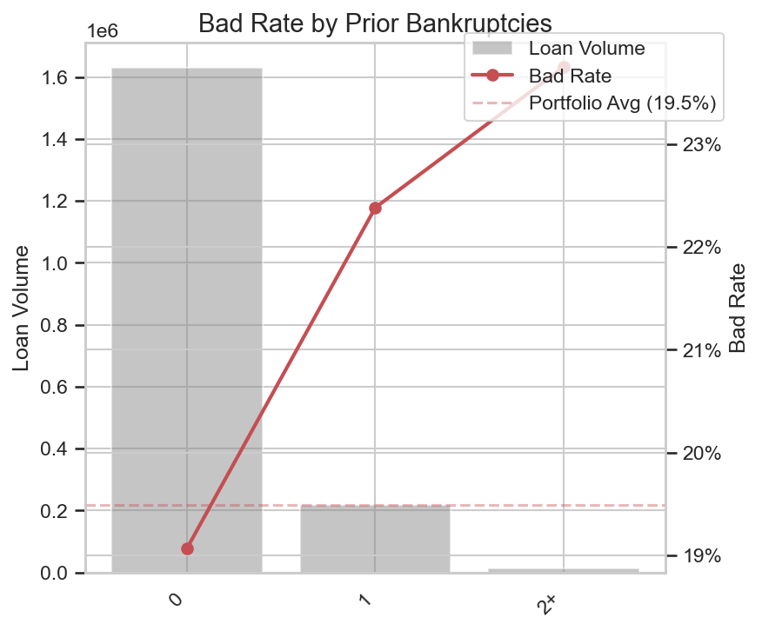
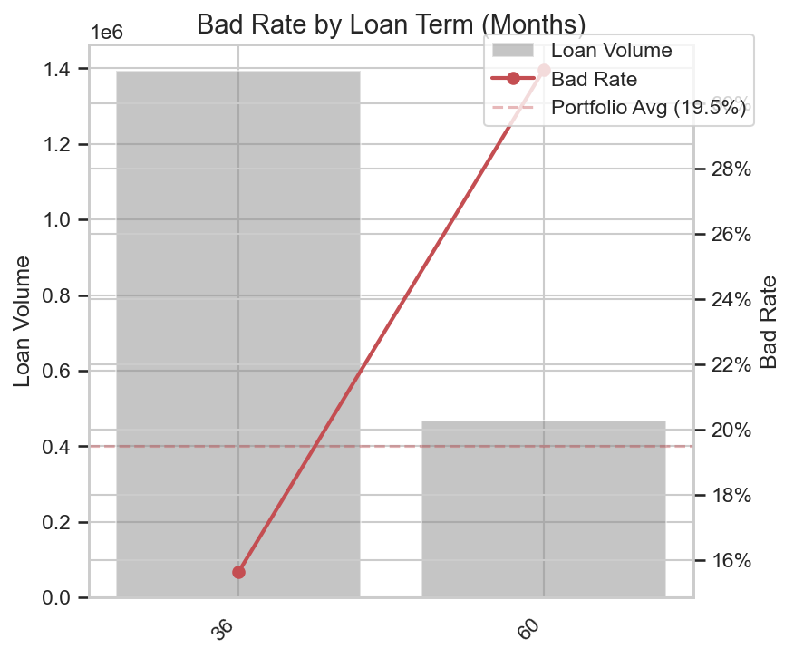
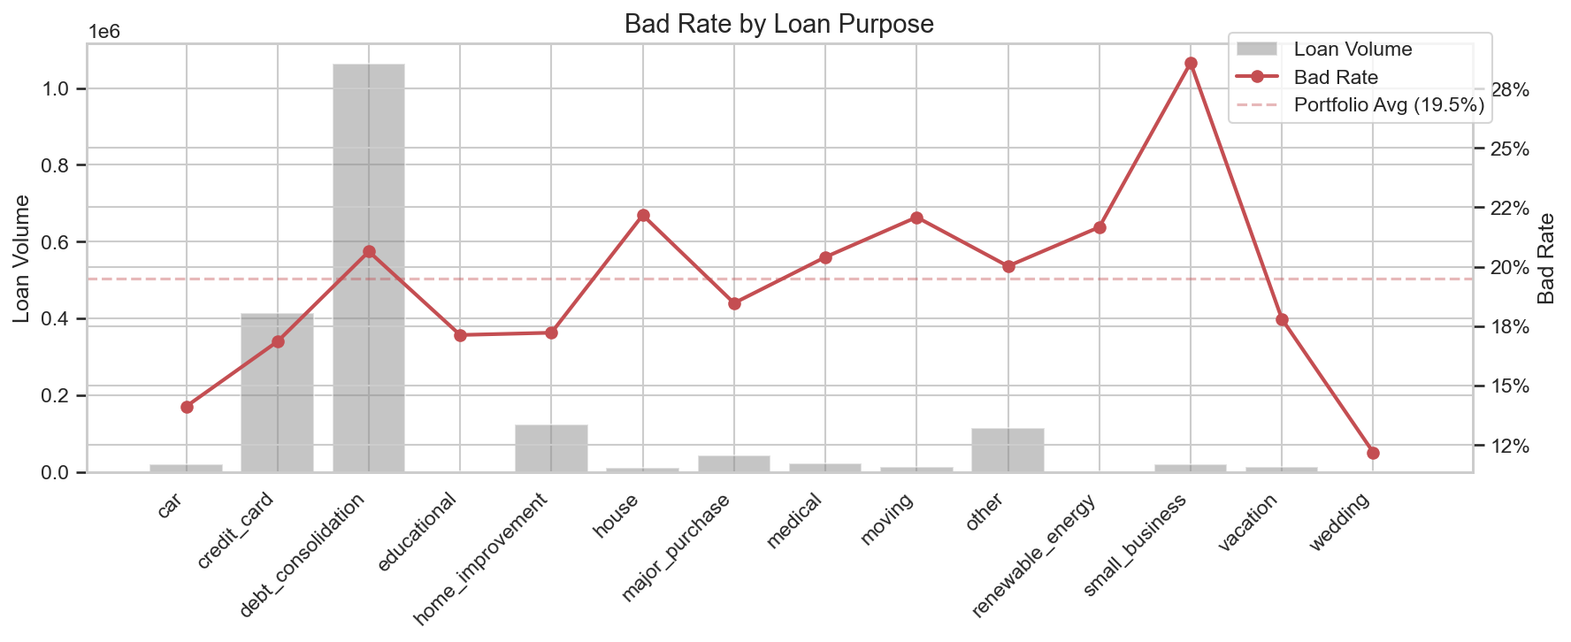
Loaded 25 columns; Examined 8 in depth based on domain knowledge and scope
Scope: Origination-time features only; No post-loan data leakage
The analysis goal is interpretable policy rules (hard cutoffs), not a predictive ML model. The most actionable signals are: Credit quality (FICO, grade),Leverage (DTI, revol_util), Credit history (pub_rec_bankruptcies, Inq_last_6mths), Loan structure (term, purpose)

Slide 4
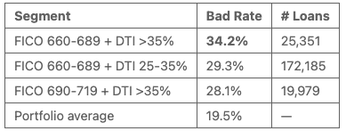
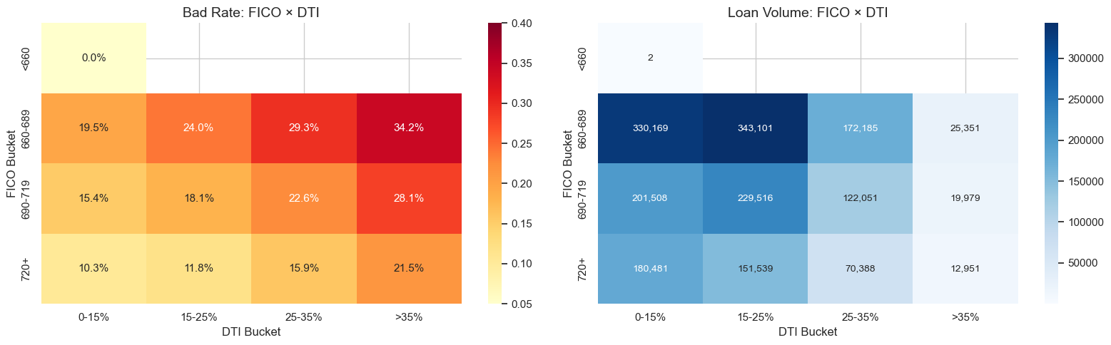
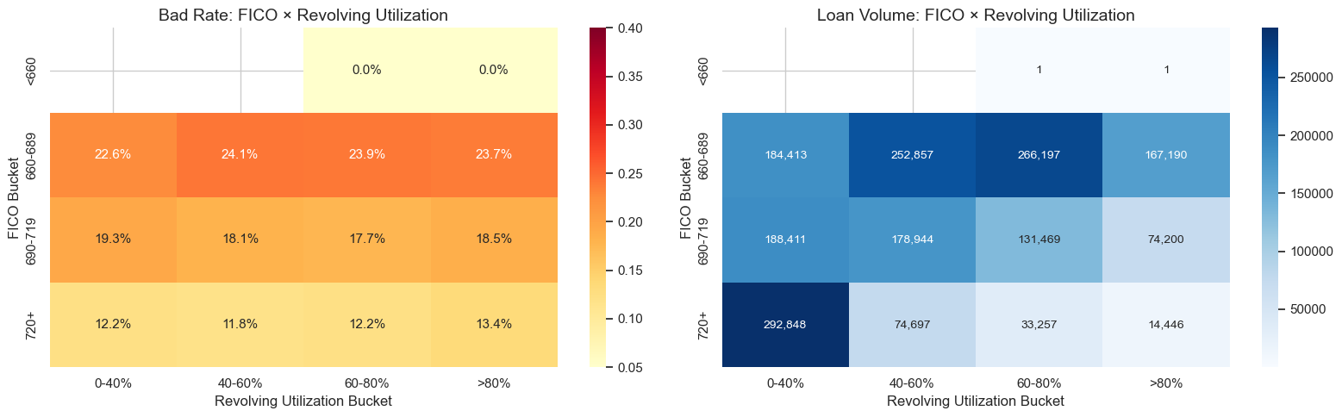
Risk Compounds: risk is not additive — it multiplies.
FICO x DTI & FICO x Revolving Utilization; Low FICO + High DTI = the worst borrower pocket
▸ The worst combined pocket (FICO 660-689 + DTI >35%) defaults at 1.75× the portfolio average and contains 25K loans — large enough to be policy-relevant, not a statistical anomaly.
▸ Within the FICO 660-689 band, bad rates cluster tightly at 23-24% regardless of which revolving utilization bucket a borrower falls in.
▸ Adding revol util on top of FICO provides little incremental separation. This suggests FICO already captures most of the credit-stress signal that revol util would add.

Slide 5
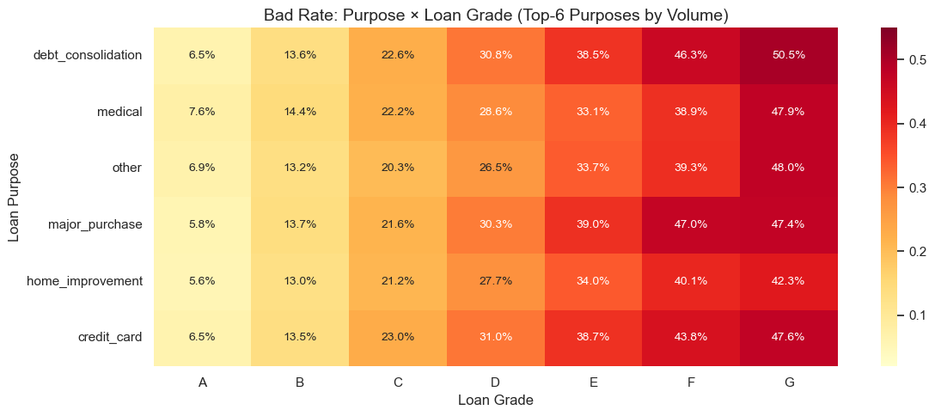
Risk Compounds: risk is not additive — it multiplies.
Purpose x Grade; Grade shows consistent trend for bad rate; Purpose add minimal value
▸ The bad rate gradient across grades (A → G) is consistent across every purpose category.
▸ Purpose adds limited incremental signal within a given grade tier. This argues for using grade as the primary categorical rule, rather than building purpose-specific cutoffs.
▸ Exception: `small_business` is elevated across all grades and may warrant a separate floor.

Slide 6
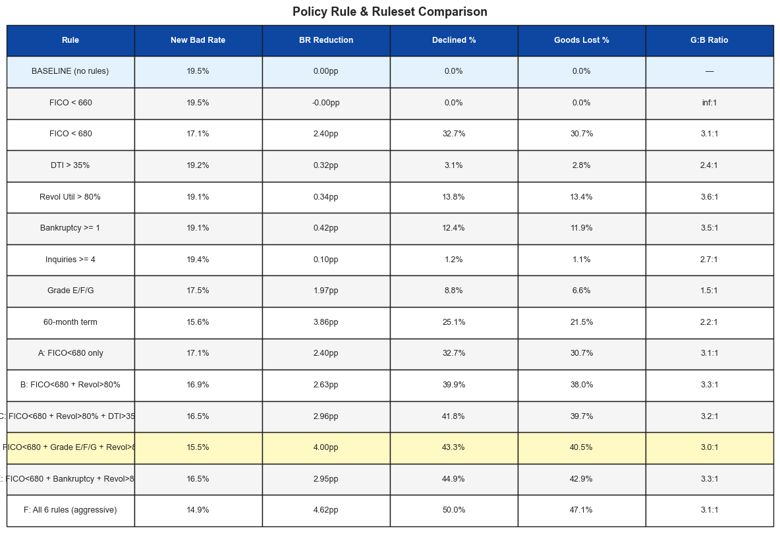
Policy Making: Swap Set Framing – Trade-off: Bads Caught v.s. Goods Lost
▸ Grade E/F/G is the single most efficient individual rule
▸ It declines only ~10% of
volume but catches a disproportionate share of defaults (bad rate ~40% in declined set, more than 2× the portfolio average).
▸ The good-to-bad ratio of ~0.9:1 means we lose almost no good loans per bad loan caught — the most favorable ratio of any rule.
▸ Ruleset D is recommended because it achieves the largest bad rate reduction at a competitive decline rate.
▸ The Grade E/F/G component is what sets D apart from C and E — it targets borrowers LC's own model already identifies as highest-risk, and it contributes a qualitatively different signal (holistic risk assessment) rather than just another continuous variable threshold.
▸ Compared to Ruleset C (FICO + Revol + DTI), Ruleset D achieves more bad rate reduction for roughly the same decline burden.
Baseline bad rate: 19.5% · All thresholds use only origination-time data

Slide 7
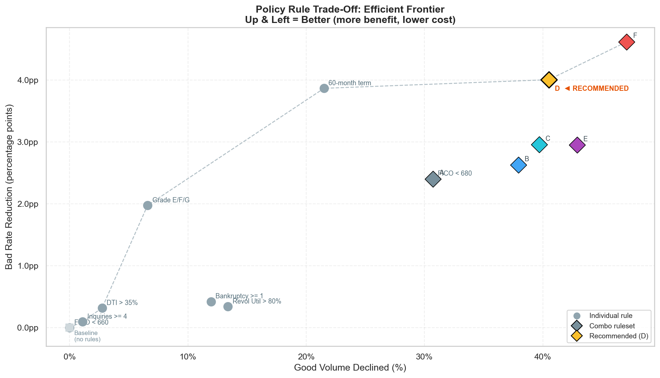
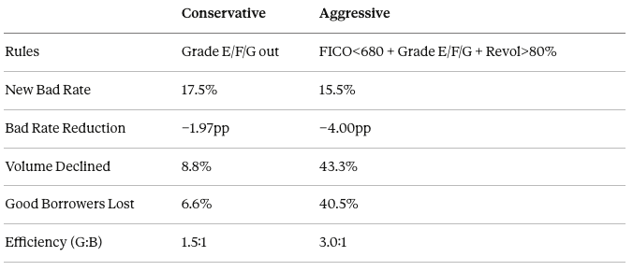
Recommendation: Conservative / Aggressive
Confirmed by efficient frontier trade-off visualization
Recommendation:
Why Not Exclude 60-Month Loans?
▸ This eliminates an entire product line, not a borrower risk segment
▸ 60-month loans exist because borrowers need lower monthly payments — many are creditworthy
▸ The right response is tighter underwriting for 60-month applicants (e.g., higher FICO floor), not removing the product
▸ Recommend flagging to product team for term-specific credit policy review
"Elbow" of the efficient frontier — meaningful risk reduction without catastrophic volume loss.

Slide 8
Next Steps
→ Future Improvements
Build a logistic regression scorecard → replace hard cutoffs with a continuous risk score; tune threshold at any desired approval rate
Vintage analysis → calibrate rules on recent cohorts (2017–2019) to avoid over-weighting the 2008 crisis
Purpose-specific policies → small business loans (26% bad rate) may need a separate, stricter policy
A/B test the rollout → measure real approval rate impact before full deployment

