Slide 1
Are We Lending to the Right Borrowers?
Consumer Credit Policy Analysis · Lending Club 2007–2020 Q3
ClarityPay Take-Home Exercise
1,860,331 completed loans | 2007–2020 Q3

Slide 2
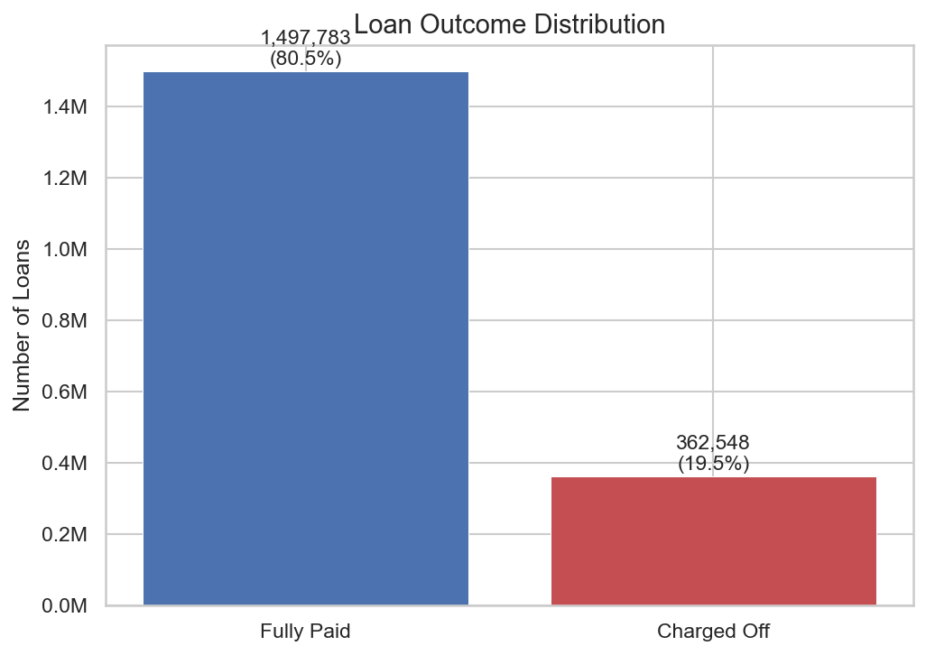
1 in 5 Lending Club Loans Were Never Repaid
19.5%
charge-off (default) rate
▸ 362,548 loans written off as uncollectible
▸ Each charge-off = 100% loss of outstanding principal
▸ Industry average for consumer installment: 2–5%
▸ LC's platform attracted near-prime / subprime borrowers
▸ Goal: identify high-risk borrowers before we lend

Slide 3
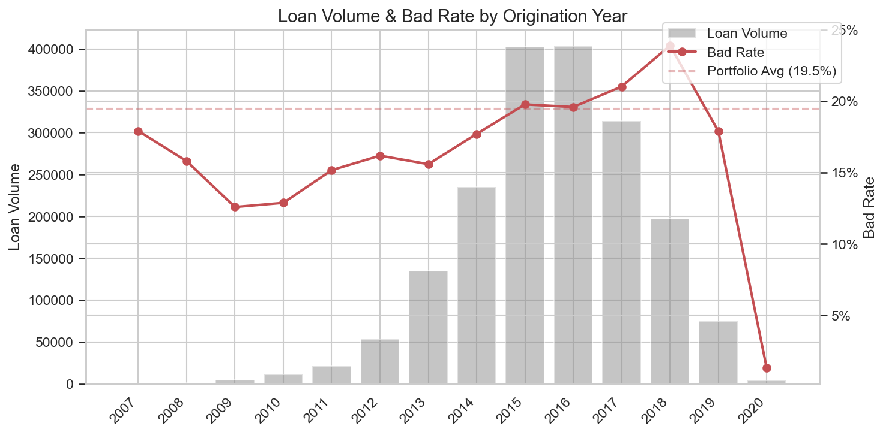
1.86 Million Completed Loans Analyzed
Scope: Fully Paid or Charged Off only · Origination-time features only · No post-loan data leakage
Total loans analyzed
1,860,331
Fully Paid
1,497,783 (80.5%)
Charged Off
362,548 (19.5%)
Date range
Jan 2007 – Sep 2020
Methodology: Only loans with a known outcome are included. In-progress loans (Current, Late, Grace Period) are excluded. All features used are observable at origination — no post-loan data.

Slide 4
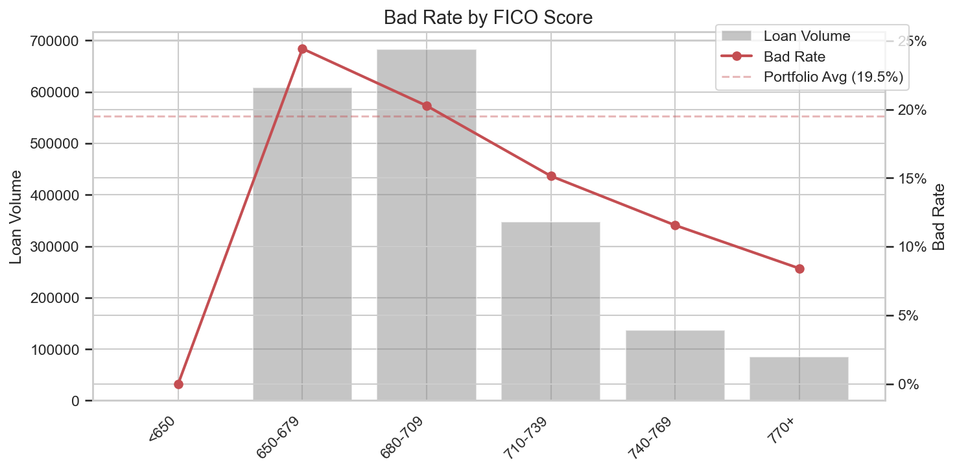
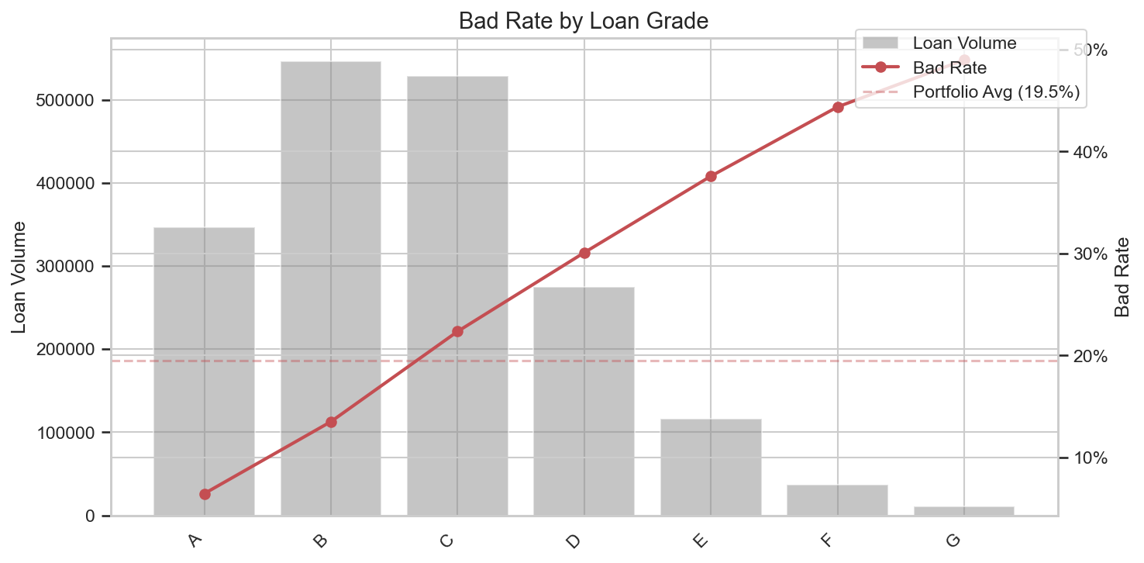
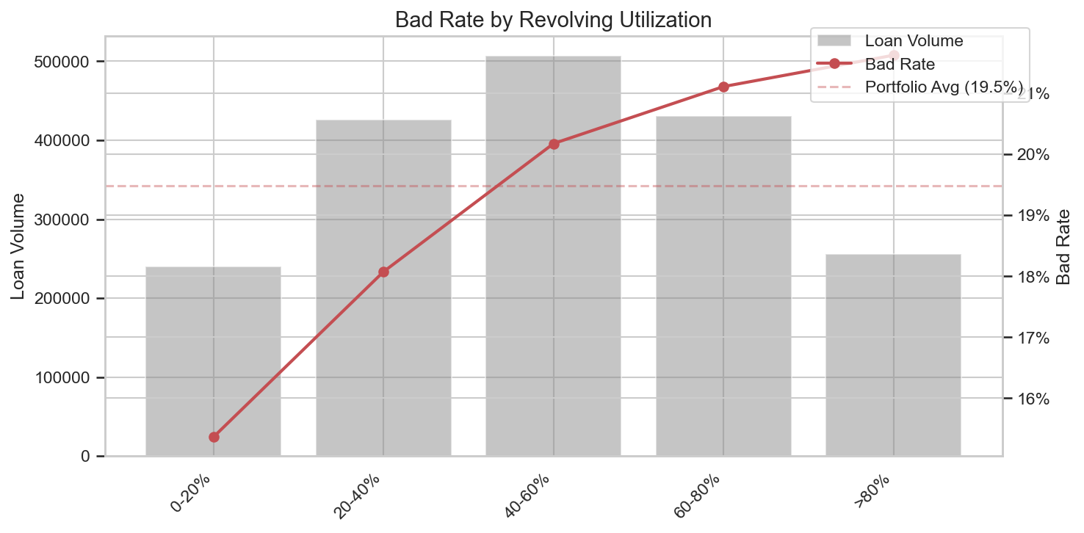
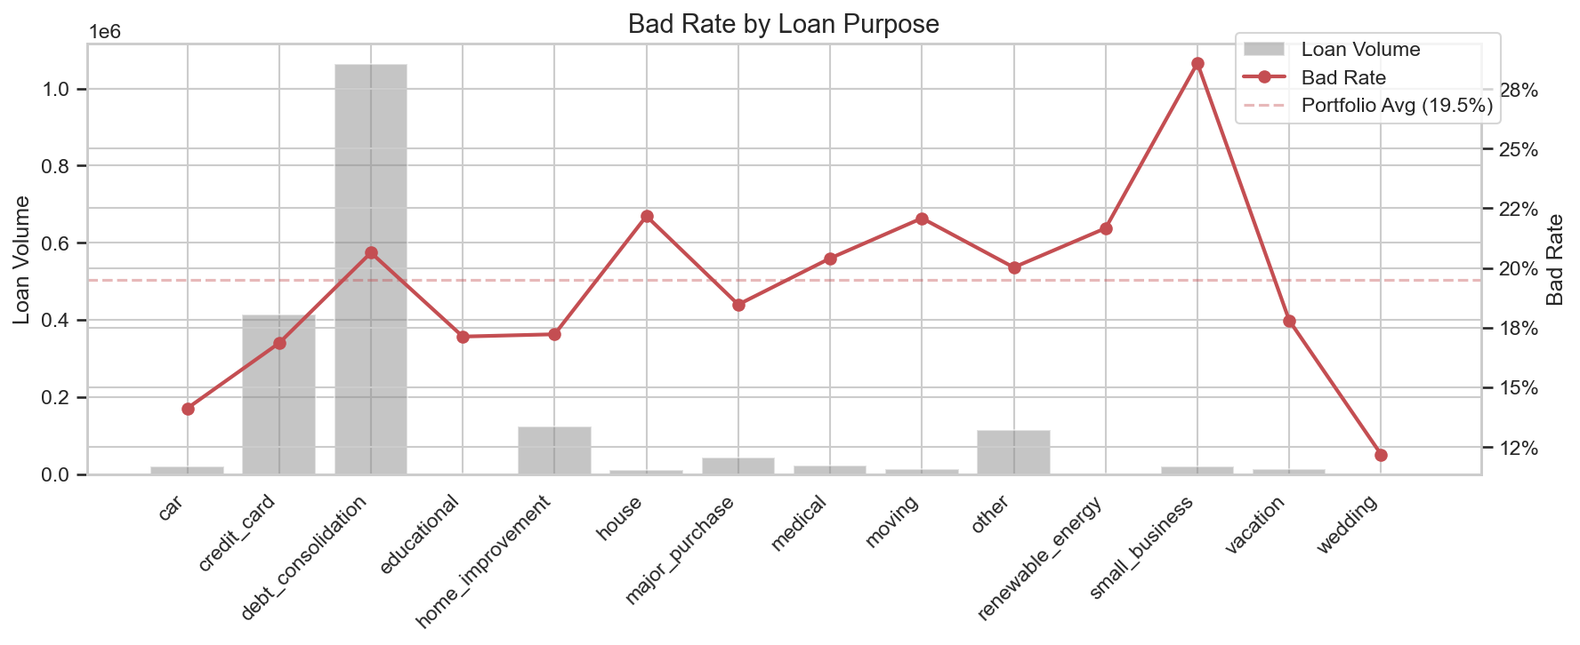
Four Attributes Predict Default Before the Loan Is Made

Slide 5
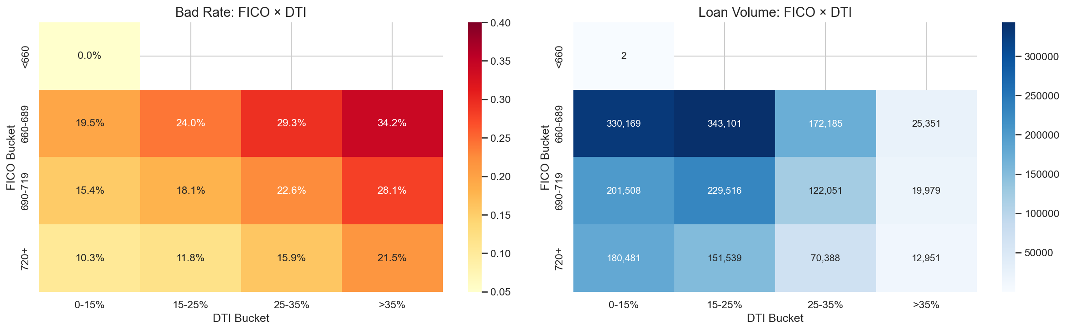
Risk Compounds: FICO × DTI Interaction
Low FICO + High DTI = the worst borrower pocket
Borrowers with FICO < 680 AND DTI > 35% default at the highest rate — nearly 2–3× the portfolio average. The right panel confirms this is a large enough segment to matter commercially.
Variables compound: risk is not additive — it multiplies.

Slide 6
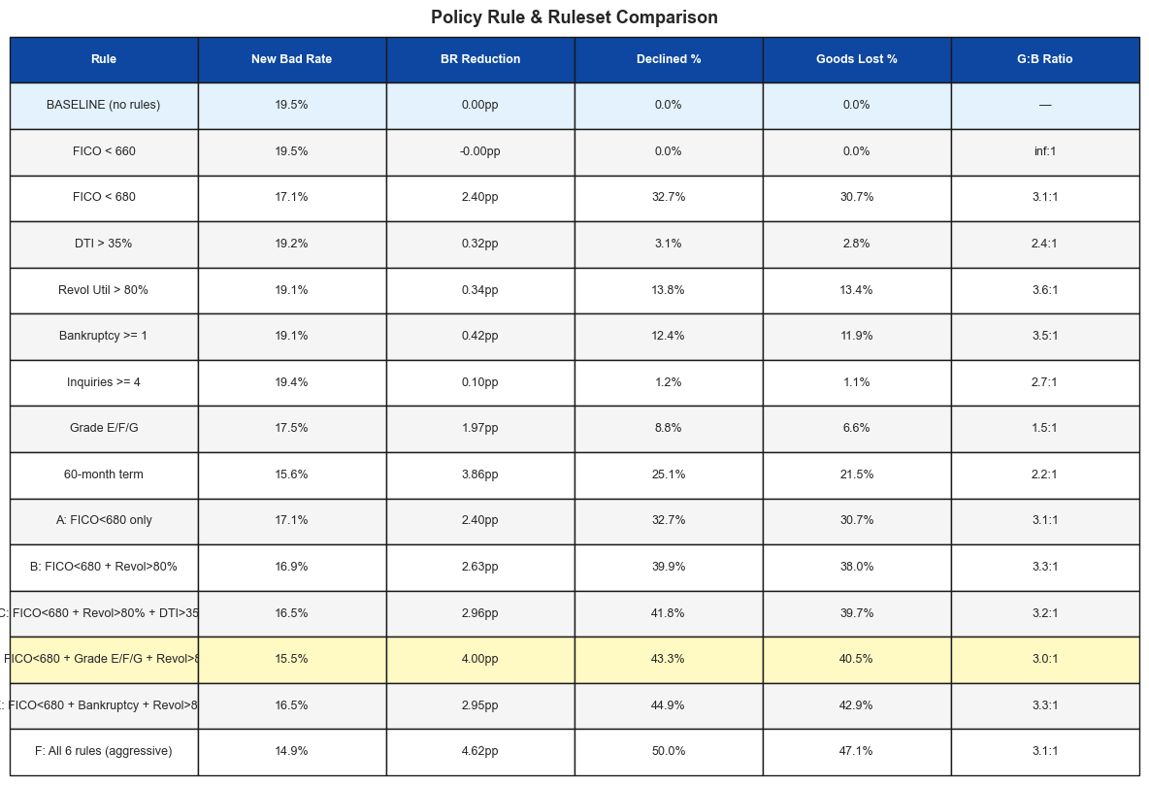
Recommended Policy: Three Evidence-Based Decline Rules
Baseline bad rate: 19.5% · All thresholds use only origination-time data

Slide 7
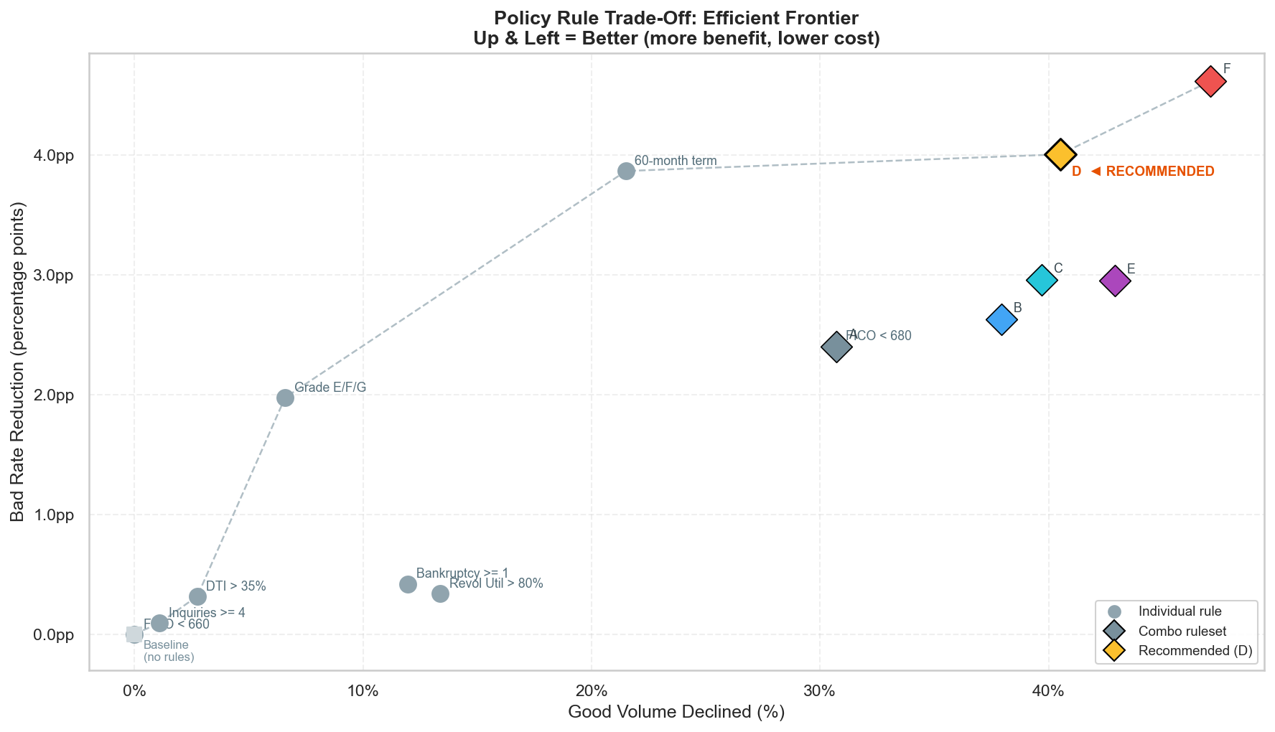
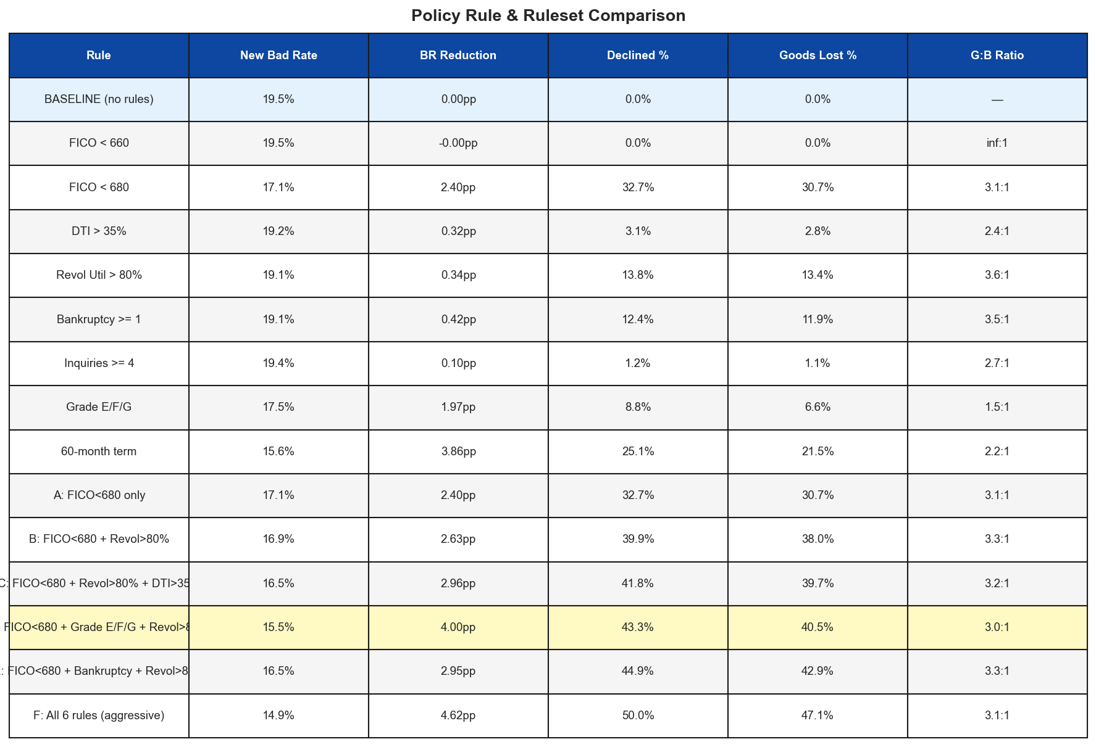
Recommended Ruleset D: FICO < 680 OR Grade E/F/G OR Revol Util > 80%
Ruleset D — Key Metrics
Baseline bad rate
19.5%
New bad rate
15.5%
Bad rate reduction
−4.0 pp (20.5%)
Volume declined
43.3%
Good loans lost
40.5%
"Elbow" of the efficient frontier — meaningful risk reduction without catastrophic volume loss.

Slide 8
Recommendations & Next Steps
✓ Implement Now
→ Future Improvements
Decline if FICO < 680 → strongest single predictor; 2× baseline bad rate
Decline if Loan Grade E, F, or G → Lending Club's own risk model endorses these thresholds
Decline if Revolving Utilization > 80% → captures financial stress independent of credit score
Add Bankruptcy as a hard cutoff (any record) → categorical signal; no exceptions policy
Build a logistic regression scorecard → replace hard cutoffs with a continuous risk score; tune threshold at any desired approval rate
Vintage analysis → calibrate rules on recent cohorts (2017–2019) to avoid over-weighting the 2008 crisis
Purpose-specific policies → small business loans (26% bad rate) may need a separate, stricter policy
A/B test the rollout → measure real approval rate impact before full deployment
All rules use only origination-time data · No post-loan information used · Analysis based on 1,860,331 Lending Club loans 2007–2020 Q3

