Slide 1
UTSA Coding Bootcamp🥾⛺
Mindset
The Big Question

Slide 2
The Hero's Journey ⛰️
“The Journey is the reward.” - Steve Jobs
“Small steps, Great distances” - Eric Thomas

Slide 3
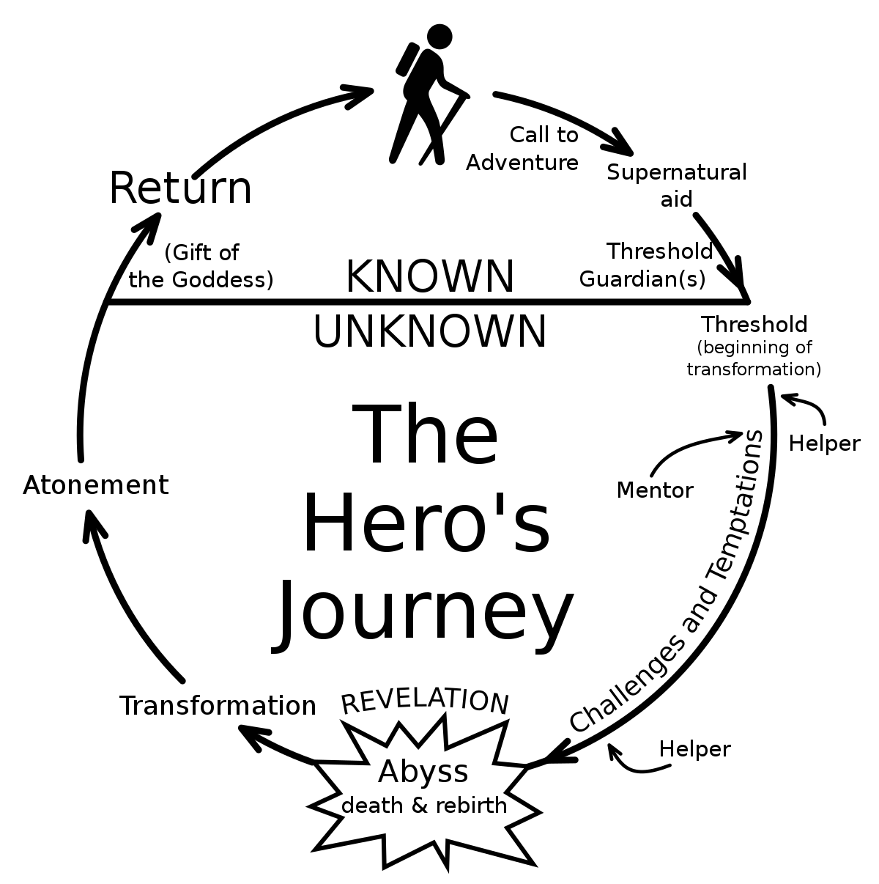

Slide 4
Identity 🪞
Who am I?
I am a problem solver.

Slide 5
Be Loud 📣
See something,
Say something

Slide 6
Brick by Brick 🧱
One line of code at a time

Slide 7
Fortitude 💪🏽
“Success Is Going from Failure to Failure Without Losing Your Enthusiasm” - Winston Churchill

Slide 8
Celebrate 🏈
Coding is hard!
When you (finally) get a win.
Celebrate!

Slide 9
Energy ⚡
“Where your attention goes, your energy flows!” - Eric Thomas

Slide 10
Why?! 🌑
“We choose to go to the moon…, not because they are easy, but because they are hard, because that goal will serve to organize and measure the best of our energies and skills” - J.F.K

Slide 11
Value and Money 💰
Value and compensation is measured by our ability to solve problems in the marketplace relative to supply and demand.

Slide 12
LFC! 💻
Let’s Freakin Code!

