Slide 1
What We Can Learn About the World of Doctors from Zocdoc
By Angie Lin

Slide 2
Business Model
Doctors subscribe to have a profile on Zocdoc.
Patients are able to review and rate doctors after they have an appointment with them.
Why is it successful?
Convenience. Patients can quickly see which doctors are available and avoid the need to call doctors offices within working hours.

Slide 3
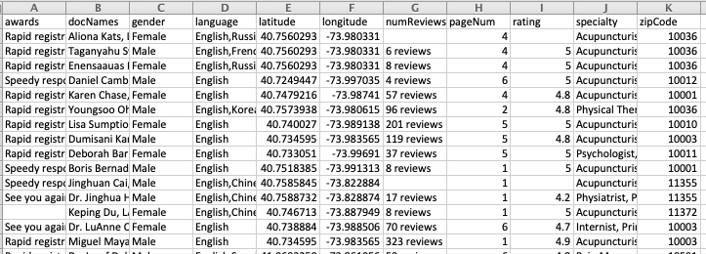
Data
Data on the profile of doctors in NYC area, with location by the 5 boroughs.
Total of 5,666 observations obtained using Scrapy

Slide 4
Objectives
What does the distribution of rating look like for doctors and why? Do they match distributions from other user sites?
Which specialties have the lowest average ratings?
Are there significant difference noticed between the boroughs of New York?
Which specialties have the most number of Zocdoc “awards”?

Slide 5
Objectives
What does the distribution of rating look like for doctors and why? Do they match distributions from other user sites?
Which specialties have the lowest average ratings?
Are there significant difference noticed between the boroughs of New York?
Which specialties have the most number of Zocdoc “awards”?

Slide 6
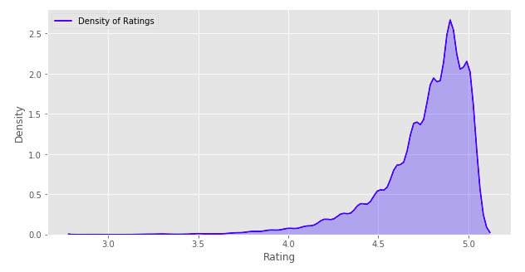
Ratings Distribution
Mean: 4.76
Skewed very right distribution.

Slide 7
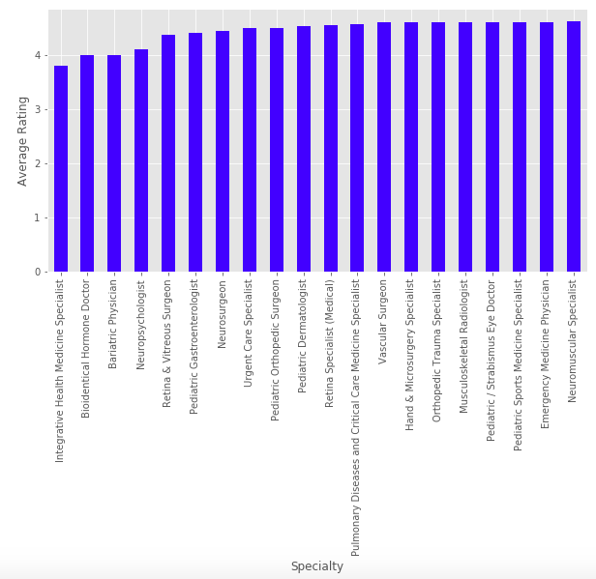
Lowest Average Ratings by Specialty

Slide 8
Why do these specialties suck?
Hormone therapy deals with a chronic disorder with no cure, often resulting with patients not getting significantly better but simply dealing with irritating medication.
Bariatric doctors surgically remove the parts of the stomach to lower food consumption
Most patients take an extremely long time to adjust to the change and frequently, the operation results in a lot of vomiting and IBM first.

Slide 9
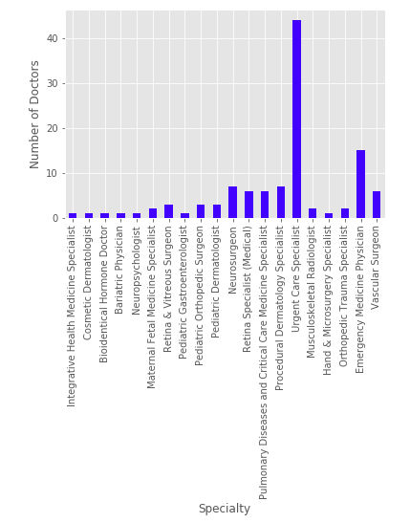
Number of Doctors in Each Specialty
There are very few doctor for each of the low category, supposing the idea that most of doctors practicing more difficult specialties (for patients) will not be on Zocdoc.

Slide 10
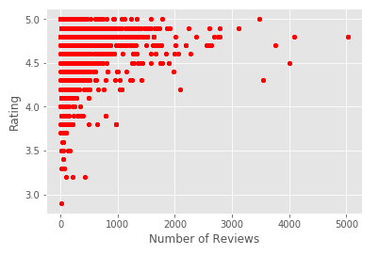
Ratings by Number of Reviews
Doctors that have over 1000 reviews on their profile have average ratings above 4 stars.
If doctors had more reviews and not a high enough rating, they would opt out of the Zocdoc subscription

Slide 11
Objectives
What does the distribution of rating look like for doctors and why? Do they match distributions from other user sites?
Which specialties have the lowest average ratings?
Are there significant difference noticed between the boroughs of New York?
Which specialties have the most number of Zocdoc “awards”?

Slide 12
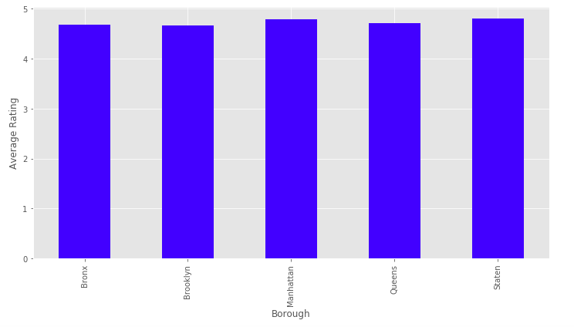
Average Rating by Borough

Slide 13
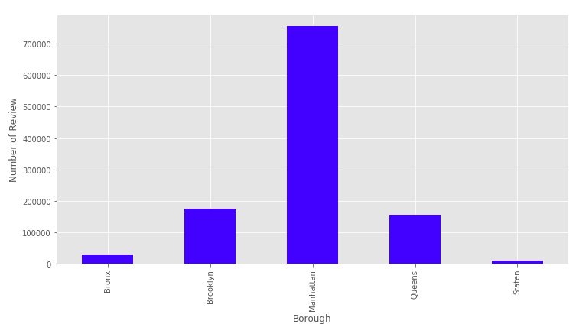
Number of Reviews in Each Borough

Slide 14
Between Boroughs
It does not look like there is a significant difference in ratings between the boroughs.
Since Manhattan has more people, it makes sense that most of the reviews are from the city.

Slide 15
Objectives
What does the distribution of rating look like for doctors and why? Do they match distributions from other user sites?
Which specialties have the lowest average ratings?
Are there significant difference noticed between the boroughs of New York?
Which specialties have the most number of Zocdoc “awards”?

Slide 16
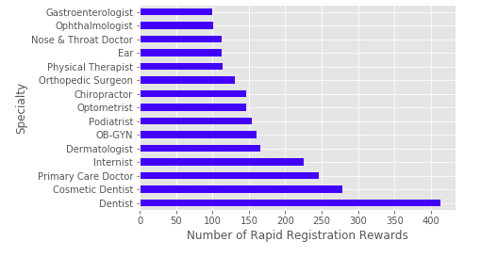
Recognition Awards
Zocdoc gives awards to its doctors in the 4 categories:
Rapid Registration
Speedy Response
“See You Again” (Return patients)
Scheduling Hero

Slide 17
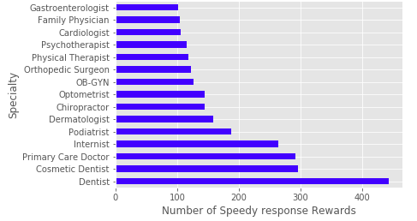
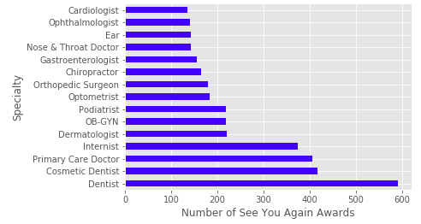
More Awards

Slide 18
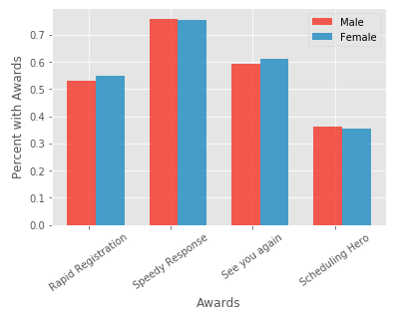
Percent of Doctors with Awards by Gender

Slide 19
Conclusions
Ratings for doctors on Zocdoc are heavily skewed to the left because of the model of Zocdoc itself.
Specialties that have the lowest rating are the ones that have deal with intensive procedures and illnesses that currently have no cure. There are also very few doctors in these particular fields with profiles on Zocdoc.
Specifically, Zocdoc is good for the specialties that focus on the occasional “check-up”, not for more risky practices like surgeries.
Users should note that Zocdoc is skewed to have only doctors with high rating on the website and therefore, will inform the user who are high rated doctors, but will not provide comparisons to low rating doctors. The sample pool of those on Zocdoc is specific.

