Slide 1

Recreation within North Ayrshire
Dyllan North, Vasileios Bardakos, Sheriff Amoah

Slide 2
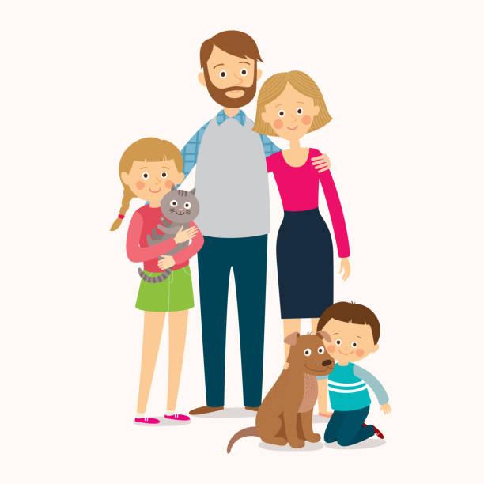
Meet Fred
Fred has 2 kids & 1 dog.
Fred and the family love cycling, but its not too accessible where he lives.
There are great cycling facilities just 10 minutes away in the Garnock Valley.
Fred currently has no way of knowing about the great cycling routes.
Fred has a car and is willing to drive up to 5 miles.

Slide 3
Datasets
What data would be of benefit to Fred ?
Dog Bins
Toilets (Areas and Times)
Cycle Routes
Car Parks**
Play park (A break for the kids)
Historical Areas of interest**
Lunch (Restaurants** or a Picnic)
Scenic View

Slide 4
Why?
What benefit can Fred bring to the community with his visit ?
Financial benefit. The money Fred spends will have a positive impact on the community
Enrichment of data. By using the journey which we facilitate we will have a better understanding of visitors to the area. Including the needs which we do not currently facilitate.
Better community involvement. By identifying Fred as visitor to the area we can directly market events happening, including clean-ups.

Slide 5
Demo!

Slide 6
Designing this Interaction
Fred is one scenario, how can we create a platform which can facilitate the many?
We need now to build a interface which enable the user to tailor the trip to their needs.
The Non-Negotiables (Accessibility, Family Inclusion, Pet Friendly, Transport)
Desirables (Types of Activities, Picnic Benches, Views)
The Extras (Restaurants, Historical Attractions i.e. Chargeable Services)

