Slide 1

Mary Noodle Doodles Professional Website for Child Content Design and Illustration
Rivera, Angie (VC1C)
Angiervr9@gmail.com; Angie.Rivera81@bcmail.cuny.edu
Supervisor: Marybeth Butler Rivera
marybeth.b.rivera@gmail.com
https://www.marybethbutlerrivera.com/

Slide 2

Abstract
This project aims to create a professional, user-friendly website for Marybeth Butler, a talented child content designer and illustrator, to help her reach scouts and potential clients in the children's content design industry. The website will serve as a portfolio platform that highlights Marybeth's work, making it easily accessible to potential clients and scouts looking for creative content for children. The goal is to build a visually appealing and responsive website that integrates a contact form, SEO optimization, and social media sharing, offering an efficient way for users to inquire about services. The project will focus on the technical aspects of building a robust platform, including web development, form handling, and ensuring a smooth user experience across devices.
Notes:
Abstract Overview:
The Abstract slide provides a comprehensive high-level overview of the project, focusing on its main goals and objectives. Key elements of the website are outlined, ensuring clarity and purpose:
Purpose and Target Audience: The website is designed to serve as a professional, user-friendly portfolio for MaryBeth Butler Rivera, a talented child content designer and illustrator. Its primary goal is to showcase her work in a way that is easily accessible to scouts and potential clients within the children's content design industry.
Core Features: The website will be crafted to be visually appealing and responsive, ensuring an engaging and seamless experience across all devices. It will also be optimized for SEO to enhance its visibility and ensure that it ranks well on search engines, helping potential clients discover MaryBeth's work easily.
Technical Aspects: The website will feature robust web development practices, integrating essential elements like form handling for communication and inquiries. Additionally, cross-device compatibility will be prioritized to ensure smooth functionality across desktop, tablet, and mobile devices, providing a consistent user experience.
In summary, the Abstract slide offers the audience a clear and concise overview of the project's key objectives, its target audience, and the essential features that will make the website both functional and effective for its intended purpose.

Slide 3
MY ROLE & specialties
As the sole developer on this project, I was responsible for both frontend and backend development, including all technical research and implementation. I built the user-facing interface using HTML, CSS, and JavaScript, ensuring responsiveness and usability. While the overall layout concept and artistic direction were guided by the stakeholder, Marybeth, my focus was on translating those ideas into a functional and interactive website. My core contributions centered on frontend development, form handling, and full-stack feature implementation, while the visual and illustrative elements were exclusively provided by the stakeholder.
Notes:
Form Submission

Slide 4

My Research
Throughout the development of this project, I utilized a variety of technical and educational resources:
HTML & CSS design and build websites by Jon Duckett (frontend for references)
www.w3schools.com- Bootstrap, Lightbox, NodeJS
Youtube.com (deployment, domain configuration, and setting up email functionality with Nodemailer.)
Google-fonts/ color contrast tool: http://davidbau.com/colors/
Notes:
Throughout the development of this project, I utilized a variety of technical and educational resources. For frontend structure and best practices, I referenced HTML & CSS: Design and Build Websites by Jon Duckett, along with documentation and tutorials from W3Schools.com, particularly for Bootstrap, Lightbox, and Node.js. I also used YouTube as a supplementary resource for guidance on deployment, domain configuration, and setting up email functionality with Nodemailer. For typography and visual styling, I incorporated fonts from Google Fonts and selected accessible color palettes with the help of David Bau’s color contrast tool (davidbau.com/colors). These tools supported my development process from design to deployment.

Slide 5
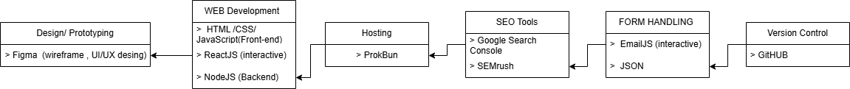
Project Layout (Draft 1-2)
Notes:
Tools Overview:
This slide provides an overview of the key programs and technologies utilized in the creation of this website:
Design & Prototyping: - The design and wireframe layout of the website were created using Figma. This tool enabled me to effectively visualize the structure and user experience before implementation.
Web Development: - The website's structure is built using HTML, which serves as the foundation for the layout. To enhance the visual presentation, CSS was applied for styling, including the adjustment of images and text. For interactive and dynamic user interfaces, ReactJS will be used to build reusable components. The Node.js framework will handle the backend operations, ensuring efficient server-side functionality.
Hosting: - After thorough research, PorkBun was selected for both web hosting and domain name registration due to its reliable service and competitive pricing.
Search Engine Optimization (SEO): - SEO practices will be implemented to optimize the website's visibility and ranking on search engines, ensuring better user discoverability.
Form Handling: EmailJS will be utilized to manage user email submissions, while JSON will be employed to organize and track incoming requests, providing a seamless communication flow for the website's users.
Version Control: GitHub will serve as the version control platform, where all files and project updates will be stored. This ensures efficient collaboration and management of the project throughout its development lifecycle.

Slide 6
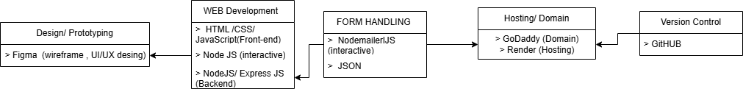
Project Layout (FINAL)
Notes:
Tools Overview:
This slide provides an overview of the key programs and technologies utilized in the creation of this website:
Design & Prototyping: - The design and wireframe layout of the website were created using Figma. This tool enabled me to effectively visualize the structure and user experience before implementation.
Web Development: - The website's structure is built using HTML, which serves as the foundation for the layout. To enhance the visual presentation, CSS was applied for styling, including the adjustment of images and text. For interactive and dynamic user interfaces, ReactJS will be used to build reusable components. The Node.js framework will handle the backend operations, ensuring efficient server-side functionality.
Hosting: - After thorough research, PorkBun was selected for both web hosting and domain name registration due to its reliable service and competitive pricing.
Search Engine Optimization (SEO): - SEO practices will be implemented to optimize the website's visibility and ranking on search engines, ensuring better user discoverability.
Form Handling: EmailJS will be utilized to manage user email submissions, while JSON will be employed to organize and track incoming requests, providing a seamless communication flow for the website's users.
Version Control: GitHub will serve as the version control platform, where all files and project updates will be stored. This ensures efficient collaboration and management of the project throughout its development lifecycle.

Slide 7
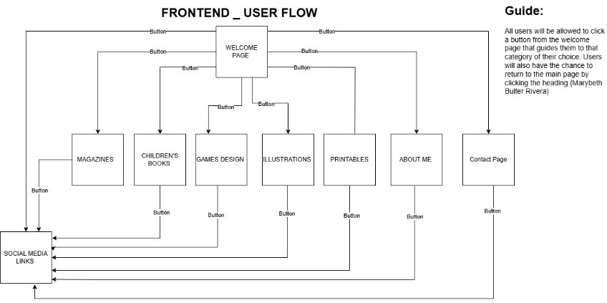
USER FLOW (DRAFT 1-2)
Notes:
User Flow Overview:
This flow diagram illustrates the user's journey and navigation throughout the website. The diagram outlines the following steps in the user experience:
Welcome Page: Upon entering the website, users are greeted with the welcome page(showcasing artist's portfolio), which serves as the initial touchpoint. From here, users can begin their exploration of the site.
Category Selection: After the welcome page, users are directed to a list of categories. Each category serves as a gateway to more specific content or features, allowing users to view all images showcased or learning about the artist and contacting the artist.
Navigation Back to the Main Page: At any point, users have the option to return to the main page. By clicking the website's heading, they can easily navigate back to the homepage, ensuring a seamless user experience.
This user flow ensures an easy navigation, allowing users to move effortlessly between pages and categories while providing a clear path back to the main page.

Slide 8
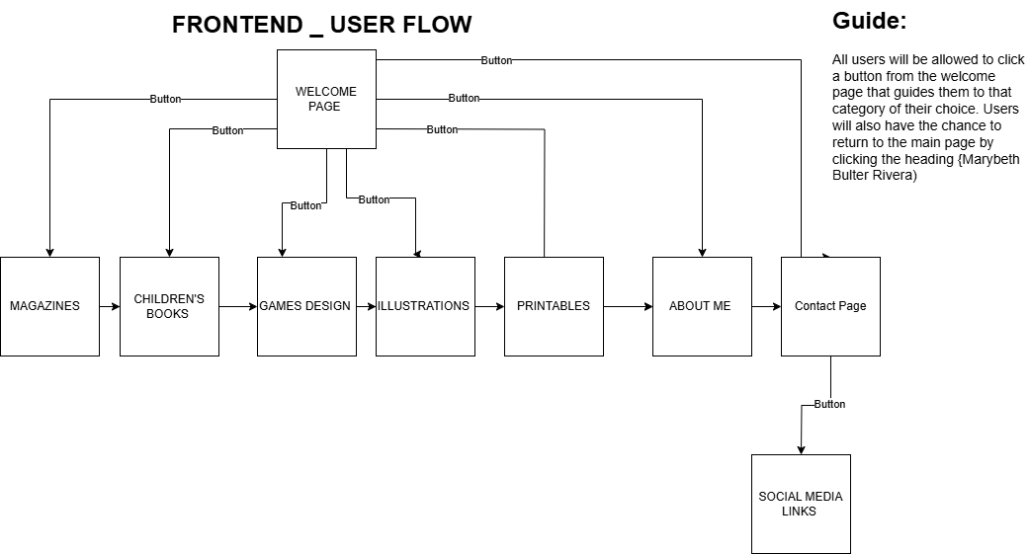
USER FLOW (FINAL)
Notes:
User Flow Overview:
This flow diagram illustrates the user's journey and navigation throughout the website. The diagram outlines the following steps in the user experience:
Welcome Page: Upon entering the website, users are greeted with the welcome page(showcasing artist's portfolio), which serves as the initial touchpoint. From here, users can begin their exploration of the site.
Category Selection: After the welcome page, users are directed to a list of categories. Each category serves as a gateway to more specific content or features, allowing users to view all images showcased or learning about the artist and contacting the artist.
Navigation Back to the Main Page: At any point, users have the option to return to the main page. By clicking the website's heading, they can easily navigate back to the homepage, ensuring a seamless user experience.
This user flow ensures an easy navigation, allowing users to move effortlessly between pages and categories while providing a clear path back to the main page.

Slide 9
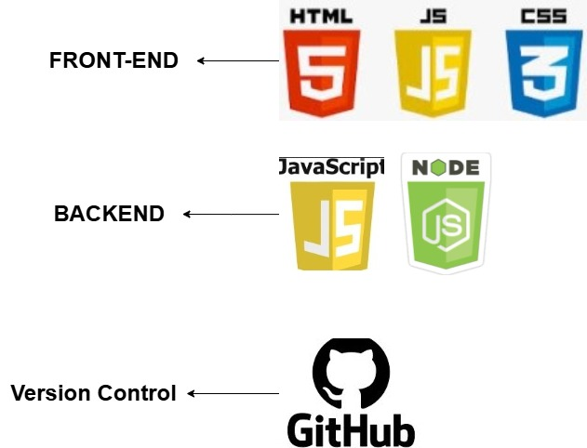
User's Browser draft 1-2

Slide 10
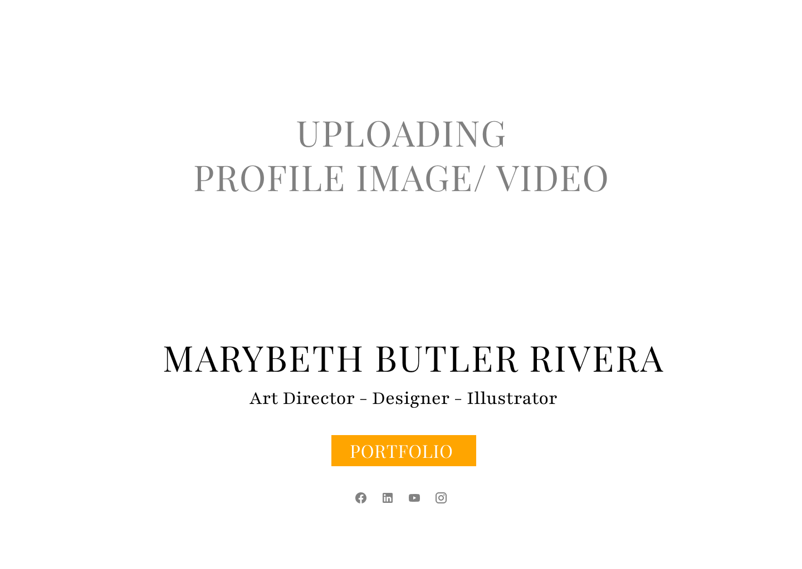
DRAFT 1 (Wire Frame)
Notes:
Welcome Page Layout Overview :(DRAFT 1) (DISCONTUINED)
The Welcome Page is designed to provide users with easy access to the artist’s portfolio, offering a clear and structured way to navigate through different categories of work. Key features of this layout include:
Portfolio Access: Users will be able to click on the Portfolio button, which will lead them to a page showcasing all the artist's work.. This organized structure allows visitors to explore various types of artwork in a way that is intuitive and engaging.
Navigation Between Categories: Once on the portfolio page, users can navigate through individual categories, making it simple to explore the full range of the artist’s work. Each category will be clearly labeled and contain relevant pieces, giving users a smooth browsing experience.
Social Media Links: In addition to viewing the artist's work, users will also have the opportunity to easily navigate to the artist’s social media profiles. Social media links will be prominently displayed, enabling users to connect with the artist on different platforms and stay updated with new projects and releases.
This Welcome Page ensures a user-friendly and interactive experience, making it easy for visitors to explore the artist’s portfolio while also connecting with them on social media.

Slide 11
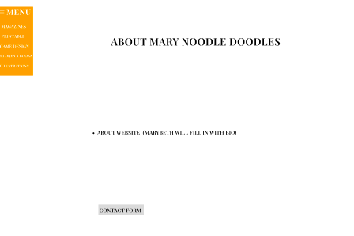
DRAFT 1 (Wire Frame)
Notes:
Portfolio Layout Overview :(DRAFT 1) (DISCONTUINED)
The Portfolio Layout is designed to provide users with an engaging overview of the artist's work while offering multiple ways to explore and connect. Key features of this layout include:
Artwork Overview: The page will feature a brief overview of the artist's body of work, providing visitors with an introduction to the style and themes used in the artwork. This section will give users a snapshot of the artist's creative journey and artistic identity.
"About Me" Section: Alongside the artwork overview, there will be a dedicated About Me section, where users can learn more about the artist’s background, influences, and creative process. This personal touch helps build a connection between the artist and the audience.
Multiple Categories: The portfolio will be organized into multiple categories, allowing users to easily navigate through different types of artwork. These categories will be accessible through a menu button, enabling visitors to quickly find the specific work they are most interested in.
Contact Information: The layout will also include an easy-to-find method for users to contact the artist for inquiries or work-related requests. This will ensure a seamless path for potential clients or collaborators to get in touch.
While this Portfolio Layout has been discontinued, the core elements would have provided users with a comprehensive and user-friendly way to engage with the artist’s portfolio.

Slide 12
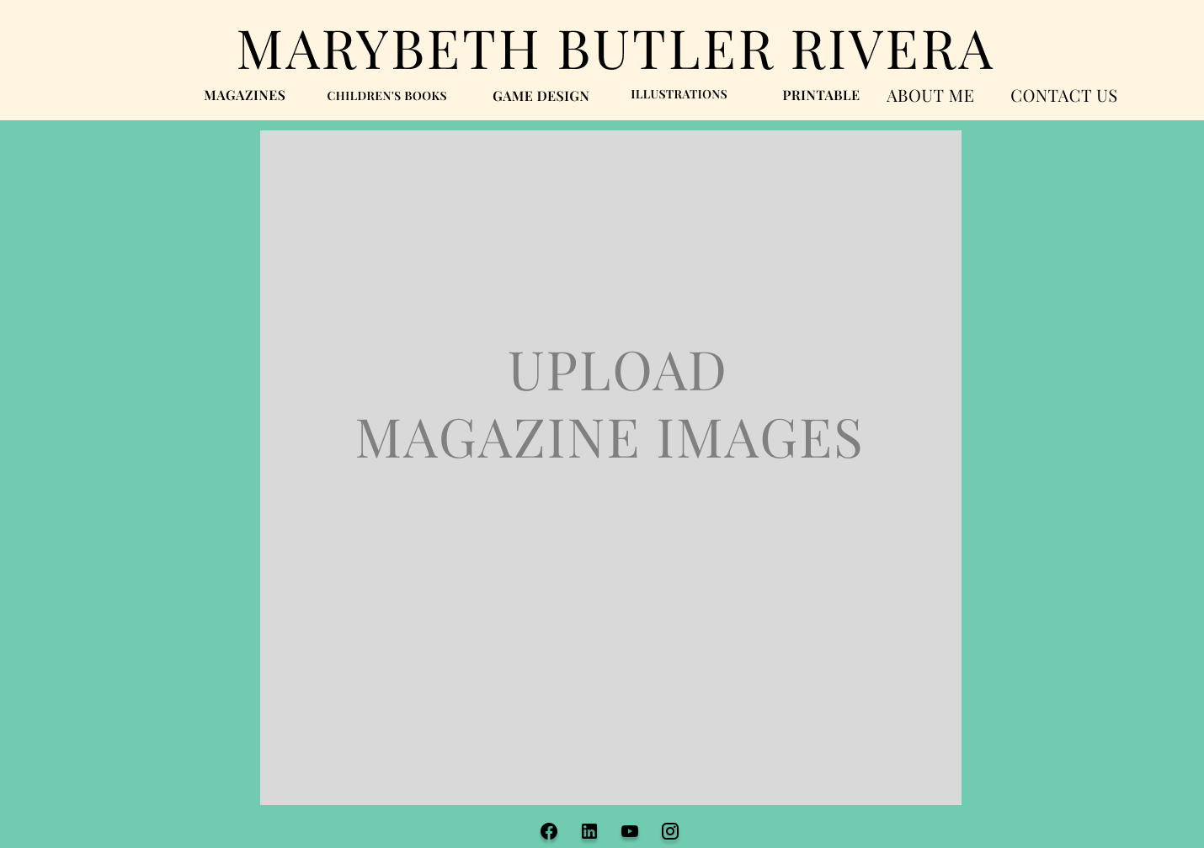
DRAFT 2 (Wire Frame)
Notes:
Category Layout Overview: (DRAFT 2)
Each category on the website will follow a consistent layout to maintain a cohesive and user-friendly experience. The key features of this layout include:
Visual Consistency: Every category will be visually structured in a similar format, ensuring a unified design throughout the site.
Relevant Imagery: Each category will feature images that directly correspond to the content or theme of that particular category. These images will enhance the visual appeal and help users quickly identify and engage with the content that interests them.
Interactive Image Experience: When a user clicks on any image within a category, the image will enlarge, allowing for a closer view. Along with an enlarged image, a brief description will appear, providing users with additional context or details about the image. This feature enhances the interactivity and informational value of the website.
This standardized and interactive approach ensures a seamless and engaging user experience while maintaining a visually appealing and informative design.

Slide 13
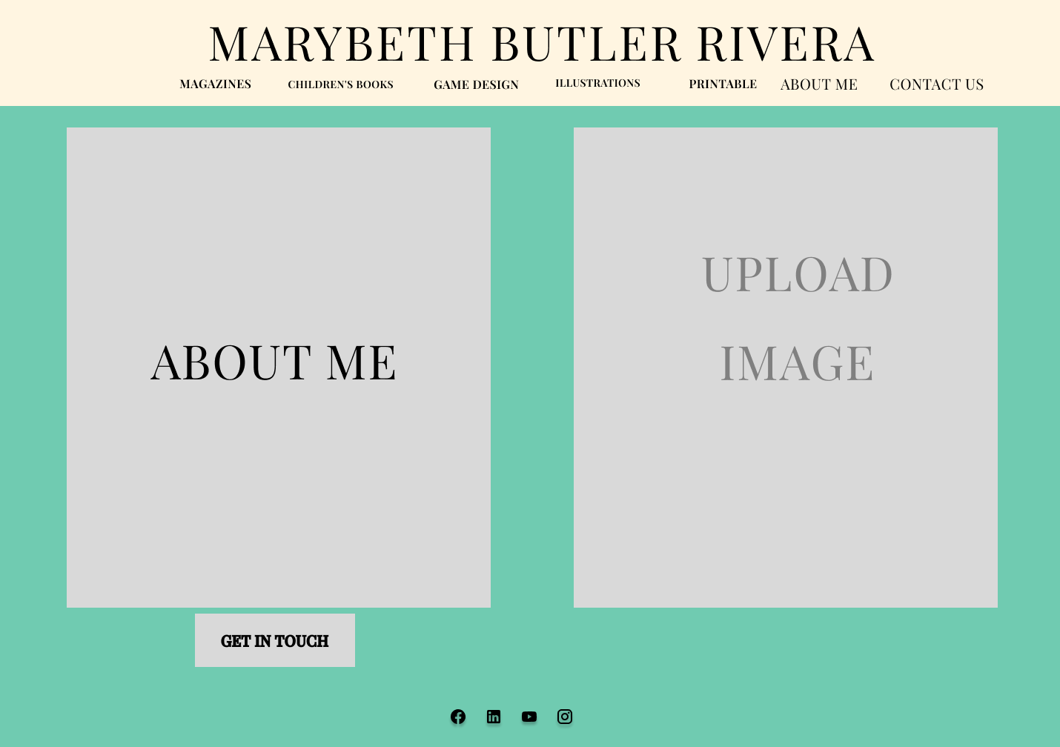
DRAFT 2 (Wire Frame)
Notes:
About Me Layout Overview: (DRAFT 2)
The About Me page will provide visitors with an engaging and concise introduction to the artist. Key features of this page include:
Artist's Description: The page will feature a brief yet informative description of the artist, highlighting their background, artistic journey, and creative process. This section will give visitors a deeper understanding of the artist's work and motivations.
Personalized Design: The layout will be designed to reflect the artist’s style and personality, creating a visual connection between the content and the artist's unique creative vision by showcasing one of their images they designed.
"Get in Touch" Button: At the end of the page, users will have the opportunity to engage further by clicking on a "Get in Touch" button. This button will guide users to the Contact page, where they can fill out an information form to initiate communication with the artist.
This About Me page will offer visitors an opportunity to connect with the artist on a more personal level while maintaining a clear, professional, and visually appealing presentation.

Slide 14
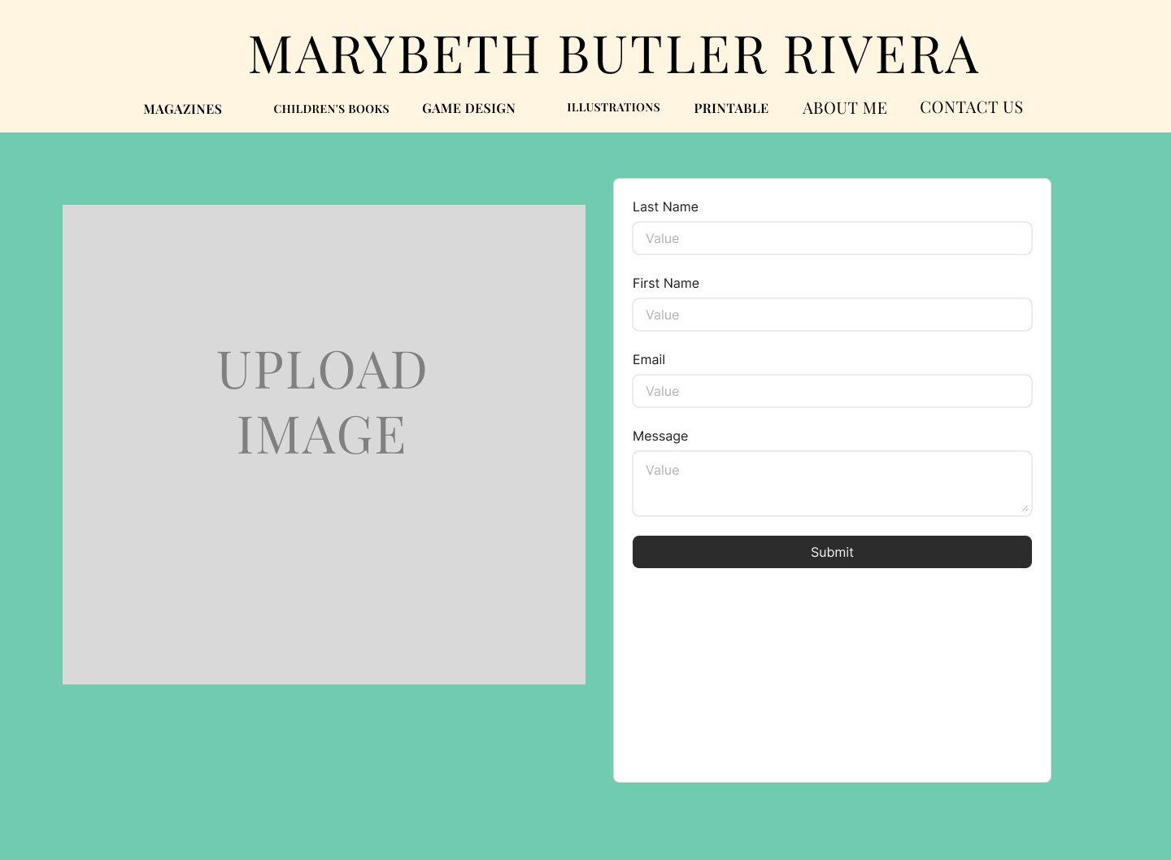
DRAFT 2 (Wire Frame)
Notes:
Contact Page Overview: (DRAFT 2)
The Contact page offers users a straightforward way to reach out and collaborate with the artist. Key features of this page include:
Contact Form: Users can easily fill out a contact form with the following fields: name, email address, subject, and a description of their inquiry. This form is designed to facilitate communication, especially for users interested in collaborating with the artist on projects.
Collaborative Intent: The form is tailored for users looking to initiate discussions about potential artistic collaborations, commissions, or inquiries, ensuring a focused and efficient means of communication.
Showcasing the Artist's Work: To make the page visually engaging, one of the artist's works will be displayed, giving users a glimpse into the artist’s style and creative output. This helps to create a deeper connection and reinforces the artist’s visual identity.
Backend Form Handling: Once the user submits the contact form, the information will be sent securely to the backend. The backend will process the form data by storing it in a database or sending it to the artist's email address for easy review.
EmailJS will be used to handle the email submission, ensuring that all inquiries are promptly delivered.
The backend will also include validation to ensure all required fields are filled out correctly before the form is submitted, reducing errors and improving the user experience.
All form submissions will be logged and tracked, allowing the artist to follow up on requests and manage ongoing collaborations efficiently.
Contact Page Overview:
The Contact page offers users a straightforward way to reach out and collaborate with the artist. Key features of this page include:
Contact Form: Users can easily fill out a contact form with the following fields: name, email address, subject, and a description of their inquiry. This form is designed to facilitate communication, especially for users interested in collaborating with the artist on projects or commissions.
Collaborative Intent: The form is tailored for users looking to initiate discussions about potential artistic collaborations, commissions, or inquiries, ensuring a focused and efficient means of communication.
Showcasing the Artist's Work: To make the page visually engaging, one of the artist's works will be displayed, giving users a glimpse into the artist’s style and creative output. This helps to create a deeper connection and reinforces the artist’s visual identity.
Backend Form Handling: Once the user submits the contact form, the information will be sent securely to the backend. The backend will process the form data by storing it in a database or sending it to the artist's email address for easy review.
EmailJS or a similar service will be used to handle the email submission, ensuring that all inquiries are promptly delivered.
The backend will also include validation to ensure all required fields are filled out correctly before the form is submitted, reducing errors and improving the user experience.
All form submissions will be logged and tracked, allowing the artist to follow up on requests and manage ongoing collaborations efficiently.
This Contact Page serves as a central point for initiating collaboration with the artist, ensuring smooth communication and providing visitors with a direct way to engage professionally.

Slide 15
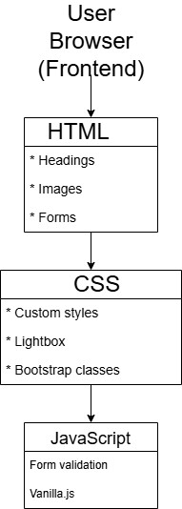
TOOLS USED
FRONTEND Tools
HTML:
Bootstrap.css
Lightbox.css
Google font (import)
CSS
Classes
Bootstrap.css
Lightbox.css
JavaScript
Vanilla
Notes:
Portfolio Layout Overview :(DRAFT 1) (DISCONTUINED)
The Portfolio Layout is designed to provide users with an engaging overview of the artist's work while offering multiple ways to explore and connect. Key features of this layout include:
Artwork Overview: The page will feature a brief overview of the artist's body of work, providing visitors with an introduction to the style and themes used in the artwork. This section will give users a snapshot of the artist's creative journey and artistic identity.
"About Me" Section: Alongside the artwork overview, there will be a dedicated About Me section, where users can learn more about the artist’s background, influences, and creative process. This personal touch helps build a connection between the artist and the audience.
Multiple Categories: The portfolio will be organized into multiple categories, allowing users to easily navigate through different types of artwork. These categories will be accessible through a menu button, enabling visitors to quickly find the specific work they are most interested in.
Contact Information: The layout will also include an easy-to-find method for users to contact the artist for inquiries or work-related requests. This will ensure a seamless path for potential clients or collaborators to get in touch.
While this Portfolio Layout has been discontinued, the core elements would have provided users with a comprehensive and user-friendly way to engage with the artist’s portfolio.

Slide 16
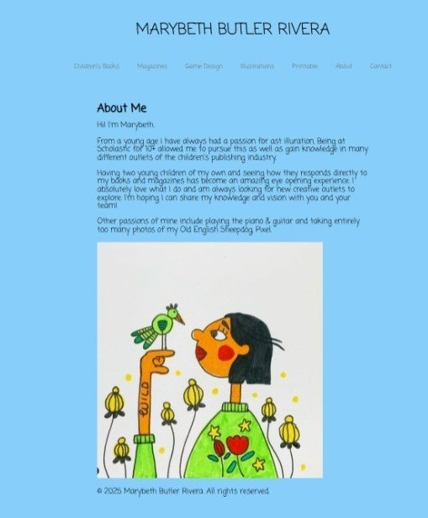
USER'S BROWSER (FRONTEND)
Notes:
About Me Layout Overview: (DRAFT 2)
The About Me page will provide visitors with an engaging and concise introduction to the artist. Key features of this page include:
Artist's Description: The page will feature a brief yet informative description of the artist, highlighting their background, artistic journey, and creative process. This section will give visitors a deeper understanding of the artist's work and motivations.
Personalized Design: The layout will be designed to reflect the artist’s style and personality, creating a visual connection between the content and the artist's unique creative vision by showcasing one of their images they designed.
"Get in Touch" Button: At the end of the page, users will have the opportunity to engage further by clicking on a "Get in Touch" button. This button will guide users to the Contact page, where they can fill out an information form to initiate communication with the artist.
This About Me page will offer visitors an opportunity to connect with the artist on a more personal level while maintaining a clear, professional, and visually appealing presentation.

Slide 17
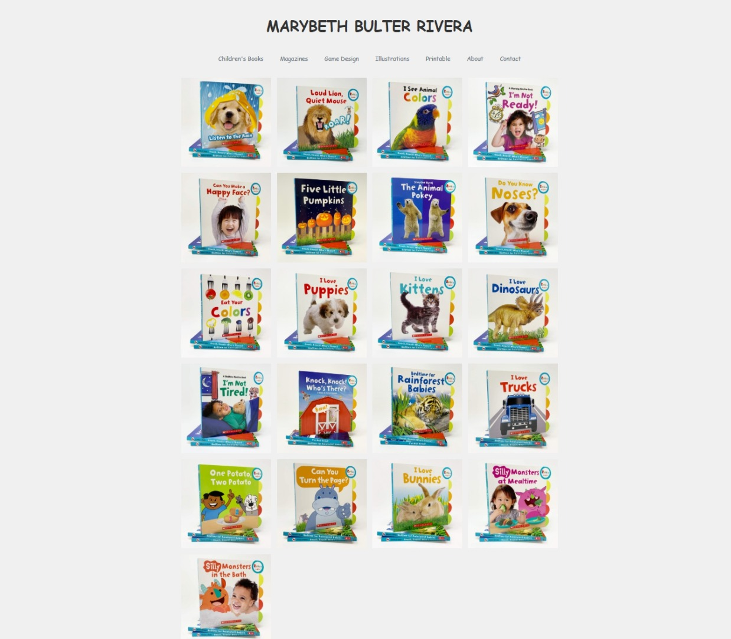
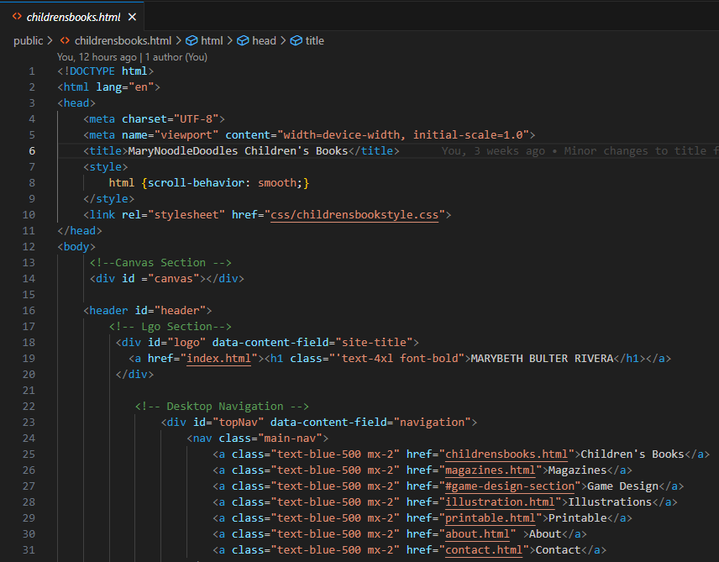
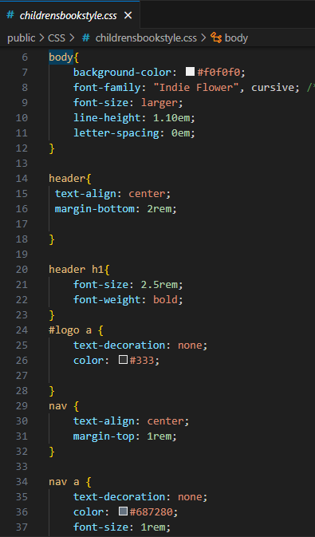
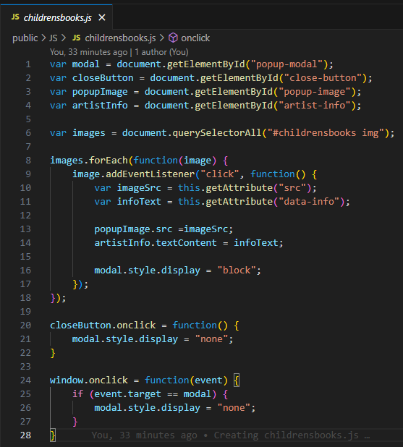
USER'S BROWSER (FRONTEND) DRAFT 1-2
HTML FILE
CSS FILE
JAVASCRIPT FILE
Notes:
Frontend (User Interface):
The Frontend (User Interface) of the Contact page is designed to offer users a seamless and interactive experience. With easy navigation and visually engaging elements, this page makes it simple for users to connect with the artist. Key features of the page include:
User-Friendly Navigation: Users can effortlessly navigate through the website by utilizing the navbar, which allows them to access different categories and sections. This intuitive navigation ensures that users can find their desired content with ease, enhancing the overall experience.
Interactive Image Gallery: One of the key features of the Contact page is the interactive image gallery. Users can click on the displayed images to access detailed information about each piece of artwork. This functionality adds a dynamic element to the page, inviting visitors to explore the artist's portfolio while maintaining a focus on the communication aspect of the site.
HTML, CSS, and JavaScript Integration: The Contact page is built with the following technologies to ensure a smooth and visually appealing user experience:
HTML provides the structure for the page, including the layout of the contact form, navigation elements, and the image gallery.
CSS enhances the visual design, ensuring that the page is both aesthetically pleasing and responsive. The styling reflects the artist’s unique brand identity, ensuring consistency across the site.
JavaScript adds interactivity to the page, particularly for the image gallery where users can click on images to view more details. JavaScript also helps to manage user interactions with the navbar and other dynamic elements of the page.

Slide 18
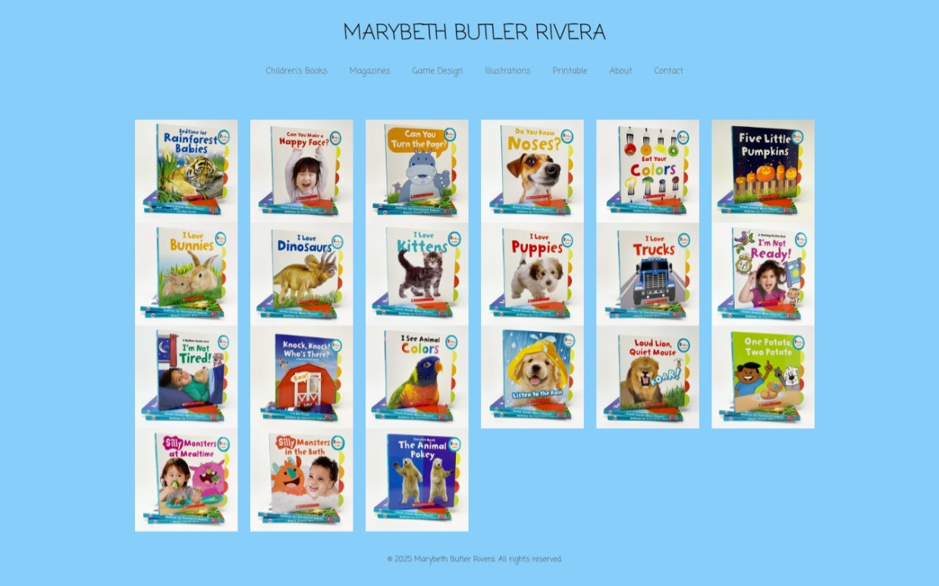
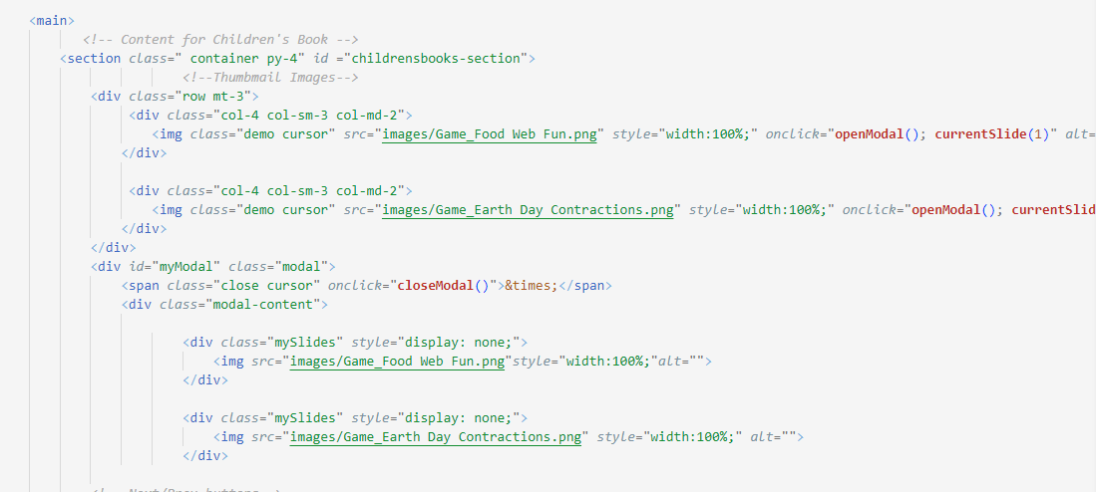
USER'S BROWSER (FRONTEND) final
Notes:
Welcome Page Layout Overview :(DRAFT 1) (DISCONTUINED)
The Welcome Page is designed to provide users with easy access to the artist’s portfolio, offering a clear and structured way to navigate through different categories of work. Key features of this layout include:
Portfolio Access: Users will be able to click on the Portfolio button, which will lead them to a page showcasing all the artist's work.. This organized structure allows visitors to explore various types of artwork in a way that is intuitive and engaging.
Navigation Between Categories: Once on the portfolio page, users can navigate through individual categories, making it simple to explore the full range of the artist’s work. Each category will be clearly labeled and contain relevant pieces, giving users a smooth browsing experience.
Social Media Links: In addition to viewing the artist's work, users will also have the opportunity to easily navigate to the artist’s social media profiles. Social media links will be prominently displayed, enabling users to connect with the artist on different platforms and stay updated with new projects and releases.
This Welcome Page ensures a user-friendly and interactive experience, making it easy for visitors to explore the artist’s portfolio while also connecting with them on social media.

Slide 19
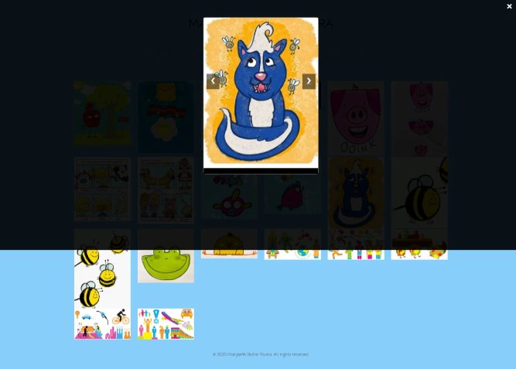
USER'S Interaction (FRONTEND) final
The pervoius code is bootstrap(Thumbnail) a responsive image gallery. It displays in a grid layout, and when clicked, they open a modal showing a larger version of the image. The modal includes next/previous arrows to navigate between slides, using JavaScript functions to control which image is visible. This provides a clean, interactive viewing experience without leaving the page
Notes:
Category Layout Overview: (DRAFT 2)
Each category on the website will follow a consistent layout to maintain a cohesive and user-friendly experience. The key features of this layout include:
Visual Consistency: Every category will be visually structured in a similar format, ensuring a unified design throughout the site.
Relevant Imagery: Each category will feature images that directly correspond to the content or theme of that particular category. These images will enhance the visual appeal and help users quickly identify and engage with the content that interests them.
Interactive Image Experience: When a user clicks on any image within a category, the image will enlarge, allowing for a closer view. Along with an enlarged image, a brief description will appear, providing users with additional context or details about the image. This feature enhances the interactivity and informational value of the website.
This standardized and interactive approach ensures a seamless and engaging user experience while maintaining a visually appealing and informative design.

Slide 20
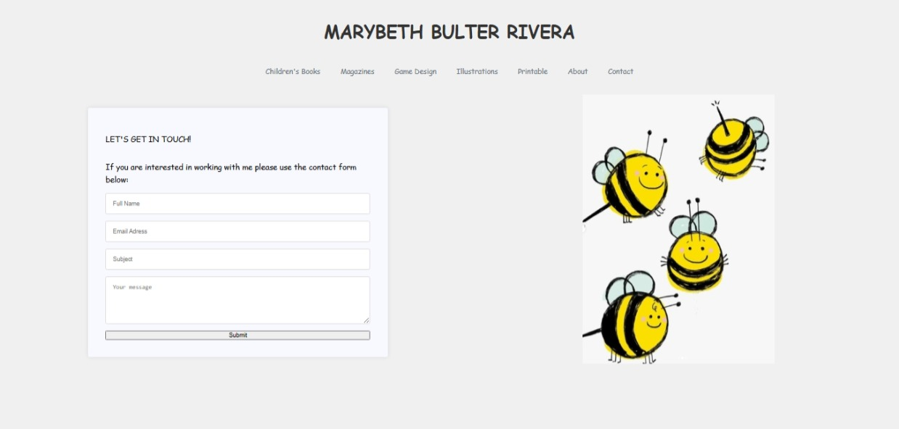
USER'S Interaction (FRONTEND/Backend) DRAFT 1-2
PENIDNG:
Will be working on back-end work for user submissions to form (will be using node js)
Notes:
Form Submission

Slide 21
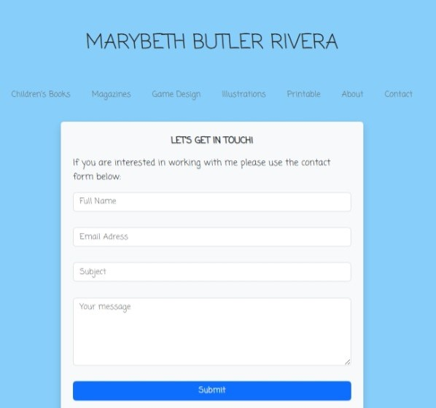
USER'S Interaction (FRONTEND/ Backend) final
Notes:
Portfolio Layout Overview :(DRAFT 1) (DISCONTUINED)
The Portfolio Layout is designed to provide users with an engaging overview of the artist's work while offering multiple ways to explore and connect. Key features of this layout include:
Artwork Overview: The page will feature a brief overview of the artist's body of work, providing visitors with an introduction to the style and themes used in the artwork. This section will give users a snapshot of the artist's creative journey and artistic identity.
"About Me" Section: Alongside the artwork overview, there will be a dedicated About Me section, where users can learn more about the artist’s background, influences, and creative process. This personal touch helps build a connection between the artist and the audience.
Multiple Categories: The portfolio will be organized into multiple categories, allowing users to easily navigate through different types of artwork. These categories will be accessible through a menu button, enabling visitors to quickly find the specific work they are most interested in.
Contact Information: The layout will also include an easy-to-find method for users to contact the artist for inquiries or work-related requests. This will ensure a seamless path for potential clients or collaborators to get in touch.
While this Portfolio Layout has been discontinued, the core elements would have provided users with a comprehensive and user-friendly way to engage with the artist’s portfolio.

Slide 22
TROUBLES (FRONTEND)
I faced challenges with adjusting images for consistent display across different screen sizes, ensuring they were properly scaled and centered. Maintaining design consistency across pages was also difficult, as aligning text and elements required careful attention. Additionally, managing CSS classes and Bootstrap columns posed issues, often leading to layout shifts or broken responsiveness. These challenges highlighted the importance of careful layout planning and reusable class structures.
.modal-content {
margin: auto;
display: block;
width: 90%;
max-width: 400px;
background-color: #fefefe;
border: 1px solid #888;
border-radius: 8px;
}
<div class="col-4 col-sm-3 col-md-2">
<div class="modal-content">
Notes:
Backend (Server-side functionality)

Slide 23
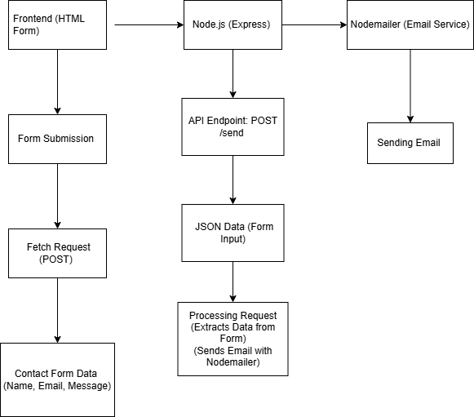
TOOLS USED for the form (frontend & backend)
Notes:
Form Submission

Slide 24
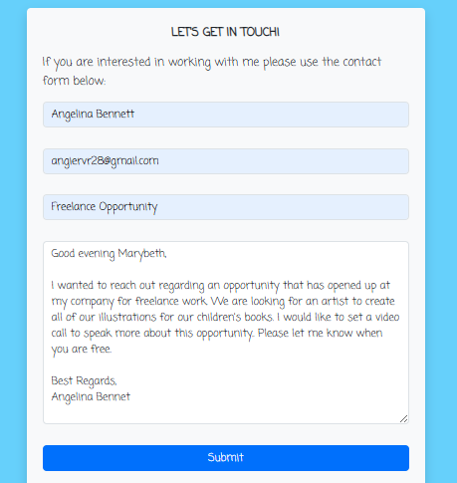
FORM ACTION (FRONTEND/BACKEND)
On the frontend, the user will interact with a contact form. They will ask to fill out their full name, email, a subject, and a message text. This form was designed to collect the necessary information for the stakeholder to reach out. Once submitted, the form data is sent to the backend, where it is processed and emailed to the stakeholder. If there is any issue the backend will reply with an unsuccessful message
Notes:
Contact Page Overview: (DRAFT 2)
The Contact page offers users a straightforward way to reach out and collaborate with the artist. Key features of this page include:
Contact Form: Users can easily fill out a contact form with the following fields: name, email address, subject, and a description of their inquiry. This form is designed to facilitate communication, especially for users interested in collaborating with the artist on projects.
Collaborative Intent: The form is tailored for users looking to initiate discussions about potential artistic collaborations, commissions, or inquiries, ensuring a focused and efficient means of communication.
Showcasing the Artist's Work: To make the page visually engaging, one of the artist's works will be displayed, giving users a glimpse into the artist’s style and creative output. This helps to create a deeper connection and reinforces the artist’s visual identity.
Backend Form Handling: Once the user submits the contact form, the information will be sent securely to the backend. The backend will process the form data by storing it in a database or sending it to the artist's email address for easy review.
EmailJS will be used to handle the email submission, ensuring that all inquiries are promptly delivered.
The backend will also include validation to ensure all required fields are filled out correctly before the form is submitted, reducing errors and improving the user experience.
All form submissions will be logged and tracked, allowing the artist to follow up on requests and manage ongoing collaborations efficiently.
Contact Page Overview:
The Contact page offers users a straightforward way to reach out and collaborate with the artist. Key features of this page include:
Contact Form: Users can easily fill out a contact form with the following fields: name, email address, subject, and a description of their inquiry. This form is designed to facilitate communication, especially for users interested in collaborating with the artist on projects or commissions.
Collaborative Intent: The form is tailored for users looking to initiate discussions about potential artistic collaborations, commissions, or inquiries, ensuring a focused and efficient means of communication.
Showcasing the Artist's Work: To make the page visually engaging, one of the artist's works will be displayed, giving users a glimpse into the artist’s style and creative output. This helps to create a deeper connection and reinforces the artist’s visual identity.
Backend Form Handling: Once the user submits the contact form, the information will be sent securely to the backend. The backend will process the form data by storing it in a database or sending it to the artist's email address for easy review.
EmailJS or a similar service will be used to handle the email submission, ensuring that all inquiries are promptly delivered.
The backend will also include validation to ensure all required fields are filled out correctly before the form is submitted, reducing errors and improving the user experience.
All form submissions will be logged and tracked, allowing the artist to follow up on requests and manage ongoing collaborations efficiently.
This Contact Page serves as a central point for initiating collaboration with the artist, ensuring smooth communication and providing visitors with a direct way to engage professionally.

Slide 25
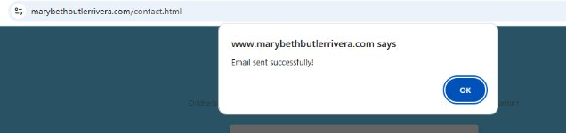
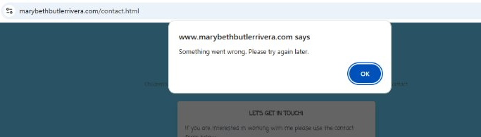
RESPONE SENT (FRONTEND/BACK)
Successful Message
Unsuccessful Message

Slide 26
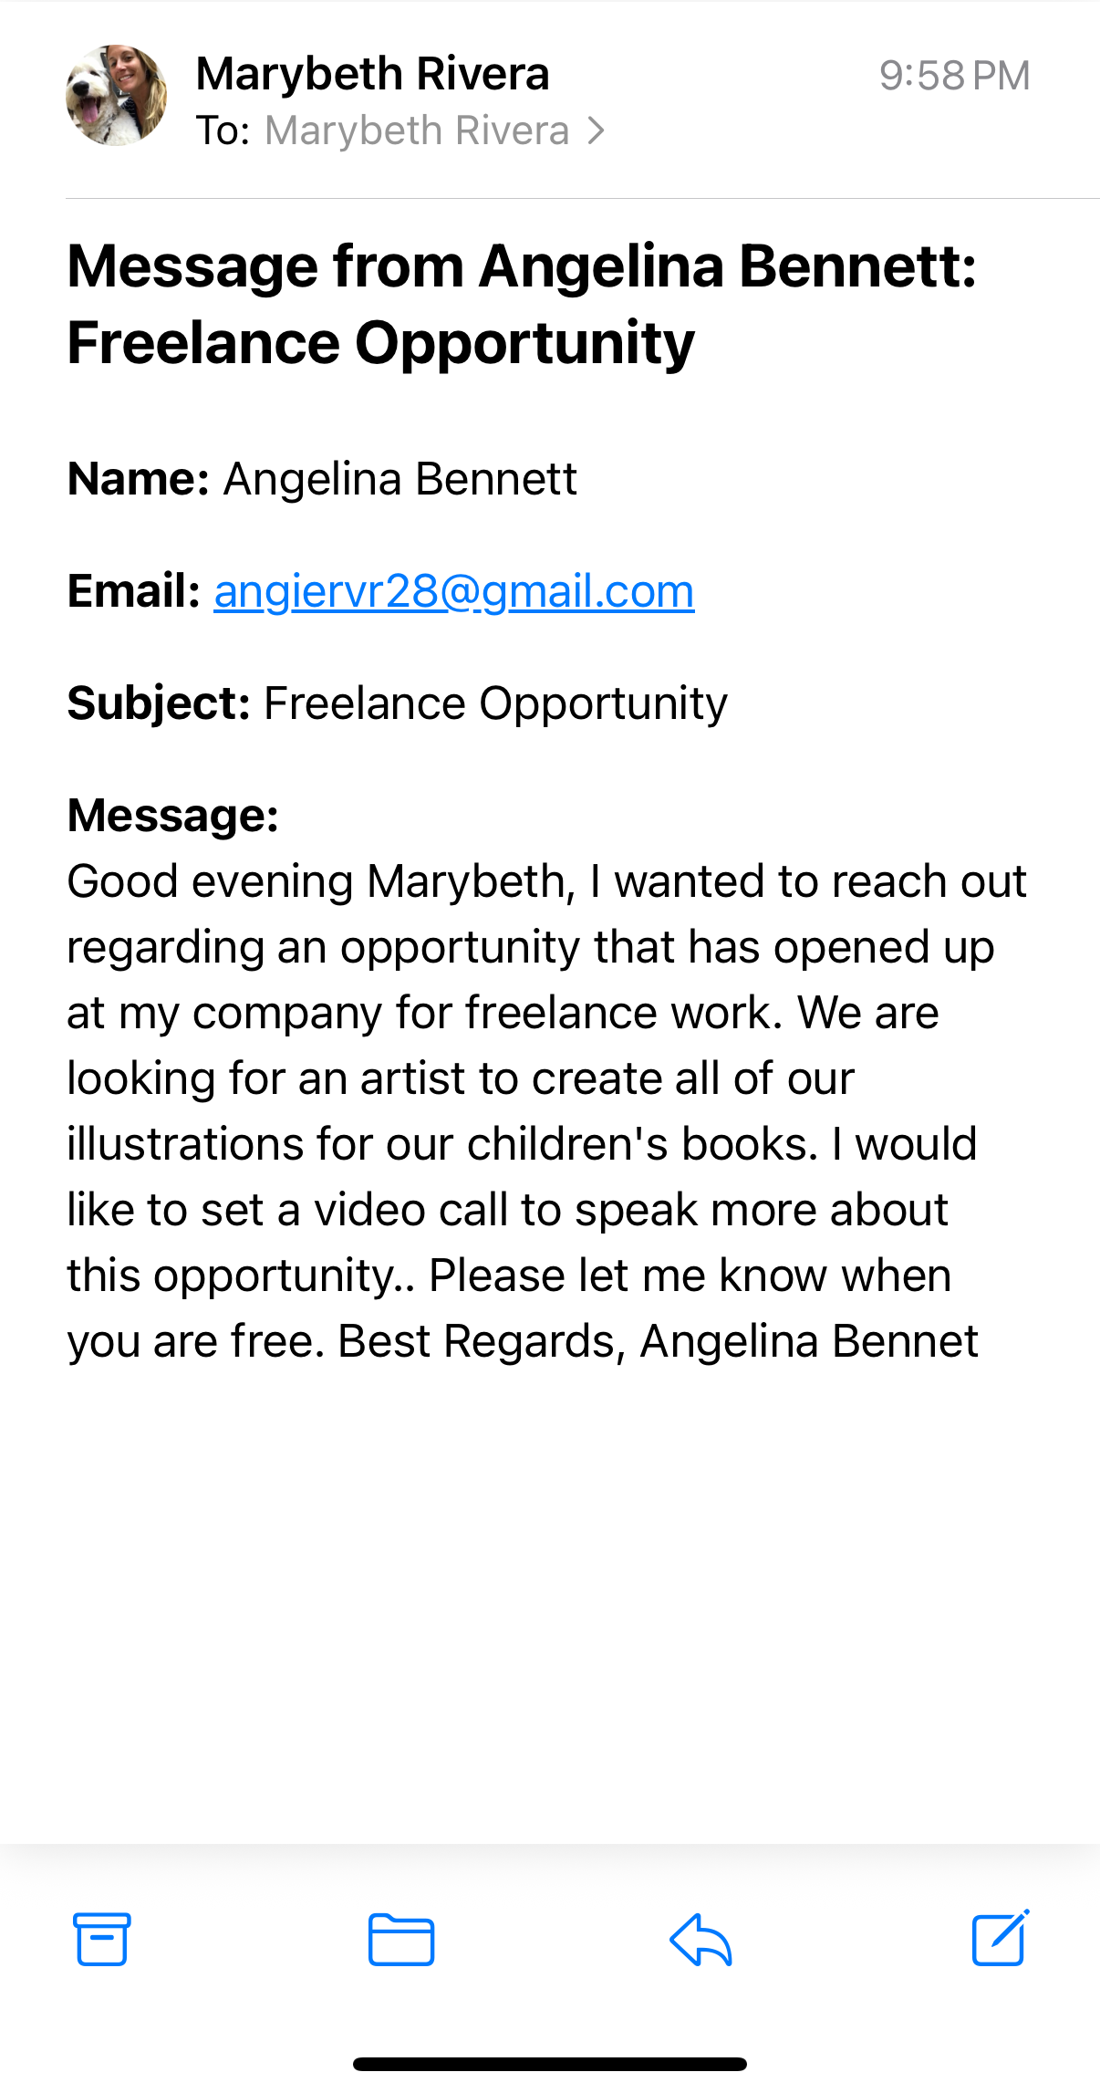
Receivers view
When the form is submitted, Marybeth will get the message in her Gmail inbox. Due to Gmail having security rules, we had to set up authentication to allow the site to send emails. This helps keep the process safe and ensures the email gets delivered properly.
Notes:
Frontend (User Interface):
The Frontend (User Interface) of the Contact page is designed to offer users a seamless and interactive experience. With easy navigation and visually engaging elements, this page makes it simple for users to connect with the artist. Key features of the page include:
User-Friendly Navigation: Users can effortlessly navigate through the website by utilizing the navbar, which allows them to access different categories and sections. This intuitive navigation ensures that users can find their desired content with ease, enhancing the overall experience.
Interactive Image Gallery: One of the key features of the Contact page is the interactive image gallery. Users can click on the displayed images to access detailed information about each piece of artwork. This functionality adds a dynamic element to the page, inviting visitors to explore the artist's portfolio while maintaining a focus on the communication aspect of the site.
HTML, CSS, and JavaScript Integration: The Contact page is built with the following technologies to ensure a smooth and visually appealing user experience:
HTML provides the structure for the page, including the layout of the contact form, navigation elements, and the image gallery.
CSS enhances the visual design, ensuring that the page is both aesthetically pleasing and responsive. The styling reflects the artist’s unique brand identity, ensuring consistency across the site.
JavaScript adds interactivity to the page, particularly for the image gallery where users can click on images to view more details. JavaScript also helps to manage user interactions with the navbar and other dynamic elements of the page.

Slide 27

Project Break down
Phase 1: (COMPLETED)
Use Figma (build a layout)
Get approval and adjust changes as need
Create HTML/CSS
Phase 3: (COMPLETED)
Backend Integration of contact form
Uploading/ working on Host/ domain website
Phase 4: (COMPLETED)
Social media links
TEST
Phase 2: (COMPLETED)
Finalize HTML/ CSS
Create a domain name (Hosting)
Notes:
Project Breakdown Overview:
The Project Breakdown is structured into four distinct phases, each designed to ensure effective project management and smooth progress tracking. This breakdown will provide clarity and control over the development process. The key elements of this approach include:
Four Phases: The project is divided into four phases(Wire Frame , Frontend, Backend, Testing) to help streamline development, allocate time effectively, and track progress at each step. This phased approach ensures that the work is manageable, organized, and completed in a timely manner.
Clear Task Management: Each phase is carefully planned, outlining specific tasks and milestones to be achieved. This allows for a clear overview of the current state of the project, ensuring that nothing is overlooked and that all aspects are on track.
In essence, this Project Breakdown provides a clear roadmap for the successful completion of the project, ensuring a streamlined workflow and efficient management of all tasks.

Slide 28
TENTATIVE schedule (DRAFT 1-2)
WEEK | TASK | DURATION
Week 1 | Finalizing project scope, gathering requirements from MaryBeth, and initial wireframe designs | 1 week
Week 2 | Phase 1-2: Frontend design(HTML, CSS) and layout development (React)/create a domain | 2 weeks
Week 3 | Phase 1-2: Frontend design(HTML, CSS) and layout development (React) /create a domain | 2 weeks
Week 4 | Test Phase 1-2 | 1 week
Week 5 | Prepare demo 1 for supervisor / Record Demo 1 w/ live Presentation | 1 week
Week 6 | Phase 3-4: Backend/Integration of contact form, social media links, and SEO setup | 2 weeks
Week 7 | Phase 3-4: Backend Integration of contact form, social media links, and SEO setup | 2 weeks
Week 8 | Test Phase 3-4 | 1 week
Week 9 | Prepare demo 2 for supervisor / Record Demo 2 w/ live Presentation | 1 week
Week 10 | Final Test / Final Recording | 1 week
Week 11 | Final Presentation Slides | 1 week
Week 12 | Final look over and Submit | 1 week
Notes:
Tentative Project Schedule:
The project is organized into weekly milestones, ensuring a structured and efficient approach to completing all tasks on time. Below is the breakdown of each week’s focus and deliverables:
Week 1: Finalizing Project Scope & Gathering Requirements
Meet with MaryBeth to gather all necessary requirements.
Finalize the overall project scope.
Begin initial wireframe designs for the website
Duration: 1 week
Week 2: Phase 1-2: Frontend Design & Layout Development
Begin frontend development with HTML and CSS to structure and style the website.
start React development for dynamic layout creation.
Set up a domain name for the website.
Duration: 2 weeks
Week 3: Phase 1-2: Frontend Design & Layout Development
Continue frontend design and layout development, refining and testing HTML, CSS, and React components.
Continue working on the domain and initial deployment tasks.
Duration: 2 weeks
Week 4: Testing Phase 1-2
Conduct thorough testing of the completed frontend design, layout, and functionality.
Ensure that the site is responsive and meets the requirements of the initial wireframes.
Duration: 1 week
Week 5: Prepare & Record Demo 1
Prepare Demo 1 for supervisor, showcasing progress on the project so far.
Record Demo 1 with a live presentation to demonstrate the frontend functionality and design.
Duration: 1 week
Week 6: Phase 3-4: Backend Development & Integration
Begin backend development, focusing on contact form integration, social media link setup, and SEO optimizations.
Start working on integrating the backend with the frontend.
Duration: 2 weeks
Week 7: Phase 3-4: Backend Integration & SEO Setup
Continue backend work and refine the integration of the contact form, social media links, and SEO elements.
Ensure proper functionality and communication between frontend and backend systems.
Duration: 2 weeks
Week 8: Testing Phase 3-4
Conduct thorough testing of backend functionalities and integrations.
Test the contact form, social media links, and SEO setup to ensure everything works correctly.
Duration: 1 week
Week 9: Prepare & Record Demo 2
Prepare Demo 2 for the supervisor, showcasing the completed backend and integrations.
Record Demo 2 with a live presentation to demonstrate the full functionality of the website.
Duration: 1 week
Week 10: Final Test & Final Recording
Perform the final round of testing on the complete website.
Record the final demo and prepare for the official presentation.
Duration: 1 week
Week 11: Final Presentation Slides
Prepare and refine the final presentation slides for the project, showcasing the completed website and its features.
Duration: 1 week
Week 12: Final Review & Submission
Conduct a final review of the project, ensuring everything is complete and polished.
Submit the final project deliverables to the supervisor.
Duration: 1 week

Slide 29
possibility OF Change
Use an array for image data (I might change my code to clean it up a little more since there are more images to come)
Include react.js for speed
Domain will expire 2027, stakeholder might change from GoDaddy.
Notes:
Backend (Server-side functionality)

Slide 30
COMING SOON /Goals
FRONTEND / Backend draft 1-2
Pending:
Looking to add a login in for stakeholder's use only (This will allow the stakeholder to upload any future images) {FIREBASE}
Notes:
Backend (Server-side functionality)

Slide 31
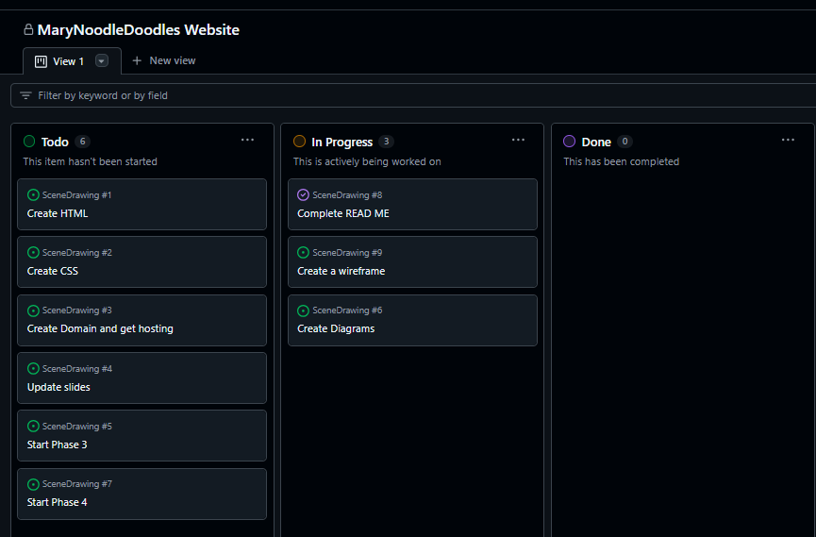
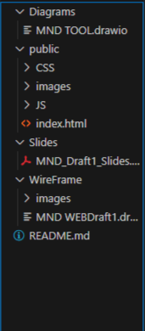
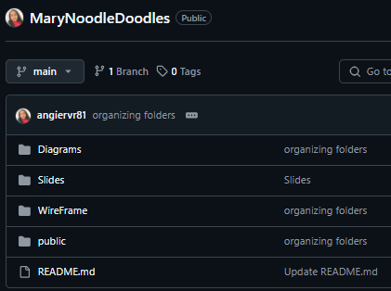
Version Control
Links to Repository & Management Tools
Repository Link: https://github.com/angiervr81/MaryNoodleDoodles.git
Project Management Link::View 1 · MaryNoodleDoodles Website
Project Mangement
Repository Layout
Notes:
Links to Repository & Management Tools:
This slide provides direct access to the project’s repository and management tools, ensuring smooth collaboration and easy access to all project files.
Repository Link:
The project’s source code and files are hosted on GitHub. You can access the full repository here: MaryNoodleDoodles GitHub Repository
This repository contains all the code, documentation, and version control history for the website project, enabling collaboration and tracking changes throughout development.
Project Management Link: Access the project management board where tasks are tracked, milestones are defined, and progress is monitored. You can view and manage tasks at: [MaryNoodleDoodles Project Management Board])View 1 · MaryNoodleDoodles Website
This link leads to the project management tool, which helps organize tasks, milestones, and deadlines to ensure efficient project execution.

