Slide 1
should future variability modeling languages express constraints in ocl?
Don Batory
Department of Computer Science University of Texas at Austin
September 2019

Slide 2
No!
The End

Slide 3

not altogether my idea, unfortunately…
I thank a referee of my paper for the humor of my introduction

Slide 4
seriously, no.
MDE tooling has long been a problem
Ideas behind OCL (Object Constraint Language) are good
design dreadful – nothing simple or elegant about it
OMG definition is 246 pages…
OCL is pfft…
So what?
This workshop is on the future of variability languages
And next generation Feature Modeling Languages
Do I know what the future holds in this area?
No!

Slide 5
next generation feature models
I do know that NGFMs will support:
Features with attributes
Numerical features
Numerical constraints
Feature replication….
I recoiled at recent attempts
CVL (Common Variability Language) – used OCL for constraints…
Don’t know the answer, I do know answer should be guided by 3 principles…

Slide 6
principle #1: simplicity!
Propositional Logic was chosen for classical FM constraints because it was a simple mathematical standard
Not sure there is a formal language for it; bottom line: hard to screw-up writing prop-logic constraints
Ideally NGFM constraints should be simple to write

Slide 7
principle #2: don’t invent, reuse!
Do we really need a new constraint language for next generation FMs?
Clearly we need more than prop-logic
But are we good enough as language engineers to create a new constraint language without making a complete mess of it?
authors of OCL were not experts in language engineering…
Our expertise is in product line engineering, not language engineering!
No!

Slide 8
principle #3: circularity avoidance
As soon as we generalize beyond hierarchical relationships of classical FMs means we are not far away from UML class diagrams and MDE meta-models (= class diagram + constraints)
Begs the use of OCL, and we’re back to square one…
Let me show you some recent work that could get us out of this mess
It may not be needed for next generation FMs
Or it might… I don’t know

Slide 9
aocl
Aocl is based on allegories, a branch of category theory with powerset domains
That’s its origin. Took me about 4-years to put it all together
The core of OCL is relational algebra
with customized names for right-semijoins.
written in OO syntax
This language is Aocl; implemented in pure Java.
Print employees named ‘don’
Emp
Print employees named ‘don’
Emp.select(t->t.name.equals(“don”))
Print employees named ‘don’
Emp.select(t->t.name.equals(“don”)).print();
Print employees that work in book department(s)
Dep
Print employees that work in book department(s)
Dep.select(t->t.name.equals(“book”))
Print employees that work in book department(s)
Dep.select(t->t.name.equals(“book”)).hasEmps()
Print employees that work in book department(s)
Dep.select(t->t.name.equals(“book”)).hasEmps().print()

Slide 10
more queries
Find divisions in which ‘don’ works
Emp.
Find divisions in which ‘don’ works
Emp.select(e->e.name.equals(“don”))
Find divisions in which ‘don’ works
Emp.select(e->e.name.equals(“don”)).worksIn()
Find divisions in which ‘don’ works
Emp.select(e->e.name.equals(“don”)).worksIn().inDiv()
Find divisions in which ‘don’ works
Emp.select(e->e.name.equals(“don”)).worksIn().inDiv().print();

Slide 11
more queries
Find division colleagues of ‘priscila’
Emp.select(e->e.name.equals(“priscila”))
Find division colleagues of ‘priscila’
Emp.select(e->e.name.equals(“priscila”))
.worksIn()
Find division colleagues of ‘priscila’
Emp.select(e->e.name.equals(“priscila”))
.worksIn().inDiv()
Find division colleagues of ‘priscila’
Emp.select(e->e.name.equals(“priscila”))
.worksIn().inDiv().hasDept()
Find division colleagues of ‘priscila’
Emp.select(e->e.name.equals(“priscila”))
.worksIn().inDiv().hasDept().employs()
Find division colleagues of ‘priscila’
Emp.select(e->e.name.equals(“priscila”))
.worksIn().inDiv().hasDept().employs().print();

Slide 12

constraints
Every Dep in Toronto must hire workers 19 and older
Dep.select(d->d.city.equals(“toronto”))
.forEach(d->d.employs().select(e->e.age<19)
.error(“%s illegally hired %s”, e->d.name, e->e.name));
aocl
provides
better
error
reporting
than just
yes/no

Slide 13

how does aocl work?
Aocl is a plug-in to a Java framework
You draw or write your class diagram and tools generate the plugin
You then write your queries and constraints
classDiagram ed.
table(Emp,[name,age:int,education]).
table(Dep,[name,nEmps:int]).
Assoc : Dep worksin BLACK_DIAMOND
-> Emp hasEmps BLANK.

Slide 14
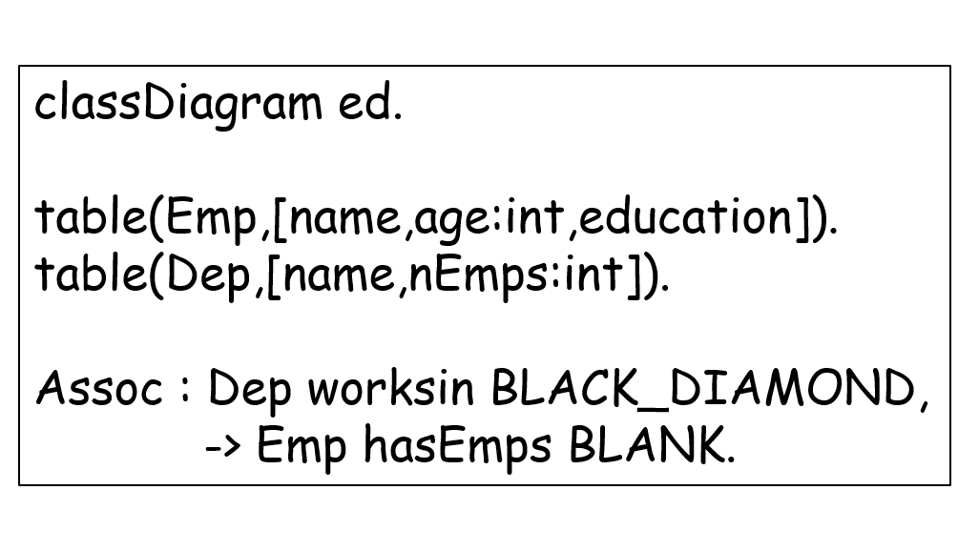
from this mde tools produce
Emp class (instances are tuples)
EmpTable class (instances are tables of Emps)
Dep class (instances are tuples)
DepTable class (instances are tables of Deps)
Database class (instances are ed databases)
Database schema** for main-memory MDE tools called MDELite

Slide 15
benefits
Pure Java
Use Pure Java IDE
No special parser
Lower overhead to adopt
Lower overhead to learn
Lower overhead to maintain

Slide 16
aocl almost available now at my web page!
Announcements!
Am seeking partners to run an empirical experiment on using OCL vs Aocl
Interest, anyone? See me afterwards…
Discusses AOCL and much more
Free to Students & Faculty

Slide 17
The End

