Slide 1


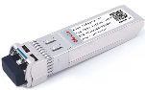
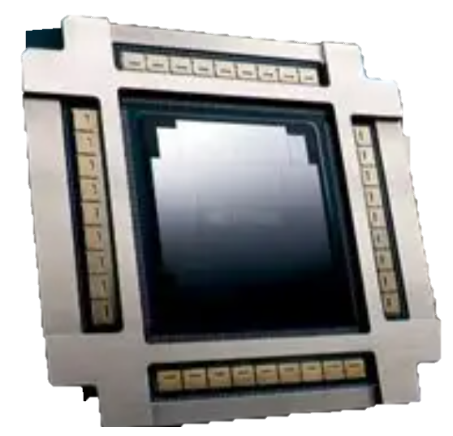
Tech
Market
Why
What
Where
Sizing
Value Chain
Players
The power issue in the copper-to-optical migration is cut significantly by CPO
Power consumption: Copper, Pluggable, and CPO
Pluggable Optics (PO): Entered mass production in 2014. ​
Copper to pluggable: 50% power consumption increase, accounting for 7.4% of GB200 NVL72 card power².
​Pluggable to CPO: ~40% system-level power cut³; 5- mn RMB/y saved for 10k-card cluster².
Power (W per 800G port)
Short reach
(≤ 5 m)
Direct Attach Copper Cable (DAC¹)
< 0.1
Copper
Active Electrical Cable
(AEC¹)
Long reach
(> 5 m)
PO
Optical
CPO
Source: LightCounting, Nvidia, Broadcom.
Note 1: The transmission reach of DAC is less than 2 meters. AEC integrates signal enhancement chips (re-timer) to extend the reach (5 meters) using more power.
Note 2: Consider GB200 NVL72 cluster with 9,216 B200 GPUs with 2-layer interconnect.
Note 3: At the 2025 Optica Executive Forum held in March, Broadcom demonstrated power savings of CPO in full 64-port system tests.
Notes:
现有功耗数据是单模，单模是趋势
800G AEC 10W（5m），5W有可能是half架构
单模是未来趋势，多模速率难提升（224G）
功耗测算逻辑：
9216 GPU -> 9216 800G光模块 + 14400 1.6T光模块
光模块->CPO的系统级功耗节约（考虑交换机）：800G 22W，1.6T 48W （）
总功耗节约：900 kW
年电费节约：5.5 mn RMB

