Slide 1
GO/HPO
Porcelli Angelica - 78083A
Roveda Gianluca - 73814A
Stefanelli Marta - 84393A

Slide 2
WORK FLOW
0.
1.
2.
3.
4.
5.
6.
7.
8.
The dataset
Feature selection
Jaccard function
TF - IDF
Three different views and HPO
Similar Network Fusion
HDBSCAN and UMAP clusters
Cluster analysis
Final analysis

Slide 3
DATASET
Biological Process
Dataset of gene, with four different binary representation:
CC = Cellular Component.
MF = Molecular Function.
BP = Biological Process.
HPO = Phenotype.
Molecular Function
Cellular Component

Slide 4
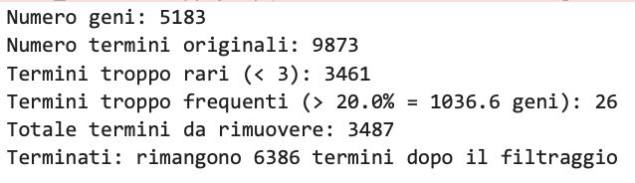

FEATURE SELECTION
Frequency filtering
Removes terms that annotate < 3 genes
Removes terms present in > 20% of genes
Eliminates both overly frequent and overly rare terms.
Redundant column removal
Uses Jaccard on sparse matrices
Removes quasi-identical columns (Jaccard ≥ 0.9)

Slide 5
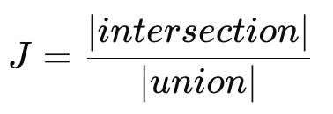
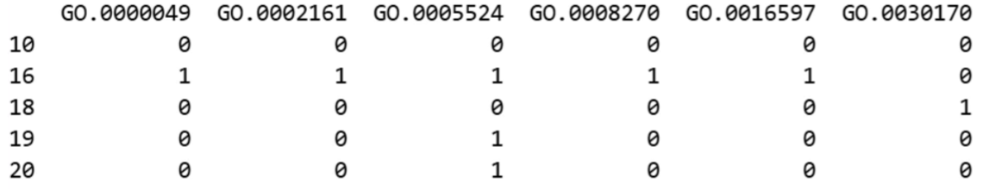
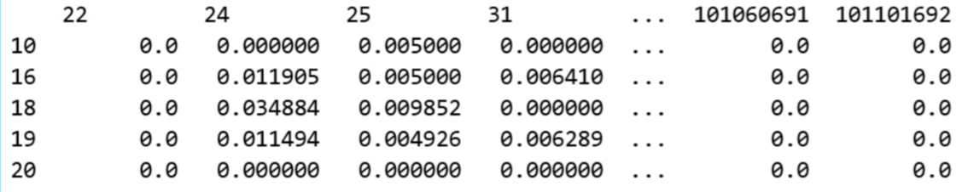
SINGLE JACCARD FUNCTION
For each view, it takes a matrix and uses the Jaccard index to build the similarity matrices for each view.
Input
Output

Slide 6
TF - IDF
Converts the gene × term matrix into sparse (CSR) format.
Computes the document frequency (df_j) for each term.
Computes IDF = log(N / df_j)
Weights each term using TF-IDF (IDF only, since TF = 1/0)
Output:
TF-IDF matrix (gene × term)
IDF vector for the terms
Goal: reduce the importance of very frequent terms and increase that of rare terms → more informative signals.

Slide 7
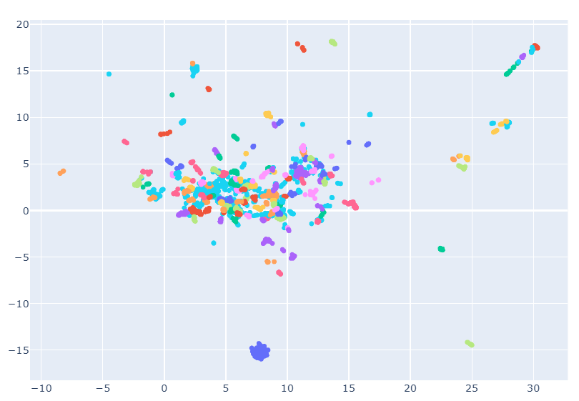
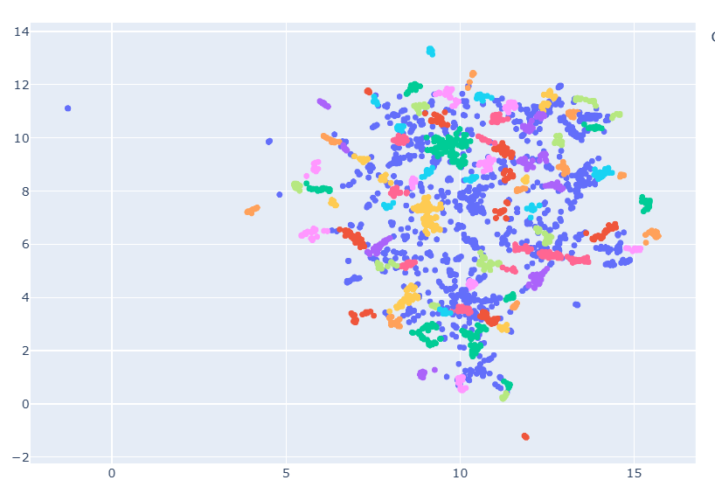
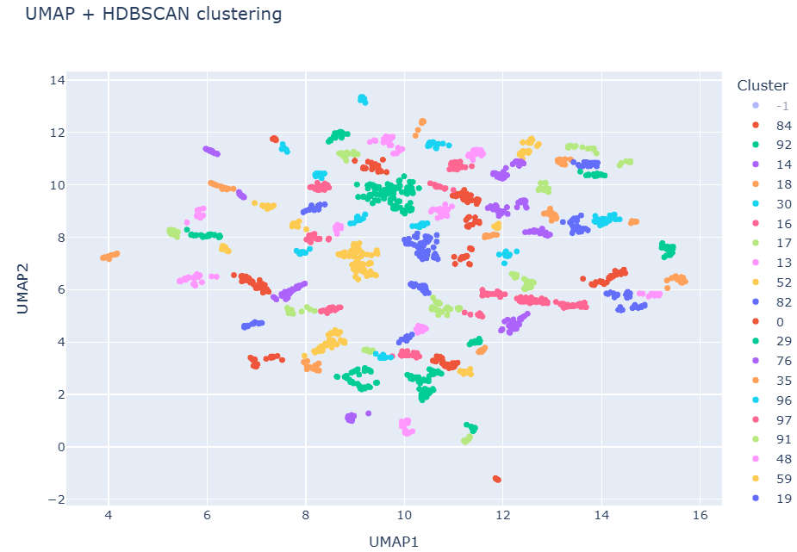
THREE DIFFERENT VIEWS
1
2
CC CLUSTERS
3
========= MATRIX: CC =========
N genes: 5183
N terms: 1478
Input: 3248 × 882
Clusters: 98, noise points: 861

Slide 8
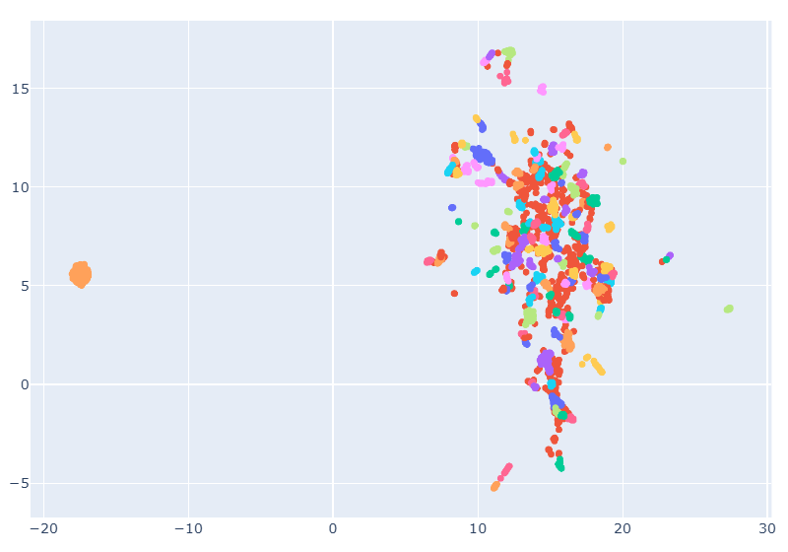
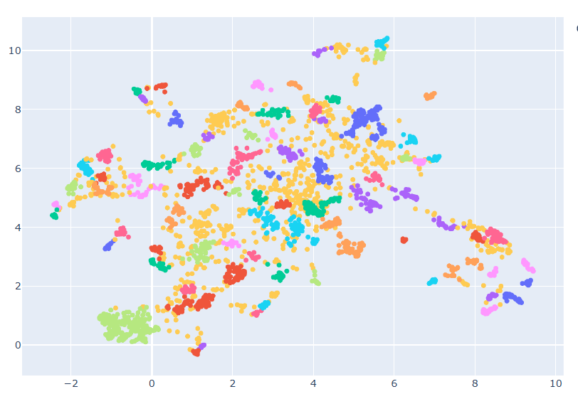
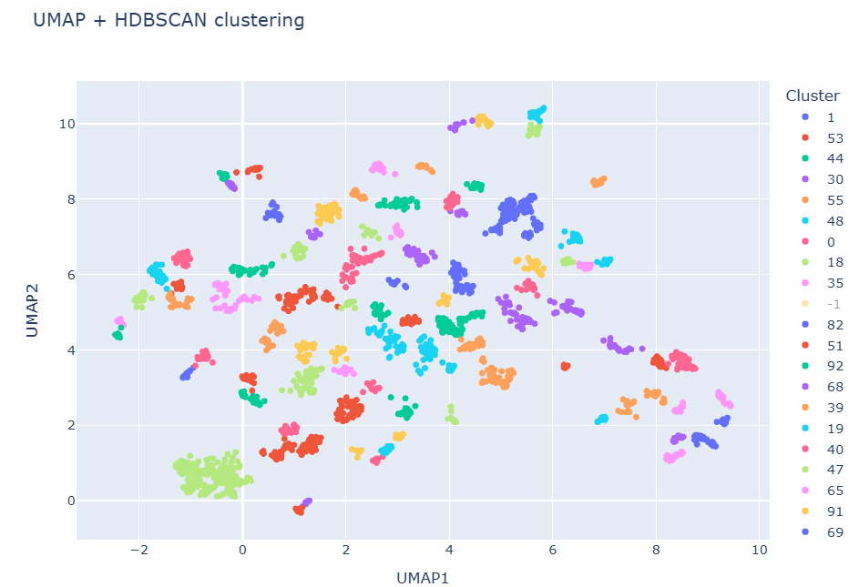
THREE DIFFERENT VIEWS
1
2
MF CLUSTERS
3
========= MATRIX: MF =========
N genes: 5183
N terms: 3258
Input: 3578 × 1337
Clusters: 94, noise points: 693

Slide 9
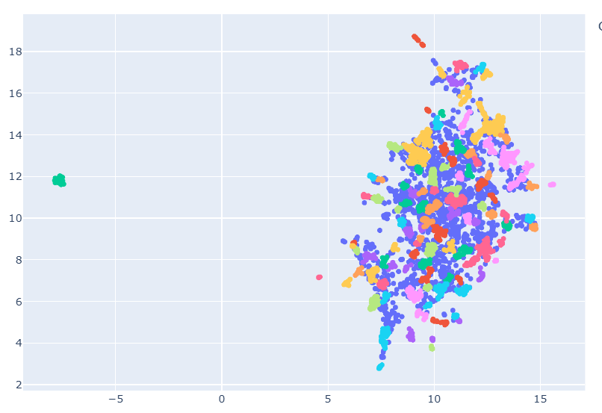
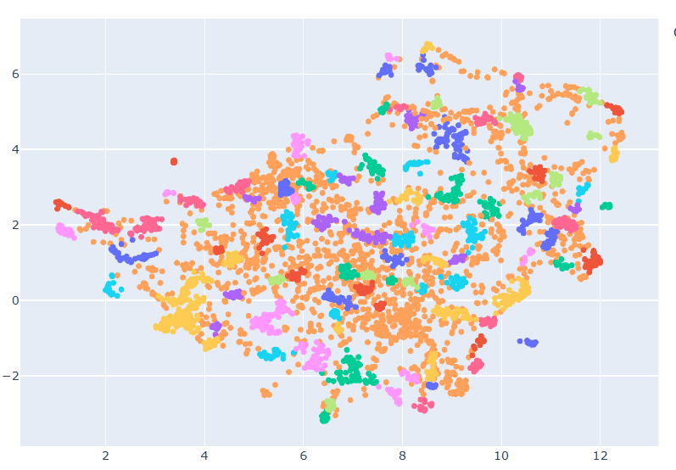
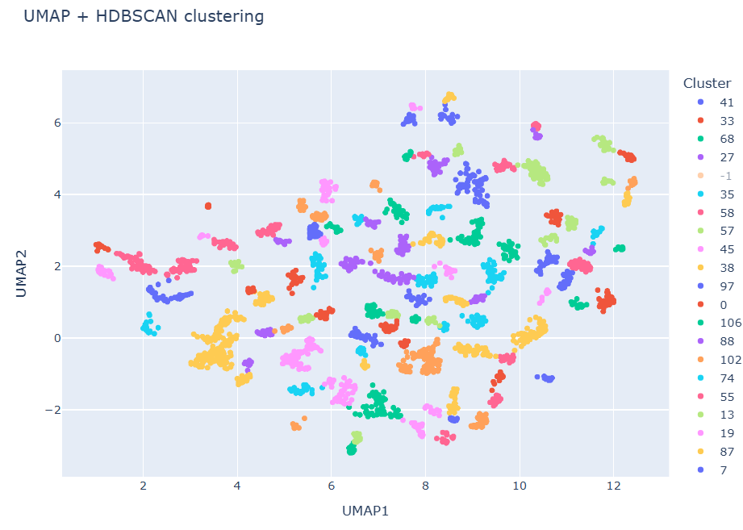
THREE DIFFERENT VIEWS
1
2
BP CLUSTERS
3
========= MATRIX: BP =========
N genes: 5183
N terms: 9873
Input: 4786 × 6119
Clusters: 109, noise points: 1536

Slide 10
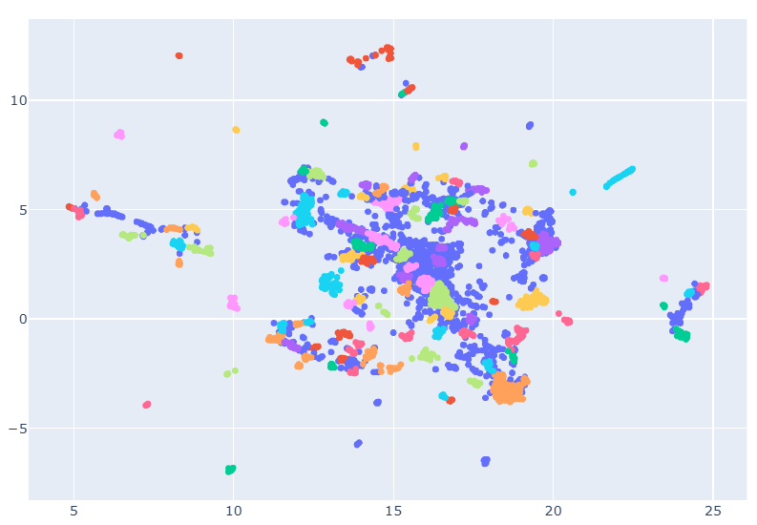
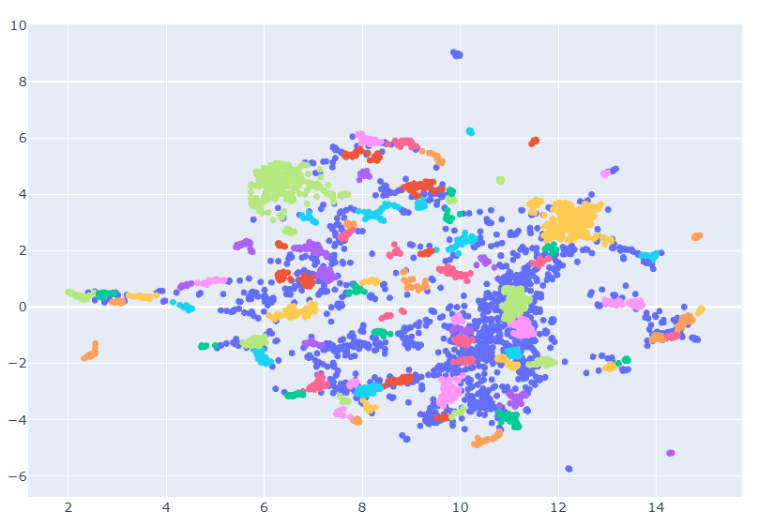
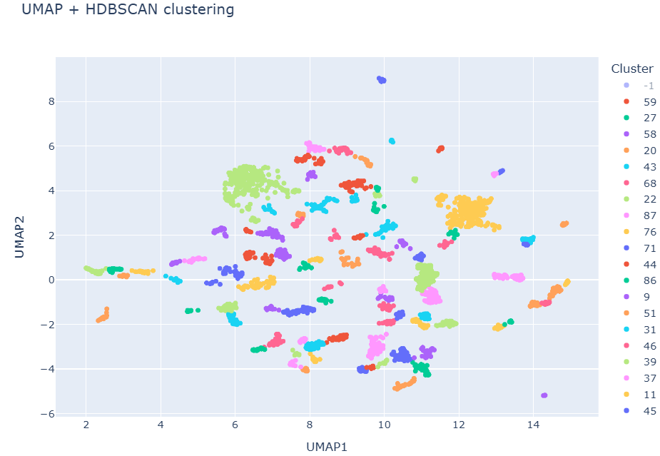
1
2
HPO CLUSTERS
3
========= MATRIX: HPO =========
N genes: 5183
N terms: 10185
Input: 4702 × 6342
Clusters: 100, noise points: 1278

Slide 11
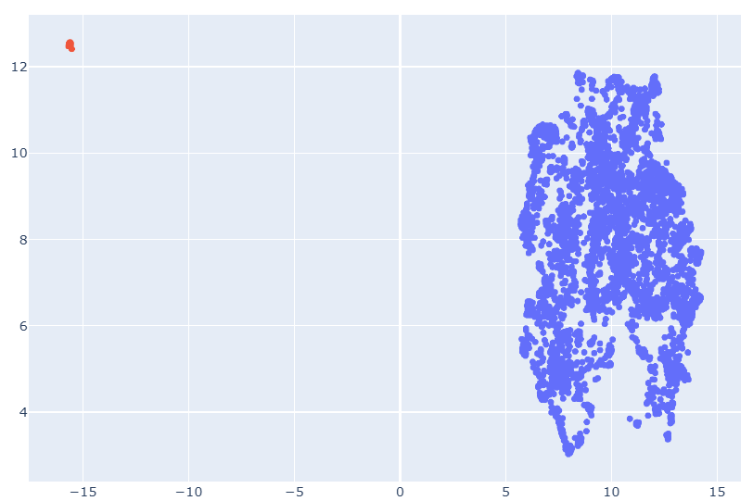
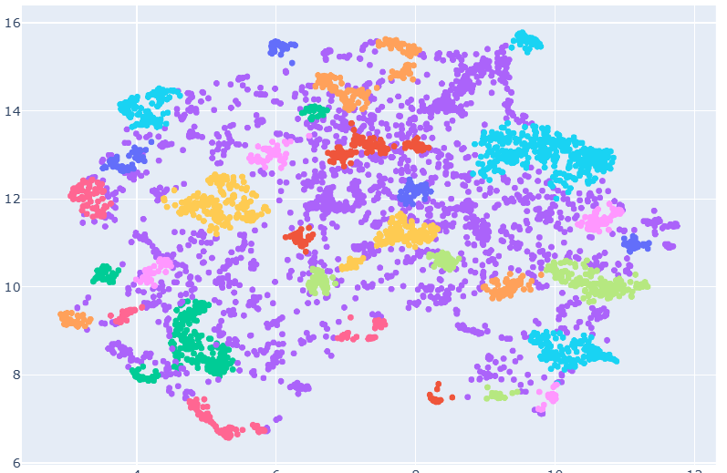
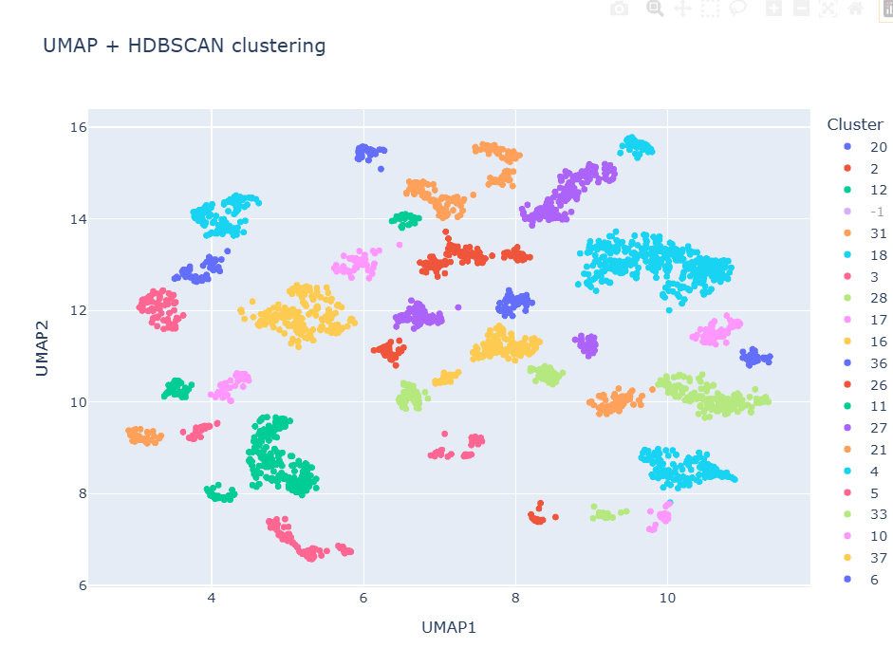
CURIOSITY FOR
1
2
Composed (CC-MF-BP)
3
======== MATRIX: COMPOSED ========
N genes: 5183
N original terms: 14609
Input: 5117 × 8265
Clusters: 38, noise points: 1810

Slide 12
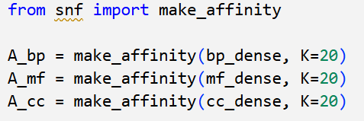

PREPARATION FOR SNF
Transforms the raw similarities into a robust affinity network based on the K nearest neighbors.
It is a fundamental step in the SNF workflow because it ensures:
comparability across different views
robustness to noise
preservation of local structures

Slide 13

SIMILARITY NETWORK FUSION - SNF
SNF merges the similarity networks of different views (BP, MF, CC) into a single, more strong network, amplifying shared similarities and reducing noise.

Slide 14
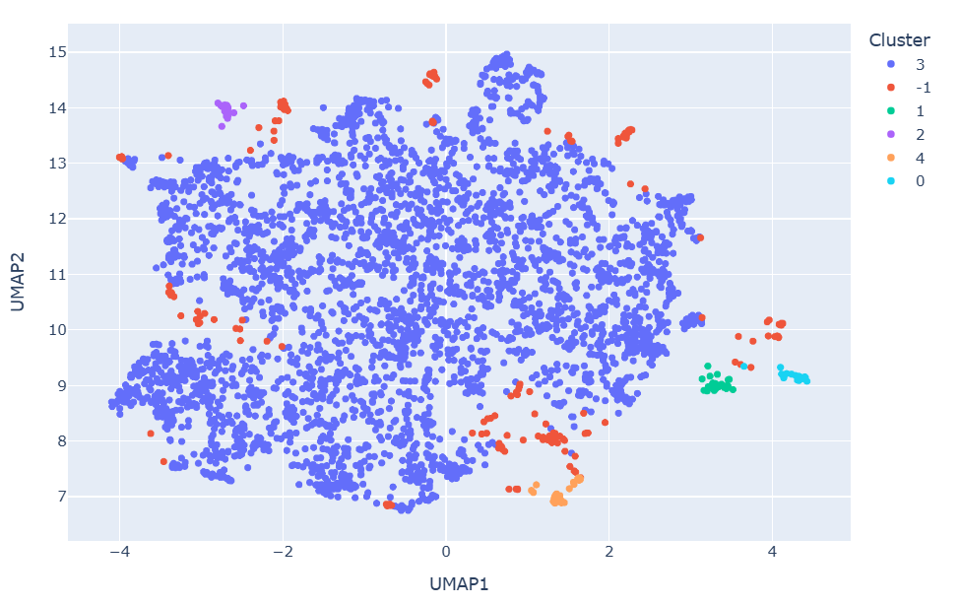
WHERE DID THE HPO GO?
Cluster 3 is:
poorly defined
share few common characteristics
elements that do not fit well into the more coherent clusters
We decided not to consider HPO but to focus on BP, MF, and CC because give us much clearer and more coherent clusters.

Slide 15
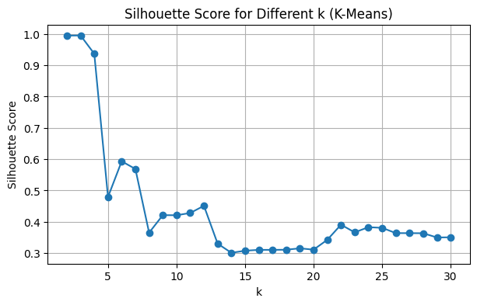
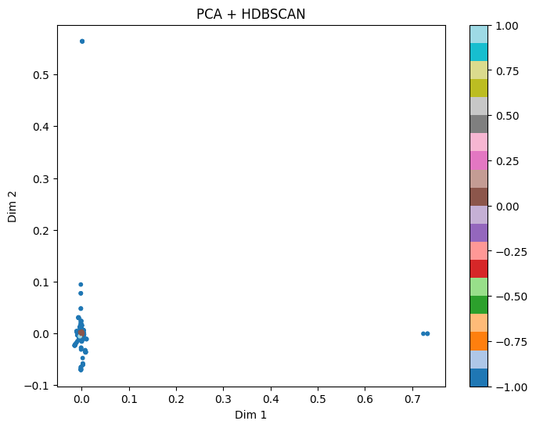
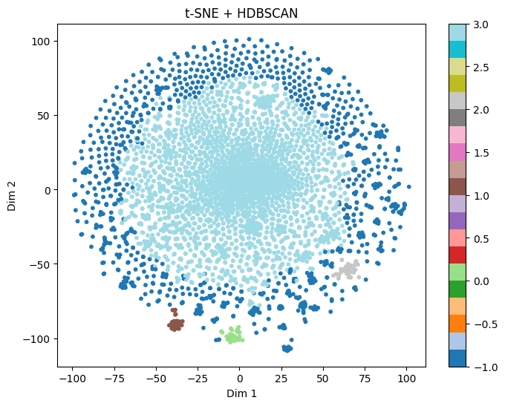
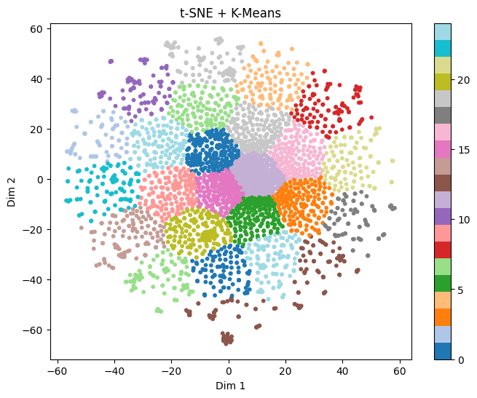
OTHER
COMBINATIONS
We try…
Best K = 2
PCA + HDBSCAN
t-SNE + HDBSCAN
t-SNE + K-Means

Slide 16
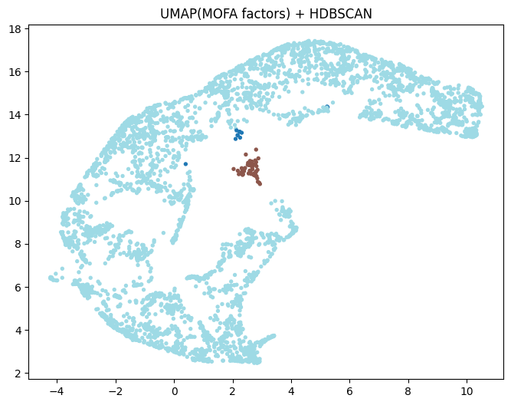
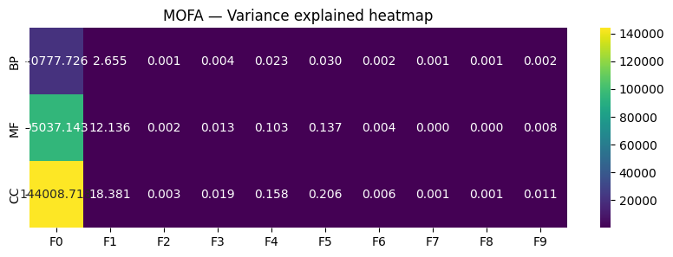
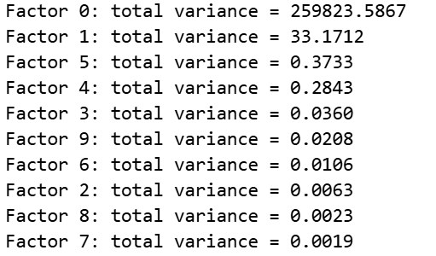
MOFA FACTORS
We also try…
The biological processes that differentiate the samples:
Factor 0 → signaling/receptors/response to stimuli
Factor 1 → differentiation (especially neuronal)
but it does not add much value to clustering, for now…

Slide 17
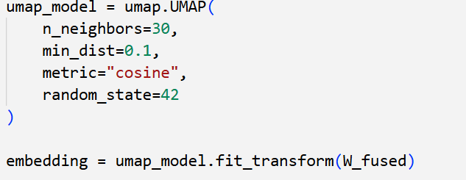
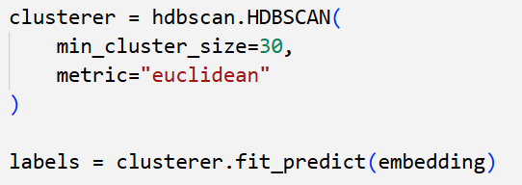
HDBSCAN & UMAP
But we choose…
UMAP is used to project the SNF matrix into 2D while preserving the local structure.
HDBSCAN automatically identifies dense clusters and removes noise without requiring a predefined number of clusters.
The chosen parameters ensure compact, stable, and biologically consistent clusters.

Slide 18
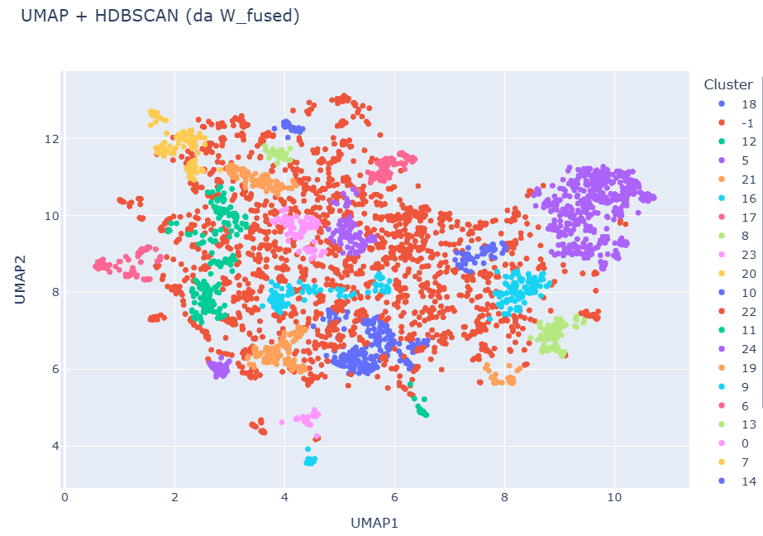
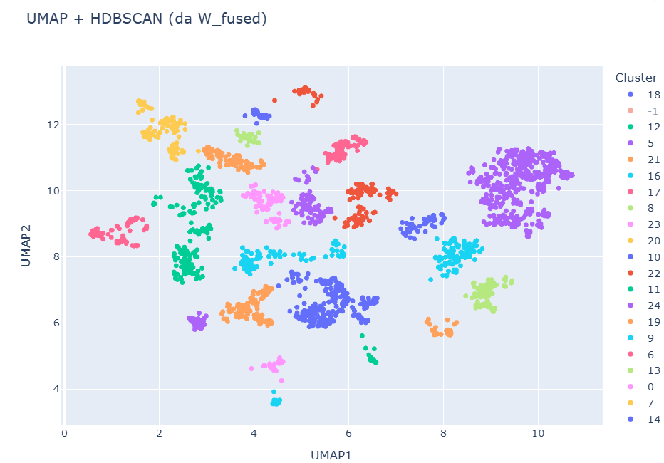
FINAL CLUSTERS
With noise
Without noise

Slide 19
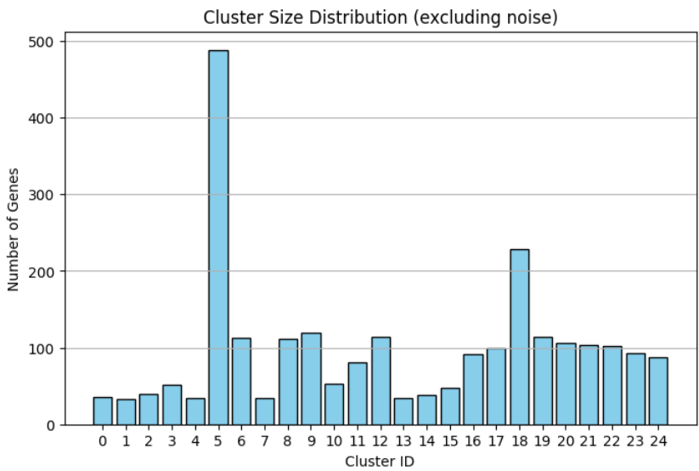
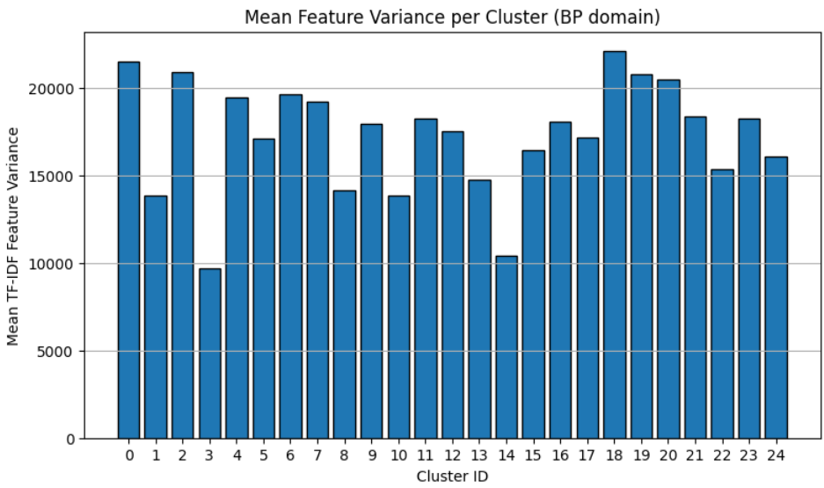
HISTOGRAMS
OF CLUSTERS
Cluster size distribution, without noise.
Variance of the clusters, without noise.

Slide 20
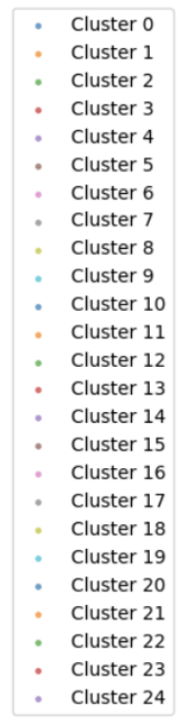
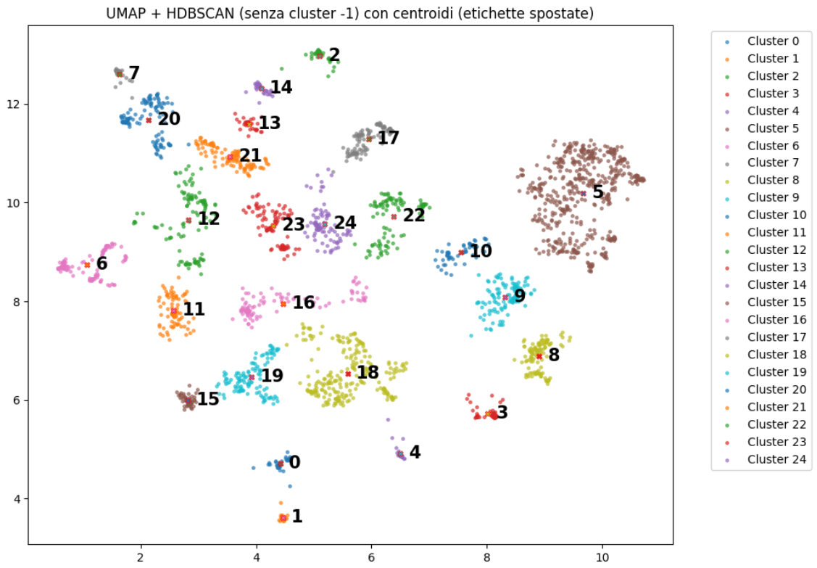
CENTROIDS OF THE CLUSTERS

Slide 21
CENTROIDS
Cluster 5
Category | GO Term | Description
MF | GO:0140110 | Transcription regulator activity
CC | GO:0000785 | Centromeric region
BP | GO:0006357 | Regulation of transcription by RNA Pol II
Cluster 20
Category | GO Term | Description
MF | GO:0005201 | Extracellular matrix structural constituent
CC | GO:0031012 | Extracellular matrix
BP | GO:0030198 | Extracellular matrix organization

Slide 22
CENTROIDS
Cluster 15
Category | GO Term | Description
MF | GO:0016757 | Glycosyltransferase activity
CC | GO:0000139 | Golgi membrane
BP | GO:0009100 | Glycolipid biosynthetic process
Cluster 16
Category | GO Term | Description
MF | GO:0004553 | Hydrolase activity (O-glycosyl compounds)
CC | GO:0005775 | Vacuolar lumen
BP | GO:0005975 | Carbohydrate metabolic process

Slide 23
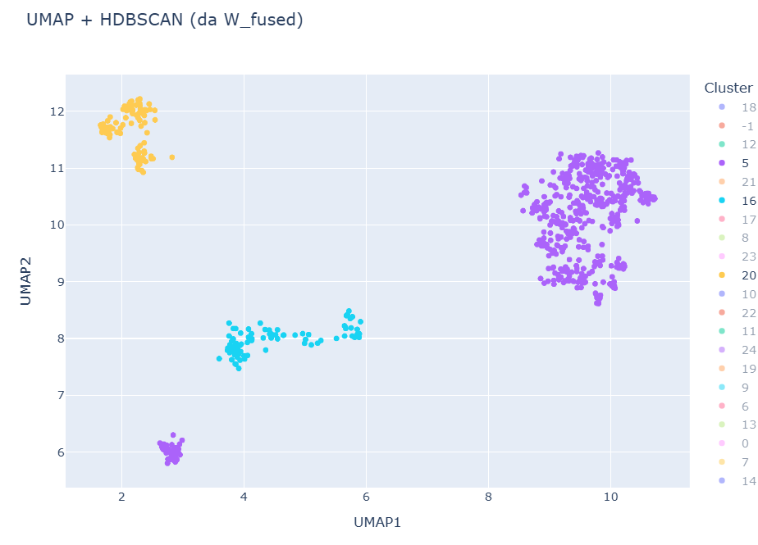
CLUSTER ANALYSIS
20
5
16
15
5
These genes localize mainly to the nucleus, chromosomes, and transcription-related complexes, consistent with their regulatory role in transcription.
20
The localizations align with the BP and MF terms: extracellular matrix, collagen, basement membrane, and cortical cytoskeleton, all structures involved in tissue support and adhesion.
15
These genes are mainly located in the Golgi apparatus and related compartments, consistent with roles in carbohydrate processing and protein glycosylation/transport.
16
The genes localize to vacuoles, lysosomes, and vesicles, consistent with metabolic and enzymatic functions that process sugars within intracellular compartments.

Slide 24
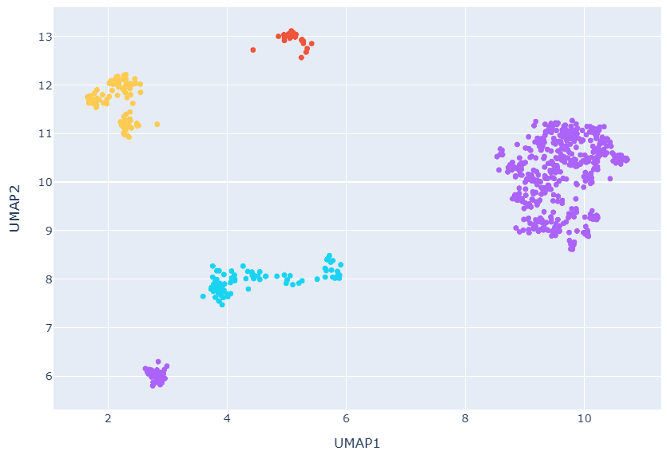
CLUSTER 2
2
BP (Biological Process)
GO.0045109 → regulation of receptor signaling pathway via JAK-STAT
GO.0045104 → positive regulation of somatic stem cell proliferation
GO.0031424 → keratinocyte differentiation
GO.0030216 → keratinocyte proliferation
GO.0043588 → skin development
The cluster includes genes involved in skin development and keratinocyte proliferation and differentiation, along with JAK–STAT signaling regulation related to cell growth and differentiation.
MF (Molecular Function)
GO.0030280 → potassium ion transmembrane transporter activity
GO.0005198 → structural molecule activity
GO.0005200 → structural constituent of cytoskeleton
GO.0019215 → transmembrane receptor protein tyrosine kinase activity
GO.1990254 → voltage-gated ion channel activity
The molecular functions include ion transport, cytoskeletal structural components, and tyrosine-kinase receptors, consistent with the regulation of keratinocyte proliferation and differentiation.
CC (Cellular Component)
GO.0005882 → intermediate filament
GO.0045111 → intercellular junction
GO.0045095 → cell junction
GO.0099512 → transmembrane transporter complex
GO.0001533 → cornified envelope
The genes localize to intermediate filaments, cell junctions, and skin-related structures (the cornified envelope), consistent with the BP and MF terms.

Slide 25
MOFA FACTORS & CLUSTERS
Infact the dataset is primarily structured by variation in extracellular signaling and receptor-mediated responses, as captured by MOFA Factor 0 and 1.
MOFA shows that the global structure of the data is driven by signaling and differentiation.
Using UMAP + HDBSCAN, we then resolved this variation into 25 biologically coherent clusters.

Slide 26
THANKS
Porcelli Angelica - 78083A
Roveda Gianluca - 73814A
Stefanelli Marta - 84393A

Slide 27
AI EXPERIENCE
codes errors
GO terms explanation

