Slide 1
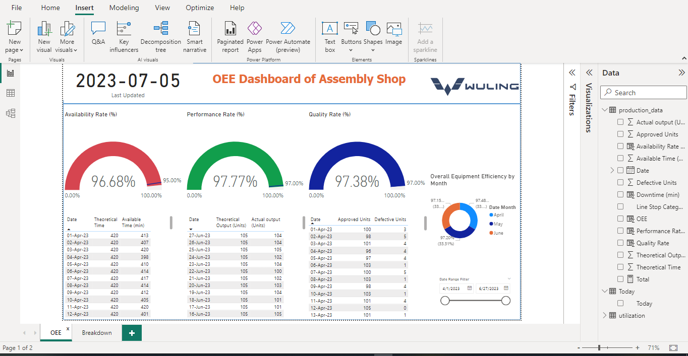
Designed By Ramadhan Adi Putra

Slide 2
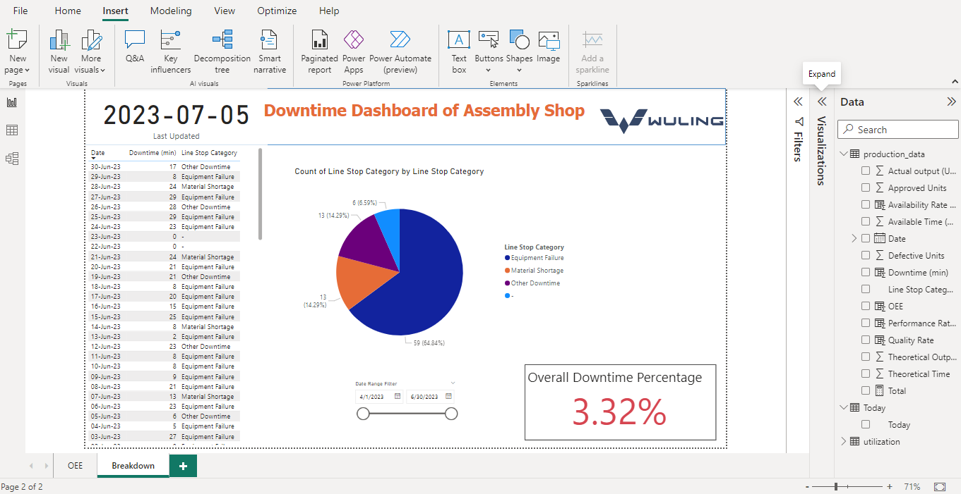
Designed By Ramadhan Adi Putra

Slide 3
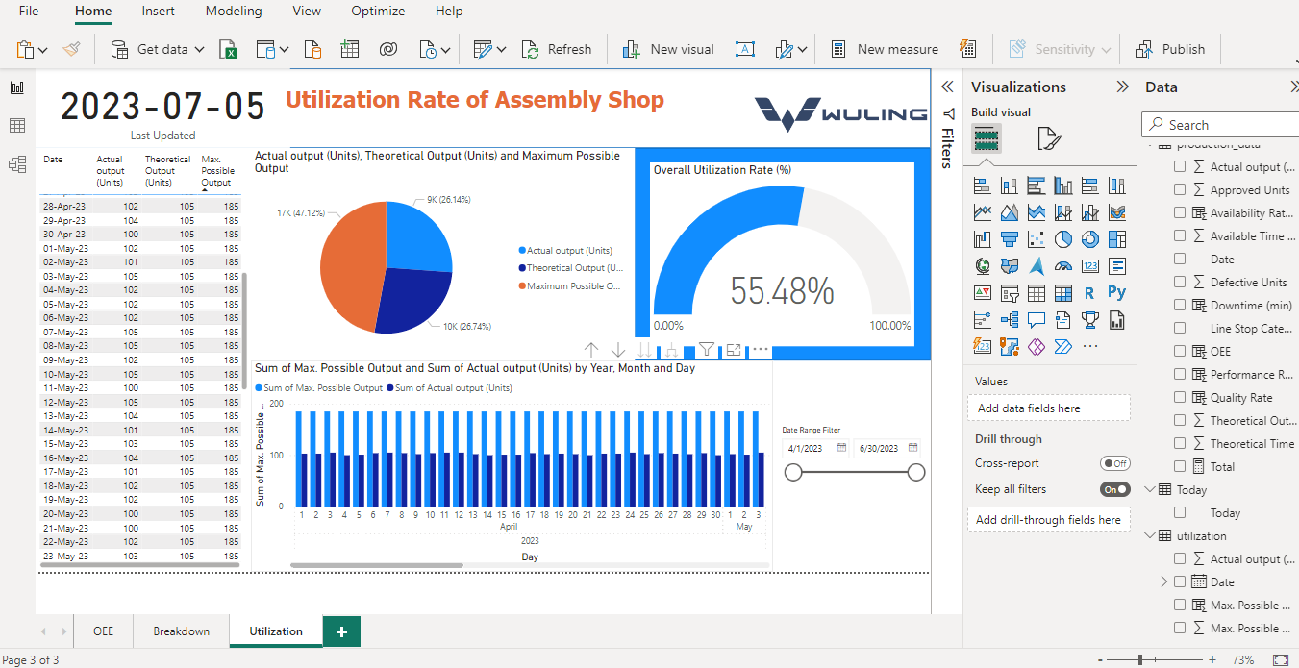
Designed By Ramadhan Adi Putra

Slide 4
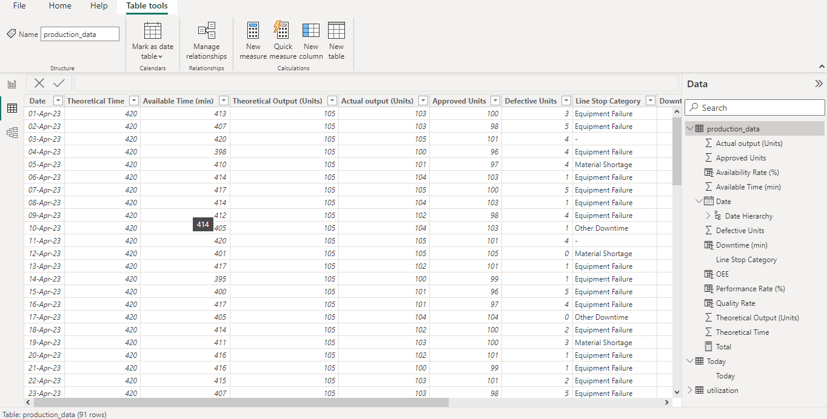
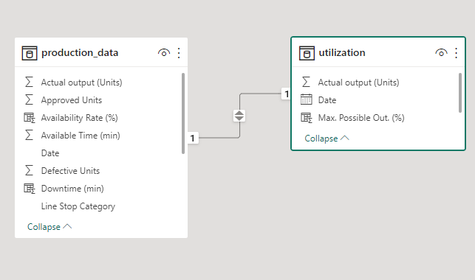
Data & Model View
Note: Random Data Source
Designed By Ramadhan Adi Putra

