Slide 1
Group Planning Session
Cognition and Emotion Group
09/10/2020

Slide 2
Acknowledgement of Country
We acknowledge the Wadjuk Nyoongar people as the original custodians of this land, and pay our respects to Elders past, present and emerging.

Slide 3
Topics
2020 review and setting future directions
Maximising visibility and inclusiveness
Updating the website
Research team award nomination

Slide 4
2020 review and setting future directions

Slide 5
Sessions this year
R sessions
Pre-registration and open science
Discussed organising a follow up at the end of the year to see how the group has tracked along with pre-registered studies/open science. Y/N?
Research metrics and quantifying research opportunities
Sharing COVID safety practices
Identifying common issues that affect ECR/MCRs
Meta-analysis using PROSPERO and JASP (thanks Danyelle)
Work design and neurocognitive impacts (Future of Work Institute)
Alexithymia and psychopathology (thanks David)
Conducting meta-analysis in R (thanks Michelle)
Health perceptions and behaviours in VR (Stephanie Thomas)
Practice candidacy presentations (Sophie Haywood; Jaspa Favero)

Slide 6
Feedback
What did you enjoy
What would you like to change?
Mixed f2f/online format?

Slide 7
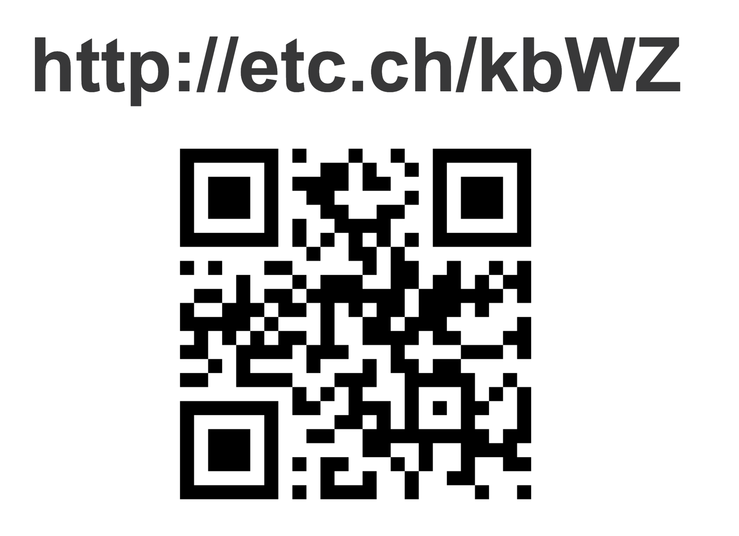
Notes:
Start poll - https://directpoll.com/c?XDVhEtgZP9MX09rXkJtSf3OpUwPhJa9
Results - https://directpoll.com/r?XDbzPBd3ixYqg8864ov0AW1chGwb7IqM9bFSrXrY
Vote - http://etc.ch/kbWZ

Slide 8
What would you like to see in 2021?

Slide 9
What would you like to see in 2021?
Suggestions:
Each lab group asked to present at least once to cognition and emotion group over the course of the year
Accessible and collaborative meeting suggestions schedule
Make use of cross school/faculty networks

Slide 10
Maximising visibility and inclusiveness

Slide 11
Maximising visibility and inclusiveness

Slide 12
Updating the CE group website

Slide 13
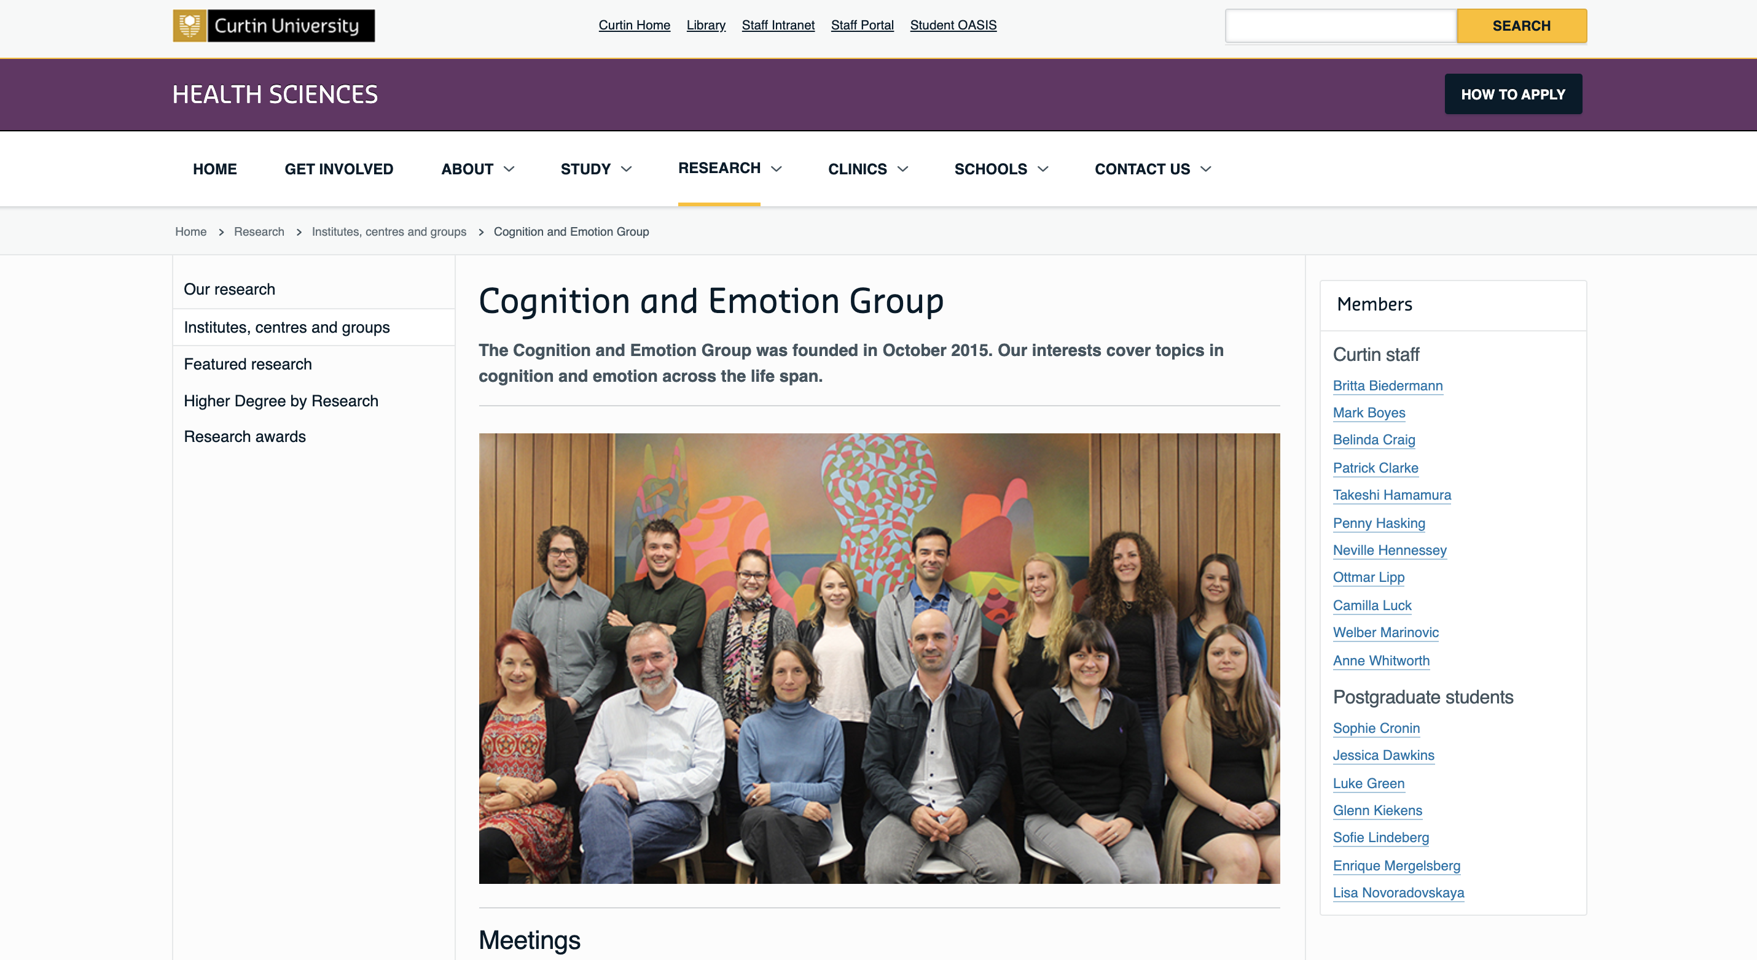

Slide 14
Updating the CE group website
Suggestions?
Short bio’s of our lab groups and projects we are working on
Link to sign up to the mailing list
Meeting time and location
Update the photo
Goals of our group?
Recent publications?
ACBN or CE group?

Slide 15
Debuting the CE group twitter
@CEgroupCurtin

Slide 16
Curtin Awards for Research Excellence
Research team award – $5,000

Slide 17
Award Criteria
Research Team Award: Recognition for a team that supports inclusive behaviours, fosters research performance, increases collaboration across Curtin and with external partners and has achieved an exceptional outcome Specific impact and/or engagement achieved and a summary of the underlying research undertaken in the last 5 years. Demonstrate how increased visibility was achieved, and showcasing of capability and footprint was represented as a single unified research group output. Provide evidence of how the research team has initiated and fostered collaborative, interdisciplinary research and education programs. Collaboration with private or public sector, non-government organisations or the community Provide clear evidence of additionality (how participation in the research group has led to research outcomes specifically due to this collaboration with other research group team members which would not have occurred otherwise).

Slide 18
Next time….
Friday 23rd October:
Danyelle Greene Milestone Three Presentation

