Slide 1


How to use R Statistics
Cognition and Emotion Group
School of Psychology
Curtin University

Slide 2


Why we here?
I want to learn R…
but I don’t know where to start
but I got stuck and gave up
but it takes too much time to learn
but I can’t write scripts and coding scares me

Slide 3
Reasons to learn R
It can do all the stats, for free!
And it’s not limited to stats.
Pre-process and organise raw data (less copy and pasting)
Make nice plots
Growing popularity
Feel included
Promotes data and analysis sharing
You also learn programming
Transferable skill – dealing with variables, using functions, for loops.

Slide 4
Purpose of the Series
Make R accessible.
Make it practical.
Keep content simple and use relevant examples.
Create opportunity to ask questions and work through problems.
Disclaimer: It’s my first time. Nnot a programming, statistics or teaching expert.

Slide 5
Session 1: Objectives
Install R and R Studio
Learn how to navigate the program
Open an Excel data file
Learn how to transform data between wide- to long-format
Save data to Excel file

Slide 6
Download Tutorial Materials from GitHub
https://github.com/angnguyen/ce_group
Clone or download > download .zip
Contains sample data, sample code, power-point slides.
Open slides to go at your own pace.
Use for future reference

Slide 7
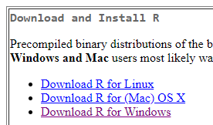
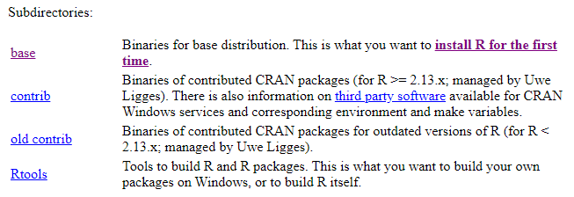
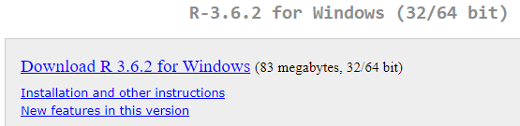
Install R (Windows)
Go here: https://cran.curtin.edu.au/

Slide 8
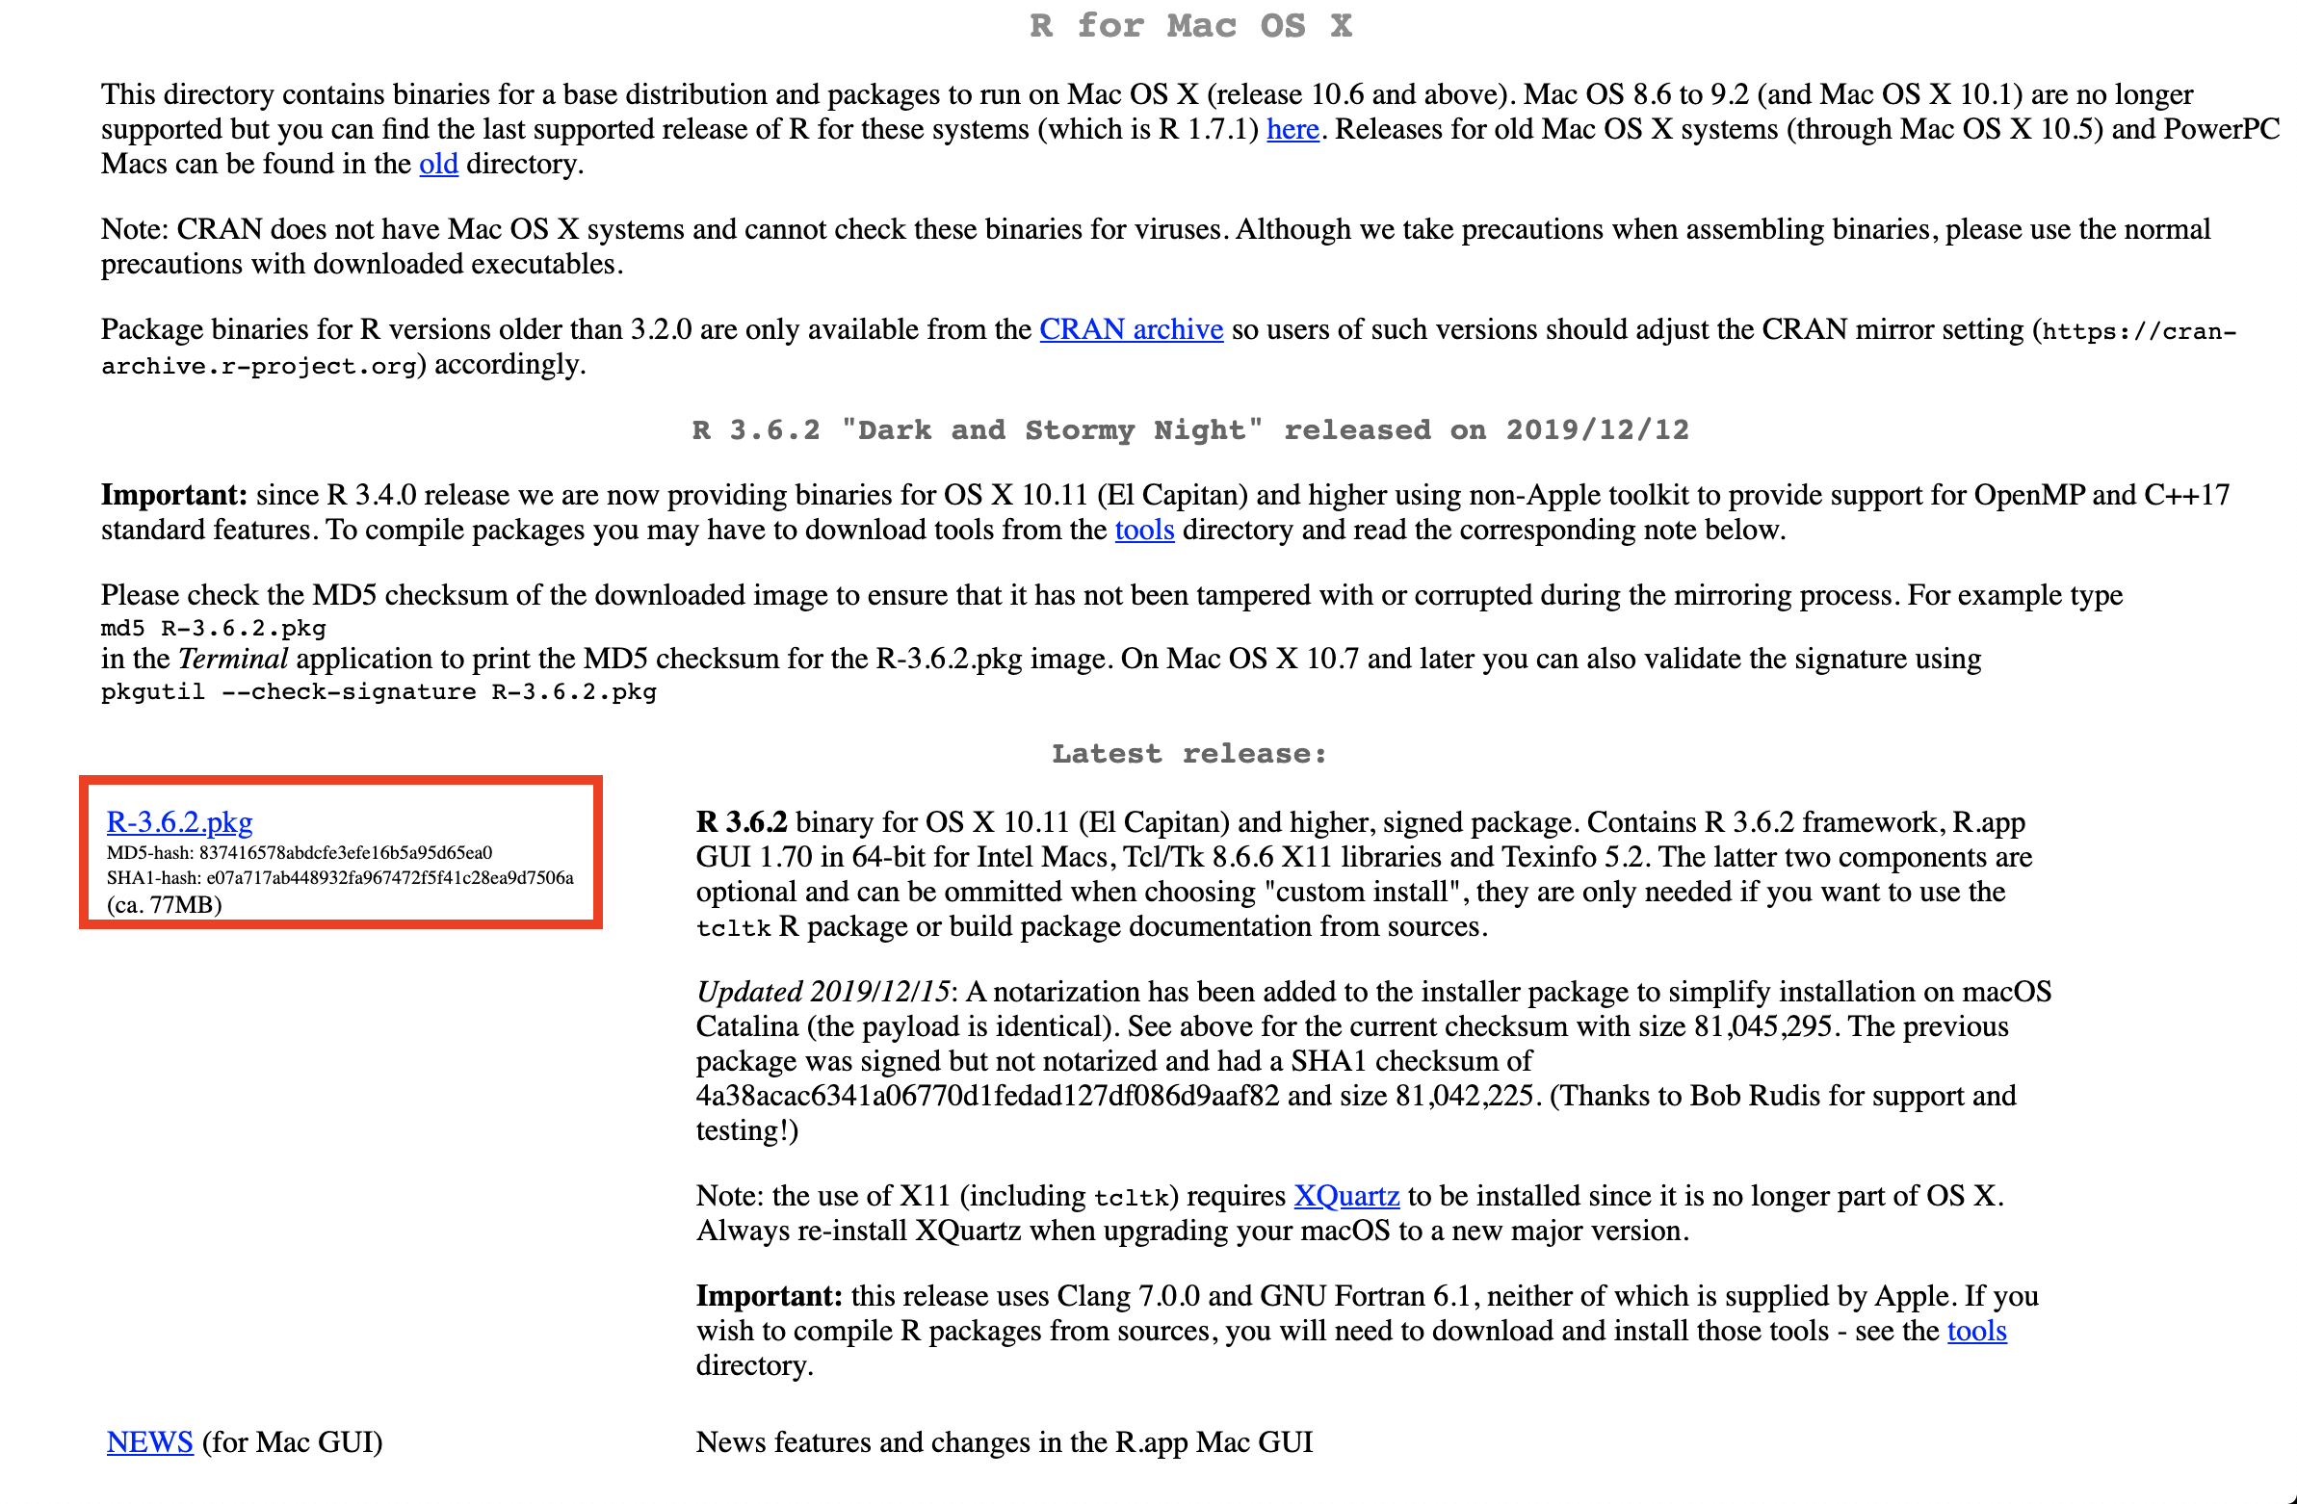
Install R (Mac OS)
Download and run R-3.6.2.pkg (or most recent version)
Install with default settings

Slide 9
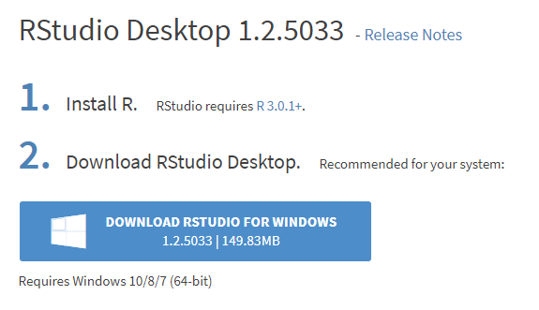
Install R Studio (Windows)
Go here: https://rstudio.com/products/rstudio/download/#download

Slide 10
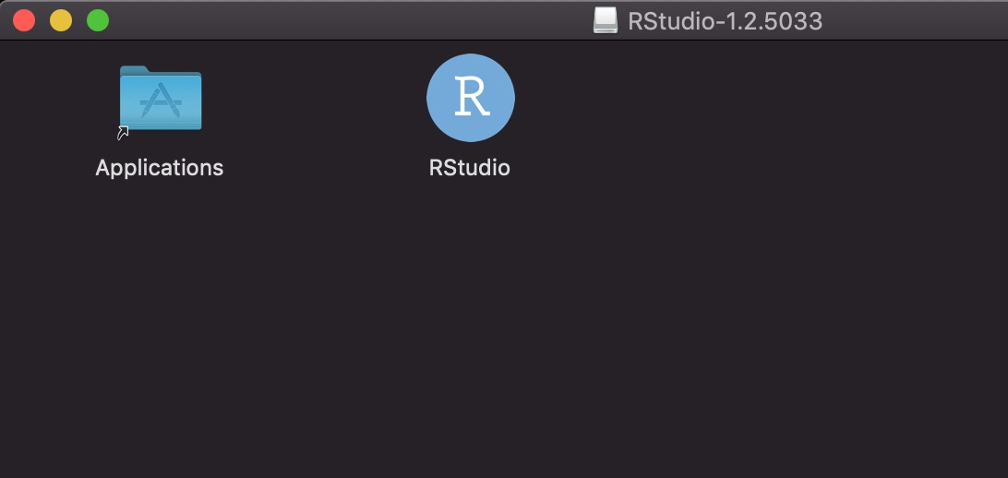
Install R Studio (Mac OS)
Run the .dmg file
Drag the RStudio icon to your “Applications” folder

Slide 11
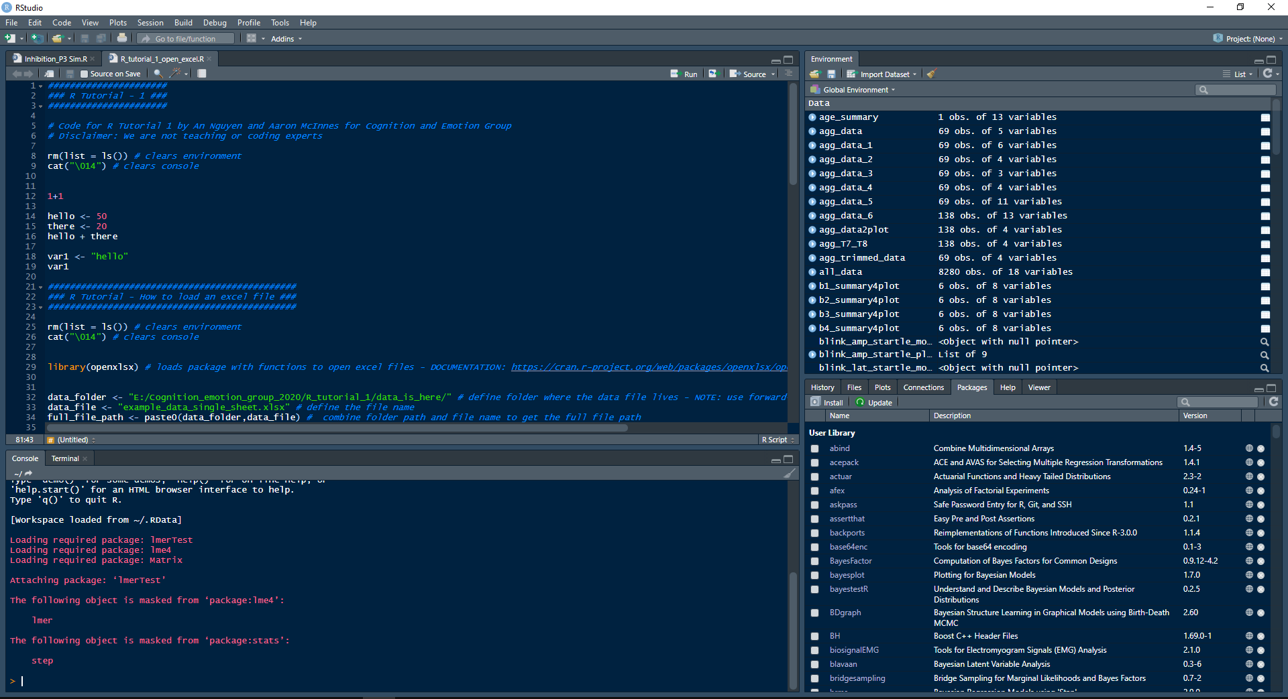
Open R Studio

Slide 12
Navigating the Interface
Environment
Script Editor
Other One
Console

Slide 13
Navigating the Interface
Script Editor (only appears if you have a script open)
Write and save R scripts
Console
Type in and run commands
Output shows up here
Environment
Existing variables and data show up here
Other One
Plots show up here and Install packages

Slide 14
Customise the look of R Studio
Tools > Global Options > Appearance
Go nuts – I like Cobalt

Slide 15
Using the Console
Use it like a calculator – output is not saved
c() stands for concatenate – use it to group things
Output can be saved into Variables
Saved in the environment (goes away when you close R)
Makes code understandable
Makes it easier to adjust values in code
Not just for numbers but also words
“Alt + minus” to get the arrow
> 1+1
[1] 2
> (50+100+60+200)*4
[1] 1640
> mean( c(2,2,5,5,7,8,9) )
[1] 5.428571
> monthly_spend <- (50+100+60+200)*4
>

Slide 16
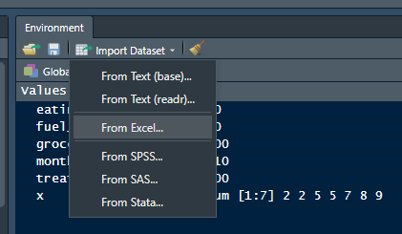
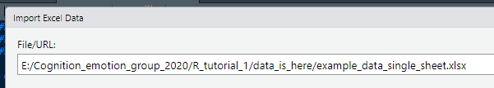
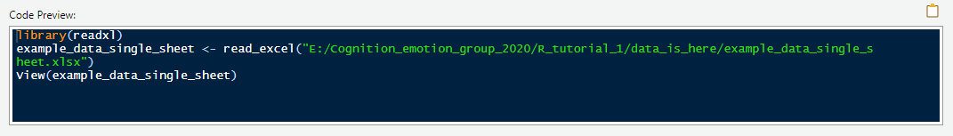
Importing Excel data manually
It’s loading the readxl package from library
What is a package? Add-on with additional functions
Ok and what is a function? Mini-program that does a specific task
Using read_excel() function to open the file
Saves data to variable called ‘example_data_single_sheet’

Slide 17
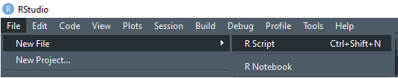
But we want to do that using scripts!
First we need to create a new script.
Create New R-Script
File > New File > R Script
Say what script is about
# this is my first script
Save the script somewhere
File > Save As

Slide 18
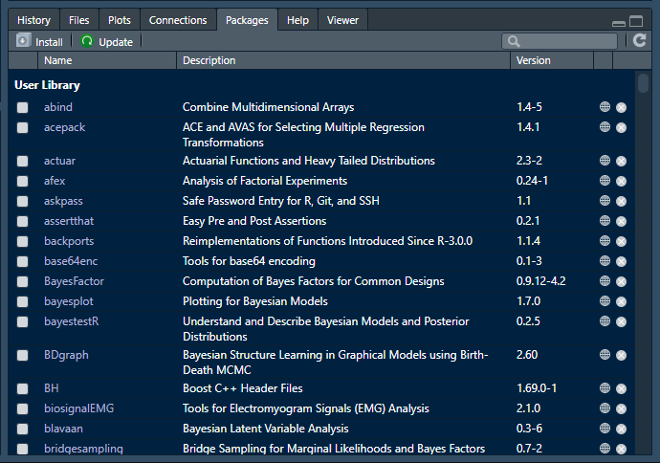
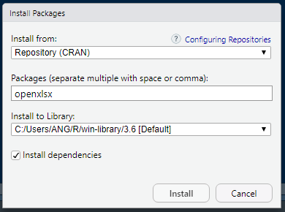
Install ‘openxlsx’ package
Bottom-left > ‘Packages’ tab > ‘Install’ > type ‘openxlsx’ > ‘Install’

Slide 19
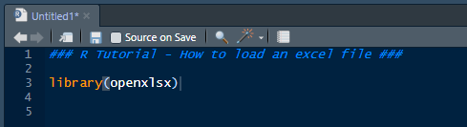
Load package into R
Type ‘library(openxlsx)’ into script
Comment the code – e.g. # for opening excel
Place cursor on that line and press Ctrl + Enter to run that line

Slide 20
Tell R where to look
Variable name – can give any name, but try to keep sort and informative
data_folder <- “E:/Cognition_emotion_group_2020/R_tutorial_1/data_is_here/”
data_file <- “example_data_single_sheet.xlsx”
full_path <- paste0( data_folder , data_file )
paste0() function – literally just stitches two words together, put comma between objects
Keep variable names short and informative
No spaces, use underscore instead
Folder directory – with forward slash (opposite to windows explorer)
Put your own directory – don’t copy this one.

Slide 21
read.xlsx() function
data2use <- read.xlsx( full_path )
Or use your own variable name
data2use should appear in environments section

Slide 22
Let’s have look at the data
Double-click variable in environment
Or type View(<insert variable name>)
This is a data-frame – basically a table, contains many variables
This data is based on the Go/No-go task
Respond quickly to Go stimulus but not No-go stimulus
RT recorded on each trial. Only Failed Nogo trials have RTs. Successful Nogo trials don’t have RTs – hence NA.
Data from 5 participants, with 5 trials each

Slide 23
R likes data in long format
What is long format?
Each variable is a separate column (participant, trial, condition, RT)
Each variable should only be specifying one thing.
Each observation is a separate row (each trial)
Long format is ideal for big datasets with many variables of different scales/type
Participant | Trial | Condition | RT
P001 | 1 | Congruent | 230
P001 | 2 | Neutral | 235
P001 | 3 | Incongruent | 290
P002 | 1 | Congruent | 220
P002 | 2 | Neutral | 230
P002 | 3 | Incongruent | 300

Slide 24
Examples of not-long data
This variable is specifying 2 things – no good.
Participant | AUDIT_Q1 | AUDIT_Q2 | AUDIT_Q3 | BISBAS_Q1 | BISBAS_Q2 | BISBAS_Q3
P001 | 4 | 2 | 2 | 1 | 1 | 2
P002 | 1 | 2 | 2 | 3 | 3 | 1
P003 | 3 | 4 | 4 | 2 | 2 | 2
These scores are from separate items and questionnaires but are on the same row… NOT LONG.
Participant | RT_Congruent | RT_Incongruent | RT_Neutral
P001 | 230 | 300 | 300
P002 | 250 | 290 | 200
P003 | 200 | 340 | 230
These RTs are from separate conditions (i.e. separate observations) but are on same row… NOT LONG.

Slide 25
This is what you want…
Participant | AUDIT_Q1 | AUDIT_Q2 | AUDIT_Q3 | BISBAS_Q1 | BISBAS_Q2 | BISBAS_Q3
P001 | 4 | 2 | 2 | 1 | 1 | 2
P002 | 1 | 2 | 2 | 3 | 3 | 1
P003 | 3 | 4 | 4 | 2 | 2 | 2
Participant | Questionnaire | Item | Score
P001 | AUDIT | 1 | 4
P001 | AUDIT | 2 | 2
P001 | AUDIT | 3 | 2
P001 | BISBAS | 1 | 1
P001 | BISBAS | 2 | 1
P001 | BISBAS | 3 | 2

Slide 26
This is what you want…
Participant | RT_Congruent | RT_Neutral | RT_Incongruent
P001 | 230 | 300 | 300
P002 | 250 | 200 | 290
P003 | 200 | 230 | 340
Participant | Condition | RT
P001 | Congruent | 230
P001 | Neutral | 300
P001 | Incongruent | 300
P002 | Congruent | 250
P002 | Neutral | 200
P002 | Incongruent | 290

Slide 27
Ok, show me how to do that.
We need tidyr package
We will use the gather() function – Wide to Long
Then we will use spread() function – Long to Wide
Links:
R-documentation (explains how to use functions):
https://www.rdocumentation.org/packages/tidyr/versions/0.8.3/topics/gather
Another guide to use gather() and spread() :
http://www.cookbook-r.com/Manipulating_data/Converting_data_between_wide_and_long_format/

Slide 28
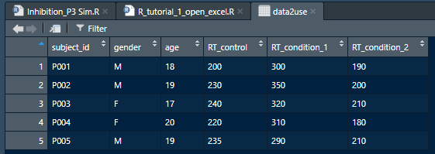
Tidyr and gather()
Install tidyr
Load tidyr from library using library()
Load ‘gather_example_data.xlsx’ into a variable using read.xlsx()
View data
not long-format, RTs for different conditions on same row
Want separate columns for RT and condition

Slide 29
Tidyr and gather()
2. Creating new column for condition names
data2use_v2 <- gather(data = data2use, key = “condition”, value = “RT”, c(“RT_control”, “RT_condition_1”, “RT_condition_2”) )
Name the ‘key’ after the variable names
Name ‘value’ after the stuff in the actual cells
View (data2use_v2)
1. Variable to transform
3. Creating new column for condition names

Slide 30
spread()
Working from the last dataset
data2use_v3 <- spread(data = data2use_v2, key = "condition", value = "RT")

Slide 31
Save variable into Excel
write.xlsx( data2use_v3 , full_path )

Slide 32
Exercise: Lets open our own data
Use read.xlsx() function to open your own file
Use gather() to convert to long format (if not already long)
If data is long, use spread() to convert to wide-format
If different sheets, single file
There is code
If different excel files
There is code
If something else
ask

Slide 33
That’s it for today
Next Cognition and Emotion Group Meeting (6 March)
Discussing pre-registration
Next R Session (13 March)
Plotting in R using ggplot2

Slide 34
Cheat sheet - Hotkeys
Ctrl + Enter – Runs single line of code
Alt + minus – <- - for defining variables
Ctrl + 3 - # - ignores stuff after this
Ctrl + Shift + C – disable/enable line of code
Ctrl + Shift + Enter – Runs whole script

Slide 35
Cheat sheet - Functions
paste0() or paste(), cbind() and rbind()
Lets you stick things together
Substring()
Extract part of a word – good for getting subject id from filenames
Unique()
Gets unique values from variable – good for checking participants or factors in large datasets
Length() and dim()
Shows you size of variable – good for troubleshooting – check if right number of trials/participants or whatever are there
Subset()
Extract a smaller part of bigger dataset – good for follow-up analyses (e.g. only want to analyse a certain condition of the data).
Aggregate()
Can use to calculate mean values per participant and condition.

