Slide 1
How to use R Statistics
Curtin University – School of Psychology
For Cognition and Emotion Group

Slide 2
Why are we here?
To learn how to use R
Learn while working on your own data (or at-least data relevant to psychology).
Opportunity to ask dumb questions.

Slide 3
Why bother to learn R
It’s free.
It can do pretty much anything data-related – not limited to stats.
Lots of people are using it or are getting into it – promotes data/analysis sharing, feel included, could help you get a job.
Helps you understand programming – transferable skill, applicable to python and Matlab.
Makes you feel smart (sometimes)
Any more reasons?

Slide 4
This Session
This session will be about installing R and R-studio (yes, there are 2 programs)
Orient you to the program
Open an excel data file in R

Slide 5
Installing R
https://www.r-project.org/ - or google R statistics
Click CRAN under download
Click Curtin link under Australia
Click Download R for Windows or (Mac) OS X
For Windows
Click install R for the first time
Click Download R 3.6.2 (or whatever the current version is) for Windows
Run .exe file, install with default settings.
For Mac
Download and run R-3.6.2.pkg (or most recent version)
Install with default settings

Slide 6
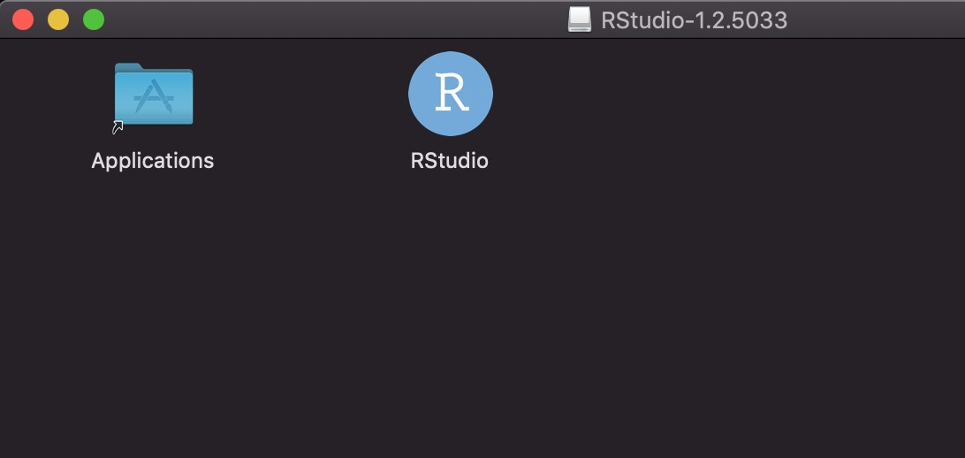
Installing R Studio
R is the back-end and R Studio is the front-end that makes R nicer to use.
https://rstudio.com/ or google R studio
Click download tab at the top
Click download under R Studio Desktop Free
Click the download R studio for windows button
Windows:
Run the .exe file, using default settings
Mac:
Run the .dmg file
Drag the Rstudio icon to your “Applications” folder

Slide 7
Open R Studio
Click R Studio Icon
Might have to choose version of R

Slide 8
Navigating the Interface
Script Editor
Write and save script here
Console
Run commands manually
Output shows up here
Environment
Variables show up here
Other one - Plots/Packages/Everything Else
Plots show up here, can install packages from here

Slide 9
Console Basics
Can use as calculator
Try 1+1, enter
Variables – a container for information
Try storing numbers in variable – they can have any name
E.g. Hello <- 50
See variable is in the environment
Can do math operations on variables (e.g. Hello + 20)
Can also store words in variables as well.

Slide 10
Importing excel data manually
Click ‘import dataset’ in environment tab
Click ‘from Excel’
It uses ‘readxl’ package
Using ‘read_excel’ function (mini program)
Input the file directory and specify the variable name you want
That’s how R does it – but there are other ways that can do more things (e.g. get data from many sheets).

Slide 11
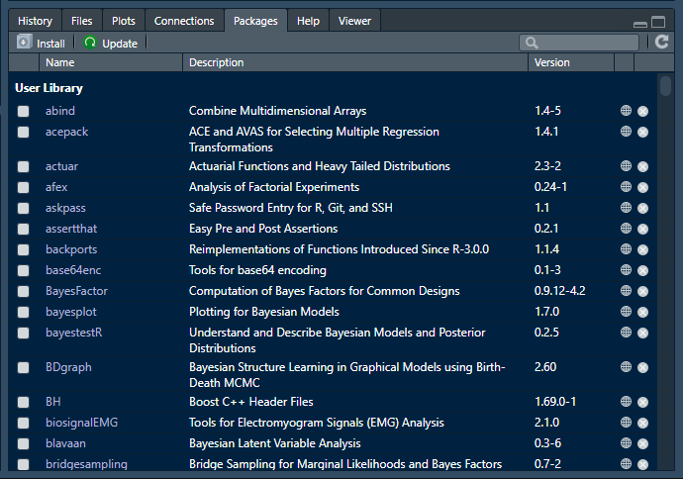
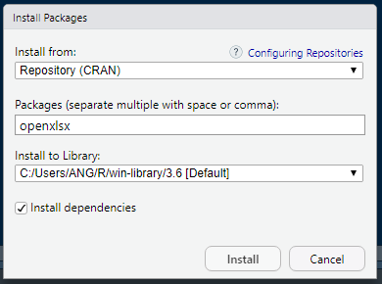
Lets try to open an excel file
You will need to install the ‘openxlsx’ package in R
Click ‘Packages’ tab > Click ‘Install’ > type ‘openxlsx’ > Click ‘Install’
Only install and load packages as needed, don’t try and install all

Slide 12
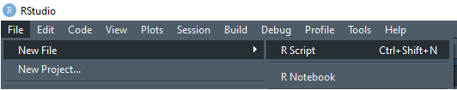
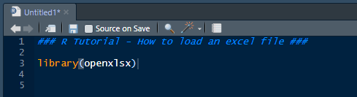
Also, create a script to save your code
Create New R-Script
File > New File > R Script
Load ‘openxlsx’ library
Type ‘library(openxlsx)’ into script
Hit ‘Ctrl + Enter’ to Run that line

Slide 13
How to Open Excel File
Tell R what file to open
data_folder <- “E:/Cognition_emotion_group_2020/R_tutorial_1/data_is_here/”
data_file <- “example_data.xlsx”
You are creating two variables, with folder path and filename information
Combine the folder path and file name to get the full path, ‘paste0()’ lets you combine character strings
full_path <- paste0(data_folder,data_file)
Load in the file you picked using read.xlsx function
Data2use <- read.xlsx(full_path)
Data2use <- read.xlsx(“E:/Cognition_emotion_group_2020/R_tutorial_1/data_is_here/example_data.xlsx”)
Data2use <- read.xlsx(paste0(data_folder,data_file))

Slide 14
Lets look at the data
Double click variable in environment
This is a Data Frame – basically a table, many variables
Explain dataset
Go/no-go task
Data from 5 participants, with 5 trials each
The condition and RT for each trial are in separate variables (columns)
R likes it long
Each observation is a separate row
Each variable is a row

Slide 15
But our data is not long…
Converting from wide to long
tidyr package
Gather()
http://www.cookbook-r.com/Manipulating_data/Converting_data_between_wide_and_long_format/
Convert from long to wide
Spread()

Slide 16
Exercise: Lets open our own data
Use read.xlsx() function to open your own file
Use gather() to convert to long format (if not already long)
If data is long, use spread() to convert to wide-format
If different sheets, single file
There is code
If different excel files
There is code
If something else
ask

Slide 17
That’s it for today

Slide 18
Cheatsheet - Hotkeys
Hotkeys – useful ones
Ctrl+Enter – Runs single line of code
Alt + minus – arrow (<-) – equivalent to ‘=‘
# - ignores stuff
Ctrl+Shift+C – comment/uncomment out line of code
Ctrl+Shift+Enter – Runs whole script

Slide 19
Cheat sheet - Useful Function
paste0() or paste(), cbind() and rbind()
Lets you stick things together
Substring()
Extract part of a word – good for getting subject id from filenames
Unique()
Gets unique values from variable – good for checking participants or factors in large datasets
Length() and dim()
Shows you size of variable – good for troubleshooting – check if right number of trials/participants or whatever are there
Subset()
Extract a smaller part of bigger dataset – good for follow-up analyses (e.g. only want to analyse a certain condition of the data).
Aggregate()
Can use to calculate mean values per participant and condition.

