Slide 1
Pre-registration and Open Science
Cognition and Emotion Group

Slide 2
Acknowledgement of Country
We acknowledge the Wadjuk Nyoongar people as the original custodians of this land, and pay our respects to Elders past, present and emerging.

Slide 3
Topics
Open Science Framework
AsPredicted.org
Pre-print servers (PsyArXiv, BioRxiv etc.)
GitHub
PROSPERO

Slide 4
Open Science Framework (OSF)
Online server used to keep track of projects.
Create Projects
Upload Data and Code
Upload Pre-prints
Linked to ORCID ID and PsyArXiv
Comprehensive Profile Page – links to ResearchGate, Twitter, GitHub

Slide 5
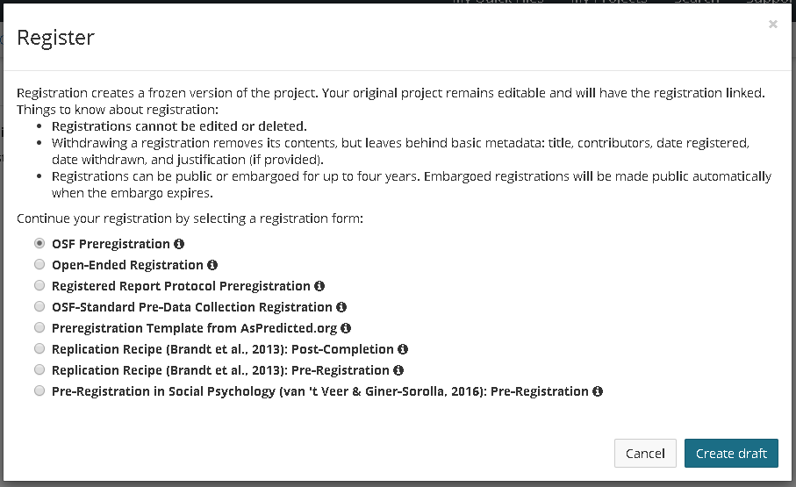
Registering Projects

Slide 6
Registering Projects
Can create projects but don’t have to register them

Slide 7
Registered Reports – Directly with Journal
Cortex
Two stage review process
First phase: Method and proposed analyses are registered and reviewed
If approved, article is accepted in principle – publication guaranteed only if they adhere precisely to registered protocol.
Second phase: Submit final manuscript for final consideration
PlosONE
Similar
Second phase reviewed for adherence to initial protocol
Two articles are bidirectionally linked.

Slide 8
AsPredicted.org
Briefly answer 9 questions about the project.
All participating authors receive e-mail asking for approval.
Stays private until the author makes it public or remains private forever.

Slide 9
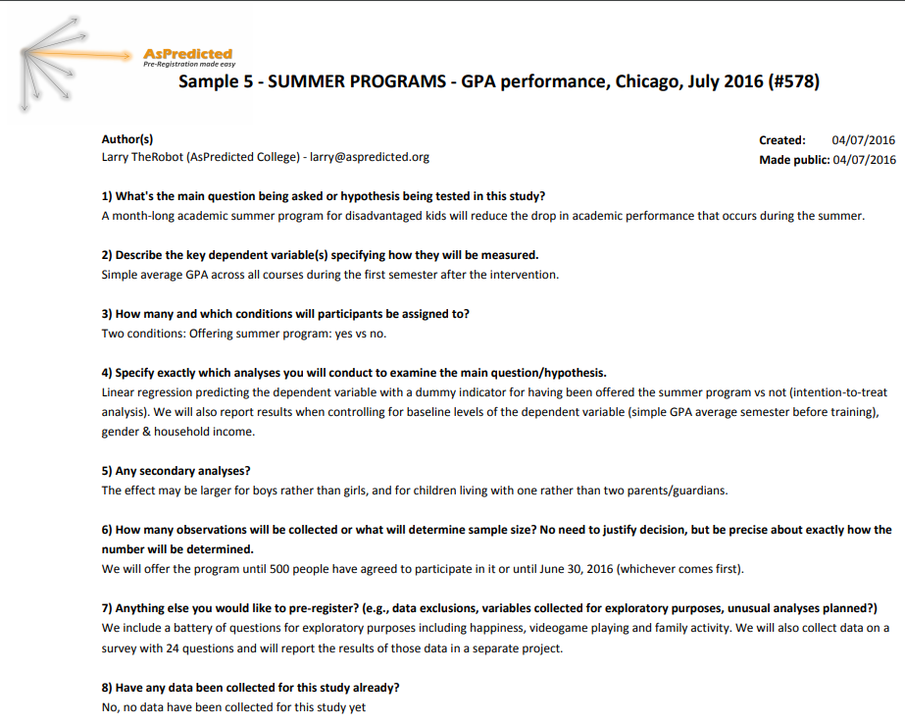

Slide 10
Pre-Print Servers
PsyArXiv and BioRxiv – many more.
PsyArXiv is linked to OSF and ORCID ID
Get opinions and feedback before submitting to journal
Some servers can forward pre-prints to journals directly as submissions

Slide 11
GitHub
Upload data and code online – for free
Version tracking - Keeps track of all versions
Collaboration – people can contribute to your code
Merge changes from different people

Slide 12
PROSPERO
Registration of Systematic Reviews
https://www.crd.york.ac.uk/prospero/

