Slide 1
Article Discussion Using Machine Learning to Generate Novel Hypotheses: Increasing Optimism About COVID-19 Makes People Less Willing to Justify Unethical Behaviors Abhishek Sheetal, Zhiyu Feng, & Krishna Savani (2020)
Cognition and Emotion Group
20/11/2020

Slide 2
Acknowledgement of Country
We acknowledge the Wadjuk Nyoongar people as the original custodians of this land, and pay our respects to Elders past, present and emerging.

Slide 3
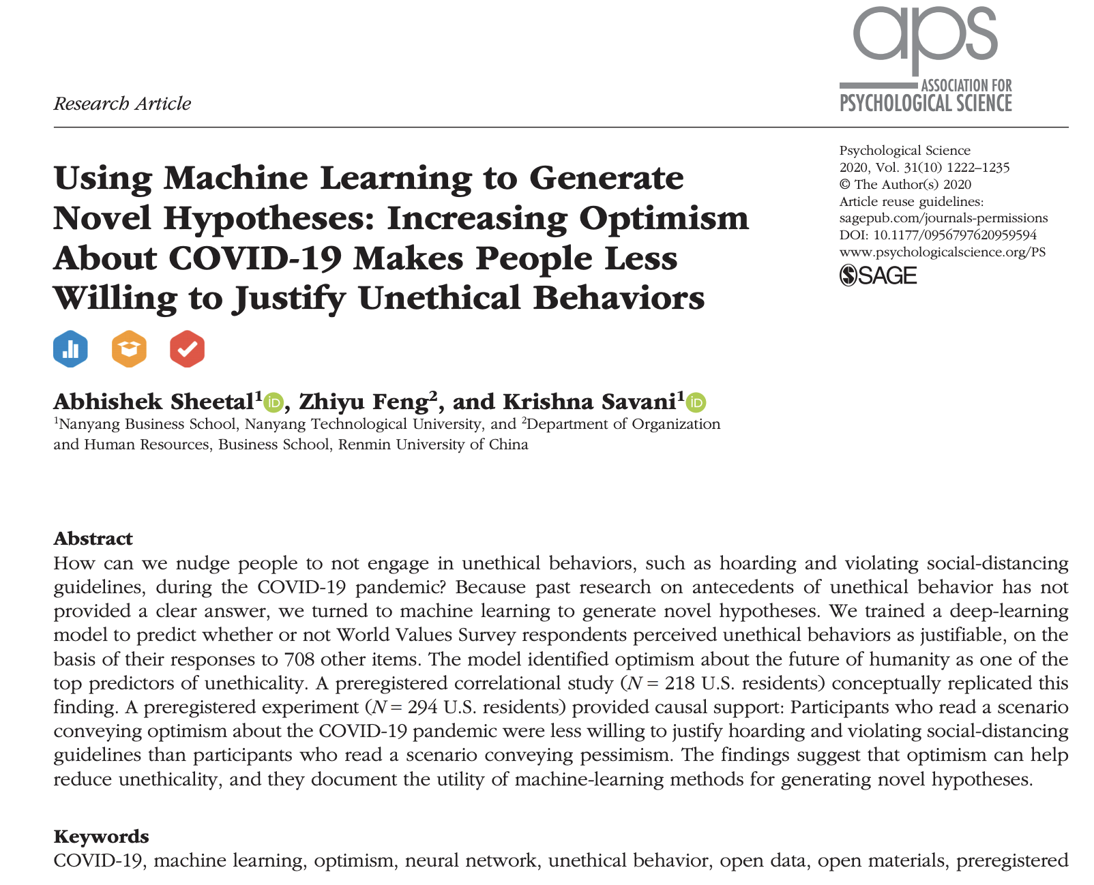

Slide 4
Background
In the midst of COVID-19 pandemic, many people hoarded protective supplies
Depriving those who need it the most (i.e. medical workers, elderly)
Authors propose understanding antecedents of, and how to reduce, unethical behaviour is particularly important in times of crisis
Previous research has identified predictors of unethical behaviour but interventions are difficult to implement in the field

Slide 5
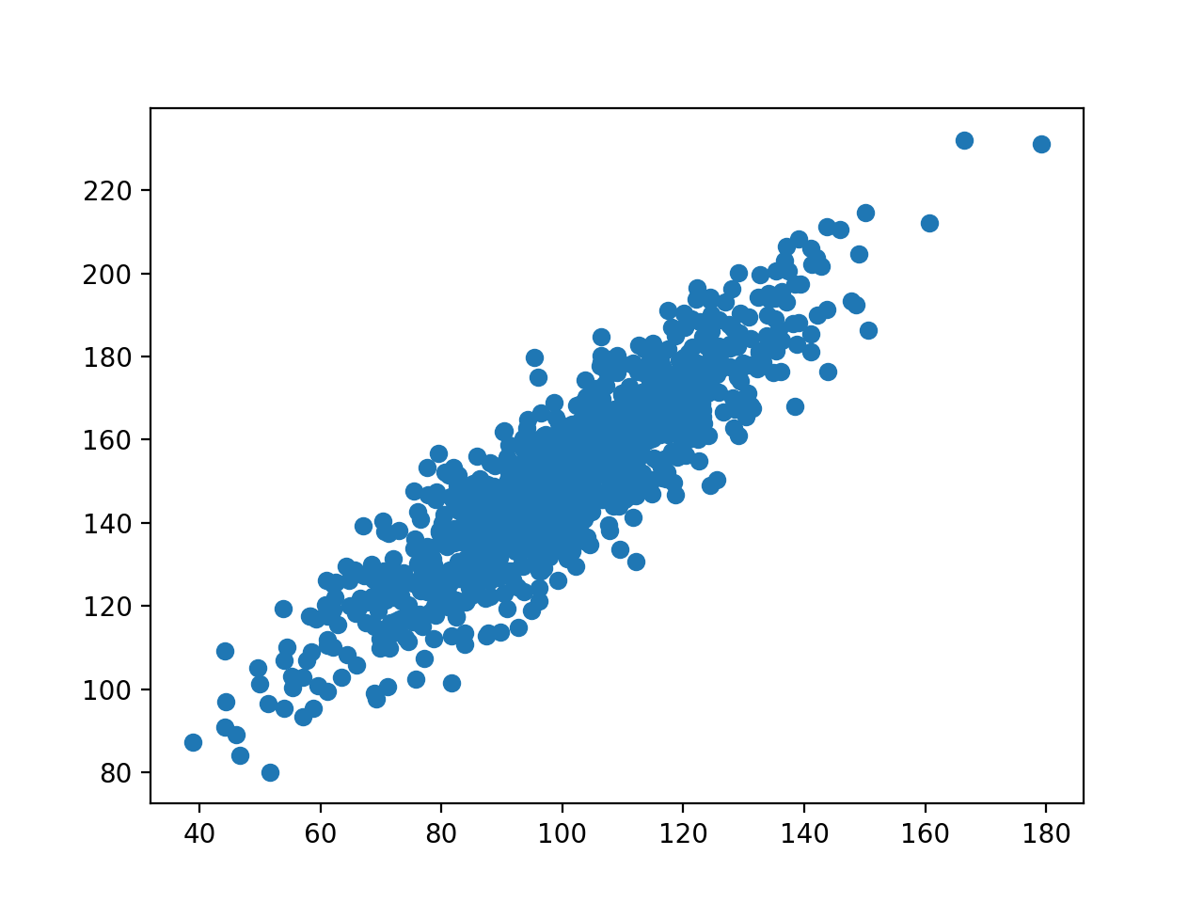
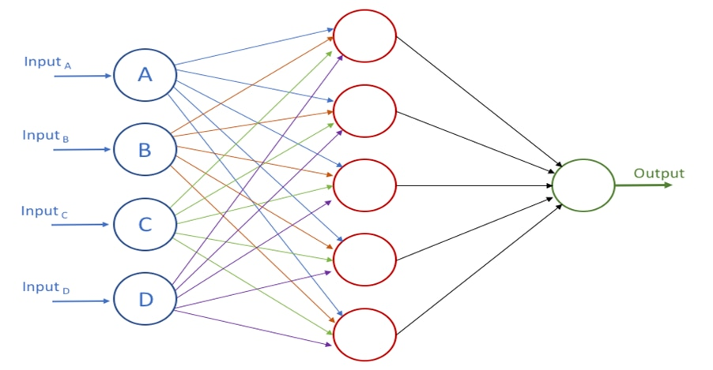

Method
Study 1: Machine learning
Study 2: Pre-registered correlational study
Study 3: Pre-registered experimental study

Slide 6
Machine Learning
A range of machine learning methods exist, e.g. random forest, gradient boost, k-nearest neighbours, support-vector machine, and neural networks
Authors used neural networks which can model complex non-linear relationships between the outcome variable and its predictors
Has been the source of recent ground-breaking findings in physics, chemistry, and biology
Algorithms that can build a model based on sample (training) data, which is used to make predictions or make decisions without explicitly being programmed to do so

Slide 7
Why use machine learning?
Linear regressions rely on assumptions such as homoscedasticity and independently, identically, and normally distributed residuals. Can only be run on observations with no missing values.
Regression methods limit the range of possible predictor variables to those that have a mostly linear and direct relationship with the outcome variable
Machine learning does not make any auxiliary assumptions and can impute large volumes of missing data (either in a separate stage prior to modelling or during the process of modelling)
Neural networks can capture nonlinear effects and complex interactions

Slide 8

Authors examined the World Values Survey (WVS)
975 variables across 348,532 individuals
Surveys conducted in 98 countries across six waves: 1981–1984, 1989–1993, 1994–1998, 1999–2004, 2005–2009, and 2010–2014
Different items were administered in different waves and in different countries within each wave
Contains a measure of unethical behaviour as well as a lot (!!!) of other potential predictors

Slide 9
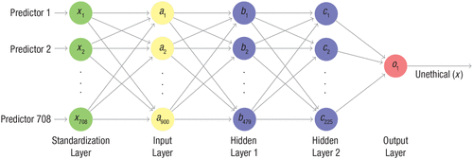

Four items in WVS related to justifiability of unethical behaviour identified – Participants split into ”ethical” and “unethical”

Slide 10
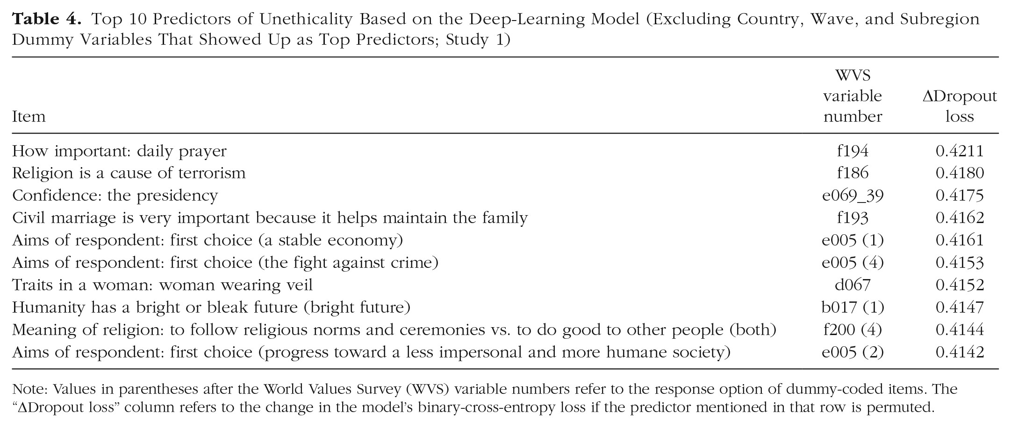

Slide 11
No overlap between top 10 predictors identified by the model and top 10 predictors identified via correlation
Predictor variables did not need to be highly correlated with the dependent variable to make a significant contribution to the model’s prediction accuracy
Regression could not be run due to missing data. GLM prediction accuracy was significantly lower than accuracy of neural network model.
Regression run on data imputed by the machine learning model also had significantly lower accuracy
Four of top 10 predictors identified by regression overlapped with model’s top 10 predictors
Identified “Humanity has a bright or bleak future” as an appropriate predictor
Hypothesised optimism reduces the justifiability of unethical behaviour

Slide 12
Correlational Replication
Scheier and Carver’s (1985) optimism scale
Detert, Treviño, and Sweitzer’s (2008) unethical-decision-making scale
Pre-registered methods and analyses – OSF
Optimism was negatively related to people’s willingness to engage in unethical behaviours (r = -.213)

Slide 13
Experiment
5 items related to justifiability of unethical behaviour related to COVID-19 e.g. “A friend suggests that despite the social distancing guidelines, it is OK to get together with a few friends for a drink, as long as everyone doesn’t show any respiratory symptoms.”
Participants randomly assigned to optimism or pessimism condition – presented scenario stating the future of COVID-19 is bright vs. bleak
Pre-registered methods and analyses – OSF
Participants in optimism condition less likely to find unethical behaviours justifiable

Slide 14
Optimism scenario
Imagine that you are in a restaurant or bar, chatting with a small group of your closest friends.
You and your friends are discussing the recent outbreak of the new coronavirus Covid-19 all over the world.
One of your friends says that the future of this epidemic is looking bright. She mentions that many countries have imposed lockdowns, preventing people from traveling and gathering in public places. China’s experience shows that locking down cities can practically stop the virus from spreading within two months. So within two months, the virus should be contained.
Another friend mentions that a vaccine will be developed much sooner than expected. Earlier scientists were saying that it will take 18 months to develop a vaccine, but a German company already has a vaccine ready. Within 6 months, everyone in the world can get the vaccine and end the coronavirus epidemic.
A third friend mentions that people and companies are taking steps to reduce contagion. She says that most companies have asked people to work from home. Most schools and colleges are closed. People are washing their hands more often and wearing masks in the public. People are going out less often. People are traveling less. Most people are staying at home. Because of these steps, the rate of new infections is guaranteed to go down.
You agree with your friends’ points. You argue that more and more countries are imposing lockdowns, prohibiting public gatherings and traveling, and producing more medical supplies, such as test kits. Very soon, we will be able to fight back the virus.
Overall, all of you agree that the future of the coronavirus situation is looking bright.

Slide 15
Pessimism scenario
Imagine that you are in a restaurant or bar, chatting with a small group of your closest friends.
You and your friends are discussing the recent outbreak of new coronavirus Covid-19 all over the world.
One of your friends says that the future of this epidemic is looking very bleak. She mentions that although many countries have imposed lockdowns, preventing people from traveling and gathering in public places, the lockdowns are not strict enough. 6 Democratic countries cannot control their citizens like China can. So it will be very difficult to contain the virus.
Another friend mentions that a vaccine takes much more time to develop than expected. Earlier scientists were saying that it will take 18 months to develop a vaccine, but recent reports say that this estimate is too optimistic. Within that time, everyone in the world will catch the coronavirus, so the vaccine won’t be of any use.
A third friend mentions that people and companies are not taking enough steps to reduce contagion. She says that people are still going out of their home for various errands and coming into contact with others. People are not washing their hands often enough, and there is a severe shortage of masks and hand sanitizer. People are still traveling, although less so than before. Because of this, the rate of new infections is still pretty high.
You agree with your friends’ points. You argue that more and more countries are seeing an uncontrolled spread of infections, and don’t have enough medical supplies and test kits. It is very difficult to imagine how they will fight the virus.
Overall, all of you agree that the future of the coronavirus situation is looking very bleak

Slide 16
Model’s hypothesis supported by correlational and experimental studies
Authors could not locate previous research documenting the link between optimism and unethical behaviour – difficult to generate current hypothesis using traditional methods of hypothesis generation
Does not identify theory or mechanism that can explain the relationship

Slide 17
Thoughts?

Slide 18
Technical barriers
Machine learning expertise – although code for model is available
Computational power
16 thread CPU – 550 AUD
128 GB RAM – 950 AUD
4x GPU – 2,000 AUD
Analysis on CPU ran for 10 days (they gave up)

Slide 19
Next time…
Milestone Three presentation – Aaron ☺
End of year lunch after?

