Slide 1
R Session #4
Cognition and Emotion Group
Data Visualisation

Slide 2
Acknowledgement of Country
We acknowledge the Wadjuk Nyoongar people as the original custodians of this land, and pay our respects to Elders past, present and emerging.

Slide 3
Last Session…
Analyses
t-tests using the t.test() function
ANOVA using the ezANOVA() function
Pairwise comparisons using emmeans()
Pearson’s r using the cor.test() function
Indexing the columns and rows we want to analyse
Check back on last session’s materials if you missed it!

Slide 4
This Week…
Data visualisation using the ggplot2 package

Slide 5
ggplot2
A system for declaratively creating graphics
Based on the grammar of graphics
The idea you can build every graph from 3 components:
A data set
A coordinate system
Visual marks that represent data points (geoms)
Provide the data, define aesthetic mappings, add layers to the plot

Slide 6
Why use ggplot2?
Looks pretty. Default output is more appealing than base graphics
Automatic legends, colours etc.
Customisable
Can export to SVG to get loss-less quality plots
Can plot individual average points
Reproducible
Large and active community

Slide 7
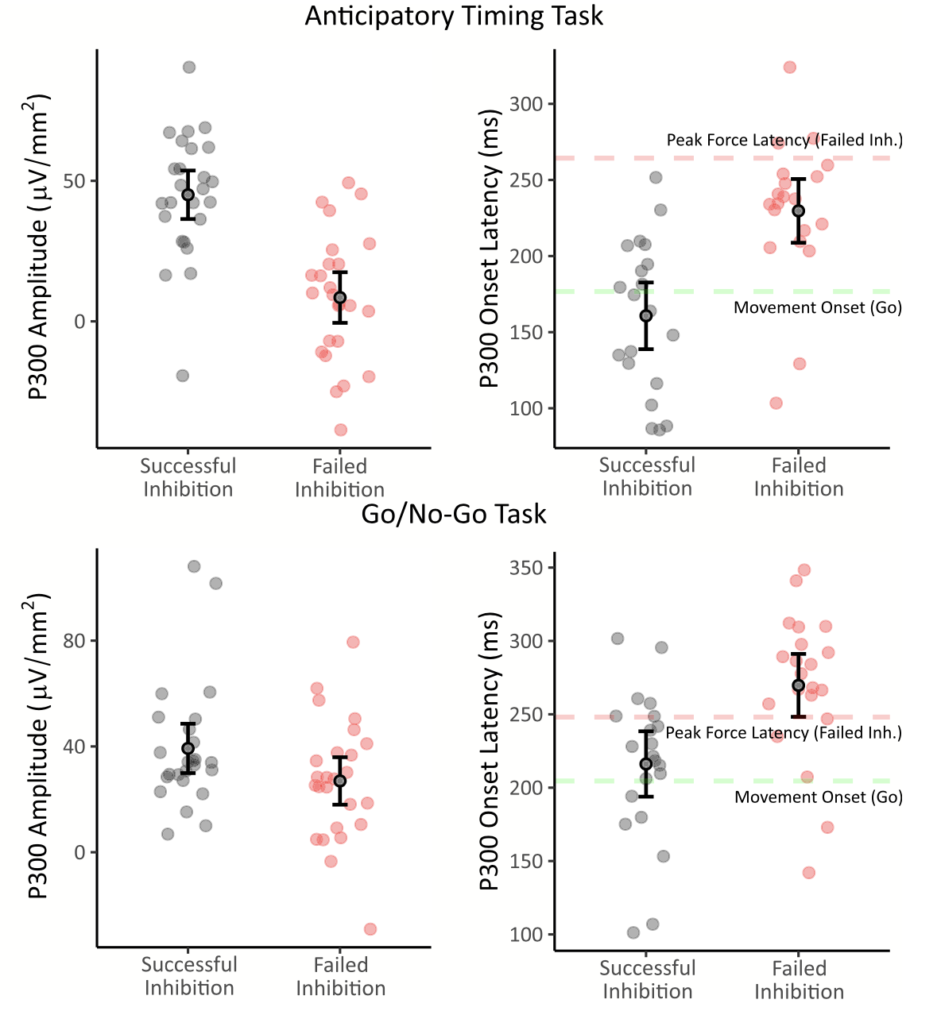
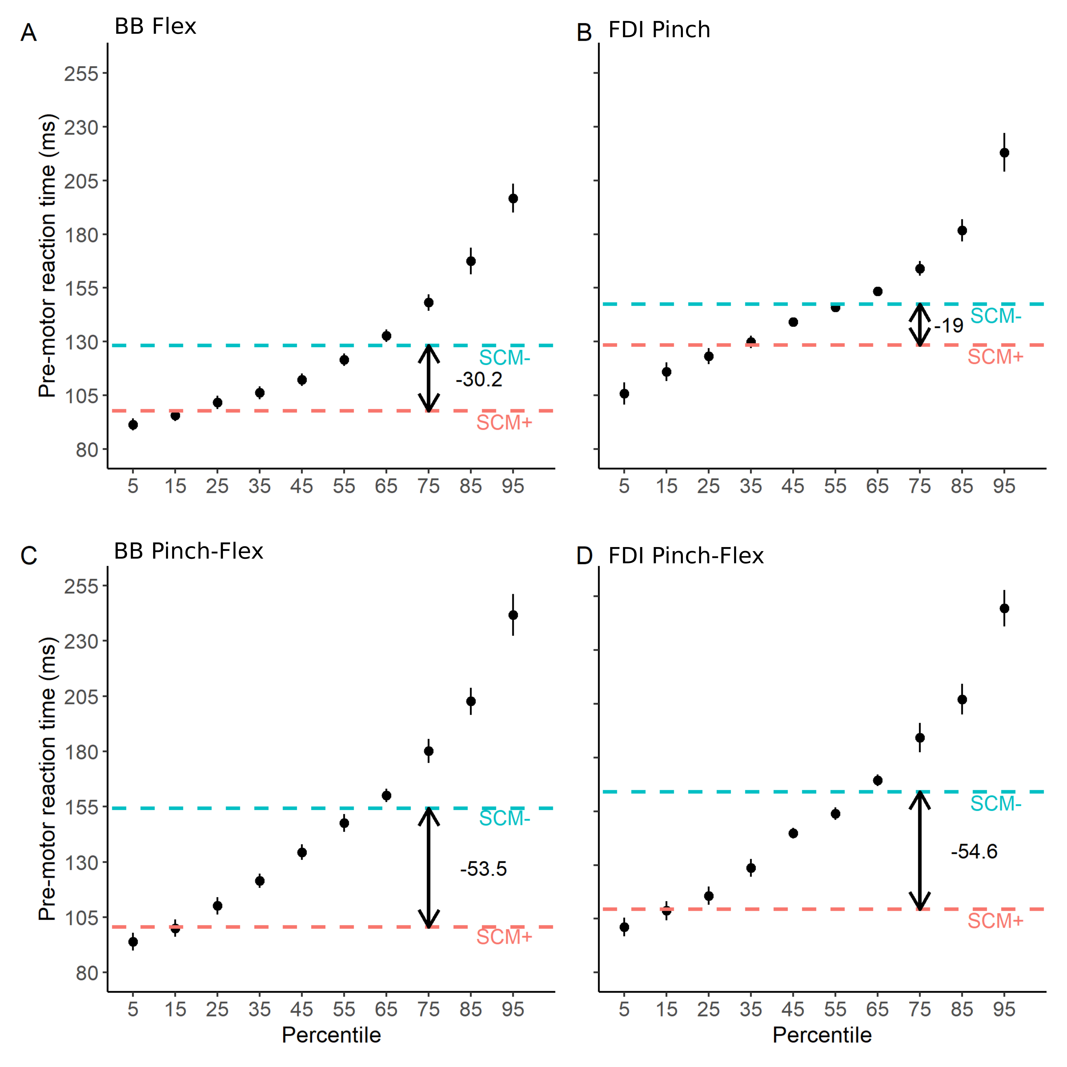
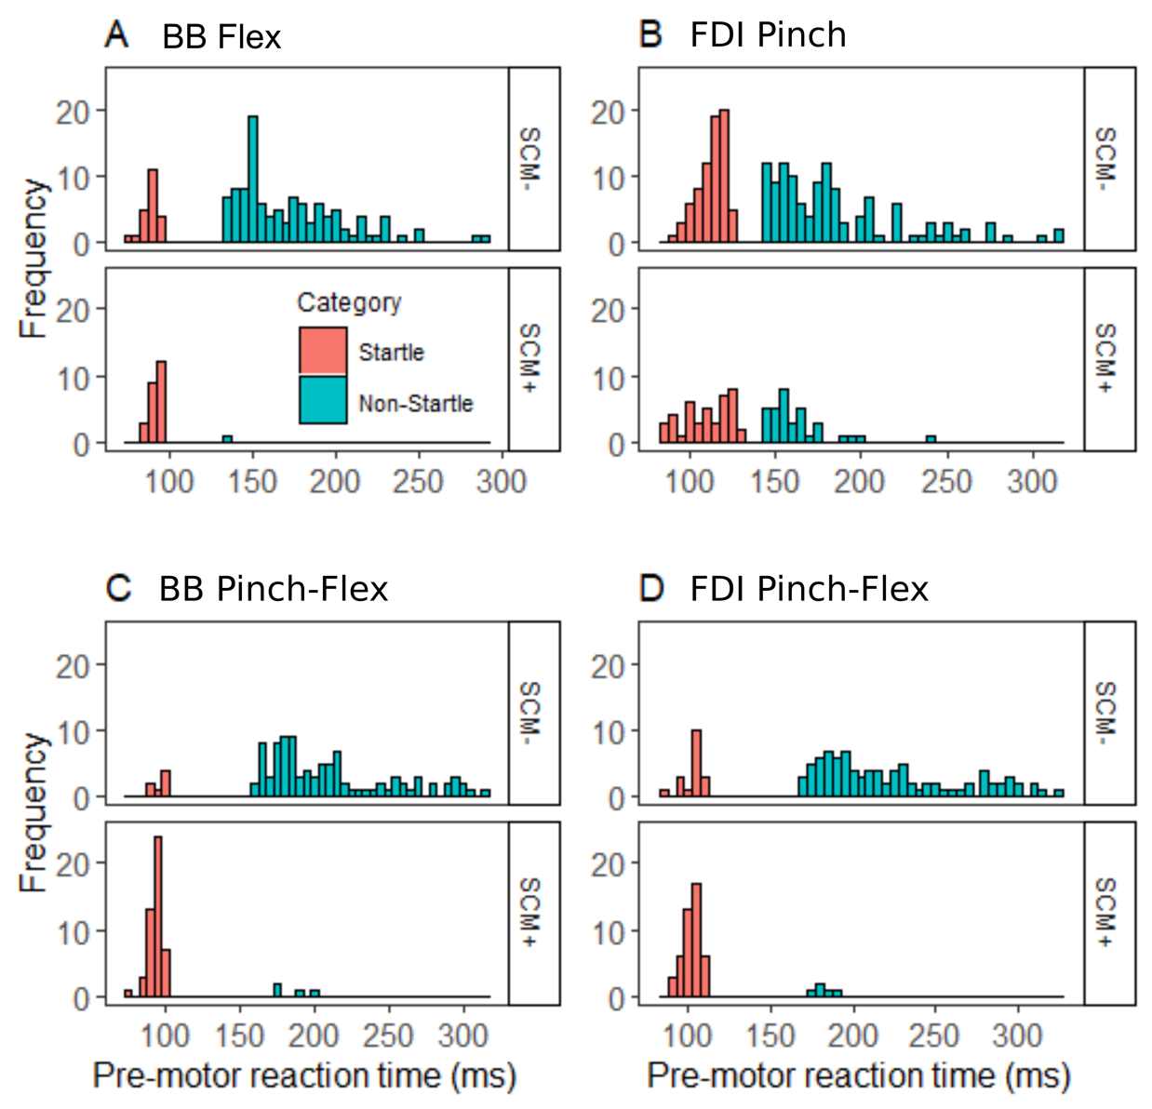

Slide 8
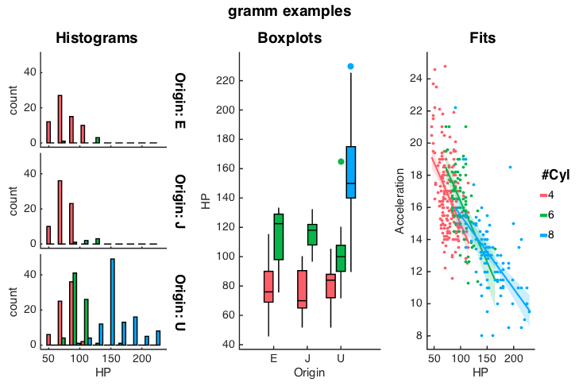

Slide 9
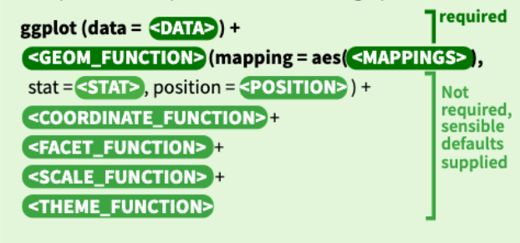
The ggplot() function

Slide 10
Bar Graphs with ggplot()
First we need to calculate averages if we want to present summary statistics
summarySEwithin() from the Rmisc package can handle this
Install Rmisc and add library(Rmisc) to the top of your script
summary <- summarySEwithin(my_data, measurevar = "RT", withinvars = c("condition"), idvar = "subject_id")

Slide 11
Bar Graphs with ggplot()
Create the most basic plot with
ggplot(data = summary, aes(x = condition, y = RT)) +
geom_bar(stat = "identity")

Slide 12
Bar Graphs with ggplot()
We can add/modify a range of things in the plot e.g.
Colours
X and Y axis labels
Legend
Error bars
Themes

Slide 13
Bar Graphs with ggplot()
To add colours to the plot, specify a fill argument in the aes mapping:
ggplot(data = summary, aes(x = condition, y = RT, fill = condition)) +
geom_bar(stat = "identity")
Note the difference between the fill and color arguments

Slide 14
Bar Graphs with ggplot()
To change the x axis labels, add a scale_x_discrete() layer
To change the y axis labels, add a scale_y_continuous() layer
ggplot(data = summary, aes(x = condition, y = RT, fill = condition)) +
geom_bar(stat = "identity")+
scale_x_discrete(labels = c("Condition 1", "Condition 2", "Control"), name = "Condition") +
scale_y_continuous(name = "Reaction Time (ms)")

Slide 15
Bar Graphs with ggplot()
To change the legend labels and title, add a scale_fill_discrete layer
ggplot(data = summary, aes(x = condition, y = RT, fill = condition)) +
geom_bar(stat = "identity")+
scale_x_discrete(labels = c("Condition 1", "Condition 2", "Control"), name = "Condition") +
scale_y_continuous(name = "Reaction Time (ms)") +
scale_fill_discrete(labels = c("Condition 1", "Condition 2", "Control"), name = "Condition")
TIP: Use theme(legend.position = “none”) to remove the legend

Slide 16
Bar Graphs with ggplot()
To add error bars, add a geom_errorbar() layer
ggplot(data = summary, aes(x = condition, y = RT, fill = condition)) +
geom_bar(stat = "identity")+
scale_x_discrete(labels = c("Condition 1", "Condition 2", "Control"), name = "Condition") +
scale_y_continuous(name = "Reaction Time (ms)") +
scale_fill_discrete(labels = c("Condition 1", "Condition 2", "Control"), name = "Condition") +
geom_errorbar(aes(ymin = RT - se, ymax = RT + se), width = .2, position=position_dodge(.9))

Slide 17
Themes in ggplot()
There are many customisable theme presets for ggplot
Try adding theme_classic() to your bar graph

Slide 18
Scatter Plots with ggplot()
Load another dataset using load(dataRT)
Create the most basic plot with
ggplot(data = dataRT, aes(x = age, y = RT)) +
geom_point()

Slide 19
Scatter Plots with ggplot()
Add a regression line using geom_smooth()
ggplot(data = dataRT, aes(x = age, y = RT)) +
geom_point() +
geom_smooth(method = lm)
You can remove the confidence interval shading by adding the se = FALSE argument to geom_smooth()

Slide 20
Scatter Plots with ggplot()
Change the shape and colour of data points by the grouping variable
ggplot(data = dataRT, aes(x = age, y = RT, shape = group, colour = group)) +
geom_point() +
geom_smooth(method = lm, se = FALSE)

Slide 21
Box Plots with ggplot()
Create simple boxplot with
ggplot(data = my_data, aes(x = condition, y = RT)) +
geom_boxplot()

Slide 22
Box Plots with ggplot()
Add data points with geom_dotplot()
ggplot(data = my_data, aes(x = condition, y = RT)) +
geom_boxplot() +
geom_dotplot(binaxis = 'y', stackdir = 'center’)
TIP: You can change the size of the dots using the dotsize = argument in geom_dotplot()

Slide 23
Violin Plots with ggplot()
Create a simple violin plot with
ggplot(data = my_data, aes(x = condition, y = RT)) +
geom_violin(trim = FALSE)

Slide 24
Violin Plots with ggplot()
Add a box plot and data points
ggplot(data = my_data, aes(x = condition, y = RT)) +
geom_violin(trim = FALSE) +
geom_boxplot(width = 0.1) +
geom_dotplot(binaxis = 'y', stackdir = 'center', dotsize = .5)

Slide 25
Violin Plots with ggplot()
Change colour by condition and edit labels
ggplot(data = my_data, aes(x = condition, y = RT)) +
geom_violin(trim = FALSE) +
geom_boxplot(width = 0.1) +
geom_dotplot(binaxis = 'y', stackdir = 'center', dotsize = .5) +
scale_fill_brewer(palette="Blues") +
scale_x_discrete(labels = c("Condition 1", "Condition 2", "Control"), name = "Condition") +
scale_y_continuous(name = "Reaction Time (ms)") +
theme_classic()+
theme(legend.position = "none")

Slide 26
Some more tips:
Patchwork library allows you to join plots together easily
Install and add library(pathwork) to the top of your script
Arrange plots horizontally with + operators
barP + scatterP + violinP
Arrange horizontally with
barP + scatterP + violinP + plot_layout(ncol = 1)
Other arrangements with different operators, e.g.
barP + scatterP / violinP

Slide 27
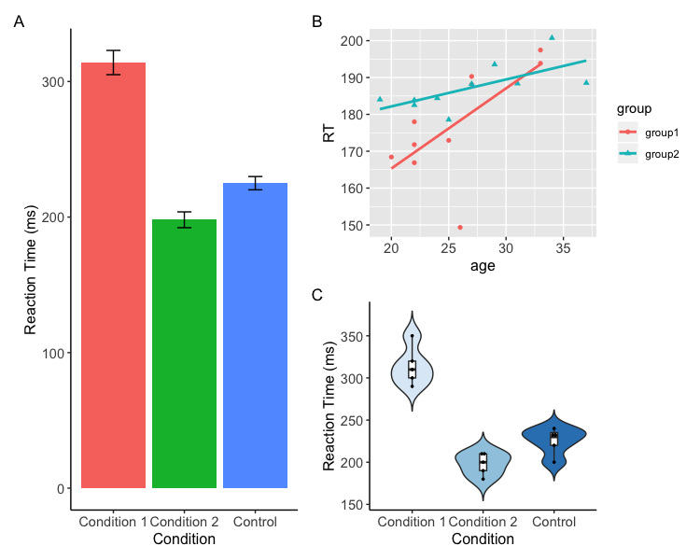
Some more tips:
Patchwork can also add annotations automatically
Useful to apply settings that are used for all plots (e.g. font style and size) when arranging e.g.
barP + scatterP / violinP +
plot_annotation(tag_levels = "A") &
theme(
axis.title.y =element_text(family="Arial", size=12),
axis.title.x =element_text(family="Arial", size=12),
axis.text.y = element_text(family="Arial", size=11),
axis.text.x = element_text(family="Arial", size=11)
)

Slide 28
Some more tips:
Default scale is usually fine but you can adjust
scale_y_continuous can be used to adjust the scale of the y axis by adding the limits = c(min, max) argument
scale_y_continuous(limits = c(150, 400)

Slide 29
Saving
You can save plots from the plot panel > export menu
Or using code:
First set the working directory (where to save the file)
setwd(“YOUR_FILE_PATH”)
Then save using
ggsave(plotToSave, filename = "Plots.svg", width = 10, height = 8)
plotToSave must match the name of an object you have created using ggplot
Change filename extension e.g. ”Plots.png” to change the file type

