Slide 1
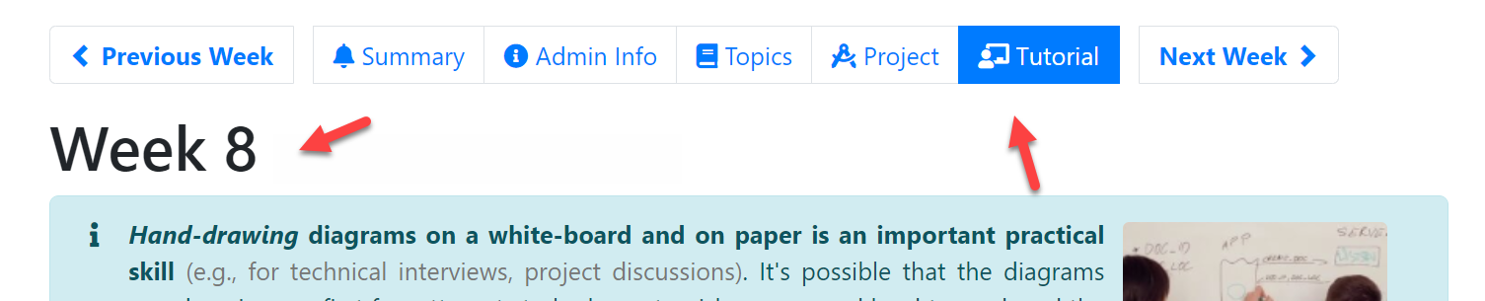
CS2103/T Tutorial – Week 8
First 10 minutes:
Copy-paste photos/scans/screenshots of the answers to this week’s tutorial tasks in T8-Workspace…pptx file. Add more slides if needed.
While waiting for the discussion to start, also look at answers posted by others.
Hand-draw the diagrams please … ATM, we are practicing for using UML diagrams in aid of discussions.

Slide 2
UML exercises
Switch-on your video camera.
I’ll show a sample answer (step-by-step) and ask what problems you notice at each step.
Send me the answer via Zoom private message. E.g. arrow line must be dashed. Multiplicity should be 1. Navigability is in the wrong direction. Everyone must answer. If you think there are no problems, answer ‘None’
Workspace slides are not graded. During the rest of the tutorial, pay attention to the discussion rather than try to fill up the workspace slides.
The final answer will be shared at the end, but not the full slide deck.

Slide 4
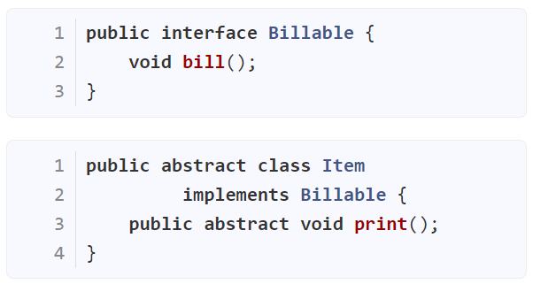
The partial class diagram below is supposed to match the code given on the left. What errors do you see? Reply ‘None’ if you don’t see any errors.
{interface} Billable
bill()
{abstract}
Item
+print() {abstract}
bill()

Slide 5
Should be a triangle. Doesn’t matter if solid or empty
<<interface>> Billable
Can put ‘+’ here.
Java interface methods are public by default.
Optional to include empty boxes
bill()
{abstract}
Item
+print() {abstract}
bill()
bill() should not appear here

Slide 6
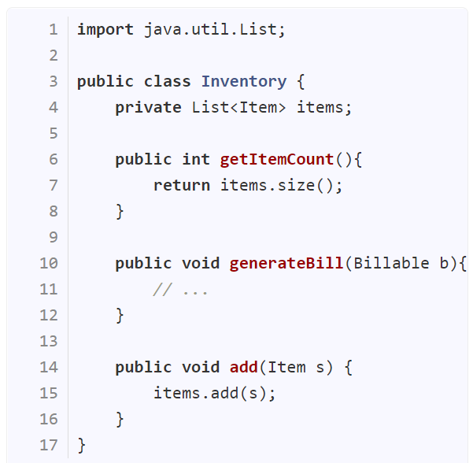
<<interface>> Billable
bill()
{abstract}
Item
*
Inventory
items
- items: List<Item>
+print() {abstract}
+getItemCount()
+generateBill(Billable)
+getItemCount()
+add(Item)

Slide 7
<<interface>> Billable
bill()
{abstract}
Item
*
Inventory
items
- items: List<Item>
+print() {abstract}
+getItemCount()
Error: Shown as both attribute and a line
+generateBill(Billable)
+getItemCount()
+add(Item)
Error: Each method in a separate box

Slide 8
<<interface>> Billable
bill()
{abstract}
Item
*
Inventory
items
+generateBill(Billable)
+getItemCount()
+add(Item)
+print() {abstract}
This is an aggregation but no need to show it (we recommend not using aggregation in class diagrams because there is not much value)
OK to show the return type here
Should this be shown as a dependency too? i.e., Item <--- Inventory

Slide 9
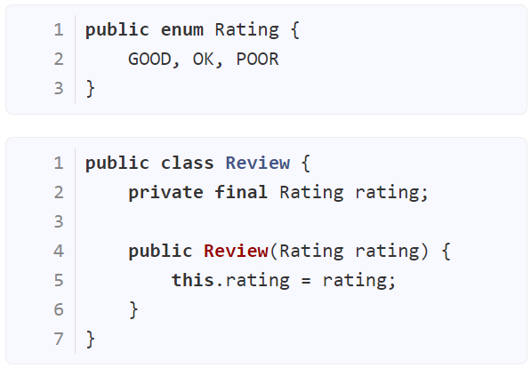
<<interface>> Billable
bill()
<<enumeration>> Rating
{abstract}
Item
*
Inventory
items
GOOD
OK
POOR
+add(Item)
+generateBill(Billable)
+getItemCount()
+print() {abstract}
rating
1
Review
+Review(Rating)

Slide 10
<<interface>> Billable
bill()
<<enumeration>> Rating
{abstract}
Item
*
Inventory
items
GOOD
OK
POOR
+add(Item)
+generateBill(Billable)
+getItemCount()
+print() {abstract}
OK to show as composition
rating
0..1
1 is OK too
Review
+Review(Rating)

Slide 11
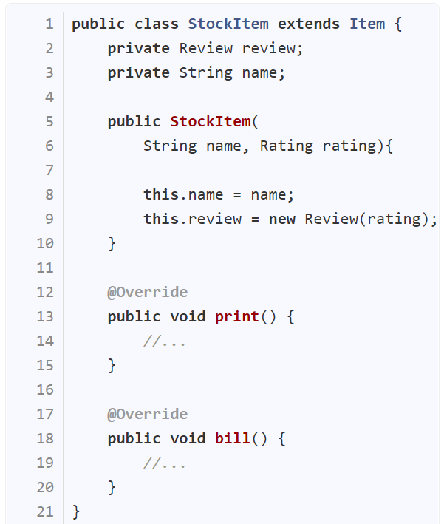
<<interface>> Billable
bill()
<<enumeration>> Rating
{abstract}
Item
*
Inventory
items
GOOD
OK
POOR
+add(Item)
+generateBill(Billable)
+getItemCount()
+print() {abstract}
rating
0..1
StockItem
Review
+Review(Rating)
1
+StockItem(String, Rating)
+print()
+bill()
name
String
0..1

Slide 12
<<interface>> Billable
bill()
<<enumeration>> Rating
{abstract}
Item
*
Inventory
items
GOOD
OK
POOR
+add(Item)
+generateBill(Billable)
+getItemCount()
+print() {abstract}
rating
0..1
StockItem
Review
- name: String
+Review(Rating)
1
name
+StockItem(String, Rating)
+print()
+bill()
String
0..1 is OK too
0..1

Slide 13
StockItem
name = “spanner”

Slide 14
Also correct (i.e., can give any name):
spanner:StockItem
s:StockItem
:StockItem
name = “spanner”

Slide 15
:Item
:Inventory
:StockItem
name = “spanner”

Slide 16
:Item
Also correct to use :Item (if the exact subclass is not relevant to the purpose)
:StockItem
:Inventory
name = “spanner”

Slide 17
:Rating
:Review
:StockItem
:Inventory
POOR
0..1
1
name = “spanner”

Slide 18
Dependencies occur between classes, not objects
:Rating
:Review
:StockItem
:Inventory
POOR
0..1
1
name = “spanner”
Object diagrams don’t show multiplicities

Slide 19
:Rating
:Review
:StockItem
:Inventory
POOR
rating=POOR
name = “spanner”

Slide 20
<<interface>> Billable
bill()
<<enumeration>> Rating
{abstract}
Item
*
Inventory
items
GOOD
OK
POOR
+add(Item)
+generateBill(Billable)
+getItemCount()
+print() {abstract}
rating
0..1
StockItem
Review
- name: String
+Review(Rating)
1
+StockItem(String, Rating)
+print()
+bill()
:Rating
:Review
:StockItem
:Inventory
POOR
name = “spanner”

Slide 21
Switching to audio mode now …

Slide 22
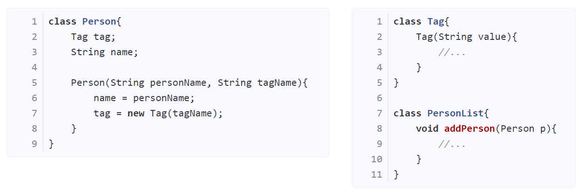
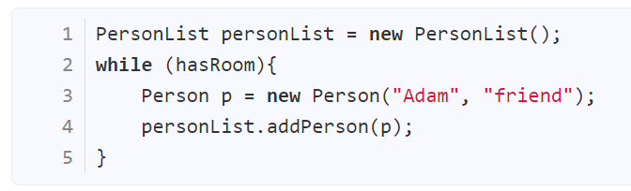

Slide 23
personList:PersonList
PersonList()

Slide 24
PersonList()
optional
personList:PersonList

Slide 25
PersonList()
personList:PersonList
Person(“Adam”, “friend”)
p:Person

Slide 26
PersonList()
personList:PersonList
Person(“Adam”, “friend”)
p:Person
Should not be longer than the return arrow position

Slide 27
PersonList()
personList:PersonList
Person(“Adam”, “friend”)
p:Person
Tag(“friend”)
:Tag

Slide 28
PersonList()
personList:PersonList
Person(“Adam”, “friend”)
p:Person
Tag(“friend”)
:Tag

Slide 29
PersonList()
personList:PersonList
Person(“Adam”, “friend”)
p:Person
Tag(“friend”)
:Tag
addPerson(p)

Slide 30
PersonList()
personList:PersonList
Person(“Adam”, “friend”)
p:Person
Tag(“friend”)
:Tag
addPerson(p)

Slide 31
PersonList()
personList:PersonList
loop (hasRoom)
Person(“Adam”, “friend”)
p:Person
Tag(“friend”)
:Tag
addPerson(p)

Slide 32
PersonList()
personList:PersonList
loop [hasRoom]
Person(“Adam”, “friend”)
p:Person
Tag(“friend”)
:Tag
addPerson(p)

Slide 33
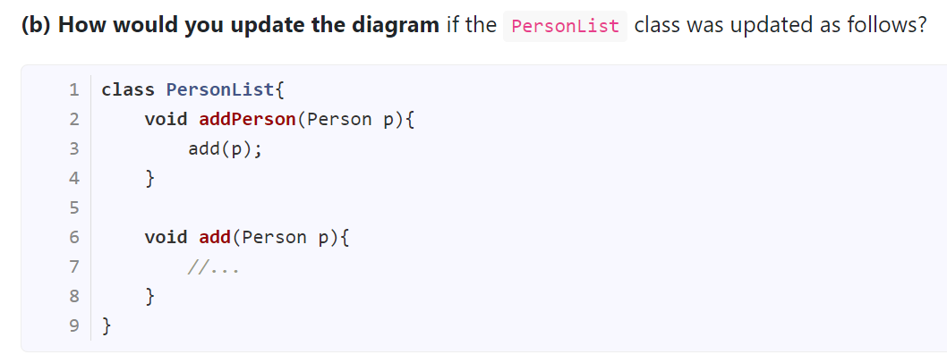
PersonList()
personList:PersonList
loop [hasRoom]
Person(“Adam”, “friend”)
p:Person
Tag(“friend”)
:Tag
add(p)
addPerson(p)

Slide 34
PersonList()
personList:PersonList
loop [hasRoom]
Person(“Adam”, “friend”)
p:Person
Tag(“friend”)
:Tag
add(p)
addPerson(p)
OK to omit (optional)

Slide 35
PersonList()
personList:PersonList
loop [hasRoom]
Person(“Adam”, “friend”)
p:Person
Tag(“friend”)
:Tag
add(p)
addPerson(p)

Slide 36
What’s next?
tP – week 8: …
tP – week 9:
If you defined v1.2 to be small as we recommended,
you should be close to finishing it, if not finished already.
no reason not to have a working product at v1.2 deadline
You’ll be asked to demo v1.2 in next week’s tutorial. It must be a working product.

Slide 37
Week 8 staff meeting
First few minutes: Do the CATcher testing, as explained in the tutor wiki

