Slide 1
Making filesystems resilient: RAID
"Redundant Array of Inexpensive Disks"

Slide 2
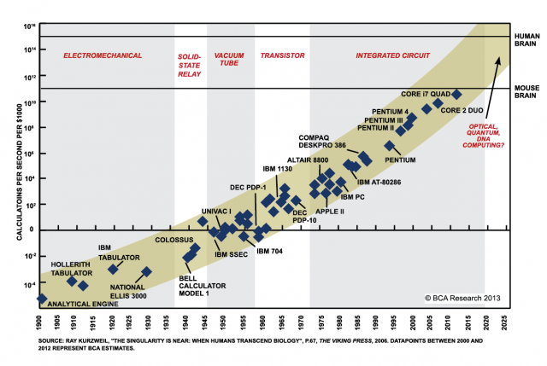
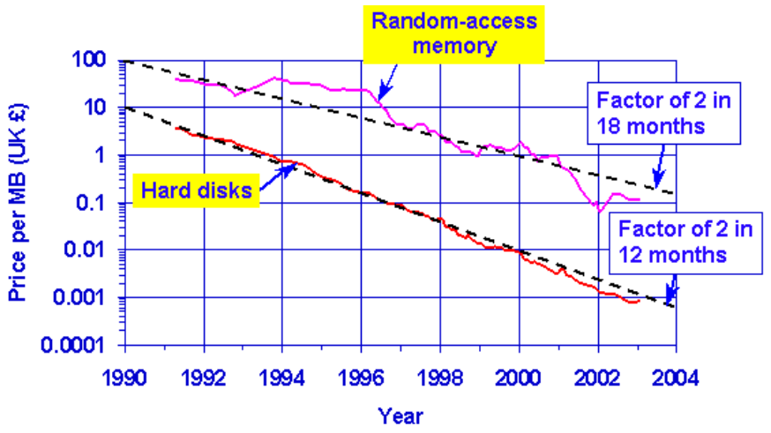
Why RAID ? Speed & Cost
Speed of disks not matching other components
Moore’s law: CPU speed doubles every 18 months
SRAM speeds increasing by 40-100% a year
In contrast, disk seek time only improving 7% a year
Although greater density leads to improved transfer times once seek is done
Emergence of PCs starting to drive down costs of disks
PC-class disks were smaller, cheaper, and only marginally slower

Slide 3
RAID Motivation
Basic idea: Build I/O systems as arrays of cheap disks
Allow data to be striped across multiple disks
Means you can read/write multiple disks in parallel – greatly improve performance
Problem: disks are unreliable
Mean Time to Failure (MTTF)
MTTF (disk array) = MTTF (single disk) / # disks
Adding more disks means that failures happen more frequently..
An array of 100 disks with an MTTF of 30,000 hours = just under 2 weeks for the array’s MTTF!

Slide 4
Increasing reliability
Idea: Replicate data across multiple disks
When a disk fails, lost information can be regenerated from the redundant data
Simplest form: Mirroring (also called “RAID 1”)
All data is mirrored across two disks
Advantages:
Reads are faster, since both disks can be read in parallel
Higher reliability (of course)
Disadvantages:
Writes are slightly slower, since OS must wait for both disks to do write
Doubles the cost of the storage system!

Slide 5
RAID 3
Rather than mirroring, use parity codes
Given N bits {b₁, b₂, ..., b_{N}}, the parity bit P is the bit {0,1} that yields an even number of “1” bits in the set {b₁, b₂, ..., b_{N}, P}
Idea: If any bit in {b₁, b₂, ..., b_{N}} is lost, can use the remaining bits (plus P) to recover it.
Where to store the parity codes?
Add an extra “check disk” that stores parity bits for the data stored on the rest of the N disks
Advantages:
If a single disk fails, can easily recompute the lost data from the parity code
Can use one parity disk for several data disks (reduces cost)
Disadvantages:
Each write to a block must update the corresponding parity block as well

Slide 6
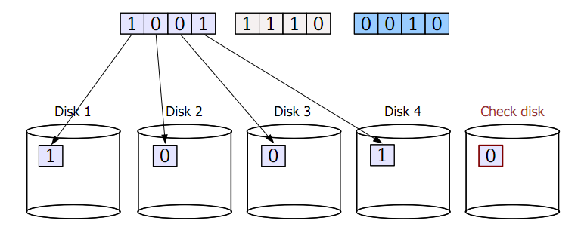
RAID 3 example

Slide 7
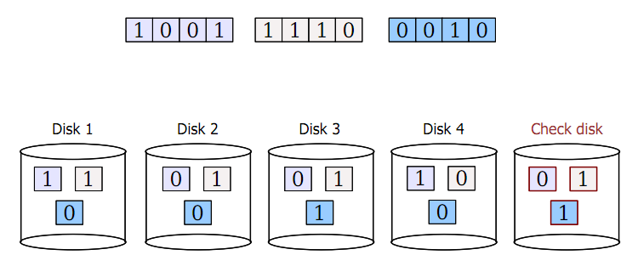
RAID 3 example

Slide 8
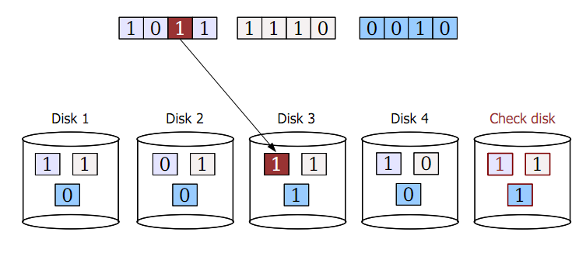
RAID 3 example

Slide 9
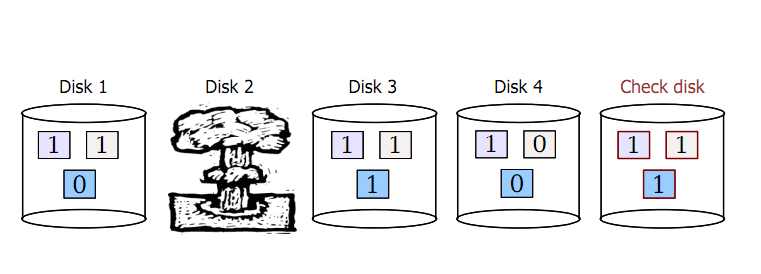
RAID 3 example

Slide 10
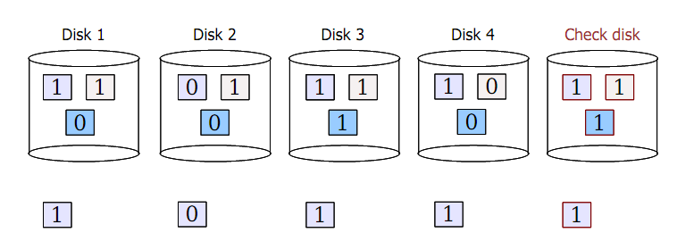
RAID 3 example
1. Read back data from other disks
2. Recalculate lost data from parity code
3. Rebuild data on lost disk

Slide 11
RAID 3 issues
Terminology
MTTF = mean time to failure
MTTR = mean time to repair
What is the MTTF of RAID?
Both RAID 1 and RAID 3 tolerate the failure of a single disk
As long as a second disk does not die while we are repairing the first failure, we are in good shape!
So, what is the probability of a second disk failure?
P(2nd failure) ≈ MTTR / (MTTF of one disk / # disks -1)
Assumes independent, exponential failure rates; see Patterson RAID paper for derivation
10 disks, MTTF (disk) = 1000 days, MTTR = 1 day
P(2nd failure) ≈ 1 day / ( 1000 / 9 ) = 0.009
What is the performance of RAID 3?
Check disk must be updated each time there is a write
Problem: The check disk is then a performance bottleneck
Only a single read/write can be done at once on the whole system!

Slide 12
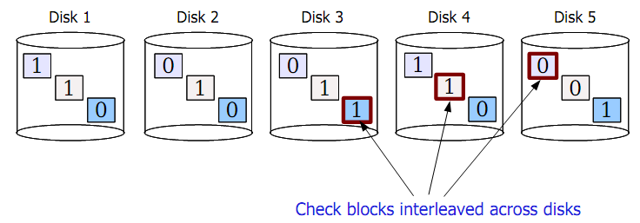
RAID 5
Another approach: Interleaved check blocks (“RAID 5”)
Rotate the assignment of data blocks and check blocks across disks
Avoids the bottleneck of a single disk for storing check data
Allows multiple reads/writes to occur in parallel (since different disks affected)

Slide 13
Reliable distributed storage
Today, giant data stores distributed across 100s of thousands of disks across the world
e.g., your mail on gmail
“You know you have a large storage system when you get paged at 1 AM because you only have a few petabytes of storage left.”
– a “note from the trenches” at Google
Notes:
Source of quote: http://goo.gl/LwFIy

Slide 14
A Planetary-sized Filesystem Case Study
Problem: Build a file system for Google
How do you make it resilient?

Slide 15
Reliable distributed storage
Issues
Failure is the common case
Google reports 2-10% of disks fail per year
Now multiply that by 60,000+ disks in a single warehouse...
Must survive failure of not just a disk, but
failure of a rack of servers or even…
a whole data center

Slide 16
How:
GFS 2001: Simple redundancy (2 or 3 copies of each file)
GFS 2010:
More efficient redundancy (analogous to RAID 3++)
Reed-Solomon codes with 1.5x redundancy
RS codes found in CDs, Space communication protocols
Lots of interesting tidbits:
https://cloud.google.com/files/storage_architecture_and_challenges.pdf
Notes:
(Voyager, Mars pathfinder…); very good at correcting bursty errors with reasonable space trade-offs.

