Slide 1
The Importance of the User Interface
Understanding the critical role UI plays in Human–Computer Interaction (HCI).
UI is the user's window into the system – it can be seen, heard, touched.
Goal: Make computing easy, productive, and enjoyable.

Slide 2
Defining the User Interface
UI is the part of the system that people can see, hear, touch, talk to, or otherwise understand.
Two components:
Input – How users communicate with the computer (keyboard, mouse, touch, voice).
Output – How the computer communicates results (display, audio, haptic).
Best UI: Not noticed by the user, allowing focus on tasks rather than mechanics.

Slide 3
The Importance of Good Design
Poor design causes frustration, inefficiency, errors, and even safety risks.
Good design improves task performance, reduces errors, and increases satisfaction.
Challenges: Limited time/resources, lack of knowledge about design principles.

Slide 4
The Benefits of Good Design
Improved productivity – e.g., 25% faster task completion.
Reduced training time & costs.
Fewer support calls; lower operational costs.
Higher user satisfaction; better customer service.
Economic value – every $1 spent on usability returns $10–$100.

Slide 5
A Brief History of the Human–Computer Interface
Early communication: gestures → spoken language → written language.
Computers initially relied on typed commands (command-line interfaces).
Other methods explored: voice recognition, handwriting recognition.

Slide 6
Introduction of the Graphical User Interface
1970s: Xerox PARC introduced mouse-based pointing and selection.
First GUIs: Xerox Alto, STAR – introduced direct manipulation.
1984: Apple Macintosh – first mass-market GUI.
1985: Microsoft Windows 1.0; Commodore Amiga.
1990s: Color, 3D effects, advanced widgets, cross-platform GUIs.

Slide 7
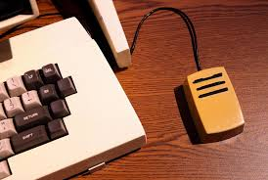
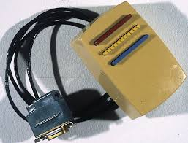
Xerox PARC had created a computer with a mouse and windows and bitmap screen before Apple or Microsoft, in fact Steve Jobs saw it and copied it for the Macintosh.
So how did they completely fail to lead personal computers?
answer

Slide 8
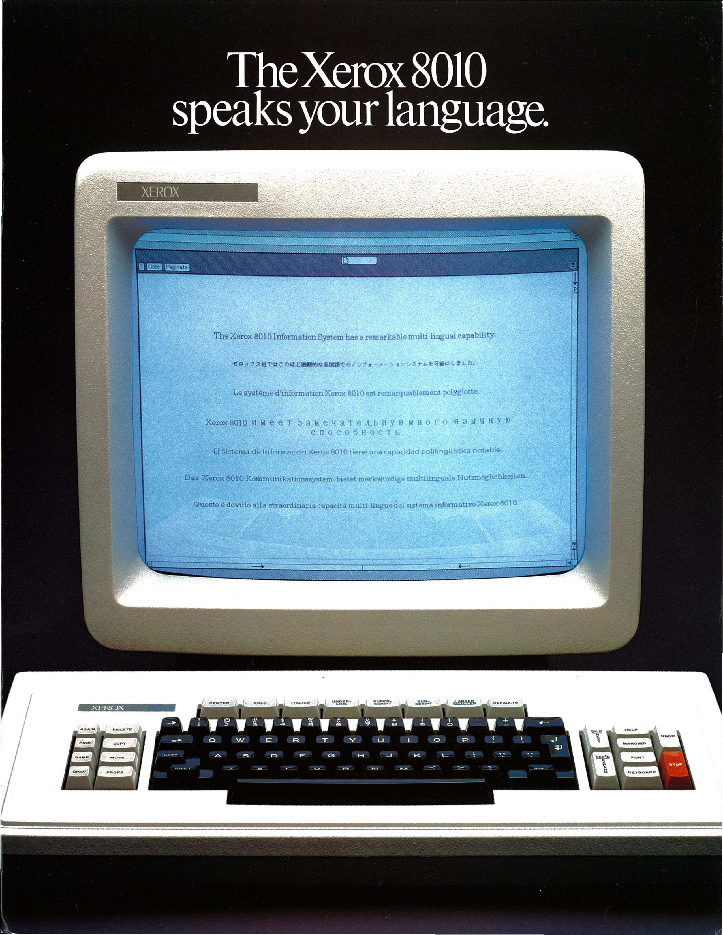
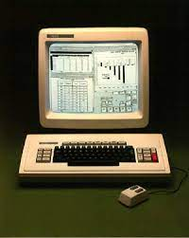
Link to the video of demonstration of first Machine
https://www.youtube.com/watch?v=_OwG_rQ_Hqw
The Xerox Alto and Xerox Star computers are foundational in the history of graphical user interfaces (GUIs), with the Alto being the first to demonstrate the desktop metaphor and GUI elements, and the Star introducing the concept of direct manipulation.

Slide 9
Interesting History
Xerox Alto (1973):
This research computer, while not commercially successful, was groundbreaking for its time. It featured a bitmapped display, a mouse for navigation, and the desktop metaphor, where the screen mimicked a physical workspace.
Xerox Star (1981):
Building on the Alto's foundation, the Star system emphasized "direct manipulation," where users could interact with on-screen objects in a more intuitive way, using a mouse and icons. This contrasted with command-line interfaces that required users to type in specific instructions.

Slide 10
The Blossoming of the World Wide Web
1960s: Internet roots in ARPANET (DARPA).
1991: Tim Berners-Lee introduced HTML and the World Wide Web.
1993: Mosaic browser – graphical web browsing.
1994–1996: Netscape Navigator, Internet Explorer, commercial internet expansion.
2000s+: Web becomes a dominant UI platform; multimedia & interactivity increase.

Slide 11
A Brief History of Screen Design
1970s: Text-only, cryptic, monochrome screens; high learning curve.
1980s: Better grouping, alignment, meaningful captions; prompts on screen.
1990s+: GUI design – borders, buttons, icons, list boxes, drop-downs.
Today: Responsive, touch-friendly, accessible designs.

Slide 12
What’s Next?
Integration of GUI and Web technologies.
More immersive interfaces – AR, VR, voice, gesture.
Personalization & AI-driven adaptive UIs.
Focus on accessibility, inclusivity, and cross-platform consistency.

