Slide 1
Design Consideration

Slide 2
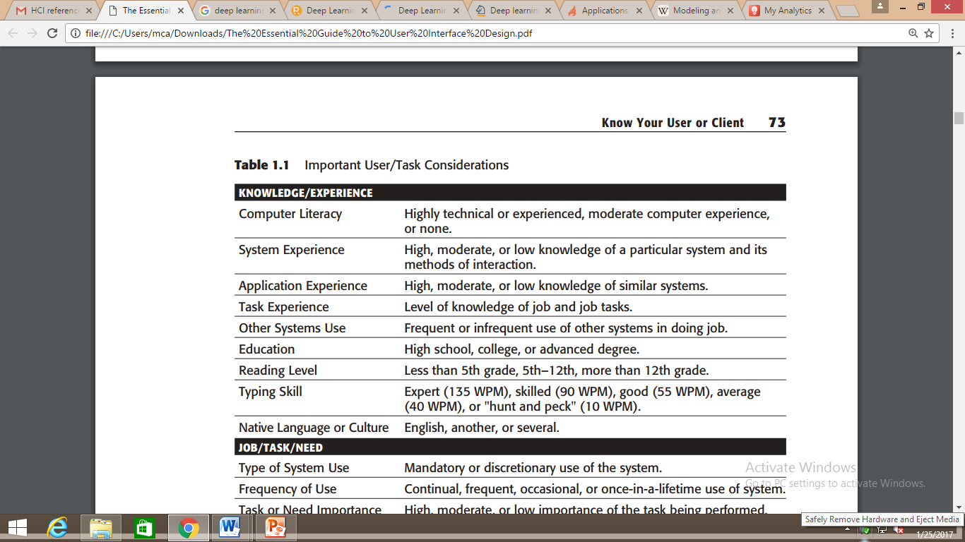
Human Considerations in Design

Slide 3
In business systems, novice users have been found to:
Depend on system features that assist recognition memory: menus, prompting information, and instructional and help screens.
Need restricted vocabularies, simple tasks, small numbers of possibilities, and very informative feedback.
View practice as an aid to moving up to expert status.

Slide 4
Experts, on the other hand:
Rely upon free recall.
Expect rapid performance.
Need less informative feedback.
Seek efficiency by bypassing novice memory aids, reducing keystrokes, chunking and summarizing information, and introducing new vocabularies.

Slide 5
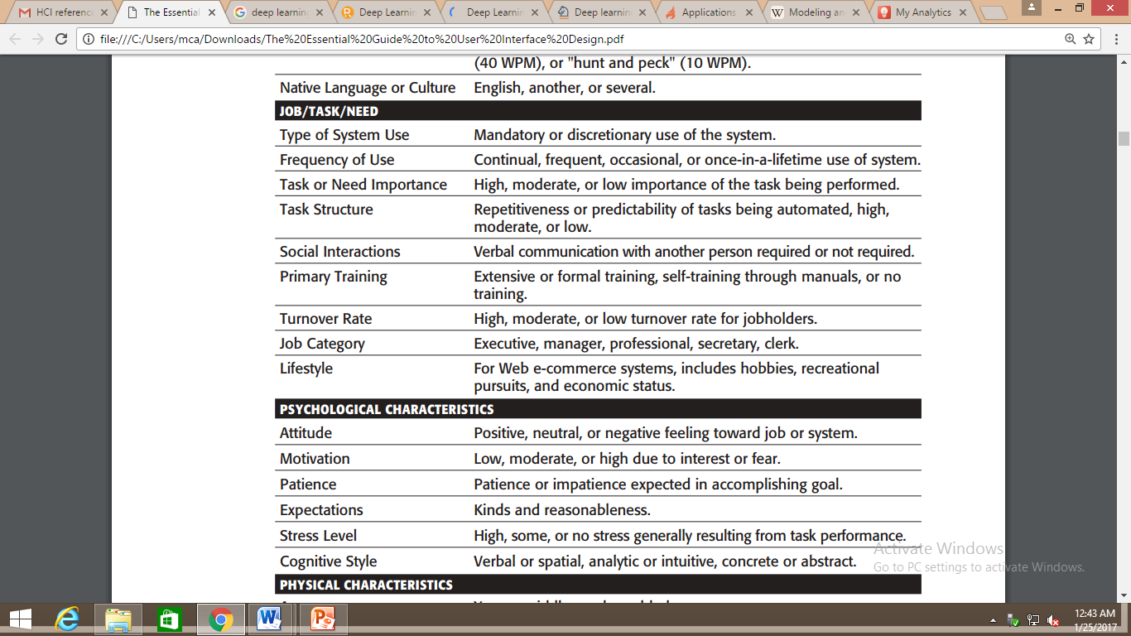
Human Considerations in Design

Slide 6
Characteristics of mandatory use can be summarized as follows:
The computer is used as part of employment.
Time and effort in learning to use the computer are willingly invested.
High motivation is often used to overcome low usability characteristics.
The user may possess a technical background.
The job may consist of a single task or function.

Slide 7
Characteristics of the discretionary user are as follows:
Use of the computer or system is not absolutely necessary.
Technical details are of no interest.
Extra effort to use the system may not be invested.
High motivation to use the system may not be exhibited.
May be easily disenchanted.
Voluntary use may have to be encouraged.
Is from a heterogeneous culture.

Slide 8
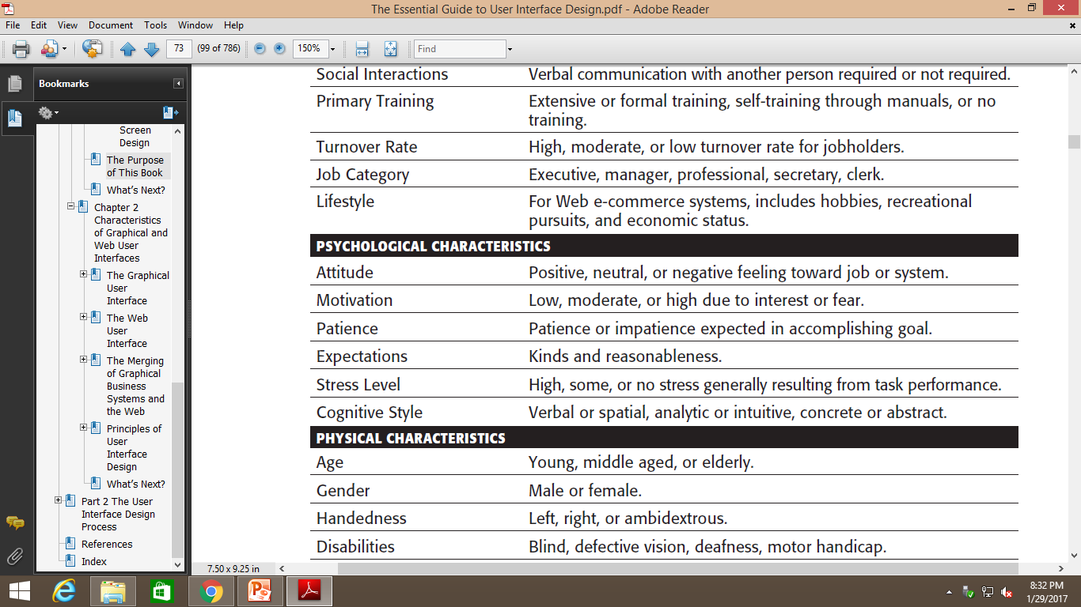
Human Considerations in Design

Slide 9
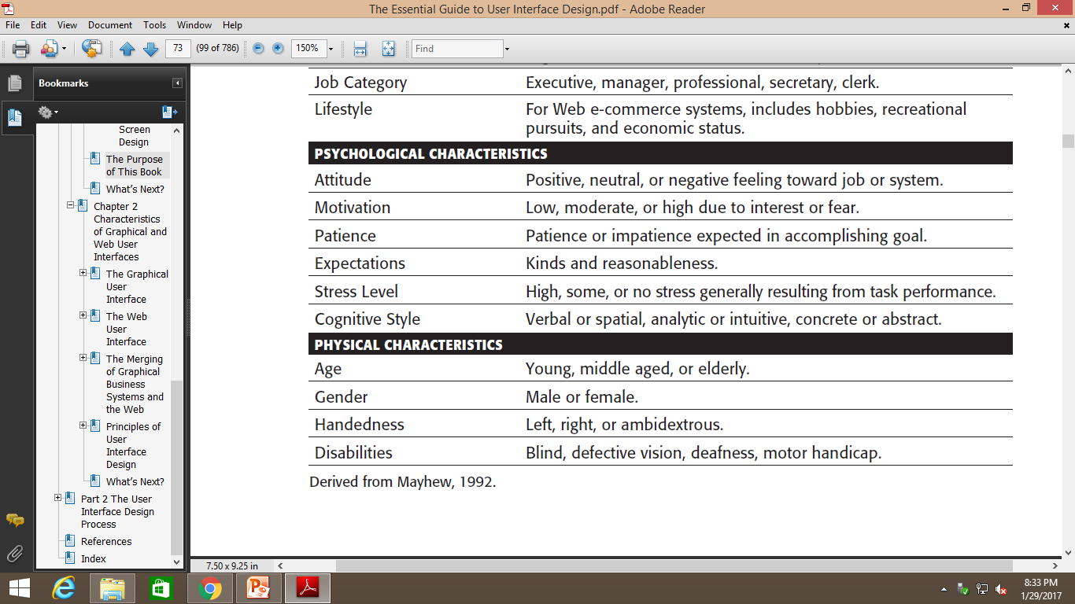
Human Considerations in Design

Slide 10
Hearing
As people age, they require louder sounds to hear, a noticeable attribute in almost any everyday activity.
Age in Years Sound Level in dB
25 57
45 65
65 74
85 85

Slide 11
Vision
Older adults read prose text in smaller type fonts more slowly than younger adults.
Brain processing also appears to slow with age. Working memory, attention capacity, and visual search appear to be degraded.

Slide 12
Human Interaction Speeds
Reading-The average adult, reading English prose in the United States, has a reading speed in the order of 250–300 words per minute.
Listening-Words can be comfortably heard and understood at a rate of 150 to 160 words per minute.
Speaking-Dictating to a computer occurs at a rate of about 105 words per minute
Keying-Fast typewriter typists can key at rates of 150 words per minute and higher. Average typing speed is considered to be about 60–70 words per minute.
Hand printing-People hand print memorized text at about 31 words per minute.

Slide 13
Methods for Gaining an Understanding of Users
Visit user locations, particularly if they are unfamiliar to you, to gain an understanding of the user’s work environment.
Talk with users about their problems, difficulties, wishes, and what works well now. Establish direct contact; avoid relying on intermediaries.
Observe users working or performing a task to see what they do, their difficulties, and their problems.
Videotape users working or performing a task to illustrate and study problems and difficulties.

Slide 14
Methods for Gaining an Understanding of Users
Learn about the work organization where the system may be installed.
Have users think aloud as they do something to uncover details that may not otherwise be solicited.
Try the job yourself. It may expose difficulties that are not known, or expressed, by users.

Slide 15
Methods for Gaining an Understanding of Users
Prepare surveys and questionnaires to obtain a larger sample of user opinions.
Establish testable behavioral target goals to give management a measure for what progress has been made and what is still required.

