Slide 1

Introduction to Human Machine Interaction
Unit-1

Slide 2
Definitions
User interface design is a subset of a field of study called human-machine interaction (HMI).
Human-Computer Interaction (HCI) is the study, planning, and design of how people and computer work together so that a person's needs are satisfied in the most effective way.
Human Machine Interaction is a multidisciplinary field with contributions from Human-Computer interaction (HCI), Human-Robot Interaction (HRI), Robotics, Artificial Intelligence (AI), Humanoid robots and exoskeleton control.
Typically information is displayed in a graphic format (Graphical User Interface or GUI).

Slide 3
The user interface is the part of a computer interface and its software that people can see, hear, touch , talk to or otherwise understand or direct.
The user interface has essentially two interface:
Input: how a person communicates his or her desires to the computer. (keyboard, mouse, trackball, voice, one’s finger etc).
Output: how the computer conveys the results of its computations and requirements to the user.

Slide 4
HCI designers must consider a variety of factors:
what people want and expect, physical limitations and abilities people possess
how information processing systems work
what people find enjoyable and attractive.
Technical characteristics and limitations of the computer hardware and software must also be considered.

Slide 5
A Brief History of Screen Design
It was visually cluttered, and often possessed a command field that challenged the user to remember what had to be keyed into it.
Ambiguous messages often required referral to a manual to interpret.
Effectively using this kind of screen required a great deal of practice and patience.
Most early screens were mono­chromatic, typically presenting green text on black backgrounds.

Slide 6
TDX95210 THE CAR RENTAL COMPANY
NAME TEL RO
_________________ ______________________ ____________________
PUD RD C RT MPD
___________ ________ _________ _________ __________
ENTRY ERROR XX465628996Q.997
COMMAND ➔
A 1970s screen.

Slide 7
THE CAR RENTAL COMPANY
RENTER»
Name: _______________________
Telephone: ___________________
LOCATION»
Office: _______________________
Pick-up Date:__________________
Return Date: __________________
AUTOMOBIL»
Class: ______(PR. ST. FU. MD. CO. SC)
Rate: _____________________________
Miles per Day:______________________
The maximum allowed miles per day is 150.
Enter Fl-Help F3-Exit F12=Cancel
A 1980s screen.

Slide 8
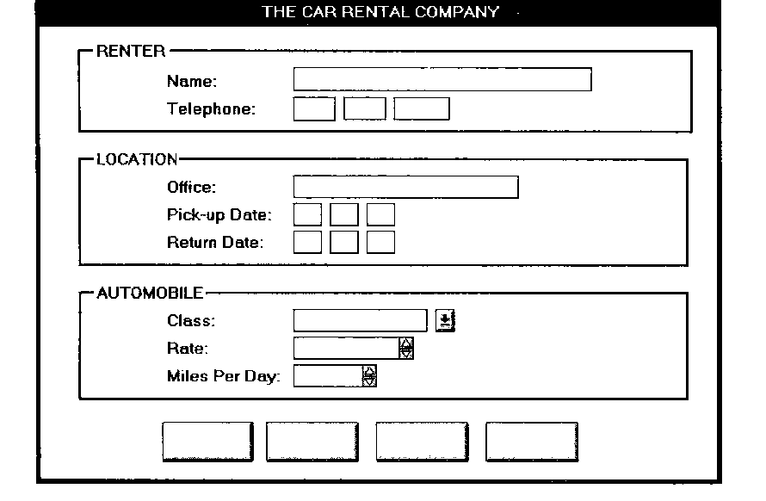
A 1990s and beyond screen

Slide 9


Slide 10
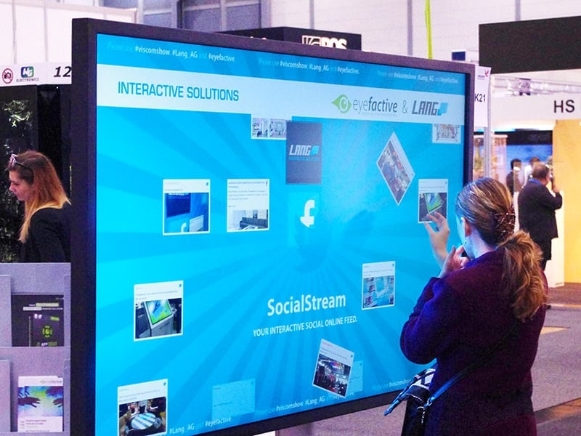
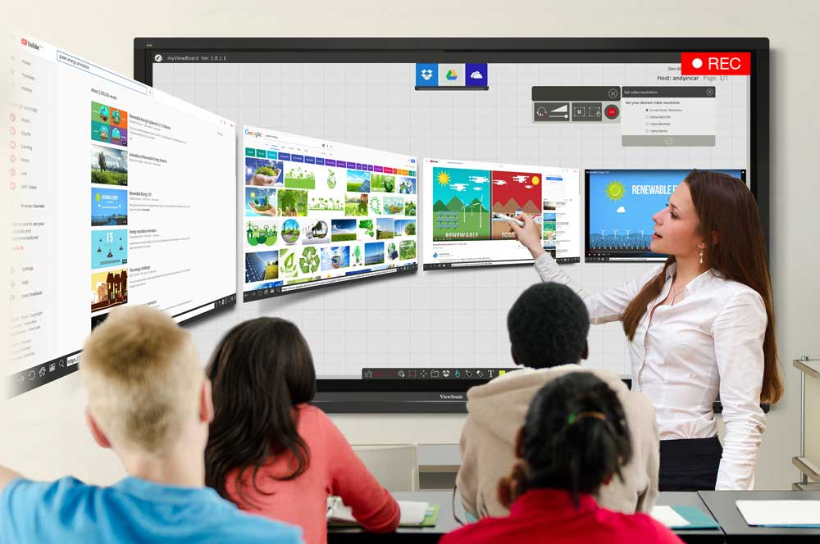
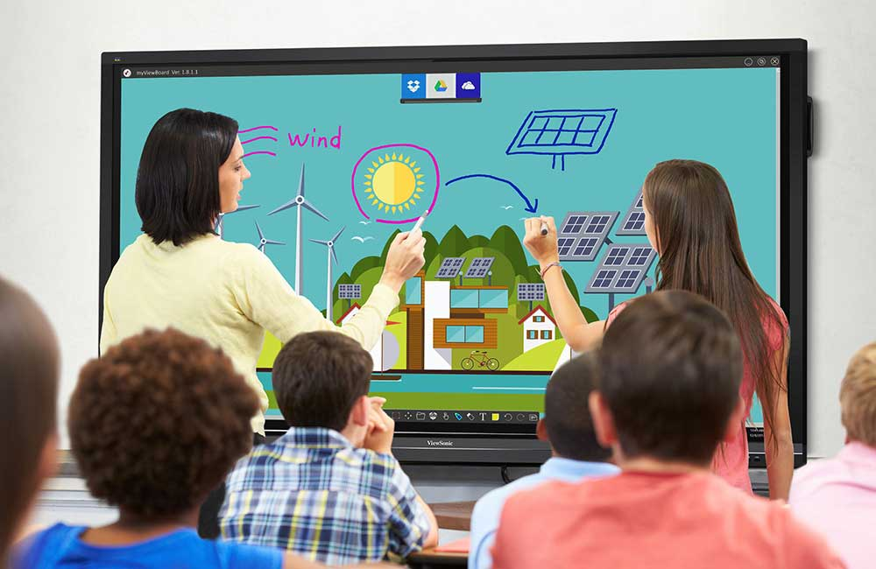

Slide 11
Usability
Bennett (1979) was the first to use the term usability to describe the effectiveness of human performance.
Shackel (1991) simply defined usability as “the capability to be used by humans easily and effectively, where,
easily = to a specified level of subjective assessment,
effectively = to a specified level of human performance.”

Slide 12
Common Usability Problems
Ambiguous menus and icons.
Languages that permit only single-direction movement through a system.
Input and direct manipulation limits.
Highlighting and selection limitations.
Unclear step sequences.
More steps to manage the interface than to perform tasks.
Complex linkage between and within applications.
Inadequate feedback and confirmation.
Lack of system anticipation and intelligence.
Inadequate error messages, help, tutorials, and documentation

Slide 13
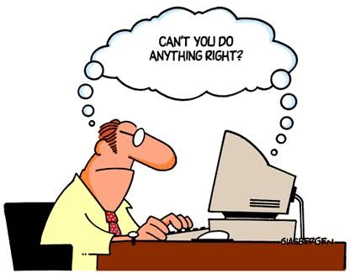

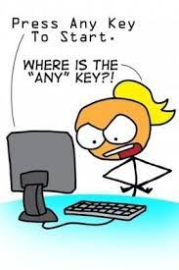


Slide 14
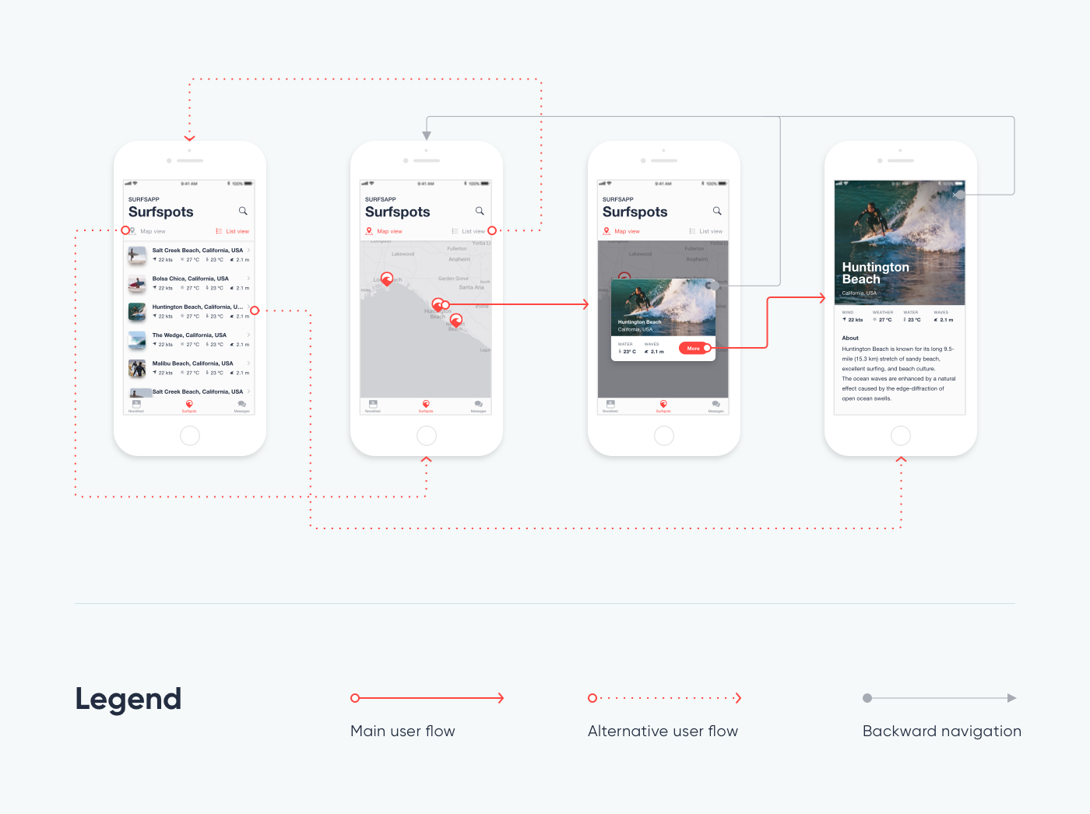

Slide 15
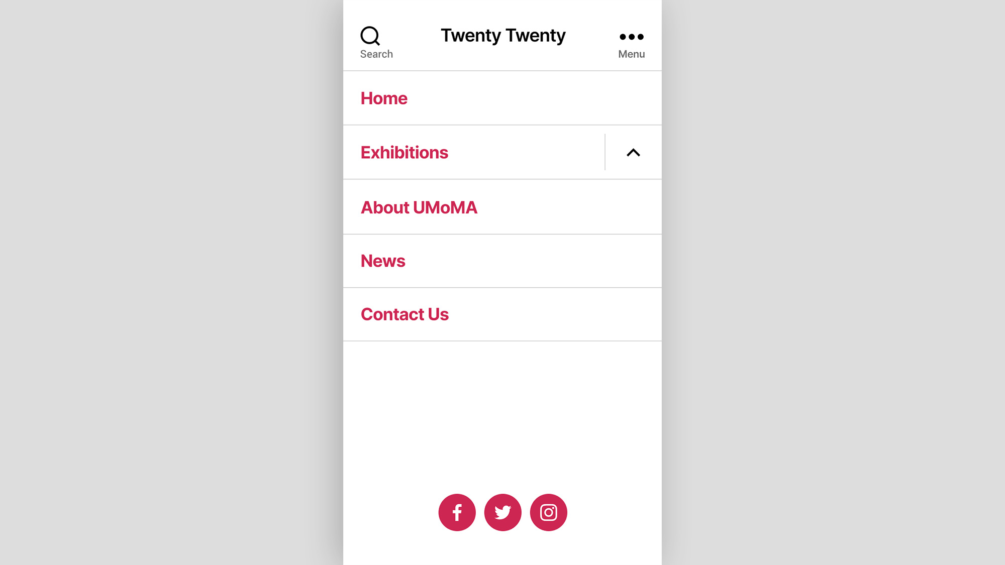

Slide 16
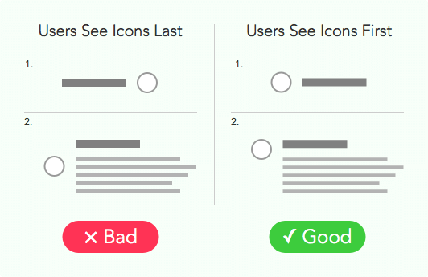

Slide 17
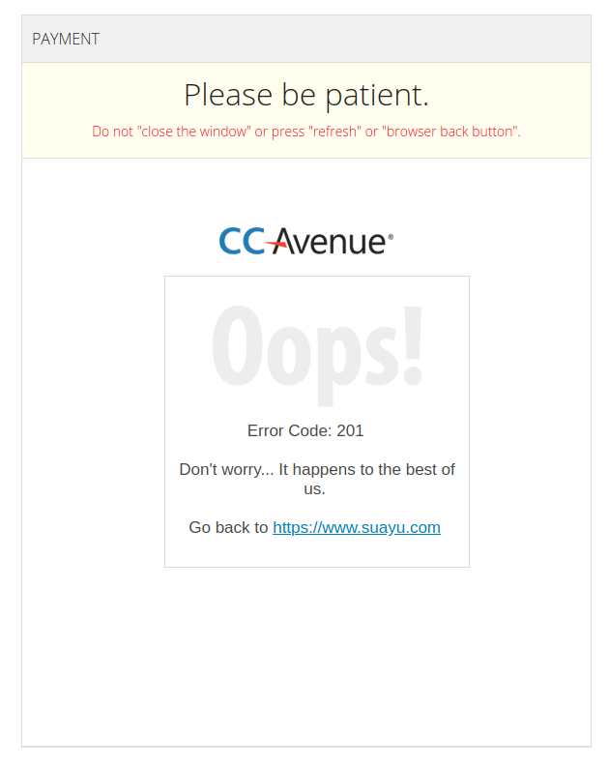

Slide 18


Slide 19
Some Practical Measures of Usability
Are people asking a lot of questions or often reaching for a manual?
Are frequent exasperation responses heard?
Are there many irrelevant actions being performed?
Are there many things to ignore?
Do a number of people want to use the product?

Slide 20
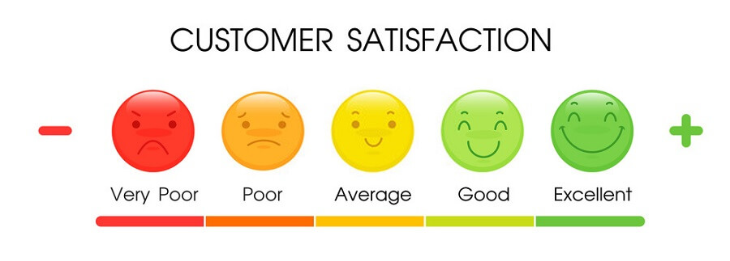

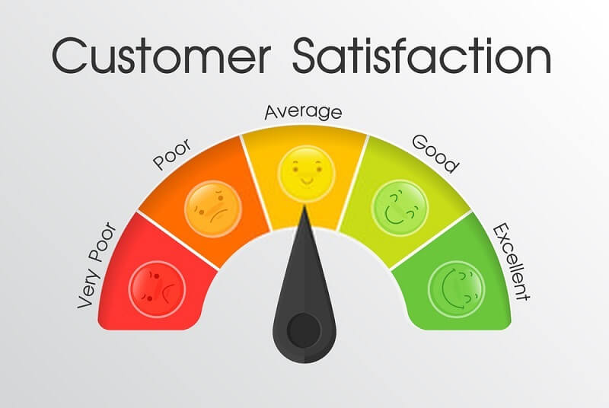


Slide 21
Graphical User Interface
A User interface is a collection of techniques and mechanisms to interact with something.
What the user interacts with is a collection of elements referred to as objects.
Objects are always visible to the user and are used to perform tasks.
People perform operations called actions, on objects.
Direct and Indirect Manipulation

Slide 22
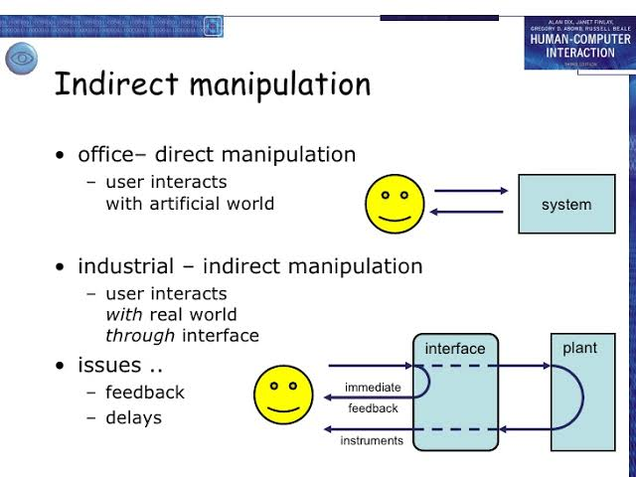

Slide 23
GUI vs WEB
GUI
WEB
Focus on data and applications.
User task is to install,configure,personalize and upgrade programs.
Response is instantaneous.
Navigation through menus, trees, list,wizard etc.
Security is tightly controlled.
Focus on Information and Navigation.
User task is to link to site, browse or read pages, fill or register for services.
Response is variable
Navigation through bookmarks, typed URLs.
Renowned for security exposure.

Slide 24
GUI vs WEB
GUI
WEB
Hardware variations limited.
Presentation elements are toolbars,windows,menus,controls etc.
Data from trusted sources or known people.
Hardware variations enormous.
Browser and pages
Sources are not always trusted and its full of unknown content.

Slide 25
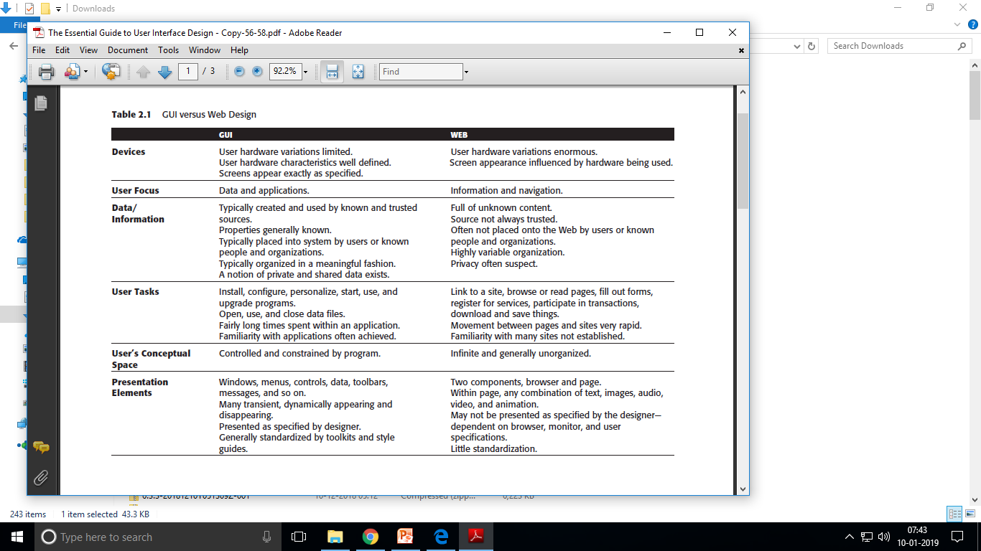

Slide 26
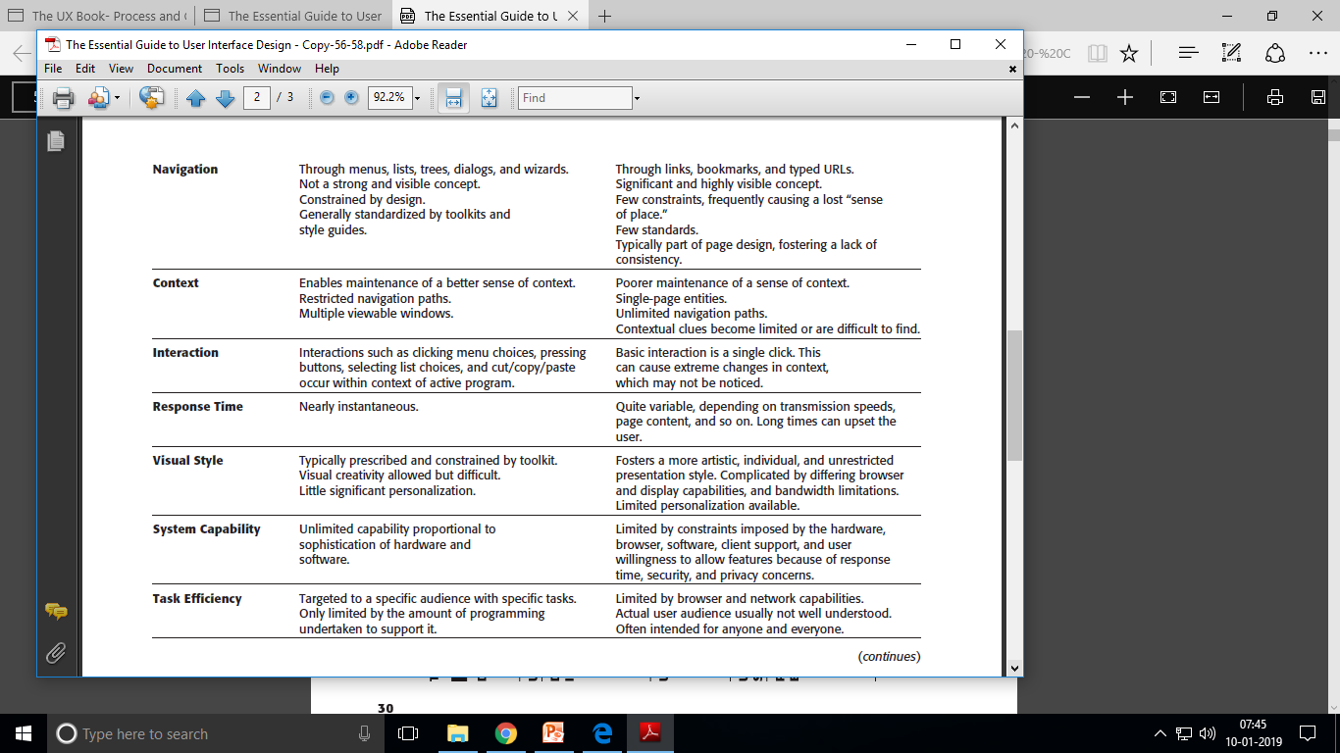

Slide 27
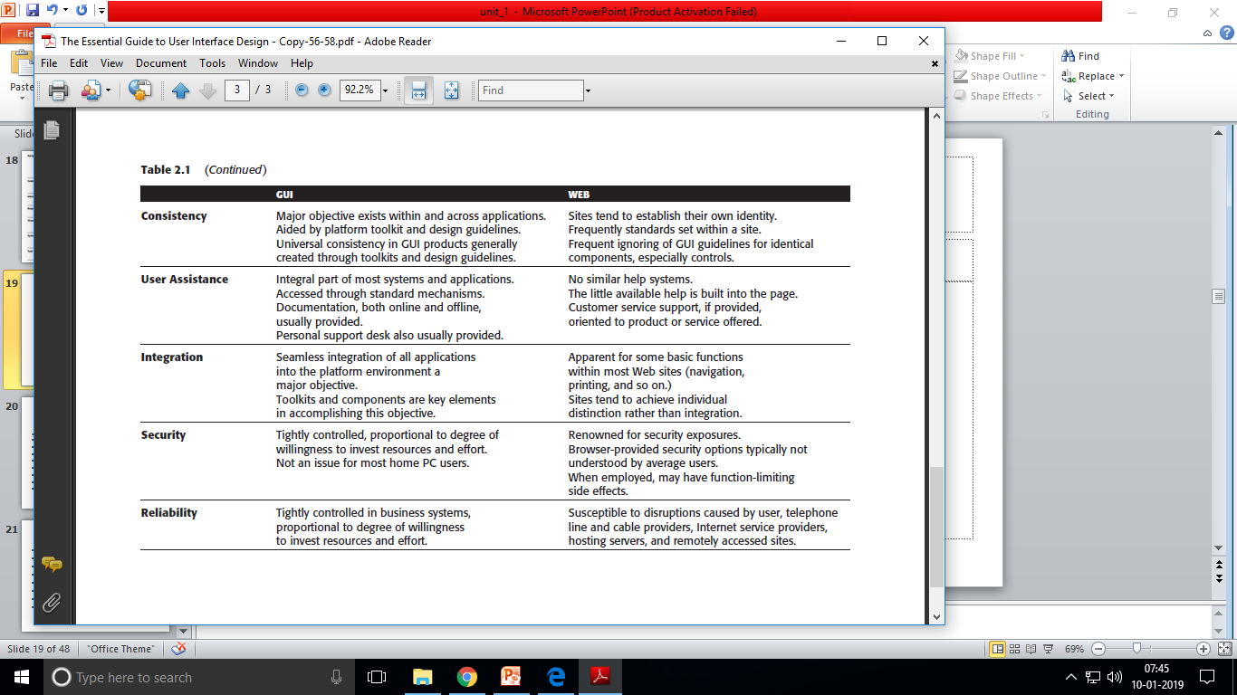

Slide 28
USER INTERFACE DESIGN GOALS
GENERAL DESIGN PRINCIPLES
Accessibility
Aesthetically Pleasing
Availability
Clarity
Compatibility
Configurability
Consistency
Control
Directness

Slide 29
PRINCIPLES OF USER INTERFACE DESIGN
Efficiency
Familiarity
Flexibility
Forgiveness
Immersion
Obviousness
Operability
Perceptibility

Slide 30
PRINCIPLES OF USER INTERFACE DESIGN
Positive First Impression
Predictability
Recovery
Responsiveness
Safety
Simplicity
Transparency
Trade-offs
Visibility

Slide 31
GENERAL DESIGN PRINCIPLES
Accessibility
Systems should be designed to be usable, without modification, by as many people as possible.
Availability
Make all objects available at all times.
Avoid the use of modes

Slide 32
GENERAL DESIGN PRINCIPLES
Aesthetically Pleasing
Provide visual appeal by:
Providing meaningful contrast between screen elements
Creating groupings
Aligning screen elements and groups
Providing three-dimensional representation
Using color and graphics effectively and simply

Slide 33
GENERAL DESIGN PRINCIPLES
Clarity
The interface should be visually, conceptually, and linguistically clear, including:
Visual elements
Functions
Metaphors
Words and text
Compatibility
Provide compatibility with the following:
The user
The task and job
The product
Adopt the user’s perspective.

Slide 34
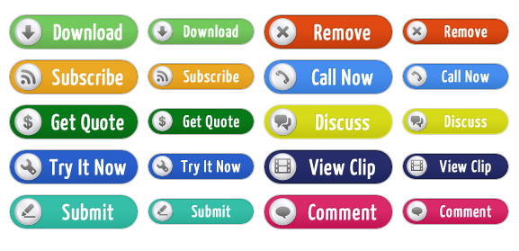

Slide 35


Slide 36
GENERAL DESIGN PRINCIPLES
Comprehensibility
A system should be easily learned and understood:
What to look at
What it is
What to do
When to do it
Where to do it
Why to do it
How to do it
Flow of actions, response, visual presentations, and information should be:
In a sensible order
Easy to recollect
Easy to place in context

Slide 37
GENERAL DESIGN PRINCIPLES
Configurability
Permit easy personalization, configuration, and reconfiguration of settings.
Enhances a sense of control
Encourages an active role in understanding

Slide 38
GENERAL DESIGN PRINCIPLES
Consistency
A system should look, act, and operate the same throughout. Similar components should:
Have a similar look
Have similar uses
Operate similarly
The same action should always yield the same result.
The function of elements should not change.
The position of standard elements should not change.

Slide 39
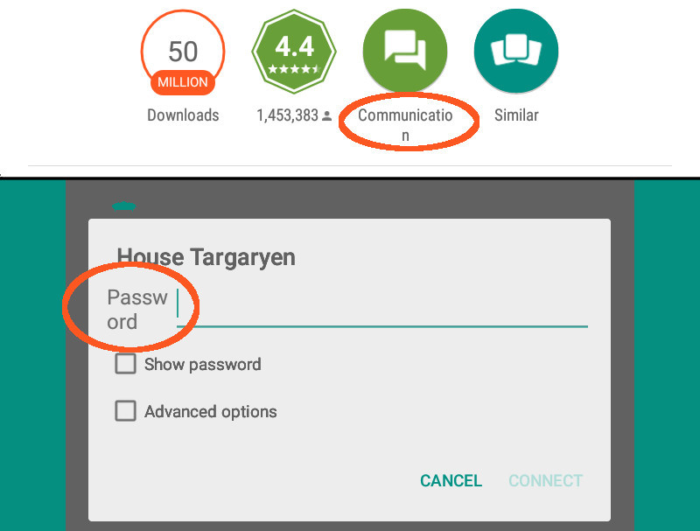

Slide 40
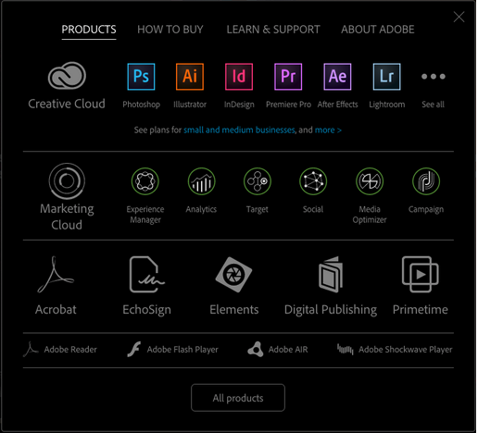

Slide 41
GENERAL DESIGN PRINCIPLES
Consistency (Continued)
Inconsistency causes:
More specialization by system users
Greater demand for higher skills
More preparation time and less production time
More frequent changes in procedures
More error-tolerant systems (because errors are more likely)‏
More kinds of documentation
More time to find information in documents
More unlearning and learning when systems are changed
More demands on supervisors and managers
More things to do wrong

Slide 42
GENERAL DESIGN PRINCIPLES
Control
The user must control the interaction.
The context maintained must be from the perspective of the user.
The means to achieve goals should be flexible and compatible with the user's skills, experiences, habits and preferences.
Avoid modes because they constrain the actions available.
Permit the user to customize the interface but provide defaults.

Slide 43
GENERAL DESIGN PRINCIPLES
Directness
Provide direct ways to accomplish tasks.
Available alternatives should be visible.
The effect of actions on objects should be visible.
Efficiency
Minimize eye and hand movements, and other control actions.
Transitions between various system controls should flow easily and freely.
Navigation paths should be as short as possible.
Eye movement through a screen should be obvious and sequential.
Anticipate the user’s wants and needs whenever possible.

Slide 44
GENERAL DESIGN PRINCIPLES
Familiarity
Employ familiar concepts and use a language that is familiar to the user
Keep the interface natural, mimicking the user’s behavior patterns
Use real-world metaphors
Flexibility
A system must be sensitive to the differing needs of its users, enabling a level and type of performance based upon:
Each user’s knowledge and skills
Each user’s experience
Each user’s personal preference
Each user’s habits

Slide 45
GENERAL DESIGN PRINCIPLES
Forgiveness
Tolerate and forgive common and unavoidable human errors
Prevent errors from occurring whenever possible
Protect against possible catastrophic errors
When an error does occur, provide constructive messages
Immersion
A state of mental focus so intense that awareness and sense of the real world is lost
Foster immersion within tasks

Slide 46
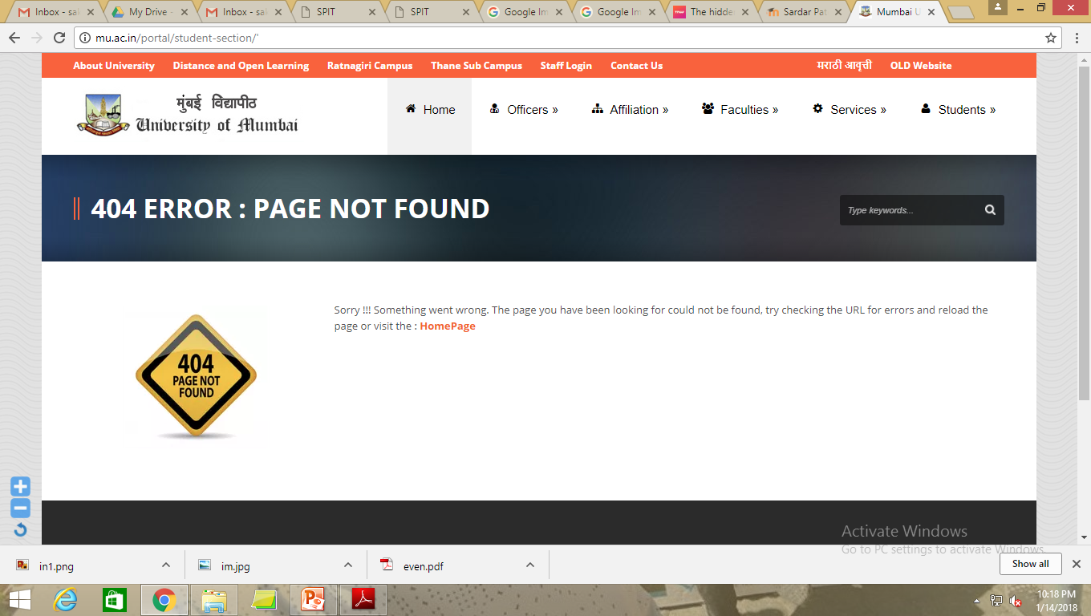

Slide 47
GENERAL DESIGN PRINCIPLES
Positive First Impression
Create a positive first impression of the system.
Points of prospect
Minimal barriers
Progressive lures

Slide 48
GENERAL DESIGN PRINCIPLES
Predictability
The user should be able to anticipate the natural progression of each task.
Provide distinct and recognizable screen elements
Provide cues to the result of an action to be performed
All expectations should be fulfilled uniformly and completely.

Slide 49
GENERAL DESIGN PRINCIPLES
Recovery
A system should permit:
Commands or actions to be abolished or reversed
Immediate return to a certain point if difficulties arise
Ensure that users never lose their work as a result of:
An error on their part
Hardware, software, or communication problems
Responsiveness
The system must rapidly respond to the user’s requests.
Provide immediate acknowledgment for all actions:
Visual
Textual
Auditory

Slide 50
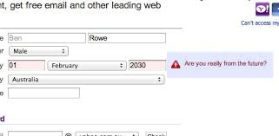

Slide 51
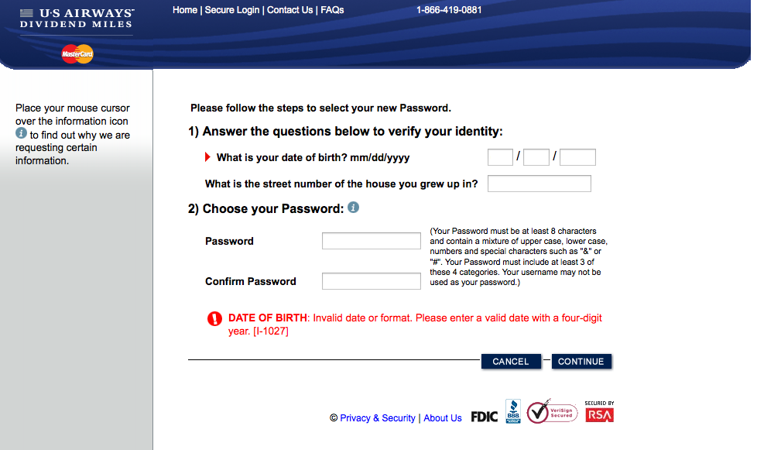

Slide 52
GENERAL DESIGN PRINCIPLES
Safety
Protect the user from making mistakes.
Provide visual cues
Reminders
Lists of choices
Other aids as necessary

Slide 53
GENERAL DESIGN PRINCIPLES
Simplicity
Provide as simple an interface as possible.
Five ways to provide simplicity:
Use progressive disclosure, hiding things until they are needed
Present common and necessary functions first
Prominently feature important functions
Hide more sophisticated and less frequently used functions
Provide defaults
Minimize screen alignment points
Make common actions simple at the expense of uncommon actions being made harder
Provide uniformity and consistency

Slide 54
GENERAL DESIGN PRINCIPLES
Transparency
Permit the user to focus on the task or job, without concern for the mechanics of the interface.
Workings and reminders of workings inside the computer should be invisible to the user
Trade-Offs
Final design will be based on a series of trade-offs balancing often-conflicting design principles.
People’s requirements always take precedence over technical requirements.

Slide 55
GENERAL DESIGN PRINCIPLES
Visibility
A system's status and methods of use should be clearly visible.
Improve visibility through
Hierarchical organization
Context sensitivity

Slide 56
Summary of Unit 1
HCI & HMI
History of UI design
Usability
Comparison between GUI and WUI
UI design GOALS

