Slide 1
meet&do
Meeting website for students and enthusiasts
Stanislas Lange
Simon Gaussmann
Stéphane Rabenarisoa
Marc-Antoine Dariel
Dept. of Computer Science
Hanyang University

Slide 2
Tech Stack
Ruby on Rail 6
PostgreSQL
Hosted on Heroku via GitHub actions (CI)
AWS S3 bucket for static assets

Slide 3
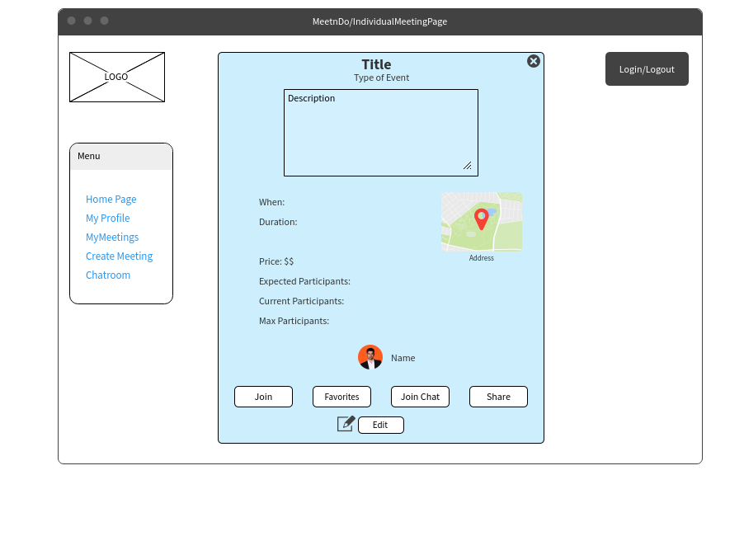
Example mockup

Slide 4
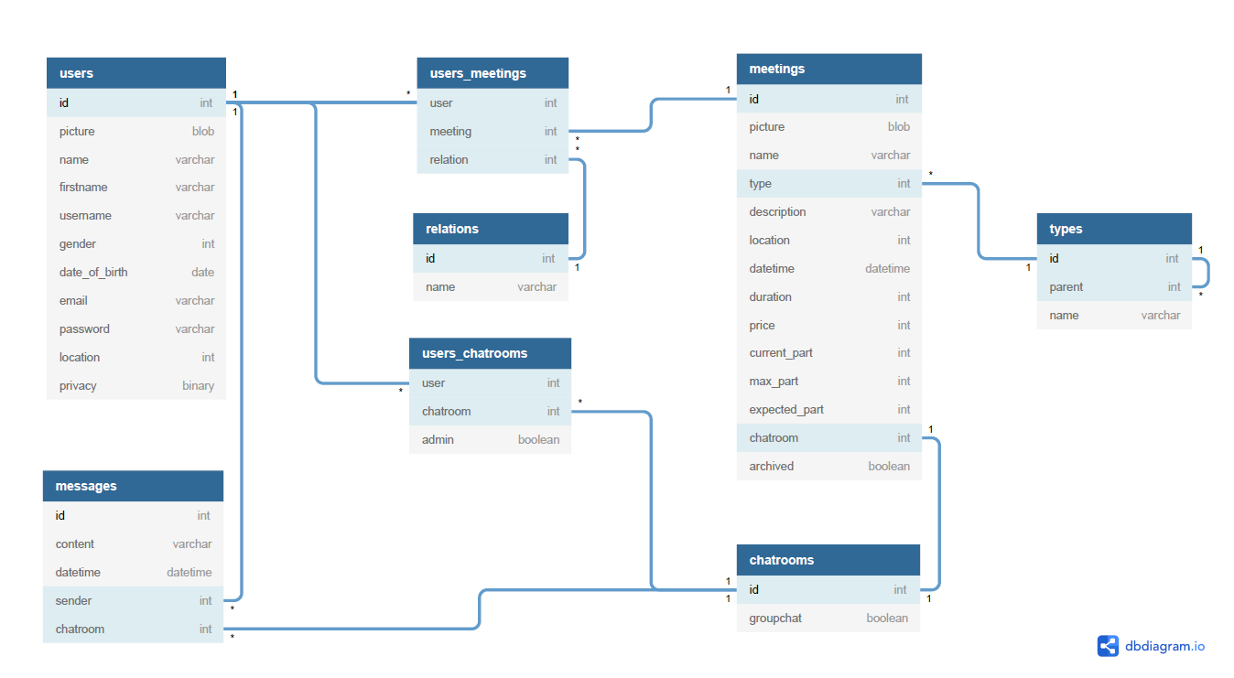
Database

Slide 5
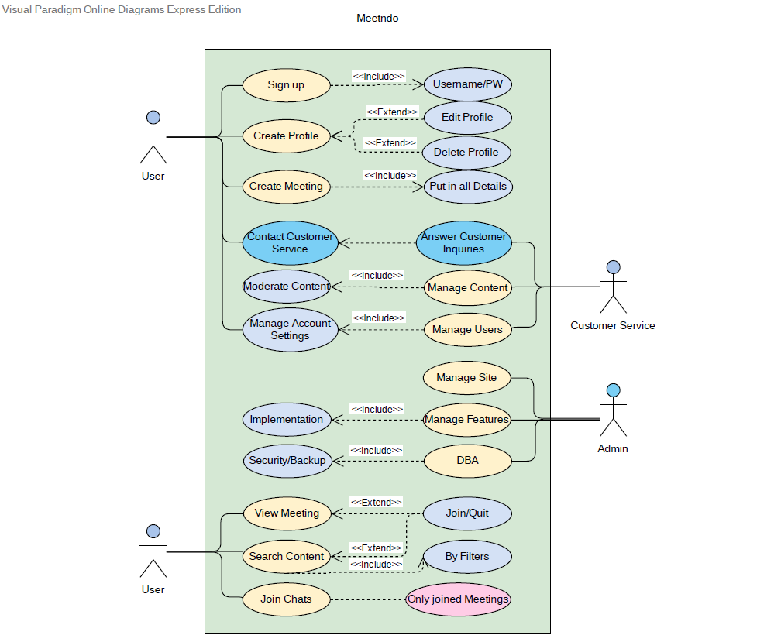
Use case

Slide 6
Demo?
meetndo.herokuapp.com

Slide 7
Experience
First experience with such precise documentation
LaTeX is hard…
First experience with Ruby on Rails
Time!

