Slide 1
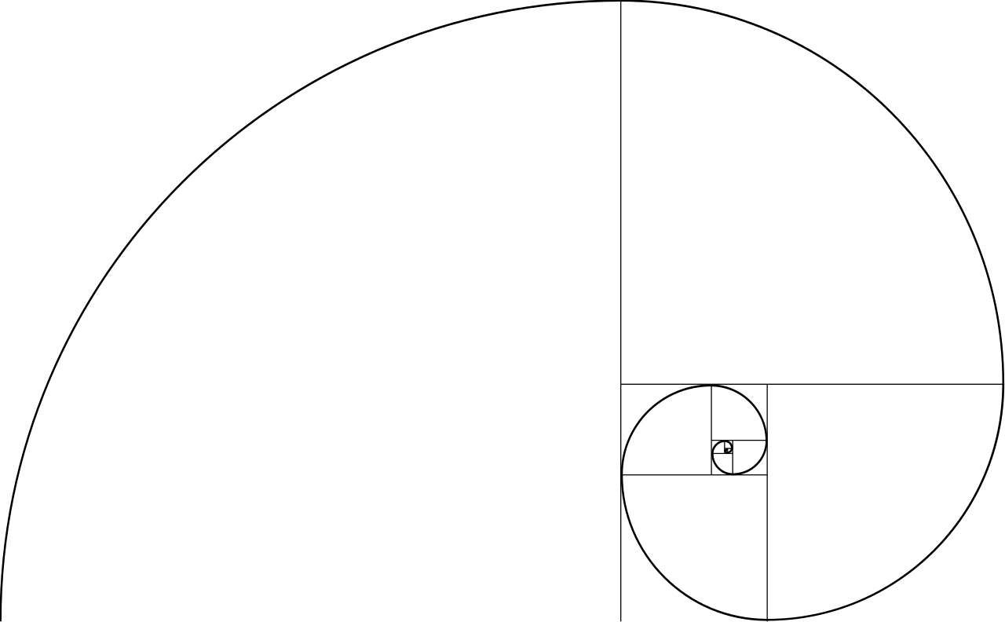
Applications of Fibonacci sequence
FAF-193
Aramă Radu-Vasile
Bîrsan Andreea
Streleț Dumitru
Miron Cristian-Cătălin

Slide 2
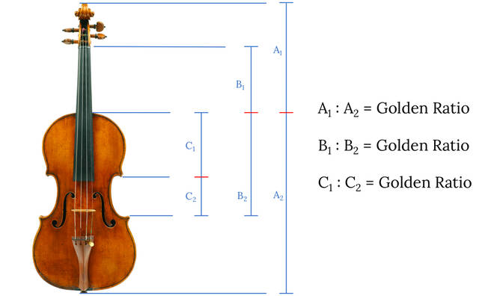
Musical instruments
Fibonacci sequence is widely used in music and also in construction of musical instruments.
Hailed as the master of violin making, Antonio Stradivari has made some of the most beautiful and sonorous violins in existence.
There's a reason a Stradivarius violin would cost you a few million pounds to buy – and its value is partly down to the Fibonacci Sequence and its Golden Ratio.
The Golden Ratio can be found throughout the violin by dividing lengths of specific parts of the violin. Some people think this is one of the reasons it sounds so good.
Notes:
Radu

Slide 3
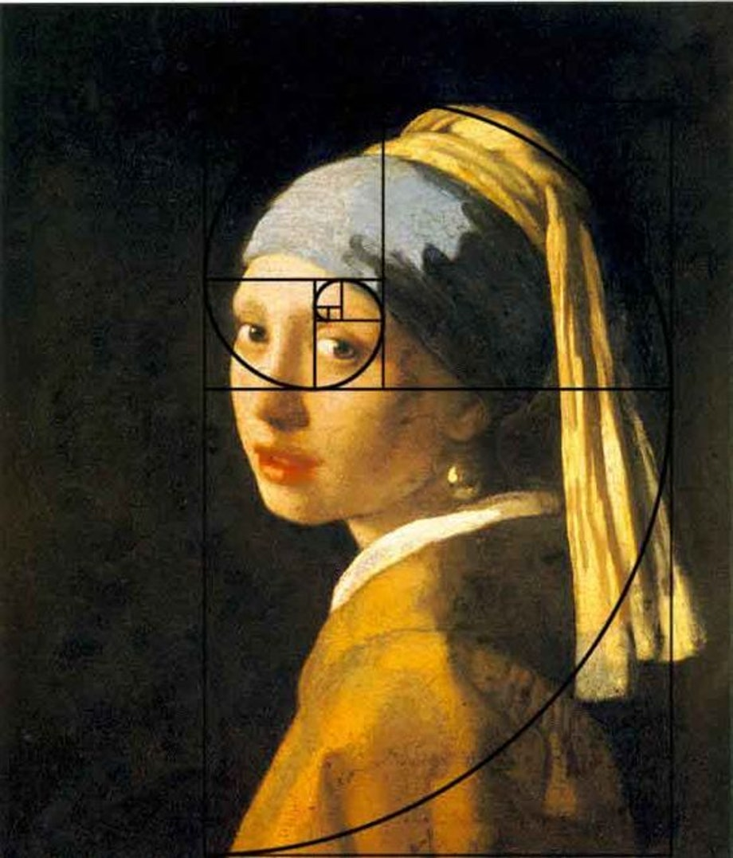
Artistic composition
Artists recognised that the Fibonacci Spiral is an expression of an aesthetically pleasing principle – the Rule of Thirds. This is used in the composition of a picture; by balancing the features of the image by thirds, rather than strictly centring them, a more pleasing flow to the picture is achieved.
From the Renaissance onwards, artists have – whether purposefully or simply by instinct – created dramatic and attractive paintings which demonstrate the Fibonacci Spiral in their composition. One excellent example is the Girl with a Pearl Earring by Johannes Vermeer, thus the painter was able to create multiple focal points though this specific technique.

Slide 4
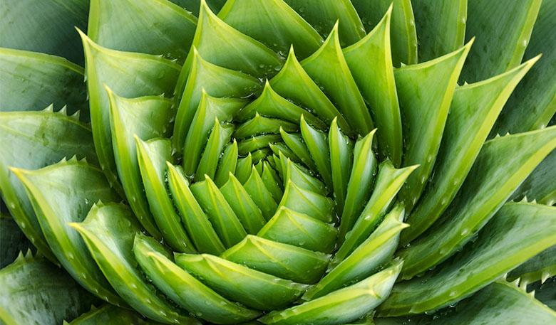
Biology
Fibonacci sequence is a way of nature to organize the structure of an organism using some patterns. Patterns are found all over the natural world. From the grasping tendrils of a plant to the dew-laden web of a spider, we can see repeated sequences as a product of living systems. One pattern we will focus on in this resource is the Fibonacci sequence. The result of the sequence creates stunning swirls and grasping hands.

Slide 5
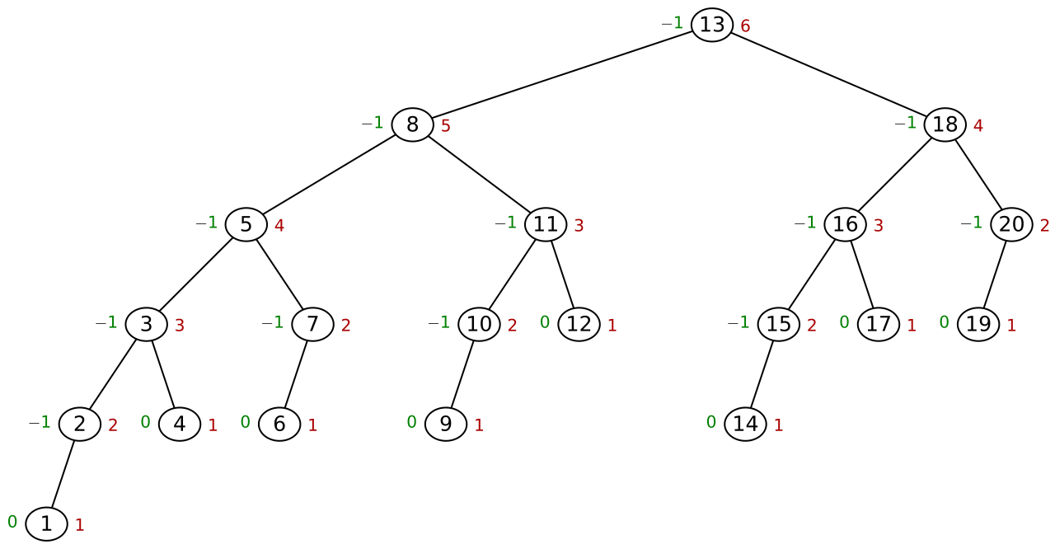
Computer Science
The Fibonacci numbers are important in analysis of Euclid’s algorithm to determine the GCD of two integers: the worst case input for this algorithm is a pair of consecutive Fibonacci numbers;
A Fibonacci tree is a binary tree whose child trees (recursively) differ in height by exactly 1. So it is an AVL tree (image to the right) In green we can see the balance factors.
Fibonacci numbers are used in some pseudorandom number generators.
They are also used in planning poker, which is a step in estimating in software development projects that use the Scrum methodology.

