Slide 1


Real-time Shipment Tracking for MSMEs
Presented by Bravo6

Slide 2
Our Team
Krushit Sheth (Team Leader) (Android), Nirma University, shethkrushit101@gmail.com
Abhi Thakkar (Android), Nirma University
Jainil Patel (Android), Nirma University
Parth Sinha (IoT), Nirma University
Vimal Sheoran (Backend and Deployment), Nirma University

Slide 3

PROBLEM
Real time shipment tracking and trip price estimation for MSMEs
Shipment tracking is a lengthy process, which involves numerous phone calls and query turn around times can be anywhere from 10 minutes to 10 hours.
Bloated estimates of trip costs lead to complex debit and credit transactions between truck drivers and brokers.
Paper records lead to bad logging of ongoing and past bookings between clients and brokers.

Slide 4

SOLUTION
What if you can know where your shipment is instantly?
What if you can have better estimates of your trip costs?
What if you had a way of managing trip data?

Slide 5




SOLUTION
We present a multi-domain solution for these problems.
Digitization
Manage and enter your trip data using our mobile application.
Data Management
Access your past data in an instant and store data related to trips, trucks and clients in one place.
Tracking
Use our IoT infrastructure to track your shipments in real-time.
Better Estimates
Better estimates the cost of your trips using our platform.

Slide 6
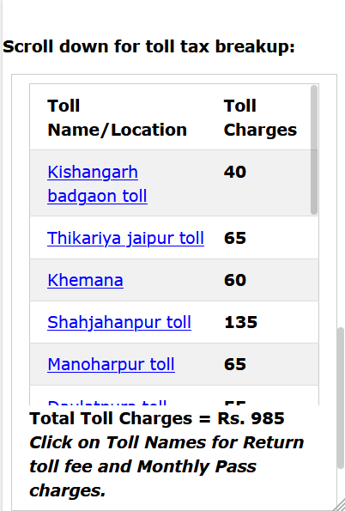
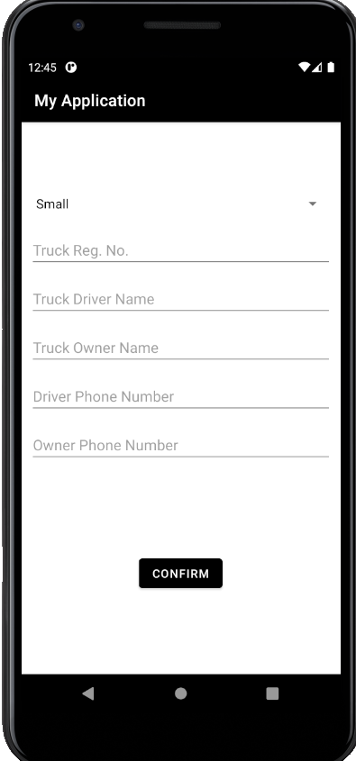
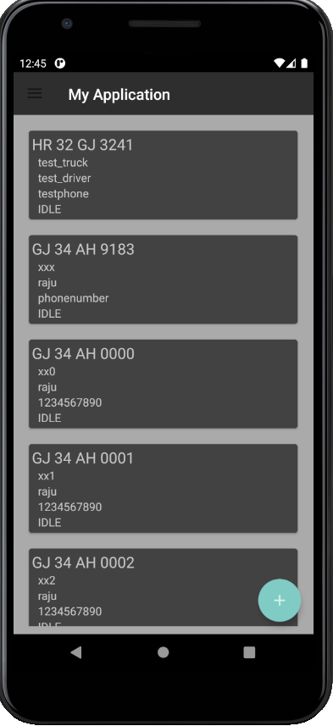
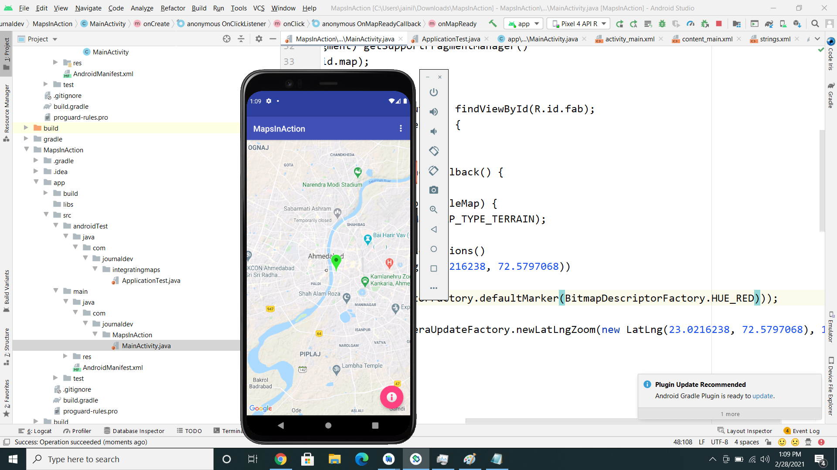
PRODUCT
These screenshots show the functionality of our application
Tracking
Estimates
Data Entry
IoT Devices

Slide 7
References
Toll Plaza Dataset, https://github.com/geohacker/toll-plazas-india
Toll Information System, NHAI, http://tis.nhai.gov.in/
Google Maps API, https://developers.google.com/maps/documentation/places/web-service/overview
Android Volley, https://developers.google.com/maps/documentation/places/web-service/overview
Python Flask, https://flask.palletsprojects.com/en/1.1.x/

Slide 8

THANK YOU!
Krushit Sheth
Phone:
+91 8780381833
Email:
shethkrushit101@gmail.com

