Slide 1
7 Application Layer

Slide 2
Introduction

Slide 3
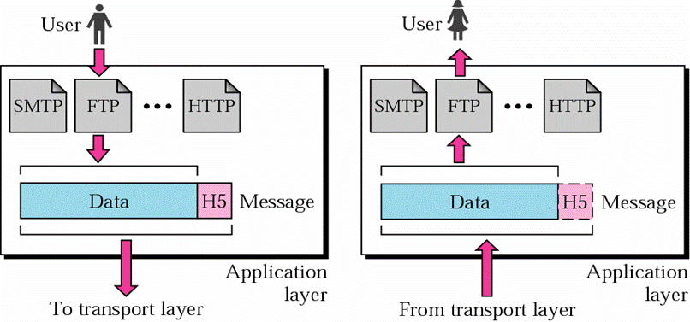
Duties and Features of Application Layer
Providing various applications to end users
Maximum number of protocols and most complex
Each protocol is specified to a type of application, no general-purpose protocols

Slide 4
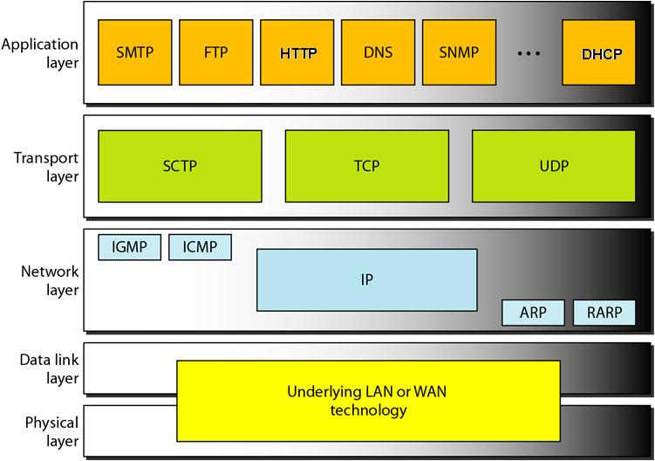
Conventional Internet Application Protocols

Slide 5
Domain Name System (DNS)

Slide 6
Hierarchical Namespace &
Resource Records

Slide 7
DNS: Domain Name System
Out-dated “hosts.txt”
A client-server application that identifies each host on the Internet with a unique user-friendly name(domain name),
e.g. www.bupt.edu.cn instead of 124.127.207.2
Providing support for other applications
Translating domain name (host name) to IP address
C function: gethostbyname()
Windows XP commands: nslookup, ipconfig/displaydns, ipconfig/flushdns
Features
UDP datagram, DNS Server
Hierarchical namespace: Host have a composite names that are all hierarchically organized
Distributed database
Naming follows organizational boundaries, not physical networks
Notes:
Flat name space: IP地址， hosts.txt
7

Slide 8
Hierarchical Namespace
Unnamed root
Top level domains
com
edu
gov
int
mil
net
org
ae
…
cn
…
zw
mit
edu
2nd level domains
cs
bupt
xx
xx.cs.mit.edu
cs.bupt.edu.cn
cs
Generic domains
Country domains
Within an organization
Subdivision possible
Arbitrary levels possible (maximum depth =128)
Not standardized, controlled locally by the organization
Naming policy
by the path upward from leaf to root, separated by “.”
Notes:
Domain name: Case insensitive
Components can be up to 63 characters long, the full pathname must not be more than 255 characters
The full name of a domain is also called its Fully Qualified Domain Name (FQDN)
8

Slide 9
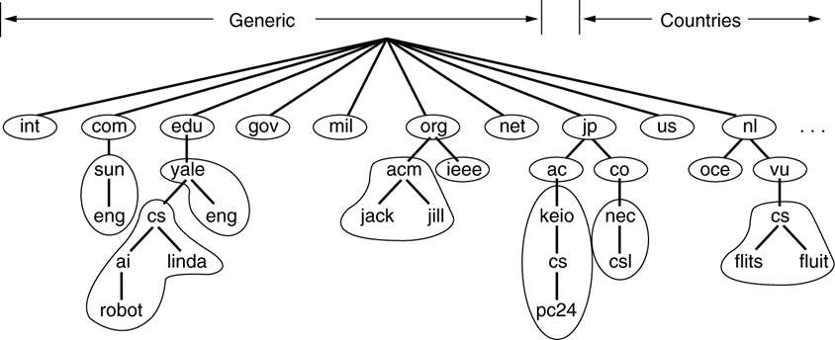
Zones
A zone corresponds to an administrative authority that is responsible for that portion of the hierarchy
e.g: bupt controls *.bupt.edu.cn
Notes:
9

Slide 10
Resource Records (RR)
Each domain in the DNS has one or more Resource Records (RRs)
Each RR has the following information
Owner: the domain name
TTL: specifies the Time To Live (in unit of second) of the cached RRs
Type: specifies the type of the resource in this RR
SOA – Start Of Authority, identifies the zone
A – Host Address
MX – Mail Exchanger
CNAME – Canonical Name, alias
HINFO – Host Information
…
Class: specifies the protocol family to use
IN – the Internet system
Value: depend on type

Slide 11
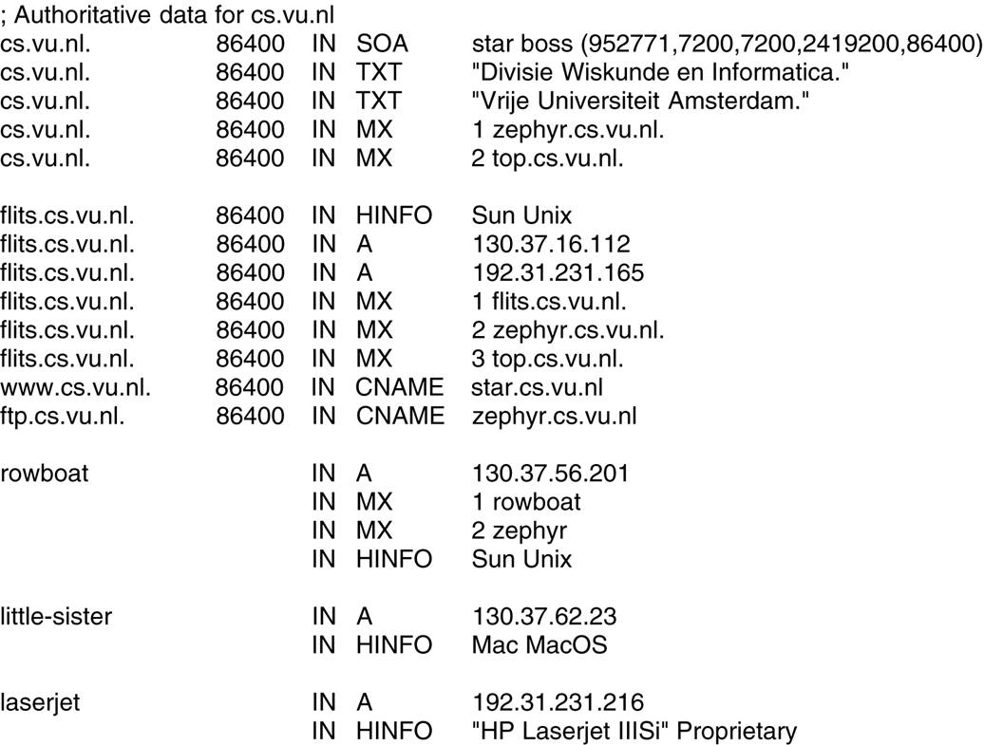
Sample of DNS Database
Domain name
Time-to-live
Class
Type Value

Slide 12
Name servers &
Name Resolution

Slide 13
DNS Client-Server Interaction
Client: resolver
software running on client, access at least one name server
Multiple DNS servers used
Arranged in hierarchy
Each server has authority over a portion of the hierarchy
Each server contains all the records for the hosts in its zone
How does a server know about other servers that are responsible for the other zones?
Every server knows the root
Root server knows about all top-level domains
Every server knows the servers further down the hierarchy

Slide 14
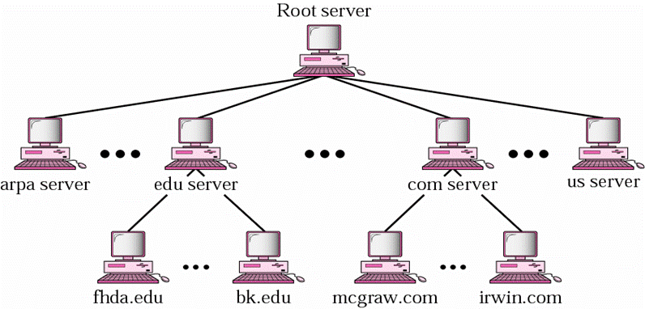
Hierarchy of Name Servers

Slide 15
DNS Lookup
Applications
Becoming DNS client
Sending request first to local name server
Local name server
Listening at port 53, normally using UDP
If answer known, returns response
If answer unknown
Requests top-level name server(via root server)
Follows links
Until reaching Authoritative Name Server, which performs name translation and returns response

Slide 16
Name Resolution Methods
Recursive resolution
A query is made to a local name server
If the queried server does not have the information, it must make a query to another
Iterative resolution
An iterative query is made to a name server, which may then respond with the address of another server
the local name server (on behalf of resolver) then queries that server (which might respond with the address of another server, and so on)
Commonly used by name servers on Internet

Slide 17
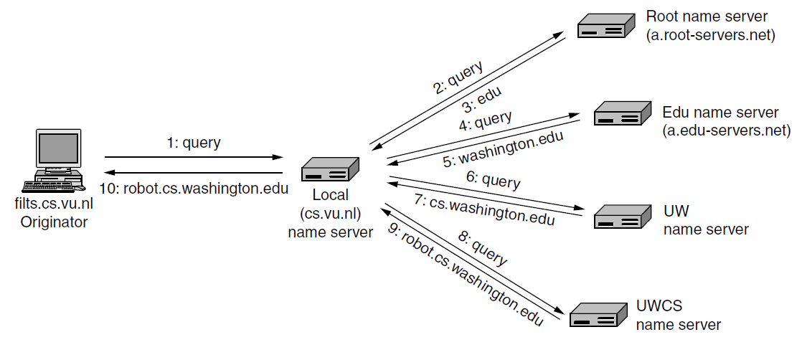
Example of Recursive Resolution

Slide 18
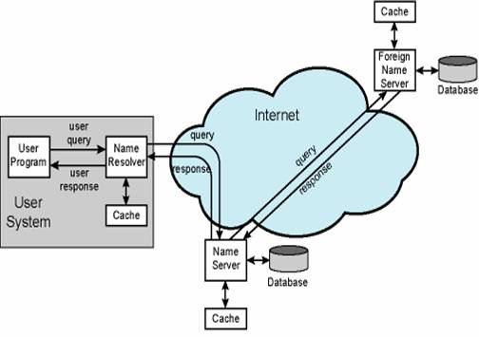
DNS Caching
Server always caches answers
Host can cache answers
Works well because high locality of reference
TTL

Slide 19
Email System and Protocols

Slide 20
System Components

Slide 21
What is Email?
Electronic Mail (email, e-mail)
Provides a means to send electronic messages from one person to another asynchronously
One of the most popular applications on the Internet and one of the most important communication methods today
Email service can be provided by
ISPs: @126.com, @163.com, @sina.com, yahoo.com.cn, …
Corporations and institutes:@bupt.edu.cn, @ietf.org, …
Bundled with other services: @139.com, @qq.com, …

Slide 22
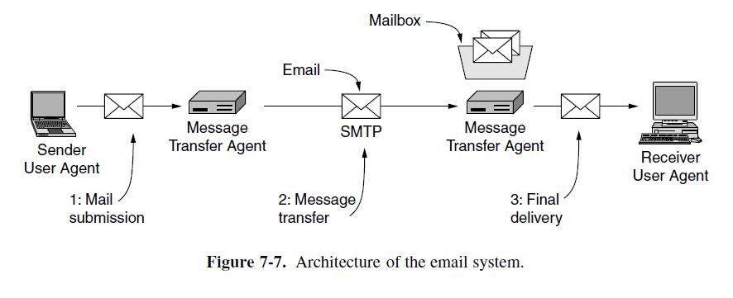
Components Of Email System
Mail Server
Mail Server
User Agent
SMTP
SMTP
POP3
User Agent
Notes:
22
和传统的邮政服务对比理解
Thinking of the post office system. Mail server likes a post office. You put your letter in mail box. And the agent helps to deliver the mail to post office in destination city, which is another mail server. And the letter is put into the mailbox of receiver.
spooling refers to a process of transferring data by placing it in a temporary working area where another program may access it for processing at a later point in time.

Slide 23
Components Of Email System
UA (User Agent)
end-user mail program
Interface between the end users and the email servers
E.g., outlook, foxmail, …
Mail Server
Responsible for transmitting/receiving emails and reporting status information about mail transferring to the mail sender
Both a client and a server
Email protocols
SMTP: used for sending an email
POP3/IMAP: used for receiving an email
Notes:
23

Slide 24
Basic Functions of Email System
Composition - creating messages and answers
Transfer - moving messages from the originator to the recipient
Reporting - informing the originator what happened to the message
Displaying - showing the messages

Slide 25
Message Format
(RFC822,2822,5322)

Slide 26
Internet Message Format (RFC822/2822)
Message (ASCII)
Messages consist of
(1)a primitive envelope
(2) some number of header fields,
(3) a blank line
(4) and then the message body
RFC 822 does not clearly distinguish the envelope fields from the header fields
Each header field consists of a single line of ASCII text:
(1)field name
(2)a colon
(3)for most fields, a value.

Slide 27
Message Field Definitions
Categories | Header | Meaning
Originator fields | From: | Person or people who created the message
 | Sender: | Email address of the actual sender
 | Reply-to: | Email address to which replies should be sent
Destination address fields | To: | Email address(es) of primary recipient(s)
 | Cc: | Email address(es) of secondary recipient(s)
 | Bcc: | Email address(es) for blind carbon copies
The origination date field | Date: | The date and time the message was sent
Identification fields | Message-Id: | Unique number for referencing this message later
 | References: | Other relevant Message-Ids
Information fields | Subject: | Short summary of the message for the one-line display
 | Keywords: | User chosen keyword
Trace fields | Received: | Line added by each transfer agent along the route
 | Return-Path: | Can be used to identify a path back to the sender
27

Slide 28
Example of Mail Message
Author of the message, required
Mailbox responsible for the actual transmission of the message, optional
From: John Doe <jdoe@machine.example>
Sender: Michael Jones <mjones@machine.example>
To: Mary Smith <mary@example.net>
Subject: Saying Hello
Date: Fri, 21 Nov 1997 09:55:06 -0600
Message-ID: <1234@local.machine.example>
This is a message just to say hello.
So, "Hello".
headers
Address(es) of the primary recipient(s)
of the message
a blank line
body
Problem of RFC 822: Only 7 bit ASCII format can be used
The header is everything up to the blank line, and the body is everything after the blank line
Notes:
ASCII: 只支持英文字符，不支持其他语言；只支持文本，不支持附件，不支持其他数据类型（二进制、压缩…）
28

Slide 29
MIME
Multipurpose Internet Mail Extension
Extension for multipart & multimedia email
Additional mail headers define content
Type: text, image, audio, video, application and subtype within (eg text/html, image/gif)
Encoding (ASCII , quoted printable, base64) to handle arbitrary binary data when email system can only handle normal ASCII chars
Supports multipart message content type
each part has its own type and encoding
MIME messages can be sent using the existing mail programs and protocols
Widely used now

Slide 30
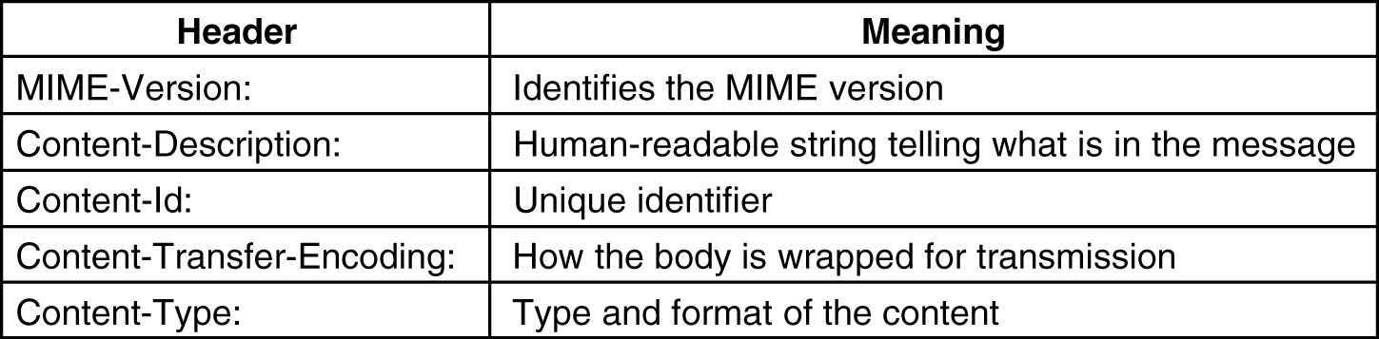
MIME: New Headers
Notes:
Content-Transfer-Encoding: tells how the body is wrapped for transmission - multiple schemes, from the the simplest - ASCII text, through to base64 encoding
30

Slide 31
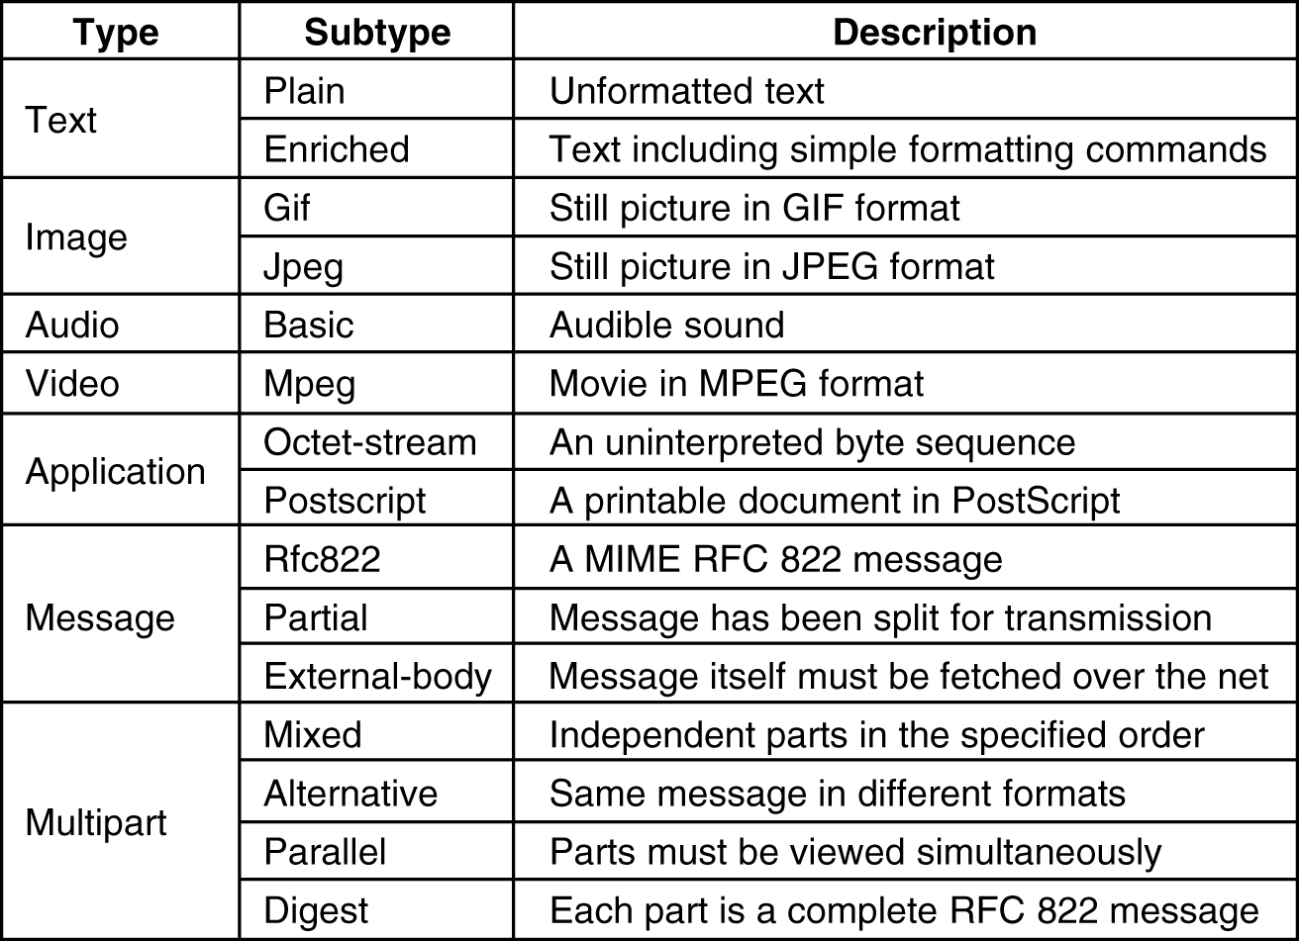
MIME: Content Types and Subtypes

Slide 32
MIME: Message Example (1)
Date: Sat, 07 Dec 2002 16:37:32 +0800
From: Adun Gaos
X-Accept-Language: zh-cn
MIME-Version: 1.0
To: adungaos@celldoft.com
Subject: MIME message!
Content-Type: multipart/mixed;
boundary="------------080202030206040206090704"
This is a multi-part message in MIME format.
--------------080202030206040206090704
Content-Type: text/html; charset=us-ascii
Content-Transfer-Encoding: 7bit
This is a MIME message. Here is body.
--------------080202030206040206090704
Content-Type: application/x-gtar;
name="binary.tgz"
Content-Transfer-Encoding: base64
Content-Disposition: inline;
filename="binary.tgz"
H4sIABmy8T0AA+3OsQ3CMBQEUI/iEb6dBM9jhIRogpSQgu1BQhQUiCpU7zVX3BV3vMx9uadd
RYk4RKSIKG36yLcUbWrjMJQo9bmv41BTjn1vvWzrrS85p37a5nO/rt92v3oAAAAAAAAAAAD4
oweF/KCgACgAAA==
--------------080202030206040206090704--
32
Notes:
32
MIME-Version：发送方用来对消息进行编码的MIME的版本。当然是1.0。 ※ Content-Type：此头字段是动作开始的地方，标识了在MIME消息中封装的数据。基本格式如下： Content-Type: type/subtype [;attribute=value;……] type定义数据的主要数据类型，subtype定义数据的相信类型，attribute是对于数据类型的附加信息，如文件名、编码类型等。 对于主要数据类型，有基本的7种： § text：普通文本数据，以ASCII格式来处理，子类型有plain（纯文本）、enriched（Rich Text格式）、html（超文本标记语言）等。 § image：图片，子类型有jpeg、gif等。 § audio：音频数据，唯一子类型是basic。 § video：视频数据，子类型有mpeg、quicktime等。 § application：二进制数据或者必需经过指定程序进行处理的数据。子类型很多，例如：msward（M$ Word文档）、x-gtar（gzip压缩的tar包）等。 § multipart：由几个独立部分构成的消息，可以合并多个不同类型的消息。它有四种子类型： ◎ mixed（混合式） 各个部分相互独立，每个部分按照发送顺序呈现在接收方。 ◎ alternative（可选式） 每个部分包含不同格式的相同数据。 ◎ paralled（平行式） 各个部分相互独立，可以按照任何顺序出现在接收方。 ◎ digest（摘要式） 与mixed相同，但消息体是RFC822格式封装。 § message：被封装的邮件消息数据。子类型有rfc822（标准RFC822格式的消息）、partial、external-body。 ※ Content-Transfer-Encoding头字段指名嵌入到消息中的二进制数据如何被编码成ASCII文本。RFC2045指定了5种方法： 7bit（标准的US ASCII编码）、8bit、binary、Quoted-printable（引用可打印的字符）、Base64。其中Base64是最常用的编码方法：把24位（bit）的二进制数据分割成四个6位字段，然后给每个分段补两个零，组成8位字符，这样产生的所有字符都属于US ASCII字符集。 ※ Content-Description：是一个用来在邮件消息的文本中标识数据的ASCII描述。 ※ 还有一个未出现在我们示例邮件消息中的头字段：Cntent-ID，用来在使用多目录内容的情况下，以一个唯一的标识代码去标识一个MIME会话。

Slide 33
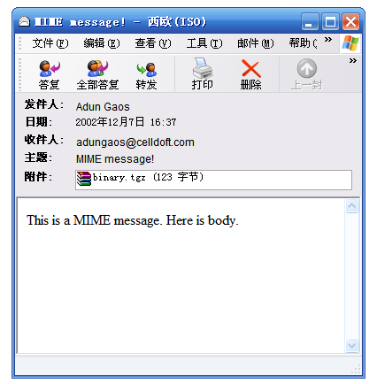
MIME: Message Example (2)
When you save the above as .eml file and open it with outlook, you can see:
33

Slide 34
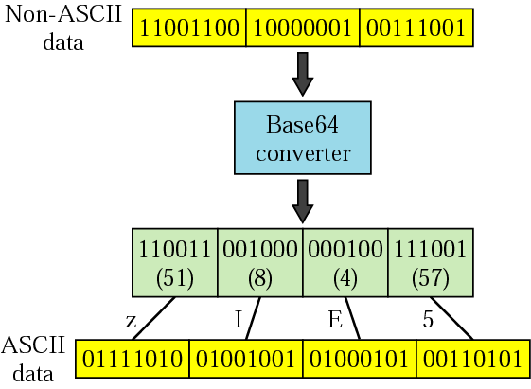
Example of Base64
Base64: a specific MIME content transfer encoding.
6 bit-data is converted into an 8-bit ASCII character
ABCDEFGHIJKLMNOPQRSTUVWXYZabcdefghijklmnopqrstuvwxyz0123456789+- = / ==
Notes:
一种编码方式， 6位→8位ASCII
34

Slide 35
SMTP,POP3,IMAP
(RFC821,1939,1730)

Slide 36
SMTP (RFC821)
Simple Mail Transfer Protocol
SMTP is a simple ASCII protocol
SMTP server listens to port 25
SMTP client establishes a TCP connection to port
Used in transferring mail messages from UA to mail server, and between mail servers
Notes:
36
Commands and replies are ASCII lines

Slide 37
SMTP Basic Model
File System
File System
MTA
MTA
SMTP commands/replies
and mail
User
SMTP client
SMTP server
MTA: Mail Transfer Agent, the mail server using SMTP
Notes:
Problem of SMTP: No authentication mechanisms
Messages are sent un-encrypted
Susceptible to misuse (Spamming, faking sender address)
37

Slide 38
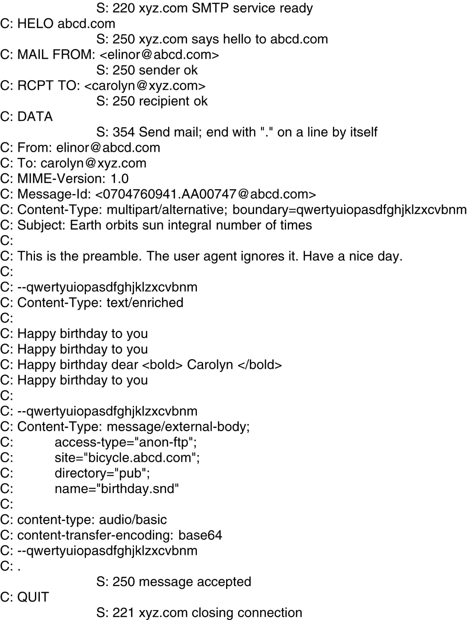
Message Transfer
Transferring a message from elinore@abcd.com to carolyn@xyz.com.

Slide 39
POP: Basic Model
Transfer mail from mail server to UA
SMTP Server:
always “on and listening”
via TCP port 25
holds incoming mail for user
Internet
SMTP/POP Mail Server
POP
User Agent
File System
SMTP
Clients:
connect to server to manipulate mail using POP3
POP Mail Access Server:
runs the POP3 service by listening on TCP port 110

Slide 40
POP: Features
Essentially store
Mail is stored on the server until the client connects and then is downloaded to the client.
You MAY be able to leave a copy on the server
Simple protocol and widely used
Similar to SMTP command/reply lockstep protocol
Used to retrieve mail for a single user, requires authentication
Many clients available such as foxmail, outlook
Common used version:
RFC1939: POP3 (POP Version 3)
For mobile users or users that use multiple machines during the day
Solution: IMAP (Internet Message Access Protocol)

Slide 41
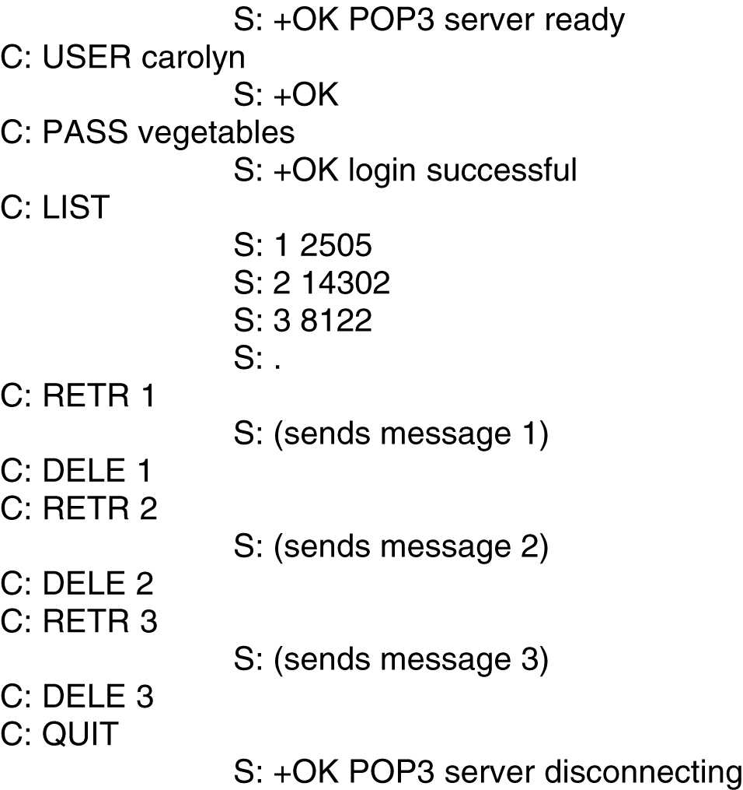
Using POP3 to Fetch 3 Messages

Slide 42
IMAP: Internet Message Access Protocol
For mobile users or users that use multiple machines during the day
IMAP (Internet Message Access Protocol)
RFC3501: IMAP4

Slide 43
World Wide Web (WWW)

Slide 44
WWW
Architecture

Slide 45
WWW: World Wide Web
A distributed hyper-media system, including multiple media information such as text, graph, image, audio, even video
Information is distributed in Internet, stored in web servers and accessed by hyperlinks
Client/Server mode, with browser program as client
Client and server interact with HTTP: Hyper-Text Transfer Protocol
WWW documents are located with URL: Uniform Resource Locator
WWW documents are written in HTML: HyperText Markup Language
Searching engines facilitate user to find information needed

Slide 46
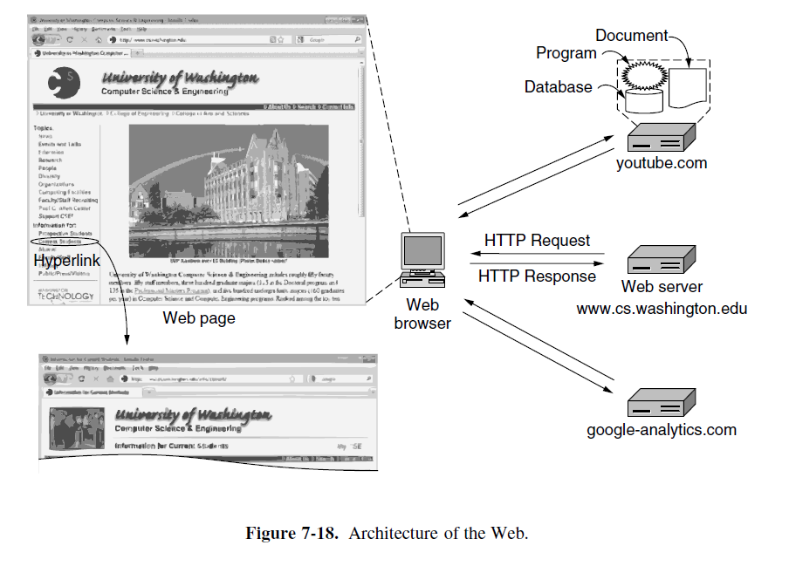
Architectural Overview of WWW

Slide 47
Client Side: Browser
An application program, as user’s interface to Web
Fetching information (Web page) from Web server
Displaying information for users
After the user clicks on a hyperlink, Browser
Determines URL, name of the linked web page, eg. www.abc.com/example.html
Asks DNS for the IP address of www.abc.com
Establishes a TCP connection to replied IP address
Asks a request of web page example.html (HTTP)
Releases TCP connection upon receiving the requested web page
Displays all the texts in example.html (HTML)
Fetches and displays all images in the file
Notes:
47
Interpreting HTML

Slide 48
Web Server
Stores set of Web documents
Responds to request from browser by sending copy of document
Steps of server’s loop
Accepts a TCP connection from a browser
Resolves name of the web page required
Fetches the requested page from disk
Returns the reply to the client
Releases the TCP connection

Slide 49
Web Documents
Also called a web page (HTML)
Types
Static web page
Stored in file
Unchanging
Dynamic web page
Can change whenever a server receives a request
Generated on server side
Output from a program on server, usually a script
Active web page
Can change after the document has been loaded into a browser
Generated on client side
Consists of a computer program, known as Java, running in browser (applet)

Slide 50
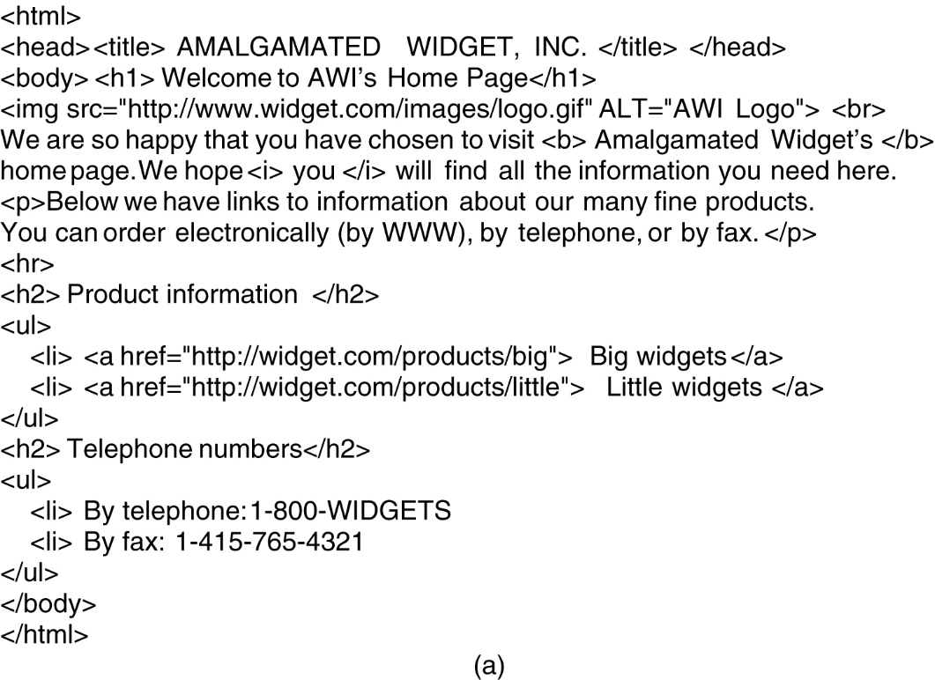
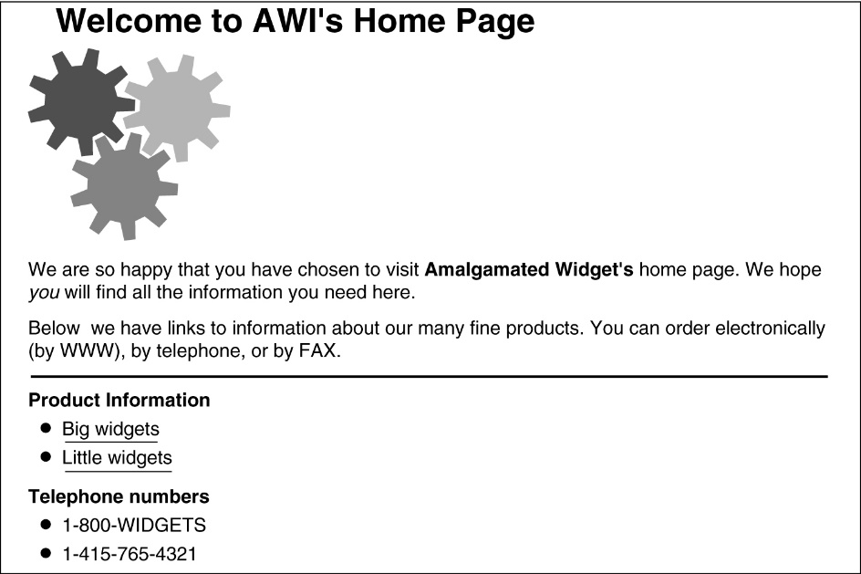
HTML – HyperText Markup Language
(a) The HTML for a sample Web page. (b) The formatted page.
(b)

Slide 51
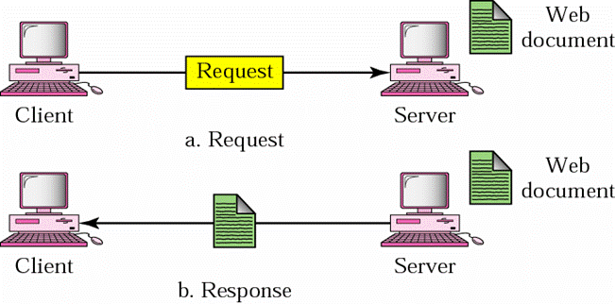
Static Web Page

Slide 52
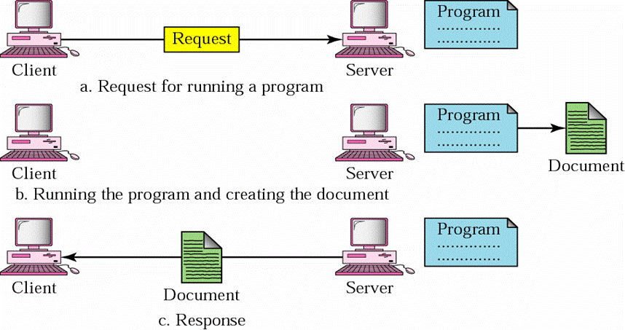
Dynamic Web Page

Slide 53
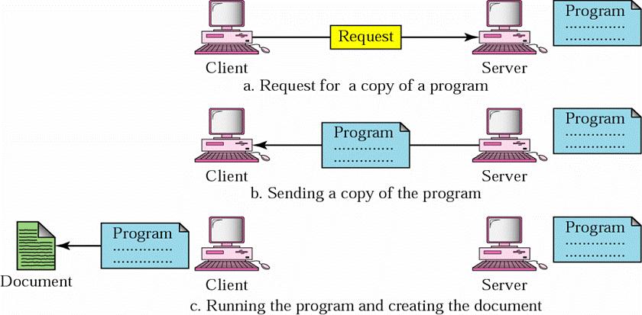
Active Web Page

Slide 54
Links to Other Pages
Embedded in HTML document
Uniform Resource Locator (URL)
Serving as worldwide name of a web page
By default, Protocol is http ; Port is 80; Path is index.html
protocol :// domain_name : port / item_name
name of access
protocol to use
domain name of
server computer
protocol port
number
path name
of item

Slide 55
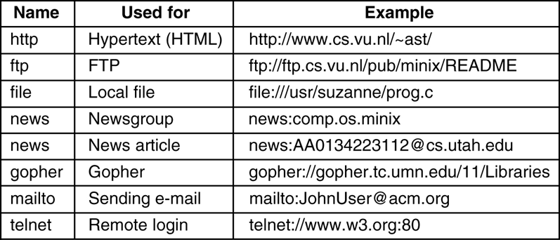
Some Common URLs
Web browsers are often called Universal Clients because most can talk other protocols besides HTTP

Slide 56
Hypertext Transfer Protocol (HTTP)

Slide 57
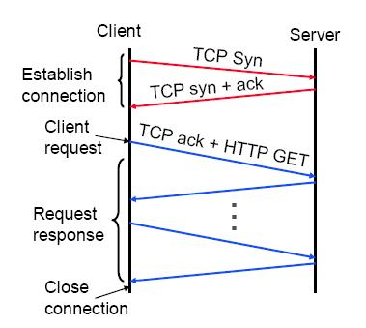
HTTP : Hyper-Text Transfer Protocol
Client-server architecture
Synchronous request/reply protocol
Running over TCP, Port 80
Stateless
Each command is
executed independently,
without any knowledge of
the previous operations

Slide 58
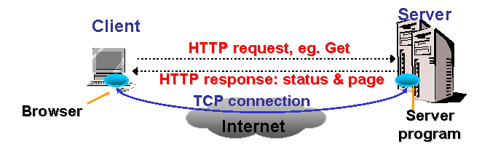
Operations of HTTP
Browser analyses URL of the hyperlink, i.e. http://www.abc.com/example.html
Browser uses DNS to get IP address of the server (www.abc.com)
Browser sets up a TCP connection with server
Browser sends a HTTP request: GET /example.html HTTP/1.0
Server sends requested page to browser
TCP connection is released
Browser displays example.html

Slide 59
HTTP Transaction
TCP connection set up, uses a port number as application reference, usually port 80
Establish connection
Client request
Client sends request message:
method URL HTTPversion
headers
Server response
server sends response message:
HTTPversion status code phrase
headers
[optional stuff]
Connection terminated
usually the server, sometimes the client “stops” it
anything else, whoever notices terminates

Slide 60
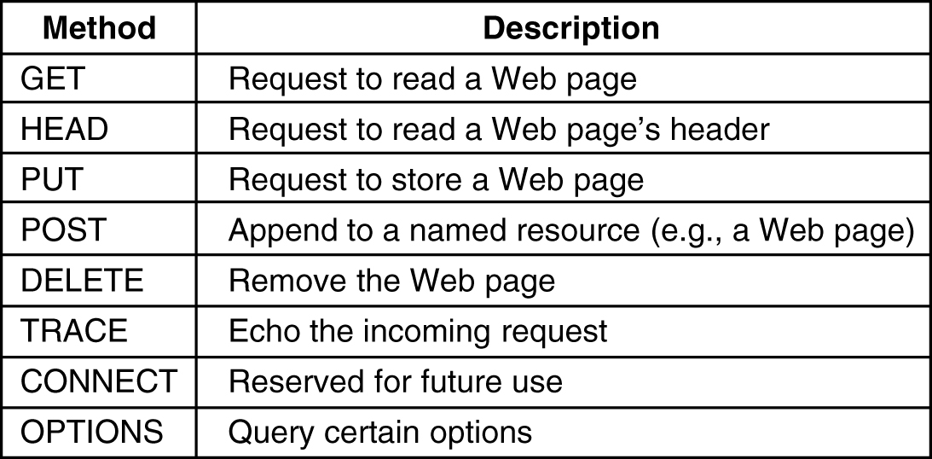
HTTP Methods
Notes:
60
A example of POST shall be added.
HEAD: only header fields returned, which is often used for testing hypertext links for validity, accessibility, and recent modification.
PUT puts a page at a specific URL. If there’s already a page there, it’s replaced in toto. If there’s no page there, a new one is created.
POST sends some data to a specified URL. The server on the other end of this URL can do whatever it wants with this data. It can store it somewhere private. (HTTP 204 NO CONTENT). It can store it in the page at the URL that was POSTed to (HTTP 205 RESET CONTENT). It can store it in a new page, in which case it returns the URL of that page in the Location field of the HTTP response header (HTTP 201 CREATED). It can use it as input for several different existing and new pages. It can throw the information away. It can insert, update, or delete records in a database (or all of the above). It can start brewing coffee (HTTP 202 ACCEPTED).
TRACE: used for debugging which echo's back input back to the user.

Slide 61
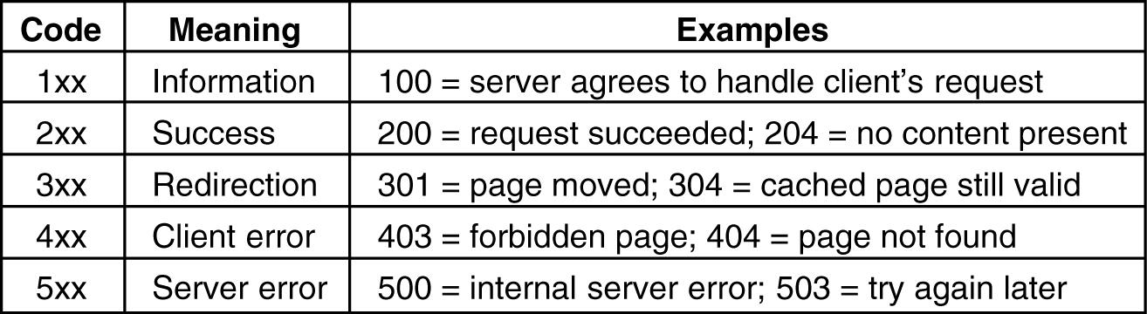
HTTP Status Codes

Slide 62
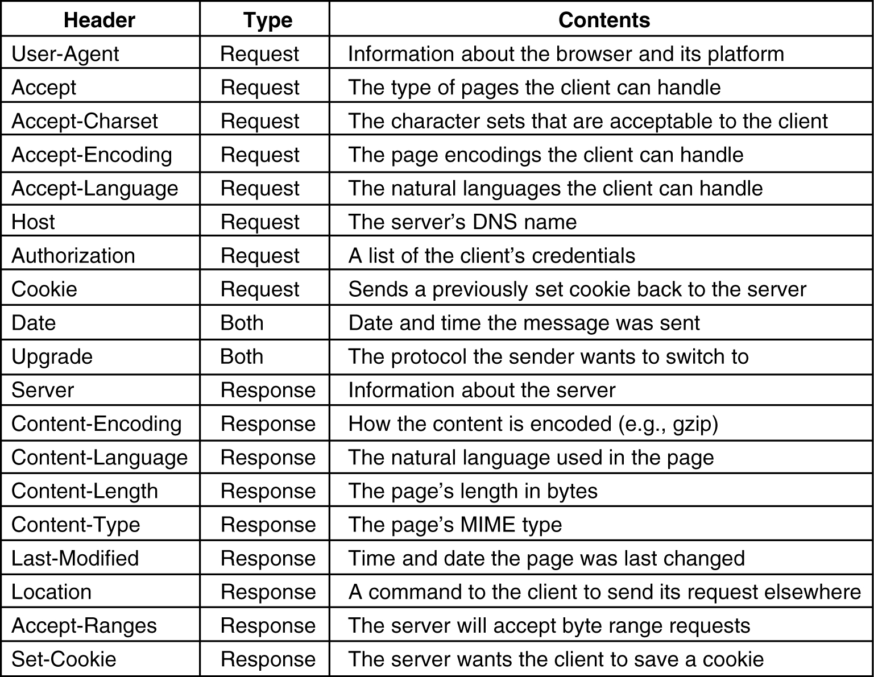
HTTP Message Headers

Slide 63
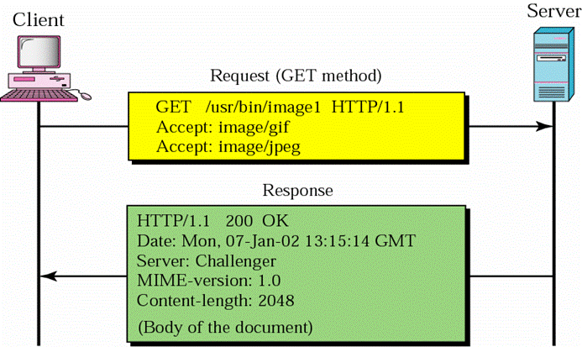
Example of HTTP Transaction

Slide 64
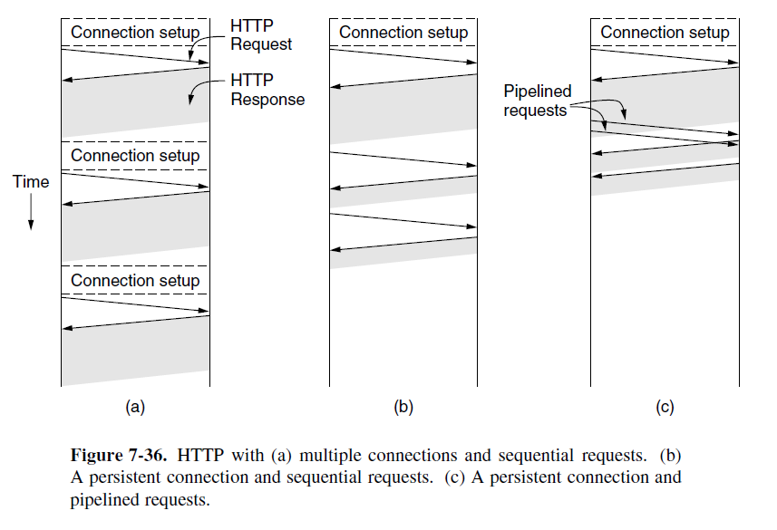
HTTP 1.0&1.1

