Slide 1
#LearnToMERN
Day????
June 6, 2016

Slide 2
Recovery from React

Slide 3
Today’s Class

Slide 4
Today’s Class!
Work on Homework.
In Class!

Slide 5
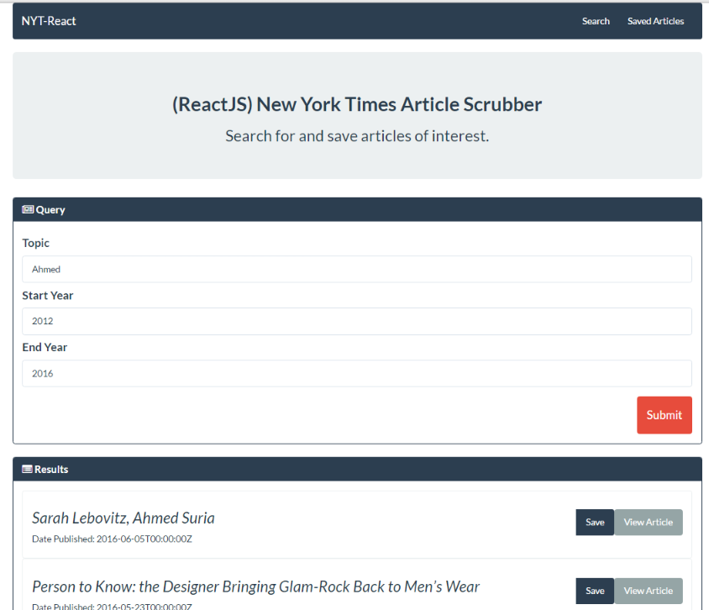
The Assignment

Slide 6
Homework Levels
Level 1 (Bare Minimum): Ain’t No React For Me
Use React Router to create the skeleton for the NYT Application.
Your final application will consist of four components with hardcoded Bootstrap HTML. Clicking the menu option will flip pages between the components.
You will have a consistent header that is on both pages (without re-load).
Level 2 (Recommended): Right on React!
You will build a complete application for querying the NYT Application.
Your final application will consist of at least four components with dynamically rendered HTML.
You will utilize the Axios HTTP package and the appropriate React Lifecycles to complete the task

Slide 7
Homework Levels
Level 3 (True Challenge): React Ront Hold me Down
You will brace for the challenge to come.
In this final challenge, you will create a complete Express, Node, and MongoDB backend for your application. (Don’t worry. This is the easy part).
Your server should have an API for saving and deleting articles of interest.
Your React front-end should allow users to work with the UI – and your code should appropriately hand the required states and properties between components as necessary.
As with the previous example, you will need to use the Axios NPM pakage, helper functions, and the appropriate React Lifecycle methods to accomplish this task.
See: react-nyt-app.herokuapp.com for a completed application.

Slide 8
JSX Gotcha’s

Slide 9
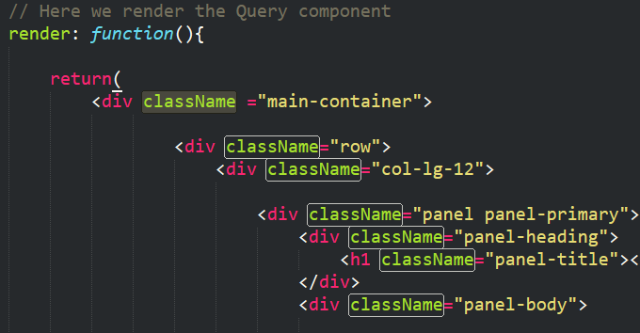
Incorporating Classes
It turns out…
You can incorporate classes into JSX
You just need to call them “className”
This is because “class” is a reserved keyword in Javascript

Slide 10
Incorporating Styles
It also turns out…
You can incorporate CSS styles into JSX
You just need to ditch the hyphen and camelcase the property.
Ex: font-size → fontSize

Slide 11
Component Refresher

Slide 12
A Moment to Ponder…
Instead of separating “layout and logic”, React JS uses what alternative paradigm?

Slide 13
A Moment to Ponder…
Instead of separating “layout and logic”, React JS uses what alternative paradigm?
Components*!
* If you only learn one thing from our lessons on React it should be this.

Slide 14
A Moment to Ponder…
What exactly are components again?

Slide 15
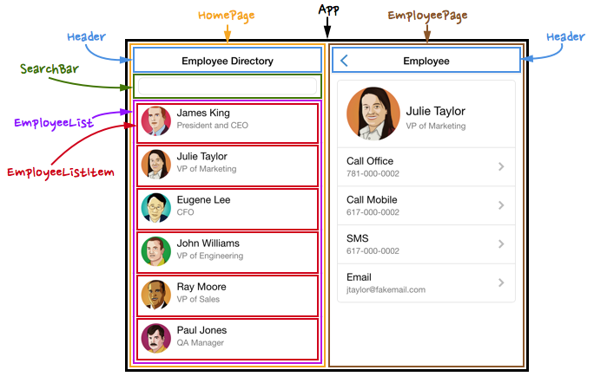
Power of Components!
By separating elements out into components...
Layout and Logic are kept bundled together in a self-contained package.
Components can easily be re-used in various points in the application without needing to be re-coded.
Components can be more easily tested. (i.e. having one re-usable component means only one UI element needs to be tested).
For complex applications each of these can be critical in finding bugs and saving time.
Power of Components!

Slide 16
A Moment to Ponder…
What method do we use to create a
new component?

Slide 17
A Moment to Ponder…
What method do we use to create a
new component?
var ClassName* = React.createClass()
* Remember that React components must be capitalized

Slide 18
A Moment to Ponder…
What method do we use to create a
render our components to the DOM?

Slide 19
A Moment to Ponder…
What method do we use to create a
render our components to the DOM?
ReactDOM.render()*
* Note that you will only be rendering a single component into the DOM. Every other component will be a child to that component.

Slide 20
A Moment to Ponder…
New Question:
Every component must contain which method?

Slide 21
A Moment to Ponder…
New Question:
Every component must contain which method?
render: function() { }*
* Our render function will define what our component will look like. It will be in JSX syntax

Slide 22
A Moment to Ponder…
New Question:
How do we deploy a component in our JSX?

Slide 23
A Moment to Ponder…
New Question:
How do we deploy a component in our JSX?
<ComponentName />

Slide 24
A Moment to Ponder…
New Question:
How would we deploy a component inside of another component?

Slide 25
A Moment to Ponder…
New Question:
How would we deploy a component inside of another component?
<ParentComponent>
<ComponentName />
</ParentComponent>

Slide 26
Component Architecting

Slide 27
Parent-Child Relationships
App.js
App.js
Header.js
Header.js
Search.js
Query.js
Search.js
Query.js
Results.js
Results.js
First step in building React applications is determining the component hierarchy.

Slide 28
Parent-Child Relationships
Main.js
Main.js
Search.js
Query.js
Search.js
Query.js
Results.js
Results.js
Sometimes, you can then simplify it by realizing certain components are static elements.

Slide 29
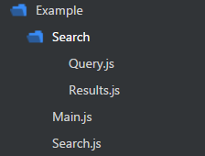
Parent-Child Relationships
Main.js
Search.js
Query.js
Results.js
You then code out your components to match the same hierarchy.

Slide 30
States and Props

Slide 31
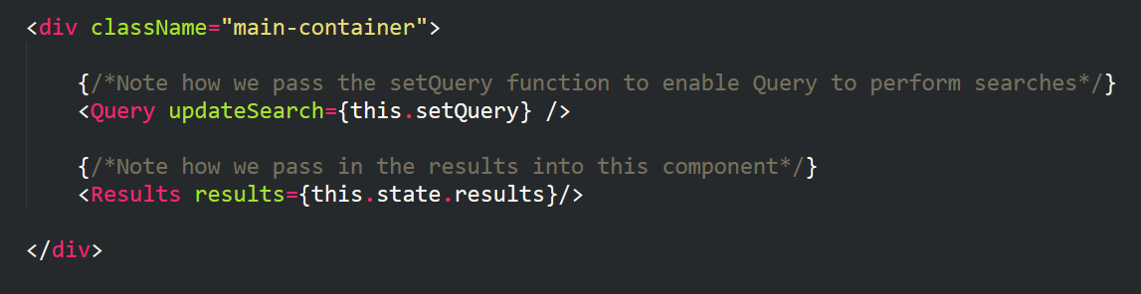
Passing State from Parent to Child
Parents can pass data (states and props) or methods to children. (It’s a bit trickier to send it to parents).

Slide 32
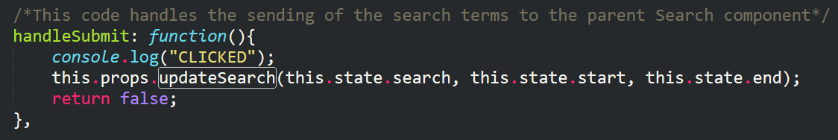
Children Inherit Props
When children inherit the data or method it ALWAYS comes in the form of a prop.
Props can be specifically referenced using this.props.propName syntax.

Slide 33
Props vs States: What’s the Difference?
States:
Mutable (i.e. changeable with UI).
States can be changed using this.setState({})
Props:
Immutable (i.e. unchangeable).
Props are static elements. They may be static properties or static methods.

Slide 34

A Moment to Ponder…
React.JS has a strong preference for passing state from parents to children…
What is the implication of this?

Slide 35
Unidirectional Data Flow

Slide 36
Unidirectional Data Flow
React.JS has a strong preference for unidirectional data flow.
This means that the variables that get manipulated are controlled by parents.
Parents are then responsible for divvying the data (and state changes) to the children.
Child A
GrandChild A
Great GrandChild A
Parent
Child B
GrandChild B
Great GrandChild B

Slide 37
Unidirectional Data Flow
Child A
GrandChild A
Great GrandChild A
Parent
Child B
GrandChild B
Great GrandChild B
“Oh Hey! My GrandChild A just changed colors”

Slide 38
Unidirectional Data Flow
Child A
GrandChild A
Great GrandChild A
Parent
Child B
GrandChild B
Great GrandChild B
“I’ll let the others know if needed….”

Slide 39
Unidirectional Data Flow
This approach is meant to create a level of manageability when it comes to data flow and UI changes.
Child A
GrandChild A
Great GrandChild A
Parent
Child B
GrandChild B
Great GrandChild B

Slide 40
Lifecycle Methods

Slide 41
Questions

Slide 42
Keep Exploring!
Start Coding! Read documentation!!

Slide 43
Questions

