Slide 1

Final Projects!
The End is Near…
Rutgers Coding Bootcamp | June 25, 2016
© 2016 | RCB - All Rights Reserved
Notes:
Start at 6:45 PM

Slide 2
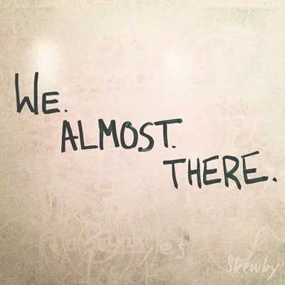

Almost There…
© 2016 | RCB - All Rights Reserved
© 2016 | Rutgers Coding Bootcamp - All Rights Reserved

Slide 3

Already There!
© 2016 | RCB - All Rights Reserved
© 2016 | Rutgers Coding Bootcamp - All Rights Reserved

Slide 4
“Damn Girl… You iz Smart”
The Browser
Dev Tools
Server Side
HTML
CSS
JavaScript
jQuery
Bootstrap
SEO
Heroku
Git
GitHub
Templating Engines
Sessions
Writing tests
Node.js
Express.js
Creating APIs
MVC
User Authentication
ORM (Sequelize)
Meteor.js
Databases
MySQL
MongoDB
API Interaction
APIs (Consuming)
JSON
AJAX
Real Time Cloud Database via Firebase
Algorithms
Design Patterns
CS Fundamentals
Cutting Edge Development
React.js

Slide 5
Goals Re-Examined…
“To land a solid career.. and be able to support a family.”
“Hope to make something of myself one day…”
“An opportunity to be more creative in my day-to-day work.”
“…to get a better paying job.”
“I want nothing more in the entire world than to be a game designer.”
“Change careers and become a web developer.”
“…to build mastery. To learn a skill that I haven’t yet explored.”
“[a chapter] better than the last.”
© 2016 | RCB - All Rights Reserved
© 2016 | Rutgers Coding Bootcamp - All Rights Reserved

Slide 6
Nudge Forward
Didn’t quite make your target?
Let’s chat.
© 2016 | RCB - All Rights Reserved
© 2016 | Rutgers Coding Bootcamp - All Rights Reserved

Slide 7
Admin Items
© 2016 | RCB - All Rights Reserved
Notes:
7:00 – 7:05

Slide 8
What’s Left
Final Projects
Remaining Topics
Computer Science Algorithms
Javascript Design Patterns
Lightning Talks:
Angular
PHP / Wordpress
AWS
?
Job Workshops
Demo Day!!!!
© 2016 | RCB - All Rights Reserved
© 2016 | Rutgers Coding Bootcamp - All Rights Reserved

Slide 9
Big News!
No homework from now till the end!
(With a small caveat)
© 2016 | RCB - All Rights Reserved
© 2016 | Rutgers Coding Bootcamp - All Rights Reserved

Slide 10
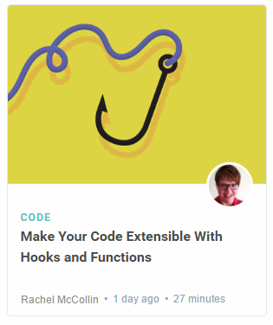
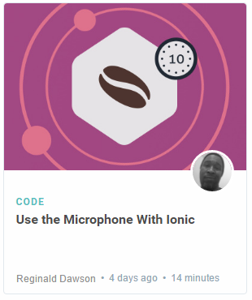
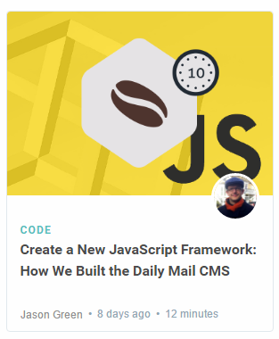
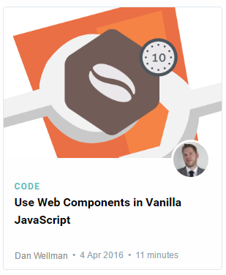
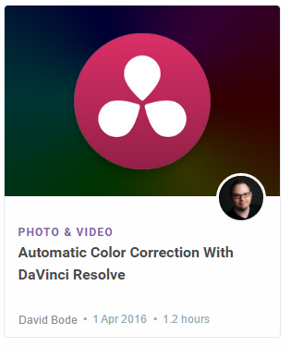
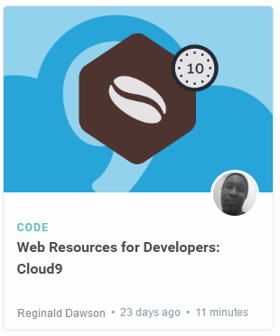
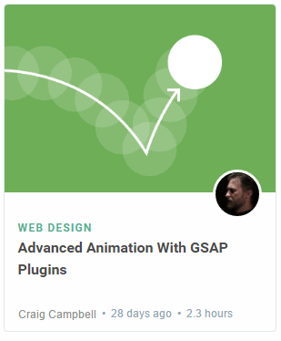
Lightning Talks!
Disclaimer: Not actual topics for Lightning Talks. I just liked the colors. Lolz.
© 2016 | RCB - All Rights Reserved
© 2016 | Rutgers Coding Bootcamp - All Rights Reserved

Slide 11

Never Stop Learning!
The key to hireability and relevance is to constantly be learning.
The field is always changing and there is never a point where you can call it quits.
Stick with it! It’s a craft that you continue to hone with time.
© 2016 | RCB - All Rights Reserved
© 2016 | Rutgers Coding Bootcamp - All Rights Reserved

Slide 12
Final Project
© 2016 | RCB - All Rights Reserved
Notes:
7:00 – 7:05

Slide 13
Your Challenge…
© 2016 | RCB - All Rights Reserved
Notes:
7:00 – 7:05

Slide 14
Your Challenge
Prove yourself.
© 2016 | RCB - All Rights Reserved
© 2016 | Rutgers Coding Bootcamp - All Rights Reserved

Slide 15
The Futility of Excuses
<Insert Quote on Excuses Here>
© 2016 | RCB - All Rights Reserved
© 2016 | Rutgers Coding Bootcamp - All Rights Reserved

Slide 16
Your Challenge
You have an entire month to work on this.
You have ALL the skills you need.
You have a team of skilled developers.
You have experts willing to help.
No excuses. Time to prove yourself.
© 2016 | RCB - All Rights Reserved
© 2016 | Rutgers Coding Bootcamp - All Rights Reserved

Slide 17
Expectations…
© 2016 | RCB - All Rights Reserved
Notes:
7:00 – 7:05

Slide 18
Expectations
We expect whatever you build to have utility
We expect you to have market or real-world research that evidences your idea has REAL value to people.
We expect you to have done research on other web / mobile applications in your domain.
We expect you to put serious time and thought into this.
We expect you to report problems you are facing along the way.
We expect you to utilize some form of project management system.
We expect you to dig deep into documentation and external resources to learn what you need.
© 2016 | RCB - All Rights Reserved
© 2016 | Rutgers Coding Bootcamp - All Rights Reserved

Slide 19
Requirements…
© 2016 | RCB - All Rights Reserved
Notes:
7:00 – 7:05

Slide 20
Coding Requirements (but not really requirements)
Must use ReactJS or Angular in some way (even if minimal)
Must use a Node and Express Web Server
Must be backed by a MySQL or MongoDB Database with a Sequelize or Mongoose ORM
Must have both GET and POST routes for retrieving and adding new data
Must be deployed using Heroku (with Data)
Must utilize at least two libraries, packages, or technologies that we haven’t discussed
Must allow for or involve the authentication of users in some way
Must have a polished frontend / UI
Must have folder structure that meets MVC Paradigm
Must meet good quality coding standards (indentation, scoping, naming)
© 2016 | RCB - All Rights Reserved
© 2016 | Rutgers Coding Bootcamp - All Rights Reserved

Slide 21
But Honestly…
Do what you want. Talk to us first. Get our input.
But if you have an idea and want to run with it, we’re not going to stop you.
Remember:
No excuses. Time to prove yourself.
© 2016 | RCB - All Rights Reserved
© 2016 | Rutgers Coding Bootcamp - All Rights Reserved

Slide 22
Deliverables…
© 2016 | RCB - All Rights Reserved
Notes:
7:00 – 7:05

Slide 23
Project Updates
Instead of homework, you will be required to submit 4 Project Deliverables.
These will be due each Saturday from now until Presentation Day.
Deliverables #1 (July 2, 2016) – Plan, Design, and Research
Deliverables #2 (July 9, 2016) – Ready MVP (Working App!), Mini-Presentation
Deliverables #3 (July 16, 2016) – Project Polish, Functionality Push, Final Plan
Final Presentation (July 27, 2016) – Presentation Time!
© 2016 | RCB - All Rights Reserved
© 2016 | Rutgers Coding Bootcamp - All Rights Reserved

Slide 24
Deliverable #1
© 2016 | RCB - All Rights Reserved
Notes:
7:00 – 7:05

Slide 25
Deliverable #1
By July 2, 2016 you must submit a detailed plan of action for your project.
In this plan, you will include:
An overview of the intended application and WHY you feel it’s valuable.
A set of DETAILED screen-by-screen design layouts with annotations describing all UI/UX components and all data relevant to the screen.
A breakdown of roles by group member.
A schedule for completion of various tasks.
A screenshot of your Jira, Trello, or Project Management Board that shows breakdown of tasks – assigned to group members with a schedule.
© 2016 | RCB - All Rights Reserved
© 2016 | Rutgers Coding Bootcamp - All Rights Reserved

Slide 26
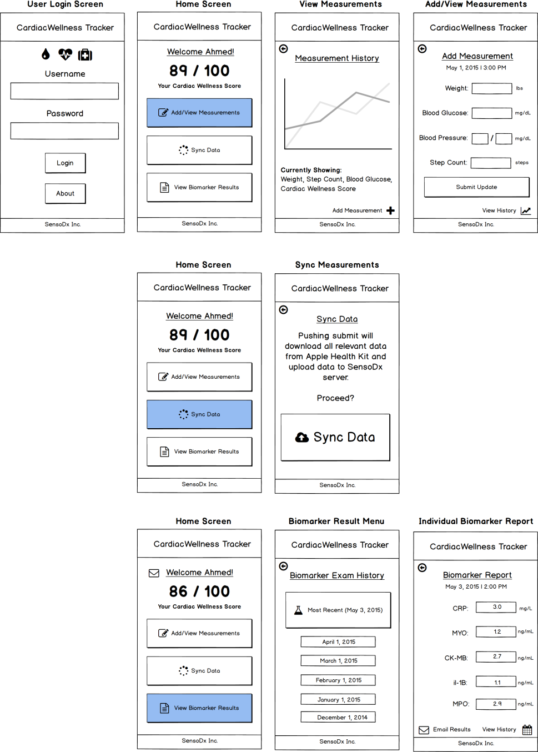
Example UI/UX Flow
Screen Map
This is intended to show you the order in which users would see screens. The three branches correlates with the three button options from the main menu.
© 2016 | RCB - All Rights Reserved
© 2016 | Rutgers Coding Bootcamp - All Rights Reserved

Slide 27
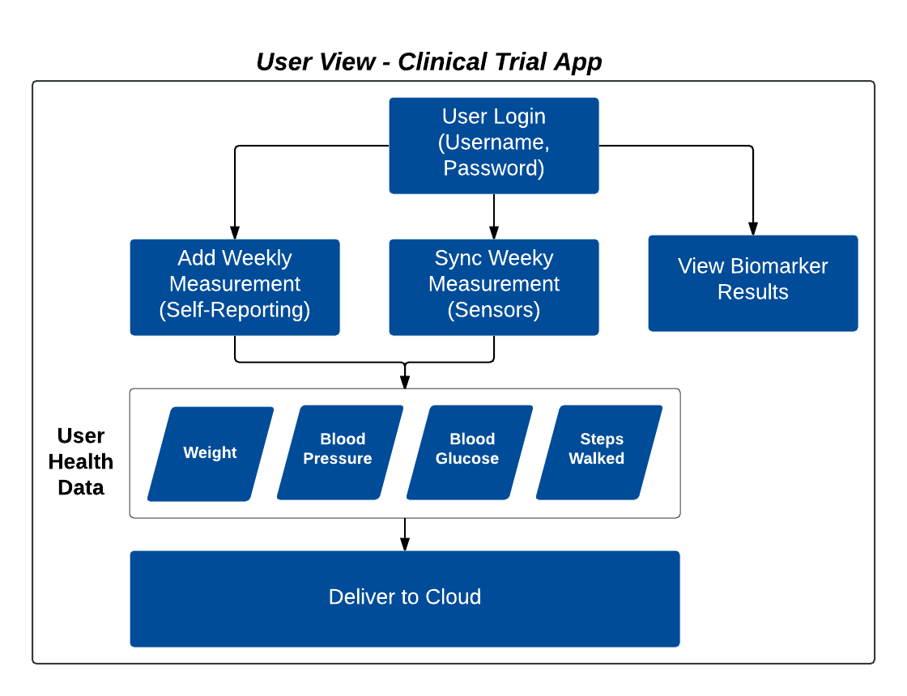
Example Data Flow
© 2016 | RCB - All Rights Reserved
© 2016 | Rutgers Coding Bootcamp - All Rights Reserved

Slide 28
Questions
© 2016 | RCB - All Rights Reserved
Notes:
7:00 – 7:05

