Slide 1

CHAPTER 6
SET THEORY
Copyright © Cengage Learning. All rights reserved.

Slide 2
SECTION 6.1
Set Theory: Definitions and the Element Method of Proof
Copyright © Cengage Learning. All rights reserved.

Slide 3
Set Theory: Definitions and the Element Method of Proof
The words set and element are undefined terms of set theory just as sentence, true, and false are undefined terms of logic.
The founder of set theory, Georg Cantor, suggested
imagining a set as a “collection into a whole M of definite and separate objects of our intuition or our thought. These objects are called the elements of M.”
Cantor used the letter M because it is the first letter of the German word for set: Menge.

Slide 4
Subsets: Proof and Disproof

Slide 5
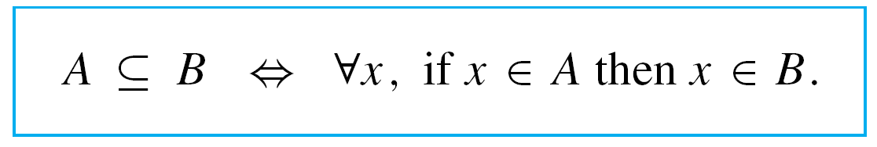
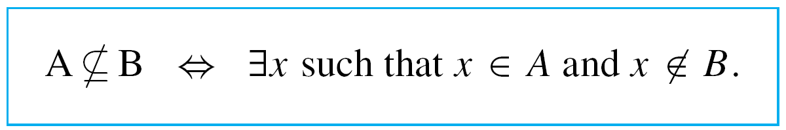
Subsets: Proof and Disproof
We begin by rewriting what it means for a set A to be a subset of a set B as a formal universal conditional statement:
The negation is, therefore, existential:

Slide 6
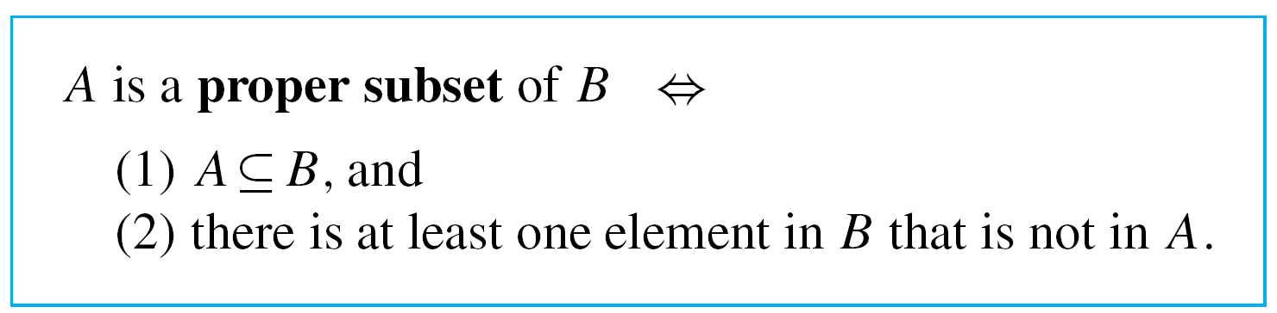
Subsets: Proof and Disproof
A proper subset of a set is a subset that is not equal to its containing set. Thus

Slide 7
Example 1 – Testing Whether One Set Is a Subset of Another
Let A = {1} and B = {1, {1}}.
a. Is A ⊆ B?
b. If so, is A a proper subset of B?
Solution:
a. Because A = {1}, A has only one element, namely the
symbol 1.
This element is also one of the elements in set B. Hence
every element in A is in B, and so A ⊆ B.

Slide 8
Example 1 – Solution
cont’d
b. B has two distinct elements, the symbol 1 and the set {1} whose only element is 1.
Since 1 ≠ {1}, the set {1} is not an element of A, and so there is an element of B that is not an element of A. Hence A is a proper subset of B.

Slide 9
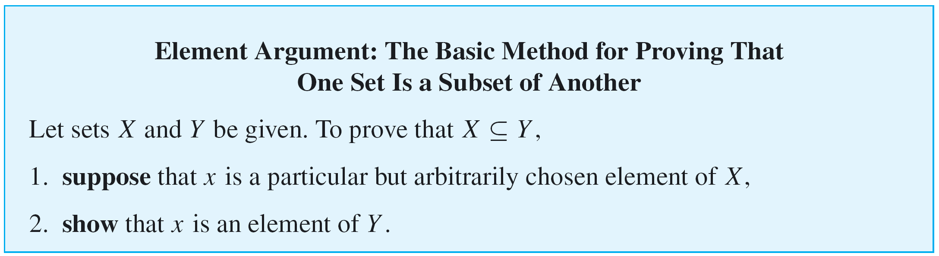
Subsets: Proof and Disproof
Because we define what it means for one set to be a subset of another by means of a universal conditional statement, we can use the method of direct proof to establish a subset relationship.
Such a proof is called an element argument and is the fundamental proof technique of set theory.

Slide 10
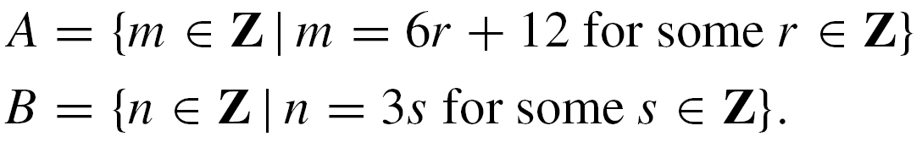
Example 2 – Proving and Disproving Subset Relations
Define sets A and B as follows:
a. Outline a proof that A ⊆ B.
b. Prove that A ⊆ B.
c. Disprove that B ⊆ A.

Slide 11

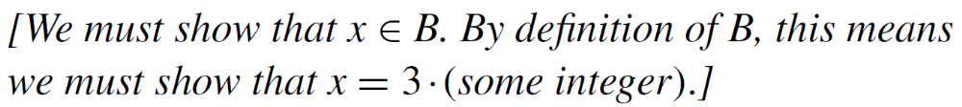
Example 2 – Solution
a. Proof Outline:
Suppose x is a particular but arbitrarily chosen element of A.
Therefore, x is an element of B.
b. Proof:
Suppose x is a particular but arbitrarily chosen element of A.

Slide 12

Example 2 – Solution
cont’d
By definition of A, there is an integer r such that
x = 6r + 12.
Let s = 2r + 4.
Then s is an integer because products and sums of integers are integers.

Slide 13
Example 2 – Solution
cont’d
Also
Thus, by definition of B, x is an element of B,
c. To disprove a statement means to show that it is false, and to show it is false that B ⊆ A, you must find an element of B that is not an element of A.

Slide 14
Example 2 – Solution
cont’d
By the definitions of A and B, this means that you must find an integer x of the form 3  (some integer) that cannot be written in the form 6  (some integer) + 12.
A little experimentation reveals that various numbers do the job. For instance, you could let x = 3.
Then x ∈ B because 3 = 3  1, but x ∉ A because there is no integer r such that 3 = 6r + 12. For if there were such an integer, then

Slide 15

Example 2 – Solution
cont’d
but 3/2 is not an integer. Thus 3 ∈ B but 3 ∉ A, and
so B A.

Slide 16
Set Equality

Slide 17
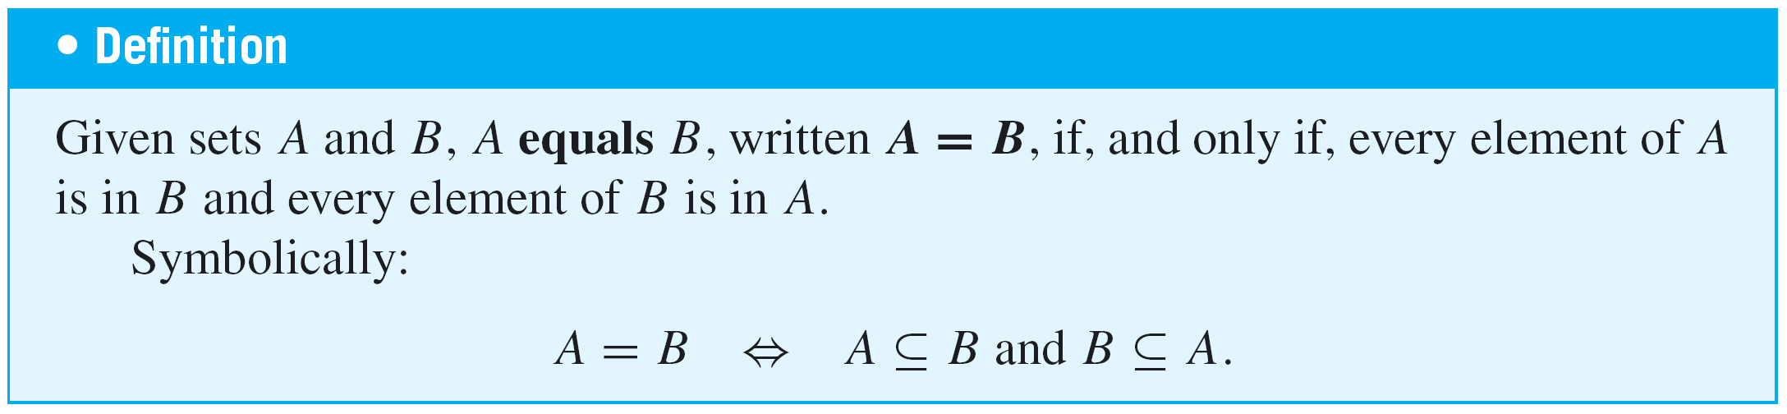
Set Equality
We have known that by the axiom of extension, sets A and B are equal if, and only if, they have exactly the same elements.
We restate this as a definition that uses the language of subsets.

Slide 18
Set Equality
This version of the definition of equality implies the following:
To know that a set A equals a set B, you must know
that A ⊆ B and you must also know that B ⊆ A.

Slide 19
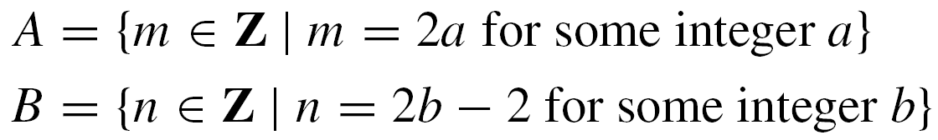
Example 3 – Set Equality
Define sets A and B as follows:
Is A = B?
Solution:
Yes. To prove this, both subset relations A ⊆ B and B ⊆ A must be proved.

Slide 20
Example 3 – Solution
cont’d
Part 1, Proof That A ⊆ B:
Suppose x is a particular but arbitrarily chosen element of A.
[We must show that x ∈ B. By definition of B, this means we must show that x = 2  (some integer) – 2.]
By definition of A, there is an integer a such that x = 2a.
[Given that x = 2a, can x also be expressed as 2  (some integer) – 2? i.e., is there an integer, say b, such that
2a = 2b – 2? Solve for b to obtain b = (2a + 2)/2 = a + 1. Check to see if this works.]

Slide 21
Example 3 – Solution
cont’d
Let b = a + 1.
[First check that b is an integer.]
Then b is an integer because it is a sum of integers.
[Then check that x = 2b – 2.]
Also 2b – 2 = 2(a + 1) – 2 = 2a + 2 – 2 = 2a = x,
Thus, by definition of B, x is an element of B
[which is what was to be shown].
Part 2, Proof That B ⊆ A:
Similarly we can prove that B ⊆ A. Hence A = B.

Slide 22
Venn Diagrams

Slide 23
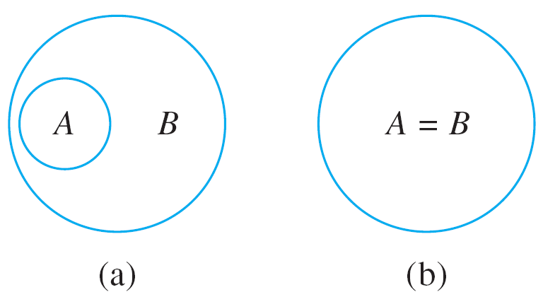
Venn Diagrams
If sets A and B are represented as regions in the plane, relationships between A and B can be represented by pictures, called Venn diagrams, that were introduced by the British mathematician John Venn in 1881.
For instance, the relationship A ⊆ B can be pictured in one of two ways, as shown in Figure 6.1.1.
A ⊆ B
Figure 6.1.1

Slide 24

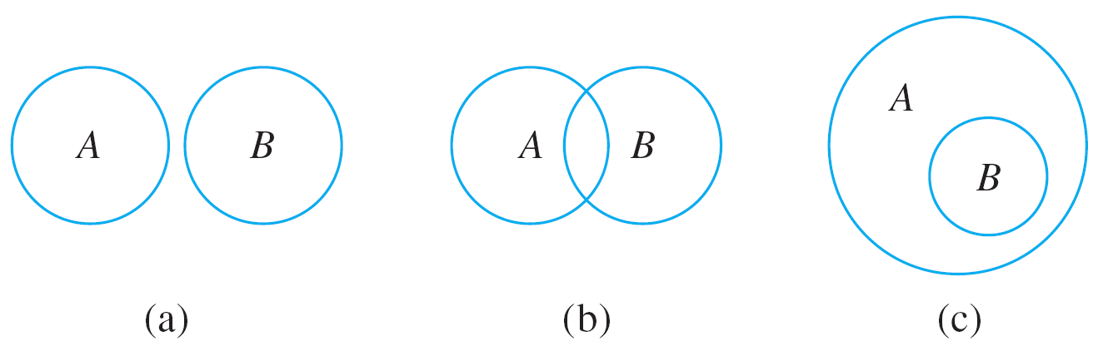

Venn Diagrams
The relationship A B can be represented in three different ways with Venn diagrams, as shown in Figure 6.1.2.
A B
Figure 6.1.2

Slide 25


Example 4 – Relations among Sets of Numbers
Since Z, Q, and R denote the sets of integers, rational numbers, and real numbers, respectively, Z is a subset of Q because every integer is rational (any integer n can be written in the form ).
Q is a subset of R because every rational number is real (any rational number can be represented as a length on the number line).
Z is a proper subset of Q because there are rational numbers that are not integers (for example, ).

Slide 26


Example 4 – Relations among Sets of Numbers
cont’d
Q is a proper subset of R because there are real numbers that are not rational (for example, ).
This is shown diagrammatically in Figure 6.1.3.
Figure 6.1.3

Slide 27
Operations on Sets

Slide 28
Operations on Sets
Most mathematical discussions are carried on within some context. For example, in a certain situation all sets being considered might be sets of real numbers.
In such a situation, the set of real numbers would be called a universal set or a universe of discourse for the
discussion.

Slide 29
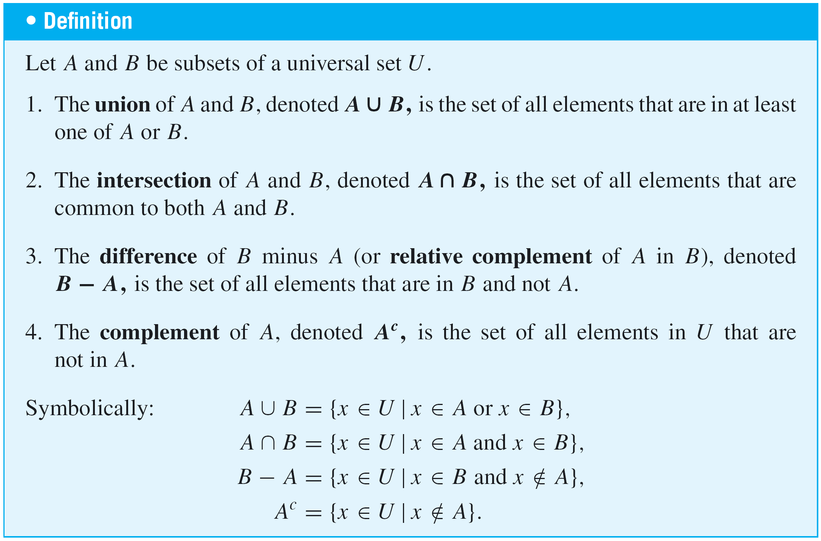
Operations on Sets

Slide 30
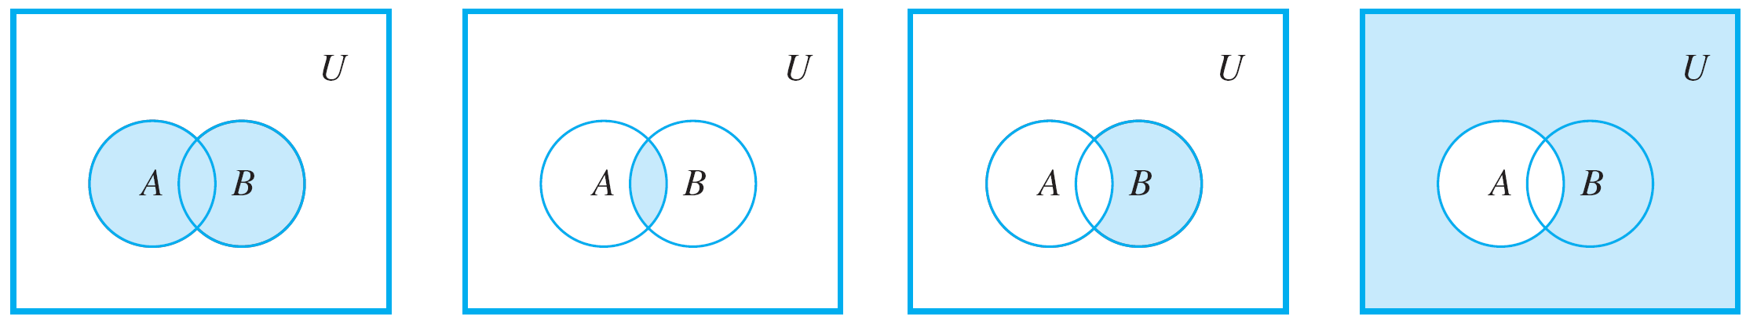
Operations on Sets
Venn diagram representations for union, intersection, difference, and complement are shown in Figure 6.1.4.
Shaded region
represents A ∪ B.
Shaded region
represents A ∩ B.
Shaded region
represents B – A.
Shaded region
represents A^{c}.
Figure 6.1.4

Slide 31




Example 5 – Unions, Intersections, Differences, and Complements
Let the universal set be the set U = {a, b, c, d, e, f, g} and let A = {a, c, e, g} and B = {d, e, f, g}. Find A ∪ B, A ∩ B,
B – A, and A^{c}.
Solution:

Slide 32
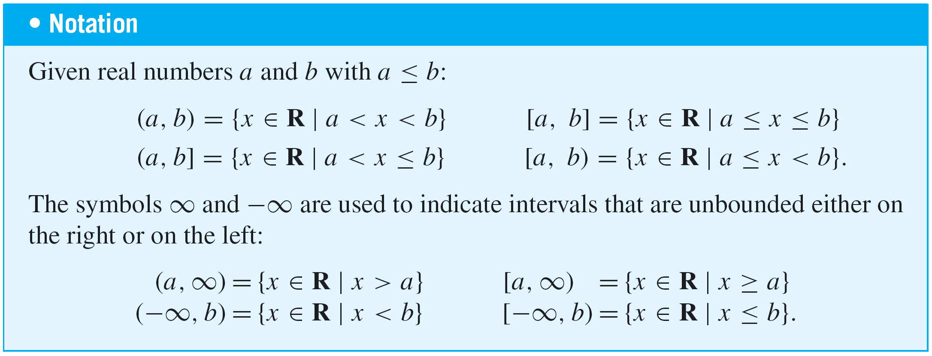
Operations on Sets
There is a convenient notation for subsets of real numbers that are intervals.
Observe that the notation for the interval (a, b) is identical
to the notation for the ordered pair (a, b). However, context
makes it unlikely that the two will be confused.

Slide 33
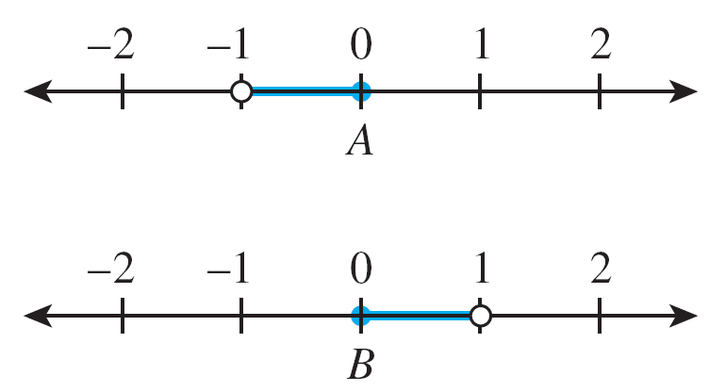
Example 6 – An Example with Intervals
Let the universal set be the set R of all real numbers and let
These sets are shown on the number lines below.
Find A ∪ B, A ∩ B, B – A, and A^{c}.

Slide 34
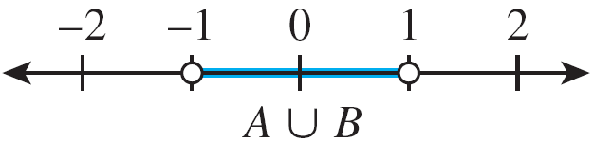
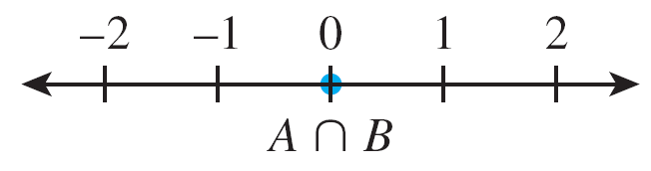
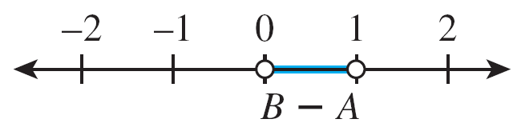
Example 6 – Solution

Slide 35
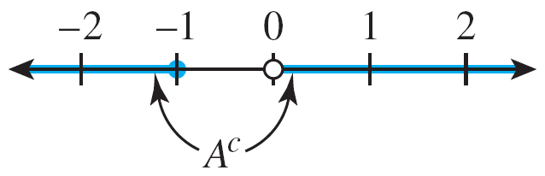
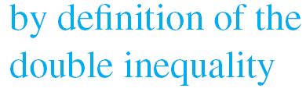

Example 6 – Solution
cont’d

Slide 36
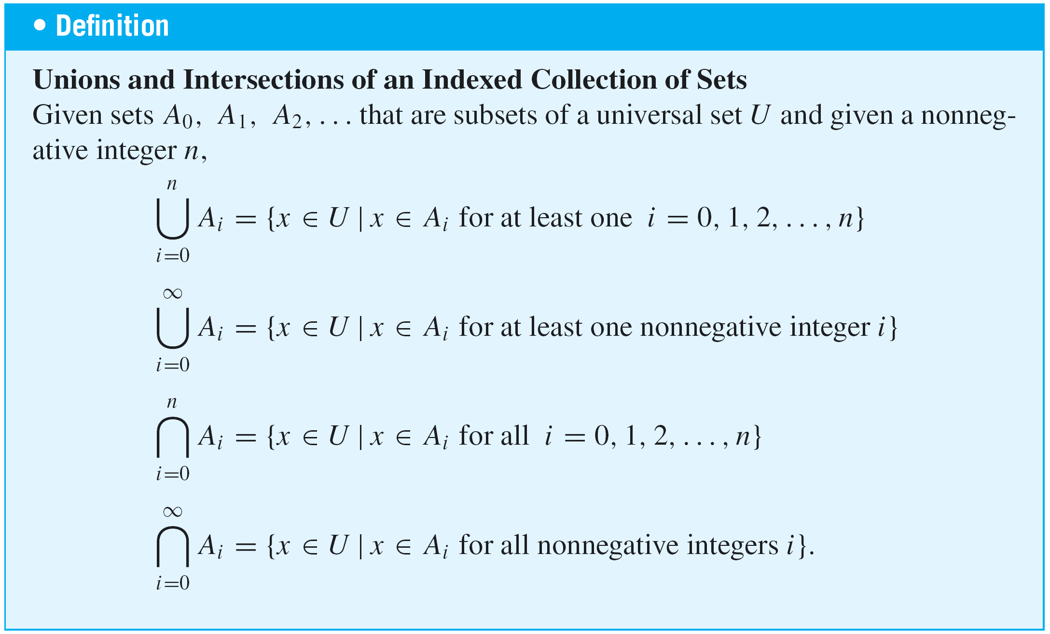
Operations on Sets
The definitions of unions and intersections for more than two sets are very similar to the definitions for two sets.

Slide 37
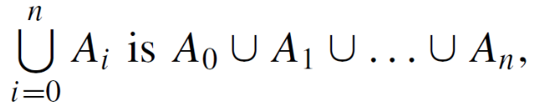
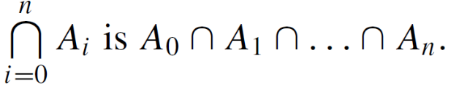
Operations on Sets
An alternative notation for and an
alternative notation for

Slide 38
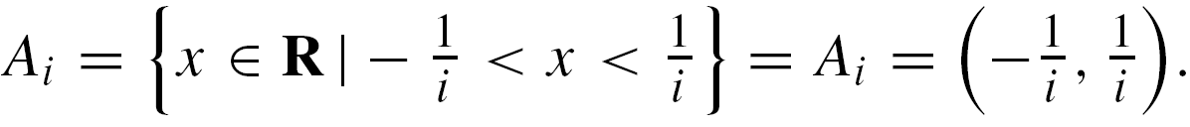
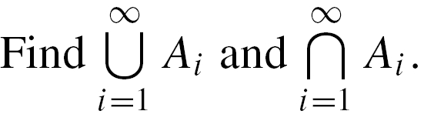
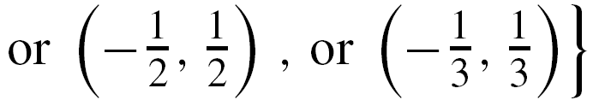
Example 7 – Finding Unions and Intersections of More than Two Sets
For each positive integer i, let
a.
b.
Solution:
a.

Slide 39
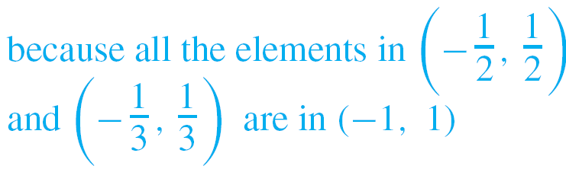


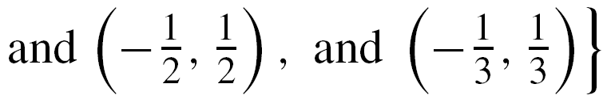
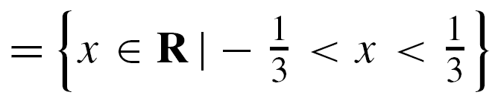
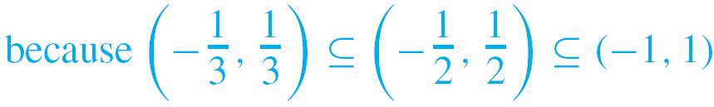
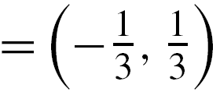
Example 7 – Solution
cont’d

Slide 40
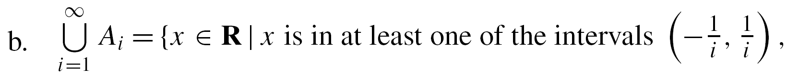

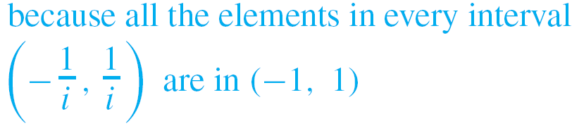


Example 7 – Solution
cont’d
b.

Slide 41
The Empty Set

Slide 42
The Empty Set
We have stated that a set is defined by the elements that compose it. This being so, can there be a set that has no elements? It turns out that it is convenient to allow such a
set.
Because it is unique, we can give it a special name. We call it the empty set (or null set) and denote it by the symbol Ø.
Thus {1, 3} ∩ {2, 4} = Ø and {x ∈ R| x² = –1} = Ø.

Slide 43

Example 8 – A Set with No Elements
Describe the set
Solution:
We have known that a < x < b means that a < x and x < b. So D consists of all real numbers that are both greater than 3 and less than 2.
Since there are no such numbers, D has no elements and so D = Ø.

Slide 44
Partitions of Sets

Slide 45
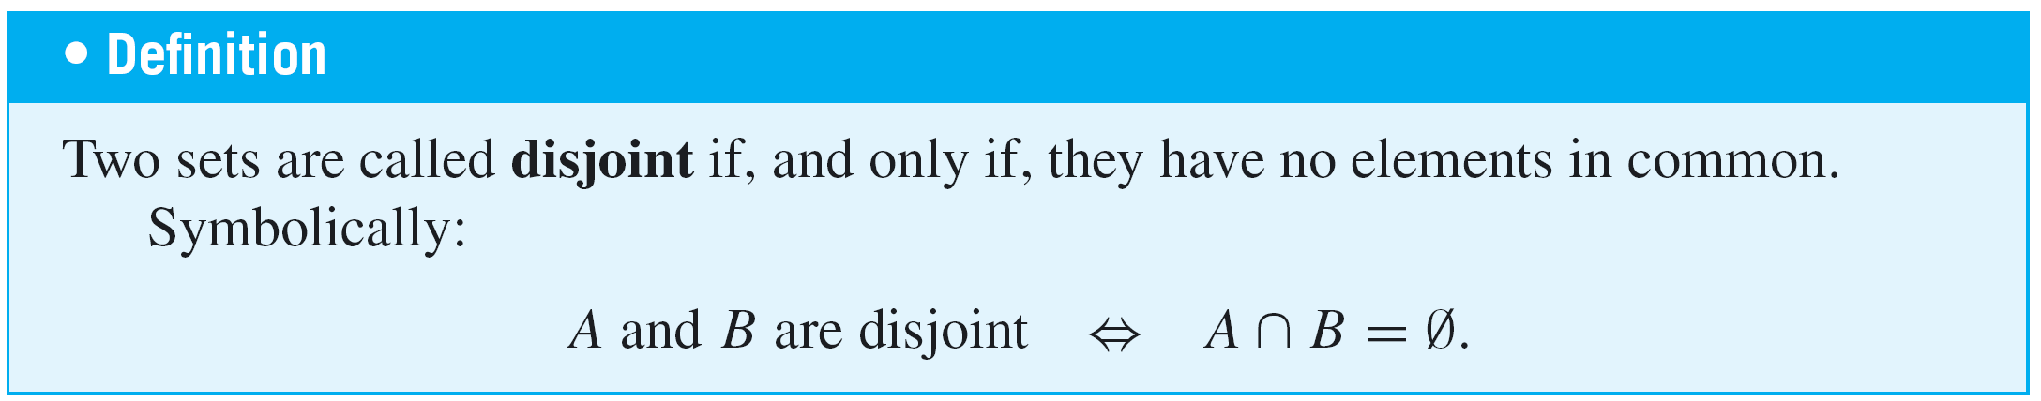
Partitions of Sets
In many applications of set theory, sets are divided up into nonoverlapping (or disjoint) pieces. Such a division is called a partition.

Slide 46
Example 9 – Disjoint Sets
Let A = {1, 3, 5} and B = {2, 4, 6}. Are A and B disjoint?
Solution:
Yes. By inspection A and B have no elements in common, or, in other words, {1, 3, 5} ∩ {2, 4, 6} = Ø.

Slide 47
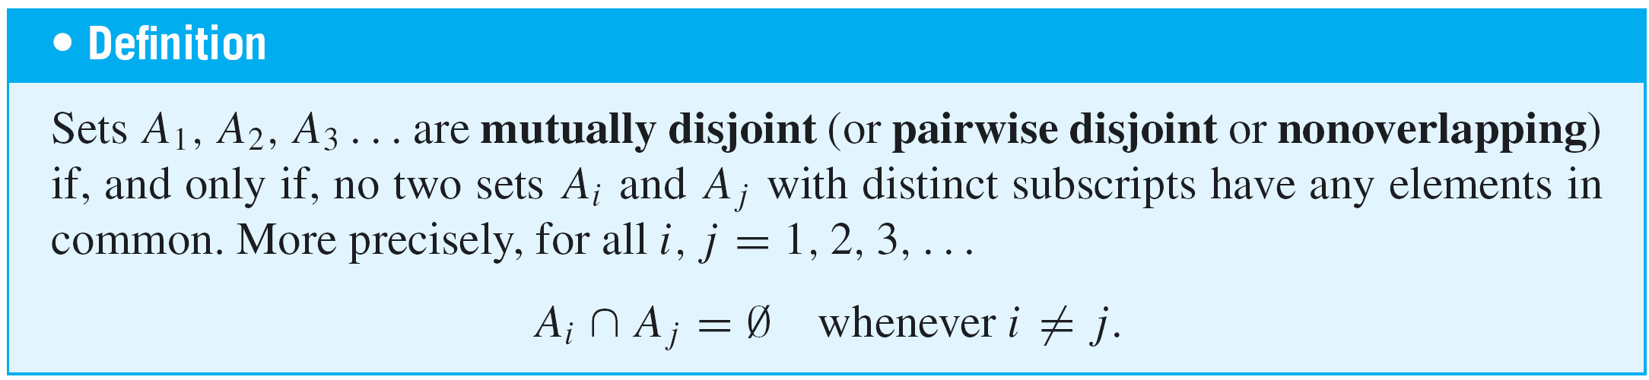
Partitions of Sets

Slide 48
Example 10 – Mutually Disjoint Sets
a. Let A₁ = {3, 5}, A₂ = {1, 4, 6}, and A₃ = {2}. Are A₁, A₂, and A₃ mutually disjoint?
b. Let B₁ = {2, 4, 6}, B₂ = {3, 7}, and B₃ = {4, 5}. Are B₁, B₂, and B₃ mutually disjoint?
Solution:
a. Yes. A₁ and A₂ have no elements in common, A₁ and A₃ have no elements in common, and A₂ and A₃ have no elements in common.
b. No. B₁ and B₃ both contain 4.

Slide 49
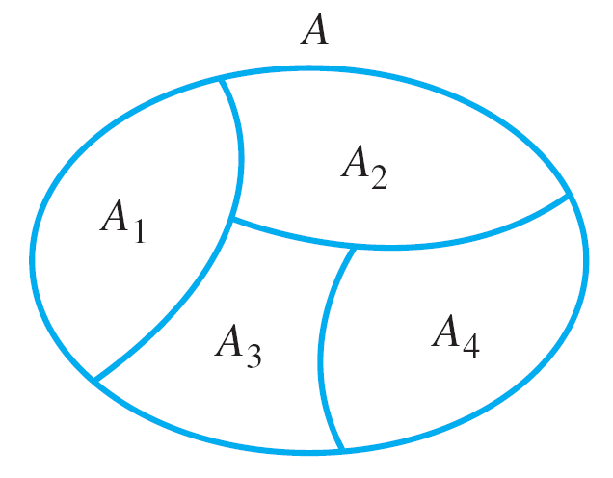
Partitions of Sets
Suppose A, A₁, A₂, A₃, and A₄ are the sets of points represented by the regions shown in Figure 6.1.5.
Then A₁, A₂, A₃, and A₄ are subsets of A, and
A = A₁ U A₂ U A₃ U A₄.
A Partition of a Set
Figure 6.1.5

Slide 50
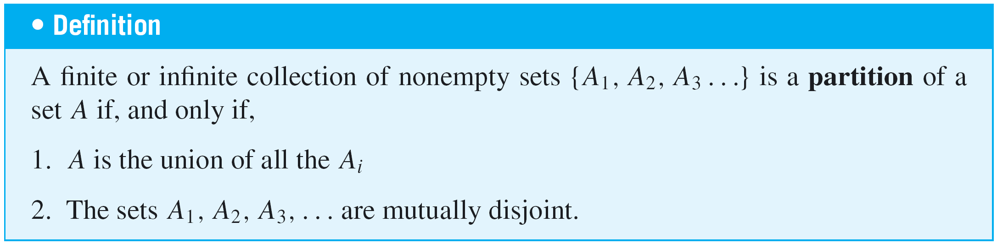
Partitions of Sets
Suppose further that boundaries are assigned to the regions representing A₂, A₃, and A₄ in such a way that these sets are mutually disjoint.
Then A is called a union of mutually disjoint subsets, and the collection of sets {A₁, A₂, A₃, A₄} is said to be a
partition of A.

Slide 51
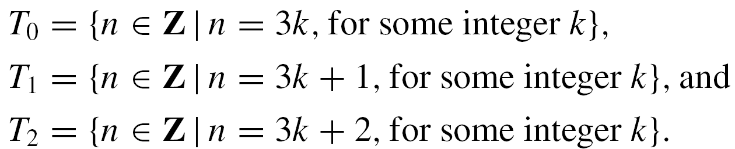
Example 11 – Partitions of Sets
a. Let A = {1, 2, 3, 4, 5, 6}, A₁ = {1, 2}, A₂ = {3, 4}, and
A₃ = {5, 6}. Is {A₁, A₂, A₃} a partition of A?
b. Let Z be the set of all integers and let
Is {T₀, T₁, T₂} a partition of Z?

Slide 52
Example 11 – Solution
a. Yes. By inspection, A = A₁ ∪ A₂ ∪ A₃ and the sets A₁, A₂, and A₃ are mutually disjoint.
b. Yes. By the quotient-remainder theorem, every integer n can be represented in exactly one of the three forms
for some integer k.
This implies that no integer can be in any two of the sets T₀, T₁, or T₂. So T₀, T₁, and T₂ are mutually disjoint.
It also implies that every integer is in one of the sets T₀, T₁, or T₂. So Z = T₀ ∪ T₁ ∪ T₂.

Slide 53
Power Sets

Slide 54
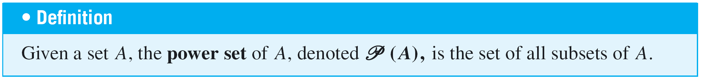
Power Sets
There are various situations in which it is useful to consider the set of all subsets of a particular set.
The power set axiom guarantees that this is a set.

Slide 55


Example 12 – Power Set of a Set
Find the power set of the set {x, y}. That is, find ({x, y}).
Solution:
({x, y}) is the set of all subsets of {x, y}. We know that Ø is a subset of every set, and so Ø ∈ ({x, y}).
Also any set is a subset of itself, so {x, y} ∈ ({x, y}). The only other subsets of {x, y} are {x} and {y}, so

Slide 56
Cartesian Products

Slide 57
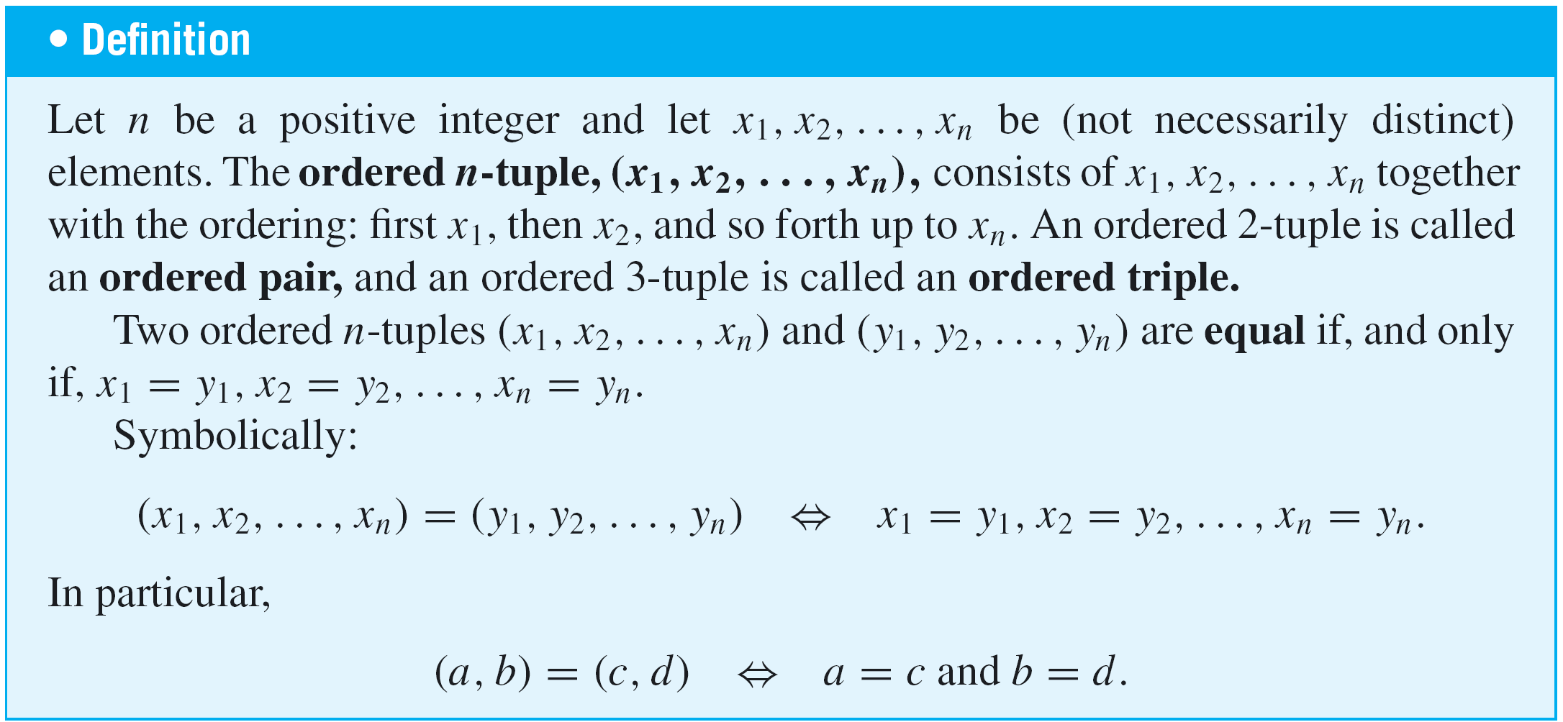
Cartesian Products

Slide 58
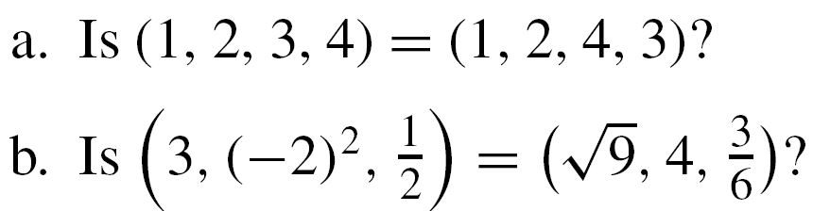
Example 13 – Ordered n-tuples
a.
b.
Solution:
a. No. By definition of equality of ordered 4-tuples,
But 3 ≠ 4, and so the ordered 4-tuples are not equal.

Slide 59
Example 13 – Solution
cont’d
b. Yes. By definition of equality of ordered triples,
Because these equations are all true, the two ordered triples are equal.

Slide 60
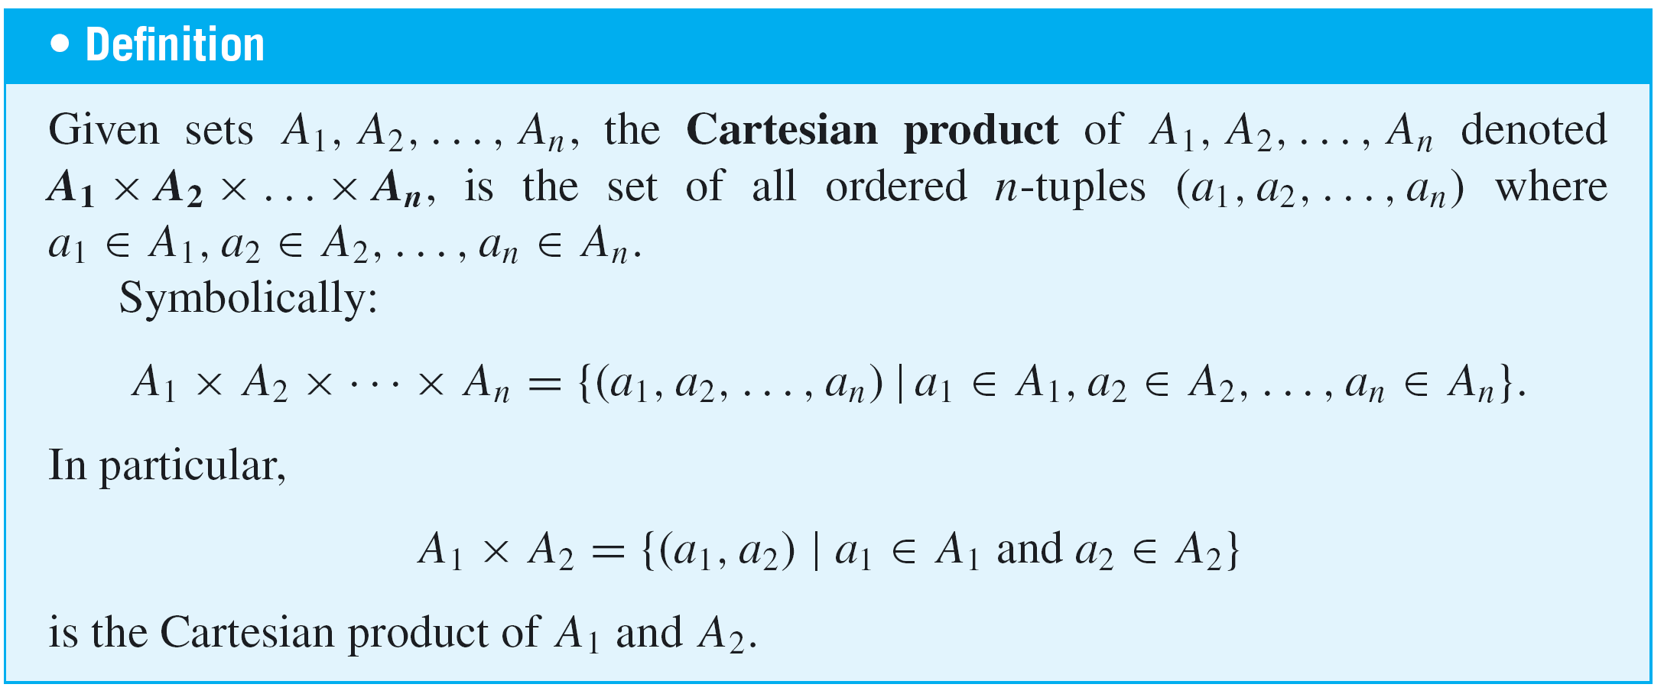
Cartesian Products

Slide 61
Example 14 – Cartesian Products
Let A₁ = {x, y}, A₂ = {1, 2, 3}, and A₃ = {a, b}.
a. b.
c.
Solution:
a. A₁ × A₂ = {(x, 1), (x, 2), (x, 3), (y, 1), (y, 2), (y, 3)}
b. The Cartesian product of A₁ and A₂ is a set, so it may be
used as one of the sets making up another Cartesian
product. This is the case for (A₁ × A₂) × A₃.

Slide 62
Example 14 – Solution
cont’d
c. The Cartesian product A₁ × A₂ × A₃ is superficially similar to, but is not quite the same mathematical object as,
(A₁ × A₂) × A₃. (A₁ × A₂) × A₃ is a set of ordered pairs of which one element is itself an ordered pair, whereas
A₁ × A₂ × A₃ is a set of ordered triples.

Slide 63

Example 14 – Solution
cont’d
By definition of Cartesian product,

Slide 64
An Algorithm to Check Whether One Set Is a Subset of Another (Optional)

Slide 65
An Algorithm to Check Whether One Set Is a Subset of Another (Optional)
Order the elements of both sets and successively compare each element of the first set with each element of the
second set.
If some element of the first set is not found to equal any element of the second, then the first set is not a subset of the second.
But if each element of the first set is found to equal an element of the second set, then the first set is a subset of the second. The following algorithm formalizes this reasoning.

Slide 66

An Algorithm to Check Whether One Set Is a Subset of Another (Optional)
Algorithm 6.1.1 Testing Whether A ⊆ B:
[Input sets A and B are represented as one-dimensional arrays a[1], a[2], . . . , a[m] and b[1], b[2], . . . , b[n], respectively. Starting with a[1] and for each successive a[i] in A, a check is made to see whether a[i] is in B. To do this, a[i] is compared to successive elements of B. If a[i] is not equal to any element of B, then answer is given the value “A B.”
If a[i] equals some element of B, the next successive element in A is checked to see whether it is in B. If every successive element of A is found to be in B, then answer never changes from its initial value “A ⊆ B.”]

Slide 67
An Algorithm to Check Whether One Set Is a Subset of Another (Optional)
Input:
m [a positive integer], a[1], a[2], . . . , a[m]
[a one-dimensional array representing the set A], n [a positive integer], b[1], b[2], . . . , b[n] [a one-dimensional array representing the set B]
Algorithm Body:
i := 1, answer := “A ⊆ B”
while (i ≤ m and answer = “A ⊆ B”)
j := 1, found := “no”
while ( j ≤ n and found = “no”)
if a[i] = b[j] then found := “yes”

Slide 68

An Algorithm to Check Whether One Set Is a Subset of Another (Optional)
j := j + 1
end while
[If found has not been given the value “yes” when execution reaches this point, then a[i] ∉ B.]
if found = “no” then answer := “A B”
i := i + 1
end while
Output: answer [a string]

Slide 69
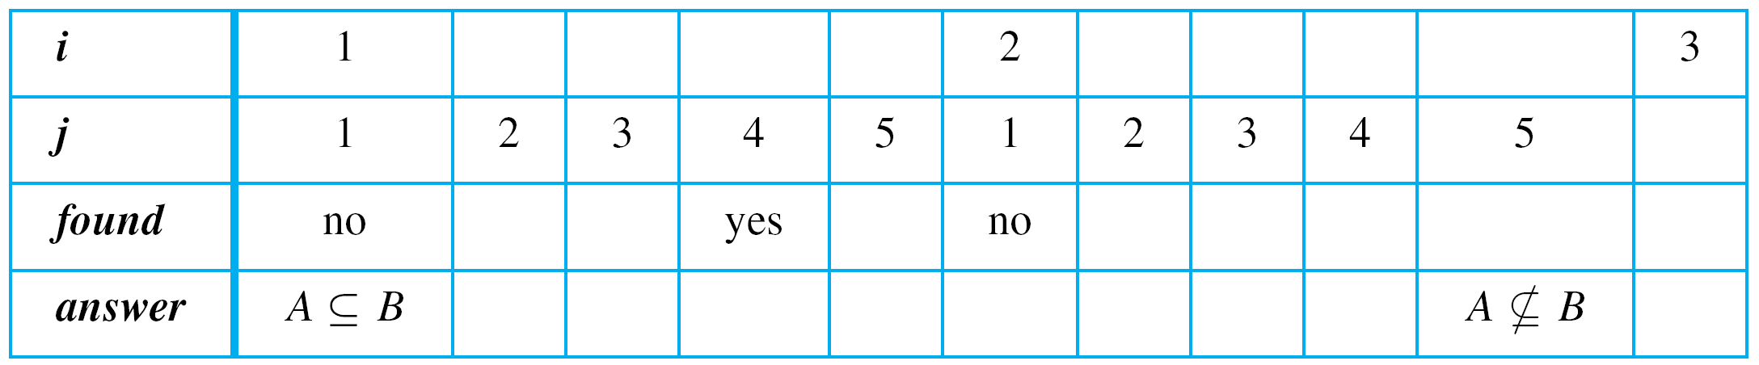
Example 15 – Tracing Algorithm 6.1.1
Trace the action of Algorithm 6.1.1 on the variables i, j , found, and answer for m = 3, n = 4, and sets A and B represented as the arrays a[1] = u, a[2] = v, a[3] = w,
b[1] = w, b[2] = x, b[3] = y, and b[4] = u.
Solution:

