Slide 1

CHAPTER 2
THE LOGIC OF
COMPOUND STATEMENTS
Copyright © Cengage Learning. All rights reserved.

Slide 2
SECTION 2.3
Valid and Invalid Arguments
Copyright © Cengage Learning. All rights reserved.

Slide 3
Valid and Invalid Arguments
In mathematics and logic an argument is not a dispute. It is a sequence of statements ending in a conclusion. In this section we show how to determine whether an argument is valid—that is, whether the conclusion follows necessarily from the preceding statements. We will show that this determination depends only on the form of an argument, not on its content.
For example, the argument
If Socrates is a man, then Socrates is mortal.
Socrates is a man.
• Socrates is mortal.

Slide 4
Valid and Invalid Arguments
has the abstract form
If p then q
p
• q
When considering the abstract form of an argument, think of p and q as variables for which statements may be substituted.
An argument form is called valid if, and only if, whenever statements are substituted that make all the premises true, the conclusion is also true.

Slide 5
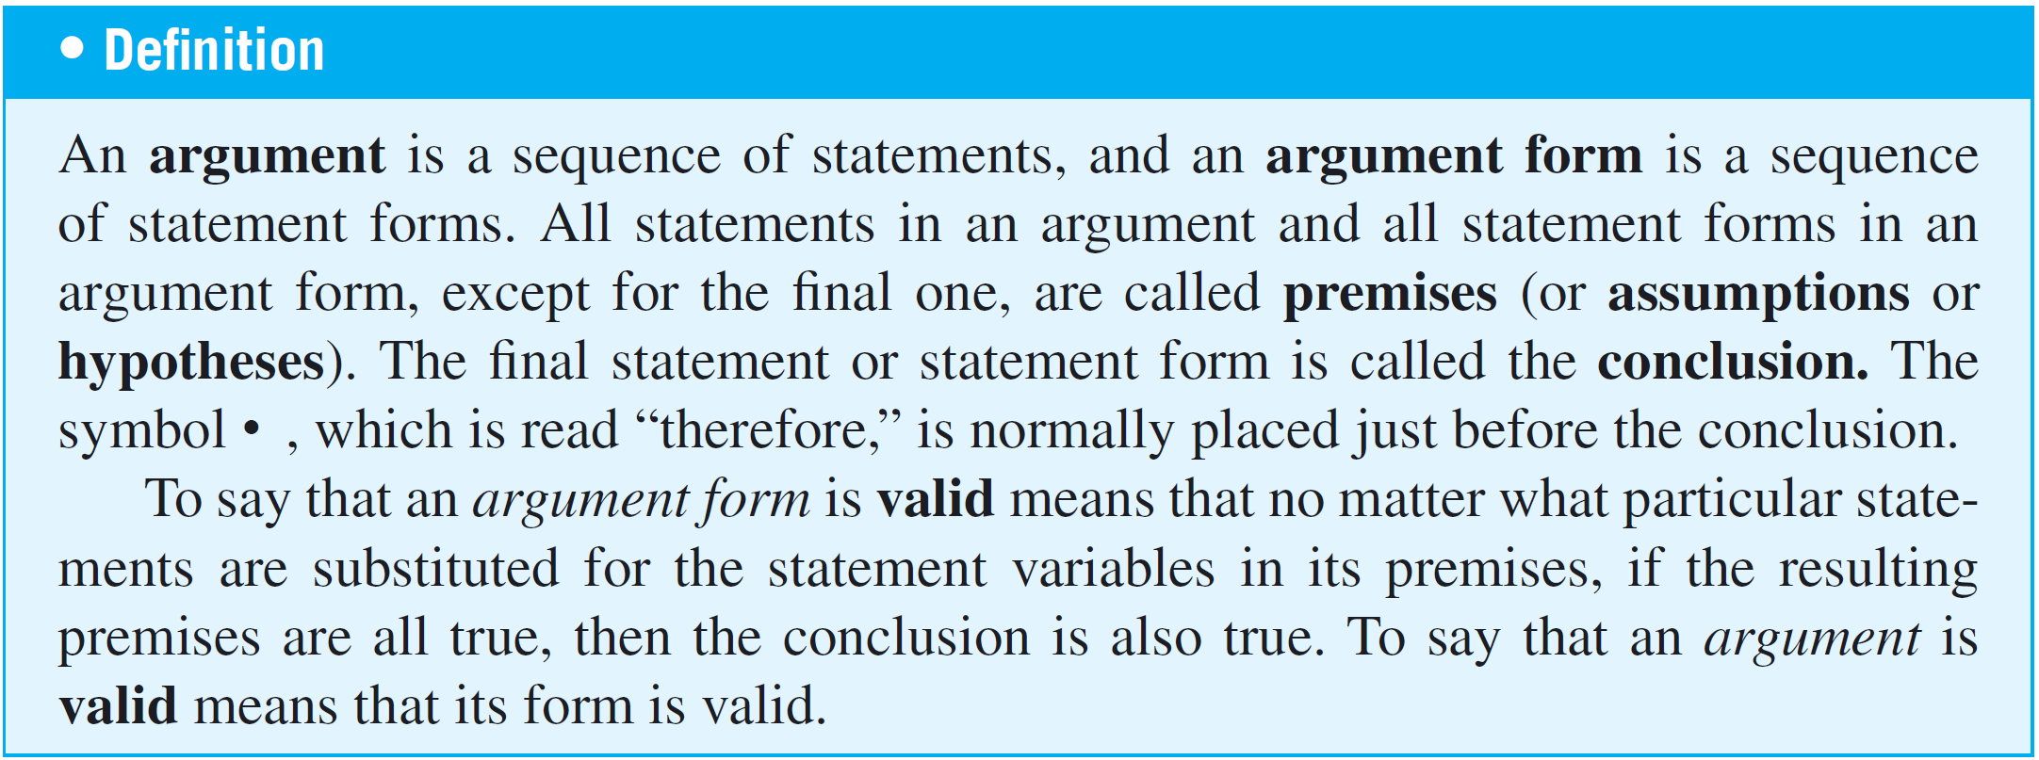
Valid and Invalid Arguments
When an argument is valid and its premises are true, the truth of the conclusion is said to be inferred or deduced from the truth of the premises. If a conclusion “ain’t necessarily so,” then it isn’t a valid deduction.

Slide 6
Valid and Invalid Arguments
Testing an Argument Form for Validity
1. Identify the premises and conclusion of the argument
form.
2. Construct a truth table showing the truth values of all the
premises and the conclusion.
3. A row of the truth table in which all the premises are true
is called a critical row. If there is a critical row in which
the conclusion is false, then it is possible for an
argument of the given form to have true premises and a
false conclusion, and so the argument form is invalid.
If the conclusion in every critical row is true, then the
argument form is valid.

Slide 7
Example 1 – Determining Validity or Invalidity
Determine whether the following argument form is valid or invalid by drawing a truth table, indicating which columns represent the premises and which represent the conclusion, and annotating the table with a sentence of explanation.
When you fill in the table, you only need to indicate the truth values for the conclusion in the rows where all the premises are true (the critical rows) because the truth values of the conclusion in the other rows are irrelevant to the validity or invalidity of the argument.

Slide 8
Example 1 – Determining Validity or Invalidity
cont’d
p → q ∨ ∼r
q → p ∧ r
• p → r
Solution:
The truth table shows that even though there are several situations in which the premises and the conclusion are all true (rows 1, 7, and 8), there is one situation (row 4) where the premises are true and the conclusion is false.

Slide 9
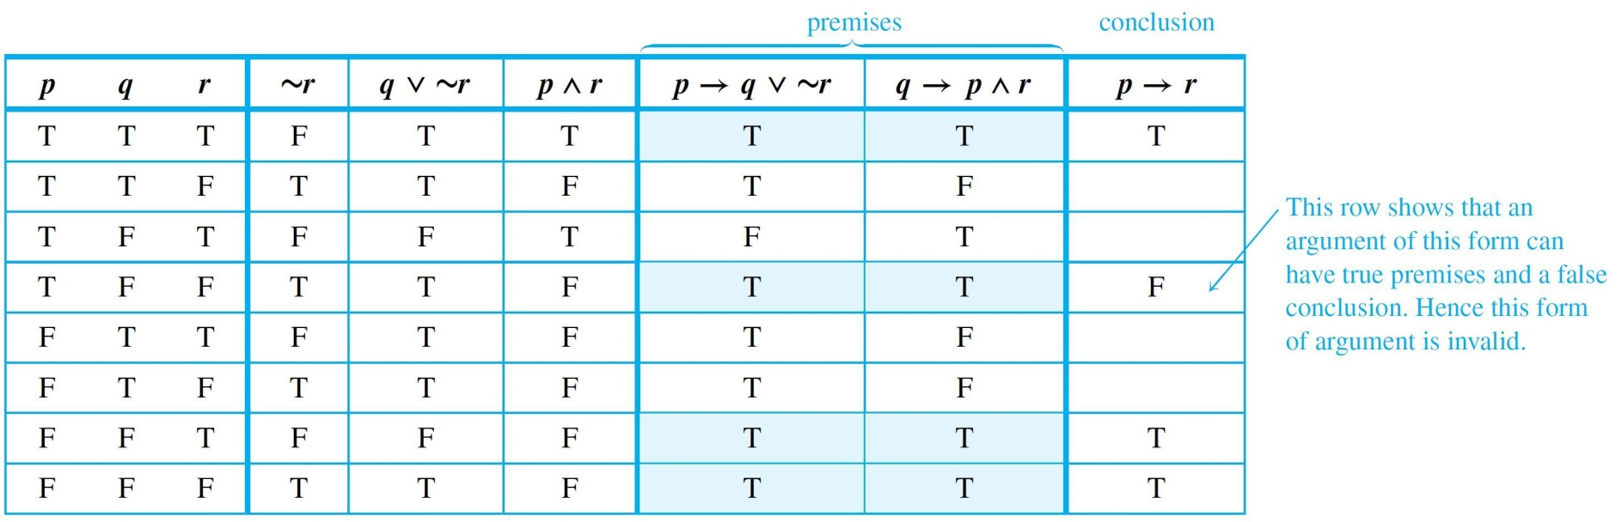
Example 1 – Solution
cont’d

Slide 10
Modus Ponens and Modus Tollens

Slide 11
Modus Ponens and Modus Tollens
An argument form consisting of two premises and a conclusion is called a syllogism. The first and second premises are called the major premise and minor premise, respectively.
The most famous form of syllogism in logic is called modus ponens. It has the following form:
If p then q.
p
• q

Slide 12
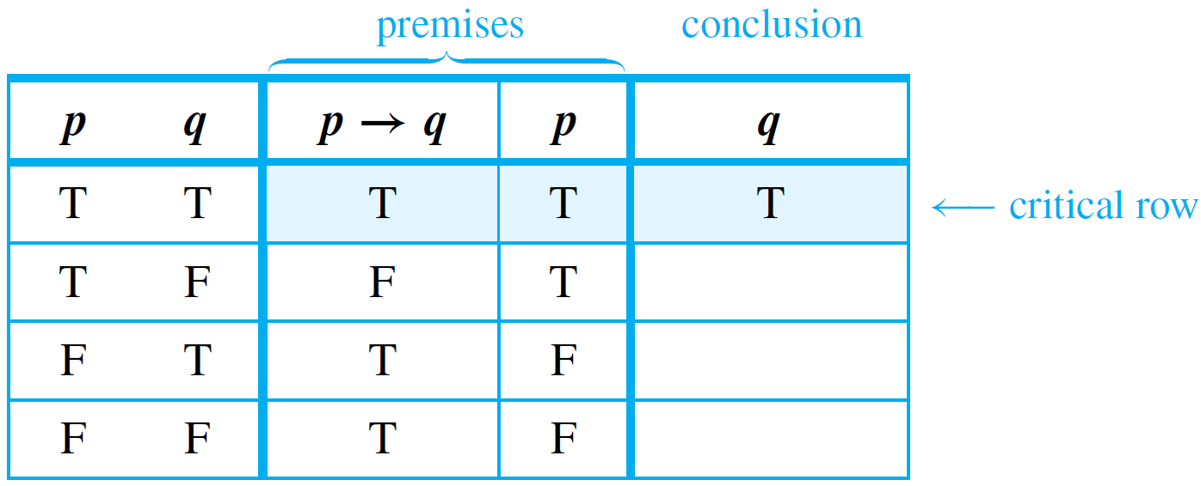
Modus Ponens and Modus Tollens
It is instructive to prove that modus ponens is a valid form of argument, if for no other reason than to confirm the agreement between the formal definition of validity and the intuitive concept.
To do so, we construct a truth table for the premises and conclusion.

Slide 13
Modus Ponens and Modus Tollens
The first row is the only one in which both premises are true, and the conclusion in that row is also true. Hence the argument form is valid.
Now consider another valid argument form called modus tollens. It has the following form:
If p then q.
∼q
• ∼p

Slide 14
Example 2 – Recognizing Modus Ponens and Modus Tollens
Use modus ponens or modus tollens to fill in the blanks of the following arguments so that they become valid inferences.
a. If there are more pigeons than there are pigeonholes,
then at least two pigeons roost in the same hole.
There are more pigeons than there are pigeonholes.
• .
b. If 870,232 is divisible by 6, then it is divisible by 3.
870,232 is not divisible by 3.
• .

Slide 15


Example 2 – Solution
a. At least two pigeons roost in the same hole.
b. 870,232 is not divisible by 6.

Slide 16
Additional Valid Argument Forms:
Rules of Inference

Slide 17
Additional Valid Argument Forms: Rules of Inference
A rule of inference is a form of argument that is valid. Thus modus ponens and modus tollens are both rules of inference.
The following are additional examples of rules of inference that are frequently used in deductive reasoning.

Slide 18
Example 3 – Generalization
The following argument forms are valid:
a. p b. q
• p ∨ q • p ∨ q
These argument forms are used for making generalizations. For instance, according to the first, if p is true, then, more generally, “p or q” is true for any other statement q.
As an example, suppose you are given the job of counting the upperclassmen at your school. You ask what class Anton is in and are told he is a junior.

Slide 19
Example 3 – Generalization
cont’d
You reason as follows:
Anton is a junior.
• (more generally) Anton is a junior or Anton is a senior.
Knowing that upperclassman means junior or senior, you add Anton to your list.

Slide 20
Example 4 – Specialization
The following argument forms are valid:
a. p ∧ q b. p ∧ q
• p • q
These argument forms are used for specializing. When classifying objects according to some property, you often know much more about them than whether they do or do not have that property.
When this happens, you discard extraneous information as you concentrate on the particular property of interest.

Slide 21
Example 4 – Specialization
cont’d
For instance, suppose you are looking for a person who knows graph algorithms to work with you on a project. You discover that Ana knows both numerical analysis and graph algorithms. You reason as follows:
Ana knows numerical analysis and Ana knows graph
algorithms.
• (in particular) Ana knows graph algorithms.
Accordingly, you invite her to work with you on your project.

Slide 22
Additional Valid Argument Forms: Rules of Inference
Both generalization and specialization are used frequently in mathematics to tailor facts to fit into hypotheses of known theorems in order to draw further conclusions.
Elimination, transitivity, and proof by division into cases are also widely used tools.

Slide 23
Example 5 – Elimination
The following argument forms are valid:
a. p ∨ q b. p ∨ q
∼q ∼p
• p • q
These argument forms say that when you have only two possibilities and you can rule one out, the other must be the case. For instance, suppose you know that for a particular number x,

Slide 24


Example 5 – Elimination
cont’d
If you also know that x is not negative, then x ≠ −2, so
By elimination, you can then conclude that

Slide 25
Example 6 – Transitivity
The following argument form is valid:
p → q
q → r
• p → r
Many arguments in mathematics contain chains of if-then statements.
From the fact that one statement implies a second and the second implies a third, you can conclude that the first statement implies the third.

Slide 26
Example 6 – Transitivity
cont’d
Here is an example:
If 18,486 is divisible by 18, then 18,486 is divisible by 9.
If 18,486 is divisible by 9, then the sum of the digits of 18,486 is divisible by 9.
• If 18,486 is divisible by 18, then the sum of the digits of 18,486 is divisible by 9.

Slide 27
Example 7 – Proof by Division into Cases
The following argument form is valid:
p ∨ q
p → r
q → r
• r
It often happens that you know one thing or another is true. If you can show that in either case a certain conclusion follows, then this conclusion must also be true.
For instance, suppose you know that x is a particular nonzero real number.

Slide 28
Example 7 – Proof by Division into Cases
cont’d
The trichotomy property of the real numbers says that any number is positive, negative, or zero. Thus (by elimination) you know that x is positive or x is negative.
You can deduce that x² > 0 by arguing as follows:
x is positive or x is negative.
If x is positive, then x² > 0.
If x is negative, then x² > 0.
• x² > 0.

Slide 29
Additional Valid Argument Forms: Rules of Inference
The rules of valid inference are used constantly in problem solving. Here is an example from everyday life.

Slide 30
Example 8 – Application: A More Complex Deduction
You are about to leave for school in the morning and discover that you don’t have your glasses. You know the following statements are true:
a. If I was reading the newspaper in the kitchen, then my
glasses are on the kitchen table.
b. If my glasses are on the kitchen table, then I saw them at
breakfast.
c. I did not see my glasses at breakfast.
d. I was reading the newspaper in the living room or I was
reading the newspaper in the kitchen.

Slide 31
Example 8 – Application: A More Complex Deduction
cont’d
e. If I was reading the newspaper in the living room then
my glasses are on the coffee table.
Where are the glasses?
Solution:
Let RK = I was reading the newspaper in the kitchen.
GK = My glasses are on the kitchen table.
SB = I saw my glasses at breakfast.
RL = I was reading the newspaper in the living room.
GC = My glasses are on the coffee table.

Slide 32












Example 8 – Solution
cont’d
Here is a sequence of steps you might use to reach the answer, together with the rules of inference that allow you to draw the conclusion of each step:
1.
2.

Slide 33












Example 8 – Solution
cont’d
3.
4.
Thus the glasses are on the coffee table.

Slide 34
Fallacies

Slide 35
Fallacies
A fallacy is an error in reasoning that results in an invalid argument. Three common fallacies are using ambiguous premises, and treating them as if they were unambiguous, circular reasoning (assuming what is to be proved without having derived it from the premises), and jumping to a conclusion (without adequate grounds).
In this section we discuss two other fallacies, called converse error and inverse error, which give rise to arguments that superficially resemble those that are valid by modus ponens and modus tollens but are not, in fact, valid.

Slide 36
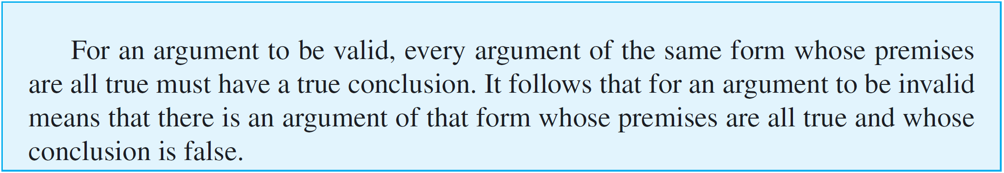
Fallacies

Slide 37
Example 9 – Converse Error
Show that the following argument is invalid:
  If Zeke is a cheater, then Zeke sits in the back row.
Zeke sits in the back row.
• Zeke is a cheater.
Solution:
Many people recognize the invalidity of the above argument intuitively, reasoning something like this:
The first premise gives information about Zeke if it is known he is a cheater. It doesn’t give any information about him if it is not already known that he is a cheater.

Slide 38
Example 9 – Solution
cont’d
One can certainly imagine a person who is not a cheater but happens to sit in the back row. Then if that person’s name is substituted for Zeke, the first premise is true by default and the second premise is also true but the conclusion is false.
The general form of the previous argument is as follows:
p → q
q
• p

Slide 39
Fallacies
The fallacy underlying this invalid argument form is called the converse error because the conclusion of the argument would follow from the premises if the premise
p → q were replaced by its converse.
Such a replacement is not allowed, however, because a conditional statement is not logically equivalent to its converse. Converse error is also known as the fallacy of affirming the consequent.
Another common error in reasoning is called the inverse error.

Slide 40
Example 10 – Inverse Error
Consider the following argument:
If interest rates are going up, stock market prices
will go down.
Interest rates are not going up.
    Stock market prices will not go down.
    Note that this argument has the following form:
    p → q
    ∼p
    • ∼q

Slide 41
Example 10 – Inverse Error
cont’d
The fallacy underlying this invalid argument form is called the inverse error because the conclusion of the argument would follow from the premises if the premise p → q were replaced by its inverse.
Such a replacement is not allowed, however, because a conditional statement is not logically equivalent to its inverse. Inverse error is also known as the fallacy of denying the antecedent.

Slide 42
Example 11 – A Valid Argument with a False Premise and a False Conclusion
The argument below is valid by modus ponens. But its major premise is false, and so is its conclusion.
If John Lennon was a rock star, then John Lennon
had red hair.
John Lennon was a rock star.
• John Lennon had red hair.

Slide 43
Example 12 – An Invalid Argument with True Premises and a True Conclusion
The argument below is invalid by the converse error, but it has a true conclusion.
If New York is a big city, then New York has tall
buildings.
New York has tall buildings.
• New York is a big city.

Slide 44
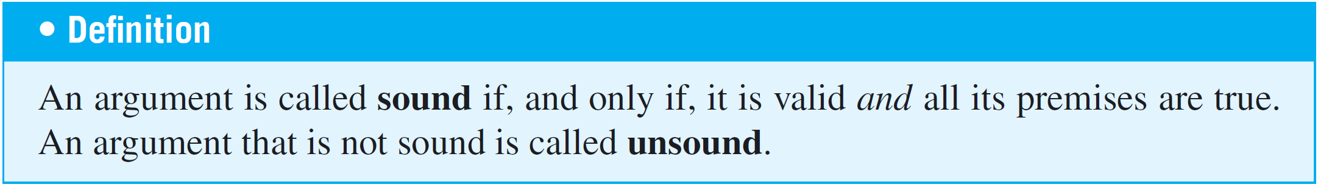
Fallacies

Slide 45
Contradictions and Valid Arguments

Slide 46
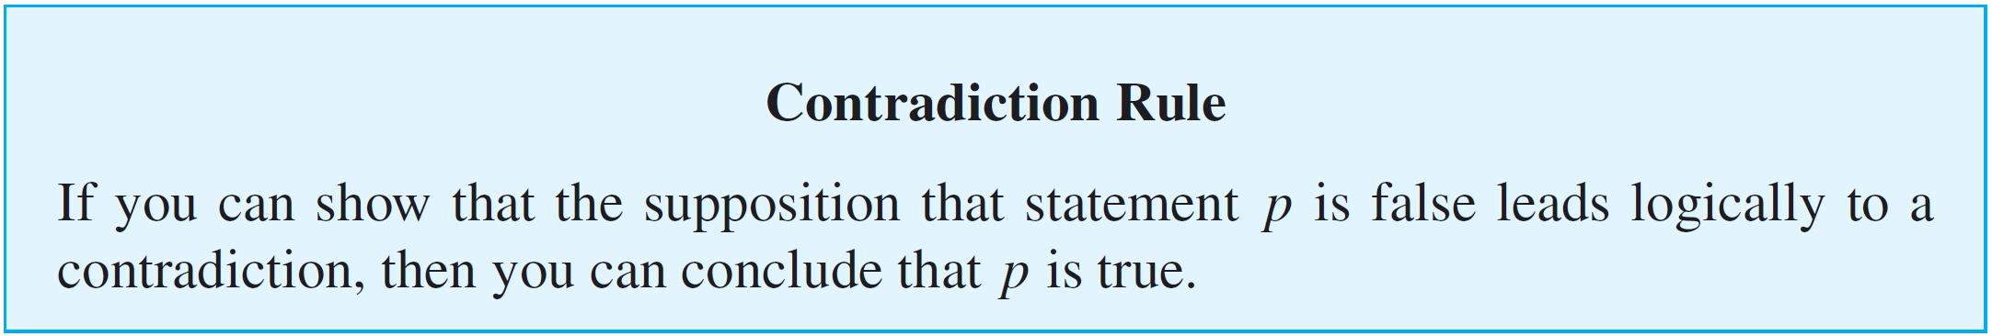
Contradictions and Valid Arguments
The concept of logical contradiction can be used to make inferences through a technique of reasoning called the contradiction rule. Suppose p is some statement whose truth you wish to deduce.

Slide 47
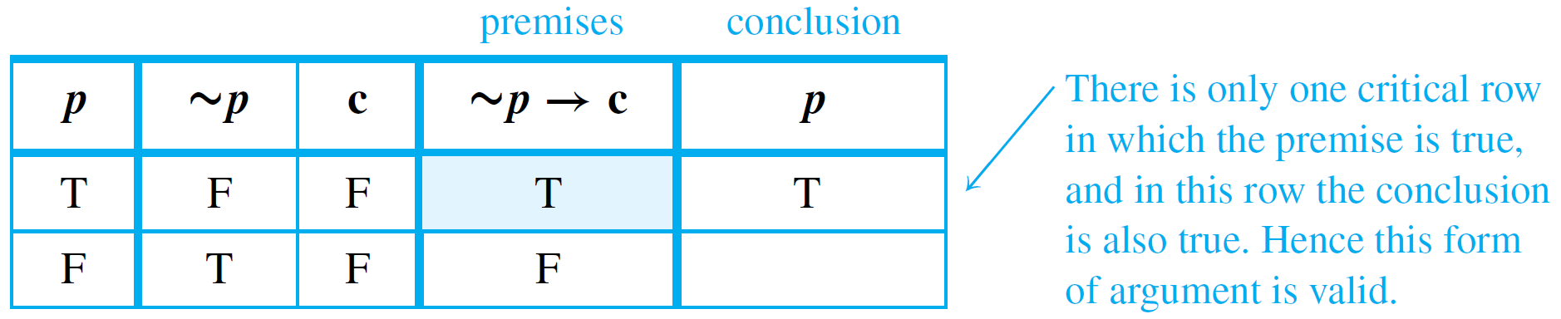
Example 13 – Contradiction Rule
Show that the following argument form is valid:
∼p → c, where c is a contradiction
• p
Solution:
Construct a truth table for the premise and the conclusion of this argument.

Slide 48
Contradictions and Valid Arguments
The contradiction rule is the logical heart of the method of proof by contradiction.
A slight variation also provides the basis for solving many logical puzzles by eliminating contradictory answers: If an assumption leads to a contradiction, then that assumption must be false.

Slide 49
Summary of Rules of Inference

Slide 50
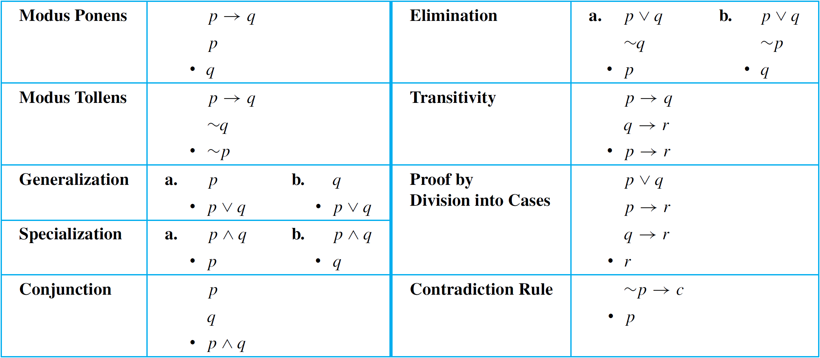
Summary of Rules of Inference
Table 2.3.1 summarizes some of the most important rules of inference.
Valid Argument Forms
Table 2.3.1

