Slide 1

CHAPTER 3
THE LOGIC OF
QUANTIFIED
STATEMENTS
Copyright © Cengage Learning. All rights reserved.

Slide 2
SECTION 3.4
Arguments with Quantified Statements
Copyright © Cengage Learning. All rights reserved.

Slide 3
Arguments with Quantified Statements
The rule of universal instantiation (in-stan-she-AY-shun) says the following:
Universal instantiation is the fundamental tool of deductive reasoning.
Mathematical formulas, definitions, and theorems are like general templates that are used over and over in a wide variety of particular situations.

Slide 4
Arguments with Quantified Statements
A given theorem says that such and such is true for all things of a certain type.
If, in a given situation, you have a particular object of that type, then by universal instantiation, you conclude that such and such is true for that particular object.
You may repeat this process 10, 20, or more times in a single proof or problem solution.

Slide 5
Universal Modus Ponens

Slide 6
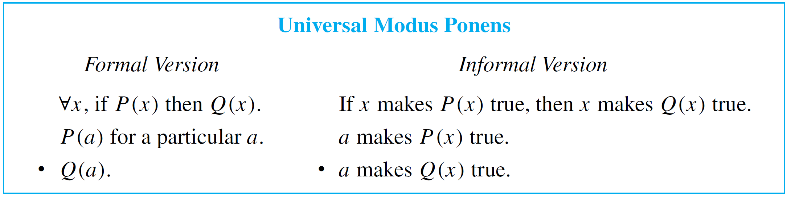
Universal Modus Ponens
The rule of universal instantiation can be combined with modus ponens to obtain the valid form of argument called
universal modus ponens.

Slide 7
Universal Modus Ponens
Note that the first, or major, premise of universal modus ponens could be written “All things that make P (x) true make Q (x) true,” in which case the conclusion would follow by universal instantiation alone.
However, the if-then form is more natural to use in the majority of mathematical situations.

Slide 8

Example 1 – Recognizing Universal Modus Ponens
Rewrite the following argument using quantifiers, variables, and predicate symbols. Is this argument valid? Why?
If an integer is even, then its square is even.
k is a particular integer that is even.
k² is even.
Solution:
The major premise of this argument can be rewritten as
x, if x is an even integer then x² is even.

Slide 9
Example 1 – Solution
cont’d
Let E (x) be “x is an even integer,” let S (x) be “x² is even,” and let k stand for a particular integer that is even.
Then the argument has the following form:
x, if E (x) then S (x).
E (k), for a particular k.
• S (k).
This argument has the form of universal modus ponens and is therefore valid.

Slide 10
Use of Universal Modus Ponens in a Proof

Slide 11
Use of Universal Modus Ponens in a Proof
Here is a proof that the sum of any two even integers is even.
It makes use of the definition of even integer, namely, that an integer is even if, and only if, it equals twice some integer. (Or, more formally: integers x, x is even if, and only if, ∃ an integer k such that x = 2k.)
Suppose m and n are particular but arbitrarily chosen even integers. Then m = 2r for some integer r,⁽¹⁾ and n = 2s for some integer s.⁽²⁾

Slide 12
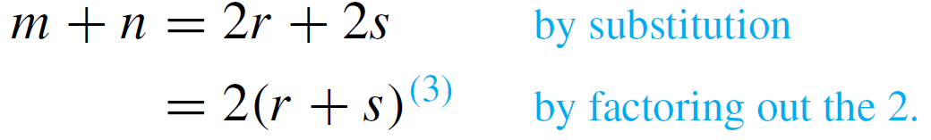
Use of Universal Modus Ponens in a Proof
Hence
Now r + s is an integer,⁽⁴⁾ and so 2(r + s) is even.⁽⁵⁾
Thus m + n is even.

Slide 13
Use of Universal Modus Ponens in a Proof
The following expansion of the proof shows how each of the numbered steps is justified by arguments that are valid by universal modus ponens.
(1) If an integer is even, then it equals twice some integer.
m is a particular even integer.
• m equals twice some integer r.
(2) If an integer is even, then it equals twice some integer.
n is a particular even integer.
• n equals twice some integer s.

Slide 14
Use of Universal Modus Ponens in a Proof
(3) If a quantity is an integer, then it is a real number.
r and s are particular integers.
• r and s are real numbers.
For all a, b, and c, if a, b, and c are real numbers,
then ab + ac = a (b + c).
2, r, and s are particular real numbers.
• 2r + 2s = 2(r + s).
(4) For all u and v, if u and v are integers, then u + v is
an integer.
r and s are two particular integers.
• r + s is an integer.

Slide 15
Use of Universal Modus Ponens in a Proof
(5) If a number equals twice some integer, then that number
is even.
2(r + s) equals twice the integer r + s.
• 2(r + s) is even.

Slide 16
Universal Modus Tollens

Slide 17
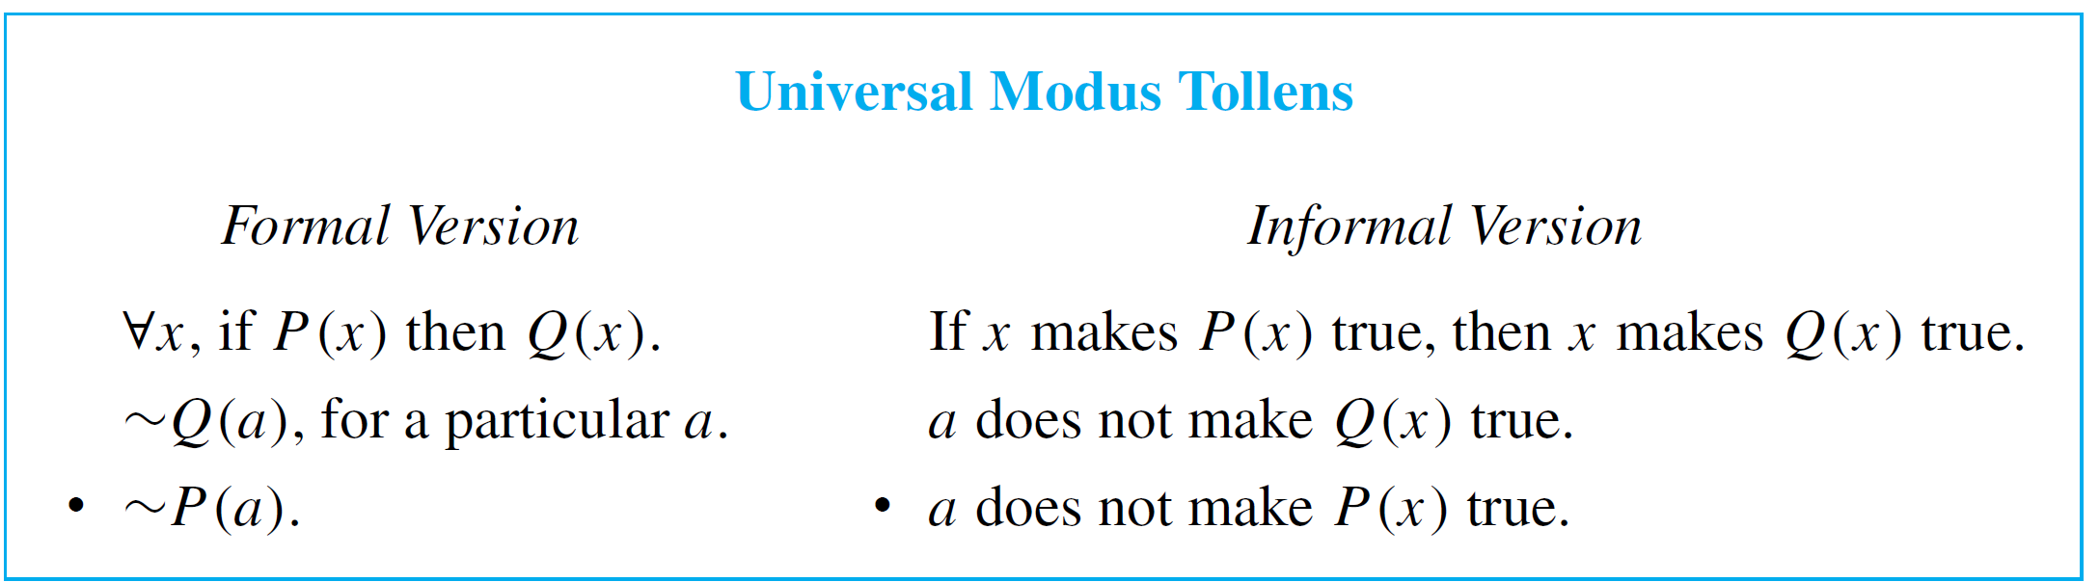
Universal Modus Tollens
Another crucially important rule of inference is universal modus tollens. Its validity results from combining universal instantiation with modus tollens.
Universal modus tollens is the heart of proof of contradiction, which is one of the most important methods of mathematical
argument.

Slide 18
Example 3 – Recognizing the Form of Universal Modus Tollens
Rewrite the following argument using quantifiers, variables, and predicate symbols. Write the major premise in conditional form. Is this argument valid? Why?
All human beings are mortal.
Zeus is not mortal.
• Zeus is not human.
Solution:
The major premise can be rewritten as
x, if x is human then x is mortal.

Slide 19
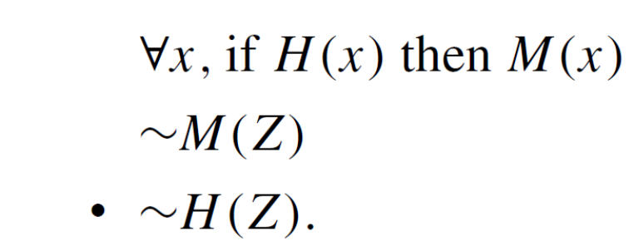
Example 3 – Solution
cont’d
Let H (x) be “x is human,” let M (x) be “x is mortal,” and let Z stand for Zeus.
The argument becomes
This argument has the form of universal modus tollens and is therefore valid.

Slide 20
Proving Validity of Arguments with Quantified Statements

Slide 21
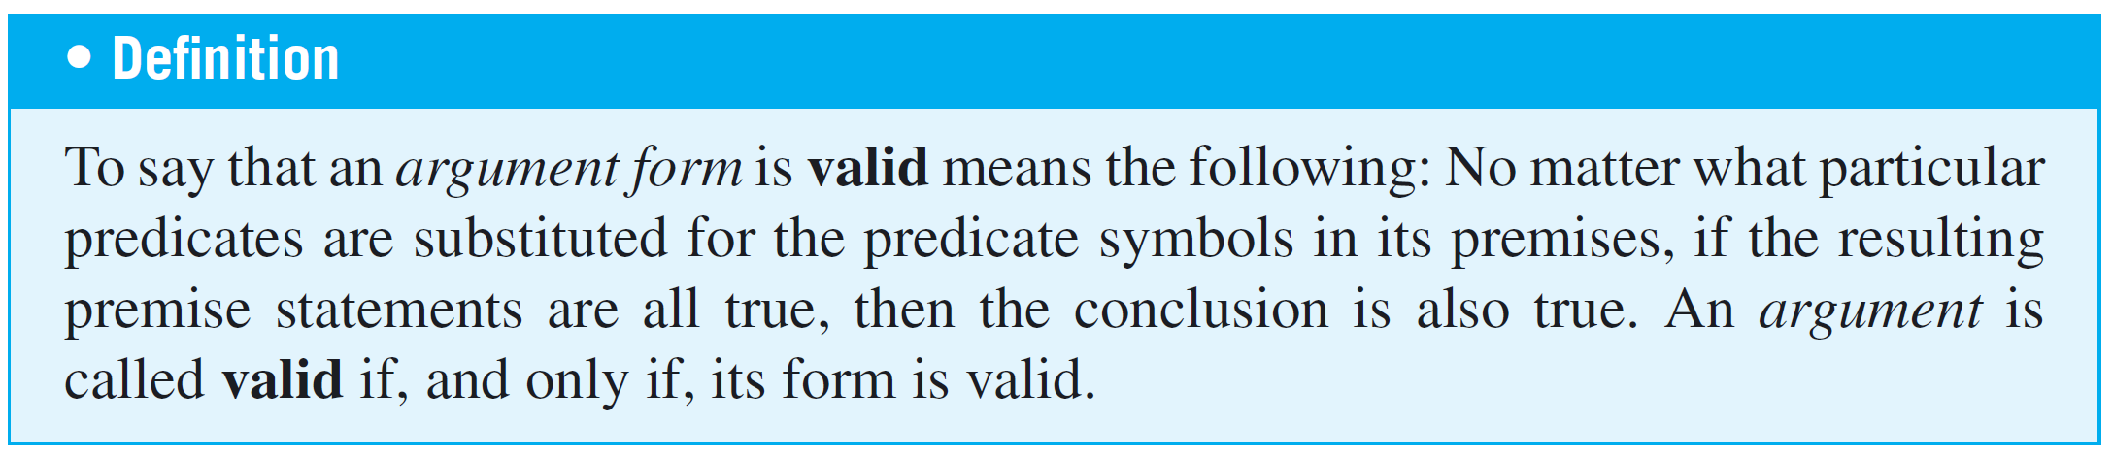
Proving Validity of Arguments with Quantified Statements
The intuitive definition of validity for arguments with quantified statements is the same as for arguments with compound statements.
An argument is valid if, and only if, the truth of its conclusion follows necessarily from the truth of its premises.
The formal definition is as follows:

Slide 22
Using Diagrams to Test for Validity

Slide 23
Using Diagrams to Test for Validity
Consider the statement
All integers are rational numbers.
Or, formally,
integers n, n is a rational number.
Picture the set of all integers and the set of all rational numbers as disks.

Slide 24
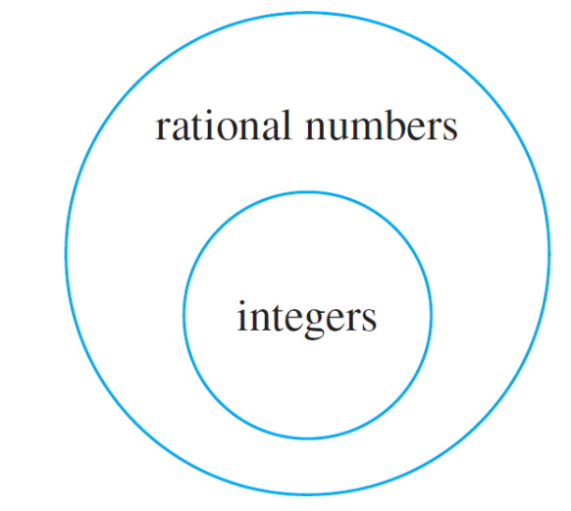

Using Diagrams to Test for Validity
The truth of the given statement is represented by placing the integers disk entirely inside the rationals disk, as shown in Figure 3.4.1.
Because the two statements
if x is in D then Q(x)” are
logically equivalent, both
can be represented by
diagrams like the foregoing.
Figure 3.4.1

Slide 25
Using Diagrams to Test for Validity
To test the validity of an argument diagrammatically, represent the truth of both premises with diagrams.
Then analyze the diagrams to see whether they necessarily represent the truth of the conclusion as well.

Slide 26
Example 6 – Using Diagrams to Show Invalidity
Use a diagram to show the invalidity of the following argument:
All human beings are mortal.
Felix is mortal.
• Felix is a human being.

Slide 27
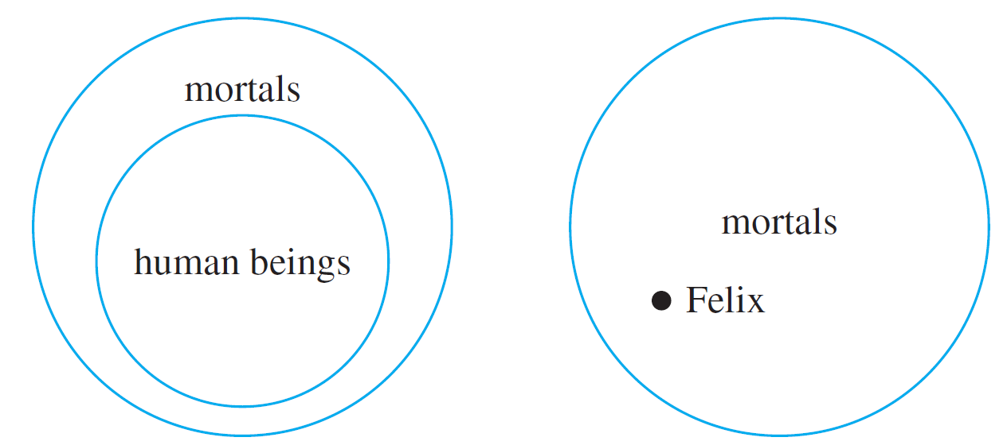
Example 6 – Solution
The major and minor premises are represented diagrammatically in Figure 3.4.4.
Major premise
Minor premise
Figure 3.4.4

Slide 28
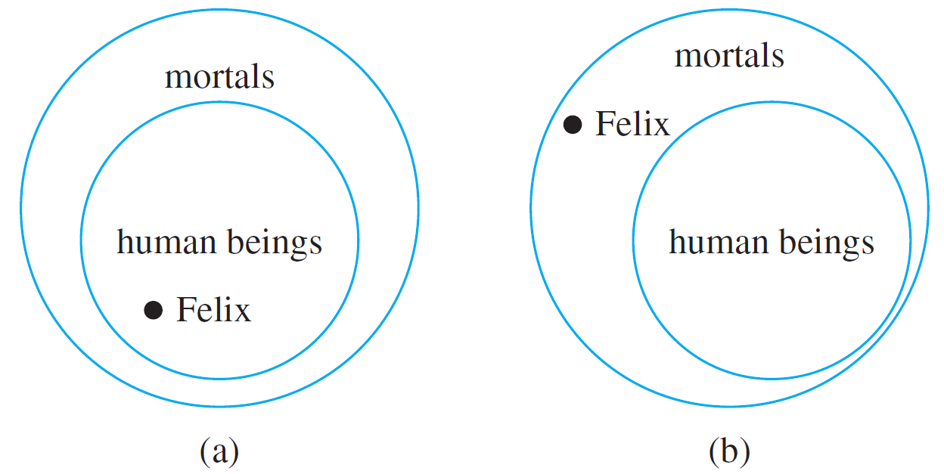
Example 6 – Solution
cont’d
All that is known is that the Felix dot is located somewhere inside the mortals disk. Where it is located with respect to the human beings disk cannot be determined. Either one of the situations shown in Figure 3.4.5 might be the case.
Figure 3.4.5

Slide 29
Example 6 – Solution
cont’d
The conclusion “Felix is a human being” is true in the first case but not in the second (Felix might, for example, be a cat).
Because the conclusion does not necessarily follow from the premises, the argument is invalid.

Slide 30
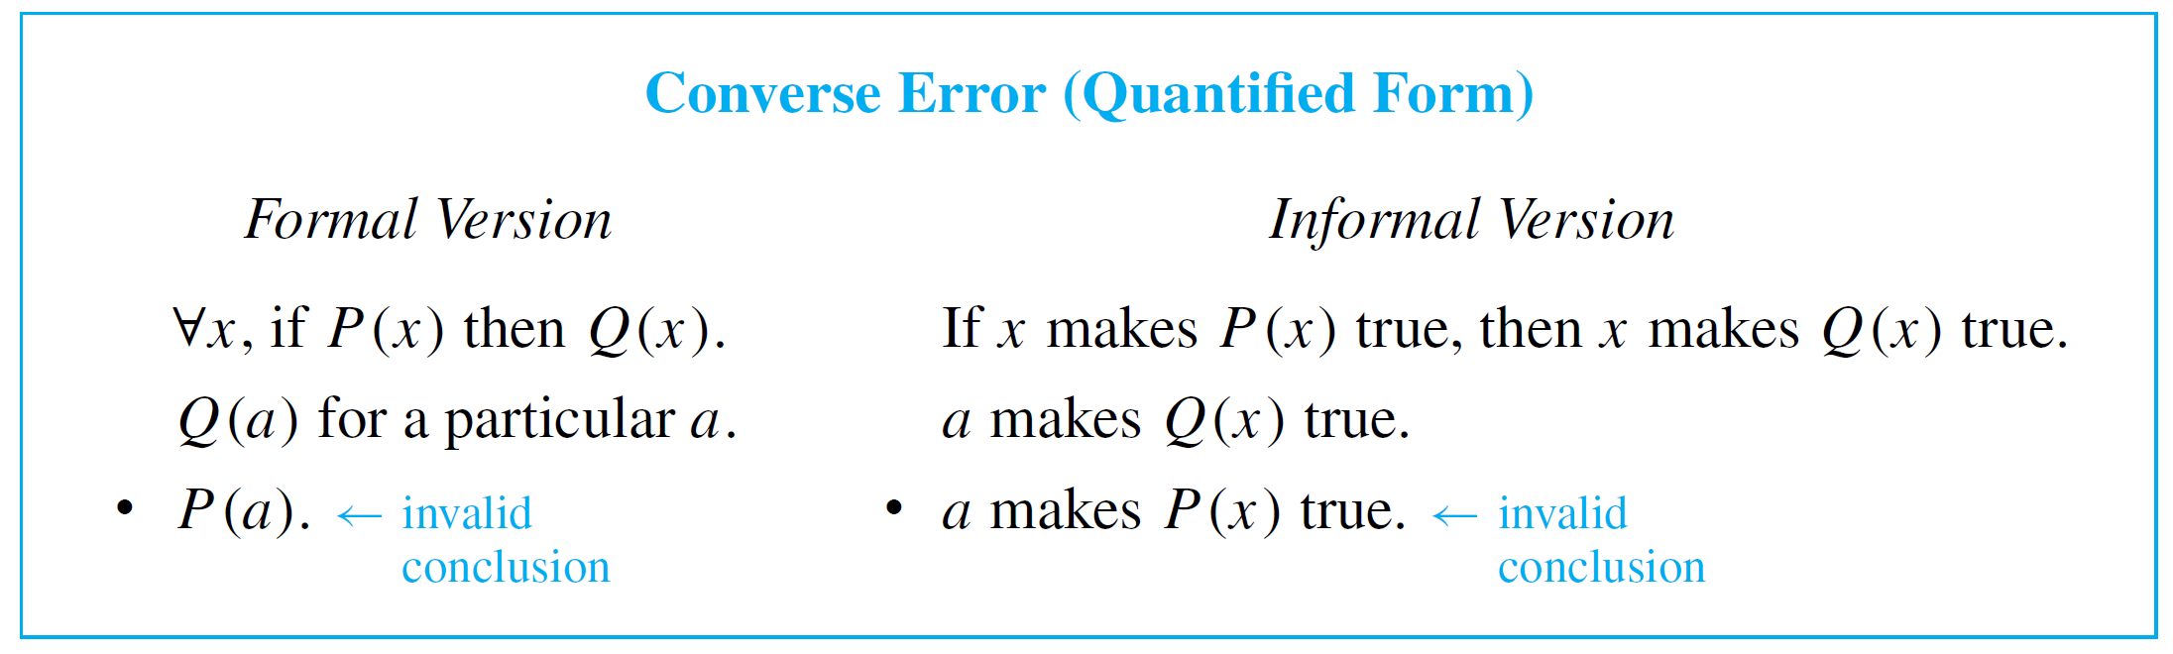
Using Diagrams to Test for Validity
The argument of Example 6 would be valid if the major premise were replaced by its converse. But since a universal conditional statement is not logically equivalent to its converse, such a replacement cannot, in general, be made.
We say that this argument exhibits the converse error.

Slide 31
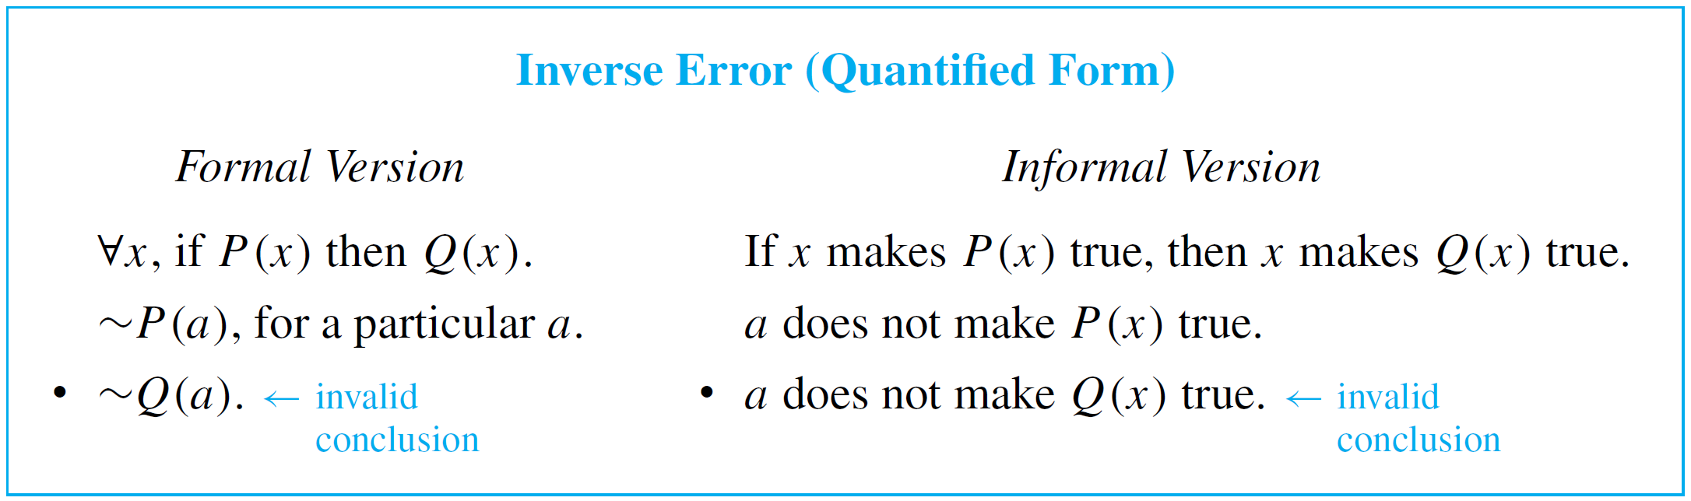
Using Diagrams to Test for Validity
The following form of argument would be valid if a conditional statement were logically equivalent to its inverse. But it is not, and the argument form is invalid.
We say that it exhibits the inverse error.

Slide 32
Example 7 – An Argument with “No”
Use diagrams to test the following argument for validity:
No polynomial functions have horizontal asymptotes.
This function has a horizontal asymptote.
• This function is not a polynomial function.

Slide 33
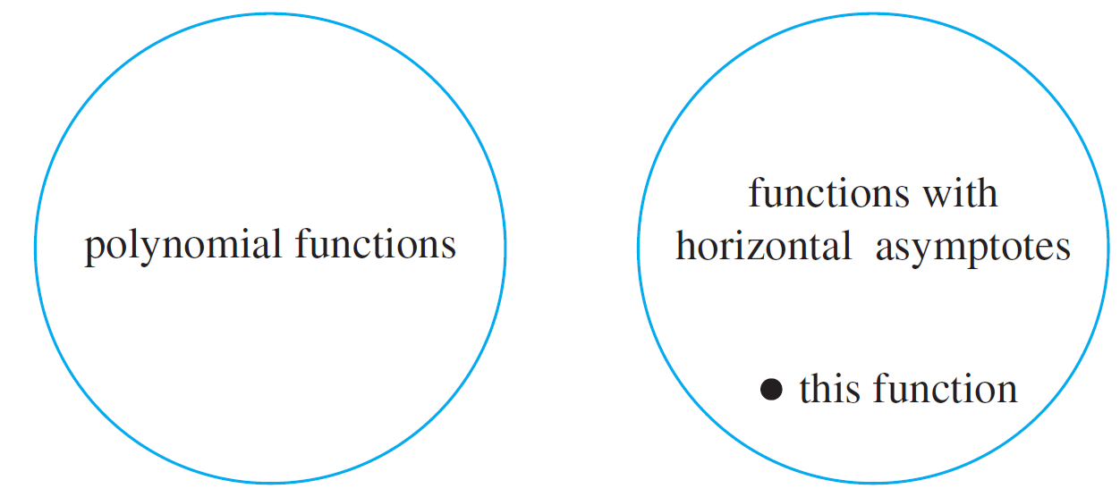
Example 7 – Solution
A good way to represent the major premise diagrammatically is shown in Figure 3.4.6, two disks—a disk for polynomial functions and a disk for functions with horizontal asymptotes—that do not overlap at all.
Figure 3.4.6

Slide 34
Example 7 – Solution
cont’d
The minor premise is represented by placing a dot labeled “this function” inside the disk for functions with horizontal asymptotes.
The diagram shows that “this function” must lie outside the polynomial functions disk, and so the truth of the conclusion necessarily follows from the truth of the premises.
Hence the argument is valid.

Slide 35
Using Diagrams to Test for Validity
An alternative approach to this example is to transform the statement “No polynomial functions have horizontal asymptotes” into the equivalent form “ x, if x is a polynomial function, then x does not have a horizontal asymptote.”

Slide 36
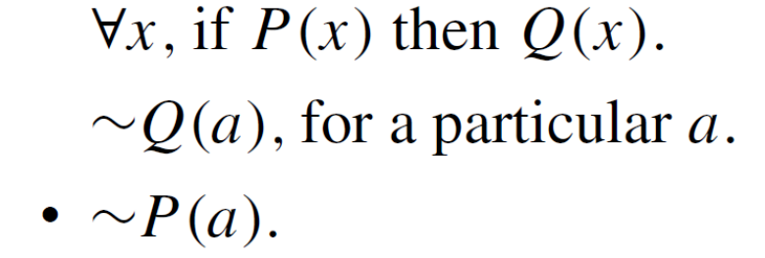
Using Diagrams to Test for Validity
If this is done, the argument can be seen to have the form
where P (x) is “x is a polynomial function” and Q (x) is
“x does not have a horizontal asymptote.”
This is valid by universal modus tollens.

Slide 37
Creating Additional Forms of Argument

Slide 38
Creating Additional Forms of Argument
Universal modus ponens and modus tollens were obtained by combining universal instantiation with modus ponens and modus tollens.
In the same way, additional forms of arguments involving universally quantified statements can be obtained by combining universal instantiation with other of the valid argument forms discussed earlier.

Slide 39
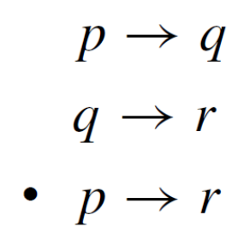
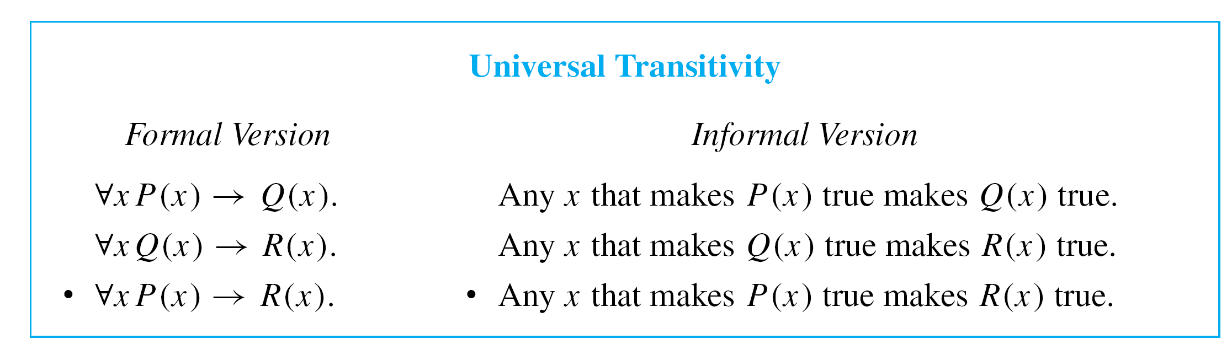
Creating Additional Forms of Argument
Consider the following argument:
This argument form can be combined with universal instantiation to obtain the following valid argument form.

Slide 40
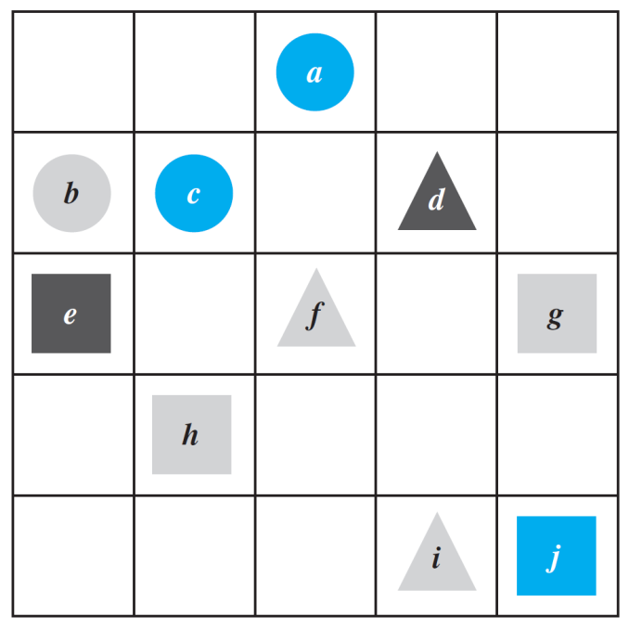
Example 8 – Evaluating an Argument for Tarski’s World
Consider the Tarski world shown in Figure 3.3.1.
Figure 3.3.1

Slide 41
Example 8 – Evaluating an Argument for Tarski’s World
cont’d
Reorder and rewrite the premises to show that the conclusion follows as a valid consequence from the premises.
1. All the triangles are blue.
2. If an object is to the right of all the squares, then it is
above all the circles.
3. If an object is not to the right of all the squares, then it is
not blue.
• All the triangles are above all the circles.

Slide 42
Example 8 – Solution
It is helpful to begin by rewriting the premises and the conclusion in if-then form:
1. x, if x is a triangle, then x is blue.
2. x, if x is to the right of all the squares, then x is above
all the circles.
3. x, if x is not to the right of all the squares, then x is not
blue.
• x, if x is a triangle, then x is above all the circles.

Slide 43
Example 8 – Solution
cont’d
The goal is to reorder the premises so that the conclusion of each is the same as the hypothesis of the next.
Also, the hypothesis of the argument’s conclusion should be the same as the hypothesis of the first premise, and the conclusion of the argument’s conclusion should be the same as the conclusion of the last premise.
To achieve this goal, it may be necessary to rewrite some of the statements in contrapositive form.

Slide 44
Example 8 – Solution
cont’d
In this example you can see that the first premise should remain where it is, but the second and third premises should be interchanged.
Then the hypothesis of the argument is the same as the hypothesis of the first premise, and the conclusion of the argument’s conclusion is the same as the conclusion of the third premise.
But the hypotheses and conclusions of the premises do not quite line up. This is remedied by rewriting the third premise in contrapositive form.

Slide 45
Example 8 – Solution
cont’d
Thus the premises and conclusion of the argument can be rewritten as follows:
1. x, if x is a triangle, then x is blue.
3. x, if x is blue, then x is to the right of all the squares.
2. x, if x is to the right of all the squares, then x is above
all the circles.
• x, if x is a triangle, then x is above all the circles.

Slide 46
Example 8 – Solution
cont’d
The validity of this argument follows easily from the validity of universal transitivity.
Putting 1 and 3 together and using universal transitivity gives that
4. x, if x is a triangle, then x is to the right of all the
squares.
And putting 4 together with 2 and using universal transitivity gives that
x, if x is a triangle, then x is above all the circles,
which is the conclusion of the argument.

Slide 47
Remark on the Converse and Inverse Errors

Slide 48
Remark on the Converse and Inverse Errors
A variation of the converse error is a very useful reasoning tool, provided that it is used with caution.
It is the type of reasoning that is used by doctors to make medical diagnoses and by auto mechanics to repair cars.

Slide 49
Remark on the Converse and Inverse Errors
It is the type of reasoning used to generate explanations for phenomena. It goes like this: If a statement of the form
For all x, if P (x) then Q (x)
is true, and if
Q (a) is true, for a particular a,
then check out the statement P (a); it just might be true.

Slide 50
Remark on the Converse and Inverse Errors
For instance, suppose a doctor knows that
For all x, if x has pneumonia, then x has a fever and
chills, coughs deeply, and feels exceptionally tired
and miserable.
And suppose the doctor also knows that
John has a fever and chills, coughs deeply,
and feels exceptionally tired and miserable.
On the basis of these data, the doctor concludes that a diagnosis of pneumonia is a strong possibility, though not a certainty.

Slide 51
Remark on the Converse and Inverse Errors
The doctor will probably attempt to gain further support for this diagnosis through laboratory testing that is specifically designed to detect pneumonia.
Note that the closer a set of symptoms comes to being a necessary and sufficient condition for an illness, the more nearly certain the doctor can be of his or her diagnosis.
This form of reasoning has been named abduction by researchers working in artificial intelligence. It is used in certain computer programs, called expert systems, that attempt to duplicate the functioning of an expert in some field of knowledge.

