Slide 1

CHAPTER 10
GRAPHS AND TREES
Copyright © Cengage Learning. All rights reserved.

Slide 2
SECTION 10.5
Trees
Copyright © Cengage Learning. All rights reserved.

Slide 3
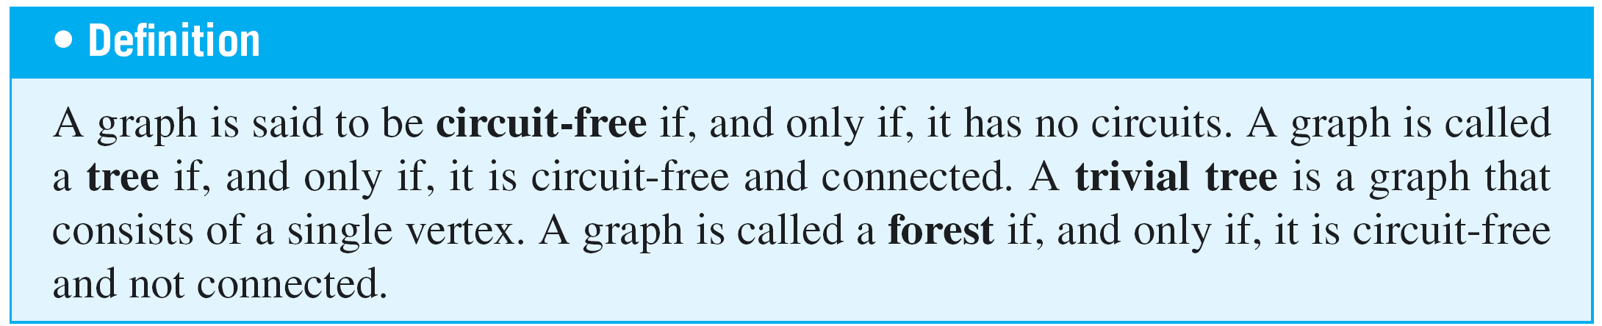
Trees
In mathematics, a tree is a connected graph that does not contain any circuits.
Mathematical trees are similar in certain ways to their botanical namesakes.

Slide 4
Example of Trees

Slide 5
Example of Trees
The next example illustrates a varied situation in which mathematical trees arise.

Slide 6
Example 3 – A Parse Tree
In the last 30 years, Noam Chomsky and others have developed new ways to describe the syntax (or grammatical structure) of natural languages such as English.
This work has proved useful in constructing compilers for high level computer languages.
In the study of grammars, trees are often used to show the derivation of grammatically correct sentences from certain basic rules. Such trees are called syntactic derivation trees or parse trees.

Slide 7
Example 3 – A Parse Tree
cont’d
A very small subset of English grammar, for example, specifies that
1. a sentence can be produced by writing first a noun
phrase and then a verb phrase;
2. a noun phrase can be produced by writing an article and
then a noun;
3. a noun phrase can also be produced by writing an
article, then an adjective, and then a noun;
4. a verb phrase can be produced by writing a verb and
then a noun phrase;

Slide 8
Example 3 – A Parse Tree
cont’d
5. one article is “the”;
6. one adjective is “young”;
7. one verb is “caught”;
8. one noun is “man”;
9. one (other) noun is “ball.”

Slide 9

Example 3 – A Parse Tree
cont’d
The rules of a grammar are called productions. It is customary to express them using the shorthand notation illustrated below.
1.
2., 3.
4.
5.

Slide 10



Example 3 – A Parse Tree
cont’d
6.
7.
8.
This notation, introduced by John Backus in 1959 and modified by Peter Naur in 1960, was used to describe the computer language Algol and is called the Backus-Naur notation.

Slide 11

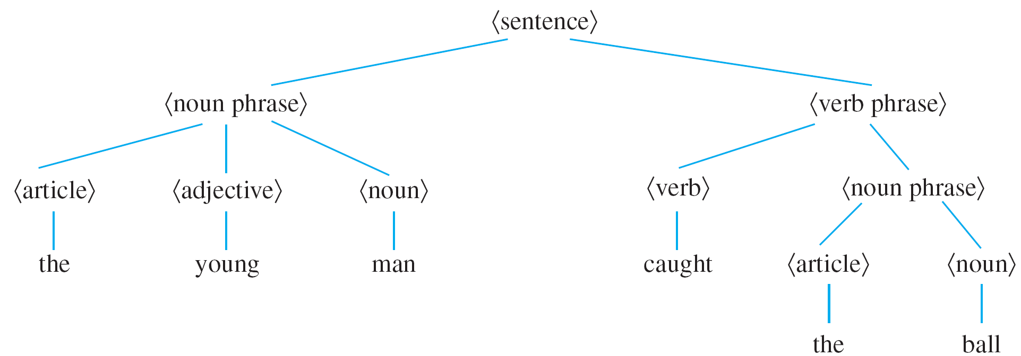
Example 3 – A Parse Tree
cont’d
In the notation, the symbol | represents the word or, and angle brackets are used to enclose terms to be defined (such as a sentence or noun phrase).
The derivation of the sentence “The young man caught the ball” from the mentioned rules is described by the tree shown below.

Slide 12
Example 3 – A Parse Tree
cont’d
In the study of linguistics, syntax refers to the grammatical structure of sentences, and semantics refers to the meanings of words and their interrelations.
A sentence can be syntactically correct but semantically incorrect, as in the nonsensical sentence “The young ball caught the man,” which can be derived from the rules given before.
Or a sentence can contain syntactic errors but not semantic ones, as, for instance, when a two-year-old child says, “Me hungry!”

Slide 13
Characterizing Trees

Slide 14
Characterizing Trees
There is a somewhat surprising relation between the number of vertices and the number of edges of a tree. It turns out that if n is a positive integer, then any tree with n vertices (no matter what its shape) has n – 1 edges.
Perhaps even more surprisingly, a partial converse to this fact is also true—namely, any connected graph with n vertices and n – 1 edges is a tree.
It follows from these facts that if even one new edge (but no new vertex) is added to a tree, the resulting graph must contain a circuit.

Slide 15
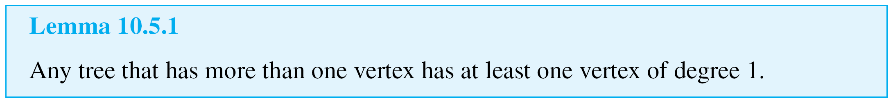
Characterizing Trees
Also, from the fact that removing an edge from a circuit does not disconnect a graph, it can be shown that every connected graph has a subgraph that is a tree.
It follows that if n is a positive integer, any graph with
n vertices and fewer than n – 1 edges is not connected.
A small but very important fact necessary to derive the first main theorem about trees is that any nontrivial tree must have at least one vertex of degree 1.

Slide 16
Characterizing Trees
A constructive way to understand this lemma is to imagine being given a tree T with more than one vertex. You pick a vertex v at random and then search outward along a path from v looking for a vertex of degree 1.
As you reach each new vertex, you check whether it has degree 1. If it does, you are finished. If it does not, you exit from the vertex along a different edge from the one you entered on.

Slide 17
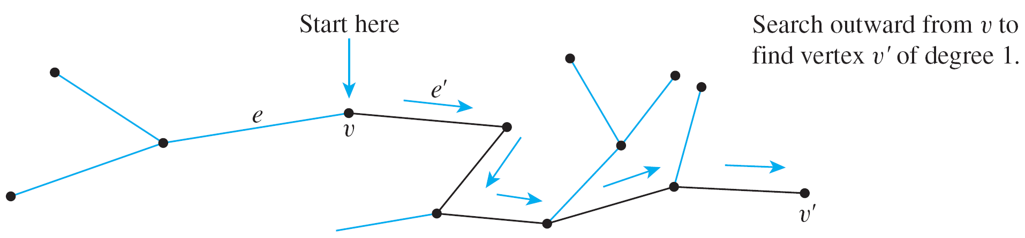
Characterizing Trees
Because T is circuit-free, the vertices included in the path never repeat. And since the number of vertices of T is finite, the process of building a path must eventually terminate.
When that happens, the final vertex v ′ of the path must have degree 1. This process is illustrated below.

Slide 18
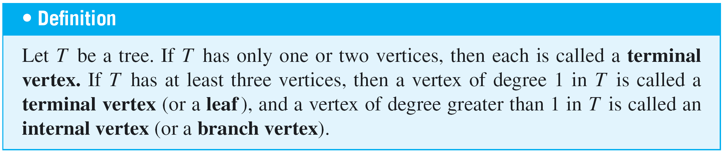
Characterizing Trees
Using Lemma 10.5.1 it is not difficult to show that, in fact, any tree that has more than one vertex has at least two vertices of degree 1.

Slide 19
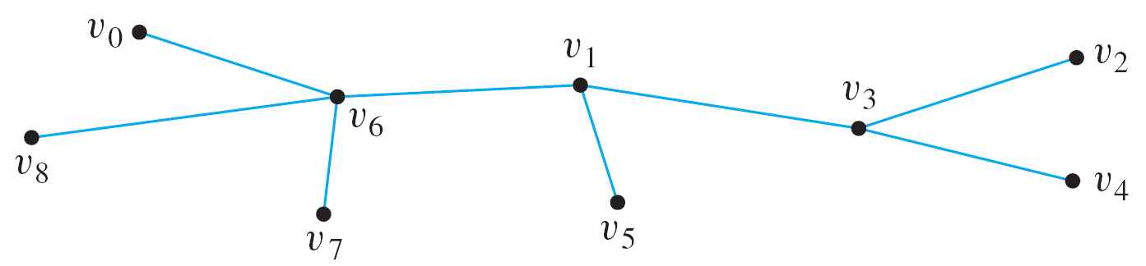
Example 5 – Terminal and Internal Vertices
Find all terminal vertices and all internal vertices in the following tree:
Solution:
The terminal vertices are v₀, v₂, v₄, v₅, v₇, and v₈.
The internal vertices are v₆, v₁, and v₃.

Slide 20
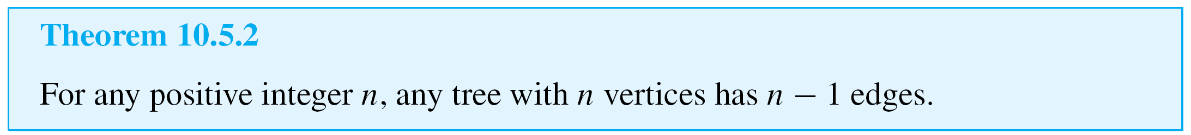
Characterizing Trees
The following is the first of the two main theorems about trees:

Slide 21
Example 7 – Finding Trees Satisfying Given Conditions
Find all nonisomorphic trees with four vertices.
Solution:
By Theorem 10.5.2, any tree with four vertices has three edges. Thus the total degree of a tree with four vertices must be 6.
Also, every tree with more than one vertex has at least two vertices of degree 1.

Slide 22
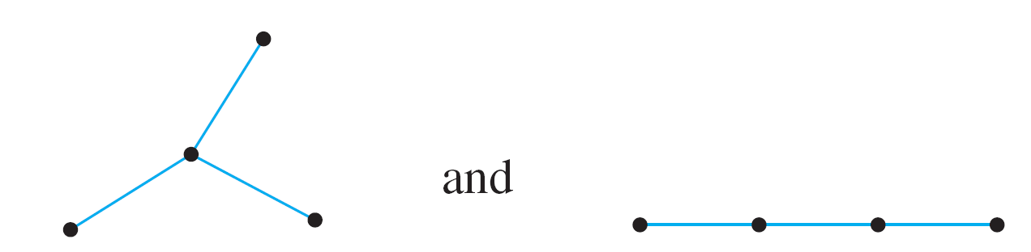
Example 7 – Solution
cont’d
Thus the following combinations of degrees for the vertices are the only ones possible:
1, 1, 1, 3 and 1, 1, 2, 2.
There are two nonisomorphic trees corresponding to both of these possibilities, as shown below.

Slide 23
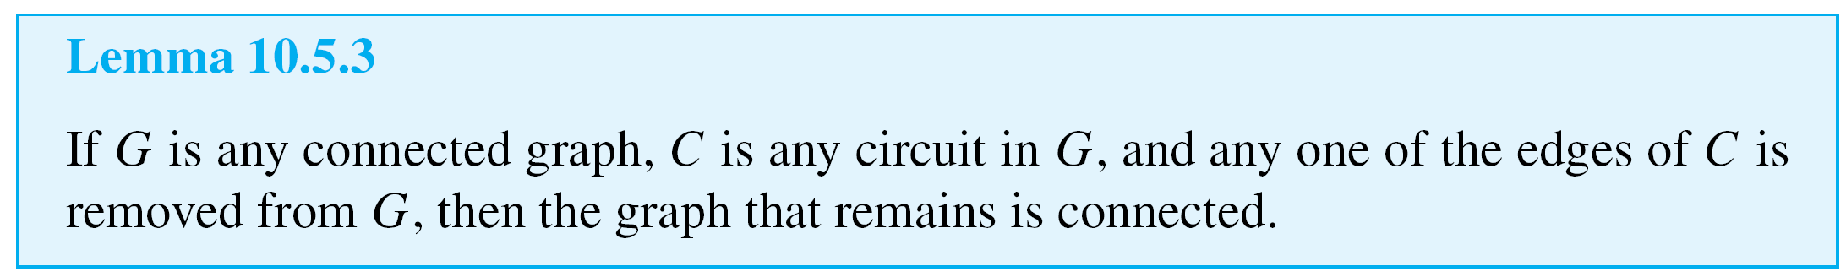
Characterizing Trees
Essentially, the reason why Lemma 10.5.3 is true is that any two vertices in a circuit are connected by two distinct paths.
It is possible to draw the graph so that one of these goes “clockwise” and the other goes “counterclockwise” around the circuit.

Slide 24


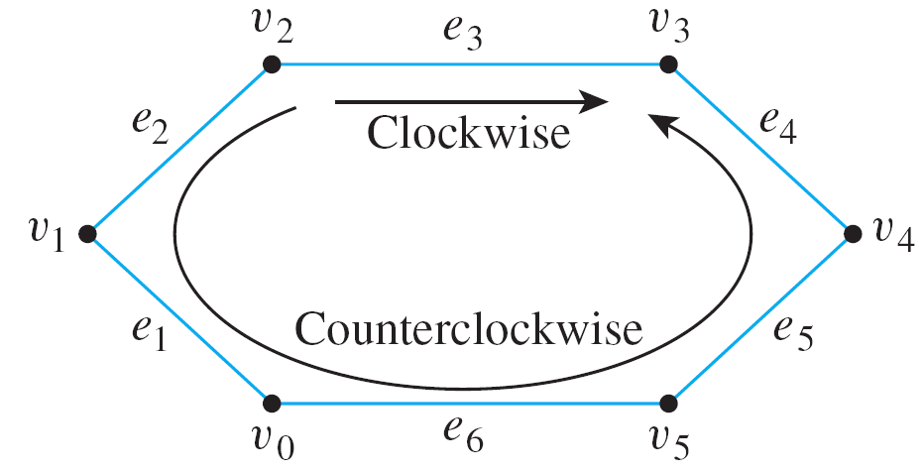
Characterizing Trees
For example, in the circuit shown below, the clockwise path from v₂ to v₃ is
and the counterclockwise path from v₂ to v₃ is

Slide 25
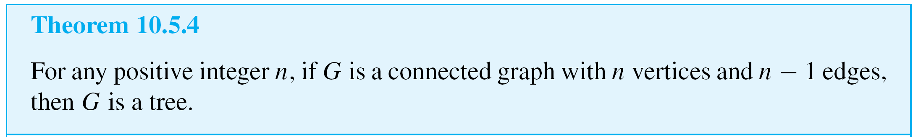
Characterizing Trees
The second major theorem about trees is a modified converse to Theorem 10.5.2.
Theorem 10.5.4 is not a full converse of Theorem 10.5.2. Although it is true that every connected graph with n vertices and n – 1 edges (where n is a positive integer) is a tree, it is not true that every graph with n vertices and n – 1 edges is a tree.

Slide 26
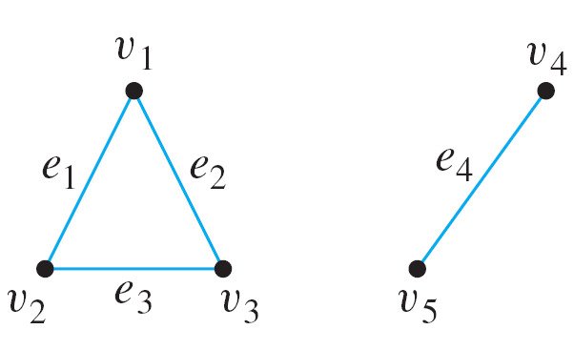
Example 8 – A Graph with n Vertices and n – 1 Edges That Is Not a Tree
Give an example of a graph with five vertices and four edges that is not a tree.
Solution:
By Theorem 10.5.4, such a graph cannot be connected. One example of such an unconnected graph is shown below.

