Slide 1
GUI Programming with Tkinter in Python
A Beginner’s Guide to Tkinter(Python library)
Presented by: Ankit Yadav

Slide 2
Introduction to GUI Programming
What is GUI?
Why use GUI over CLI?
Importance of GUI in modern apps

Slide 3
What is Tkinter?
A Graphical User Interface (GUI) is a system of interactive visual components for computer software. It allows users to interact with electronic devices through graphical icons and visual indicators rather than text-based commands. This interface is designed to be user-friendly and intuitive, making it easier for users to perform tasks without needing to memorize complex commands
A Command Line Interface (CLI) and a Graphical User Interface (GUI) are two distinct methods for interacting with computer systems and software. Both have their own advantages and disadvantages, catering to different user needs and preferences.
GUIs are standard in software programming for computers, smartphones, and other electronic devices. They enhance the user experience by allowing actions like clicking on icons, dragging and dropping files, and resizing windows.

Slide 4
Installing and Importing Tkinter
```python
import tkinter as tk
from tkinter import *
```
• Usually pre-installed with Python

Slide 5
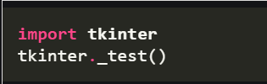
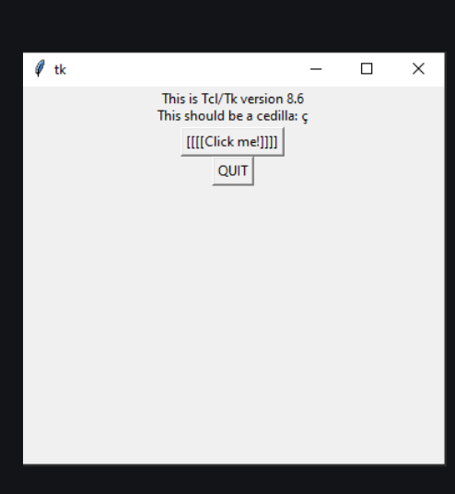
Installing and Importing Tkinter

Slide 6
Basic Tkinter Window
```python
root = Tk()
root.mainloop()
```
• Creating the root window
• Running the mainloop

Slide 7
Tkinter Widgets Overview
Common Widgets:
• Label
• Button
• Entry
• Text
• Frame
• Canvas

Slide 8
Labels and Buttons
```python
Label(root, text="Hello Tkinter!").pack()
Button(root, text="Click Me", command=callback).pack()
```
• pack() and event handling

Slide 9
Entry and Text Widgets
• Input from users
```python
entry = Entry(root)
entry.pack()
```
• Multi-line input with Text()

Slide 10
Layout Management
Geometry managers:
• pack()
• grid()
• place()
• Best use cases for each

Slide 11
Handling Events
• Using `command=` in widgets
• Binding keys and mouse actions
```python
widget.bind("<Button-1>", handler)
```

Slide 12
Message Boxes
• Show info, warning, error dialogs
```python
from tkinter import messagebox
messagebox.showinfo("Title", "Message")
```

Slide 13
Menus and Frames
• Adding Menus
• Using Frames for layout
```python
menu = Menu(root)
root.config(menu=menu)
```

Slide 14
Simple Tkinter App Example
• Mini calculator or form app
• Combines multiple widgets and logic

Slide 15
Pros and Cons of Tkinter
✅ Easy to use, included in Python
✅ Good for small apps
❌ Limited styling
❌ Slower than modern frameworks

Slide 16
Conclusion & Resources
Summary of key points
Further reading:
- Python Docs
- TutorialsPoint / RealPython

Slide 17
Mini Project on Tkinter
https://github.com/angrymine27/Mini-Project-Assignment3.git
The above link of my Repo where the mini project located

