Slide 1

Scientific Reporting Tutorial
Dr Alexandra Klimova
alexandra.klimova@itmo.ru
2019

Slide 2
Outline
- Scientific reporting
- Common mistakes
- Scientific databases

Slide 3
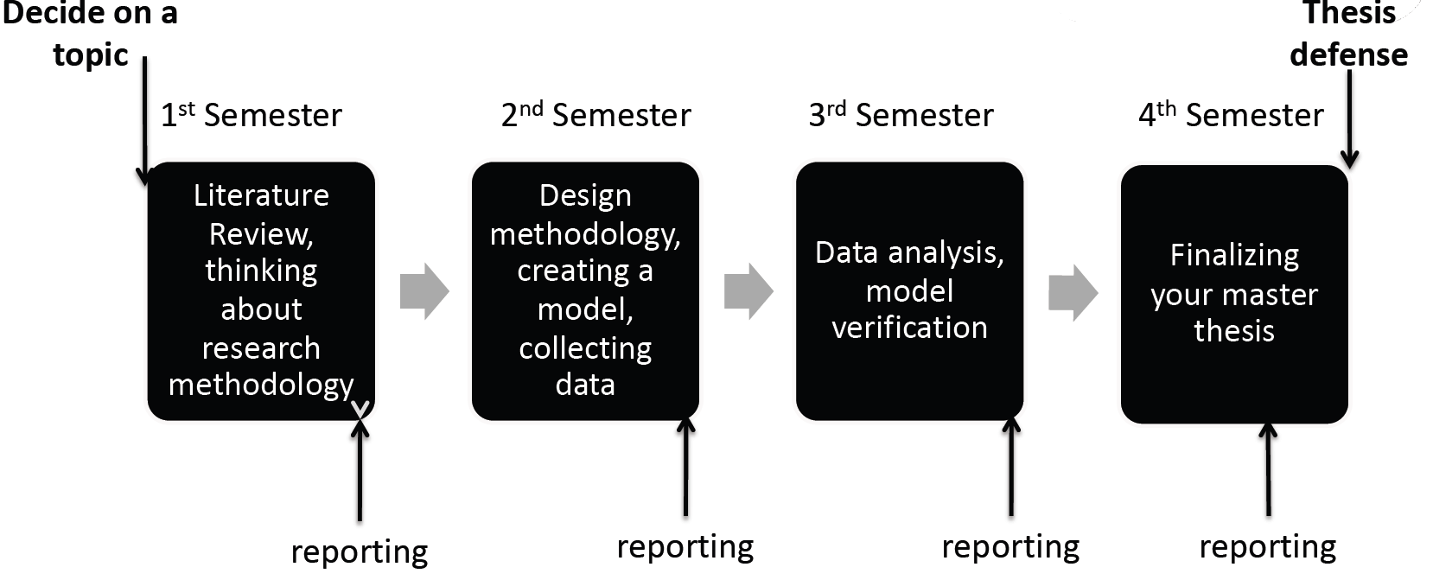
Master Thesis

Slide 4
Documents:
Individual task for research work: brief guidelines, content of the report, references recommended
Diary: ones a week
Report
Review of supervisor: evaluation of students research work
Индивидуальное задание
Дневник практики
Отчет
Отзыв руководителя

Slide 5
Scientific work
Dates: 09/09/2019 – 24/12/2019
Stages:
Topic selection
Tutorial
Schedule for scientific work (with your supervisor)
Work on the project
Reporting: 12th of December
Defense: 16/12/2019 – 20/12/2019

Slide 6
1st Semester
Analysis of scientific literature
• Minimum 20 pages of Related work
Report Defense: 16.12 - 20.12.2019
Presentation for 8 minutes + Q&A session
Package of required documents:
• Scientific Task
• Diary
• Report
• Review from your supervisor
• Presentation
1st Semester
Presentation in English (both slides and talk) for all students
Report in English for Big Data and Machine Learning
Report in Russian for others

Slide 7
Your grade: • Grade from your supervisor • Compliance with ГОСТ 7.32. • Grade for presentation
Report and supplementary documents:
1. Checked and signed by your supervisor
2. Checked and signed by compliance manager
3. Hard copies of the documents properly signed Electronic copies (in docx) are given to Alexandra Klimova for the final grade.

Slide 8
Common mistakes
Literature is out-of-date:
should be at least 20-25 scientific papers of 2014 and more recent year of publication
Plagiarism
should be used paraphrasing and summarizing
Papers are not referenced properly
Not scientific
Without compliance to the GOST (figure and table titles, fonts,
paragraphs, etc )

Slide 9
Academic databases and search engines

Slide 10

Scopus
The largest abstract and citation database of peer-reviewed literature: scientific journals, books and conference proceedings.
Scopus is updated daily and titles are evaluated regularly.

Slide 11
What can you do there?
Search by document, author or affiliation
Link to full-text articles your institution already subscribes to
Track citations over time
View h-index for specific authors
Assess document performance
… and many other things

Slide 12
Databases and libraries
Google Scholar
Science Direct (http:// sciencedirect.com),
Emerald (http:// emeraldinsight.com),
Springer (http://link.springer.com)
EBSCOhost Business Searching Interface (http://search.ebscohost.com/),
AIS Electronic Library (http://aisel.aisnet.org/)
ACM Digital Library (http://dl.acm.org/)
IEEE Electronic Library (http://ieeexplore.ieee.org/Xplore/home.jsp),
IEEE Xplore (http://www.ieee.org/publications_standards/publicati

Slide 13
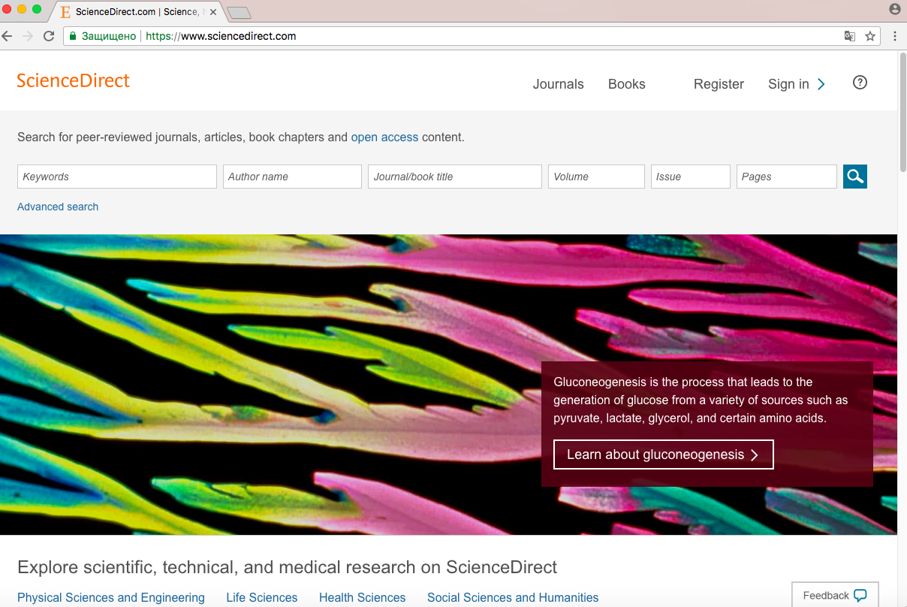
Finding a scientific paper in database
Keywords
Author name
Journal title

Slide 14
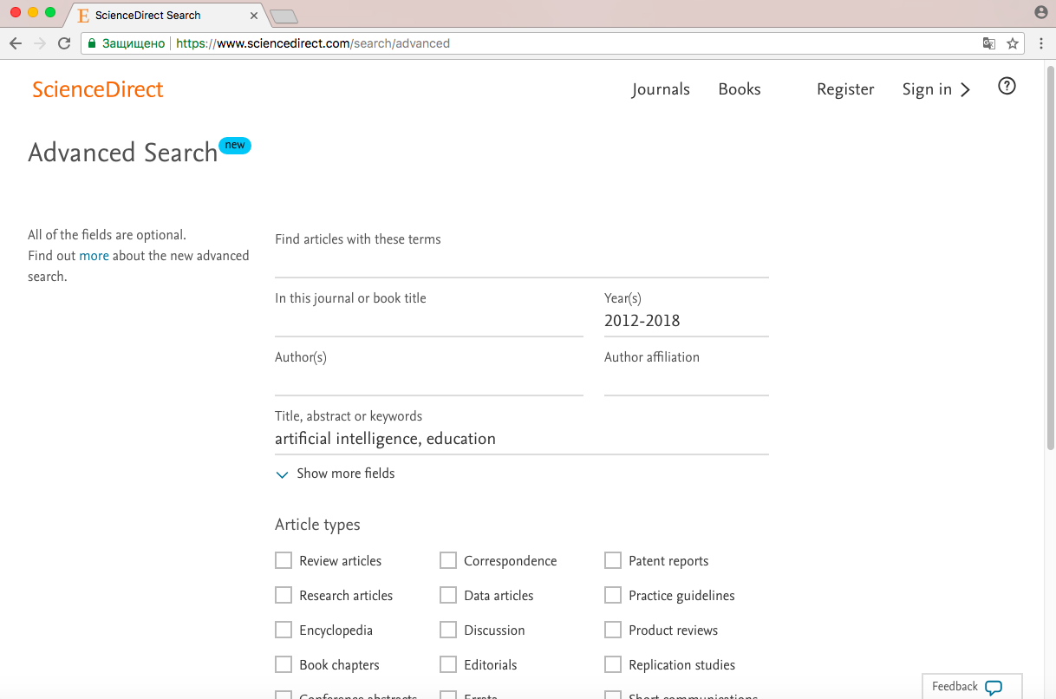
Keyword | All fields | Title, abstract, keywords
Artificial intelligence AND education | 7736 | 45

Slide 15
Reference management software

Slide 16
Different Systems of Paper Referencing
The Harvard (author-year-style or parenthetical referencing)
Indeed, “complexity, synonymous in engineering terms with instability, had become a hallmark of the early 21st century” (Watson, 2012)
IEEE , GOST
Indeed, “complexity, synonymous in engineering terms with instability, had become a hallmark of the early 21st century” [1].
Oxford
Indeed, “complexity, synonymous in engineering terms with instability, had become a hallmark of the early 21st century”.

Slide 17
Reference management software
Mendeley (https://www.mendeley.com/): a free reference manager and an academic social network.
Zotero (https://www.zotero.org/): a powerful, easy-to-use research tool that helps you gather, organize, and analyze sources and then share the results of your research.
EndNote (endnote.com/) - is the industry standard software tool for publishing and managing bibliographies, citations and references on the Windows and Macintosh desktop.

Slide 18
Why do we need them?
Much easier to manage different types of citation
Share your bibliography with your colleagues
Create your own library
You may correct and cite everything

Slide 19
Mendeley
Create an account: https://www.mendeley.com
Download Mendeley desktop
Include plug in to MS word: https://www.mendeley.com/referencemanagement/
citation-plugin
Organise a library

