Slide 1

Course Information
Instructor: Ekaterina Vladimirovna Bolgova
E-mail: ekaterina_bolgova@itmo.ru
Course language: English.
Classes starts at September 14, 2019.
Duration: 1 semester.
Classes’ types:
Lectures (4): 14/09, 21/09, 28/09, 05/10
Labs (programming tasks): starts at October 19, 2019
Exam (2/1/0 question(s)):
Submit all labs (code + report)
Make presentation (at least 1)
Attendance & activity
Bonus: if make workshop

Slide 2
Basics of Parallel Programming with OpenMP
PhD Katerina Bolgova
eScience Research Institute & HPC Department

Slide 3
Background
What are Parallel Computer Memory Architectures?
Distributed Memory
Shared Memory
Hybrid Shared-Distributed
Memory
Shared Memory
UMA
NUMA
CPU
M
E
M
O
R
Y
CPU
CPU
CPU
CPU
CPU
MEMORY
MEMORY
CPU
CPU
MEMORY
MEMORY
CPU
CPU
CPU
CPU
CPU
CPU
Symmetric Multiprocessor

Slide 4
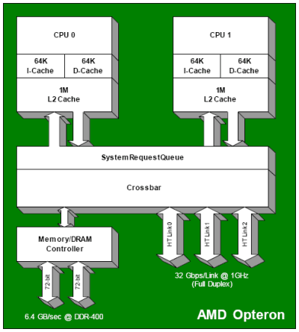
Background
Intel Core 2 Duo
AMD Opteron
Memory Bus Controller
P₀
P₁
L1-I
L1-D
L1-I
L1-D
L2 cach
Intel Core i7
Memory Bus Controller
P₀
P₁
P₂
P₃
P₄
P₅
L1-I
L1-D
L1-I
L1-D
L1-I
L1-D
L1-I
L1-D
L1-I
L1-D
L1-I
L1-D
L2 cach
L2 cach
L2 cach
L2 cach
L2 cach
L2 cach
L3 cach
Notes:
Xnj jgjhghj

Slide 5

OpenMP Overview
OpenMP :
is an Application Program Interface (API) that may be used to explicitly direct multi-threaded, shared memory parallelism
is managed by the OpenMP Architecture Review Board (or OpenMP ARB)
provides a portable, scalable model for developers of shared memory parallel applications.
supports C/C++ and Fortran
is a set of compiler directives and library routines for parallel application programmers
Brief history
The OpenMP standard specification started in 1997. (The version for Fortran appeared).
In 1998 the C/C++ standard was released
Since 2005, C and Fortran specifications have been released together
The latest version (4.0) of the specification was released in July 2013

Slide 6

Advantages of OpenMP
Provide a standard among a variety of shared memory architectures
Establish a simple and limited set of directives for programming shared memory machines
Significant parallelism can be implemented by using just 3 or 4 directives
Provide capability to incrementally parallelize a serial program
The API is specified for C/C++ and Fortran
Public forum for API and membership
Most major platforms have been implemented including Unix/Linux platforms and Windows

Slide 7
OpenMP Programming Model
master thread
OpenMP program begins as a single process: the master thread
FORK: the master thread then creates a team of parallel threads
Parallel execution
JOIN: the team threads terminate, leaving only the master thread
parallel regions
sequential parts
Parallelism added incrementally
The number of parallel regions and the threads that comprise them are arbitrary
Each thread can spawn another team of threads (nested parallelism)
FORK-JOIN Model

Slide 8
OpenMP Solution Stack
End User
User
layer
Application
Prog.
layer
Compiler Directives
OpenMP library routines
Environment variables
OpenMP Runtime library
System
Layer
OS/system support for shared memory and threading
P₀
P₁
P₂
P_{n}
HW
Shared Address Space
Source: Tim Mattson, Introduction to OpenMP

Slide 9
OpenMP Directives Format
#pragma omp directive-name [clause[ [,] clause]...] new-line
Each directive starts with #pragma omp
Compilers can ignore OpenMP directives and conditionally compiled code if support of the OpenMP API is not provided
Directives are case-sensitive
An OpenMP executable directive applies to at most one succeeding statement, which must be a structured block
Long directive lines can be "continued" on succeeding lines with a backslash ("\") at the end of a directive line
for C/C++ it needs to include the <omp.h> header file
Example:
#pragma omp parallel default(shared) \
private(beta,pi)

Slide 10
Thread Creation
#pragma omp parallel [clause ...] newline structured_block
￼
When thread reaches this directive, it creates a team of threads
All threads will execute code of this parallel region
There is an implied barrier at the end of a parallel section
The number of threads in the team remains constant for the duration of that parallel region
Example:
#include <omp.h>
int main(){
#pragma omp parallel
{
int ID = omp_get_thread_num();
cout<<" hello ("<< ID <<")\n";
cout<<" world ("<< ID <<")\n";
}
}
OpenMP include file
Parallel region
End of the Parallel region

Slide 11
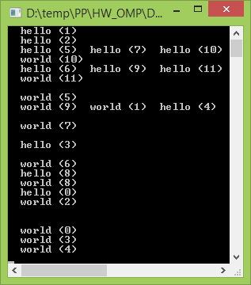
Thread Creation
Sample Output:
How it works:
￼
meet a parallel structure here
Creation a (default) number of threads
Print
“Hello (0)”
Print
“Hello (1)”
Print
“Hello (2)”
Print
“World(0)”
Print
“World(1)”
Print
“World(2)”
Only master thread continues execution
Threads wait here for all threads to finish before proceeding (i.e. a barrier)

Slide 12
Clauses of Parallel Construct Overview
num_threads (integer-expression ) – explicitly determine the number of threads
private (list ) – each thread will have a local copy and use it as a temporary variable
firstprivate (list) – like private except initialized to original value
shared (list ) – the data within a parallel region is shared
default (shared | none) – allows the programmer to state that the default data scoping within a parallel region will be either shared, or none
reduction (operator :list ) – a safe way of joining work from all threads after construct
if (scalar-expression ) – This will cause the threads to parallelize the task only if a condition is met. Otherwise the block executes serially

Slide 13
Defining the Time of Program Execution
Time in Seconds since a fixed point in the past:
double omp_get_wtime(void)
Scheme of using the omp_get_wtime function:
double t_1, t_2, dt; t_1 = omp_get_wtime();
... t_2 = omp_get_wtime();
dt = t_2 – t_1;

Slide 14
Determining Number of Threads
The number of threads in a parallel region is determined by the following factors, in order of precedence:
Evaluation of the if clause
Setting of the num_threads clause
Use of the omp_set_num_threads() library function
Setting of the OMP_NUM_THREADS environment variable
#pragma omp parallel if (NMAX>LIMIT)
#pragma omp parallel num_threads(4)
void omp_set_num_threads (int num_threads);

Slide 15

Sample: PI evaluation
F(x)
We know that:
4
2
x
0
1
We can approximate the integral as a sum of rectangles:
– rectangle width
where
– rectangle height

Slide 16
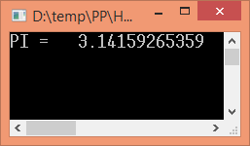
PI: Serial Program
static long cntSteps=10000000;
double step;
void main() {
double x, pi, sum = 0.0;
int i;
step = 1.0/(double)cntSteps;
for (i=0; i<cntSteps; i++) {
x = (i + 0.5)*step;
sum = sum + 4.0/(1.0+ x*x);
}
pi = sum*step;
cout << “PI = "<<setw(15)<<setprecision(12)<<pi;
}

Slide 17
PI: Simple Parallel Program
#include <omp.h>
static long cntSteps=10000000; double step;
void main() {
int i;
step = 1.0/(double)cntSteps;
cout << “PI = "<<setw(15)<<setprecision(12)<<pi;
}
#define thrdsCount = 2
The SPMD design pattern
(Single Program Multiple Data)
double pi, sum[thrdsCount];
double x, pi, sum = 0.0;
#pragma omp parallel
{
num_threads(thrdsCount)
int i,id; double x;
id = omp_get_thread_num();
for (i=id, sum[id]=0.0;i<cntSteps; i+=thrdsCount) {
x = (i + 0.5)*step;
sum[id] += 4.0/(1.0 + x*x);
}
for (i=0; i<cntSteps; i++) {
x = (i + 0.5)*step;
sum += 4.0/(1.0 + x*x);
}
}
pi = sum*step;
for(i=0, pi=0.0; i< thrdsCount;i++)
pi += sum[i] * step;

Slide 18
PI: Simple Parallel Program
#include <omp.h>
static long cntSteps=10000000; double step;
#define thrdsCount = 2
void main() {
double pi, sum[thrdsCount];
int i;
step = 1.0/(double)cntSteps;
#pragma omp parallel num_threads(thrdsCount)
{
int i,id; double x;
id = omp_get_thread_num();
for (i=id, sum[id]=0.0;i<cntSteps; i+=thrdsCount) {
x = (i + 0.5)*step;
sum[id] += 4.0/(1.0 + x*x);
}
}
for(i=0, pi=0.0; i<thrdsCount;i++)
pi += sum[i] * step;
cout << “PI = "<<setw(15)<<setprecision(12)<<pi;
}
#Th
T_{p}
S_{p}
1
2
4
8
16
0,79
0,51
0,46
0,43
0,36
1
1,55
1,72
1,84
2,19

Slide 19
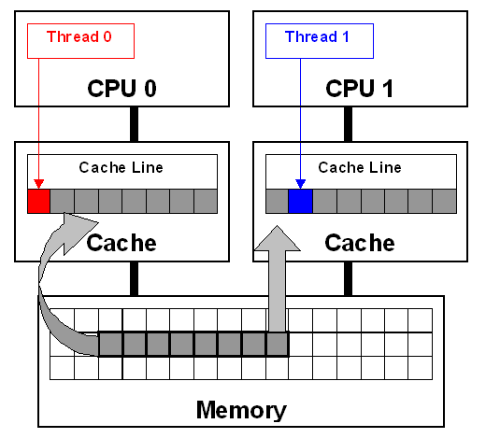
False sharing
Modifying variables that reside on the same cache line by threads on different processors will cause the cache lines to “slosh back and forth” between threads.
It’s the reason of “false sharing”
Combining scalars to an array program is a very common way to support creation of an SPMD
But most likely the array elements are contiguous in memory and hence share cache lines
Simple solution: Pad arrays

Slide 20
PI: Simple Parallel Program
#include <omp.h>
static long cntSteps=10000000; double step;
#define thrdsCount = 2
#define PAD 8 // assume 64 bytes L1 cache line size
void main() {
double pi, sum[thrdsCount][PAD];
int i;
step = 1.0/(double)cntSteps;
#pragma omp parallel num_threads(thrdsCount)
{
int i,id; double x;
id = omp_get_thread_num();
for (i=id, sum[id][0]=0.0;i<cntSteps; i+=thrdsCount) {
x = (i + 0.5)*step;
sum[id][0] += 4.0/(1.0 + x*x);
}
}
for(i=0, pi=0.0; i<thrdsCount;i++)
pi += sum[i][0] * step;
cout << “PI = "<<setw(15)<<setprecision(12)<<pi;
}
#Th
1stT_{p}
2ndT_{p}
S_{p}
1
2
4
8
16
0,79
0,51
0,46
0,43
0,36
0,78
0,41
0,23
0,14
0,13
1
1,9
3,39
5,57
6,0
Padding arrays doesn’t resolve
the “false sharing” problem

Slide 21
Work-Sharing in OpenMP
Types of Work-Sharing Constructs (WShCs):
Loop construct
Sections/section constructs
Single construct
Workshare construct
Task construct
A WShC divides the execution of code region among the members of the team
WShCs do not launch new threads
There is no implied barrier upon entry to a WShC, however there is an implied barrier at the end of a WShC.
A WShC must be enclosed within a parallel region
WShCs must be encountered by all members of a team or none at all

Slide 22
Loop Construct
Directive format:
#pragma omp for [clause,... ] new-line
for-loop
master thread
#pragma omp parallel
{
#pragma omp for
for (i=0;i<N;i++) {
work_for_loop(i);
}
}
FORK
For loop
team
JOIN
master thread
for directive specifies that the iterations of the loop (following it) must be executed in parallel by the team
The loop variable (i in this case) is made “private” to each thread by default

Slide 23
Clauses of For Construct Overview
private (list) – each thread will have a local copy and use it as a temporary variable
firstprivate (list) – like private except initialized to original value
lastprivate (list) – each variable from the sequentially last iteration of the associated loop is assigned to the variable's original object
reduction (operator: list) – a safe way of joining work from all threads after construct
schedule (type[, chunk]) – describes how iterations of the loop are divided among the threads in the team
collapse (n) — Specifies how many loops in a nested loop should be collapsed into one large iteration space and divided according to the schedule clause
ordered – the iterations of the loop must be executed as they would be in a serial program
nowait – threads do not synchronize at the end of the parallel loop
1. Task for report

Slide 24
Construct Comparison
Serial code:
for(i=0;i<n;i++) {
a[i] = a[i-1]+c[i];
}
Parallel region: SPMD pattern
Parallel region: worksharing
#pragma omp parallel
{
int id, i, Nths, istart, iend;
id = omp_get_thread_num();
Nths = omp_get_num_threads();
istart = id * N / Nthrds;
iend = (id+1) * N / Nthrds;
if (id == Nthrds-1)
iend = N;
for(i=istart;i<iend;i++) {
a[i] = a[i-1] + c[i];
}
}
#pragma omp parallel
{
#pragma omp for
for(i=0;i<n;i++) {
a[i] = a[i-1] + c[i];
}
}
or
#pragma omp parallel for
for(i=0;i<n;i++) {
a[i] = a[i-1] + c[i];
}

Slide 25
Sample of For construct
#include <omp.h>
#define NMAX 1000
main () {
int i, j, sum; float a[NMAX][NMAX]; <data initialization>
#pragma omp parallel for shared(a) private(i,j,sum)
{
for (i=0; i < NMAX; i++) {
sum = 0; for (j=0; j < NMAX; j++)
sum += a[i][j]; printf (“Sum of %d-string equals %f\n",i,sum);
}
}
#include <omp.h>
#define NMAX 1000
main () {
int i, j, sum; float a[NMAX][NMAX]; <data initialization>
#pragma omp parallel shared(a) private(i,j,sum)
{
#pragma omp for for (i=0; i < NMAX; i++) {
sum = 0;
for (j=0; j < NMAX; j++)
sum += a[i][j]; printf ("Сумма эл-ов строки %d равна %f\n",i,sum);
}
}

Slide 26
Data-Sharing Attribute Clauses
Any variable in OpenMP is either shared or private
Data-Sharing Attribute Clauses are used to explicitly define how variables should be scoped
Data-Sharing Attribute Clauses include:
shared,
private,
firstprivate,
lastprivate,
reduction,
default,
copyin,
copyprivate.
All the variables of the program are shared by default

Slide 27
Data-Sharing Attribute Clauses
The code combines values into a single variable (sum)
there is a true dependence between loop iterations that can’t be trivially removed
int sum = 0, a[NMAX], j; for (j=0; j < NMAX; j++)
sum += a[j];
Such situation is called a Reduction and it is frequently used.
REDUCTION Clause
Format: reduction(op:list)
A private copy of each list variable is created for each thread of a team
Local copies are initialized depending on the “op” (1 for “*” and 0 for “+”)
At the end of the reduction the final value of each of the local copies are combined with the original global value using the operator specified
The variables in “list” must be shared in the enclosing parallel region

Slide 28
PI: PP with Worksharing and Reduction
static long cntSteps=10000000; double step;
void main() {
double x, pi, sum = 0.0;
int i;
step = 1.0/(double)cntSteps;
for (i=0; i<cntSteps; i++) {
x = (i + 0.5)*step;
sum += 4.0/(1.0+ x*x);
}
pi = sum*step;
cout << “PI = "<<setw(15)<<setprecision(12)<<pi;
}
#include <omp.h>
#pragma omp parallel
{
double x;
#pragma omp for reduction(+:sum)
}

Slide 29
Data-Sharing Attribute Clauses
SHARED Clause
Format: shared(list)
declares variables in its list to be shared among all threads in the team
A shared variable exists in only one memory location and all threads can read or write to that address
It is the programmer's responsibility to ensure that multiple threads properly access shared variables
DEFAULT Clause
Format: default(shared|none)
allows the user to specify a default scope for all variables in the lexical extent of any parallel region
Using none as a default requires that the programmer explicitly scope all variables
Specific variables can be exempted from the default using the shared clause

Slide 30
Data-Sharing Attribute Clauses
PRIVATE Clause
Format: private(list)
declares variables in its list to be private in each thread of the team
Variables declared private should be uninitialized for each thread
The original object referenced by the variable has an indeterminate value upon entry to the construct, and has an indeterminate value upon exit from the construct
FIRSTPRIVATE Clause
Format: firstprivate(list)
private clause with automatic initialization of the variables in its list
Listed variables are initialized according to the value of their original objects prior to entry into the parallel or work-sharing construct
LASTPRIVATE Clause
Format: lastprivate(list)
private clause with a copy from the last (sequentially) loop iteration or section to the original variable object

Slide 31
Data-Sharing Attribute Clauses
How the firstprivate works:
Smth
#pragma omp parallel firstprivate(Smth)
Thread 3
Thread 1
Thread N
Local copies are created
with Smth global value
Smth
Smth
Smth
…
Smth
Smth
Smth
The Smth global value
doesn‘t change
Smth

Slide 32
Data-Sharing Attribute Clauses
How the lastprivate works:
4 threads
9 loop iterations
sum
#pragma omp parallel for lastprivate(sum)
Thread 3
Thread 0
Thread 2
Thread 1
sum
sum
sum
sum
loops
loops
loops
loops
sum₂
sum₁
sum₀
sum₈
sum₃
sum₅
sum₈
sum₇
sum₄
sum₆
sum
sum

Slide 33
Data-Sharing Attribute Clauses: Examples
int main() {
int b = 3;
b += 7;
printf ("b is %d\n”, b);
}
int b = 3;
#pragma omp parallel firstprivate(b)
{
b += 7;
printf ("b is %d\n”, b);
}
int b = 3;
#pragma omp parallel private(b)
{
b += 7;
printf ("b is %d\n”, b);
}
int b = 3;
#pragma omp parallel
{
b += 7;
printf ("b is %d\n”, b);
}

Slide 34
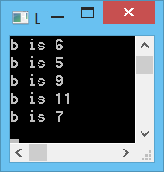


Synchronization Constructs in OpenMP
Sample:
int b = 3;
#pragma omp parallel
{
b += 1;
printf ("b is %d\n”, b);
}
Synchronization: bringing one or more threads to a well defined and known point in their execution
OpenMP includes:
barrier
critical
atomic
ordered
locks
flush
Barrier
High level synchronization
Mutual exclusion
Low level synchronization

Slide 35
Synchronization in OpenMP
BARRIER Directive
Format: #pragma omp barrier
synchronizes all threads in the
When a barrier directive is reached, a thread will wait at that point until all other threads have reached that barrier
All threads then resume executing in parallel the code that follows the barrier
All threads in a team (or none) must execute the barrier region

Slide 36
Synchronization in OpenMP
CRITICAL Directive
Format: #pragma omp critical [name]
structured_block
specifies a region of code that must be executed by only one thread at a time
If a thread is currently executing inside a critical region and another thread reaches that critical region and attempts to execute it, it will block until the first thread exits that critical region
Names act as global identifiers. Different critical regions with the same name (or are unnamed) are treated as the same region
It is illegal to branch into or out of a CRITICAL block

Slide 37
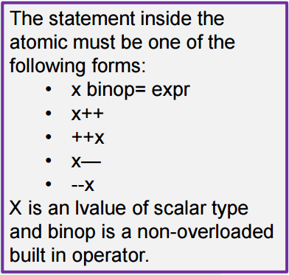
Synchronization in OpenMP
ATOMIC Directive
Format: #pragma omp atomic
x <operator> = <expression>
specifies that a memory location must be updated atomically, rather than letting multiple threads attempt to write to it
The directive applies only to a single, immediately following statement
Sample:
double A[NMAX];
#pragma omp parallel for
for (i = 0; i < NMAX; i++){
big_computations(A);
#pragma omp atomic
sum += A[i];
}

Slide 38
Synchronization in OpenMP
Lock Functions
Initialize a simple/nested lock
void omp_init_lock(omp_lock_t *lock); void omp_init_nest_lock(omp_nest_lock_t *lock);
Wait until a lock is available
void omp_set_lock(omp_lock_t *lock); void omp_set_nest_lock(omp_nest_lock_t *lock);
Release a simple/nested lock
void omp_unset_lock(omp_lock_t *lock); void omp_unset_nest_lock(omp_lock_t *lock);
Remove a simple/nested lock
void omp_destroy_lock(omp_lock_t *lock); void omp_destroy_nest_lock(omp_nest_lock_t *lock);
Test a simple/nested lock
int omp_test_lock(omp_lock_t *lock); int omp_test_nest_lock(omp_lock_t *lock);

Slide 39
Synchronization in OpenMP
Lock Functions. Example
int A[NMAX], sum = 0, i;
for (i = 0; i < NMAX; i++)
A[i] = i;
omp_lock_t lock; omp_init_lock(&lock); #pragma omp parallel for
{
for (i=0; i < NMAX; i++) {
omp_set_lock (&lock);
sum += A[i];
omp_unset_lock (&lock);
} }
omp_destroy_lock (&lock);

Slide 40
HW: Tasks for report
2. Tell about:
Flush directive
Single directive
Master directive
Ordered directive
Sections Construct
3. Common Mistakes in OpenMP and How To Avoid Them (article)

Slide 41
Learning more about OpenMP
OpenMP architecture review board URL, the “owner” of the OpenMP specification:
www.openmp.org
OpenMP User’s Group (cOMPunity) URL:
www.compunity.org
The OpenMP reference card:
http://openmp.org/mp-documents/OpenMP3.1-CCard.pdf

Slide 42
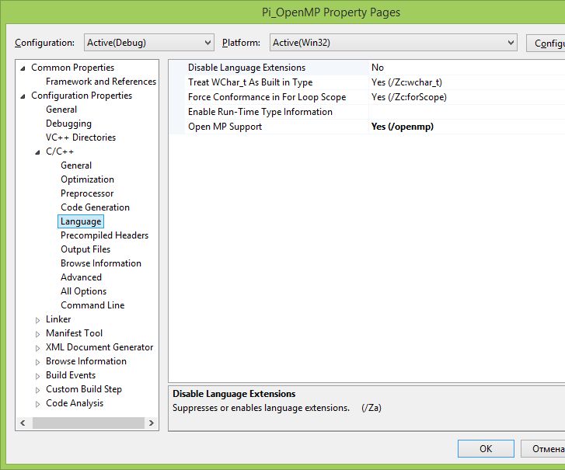
Getting Started. OpenMP vs. Visual Studio
To use OpenMP with Visual Studio, you need:
Visual Studio 2005 Professional or better
A multi processor or multi core system to see speed improvement
An algorithm to parallelize
Visual Studio uses OpenMP standard 2.0 and is located in the vcomp.dll
To use OpenMP:
Include <omp.h>
Enable OpenMP compiler switch
in Project Properties

