Slide 1
Parallel Algorithms of Data Analysis and Synthesis (PA) Introduction
PhD Katerina Bolgova
Ekaterina_bolgova@itmo.ru

Slide 2
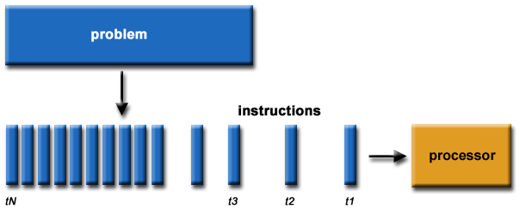
Serial Computing
A problem is broken into a discrete series of instructions
Instructions are executed sequentially one after another
Instruction is executed on a single processor
Only one instruction may be executed at any moment in time

Slide 3
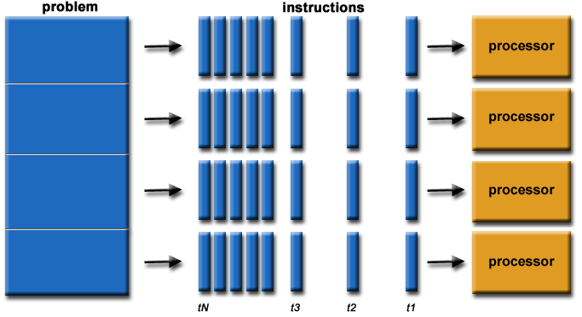
What is Parallel Computing?
A problem is broken into discrete parts to be solved concurrently
Each part is further broken down to a series of instructions
Instructions from each part are executed simultaneously on different processors
An overall control/coordination mechanism is employed

Slide 4
The First Definition
A parallel computer
is a set of processing elements that are able to work cooperatively to solve computational problems quickly.
computers, processors, nodes, cores…
We should care about performance and efficiency
Parallel computing is using multiple processors in parallel to solve problems faster than with a single processor

Slide 5
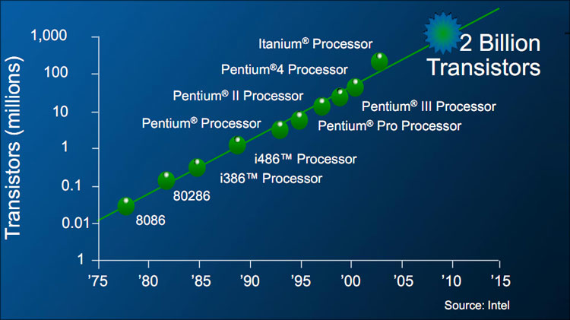
Processor Development
Gordon Moore (co-founder of Intel) predicted in 1965 that the transistor density of semiconductor chips would double roughly every 18 months ( “Moore’s Law”)
Microprocessors have become smaller, denser, and more powerful!
You can run, but…

Slide 6
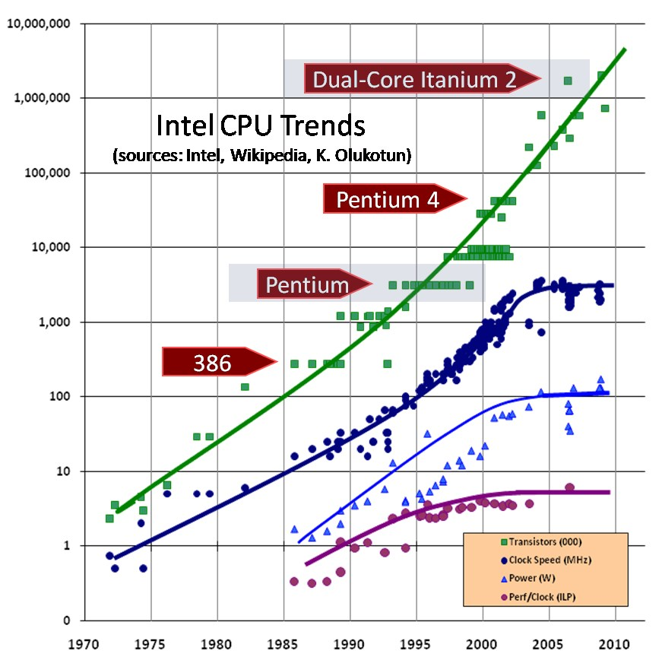

Processor Development (cont.)
… but you can't hide
Clock rates stopped increasing in ~2005 because of limits on power consumption
More power = More heat
Technological limits

Slide 7

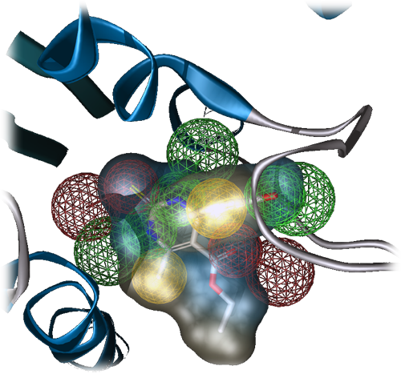
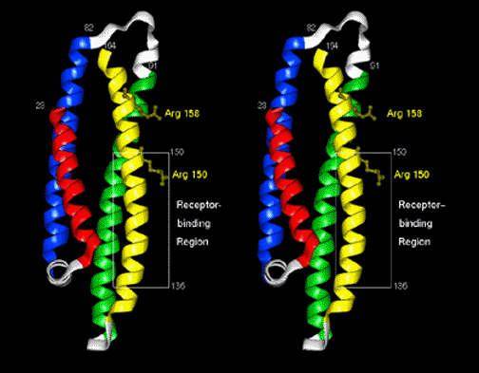
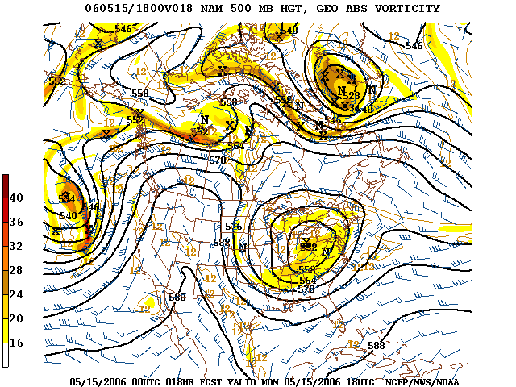

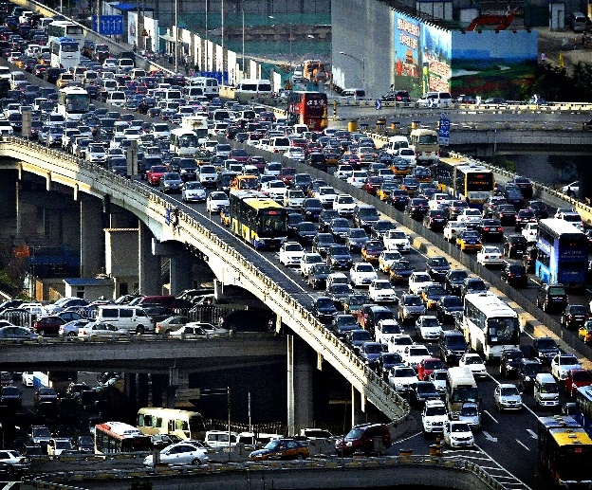
Who Needs Computational Power?
climate change
drug design
modeling of the human genome
…
weather forecasting
planetary movements
rush hour traffic

Slide 8
Why Parallel Computing?
Moore's law isn't true any longer: It’s impossible to make reliable low-cost processors that run significantly faster.
Lots of computer systems that we use every day are parallel systems.
If we want to take advantage of the processing power of these systems, we need parallel computing
Parallel computing makes it possible to
solve problems that are too large to fit in the memory of one processor
solve problems that take too long to solve on a single processor

Slide 9
Parallel Computer Memory Architectures
Shared Memory
Distributed Memory
Hybrid Distributed-Shared Memory

Slide 10
Shared Memory
Multiple processors can operate independently but share the same memory resources
Changes in a memory location effected by one processor are visible to all other processors
Shared memory machines have been classified as UMA and NUMA
Advantages:
Global address space provides a user-friendly programming perspective to memory
Data sharing between tasks is both fast and uniform due to the proximity of memory to CPUs
Disadvantages:
Lack of scalability between memory and CPUs
Programmer is responsible for Synchronization Constructs that ensure correct access of global memory

Slide 11
Shared Memory
Uniform Memory Access (UMA):
Most commonly represented today by Symmetric Multiprocessor (SMP) machines
Identical processors
Equal access and access times to memory
Sometimes called CC-UMA - Cache Coherent UMA. Cache coherent means if one processor updates a location in shared memory, all the other processors know about the update.
Memory
CPU
CPU
CPU

Slide 12
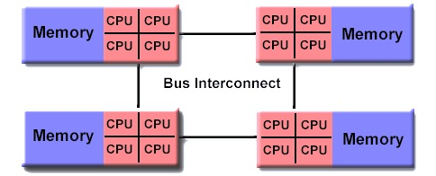
Shared Memory
Non-Uniform Memory Access (NUMA):
Often made by linking physically two or more SMPs
One SMP can directly access memory of another SMP
Not all processors have equal access time to all memories
Memory access across link is slower
If cache coherency is maintained, then may also be called CC-NUMA - Cache Coherent NUMA

Slide 13
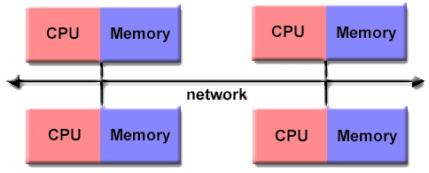
Distributed Memory
The processors are complete computer systems
each processor has its own local memory and address space
connected to each other by a communication network
It is usually the task of the programmer to explicitly define how and when data is communicated
Synchronization between tasks is likewise the programmer's responsibility

Slide 14
Distributed Memory
Advantages:
Memory is scalable with the number of processors.
Each processor can rapidly access its own memory without interference and without the overhead incurred with trying to maintain global cache coherency.
Cost effectiveness: can use commodity, off-the-shelf processors and networking.
Disadvantages:
The programmer is responsible for many of the details associated with data communication between processors.
It may be difficult to map existing data structures, based on global memory, to this memory organization.
Non-uniform memory access times - data residing on a remote node takes longer to access than node local data.

Slide 15
Speedup
Parallel computing is using multiple processors in parallel to solve problems more quickly than with a single processor
?
define Speedup S as:
the ratio of 2 program execution times
constant problem size
T₁ is the execution time for the problem on a single processor
Absolute Speedup if this is measured with the best serial implementation
Relative Speedup if we use the parallel implementation with one CPU
remember that algorithms probably change when moving to parallel
• T_{P} is the execution time for the problem using P processors

Slide 16
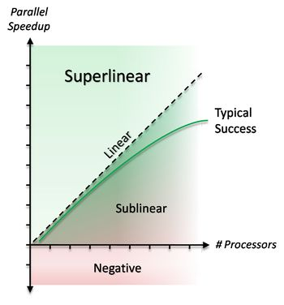
Speedup
Linear (ideal) speedup
the time to execute the problem decreases by the number of processors
if a job requires 1 week with 1 processor, it will take less that 10 minutes with 1024 processors
Sublinear speedup
the most often speedup
?
Superlinear speedup

Slide 17
But…
It’s Not Easy to Make it Fast
Three contributions to the total time spend in the program:
￼￼￼Parallelism phase: time spend managing parallel threads, overhead of synchronization (T_{p)}
￼￼Computation phase: time spend calculating on independent, local data (T_{c)}
Interaction phase: time spend in communication, synchronization or other data movement (T_{i})

Slide 18







Overhead of Parallelism
Load imbalance
some processes may be idle while the others are working
start-up and shutdown phases
inherently sequential parts of the computation, which can not be done in parallel
computations may not be evenly distributed among the processors (load balancing)

Slide 19
Overhead of Parallelism
Algorithmic overhead
extra computations in the parallel solution which are not present in the sequential solution
parallel algorithm may have to do more work to keep distributed data structures up to date
calculations may be duplicated in order to avoid communication
Communication time
all communication in a parallel program is the overhead caused by the parallel decomposition, compared to a sequential solution

Slide 20

Measuring speedup is not always easy
Memory limitations
Cache effects
For measuring absolute speedup, we have to implement both a sequential and a parallel algorithm
The best sequential algorithm may not be known or may change over time
Using faster processors in a parallel solution may result in a smaller speedup

Slide 21
Amdahl’s Law
The computation time is divided in two parts
serial f
parallel 1-f
the maximum speedup that can be obtained by using P processors is:

Slide 22
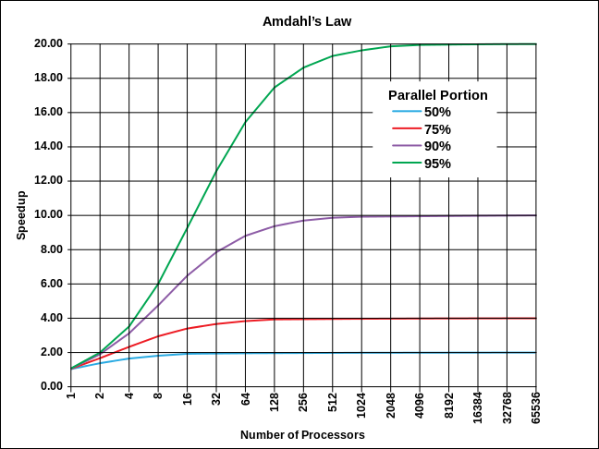

Amdahl’s Law
need to parallelize as much of the program as possible to get the best advantage from multiple processors

Slide 23
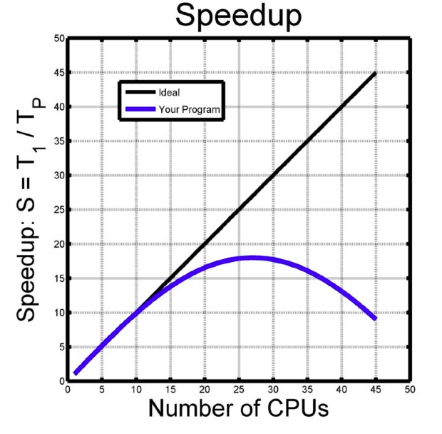
Back to Speedup
QUESTION: how many CPUs need to run this program?
it’s hard to tell how a program will behave on many processors
How to deal with it?
DO a speedup test

Slide 24

And now…
Let’s try to think parallel

Slide 25
Some Definitions We Need
PROCESS
instance of a computer program that is being executed
Thread
a sequence of instructions within a process
Resource
any object of computer system that can be used by the process for its execution (processor, memory, programs, data, etc.)

Slide 26
Threads vs. Processes
PROCESSES
Threads
typically independent
exist as subsets of a process
carry considerably more state information
share process state (memory and other resources)
have separate address spaces
share their address space
interact only through system-provided inter-process communication mechanisms
context switching between threads in the same process is typically faster than context switching between processes

Slide 27
Interprocess Communication
Process cooperation deals with three main issues
Passing information between processes/threads
Making sure that processes/threads do not interfere with each other
Ensuring proper sequencing of dependent operations
An independent process cannot affect or be affected by the execution of another process.
A cooperating process can affect or be affected by the execution of another process
Co-operating processes require an interprocess communication (IPC) mechanism that allow them to exchange data and information

Slide 28
The Consumer-Producer Problem
Suppose there are producer and consumer processes. Producer produces objects, which consumer uses for something. There is one Buffer object used to pass objects from producers to consumers.
The problem is to allow producers and consumers to access the Buffer while ensuring the following:
The shared Buffer should not be accessed by these processes simultaneously.
Consumers do not try to remove objects from Buffer when it is empty.
Producers do not try to add objects to the Buffer when it is full.
Producer
Buffer
Consumer

Slide 29
Producer & Consumer
Cwhile (1) {
while (counter == BUFFER_SIZE)
; // do nothing
//produce an item and put in nextProduced
buffer[in] = nextProduced;
in = (in + 1) % BUFFER_SIZE;
counter++;
}er-
Producer
while (1) {
while (counter == 0)
; // do nothing
nextConsumed = buffer[out];
out = (out + 1) % BUFFER_SIZE;
counter--;
//consume the item in nextConsumed
}
Consumer

Slide 30
Updating of Shared Variable
Let’ focus on counter variable.
‘counter++’ & ‘counter--' could be implemented
counter ++ | counter --
reg1 = counter | reg2 = counter
reg1 = reg1 + 1 | reg2 = reg2 - 1
counter = reg1 | counter = reg2
counter = ?

Slide 31
Possible Execution Interleaving
or
Producer Thread | Consumer Thread | reg1- value | reg2- value
reg1 = counter |  | 5
reg1 = reg1 + 1 |  | 6
 | reg2 = counter |  | 5
 | reg2 = reg2 - 1 |  | 4
 | counter = reg2 | counter = 4
counter = reg1 |  | counter = 6
Producer Thread | Consumer Thread | reg1- value | reg2- value
reg1 = counter |  | 5
reg1 = reg1 + 1 |  | 6
counter = reg1 |  | counter = 6
 | reg2 = counter |  | 6
 | reg2 = reg2 - 1 |  | 5
 | counter = reg2 | counter = 5
Producer Thread | Consumer Thread | reg1- value | reg2- value
reg1 = counter |  | 5
reg1 = reg1 + 1 |  | 6
 | reg2 = counter |  | 5
 | reg2 = reg2 - 1 |  | 4
counter = reg1 |  | counter = 6
 | counter = reg2 | counter = 4
Concurrent access to shared data may result in data inconsistency

Slide 32
Race Condition
A situation when several processes access and manipulate the same data concurrently and the outcome of the execution depends on the particular order in which the access takes place
The only way to deal with race conditions is through very careful coding.
Hence proccesses must be synchronized

Slide 33



The Critical-Section Problem
Critical section is a section of code or collection of operations in which only one process may be executing at a given time
General structure of a typical process:
while (1){
entry section;
critical section;
exit section;
remainder section;
}
entry section
exit section
Critical section

Slide 34
The Critical-Section Problem
The critical-section problem is to design a protocol that the processes can cooperate.
Each process must request permission to enter its critical section.
The section of code implementing this request is called entry section.
The critical section may be followed by a section of code known as exit section.
The remaining code is known as remainder section.

Slide 35
The Critical-Section Problem
Any solution to critical section problem must satisfy the following:
1. Mutual Exclusion:
If a process P_{i} is executing in its critical section, then-no other processes can be executing in their critical sections.
2. Progress:
The selection of the processes that will enter the critical section next cannot be postponed indefinitely
3. Bounded Waiting:
There exists a bound on the number of times that other processes are allowed to enter their critical sections after a process has made a request to enter its critical section and before that request is granted.

Slide 36
Types of solutions to CS problem
Software-based
Some known algorithms (as Peterson, Bakery, Busy Waiting, and others)
Hardware-based
locks, test_and_set Instruction, semaphores, monitors…

Slide 37
Semaphores
Semaphore S is integer variable used by processes to send signals to other processes
Less complicated
Accessed only through two standard atomic (indivisible) operations:
P() or wait()
V() or signal()
Wait(S) {
while (S <= 0) ; // do nothing
S--; }
Signal(S) {
S++;
}

Slide 38
Semaphores
Counting semaphore – integer value can range over an unrestricted domain
Binary semaphore – integer value can range only between 0 and 1; can be simpler to implement
Also known as mutex locks
Provides mutual exclusion
Semaphore mutex; // initialized to 1 do { wait (mutex); // Critical Section signal (mutex); // remainder section } while (TRUE);

Slide 39
Synchronization problems
Deadlock – two or more processes are waiting indefinitely for an event that can be caused by only one of the waiting processes.
Let S and Q be two semaphores initialized to 1
P₀
wait (S);
wait(Q);
…
signal(S);
signal(Q);
P₁
wait (Q);
wait(S);
…
signal(Q);
signal(Q);

Slide 40
Synchronization problems
Starvation(=indefinite blocking)
Related to deadlocks (but different)
Occurs when a process waits indefinitely in the semaphore queue
For example, assume a LIFO semaphore queue
Process pushed first into it might not get a chance to execute
Priority Inversion
A situation when a higher-priority process needs to wait for a lower-priority process that holds a lock

Slide 41
Classical Problems of Synchronization
Classical problems used to test newly-proposed synchronization schemes
Bounded-Buffer Problem (Producer-Consumer Problem)
Readers and Writers Problem
Dining-Philosophers Problem
Sleeping-Barber Problem

Slide 42
Solution of the Bounded-Buffer Problem
Producer
Buffer
Consumer
Shared data structure
int n;
semaphore mutex = 1; //Guards the access to the buffer pool
semaphore empty = n; // Counts the number of empty buffers
semaphore full = 0; // Counts the number of full buffers

Slide 43
Solution of the Bounded-Buffer Problem
The structure of the producer process
while (true) {
...
/* produce an item in next_produced */
...
wait(empty); //suspend self if the buffer is full
wait(mutex); //get access to the buffer
...
/* add next produced to the buffer */
...
signal(mutex); //release the lock to the buffer
signal(full); //
}

Slide 44
Solution of the Bounded-Buffer Problem
The structure of the consumer process
while (true) {
wait(full); //suspend self if the buffer is empty
wait(mutex); // get access to the buffer
...
/* remove an item from buffer to next_consumed */
...
signal(mutex); // release the lock to the buffer
signal(empty);
...
/*consume the item in next_consumed */
...
}

Slide 45


Readers-Writers Problem
A data set is shared among a number of concurrent processes
Readers – only read the data set; they do not perform any updates
Writers – can both read and write
Problem – allow multiple readers to read at the same time. Only one single writer can access the shared data at the same time
Solution: try find it by yourself

Slide 46
Designing Parallel Programs
PhD Katerina Bolgova
eScience Research Institute & HPC Department

Slide 47


Designing Parallel Programs
communication
Problem
partitioning
PCAM Methodology
agglomeration
P₀
P₁
P₂
P₃
mapping

Slide 48
Designing Parallel Programs
Partitioning
Domain Decomposition
Functional Decomposition
Problem Data Set
Problem Data Set
P₀
P₁
P₂
P₃
P₀
P₁
P₂
P₃
Notes:
In the domain decomposition approach to problem partitioning, we seek first to decompose the data associated with a problem. If possible, we divide these data into small pieces of approximately equal size. Next, we partition the computation that is to be performed, typically by associating each operation with the data on which it operates. This partitioning yields a number of tasks, each comprising some data and a set of operations on that data. An operation may require data from several tasks. In this case, communication is required to move data between tasks. This requirement is addressed in the next phase of the design process.
Functional decomposition represents a different and complementary way of thinking about problems. In this approach, the initial focus is on the computation that is to be performed rather than on the data manipulated by the computation. If we are successful in dividing this computation into disjoint tasks, we proceed to examine the data requirements of these tasks. These data requirements may be disjoint, in which case the partition is complete. Alternatively, they may overlap significantly, in which case considerable communication will be required to avoid replication of data. This is often a sign that a domain decomposition approach should be considered instead.

Slide 49
Partitioning Design Checklist
Does your partition define at least an order of magnitude more tasks than there are processors in your target computer?
Does your partition avoid redundant computation and storage requirements?
Are tasks of comparable size?
Does the number of tasks scale with problem size?
Have you identified several alternative partitions?

Slide 50

Designing PP. Communication
The need for communications between tasks depends on your problem:
Most parallel applications do require tasks to share data with each other
Embarrassingly parallel problems tend to require little or no communication of results between tasks
Some factors to consider:
Cost of communications
Latency and Bandwidth
Visibility of communications
Synchronous and asynchronous communications
…

Slide 51
Communication Design Checklist
Do all tasks perform about the same number of communication operations?
Does each task communicate only with a small number of neighbors?
Are communication operations able to proceed concurrently?
Is the computation associated with different tasks able to proceed concurrently?

Slide 52
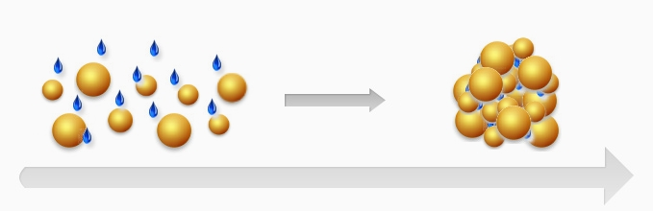
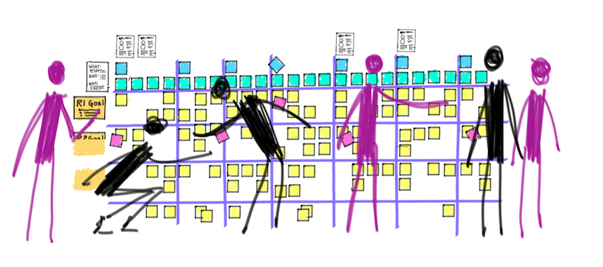
Designing Parallel Programs
Agglomeration
Tasks are combined into larger tasks to improve performance or to reduce development costs (if necessary).
Mapping
Main goals: maximizing processor utilization and minimizing communication costs.
Mapping can be specified statically or determined at runtime by load-balancing algorithms.

