Slide 1
5th Programming Task Matrix multuplication

Slide 2
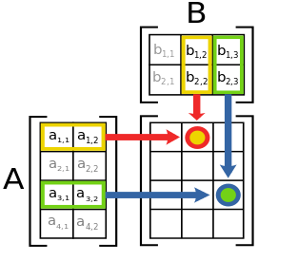

The Matrix Multiplication Problem
Matrix multiplication is a binary operation that takes a pair of matrices, and produces another matrix.
Computing matrix products is both a central operation in many numerical algorithms and potentially time consuming, making it one of the most well-studied problems in numerical computing. Various algorithms have been devised for computing C = AB, especially for large matrices.
//Serial algorithm of Matrix Multiplication
double A[Size][Size], B[Size][Size] C[Size][Size];
int i,j,k;
...
for (i=0; i<Size; i++) {
for (j=0; j<Size; j++){
C[i][j] = 0;
for (k=0; k<Size; k++){
C[i][j] += A[i][k]*B[k][j];
}
}
}

Slide 3
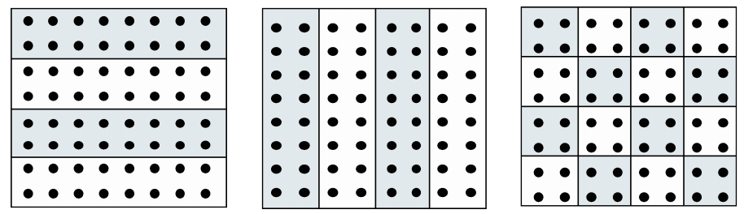
The Problem Decomposition
There are 3 ways of problem decomposition depending on dividing matrix:
You should use the dividing matrices A by rows and B - by columns.
Х
=

Slide 4
The Task
Implement the serial version of the Matrix Multiplication
Chose (actually use) the problem decomposition
Define sub-problems and size of each sub-problem
Define information dependencies between sub-problems
Implement the parallel algorithm of matrix multiplication
Determine the speedup

